Slide 1
Client Enrichment Series
Welcome to today’s presentation on:
Introduction to GSA Account Management,
The Voice of the Customer
the presentation will start at 2:00 p.m. Eastern time
Note: Phones are automatically muted during the presentation. You have the ability to send questions to the host and presenters through your questions pane. They will answer as many of the questions as possible throughout and at the end of the presentation. All questions will be captured, and answers sent to all participants within 2 weeks.
Notes:
1:45PM: Countdown to opening up the CES Session in 5 min increments
2:00PM: Leah to open up the Session with Welcome Comments

Slide 2
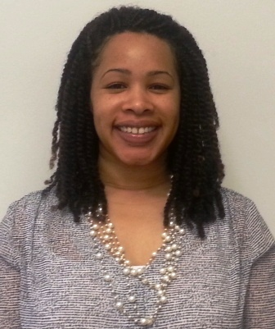
GSA Account Management, The Voice of the Customer
Client Enrichment Series
Hosted by:
Leah Fant, National Account Manager, PBS Central Office of Client Solutions
Notes:
Leah to Introduce herself

Slide 3
GSA Account Management, The Voice of the Customer
Presented by:
Herman Goodyear, Director of National Accounts, PBS Office of Client Solutions
Mark Hackley, Regional Account Manager, PBS Office of Client Solutions
Notes:
Leah to Introduce Herman & Mark by reading their bios
Leah to explain housekeeping items
Leah to gauge audience participation through launching the poll, showing the results and
provide quick comments.
Will then transition to Herman by saying, “Please welcome Herman Goodyear...

Slide 4
Agenda
An Introduction to Account Management in Three Parts:
What is the GSA Account Management Program?
What you have told us
The purpose of account management
Our structure within GSA
d. Account planning and results
How national and regional programs are implemented
Examples of success
What are the benefits to you?
Closing

Slide 5
We have asked for feedback on how we can improve our partnership with you…
…and you told us that
• GSA wasn’t always listening to you.
• There was a lack of knowledge about your agency and that we didn’t always understand your mission priorities.
• GSA was reactive and not consistently using a proactive approach to service delivery.
• There have been regional inconsistencies that cause confusion within your agencies.

Slide 6
Purpose of Account Management
• Promote customer knowledge and consistency within GSA.
Ensure your voice is heard within GSA.
• Align GSA services to meet the needs of all federal agencies.
• Promote innovative solutions using a team-based approach.
• Educate GSA on your current and long-term needs.
Notes:
Account Management is a strategic business practice that helps to align an organization’s services to a client’s needs.
Account Management collaborates with other divisions of GSA; promotes innovative customer solutions.
Infusion of customer’s voice into our organization - long term planning and service delivery.

Slide 7
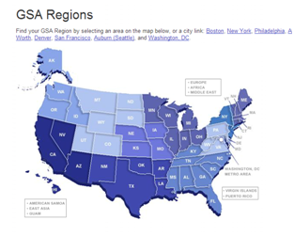
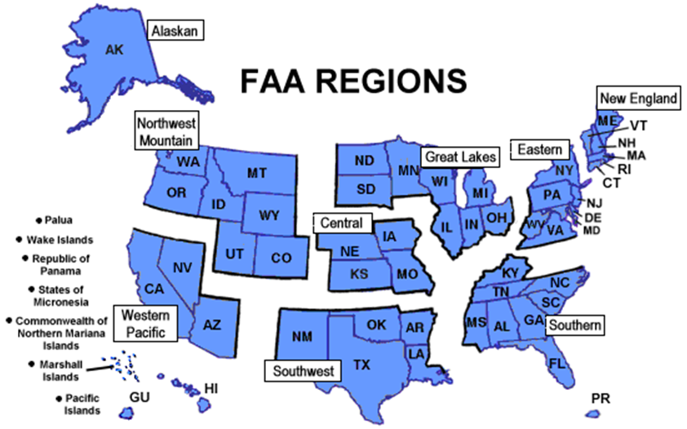
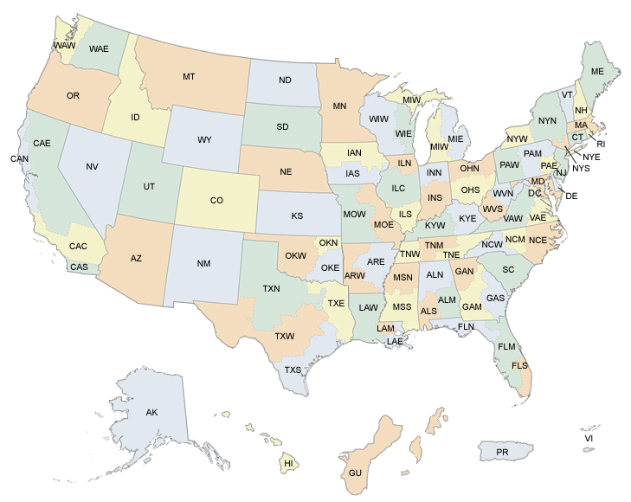
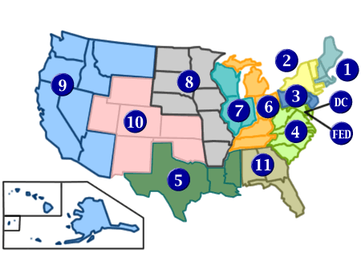
Who We Are and How We Connect
11 PBS Regions
9 FAA Regions
11 PBS Regions
94 USAO Districts
11 Judicial Circuits
7
Notes:
Purpose of this slide is to show how customers and GSA are different in organizational alignment. As a result, Account Management helps to ease inconsistencies by having account advocates in each of our regions. These advocates network across regions, promoting consistency, customers needs and requirements.

Slide 8
Organizational Structure
• Nationwide core network of account managers.
National Account Managers in GSA Central Office are there to serve your headquarters and your offices across the country.
Regional Account Managers are assigned to customer agencies in all 11 GSA regions to serve your regional/field offices.
• We use a multi-disciplined, dynamic account team
approach.
We access subject matter expertise to meet your changing needs and business objectives.
Notes:
The Office of Client Solutions’ National Account Managers and the Regional Account Managers form the core of an Account Team
• Team membership based upon the unique needs of an agency (Specialists from GSA including realty, portfolio, and the Federal Acquisition Service)
• Composition is fluid based on the client’s changing needs and internal resource availability
HERMAN - Pause after this slide to allow Leah to transition to Poll Question –
Have you worked with your Regional Account Managers in the past? (Yes/No/IDK who my RAMs are)
Have you worked with your National Account Managers in the past? (Yes/No/IDK who my NAM is)
Leah to provide comments based on the responses provided by the audience. Then pass it back over to Herman…

Slide 9
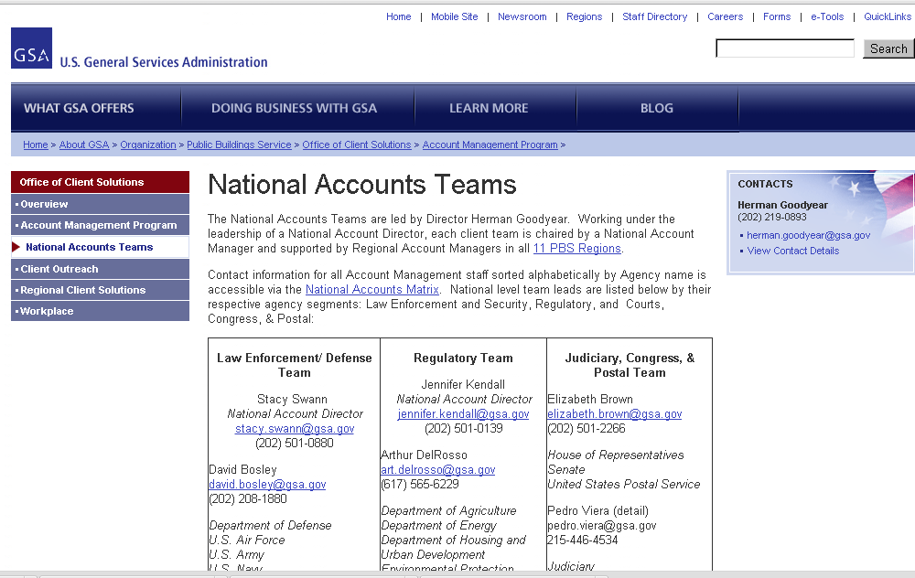
National Accounts Network Matrix
National Account Teams on gsa.gov
Notes:
Herman – Matrix accessible through this page provides contacts for all 11 GSA Regional OCS Offices (Directors, Branch Chiefs, RAMs) as well as NADS, NAMs, and FAS Counterparts

Slide 10
Role of Account Managers
National and Regional Account Managers
No group of professionals in PBS are more conversant in your
mission and business focus than our account management
community.
Help you navigate GSA and connect you to services with a
broad extensive knowledge of GSA solutions and services.
Serve as an advocate/liaison for your needs.
Identify opportunities to improve service delivery.
Notes:
No group of professionals in PBS is more conversant in your mission and business focus than our AM community
Broad and extensive knowledge of GSA solutions and products
Act as extension of you = represent your interests,. concerns, and attuned to helping you achieve your program goals via GSA services
Continuously work with planning and operations staff to be your “voice” inside GSA - Collaborate with and/or lead GSA teams to serve needs
Analyze intelligence about you - understand impact on you, communicate throughout organization in order to improve services, satisfaction and loyalty

Slide 11
National/Regional Planning
Account Planning
• Knowledge management - understand your people, culture,
work and priorities
• Opportunity management - GSA solutions for your business
concerns
Outcomes - helping you meet your mission objectives via
Optimizing your Real Estate Portfolio.
Identifying and implementing cost savings initiatives
Developing workplace solutions
Change management
Notes:
Through our Account Planning efforts, we inform and infuse your needs throughout the PBS Organization...
Account Planning is collaboration on our mutual goals and points of interest to support your missions.
CPP - Partnerships and feedback on your long-term needs and opportunities
Example:
Workplace: they develop strategies to balance efficiency and effectiveness in the workplace
Workplace includes space, people, and technology solutions customized to the differing workplace needs of federal agencies seeking to reduce their real estate costs and increase their workplace efficiencies.
Balance between best use of your portfolio and what you need for your business performance to drive workplace solutions (portfolio optimization balanced with business performance)

Slide 12
Poll Question Results
If you are engaged with your National and Regional Account Managers, in what business areas do you partner with them?
Transmitting/tracking RWAs, OAs, etc.
Escalating/resolving service issues
Discussing policy issues/implications
Exploring the development of workplace solutions
Collaborating on joint efforts to meet mutual business goals
Notes:
Results of Pre-Presentation Survey – Herman and Leah do a Regis and Kathy Lee…
Herman and Leah to discuss the Results of Registration Survey
Tentative Script
>>>>Herman: Now that I’ve shared with you some of the national planning resources that we utilize to continue building partnerships with you -- this is a good time to segue into the survey responses that you all provided when you registered for today’s Client Enrichment Series.
We asked you -- “If you are engaged with your National and Regional Account Managers, in what business areas do you partner with them?”
>>>>Leah: That’s right Herman! And here are the top 3 responses that have come in:
36% Escalating / resolving service issues
24% Transmitting / tracking RWA's, OA's, etc.
21% Discussing policy issues / implications
Herman / Mark – Can you tie the results of the Pre-Presentation poll to one or 2 of the points you highlight in your slides on National/Regional activities?

Slide 13
Account Management at National Level
• Long-range planning and coordination with GSA
business lines on your mission priorities – aligning
strategies and activities with your goals.
• HQ relationships and access.
• Trending - what is happening at your agency; what is
happening throughout the federal workplace?
• Serve as a feedback loop - policies and their impact.
• GSA Administrator’s cost savings meetings and reports.

Slide 14
Examples of Success - National Level
• Client Portfolio Planning
In FY 2013, 43 opportunities to reduce costs and better utilize space for 9 agencies (Commerce, DHS/ICE, DOT/FAA, EPA, FEMA, HHS, SEC, SSA, State) were identified for a combined savings/cost avoidance of $114.7M and a reduction of approximately 3.5 Million RSF
• Workplace Pilots
USDA/NASS, HHS, DHS & DOI/FWS
• Cost Savings Initiatives
GSA Administrator Dan Tangherlini has been sending out reports
since October 2013
Notes:
● USDA’s National Agricultural Statistics Service will reduce its footprint from 43 state offices across the country to 12 regional locations which will create significant savings. Through the efforts to-date, the agency is projected to save more than $700,000 in annual real estate costs.
● The Department of Health and Human Services (HHS) will use GSA's Total Workplace to improve space efficiencies, reduce the agency’s footprint, and save the federal government more than $15 million in real estate costs over a ten year lease at their office in Seattle, Washington.
● Increased teleworking at the Department of Homeland Security (DHS), reduced rented space with subleasing, and the adoption of desk sharing has allowed the agency to begin reducing its real estate footprint, resulting in a projected savings of $55 million in office real estate costs.
● The U.S. Fish & Wildlife Service is working with GSA’s Total Workplace to eliminate 72,200 square feet by consolidating three buildings in Northern Virginia, and saving taxpayers more than $3 million in annual real estate costs.
At the end of Slide 14, Herman to Introduce Mark and pass webinar control to Mark

Slide 15
Account Management at Local Level
Serve as client advocate
Share client intelligence
Develop strategies to meet client goals
Promote client education
Notes:
Advocate - daily basis, any given project, sticking points...communication/translation...voice at the table
Flooding incident - in accordance with pricing policy - customer had just completed 500K rwa project...all recently completed TI work was destroyed...first blush interpretation of pricing policy - no room to provide relief to the customer! AM brought in by Client - worked with PT to come up with suggestions to work through this - pricing policy was actually changed - mutually beneficial change - treated as a “forced move” situation… Advocacy can help address systemic things - to bring about sensible change.
Intel - Initiative, what’s coming down the pike - national initiatives - SSA barrier wall - pipeline head’s up helps Region gear for client workload. Change in how a client will be servicing their OWN customers - and how this might impact how client will need support from GSA...we have to be ready to support client in being agile enough to them as they change. Holistic intel - make GSA mgt aware of Client business needs - Synthesizing intel from many sources - Your strategic plan down to nitty gritty data - to help develop appropriate strategies to help us serve you better
Strategies to meet Client goals - may take different approach in every Region, but reporting is unified and end result/outcome is aligned to client goal. AM relationship with PM staff to help coordinate projects, helping team stay focused on desired client outcomes and managing expectations / issues. Example - market rates gaps with current lease rates - target leases for early renegotiation for Clients. Courts following NNN example - established their own goals - RAM assembled Regional interdisciplinary team to help Courts meet their measures - understanding flexibility within our arrangements in order to help achieve mutual goals.
Matching up Tenant Sat Survey with SSA ODAR claims rates - claims process shortcomings with low TSS scores - correlation and targeting for special action - seek operational relationship between space and client performance. (major goal in SSA performance)
Promote Client Education - FAce to client - communication (FTF) - government-wide initiative Total Workplace and Stand Alone Furniture Inititiative - can 25k-150k can fulfill orders - new offerings, explaining services, processes and value to be attained. Another example - this very Webinar that you are attending today! OCS helps organize and deliver training. Through processes, etc (Like SEC and our leasing acquisition process). Tailored, expanded versions of the webinar topics to your needs/interests. Sustainability (DOD and IRS) - working session presentations - shared and walk through tools

Slide 16
Examples of Success - Local Level
Championing client perspective
Annual Client briefings to senior management
Regional coordination of strategies to achieve national goals (like No Net New - Freeze the Footprint)
Client Enrichment Series
Notes:
Championing -
Promote delivery of service as promised (under Pricing Policy)
Make it easier to use GSA - Adapt our approach to match Client organization/needs
Geographic / Organizational structure
At the end of Slide 16, Mark to pass webinar control back to Herman

Slide 17
Benefits
Coordination With YOU – Long Term Planning and Building Partnerships
Tangible benefits and building value for you – collaborating with GSA
and you, our customer, to develop innovative solutions that align with
what you value and to support your long term goals
Ours is a consultative relationship
We strive to be proactive vs. reactive in our approach
We want to grow our partnerships
Advocate and serve as liaisons between senior levels within your agency
and GSA
Notes:
*Different looks region to region; same advocacy and extension of your organization.
At the end of Slide 19, pass webinar control to Leah

Slide 18
Benefits
Coordination within GSA on your behalf
• Translate and advocate your needs and knowledge of your mission
priorities throughout PBS to improve your experience and your
outcomes
• Account Management has a responsibility to communicate
throughout the organization what it takes to be successful with each
Account - create organizational coherence around your expectations
and needs
• Grow our knowledge and sensitivity to your culture, business
processes, operational flow
• Understand your goals and your definition of “High Performance”
• Help you solve problems and resolve issues

Slide 19
Getting the Most Out of Account Management
Traditional - Customer Service
Troubleshooting, issue resolution, project coordination,
communication
Future Focused - Strategic Partnership
Want the Account Team to be advocates and honest brokers
for you
Translate account knowledge into customer-centric solutions
within GSA
Help you stay focused on your mission goals by
understanding your long term plans and strategies
Notes:
Closing slide - it is not just about service. It is about partnership!
Expanding Our Service/Client Centricity

Slide 20
Questions?
Notes:
Leah to present the planted questions (see Q&A) Handout. If there is time left in the presentation, will select a couple of audience questions coming in via chat.

Slide 21
Thank you for joining us today for a discussion on
Introduction to GSA Account Management,
Voice of the Customer
Notes:
Leah to address: Thanks to Herman & Mark for presenting today

Slide 22
National Accounts Teams
http://www.gsa.gov/portal/content/100859

Slide 23
Contacts
Leah Fant
National Account Manager
Office: 202.501.0514
Mobile: 202.525.8917
leah.fant@gsa.gov
Herman Goodyear
Director, National Accounts
Office: 202.219.0893
Mobile: 240.893.3678
herman.goodyear@gsa.gov
Mark Hackley
Region 8 Account Manager
Office: 303.236.1980
Mobile: 303.819.3969
mark.hackley@gsa.gov

Slide 24
Upcoming Client Enrichment Series
January 30, 2014 – Introduction to Total Workplace
February – Introduction to Sustainability
March - Introduction to Requirements Development
April – Introduction to Project Management Practices
Client Enrichment Series Website
ClientEnrichmentSeries@gsa.gov

