Slide 1
Contract Payment Reporting Module (CPRM)
Advanced Instruction on Entering Invoice Data & CAF Payment Data
CPRM Training Module for Contractor Users
Created: November 30, 2014 Last Updated: October 07, 2016

Slide 2
About this Training
About this Training
You Will Learn
CPRM Overview
High-level Workflow
Timing
How to…
Invoice Data Reporting
Enter Invoice Data
Upload Package
Zero Invoice Reporting
Enter Zero Invoice
CAF Payment Data Reporting
Enter CAF Payment Data
Pay CAF with Pay.gov
Search for CAF Payment Data
CAF Payment Reconciliation
Reports
Resources…
Glossary
Contractor Workflow
Help Resources
Training is self-paced. Use your keyboard arrow buttons or click the slide to advance to the next slide
Utilize the left-hand Quick Navigation menu to access different parts of the training
Detailed information may be accessed on many slides by clicking ‘explain…’ or ‘show me…’.
Example, click on the words below to expose text and click on it again to hide the text.
show me…
Detailed information is presented this way.
explain…
Detailed explanations are presented this way.

Slide 3
In this Training, you will learn…
About this Training
You Will Learn
CPRM Overview
High-level Workflow
Timing
How to…
Invoice Data Reporting
Enter Invoice Data
Upload Package
Zero Invoice Reporting
Enter Zero Invoice
CAF Payment Data Reporting
Enter CAF Payment Data
Pay CAF with Pay.gov
Search for CAF Payment Data
CAF Payment Reconciliation
Reports
Resources…
Glossary
Contractor Workflow
Help Resources
Topics
Overview
High-level Workflow Diagram
Invoice Data Reporting and Entering Invoice Data
Upload Invoice Data using Upload Package
Zero Invoice Data Reporting and Entering Zero Invoice Data
CAF Payment Data Reporting and Entering CAF Payment Data
Pay CAF with Pay.gov
Search for CAF Payments
CAF Payment Reconciliation
Conclusion
For a high-level overview of the CPRM, please refer to the CPRM Training Module page

Slide 4
Overview
About this Training
You Will Learn
CPRM Overview
High-level Workflow
Timing
How to…
Invoice Data Reporting
Enter Invoice Data
Upload Package
Zero Invoice Reporting
Enter Zero Invoice
CAF Payment Data Reporting
Enter CAF Payment Data
Pay CAF with Pay.gov
Search for CAF Payment Data
CAF Payment Reconciliation
Reports
Resources…
Glossary
Contractor Workflow
Help Resources
The CPRM was designed to enable you to report Transactional Data, such as order data, invoice data and contract access fee (CAF) payment data for your task/delivery orders awarded on GWACs, Connections II, OASIS, HCaTS, BMO, and other IDIQ Multiple Award Contracts (MACs)
This presentation focuses on:
Reporting invoice data
Reporting CAF payment data

Slide 5
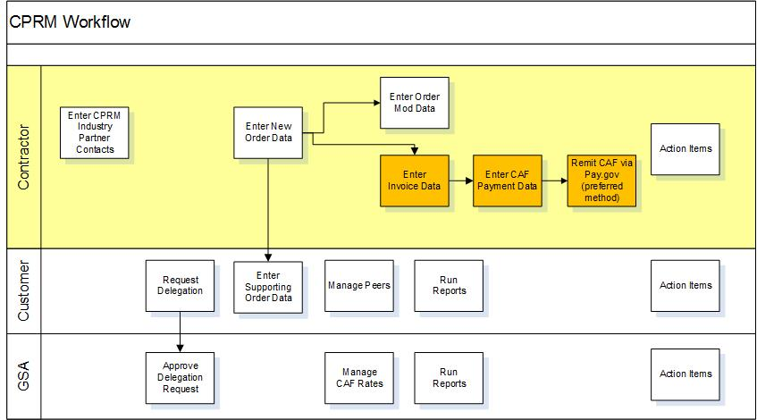
High-level CPRM Workflow
About this Training
You Will Learn
CPRM Overview
High-level Workflow
Timing
How to…
Invoice Data Reporting
Enter Invoice Data
Upload Package
Zero Invoice Reporting
Enter Zero Invoice
CAF Payment Data Reporting
Enter CAF Payment Data
Pay CAF with Pay.gov
Search for CAF Payment Data
CAF Payment Reconciliation
Reports
Resources…
Glossary
Contractor Workflow
Help Resources
explain…
Each ‘swimlane’ in this diagram provides the basic workflow steps expected of each user type.
explain…
Contractor: The person(s) who manage the task order, invoice data and CAF Payment reporting for their company in CPRM. This presentation focuses on the orange-highlighted steps.
explain…
Customer: The contracting point of contact who signs the award document for the task order, i.e. Ordering Contracting Officer (OCO)
explain…
GSA: The program office that manages the IDIQ program.

Slide 6
Timing
About this Training
You Will Learn
CPRM Overview
High-level Workflow
Timing
How to…
Invoice Data Reporting
Enter Invoice Data
Upload Package
Zero Invoice Reporting
Enter Zero Invoice
CAF Payment Data Reporting
Enter CAF Payment Data
Pay CAF with Pay.gov
Search for CAF Payment Data
CAF Payment Reconciliation
Reports
Resources…
Glossary
Contractor Workflow
Help Resources
When am I supposed to report Invoices and CAF Payments?
Your contract’s program office will provide guidance
General guidelines:
Report task order awards and mods within 30 days of award
Report invoices and CAF payments Quarterly
The general guideline is to report all invoices and CAF within 30 days after the end of a calendar quarter
Report on all invoices that fall in the prior quarter, AND
Report and pay CAF based on those invoices for that calendar quarter
Example of Quarterly Reporting
Quarter 1: Jan – Mar
Enter all invoice data that occurred during Jan, Feb, Mar by the end of April
Report CAF payment and remit your CAF Payment by end of April

Slide 7
Introduction to Invoice Data Reporting
About this Training
You Will Learn
CPRM Overview
High-level Workflow
Timing
How to…
Invoice Data Reporting
Enter Invoice Data
Upload Package
Zero Invoice Reporting
Enter Zero Invoice
CAF Payment Data Reporting
Enter CAF Payment Data
Pay CAF with Pay.gov
Search for CAF Payment Data
CAF Payment Reconciliation
Reports
Resources…
Glossary
Contractor Workflow
Help Resources
For each task/delivery order reported in the CPRM, you should report Invoice Data:
You should report all the invoices within thirty days after the end of each reporting period, or as specified on your contract
Invoice Data may be entered manually or by using the import feature for a single invoice on the Invoice Data form
- or -
Invoice Data may be uploaded in bulk using CSV or Excel files using the ‘Upload Package’ feature
It is important to enter all of your invoice data on task orders awarded on GWACs, Connections II, OASIS, HCaTS, BMO, or other IDIQs supported in CPRM in order to meet contractual requirements.

Slide 8
Entering New Invoice Data (slide 1 of 8)
About this Training
You Will Learn
CPRM Overview
High-level Workflow
Timing
How to…
Invoice Data Reporting
Enter Invoice Data
Upload Package
Zero Invoice Reporting
Enter Zero Invoice
CAF Payment Data Reporting
Enter CAF Payment Data
Pay CAF with Pay.gov
Search for CAF Payment Data
CAF Payment Reconciliation
Reports
Resources…
Glossary
Contractor Workflow
Help Resources
Access the Invoice Data form from the Invoice Data menu → select Enter New Invoice Data
Alternatively, access the Invoice Data form from the ‘add’ link on the Order Data form, above Invoice Data table
The Invoice Data form will open in ‘edit-mode’
The following slides provide explanation of each form field

Slide 9
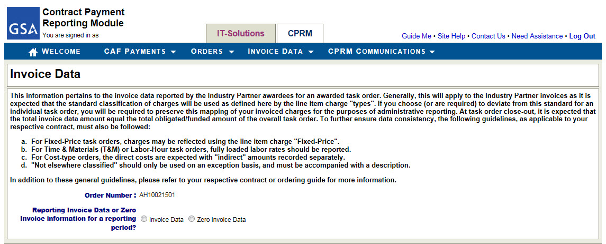
Entering New Invoice Data (slide 2 of 8)
About this Training
You Will Learn
CPRM Overview
High-level Workflow
Timing
How to…
Invoice Data Reporting
Enter Invoice Data
Upload Package
Zero Invoice Reporting
Enter Zero Invoice
CAF Payment Data Reporting
Enter CAF Payment Data
Pay CAF with Pay.gov
Search for CAF Payment Data
CAF Payment Reconciliation
Reports
Resources…
Glossary
Contractor Workflow
Help Resources
Start by Indicating Invoice Data
If you access the form from the Invoice Data menu, then start by selecting the Order Number.
Select ‘Invoice Data’ to set the form to enable you to enter invoice information.

Slide 10
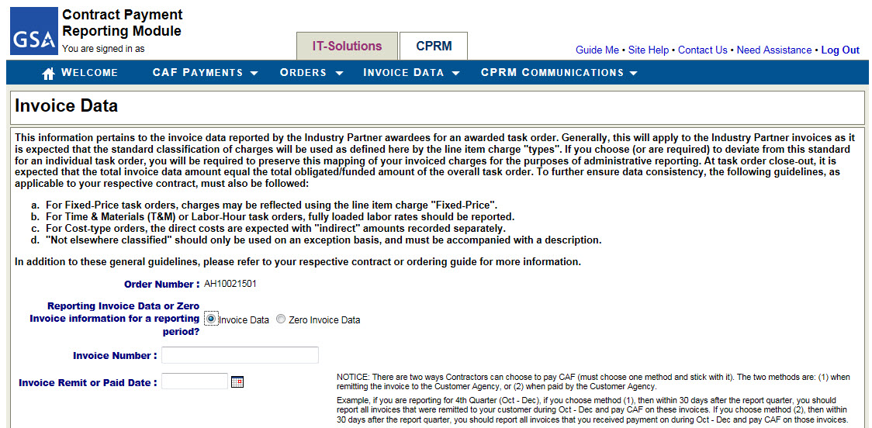
Entering New Invoice Data (slide 3 of 8)
About this Training
You Will Learn
CPRM Overview
High-level Workflow
Timing
How to…
Invoice Data Reporting
Enter Invoice Data
Upload Package
Zero Invoice Reporting
Enter Zero Invoice
CAF Payment Data Reporting
Enter CAF Payment Data
Pay CAF with Pay.gov
Search for CAF Payment Data
CAF Payment Reconciliation
Reports
Resources…
Glossary
Contractor Workflow
Help Resources
Entering the Invoice Number and Date
Enter the Invoice Number. This should be a unique number to your order. No order should have duplicate invoice numbers.
Enter the Invoice Remit or Paid Date.
Contract Access Fees (CAF) are calculated based on the invoice amount and ‘Invoice Remit or Paid Date’. You have two options for paying CAF, choose one and be consistent for the life of the order / contract:
Pay CAF when you remit the invoice to the customer agency
Pay CAF when you are paid by the customer agency
If you chose option 1, then enter the ‘Remit’ Date in ‘Invoice Remit or Paid Date’
If you chose option 2, then enter the ‘Paid’ Date in ‘Invoice Remit or Paid Date’

Slide 11
Entering New Invoice Data (slide 4 of 8)
About this Training
You Will Learn
CPRM Overview
High-level Workflow
Timing
How to…
Invoice Data Reporting
Enter Invoice Data
Upload Package
Zero Invoice Reporting
Enter Zero Invoice
CAF Payment Data Reporting
Enter CAF Payment Data
Pay CAF with Pay.gov
Search for CAF Payment Data
CAF Payment Reconciliation
Reports
Resources…
Glossary
Contractor Workflow
Help Resources
Examples of Invoice Remit or Paid Date
Example 1 – Using the Invoice ‘Remit’ Date paradigm
Timing choice: My company decided it is most efficient for us to report invoice data and pay CAF based on a timeline that corresponds to when we send (remit) our invoices to our customer.
Reporting Period: Quarterly
Quarter 1, January – March
Enter invoice data for all invoices my company sent to the customer with invoice dates between Jan 1 – Mar 31.
For each invoice I enter into CPRM, I will enter the date that the invoice was sent to the customer in the Invoice Remit or Paid Date field.
I will complete the activity of reporting these invoices by April 30.
Also prior to April 30, I will calculate the CAF amount based on the invoices dated between Jan 1-Mar 31 and enter a CAF Payment Data form to report payment.
If I have multiple task orders on one contract, I will enter invoice data for all task orders and can make a single CAF payment.
For subsequent quarters, I will repeat this process.

Slide 12
Entering New Invoice Data (slide 5 of 8)
About this Training
You Will Learn
CPRM Overview
High-level Workflow
Timing
How to…
Invoice Data Reporting
Enter Invoice Data
Upload Package
Zero Invoice Reporting
Enter Zero Invoice
CAF Payment Data Reporting
Enter CAF Payment Data
Pay CAF with Pay.gov
Search for CAF Payment Data
CAF Payment Reconciliation
Reports
Resources…
Glossary
Contractor Workflow
Help Resources
Examples of Invoice Remit or Paid Date
Example 2 – Using the Invoice ‘Paid’ Date paradigm
Timing choice: My company decided it is most efficient for us to report invoice data and pay CAF based on a timeline that corresponds to when we are paid on our invoices by our customer.
Reporting Period: Quarterly
Quarter 1, January – March
Enter invoice data for all invoices my company received payment on from our customer between Jan 1 – Mar 31.
For each invoice I enter in CPRM, I will enter the approximate date that the invoice was paid by the customer in the Invoice Remit or Paid Date field.
I will complete the activity of reporting these invoices by April 30.
Also prior to April 30, I will calculate the CAF amount based on the invoices dated between Jan 1-Mar 31 and enter a CAF Payment Data Form to report payment.
Note: I won’t just enter today’s date for each invoice. The date entered on the Invoice Data form will reflect either the date the invoice was sent or the date the invoice was paid.

Slide 13
Entering New Invoice Data (slide 6 of 8)
About this Training
You Will Learn
CPRM Overview
High-level Workflow
Timing
How to…
Invoice Data Reporting
Enter Invoice Data
Upload Package
Zero Invoice Reporting
Enter Zero Invoice
CAF Payment Data Reporting
Enter CAF Payment Data
Pay CAF with Pay.gov
Search for CAF Payment Data
CAF Payment Reconciliation
Reports
Resources…
Glossary
Contractor Workflow
Help Resources
Enter the Line Item Data
The system will automatically calculate the line item total. The value may be edited, if needed.
Use the Import Invoice Line Items feature to upload line items for this single invoice into the form.
Click the red X to delete a line item from the invoice.
Enter the first line item into this set of fields. All fields are required. The Line ID must be unique to the invoice.
The system will automatically calculate the invoice total and an estimate of the CAF Amount associated to the invoice.
Click ‘Add Line Item’ to add a new line to the table.
Click ‘Submit’ to submit the form.
Click ‘Cancel’ to close the form without saving.
The system will perform validations on the data entered, such as:
The Invoice Remit or Paid Date must be equal to or later than the POP Start Date and equal to or earlier than the current date.
The sum of all invoice data for the order must be equal to or less than the Total Obligated / Funded Amount of the task order.
An invoice may not be submitted if it conflicts with a ‘Zero Invoice Data’ record.
For OASIS / OASIS Small Business: every invoice must have at least two line items, and one line item must be of type Contract Access Fee (CAF).

Slide 14
Entering New Invoice Data (slide 7 of 8)
About this Training
You Will Learn
CPRM Overview
High-level Workflow
Timing
How to…
Invoice Data Reporting
Enter Invoice Data
Upload Package
Zero Invoice Reporting
Enter Zero Invoice
CAF Payment Data Reporting
Enter CAF Payment Data
Pay CAF with Pay.gov
Search for CAF Payment Data
CAF Payment Reconciliation
Reports
Resources…
Glossary
Contractor Workflow
Help Resources
Using the Import Invoice Line Items Feature
If you wish to upload the line item data for a single invoice, you can do so using the Import Invoice Line Items feature.
Click Browse to find the pre-formatted file on your computer. You must format the file in accordance with the CPRM Excel or CSV template.
Click Upload and the system will populate the data directly onto the Invoice Data form. The data may be edited.
Click here to access the templates and extensive help on this topic.

Slide 15
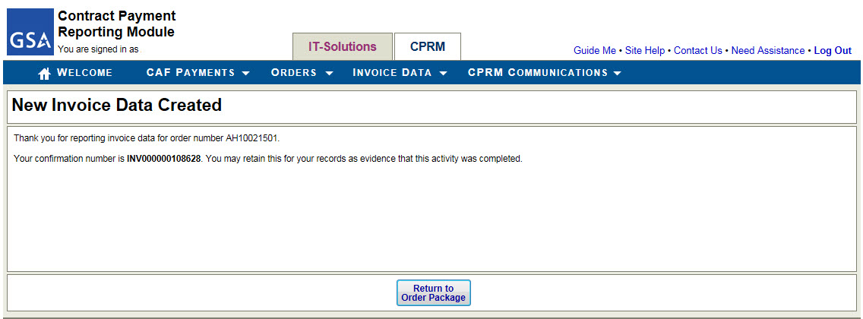
Entering New Invoice Data (slide 8 of 8)
About this Training
You Will Learn
CPRM Overview
High-level Workflow
Timing
How to…
Invoice Data Reporting
Enter Invoice Data
Upload Package
Zero Invoice Reporting
Enter Zero Invoice
CAF Payment Data Reporting
Enter CAF Payment Data
Pay CAF with Pay.gov
Search for CAF Payment Data
CAF Payment Reconciliation
Reports
Resources…
Glossary
Contractor Workflow
Help Resources
Confirmation Page
Upon successful submission, the system will present a confirmation page.

Slide 16
Using Upload Package (slide 1 of 5)
About this Training
You Will Learn
CPRM Overview
High-level Workflow
Timing
How to…
Invoice Data Reporting
Enter Invoice Data
Upload Package
Zero Invoice Reporting
Enter Zero Invoice
CAF Payment Data Reporting
Enter CAF Payment Data
Pay CAF with Pay.gov
Search for CAF Payment Data
CAF Payment Reconciliation
Reports
Resources…
Glossary
Contractor Workflow
Help Resources
Upload Package enables you to upload multiple invoices for multiple orders at once
High-level Process
Access the Upload Package feature from the Invoice Data menu → select Upload Multiple Invoices (Upload Package)

Slide 17
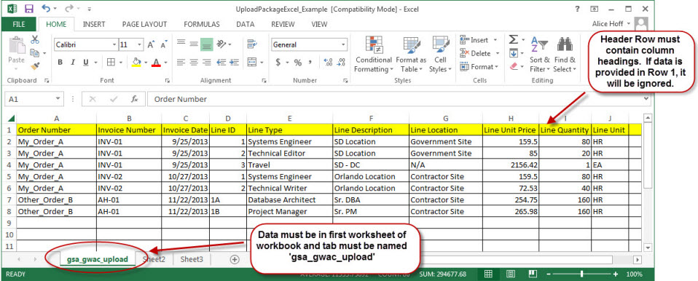
Using Upload Package (slide 2 of 5)
About this Training
You Will Learn
CPRM Overview
High-level Workflow
Timing
How to…
Invoice Data Reporting
Enter Invoice Data
Upload Package
Zero Invoice Reporting
Enter Zero Invoice
CAF Payment Data Reporting
Enter CAF Payment Data
Pay CAF with Pay.gov
Search for CAF Payment Data
CAF Payment Reconciliation
Reports
Resources…
Glossary
Contractor Workflow
Help Resources
Start by formatting your Invoice Data
Create the Excel or CSV file, such as this example:
Click here to access the templates and additional detail about how to format the data in the template

Slide 18
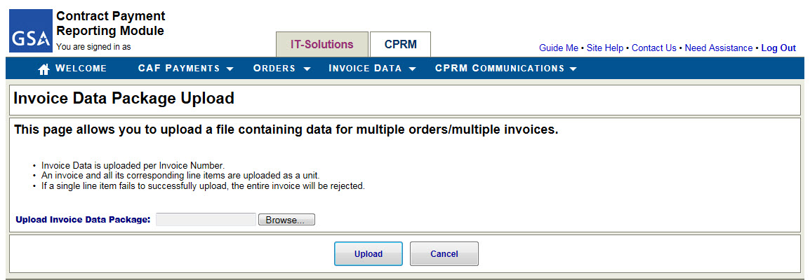
Using Upload Package (slide 3 of 5)
About this Training
You Will Learn
CPRM Overview
High-level Workflow
Timing
How to…
Invoice Data Reporting
Enter Invoice Data
Upload Package
Zero Invoice Reporting
Enter Zero Invoice
CAF Payment Data Reporting
Enter CAF Payment Data
Pay CAF with Pay.gov
Search for CAF Payment Data
CAF Payment Reconciliation
Reports
Resources…
Glossary
Contractor Workflow
Help Resources
Navigate to the Invoice Data Package Upload form
Click Browse to find your file on your computer.
Click ‘Upload’ to instruct the system to extract data from the file and perform validations.
Click ‘Cancel’ to cancel.
Upon clicking ‘Upload’, the system will present a new form with a data summary for you to review.

Slide 19
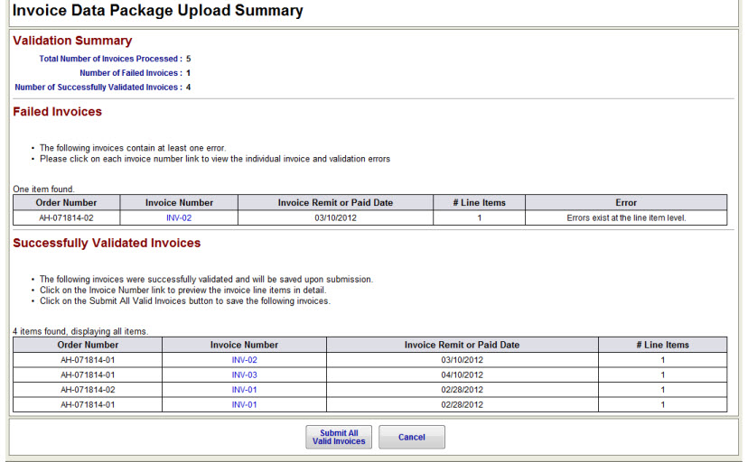
Using Upload Package (slide 4 of 5)
About this Training
You Will Learn
CPRM Overview
High-level Workflow
Timing
How to…
Invoice Data Reporting
Enter Invoice Data
Upload Package
Zero Invoice Reporting
Enter Zero Invoice
CAF Payment Data Reporting
Enter CAF Payment Data
Pay CAF with Pay.gov
Search for CAF Payment Data
CAF Payment Reconciliation
Reports
Resources…
Glossary
Contractor Workflow
Help Resources
Review the Validation Results
Summary of Failed and Successful Invoices is presented at the top of the page.
If the system identifies errors, they are presented in the Failed Invoices section.
If the system identifies successful invoices (those with zero validation errors), they are presented in the Successfully Validated Invoices section.
Click ‘Submit All Valid Invoices’ to approve upload of the successful invoices to the CPRM.
Click ‘Cancel’ to exit the process.

Slide 20
Using Upload Package (slide 5 of 5)
About this Training
You Will Learn
CPRM Overview
High-level Workflow
Timing
How to…
Invoice Data Reporting
Enter Invoice Data
Upload Package
Zero Invoice Reporting
Enter Zero Invoice
CAF Payment Data Reporting
Enter CAF Payment Data
Pay CAF with Pay.gov
Search for CAF Payment Data
CAF Payment Reconciliation
Reports
Resources…
Glossary
Contractor Workflow
Help Resources
Confirmation
Upon successful submission, the system will present a confirmation page.

Slide 21
Introduction to Zero Invoice Reporting
About this Training
You Will Learn
CPRM Overview
High-level Workflow
Timing
How to…
Invoice Data Reporting
Enter Invoice Data
Upload Package
Zero Invoice Reporting
Enter Zero Invoice
CAF Payment Data Reporting
Enter CAF Payment Data
Pay CAF with Pay.gov
Search for CAF Payment Data
CAF Payment Reconciliation
Reports
Resources…
Glossary
Contractor Workflow
Help Resources
What is a Zero Invoice?
A Zero Invoice enables you to indicate that there will be no invoicing for a particular reporting period for your task order.
The GSA contract program office will expect you to report Invoice Data for every reporting period within the task order’s Period of Performance. If you do not have invoices for a period, you should submit a ‘Zero Invoice Data’ record thus acknowledging that no invoice data should be expected.
For example, at the beginning of the task order’s period of performance you may have no invoices for the first reporting quarter. In this case, you should submit a Zero Invoice Data record for the order’s first reporting quarter.
If you neglect to submit Zero Invoice Data and also do not submit Invoice Data for a reporting period, it may be interpreted as a reporting deficiency.

Slide 22
Entering Zero Invoice Data (slide 1 of 4)
About this Training
You Will Learn
CPRM Overview
High-level Workflow
Timing
How to…
Invoice Data Reporting
Enter Invoice Data
Upload Package
Zero Invoice Reporting
Enter Zero Invoice
CAF Payment Data Reporting
Enter CAF Payment Data
Pay CAF with Pay.gov
Search for CAF Payment Data
CAF Payment Reconciliation
Reports
Resources…
Glossary
Contractor Workflow
Help Resources
Access the Zero Invoice Data form from the Invoice Data menu → select Enter New Invoice Data
Alternatively, access the Invoice Data form from the ‘add’ link on the Order Data form, above Invoice Data table
The Invoice Data form will open in ‘edit-mode’ and you can choose to report Zero Invoice Data
The following slides provide explanation of each form field

Slide 23
Entering Zero Invoice Data (slide 2 of 4)
About this Training
You Will Learn
CPRM Overview
High-level Workflow
Timing
How to…
Invoice Data Reporting
Enter Invoice Data
Upload Package
Zero Invoice Reporting
Enter Zero Invoice
CAF Payment Data Reporting
Enter CAF Payment Data
Pay CAF with Pay.gov
Search for CAF Payment Data
CAF Payment Reconciliation
Reports
Resources…
Glossary
Contractor Workflow
Help Resources
Start by Indicating Zero Invoice Data
If you access the form from the Invoice Data menu, then start by selecting the Order Number.
Select ‘Zero Invoice Data’ to set the form to enable you to enter the zero invoice information.

Slide 24
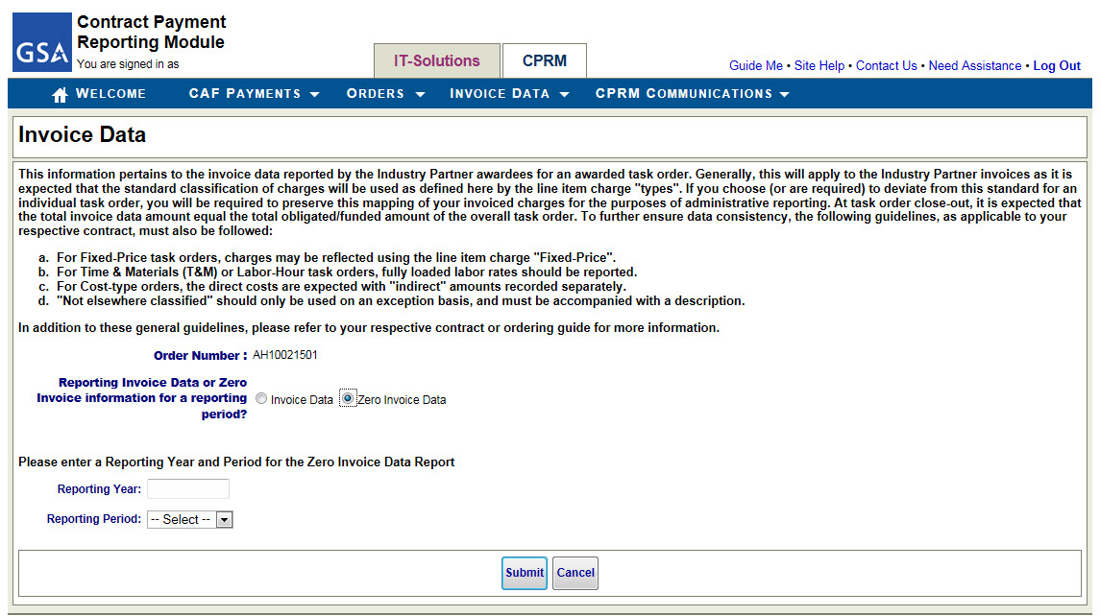
Entering Zero Invoice Data (slide 3 of 4)
About this Training
You Will Learn
CPRM Overview
High-level Workflow
Timing
How to…
Invoice Data Reporting
Enter Invoice Data
Upload Package
Zero Invoice Reporting
Enter Zero Invoice
CAF Payment Data Reporting
Enter CAF Payment Data
Pay CAF with Pay.gov
Search for CAF Payment Data
CAF Payment Reconciliation
Reports
Resources…
Glossary
Contractor Workflow
Help Resources
Identify the Reporting Year / Period
Enter the Reporting Year and Period for which there will be no invoicing.
Click ‘Submit’ to submit the form.
Click ‘Cancel’ to close the form without saving.
The system will perform validations on the data entered, such as:
The Reporting Year / Period must overlap with the Period of Performance.
A Zero Invoice Data record may not be submitted if it conflicts with existing Invoice Data for the task order.

Slide 25
Entering Zero Invoice Data (slide 4 of 4)
About this Training
You Will Learn
CPRM Overview
High-level Workflow
Timing
How to…
Invoice Data Reporting
Enter Invoice Data
Upload Package
Zero Invoice Reporting
Enter Zero Invoice
CAF Payment Data Reporting
Enter CAF Payment Data
Pay CAF with Pay.gov
Search for CAF Payment Data
CAF Payment Reconciliation
Reports
Resources…
Glossary
Contractor Workflow
Help Resources
Confirmation Page
Upon successful submission, the system will present a confirmation page.
Zero Invoice Data record will appear in Invoice Data table:

Slide 26
Introduction to CAF Payment Data Reporting
About this Training
You Will Learn
CPRM Overview
High-level Workflow
Timing
How to…
Invoice Data Reporting
Enter Invoice Data
Upload Package
Zero Invoice Reporting
Enter Zero Invoice
CAF Payment Data Reporting
Enter CAF Payment Data
Pay CAF with Pay.gov
Search for CAF Payment Data
CAF Payment Reconciliation
Reports
Resources…
Glossary
Contractor Workflow
Help Resources
For each of your contracts (GWAC, Connections II, OASIS, other) supported in the CPRM, you must report and pay the Contract Access Fee (CAF)
You should report and pay CAF in accordance with your contract’s reporting period and CAF Rate rules
For example, your contract may require payment of CAF on a quarterly basis. If this is the case,
You must report all invoice data within 30 days of the end of the reporting quarter
You must report and pay CAF within 30 days of the end of the reporting quarter
The CPRM enables you to report the CAF Payment and to pay the CAF using the Pay.gov feature directly from the system
With Program Office approval, you may pay CAF using an alternative method
Other CAF Payment methods: Click here for additional information

Slide 27
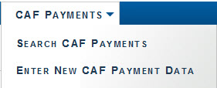
Entering CAF Payment Data (slide 1 of 4)
About this Training
You Will Learn
CPRM Overview
High-level Workflow
Timing
How to…
Invoice Data Reporting
Enter Invoice Data
Upload Package
Zero Invoice Reporting
Enter Zero Invoice
CAF Payment Data Reporting
Enter CAF Payment Data
Pay CAF with Pay.gov
Search for CAF Payment Data
CAF Payment Reconciliation
Reports
Resources…
Glossary
Contractor Workflow
Help Resources
Access the CAF Payment Data form from the CAF Payments menu → select Enter New CAF Payment Data
The CAF Payment Data form will open in ‘edit-mode’
The following slides provide explanation of each form field

Slide 28
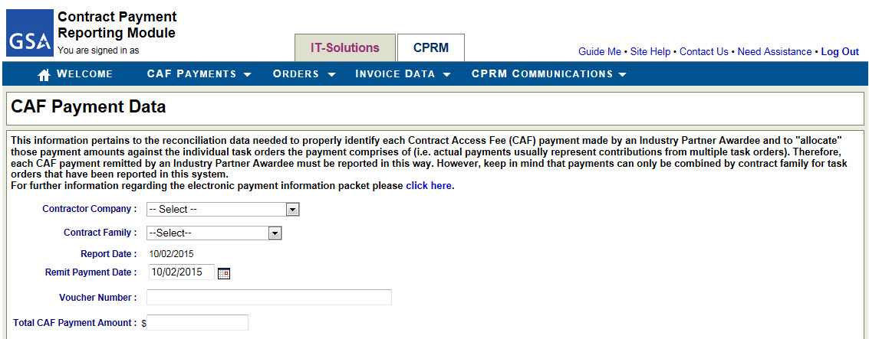
Entering CAF Payment Data (slide 2 of 4)
About this Training
You Will Learn
CPRM Overview
High-level Workflow
Timing
How to…
Invoice Data Reporting
Enter Invoice Data
Upload Package
Zero Invoice Reporting
Enter Zero Invoice
CAF Payment Data Reporting
Enter CAF Payment Data
Pay CAF with Pay.gov
Search for CAF Payment Data
CAF Payment Reconciliation
Reports
Resources…
Glossary
Contractor Workflow
Help Resources
Start by selecting your Company Name and Contract Family Name
Select your company name.
Select the Contract Family name associated to the contract for which you wish to pay CAF.
The Report Date reflects the current date.
Enter the date that you expect the CAF payment will be paid by your company.
Enter the Voucher Number.
This is a tracking number that you can use, such as ‘Q2 2014 CAF’.
Enter the total amount that you will pay on this CAF Payment.

Slide 29
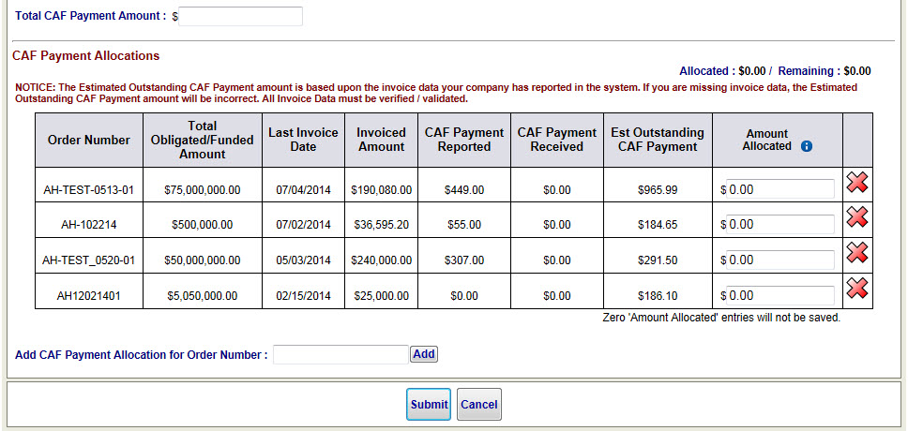
Entering CAF Payment Data (slide 3 of 4)
About this Training
You Will Learn
CPRM Overview
High-level Workflow
Timing
How to…
Invoice Data Reporting
Enter Invoice Data
Upload Package
Zero Invoice Reporting
Enter Zero Invoice
CAF Payment Data Reporting
Enter CAF Payment Data
Pay CAF with Pay.gov
Search for CAF Payment Data
CAF Payment Reconciliation
Reports
Resources…
Glossary
Contractor Workflow
Help Resources
Allocate the Total CAF Payment Amount to the Orders in the Allocation table
As you allocate the Total CAF Payment Amount to the orders in the table, the Allocated vs. the Remaining amounts will update at the top of the table.
Text explains how the Est. Outstanding CAF Payment amount is calculated.
Click the red X to delete a line from the table.
Allocate the Total CAF Payment Amount to one or more orders. Any orders that are not covered by the CAF payment may remain set to $0.00.
If you need to add an order to the table, use the ‘Add’ feature.
NOTE: only orders with invoice data in CPRM may be added to the table.
Click ‘Submit’ to submit the CAF Payment Data form to the CPRM.
Click ‘Cancel’ to close the form.
Once you select the Contract Family, the CAF Payment Allocation table will populate with all your task orders for which Invoice Data has been entered.

Slide 30
Entering CAF Payment Data (slide 4 of 4)
About this Training
You Will Learn
CPRM Overview
High-level Workflow
Timing
How to…
Invoice Data Reporting
Enter Invoice Data
Upload Package
Zero Invoice Reporting
Enter Zero Invoice
CAF Payment Data Reporting
Enter CAF Payment Data
Pay CAF with Pay.gov
Search for CAF Payment Data
CAF Payment Reconciliation
Reports
Resources…
Glossary
Contractor Workflow
Help Resources
Confirmation Page
Upon successful submission, the system will present a confirmation page.
The data will also appear in the table in the Order Data package.

Slide 31
Pay CAF using Pay.gov (slide 1 of 5)
About this Training
You Will Learn
CPRM Overview
High-level Workflow
Timing
How to…
Invoice Data Reporting
Enter Invoice Data
Upload Package
Zero Invoice Reporting
Enter Zero Invoice
CAF Payment Data Reporting
Enter CAF Payment Data
Pay CAF with Pay.gov
Search for CAF Payment Data
CAF Payment Reconciliation
Reports
Resources…
Glossary
Contractor Workflow
Help Resources
The Pay button enables you to remit your CAF payment to the GSA using the U.S. Treasury’s Pay.gov system.
Pay button appears after you submit the CAF Payment Data form, or
Pay button appears on pending CAF Payment Data forms
Process:
Pay.gov payments are done by electronic bank transfer.
NOTE: credit card payments will be accepted in the near future.
Recommendation: use Internet Explorer browser.

Slide 32
Pay CAF using Pay.gov (slide 2 of 5)
About this Training
You Will Learn
CPRM Overview
High-level Workflow
Timing
How to…
Invoice Data Reporting
Enter Invoice Data
Upload Package
Zero Invoice Reporting
Enter Zero Invoice
CAF Payment Data Reporting
Enter CAF Payment Data
Pay CAF with Pay.gov
Search for CAF Payment Data
CAF Payment Reconciliation
Reports
Resources…
Glossary
Contractor Workflow
Help Resources
Click the Pay button
TIP: It is recommended to use Internet Explorer 9. The system will not function correctly if using Firefox.
Important Note: By using the Pay button to access Pay.gov, your contract number will be linked to and reported with your CAF Payment to the GSA.
By clicking the Pay button, you will leave the CPRM and open a new connection to the U.S. Treasury Pay.gov application. Upon completing your payment via Pay.gov, you will be returned to the CPRM.
The CPRM does not collect any banking information.

Slide 33
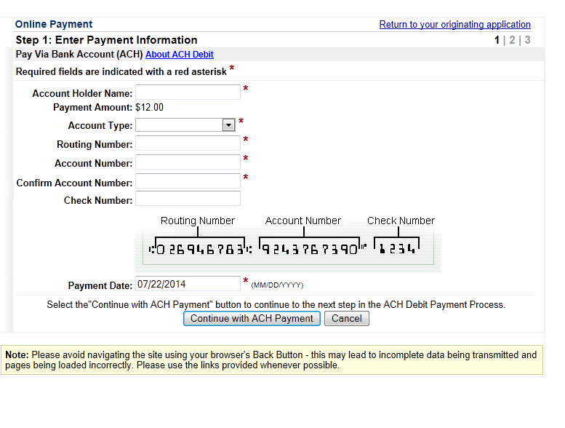
Pay CAF using Pay.gov (slide 3 of 5)
About this Training
You Will Learn
CPRM Overview
High-level Workflow
Timing
How to…
Invoice Data Reporting
Enter Invoice Data
Upload Package
Zero Invoice Reporting
Enter Zero Invoice
CAF Payment Data Reporting
Enter CAF Payment Data
Pay CAF with Pay.gov
Search for CAF Payment Data
CAF Payment Reconciliation
Reports
Resources…
Glossary
Contractor Workflow
Help Resources
Enter your Banking Information
Enter the Account Holder Name. This should be the Company Account Holder Name who is registered with the bank.
The amount matches the amount entered on the CAF Payment Data Form.
Provide the account and routing number.
Enter a Payment Date.
Click to advance to the next step.

Slide 34
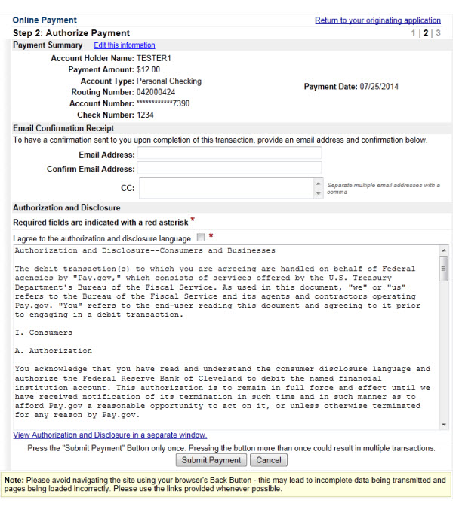
Pay CAF using Pay.gov (slide 4 of 5)
About this Training
You Will Learn
CPRM Overview
High-level Workflow
Timing
How to…
Invoice Data Reporting
Enter Invoice Data
Upload Package
Zero Invoice Reporting
Enter Zero Invoice
CAF Payment Data Reporting
Enter CAF Payment Data
Pay CAF with Pay.gov
Search for CAF Payment Data
CAF Payment Reconciliation
Reports
Resources…
Glossary
Contractor Workflow
Help Resources
Enter your Contact Information and Authorize the Payment
Review the payment information.
Enter your email address.
Read then check the box to agree to the authorization and disclosure language.
Click to advance to the next step.

Slide 35
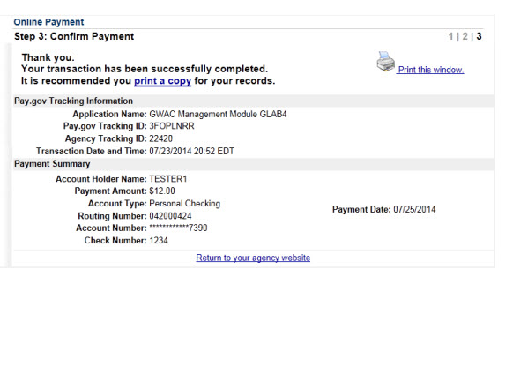
Pay CAF using Pay.gov (slide 5 of 5)
About this Training
You Will Learn
CPRM Overview
High-level Workflow
Timing
How to…
Invoice Data Reporting
Enter Invoice Data
Upload Package
Zero Invoice Reporting
Enter Zero Invoice
CAF Payment Data Reporting
Enter CAF Payment Data
Pay CAF with Pay.gov
Search for CAF Payment Data
CAF Payment Reconciliation
Reports
Resources…
Glossary
Contractor Workflow
Help Resources
Print your Confirmation and Return to CPRM
Print a copy of this form for your records.
Click link to return to CPRM.

Slide 36
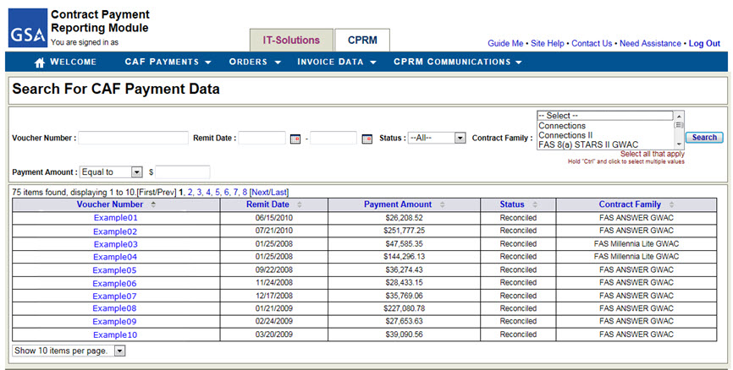
How to Search for CAF Payments
About this Training
You Will Learn
CPRM Overview
High-level Workflow
Timing
How to…
Invoice Data Reporting
Enter Invoice Data
Upload Package
Zero Invoice Reporting
Enter Zero Invoice
CAF Payment Data Reporting
Enter CAF Payment Data
Pay CAF with Pay.gov
Search for CAF Payment Data
CAF Payment Reconciliation
Reports
Resources…
Glossary
Contractor Workflow
Help Resources
You can access all your CAF Payment Data forms from the Search for CAF Payment Data page
How to access this page: menu option CAF Payments → Search CAF Payments
Table is pre-populated with all CAF Payments associated to your company.
Click the Voucher Number to open the CAF Payment Data form.
A CAF Payment may have the following status settings:
Pending – not yet reconciled with a payment received by the GSA. You may edit a Pending form.
Rejected – a Pay.gov payment was rejected. You may edit the form and submit a new payment.
Reconciled – matched to a payment received by the GSA.
Reallocation – a net $0.00 CAF Payment used by GSA to reallocate CAF from one order to another.

Slide 37
CAF Payment Reconciliation
About this Training
You Will Learn
CPRM Overview
High-level Workflow
Timing
How to…
Invoice Data Reporting
Enter Invoice Data
Upload Package
Zero Invoice Reporting
Enter Zero Invoice
CAF Payment Data Reporting
Enter CAF Payment Data
Pay CAF with Pay.gov
Search for CAF Payment Data
CAF Payment Reconciliation
Reports
Resources…
Glossary
Contractor Workflow
Help Resources
Actual payment data is imported to the CPRM system from GSA General Ledger each night.
The actual payment data is matched to the CAF Payment Data forms.
When matches are made, the system updates the CAF Payment Data form status to ‘Reconciled’.
When there is no match, the system sets the CAF Payment Data form status to ‘Pending’.
If a payment made via Pay.gov is rejected for any reason, the system sets the CAF Payment Data for status to ‘Rejected’.
If the GSA needs to assist a company in reallocating CAF paid for one task order to another task order, the status of the entry will be ‘Reallocation’.
Matches are made on the amount and date reported on the CAF Payment Data form.
The amount on the form must exactly match the actual payment.

Slide 38
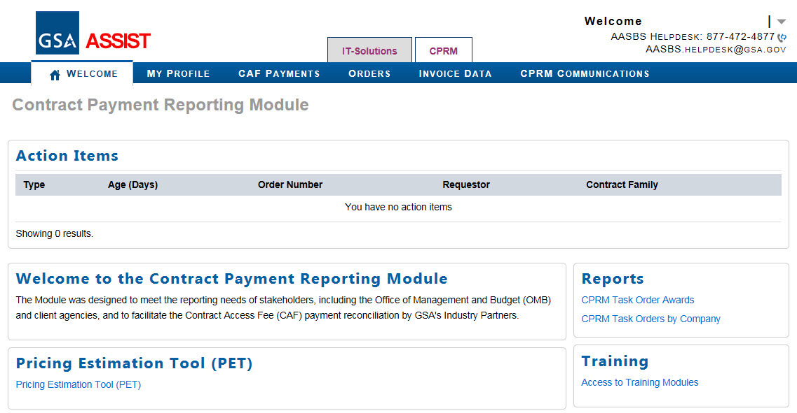
Reports
About this Training
You Will Learn
CPRM Overview
High-level Workflow
Timing
How to…
Invoice Data Reporting
Enter Invoice Data
Upload Package
Zero Invoice Reporting
Enter Zero Invoice
CAF Payment Data Reporting
Enter CAF Payment Data
Pay CAF with Pay.gov
Search for CAF Payment Data
CAF Payment Reconciliation
Reports
Resources…
Glossary
Contractor Workflow
Help Resources
Use the ‘Task Order Awards by Company’ report to validate that the invoice data is accurate and complete for your order(s) and the CAF payments have been made for the full amount owed.
Report Portlet

Slide 39
Conclusion
About this Training
You Will Learn
CPRM Overview
High-level Workflow
Timing
How to…
Invoice Data Reporting
Enter Invoice Data
Upload Package
Zero Invoice Reporting
Enter Zero Invoice
CAF Payment Data Reporting
Enter CAF Payment Data
Pay CAF with Pay.gov
Search for CAF Payment Data
CAF Payment Reconciliation
Reports
Resources…
Glossary
Contractor Workflow
Help Resources
Thank you for completing the CPRM Training Module: Advanced Instruction on Entering Invoice Data and CAF Payment Data
Be sure to visit the other modules:
CPRM Training Module: Advanced Instruction on Workflow and System Access
CPRM Training Module: Advanced Instruction on Entering Order Data and Modification Data
Tip: Help is available on each page in the system by clicking the ‘Guide Me’ link at the top.
AASBS Helpdesk contact info:
aasbs.helpdesk@gsa.gov
877-472-4877

Slide 40
About this Training
You Will Learn
CPRM Overview
High-level Workflow
Timing
How to…
Invoice Data Reporting
Enter Invoice Data
Upload Package
Zero Invoice Reporting
Enter Zero Invoice
CAF Payment Data Reporting
Enter CAF Payment Data
Pay CAF with Pay.gov
Search for CAF Payment Data
CAF Payment Reconciliation
Reports
Resources…
Glossary
Contractor Workflow
Help Resources
Resources

Slide 41
Glossary
About this Training
You Will Learn
CPRM Overview
High-level Workflow
Timing
How to…
Invoice Data Reporting
Enter Invoice Data
Upload Package
Zero Invoice Reporting
Enter Zero Invoice
CAF Payment Data Reporting
Enter CAF Payment Data
Pay CAF with Pay.gov
Search for CAF Payment Data
CAF Payment Reconciliation
Reports
Resources…
Glossary
Contractor Workflow
Help Resources
Term | Definition
AASBS | Assisted Acquisition Services – Business Systems
ACH | Automated Clearing House
AGF | Associated Government Fee
ASSIST | Assisted Services Shared Information SysTem
CAF | Contract Access Fee
CLIN | Contract Line Item Number
CPRM | Contract Payment Reporting Module
GWAC | Government-wide Acquisition Contract
GL | General Ledger
IDIQ | Indefinite Delivery Indefinite Quantity
ITSS | IT Solutions Shop
IP | Industry Partner
MAC | Multiple Award Contract
OASIS / OASIS SB | One Acquisition Solution for Integrated Services; SB: Small Business
OCO | Ordering Contracting Officer
OMB | Office of Management and Budget
Pay.gov | A U.S. Treasury application that enables U.S. government agencies to accept payments via electronic bank transfer or credit card.
PCO | Procuring Contracting Officer
POP | Period of Performance
REX | Remittance Exchange. Another method for contractors to remit payments to the U.S. Government

Slide 42
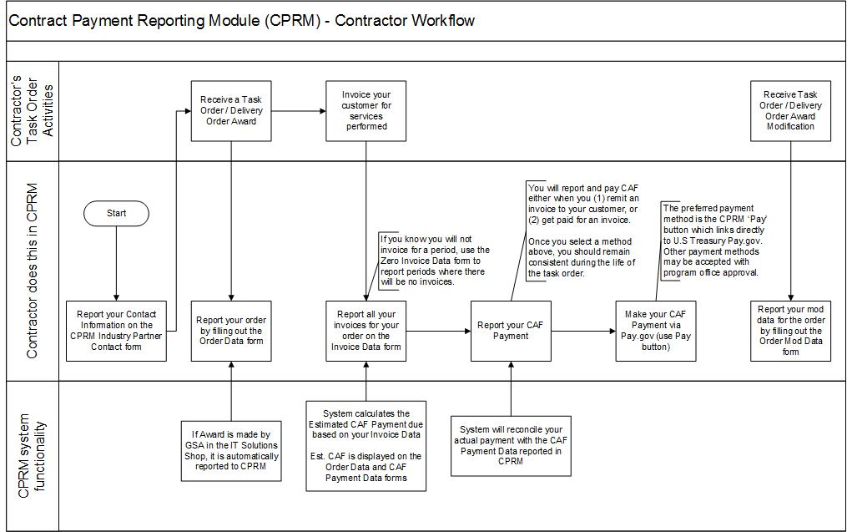
Contractor (Industry Partner) Workflow
About this Training
You Will Learn
CPRM Overview
High-level Workflow
Timing
How to…
Invoice Data Reporting
Enter Invoice Data
Upload Package
Zero Invoice Reporting
Enter Zero Invoice
CAF Payment Data Reporting
Enter CAF Payment Data
Pay CAF with Pay.gov
Search for CAF Payment Data
CAF Payment Reconciliation
Reports
Resources…
Glossary
Contractor Workflow
Help Resources
explain…
This diagram details the Contractor’s workflow and how it corresponds to activities that occur outside of the CPRM.
explain…
The CPRM system includes a custom link to the U.S. Treasury’s Pay.gov system via the ‘Pay’ button.
It is important to use the CPRM ‘Pay’ button to remit your CAF Payment because the system links your payment information to your contract number and other pertinent data in CPRM.
With the correct contract number and other data associated to your payment, the GSA’s systems and processes function most efficiently.

Slide 43
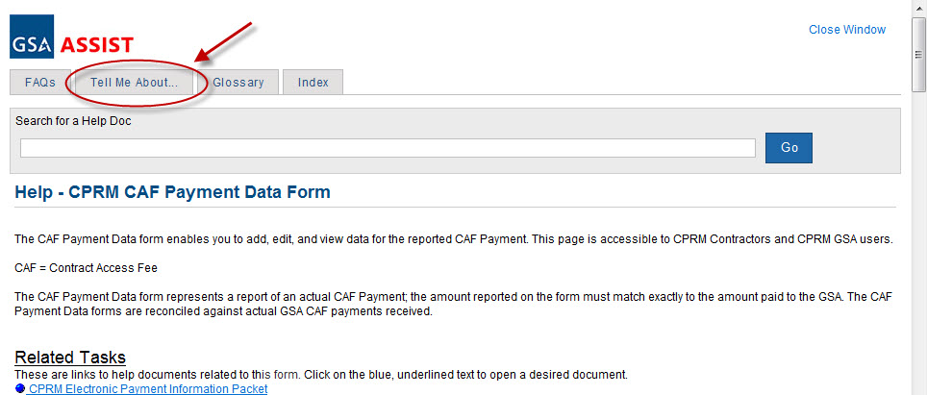
Help Resources
About this Training
You Will Learn
CPRM Overview
High-level Workflow
Timing
How to…
Invoice Data Reporting
Enter Invoice Data
Upload Package
Zero Invoice Reporting
Enter Zero Invoice
CAF Payment Data Reporting
Enter CAF Payment Data
Pay CAF with Pay.gov
Search for CAF Payment Data
CAF Payment Reconciliation
Reports
Resources…
Glossary
Contractor Workflow
Help Resources
Access Help Pages by clicking the “Guide Me” link at the top of each page
Inside the help system, you may access other help documents using the ‘Tell Me About…’ tab

