Slide 1

Client Enrichment Series
Welcome to today’s presentation on:
Sustainability in Leasing - Green Lease Requirements
the presentation will start at 2:00pm Eastern
Note: Phones are automatically muted during the presentation. You have the ability to send questions to the host and presenters through your questions pane. They will answer as many of the questions as possible throughout and at the end of the presentation. All questions will be captured, and answers sent to all participants prior to the next presentation.

Slide 2


Sustainability in Leasing - Green Lease Requirements
Client Enrichment Series
Hosted by: Dawn Warner
PBS Regional Account Manager
Denver, CO
Presented by: Alexandra Kosmides, Management Analyst, LEED AP
PBS Office of Leasing
Washington, DC

Slide 3

GSA Office of Leasing Sustainability Initiatives
Net of Utility Leases Pilots
    Examine utility consumption and costs as a sample of leases are shifted from F.S. to Net of Utilities, or from GSA to Tenant paying utilities.
    Have offerors provide utility rates for both F.S. And Net of Utilities.
Green Language Changes
    Recently modified green specs related to Key Sustainable Product standards.
    Language changes pending – related to new E.O. + Energy Act
    Language changes pending – related to LEED v4, GG, LBC.
Net of Utility Pilots
Green Language Modifications
Utility Consumption Reporting
    Developing and testing process for lessors to report energy and water consumption data on a monthly basis.
    Lease language changed to make this mandatory.
Office of Leasing
Sustainability
Initiatives
Guiding Principle Compliance
    Provide clear guidance for “culprit clauses.”
    New Guiding Principles in Oct. 2015 – lease language will change in response.
Utility Consumption Reporting
Guiding
Principle
Compliance
First Fuel Pilots
Outreach and Training
Outreach/Training
    Collaborate with private-sector, other agencies, industry experts on green leasing issues.
    Regular “Industry Days/Roundtables”, webinar training, etc.
First Fuel Pilots
    “Rapid Building Assessments”/ Virtual Energy Audits being applied to 7 leased buildings.
    Develop guidance/best practices related to common findings.
Notes:
Overview of the mix of sustainability initiatives we’re pursing in the Office of Leasing

Slide 4
Green Lease Language Modifications
E.O. 13693 + Energy
Efficiency
Improve-
ment Act
LEED v4,
Green Globes,
Rating
System
Updates
Key
Sustainable
Products
Guiding
Principles
Changes
New E.O. on Sustainability
(March 2015)
Energy Efficiency Act (April 2015)
PBS Consistency
LAC Issued
(April 2015)
KSP language in new lease models
(May 2015)
LEED v4 mandatory (October 2016)
Cost study D&C
Green Globes/ Living Bldg. Challenge + Guiding Principles
New Guiding Principles
(October 2015)
Lease language will align with new GPs
Notes:
Some of these initiatives will translate into changes to our Green Lease Language.
Key Sustainable Products
Commissioner Dong’s goal for consistency among PBS business lines -- with top 10 green products
Lease Acquisition Circular issued April 2015
Language now reflected in May 2015 lease models
9 of 10 KSPs apply to Leasing: Gypsum Board/ Concrete/ Acoustic Ceiling Tile/ Interior Paint/ Nylon Carpet/ Paper Towels/ Bath Tissue/ Hand Soap/ Floor Cleaner (wastebasket liners don’t yet apply)
Gypsum board and Concrete represent new green clauses
Ceiling Tile and Concrete apply to New Lease Construction only
LEED Version 4:
There is a major emphasis on product disclosure and transparency in the new LEED version 4 rating system.
Green Globes (Green Building Initiative) has a new rating system for interior tenant spaces.
The prior LEED rating system (2009) can be used THROUGH OCTOBER 2016.
There is a new rating system that addresses Guiding Principle compliance.

Slide 5
New Executive Order 13693: Planning for Federal Sustainability in the Next Decade (March 19, 2015)
Energy Efficiency Performance Criteria or Source Selection Factor
  All new solicitations over 10,000 RSF require energy efficiency either as a required
performance criterion or as a source selection factor in best-value tradeoff procurement.
  Leasing is using the existing Energy Star requirement or cost-effective improvement provision in the lease document to be equivalent to this “criteria for energy efficiency as a required performance specification.”
Energy Disclosure
  Lessors are required to disclose carbon emissions and/or energy consumption data for the leased spaces over 10,000 RSF via sub-metering or estimation from pro-rated occupancy data.
  Office of Leasing is developing a process to track and report energy consumption by lessors. Testing to begin in August 2015.
Guiding Principle Targets
  Revised Guiding Principles will be issued within 150 days of the new E.O. (by late Aug. 2015) ; Implementing instructions to be provided with 45 days (by May 2015)
  While the EO provision addressing Guiding Principles is silent on leases, the proposed revisions to the GPs that GSA and DOE submitted to CEQ last year did include GPs for leases.
  Leasing is estimating that an FY 2016 GP target will increase from 18% (in FY15) to a range of 20-22%.
Optimize Space Usage + Consider Existing Transp.+ Infrastructure
  Implementing Instructions from EO 13514 is kept under this E.O. – CEQ can revise. Focus on an appropriate balance of sustainability, cost, and security.
Notes:
MAIN DRIVERS/GOAL:
Reduction of Greenhouse Gas Emissions
Improved Energy Efficiency
Reduced Reliance on Non-renewable energy sources
4 KEY LEASING RELATED PROVISIONS
The new Executive Order requires Lessors for leased space OVER 10,000 RSF to report utility consumption
The new Executive Order refers to new, revised Guiding Principles.
The new Executive Order refers to the prior E.O. for space usage and optimization.
Lessors will need to disclose energy consumption for leased spaces over 10,000 sf. under the new E.O.

Slide 6
Guiding Principles
Employ
Integrated Design
Protect and
Conserve Water
Reduce Environmental Impact of Materials
5 Guiding Principles
Optimize Energy Performance
Enhance Indoor Environmental
Quality
Notes:
The Guiding Principles are the common strategies related to planning, acquiring, siting, designing, building, operating, and maintaining facilities in a sustainable way.
They were established by the MOU discussed earlier in the lesson.
The 5 Guiding Principles are shown in this diagram:
1) Employing integrated design, which takes a holistic approach to designing building to optimize efficiency;
2) Reducing the environmental impact of materials;
3) Enhancing indoor environmental quality;
4) Optimizing energy performance; and
5) Protecting and conserving water.

Slide 7
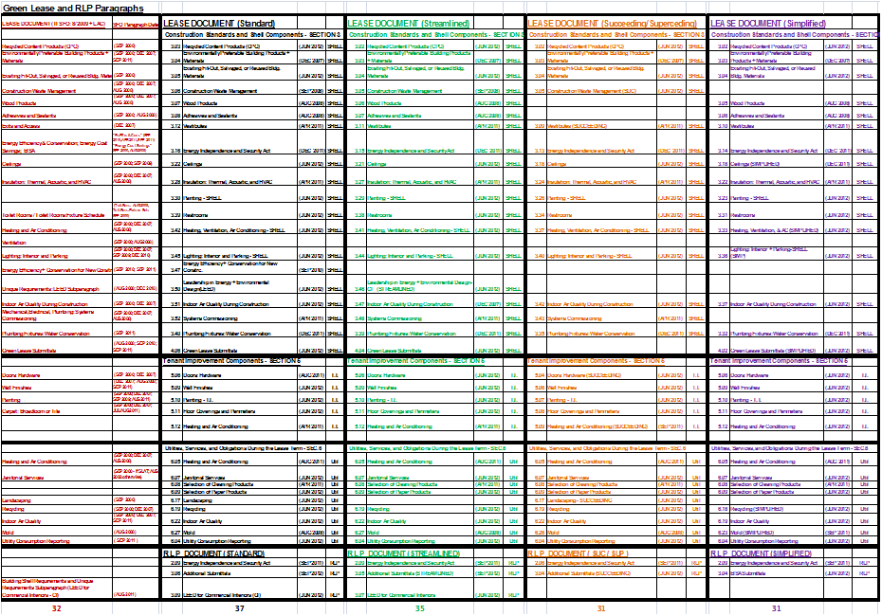
Matrix of Green Clauses that Align With the Guiding Principles Modifications Pending Per the New Guiding Principles
external PBS Portal GREX - Docs/Sustainability or GSA internal NOL Google Site
Notes:
Link – on the PBS Portal
Our Green LEASE LANGUAGE will be modified to Align with the new Guiding Principles
Stay tuned for these changes.

Slide 8
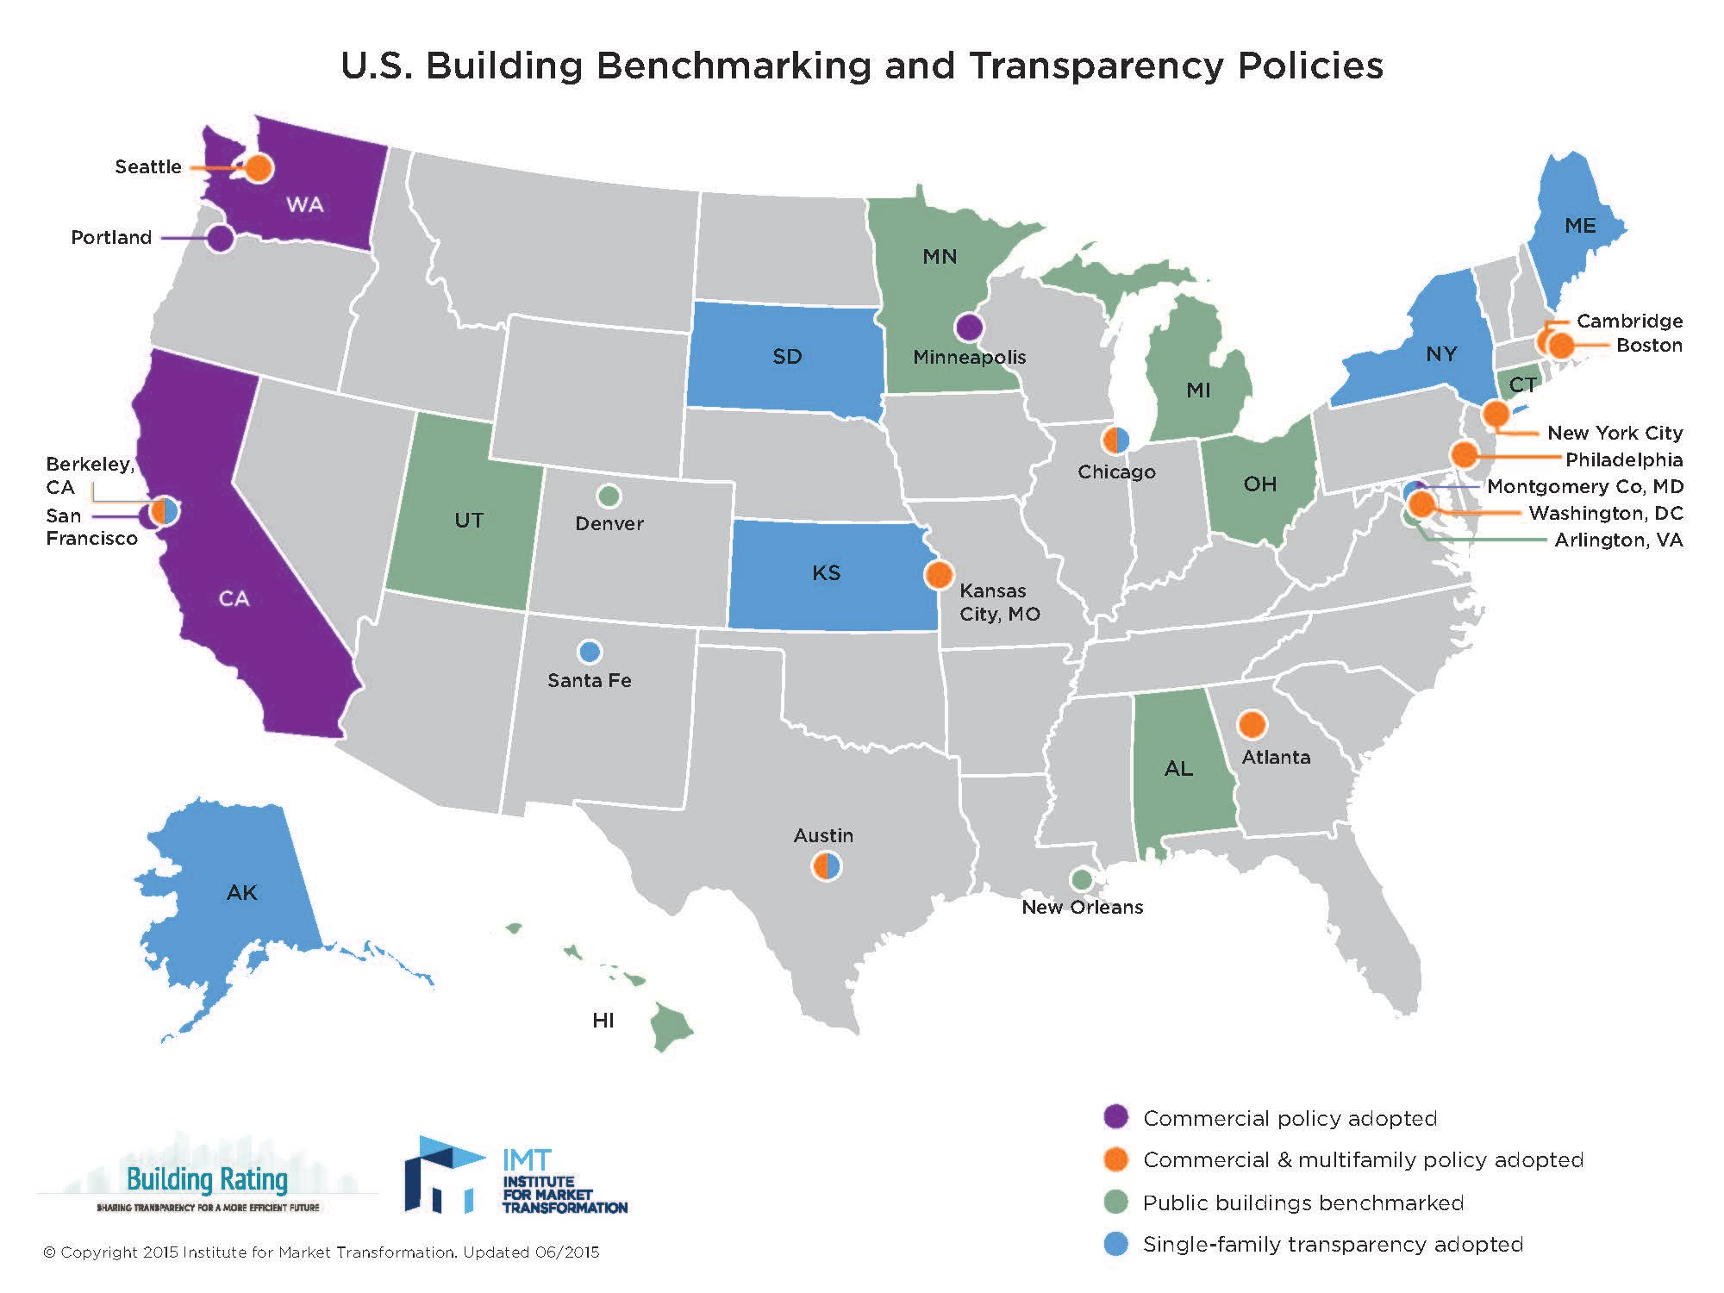
Energy Disclosure/Benchmarking Jurisdictions
Notes:
Energy Disclosure has become a major focus lately
This map identifies all of the jurisdictions that have adopted some kind of energy disclosure requirement
Usual mix that you typically see – D.C., San Francisco, Seattle, Boston
What’s interesting is the mix of cities – such as Atlanta and Kansas City – who are not typically the pioneers

Slide 9
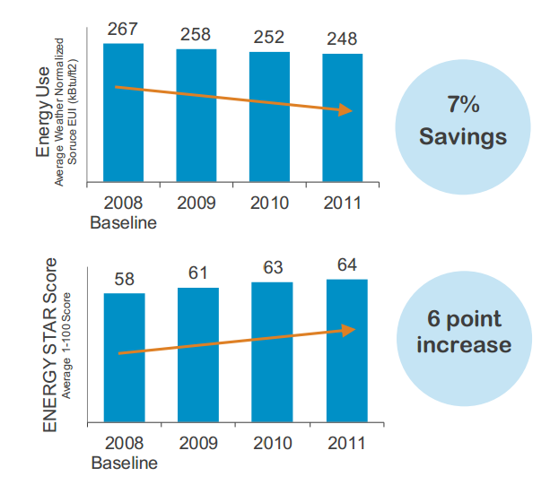

Energy Savings Related to Tracking Energy Usage
According to a 2012 EPA analysis, buildings that used Portfolio Manager to track energy usage between 2008 and 2011 realized an annual energy savings of 2.4% and a total energy savings of 7.0%.
Based on a 2015 “Resources for the Future” Study, Benchmarking and Transparency laws correlated with 3% lower utility expenses in private office buildings.
Source: EPA ENERGY STAR Portfolio Manager “Benchmarking and Energy Savings” Data Trends, October 2012.
Notes:
Graph from EPA and IMT – shows that just by tracking your energy consumption -→ there is a reduction in usage and cost.
EPA Energy Star is not involved in advocating for or designing benchmarking and disclosure mandates, but does provide technical assistance to jurisdictions with mandatory benchmarking requirements in place.
More than 15 billion square feet of commercial space has been voluntarily benchmarked in the past decade
Top performing buildings are eligible for Energy Star “label” recognizing the top 25% of energy-efficient buildings nationwide
Washington, DC is requiring Energy Star Target Finder scores for new buildings

Slide 10
Utility Consumption Reporting Process
Adjust Lease Language to Make Utility Reporting Mandatory for 10,000+ Leases
Developing/Testing Process for Lessors to Report Monthly Energy/ Water Data
Lessors Populate Consumption Data in EPA’s Portfolio Manager Tool
Adjust Data for Partial Building Occupancies
Regularly Report Utility Data to GSA and Provide Annual GHG Estimates
Notes:
Steps we’re taking to RESPOND to the Executive Order and to Implement the UCR

Slide 11

Utility Consumption Reporting Clause
UCR clause and UCR process is a response to GHG reporting requirements (2008-2014) and the new E.O. (2015)
UTILITY CONSUMPTION REPORTING CLAUSE (OCT 2015)
Upon the effective date of the Lease, only for leases over 10,000 RSF, the Lessor shall provide regular quarterly reports for the amount of utilities (including water) consumed at the Building broken down by utility type per month for the duration of the Lease. Lessors shall report this utility consumption data within 45 calendar days of the end of each calendar quarter. Data reported includes, but is not limited to, the number of actual units consumed, by utility type per month, and associated start and end date(s) for that consumption.
Notes:
We’ve had PLACEHOLDER language in our lease since 2011/2012.
Upon request from the Lease Contracting Officer or Contracting Officer's Representative, the Lessor shall provide regular quarterly reports of the amount of all utilities consumed at the Building in monthly detail for the duration of the Lease. These reports must be provided within 45 days of the end of each quarterly period and shall be in either written or electronic form, as requested by the Government. The reports shall contain the number of actual units consumed. If reports are available detailing only the Government's consumption, then the reports shall be limited solely to the Government's consumption. Additionally, said reports shall indicate, for each utility being reported, the use of the specific utility. For example, electricity consumption shall indicate if it includes heating or air conditioning, and if so whether just diffusers or diffusers and heating are included in electricity consumption.

Slide 12
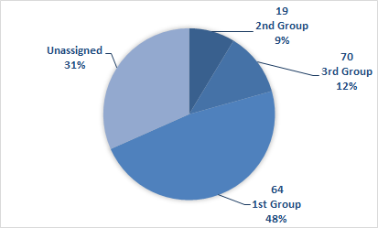
UCR Testing by Pilot Group
Universe of Leases | RSF | FY15 | FY16 | FY17
8,500 Total Leases (As of Jan 2015 REXUS Data) | 195,650,597
1,036 Leases w/ UCR Clause (Jan. 2013) | 22,492,987 (100%)
1st Pilot Group - 64 Leases Full Occupancy; >= 50K RSF | 10,726,293 (48%) | ✔
2nd Pilot Group - 19 Leases Partial Occupancy; >= 50K RSF | 1,948,462 (9%) |  | ✔
3rd Pilot Group - 70 Leases All Occupancy; <50K & >=30K RSF | 2,701,400 (12%) |  | ✔
New EO Leases All Occupancy; >= 10K RSF |  |  | ✔ | ✔
Notes:
We’ll be testing this process over the next year
AND
Fine-Tuning the process/ Identifying ways to make this smoother for lessors
Data Sharing issues and Privacy issues we’re working through.

Slide 13
Energy Efficiency Improvement Act: PL 114-11 (April 2015) : Leasing Related Provisions
Energy Efficiency Improvement Act:
Leasing-Related Provisions
Tenant
Star
Model
Commercial
Leasing
Provisions
Federal
Tenant
Benchmarking
Separate
Spaces
Study
Notes:
A month after the new E.O. came out, an Energy Bill was passed that also relates to Sustainability and Energy Reduction
There are 4 KEY Components related to Leasing
TENANT STAR: DOE to establish program to certify/recognize commercial tenants who voluntarily achieve high level of energy efficiency
EPA (and DOE) are required to develop TS under the Energy Star program
Expand the data collected through the Energy Info. Admin’s. CBECS to include info on building occupants who consume significant amounts of energy
Mod Com Lsg Prov: GSA required to develop modemodel leasing provisions and best practices to encourage commercial bldg. owners + tenants to invest in cost-effective energy + water efficiency measures
GSA required to publish the leasing provisions with explanatory materials to encourage private-sector use of the efficiency measures in leases
GSA is directed to make provisions + best practices available to state, county, and municipal governments to encourage investment in energy + water efficiency in bldg spaces they own/lease
GSA is directed to develop a system to implement cost-effective energy + water efficiency measures for realty services it provides to other federal agencies + clients
FED TENANT BENCHMARKING:
Requires federal agencies that lease certain buildings without Energy Star certification to compare their energy use to other facilities or past performance (benchmarking)
Agencies are exempt if their spaces are in buildings whose owners cannot access utility consumption data for the whole building
Energy Dept. (with EPA) is required to complete a study on the benchmarking, compliance, and best practices in building energy efficiency AND is required to maintain a database of energy-related information on commercial and multifamily buildings
SEPARATE SPACES STUDY:
Energy Department required to conduct a study within 1 year of bill’s enactment on the feasibility of improving energy efficiency through the design and construction of “separate spaces” within a building that could be leased or otherwise occupied by a tenant
Energy Dept. required to publish a notice in Federal Register within 90 days of bill’s enactment requesting public comments on effective methods, measures, and practices for design and construction of separate spaces with energy efficient design and construction

Slide 14
Energy Efficiency Improvement Act:
PL 114-11 (April 2015)
Model Commercial Leasing Provisions
(Section 301)
GSA (with DOE) shall develop model leasing provisions and best practices to encourage commercial bldg. owners + tenants to invest in cost-effective energy + water efficiency measures
GSA shall periodically publish the model commercial leasing provisions with explanatory materials to encourage private-sector use of the efficiency measures in leases
GSA shall make provisions and best practices available to State, county, and municipal governments – with the goal of encouraging investment in cost effective energy + water efficient measures
GSA shall develop policies and practices to implement cost-effective energy + water efficient measures for realty services it provides to other Federal agencies

Slide 15
Better Building Act of 2015- Model Commercial Leasing Provision: Time Frame for Developing New Provisions + Publishing in Federal Register
FY 2015
FY 2016
Use existing GSA RLP + Lease as model commercial provisions (MCP)
Research/Develop Leasing Provisions
Modify existing GSA lease language for commercial landlord application
“Issue Info. Collection Request”
PBS Issuance Process for New Provision
Reach out to DOE for Input
Public Comment Period
Publish Draft MCP in Federal Register
Publish in Federal Register
Public Comment Period (prior to Fed. Reg.
May 2015
June 2015
July 2015
Aug 2015
Sept 2015
Oct 2015
F Y 2016
FY 2016
Notes:
We recently put out a Federal Register notice to ask for comments and feedback on this
THANK YOU to some of those of you who provided comments.
We’ll be going through another “outreach” process in FY 16 – to gather additional feedback and input on what makes up “Model Green Provisions’
Model commercial leasing provisions that address energy efficiency measures are part of GSA’s existing language in the RLP and Lease documents. These current lease documents are updated regularly to reflect current green industry standards and best practices.
The 180-day time frame (Oct.30) required to publish model commercial leasing provisions beyond those that are currently in place, is insufficient to allow for researching/developing new provisions, taking new provisions through the PBS issuance process, and allowing for public comment.
Leasing provisions will be regularly/periodically updated in the RLP and Lease documents to align with industry standards and best practices. GSA will reach out to other federal agencies and industry experts to gather input on these.
GSA continues to work internally with GSA's leasing specialist and property management community to develop ways to effectively enforce the current RLP/Lease language.

Slide 16
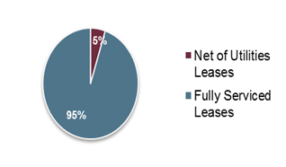

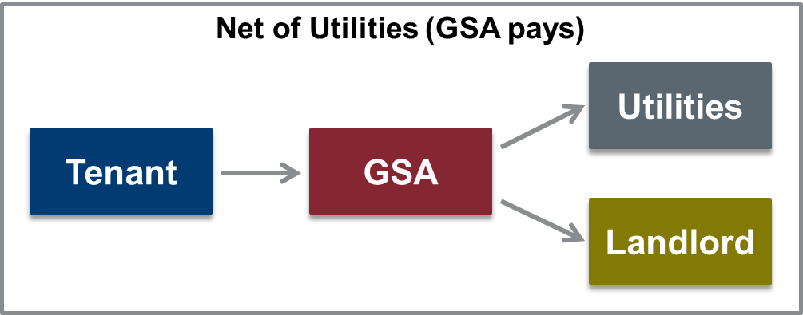
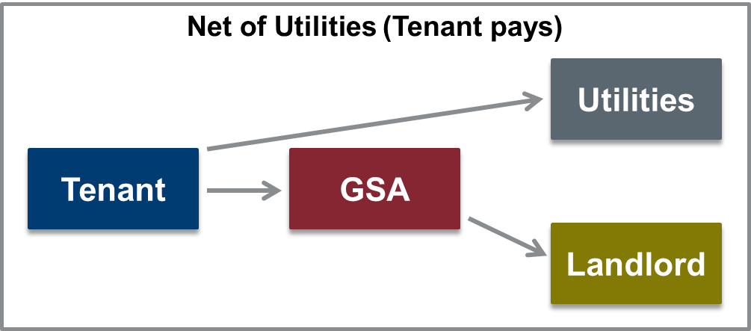
Fully Serviced vs. Net of Utilities Leases
Lease Type | Risk Burden | Utility Payment | Lease Structure
Fully Serviced | Landlord | Tenant pays utilities in Rent
Net of Utilities (GSA pays) | GSA | Tenant Pays GSA for Utilities
Net of Utilities (Tenant pays) | Tenant | Tenant Pays Utility Bill Directly to Utility Provider
GSA’s Leased Portfolio by # of Leases
95% of GSA’s leases are Fully Serviced
5% of GSA’s leases are Non-Fully Serviced
Notes:
95 % of our Leases are Fully Serviced
We’re exploring whether it makes sense for some of our Leases to be shifted to Net of Utilities

Slide 17
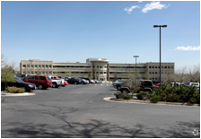


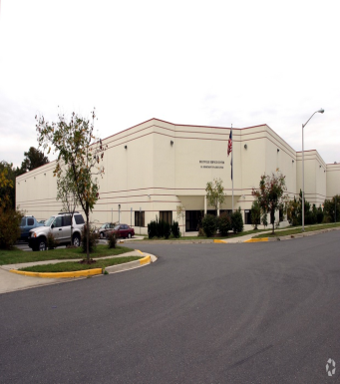
Net of Utility Pilot 1 Studies Underway (10/2015)
Region 8: DOE-Western Area Power Administration (Lakewood, CO.)
115,650 RSF lease representing 100% of building
12155 West Alameda Parkway: LCO 013474; Expiration: 11/1/29
Lease shifted from Fully Serviced to Net of Utilities (in DOE’s name) in 11/2014
Region 11: DOJ- Criminal Division (Washington, D.C.)
168,496 RSF lease representing 100% of building
1400 New York Avenue: Bond Building: LDC 012554; Expiration:8/31/29
“Hybrid” pilot: Lease shifted from Net of Utilities in GSA’s name to DOJ’s name (in 9/2014)
Region 9: BLM- National Training Center (Phoenix, AZ.)
72,454 RSF lease representing 100% of building
9828 N. 31st Avenue (3-building complex): LAZ 03224
Lease shifted from Fully Serviced to Net of Electric + Gas in 8/2014
Lease expiration: 7/2017 firm term; 7/2019 full term; BLM prefers to move in 7/2017
Region 11: USDA Service Center- Warehouse (Washington, DC)
116,987 RSF lease representing 100% of building
6351 Ammendale Road: LMD 12550; Expiration: 3/31/21
Lease shifted (2 years ago) from GSA paying utilities to USDA paying utilities
Notes:
We’re examining some “live” pilots – tracking utility cost/consumption over the life of a lease – both BEFORE (when lease was Fully Serviced) and AFTER (when lease shifts to Net of Utilities/Electric)

Slide 18
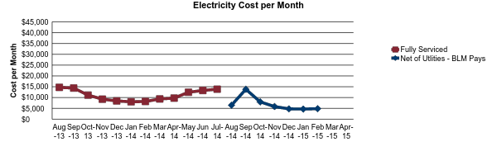
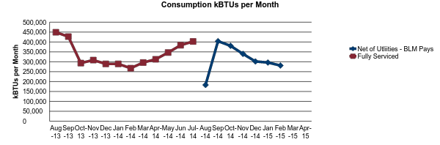
Sample Data for Net of Utility Pilot Studies:
Utility Costs and Consumption– “Before” (as F.S.) + “After” (as N.U.)
Transition
Period
← Fully Serviced →
Tenant Pays Utilities→
*2014 EUAS data for Federally owned facilities was used for the AZ data
Notes:
Tracking the “BEFORE” and “AFTER” utility data – for both CONSUMPTION and COST – for a handful of leases that shifted from Fully Serviced to Net of Utilities

Slide 19
First Fuel Pilots
FF is the FMSP “Rapid Building Assessment” project where a sample of buildings go through a “virtual” energy audit and analysis.
Identify opportunities for energy savings and efficiencies.
“365-day/ 24-hour” analysis of a building.
Operational and Retrofit Recommendations are provided.
Pilot 1: Buildings | Tenant Agency
Silver Spring, MD.: 1305 E-W Highway | NOAA
Silver Spring, MD.: 1315 E-W Highway | NOAA
Silver Spring, MD.: 1325 E-W Highway | NOAA
Pilot 2: Buildings | Tenant Agency
Kansas City, MO.: 6501 Beacon Drive | USDA
Lincoln, NE.: 1301 Highland Blvd. | CIS
Waco, TX.: 800 Franklin St. | U.S. Courthouse

Slide 20


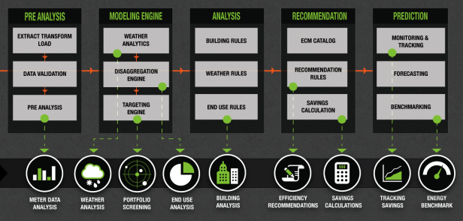
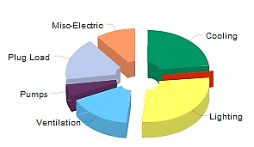


First Fuel Analysis
Remote Building Assessments
1
2
3
Minimal Data Inputs
First Fuel Meter Data Analytics
Deep Building Insight
Building address
1 yr electric interval meter data
Annual Electric End-Use per SqFt
From GSA:
Local weather
data
GIS Mapping/ Semantic Search
Patent Pending RBA platform
From First Fuel:
FF is the FMSP “Rapid Building Assessment” project where a sample of buildings go through a “virtual” energy audit and analysis.
Opportunities for energy savings and efficiencies are identified.
Operational and Retrofit Recommendations are provided.
Applied to 100+ Federally Owned buildings.

Slide 21
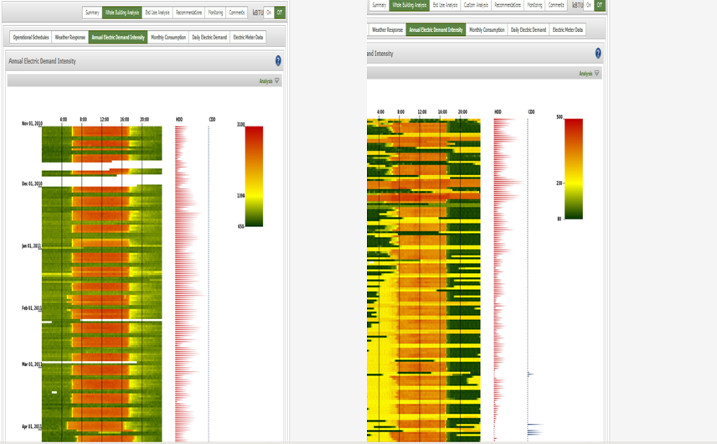
First Fuel
Building Comparison – Energy Intensity
365 Day/ 24 Hour Building Profile
Building A
Building B

Slide 22
Wrap Up
Given the quickly shifting sustainability landscape, it’s important to stay current with all changes related to Executive Orders, legislation, and changing industry standards.
We can support your agency with the following:
  Hosting further discussions specific to your agency for your key sustainability stakeholders
  Sharing the results of our pilot efforts and lessons learned
  Collaborating to provide guidance with various reporting requirements
Contact Information: Alexandra.Kosmides@gsa.gov (202) 208-4067

Slide 23
Thank you for joining us today for a discussion on
Sustainability in Leasing - Green Lease Requirements
Next session
  February 18, 2016 - Updated RWA Policies
www.gsa.gov/ces
ClientEnrichmentSeries@gsa.gov

