Slide 1
GSA PBS Client Workshop
Thursday, November 17, 2011
Pricing Basics
Office of Client Solutions | 400 15th St SW, Auburn, WA 98001 | www.gsa.gov

Slide 2
Topics
Legislative Foundation
Building Shell
Tenant Improvements
Move Policy
Tenant Agency Rights
Q&A

Slide 3
Legislative Foundation
Federal Property and Administrative Services Act of 1949, as amended (40 U.S.C. § 586)
  GSA Administrator is authorized and directed to charge anyone furnished space and services at rates that approximate commercial charges for comparable space and services
PDG Section 2.15 and 3.16

Slide 4
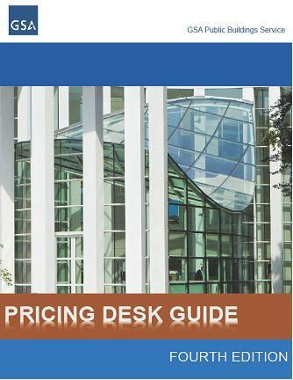
PBS Pricing Desk Guide
Federally owned space
  Rent is based on an appraisal or return on investment
Leased space
  Rent is a pass-through of the underlying lease contract rent plus:
    any standard operating costs not performed through the lease
    PBS lease fee
PDG Section 1.2

Slide 5
Building Shell

Slide 6
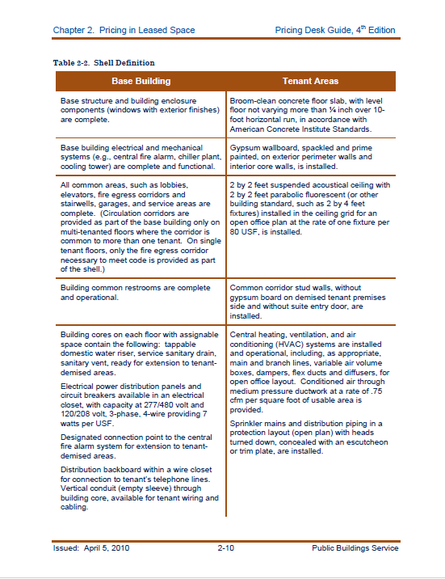
PBS Building Shell
The complete enveloping structure, the base building systems, and the finished common areas of a building that adjoin the tenant areas. Detailed in PDG.
PDG Sections 2.4.1 and 3.5.1

Slide 7
PBS Building Shell
Base Building Includes:
  Base structure and building enclosure
  Base building electrical & mechanical systems
  Common areas
Tenant Areas Includes:
  Wall board on exterior perimeter & interior core walls
  Common corridor stud walls without gypsum board
  Suspended acoustical tile ceiling with parabolic fluorescent lighting (open office layout)
  Concrete floor

Slide 8
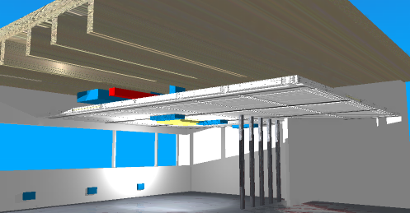
Building Shell in Tenant Area
Suspended ceiling with fluorescent light fixtures
HVAC distribution for general office space
Electrical service to floor for general office space
Primed gypsum wall board
on exterior perimeter walls
& core elements
Level Concrete Floor
PDG Sections 2.4.1 and 3.5.1

Slide 9
Building Shell
PBS uses the shell definition for consistency
Building standards and design guides are not part of the building shell merely because they are called “standards”
Tenant agency driven upgrades to building shell are separately priced and considered TIs
The shell and TI distinction is an impermeable barrier or "firewall" across which funding cannot shift
PDG Sections 2.4.1 and 3.5.1

Slide 10
Shell Rent – Leased Space
Pass-through of the underlying PBS lease contract shell rent
Lessors use shell definition in SFO or RLP to develop their shell rental rate
  PBS policy is to include cyclic painting and carpet replacement in leases as a shell cost
  Design Intent Drawings (DIDs) included in shell unless Contracting Officer specifies Government will provided DIDs.
PDG Section 2.4.1
Notes:
Lease may have step rents
GSA consults with tenant agency on determination

Slide 11
Shell Rent – Federally Owned Space
Shell rents are established for 5 year periods
Shell rent based on a FAR appraisal
  General storage receives discount
PDG Section 3.5.3

Slide 12
General Storage
Space that is used for storage and has diminished use that prohibits the space from otherwise being used as general office space.
PBS makes space classification
  The space is not within general office space and the space is not completely built out to shell, or
  The space must have permanent conditions, obstructions, or protrusions below the ceiling height and into or within all or a portion of the space that do not allow for general office use and it would be cost prohibitive to build out the space to office standards.
National Business Space Assignment Policy

Slide 13
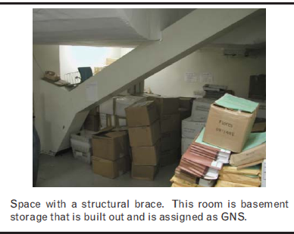
General Storage Example
National Business Space Assignment Policy

Slide 14
Tenant Improvements

Slide 15
Tenant Improvements
The finishes and fixtures tenant agency elects that typically take space from the shell condition to a finished, usable condition; compliant with all applicable building codes and standards
The existence of building standards does not mean they are part of shell – they are still TIs (e.g. suite entry door specification, restricted color palettes)
PDG Sections 2.5.1 and 3.6.1

Slide 16
Typical Tenant Improvements
Electrical wiring, outlets, and horizontal conduit, including cable trays and hooks, within the tenant agency’s demised premises and to the building core.
Carpeting or other floor covering; raised access flooring
Plumbing fixtures within the demised premises and all lines connecting to the building core–except for common bathrooms
Partitioning and wall finishes
Doors (including suite entry), sidelights, frames, and hardware
Millwork
Thermostats
Window treatments
PDG Sections 2.5.2 and 3.6.2

Slide 17
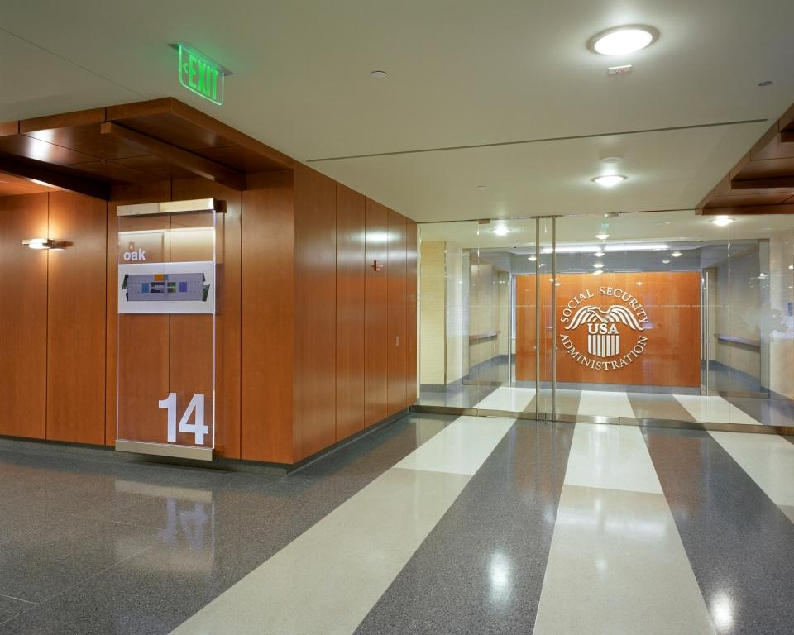
Shell vs TI Example
Suite Entry Door
Wood Wall & Stainless Steel Logo
Building Signage
Wood
(Common Area)
Terrazzo Tile
(Tenant Space)
Legend
Glass Wall with Leaf Graphic
(Common Area)
Shell
Terrazzo Tile
(Common Area)
Tenant Improvement

Slide 18
Application of TI Allowances
Tenant agency elects how its space is to be finished
Rent payment is lower if an amount less than the allowance limit is used
If the full allowance is not used for initial buildout, it is no longer available
Can only be used to pay for items that are real property, or which become real property when attached or affixed to the building
PDG Sections 2.5.9 and 3.6.9

Slide 19
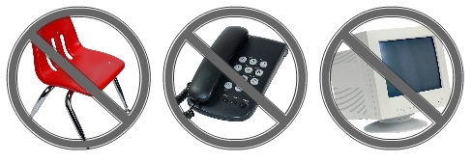
TI Cannot Fund Personal Property
Examples Include:
Furniture
Microwaves
Refrigerators
Artwork
Personal computers
Audiovisual equipment
Televisions for conference rooms
Phone handsets
Physical relocation expenses of personal property
PDG Sections 2.5.9 and 3.6.9

Slide 20
Application of TI Allowance
Initial occupancies (including expansions)
  New space, new tenant
  Tenant agency provided the full TI allowance
  Tenant agency cannot buy down the general allowance in first generation space through use of an RWA
Backfill occupancies
  2nd generation space, new tenant
  The full TI allowance may be provided to tenant agency, subject to availability of funds
PDG Sections 2.5.3 and 3.6.3

Slide 21
Application of TI Allowance
Midoccupancy / post initial occupancy
  TIs typically funded by the tenant agency
  No obligation to provide TI allowance, but may be provided to tenant agency subject to availability of funds
Continuing occupancies
  Leased Space
    Tenant agency provided the full TI allowance
  Federally Owned Space
    Tenant agency provided the full or partial TI allowance, subject to availability of funds
PDG Sections 2.5.3 and 3.6.3

Slide 22
General TI Allowance
Takes the space from shell to “vanilla” office space
Set nationally and indexed to local construction costs
  Recently increased to $38.95 per USF (Washington, D.C.)
  New allowance will be in effect for all new projects
PDG Sections 2.5.4 and 3.6.4

Slide 23
Customization TI Allowance
Takes the space from “vanilla” office space to space specifically designed to function for a particular tenant agency’s mission
Examples include
  custom cabinetry or millwork
  laboratory countertops and fume hoods
  private restrooms
  raised access flooring
  upgraded ventilation for high occupancy uses
  slab-to-slab walls
PDG Sections 2.5.5 and 3.6.5

Slide 24
TI Allowance by Tier
PBS created a series of customization tiers
  tier 0 to tier 6
Each tier is equal to 10% of the value of the general allowance
Each tenant agency and bureau is assigned a tier
PDG Sections 2.5.5., 2.5.6 and 3.6.5, 3.6.6

Slide 25
TI Allowance by Tier
General Allowance in D.C.
x Local Construction Index
= General Allowance
General Allowance
x 10% for each Tier
= Custom Allowance
General Allowance
+ Custom Allowance
= Total Allowance
$ 38.95 per USF
x 0.96 (varies by city)
= $ 37.39 per USF
$ 38.95 per USF
X 20% (Tier 2)
= $ 7.48 per USF
$ 37.39
+ $ 7.48
= $ 44.87
PDG Sections 2.5.5., 2.5.6 and 3.6.5, 3.6.6
Notes:
Range of LCI ()
RS Means

Slide 26
TI Allowance by Functional Estimate
The TI allowance is set in accordance with the benchmarks or cost estimates
Must cover the cost of basic functionality that meets the tenant agency’s operational requirements for its specific space use.
  PBS is not obligated to ensure that all aspects of a tenant agency’s design guidelines are incorporated into the TI allowance
Space must be finished, functional, and compliant with all applicable building codes.
PDG Sections 2.5.7 and 3.6.7

Slide 27
TI Allowance Amortization - Leases
Amortization term usually the firm term of the lease
Two rules for limiting amortization terms for TIs:
  The amortization term must not exceed the economic life of the improvements
  The amortization term must not exceed the term of the OA
    Exception: Lessors, with PBS and tenant agency agreement, can set amortization term beyond the lease firm term provided no lump-sum costs due if PBS exercises termination rights or leaves at the end of the lease term
Interest rate negotiated between the successful offeror and PBS
PDG Section 2.5.8

Slide 28
TI Allowance Amortization - Owned
Standard amortization term is 10 years
  Amortization period for courtrooms and chambers assignments can be 20 years
Two rules for limiting amortization terms for TIs:
  The amortization term must not exceed the economic life of the improvements
  The amortization term must not exceed the term of the OA
Interest rate set annually, 10 year Treasury plus 12.5 basis points
  3.295% as of June 2011
PDG Section 3.6.8

Slide 29
Occupancy Agreements

Slide 30
The Occupancy Agreement (OA)
A complete, concise statement of the business terms governing the relationship between PBS and the tenant agency for a specific space assignment
Serves as the billing document
Formal agreement between the signing parties
PDG Sections 2.1 and 3.1

Slide 31
OAs
Pro Forma OA
  Estimate of rent charges
  Additional iterations as appropriate
Final OA
  Billing OA reflecting rent charges
Administrative OA
  Revisions to billing OAs that do not require customer signature
  Sent to customer with a cover letter for notification purposes

Slide 32

OA Signature
Signature required
  Before awarding a lease contract, purchasing a site or awarding a design contract
  Expands or reduces space
  Revise the OA terms
There are actions that do not require signature
  Fiscal Year rate updates
  Addition of a parking space
  Planned rent increase (step rent)
PDG Sections 2.1.3 and 3.1.3

Slide 33
Move Policy

Slide 34
Move Policy
Agencies responsible for funding their own physical moves and telecommunication costs
Customer agencies in both leased and federally owned space can expect to fund all move costs at the end of their OA term
Exceptions:
  Forced moves
  Emergency relocations due to disasters or crises , PBS may fund the moves up front, subject to funds availability
PDG Chapter 4

Slide 35
Tenant Agency Rights

Slide 36
Tenant Agency Rights - Cancellation
Prior to Contract Execution
  No fault cancellation
After Contract Execution, Prior to Occupancy
  Leased space, the agency is liable for the lesser of these two costs
    In the case of a lease, the lease buyout costs, or
    16 month rental obligation had it occupied the space, plus the unamortized balance of the Tis
  Owned space
    The total project costs incurred
PDG Section 5.1

Slide 37
Agency Rights - Return of Space
With 4 months’ written notice, tenant has right to release space to PBS provided the following conditions are met:
  There is no longer a need for the space
  The space is in marketable blocks
  The space is not designated as non-cancelable
PDG Section 5.3

Slide 38
Noncancelable Space
Remote or not easily accessible location
Special purpose use or buildout necessitating significant capital outlays to retrofit the space to a more conventional use
Unusual term
Lack of any realistic federal need for the space, other than the requesting tenant agency
Any other factors that would significantly impair PBS’ ability to backfill the space
PDG Sections 2.15.2 & 5.2

Slide 39
Tenant Agency Rights
Tenant agency is entitled to a reduction in the PBS fee from 7% to 5% for leased assignments designated as non-cancelable for the term of the OA
  Tenant agencies may not volunteer to designate their space as non-cancelable as PBS solely makes that determination; will be reflected in the first pro forma OA
  Once space has been designated (or not designated) as non-cancelable, it may not be changed during the OA term
PDG Section 5.2

Slide 40
PBS Lease Fee
Leases charged a fixed, non-divisible 7% PBS Fee
7% Fee applies to all lease actions with two exceptions:
  5% fee for non-cancelable space
  4% fee for USPS controlled space
PBS Fee covers
  Contract risk
  Lease acquisition services
  Lease administration
PDG Section 2.15 and 3.16

Slide 41
Questions
?

