Slide 1
EPA SmartWay Transport Partnership: Assessing Transportation Emissions in the Supply Chain
Government Services Administration
Governmentwide Transportation Policy Council
October 8, 2015

Slide 2
Sustainability Reporting Trends in Transportation
Sustainability Reporting Overview
Why report?
What to report?
Federal sustainability goals and reporting guidelines
Brief history
Executive Order 13693, Planning for Federal Sustainability in the Next Decade (March 2015)
Private sector sustainability goals and reporting guidelines
Global Reporting Initiative, Carbon Disclosure Project, Sustainable Purchasing Leadership Council
Discussion

Slide 3
Why report sustainability efforts?
Internal vs external pressure
Regulatory requirements
Stock exchange listings
Financial and other indices
Tender processes
Report format
Scope
Guidelines

Slide 4
What to report?
Business Impacts
Stakeholder Interest
Resources
Efficiency
Energy consumption
Emissions
Water Use
Waste Disposal
Other . . .

Slide 5
Federal sustainability goals & reporting guidelines
Federal sustainability goals date back to 1970s
Goals revised under Energy Policy Act of 2005 (EPAct) and Energy Independence & Security Act of 2007 (EISA)
2009 Exec Order 13514 addresses supply chain emissions, including transportation emissions
Executive Order 13693 refines focus on supply chain, including transportation and freight

Slide 6
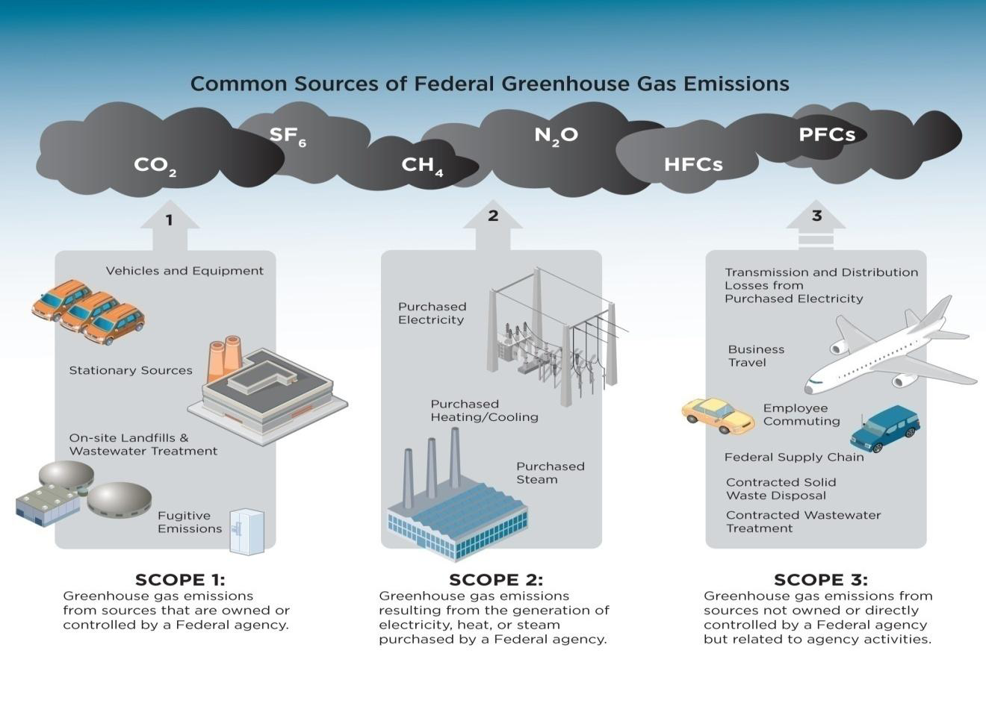

Slide 7
Executive Order 13693, Planning for Federal Sustainability in the Next Decade (March 2015)
Revises and extends reach of EO 13514
Retains federal strategic sustainability performance plans
OMB scorecards
Emphasis on promoting energy conservation and efficiency
Improving water use efficiency and management
Emphasis on vehicle fleet management, building efficiency and sustainable procurement and acquisition
Promotes sustainable acquisition and procurement with preferences for SmartWay transport partners and products (fuel efficient products and services)

Slide 8
DDS3 Package Delivery Contract
Contract for domestic package deliveries awarded May, 2014
Multi-year, multi-agency contract valued at over $1B
Carbon management features:
Require all contractors to report GHG emissions and/or belong to EPA SmartWay Transport Partnership
Annual carbon reports allocated at the agency account level
Requirement to set company-wide targets for GHG, alternative fuel use, etc

Slide 9
Private sector sustainability goals and reporting guidelines for emissions
Greenhouse Gas Protocol
World Resources Institute and World Business Council on Sustainable Development
Global Reporting Initiative
Multi-stakeholder support
Established framework on comprehensive range of sustainability matters
CDP (formerly Carbon Disclosure Project)
Investors, members
Climate change, water, supply chain and forest program

Slide 10
Private sector sustainability goals and reporting guidelines for emissions
Sustainable Leadership Purchasing Council
Establish principle and guidance for sustainable procurement practices
Address procurement practices for transportation products and services
Several other products and services including cleaning and sanitizing Chemicals, furnishings, food and beverage services

Slide 11
EPA SmartWay Transport Partnership
Provides Assessment Tools
Assess freight activity
Measure emissions
Industry benchmarking
Carrier progress
Partnership Participation
Truck, rail, barge carriers
Logistics providers
Shippers
Affiliates
Goals
Encourage improvements in freight efficiency
Provide tools to quantify freight emissions
Serve as platform for information exchange and technology development
Develop consistent metrics to measure freight’s environmental performance in a global economy

Slide 12
Discussion

