Slide 1
How to Become a GSA Multiple Award Schedule Contractor

Slide 2
Agenda
The Roadmap
The Structure
The Market
The Solicitation
The Offer

Slide 3
MAS Program
GSA establishes long-term, governmentwide contracts with companies who provide ordering activities with access to a wide variety of commercial supplies or services.
Schedule contracts:
Achieve fair and reasonable pricing negotiated at the contract level
Allow for price discounts at the order level
Are Multiple Award IDIQs (Indefinite Delivery, Indefinite Quantity)
Have a 5-year base period, with three 5-year options available
www.gsa.gov/schedule

Slide 4
MAS: Quick Facts
Over 14,000 active contracts
Annual obligations ~$40 Billion
Available for all Federal Agencies to place orders
Under certain conditions, available to State, Local, and Tribal entities
Provides for commercial products and services
Open and standing solicitation on SAM.gov

Slide 5
The Roadmap

Slide 6
MAS Roadmap
What is the MAS Roadmap?
Provides information on the contract award process to make it easier to do business with the government
Why is this helpful?
Breaks down the offer process into easy to follow step-by-step instructions
www.gsa.gov/masroadmap

Slide 7
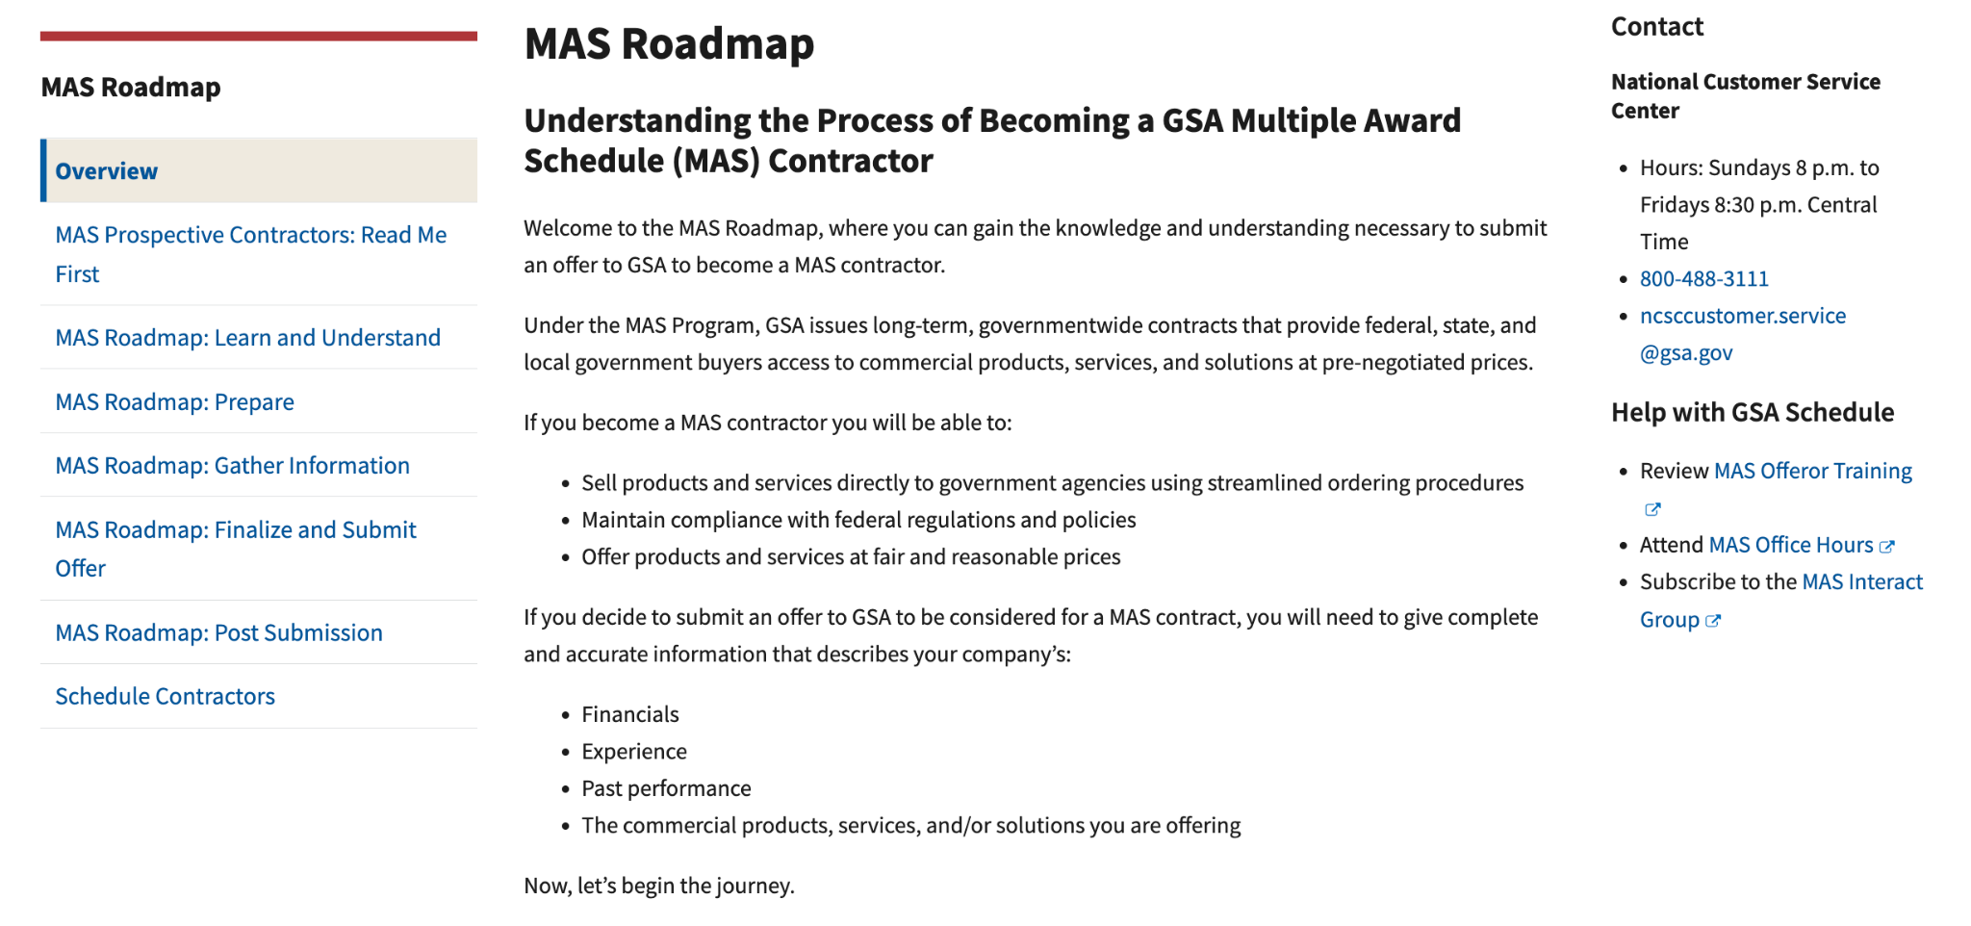
MAS Roadmap

Slide 8
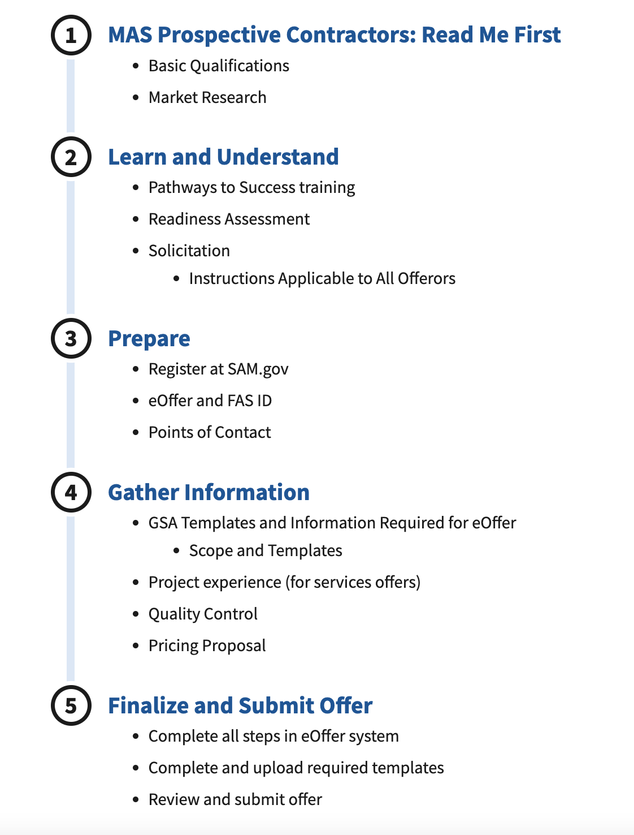
MAS STEPS

Slide 9
The Structure

Slide 10
Multiple Award Schedule
Large Category: 12 Large Categories
Subcategory: 83 Subcategories
Special Item Number (SIN): 330 SINs

Slide 11
12 Large Categories
Facilities | Furniture and Furnishings | Human Capital | Industrial Products and Services
Information Technology | Miscellaneous | Office Management | Professional Services
Scientific Management and Solutions | Security and Protection | Transportation and Logistics | Travel

Slide 12
MAS Subcategories
Facilities
Furniture & Furnishings
Human Capital
Industrial Products & Services
Information Technology
Miscellaneous
Structures
Facilities Services
Food Service Equipment
Facilities Supplies
Facilities Solutions
Facilities Maintenance and Repair
Miscellaneous Furniture
Office Furniture
Flooring
Fitness Solutions
Signs
Household, Dormitory & Quarters Furniture
Packaged Furniture
Healthcare Furniture
Furniture Services
Human Resources
Background Investigations
Compensation and Benefits
Temporary Help Services
Social Services
Industrial Products
Packaging
Cleaning Supplies
Fire / Rescue / Safety / Environmental Protection Equipment
Hardware and Tools
Fuel Management
Machinery and Components
Test and Measurement Supplies
Industrial Products and Services Maintenance and Repair
IT Hardware
IT Software
Telecommunications
IT Solutions
IT Training
Electronic Commerce
IT Services
Apparel
Complimentary Special Item Numbers (SINs)
Personal Hair Care Items
Musical Instruments
Awards
Flags

Slide 13
MAS Subcategories (cont)
Office Management
Professional Services
Scientific Management & Solutions
Security & Protection
Transportation & Logistics Services
Travel
Printing and Photographic Equipment
Office Supplies
Audio Visual Products
Media Services
Media Products
Records Management
Document Services
Office Services
Audio Visual Services
Mail Management
Office Management Maintenance and Repair
Marketing and Public Relations
Financial Services
Legal Services
Technical & Engineering Services (non-IT)
Business Administrative Services
Logistical Services
Language Services
Environmental Services
Training
Identity Protection Services
Laboratory Equipment
Laboratory Animals
Search and Navigation
Medical Equipment
Testing and Analysis
Scientific Services
Protective Equipment
Security Services
Security Systems
Security Animals and Related Services
Marine and Harbor
Testing Equipment
Motor Vehicles (non-Combat)
Automotive Body Maintenance and Repair
Packaging Services
Package Delivery
Transportation of Things
Employee Relocation
Lodging
Travel Agent and Misc Services

Slide 14
What is a SIN?
A Special Item Number (SIN) is a GSA numbering system that identifies each scope area
SINs align with NAICS codes to make it easier for federal buyers to understand the scope of each SIN
If a SIN doesn’t exist for the product or service you are selling, it isn’t purchased through the GSA Schedule contract
SINs may have more than one NAICS assigned, but they will be closely related to each other

Slide 15
MAS Large Category > Subcategory > SIN
Large Category: MAS Information Technology (MAS IT)
Subcategory: IT Hardware
SIN: 33411 - Purchasing of new electronic equipment
(NAICS 334111 AND 334112)
Large Category: MAS Professional Services (MAS PS)
Subcategory: Engineering
SIN: 541330ENG – Engineering Services
Large Category: MAS Facilities
Subcategory: Facilities Services
SIN: 561210FS - Facilities Support Services

Slide 16
Special Item Number (SIN) Structure – Example 1
NAICS: 541614 - Process, Physical Distribution, and Logistics Consulting Services
Logistics Services
SINs | Title | Example Services
541614 541614SVC | Deployment, Distribution and Transportation Logistics Services Supply and Value Chain Management | Services include the following: Deployment Logistics such as contingency planning, identifying/utilizing regional or global resources, integrating public/private sector resources… Includes supply and value chain management, which involves all phases of the planning, acquisition, and management of logistics systems.

Slide 17
Special Item Number (SIN) Structure – Example 2
NAICS:
541511 - Custom Computer Programming Services
541512 - Computer Systems Design Services
541513 - Computer Facilities Management Services
541519 - Other Computer Related Services
IT Services
SIN | Title | Example Services
54151S | Information Technology Professional Services | IT Professional Services and/or labor categories for database planning and design; systems analysis, integration, and design; programming, conversion and implementation support; network services, data/records management, and testing.

Slide 18
GSA eLibrary
Category
Subcategory
SIN
Contractor Details
Size Status
Contract Clauses
eLibrary - The official online source for complete GSA and VA Schedules information – a great market research tool.
www.gsaelibrary.gsa.gov
Notes:
GSA eLibrary is your one source for the latest GSA contract award information. GSA offers unparalleled acquisition solutions to meet today’s acquisition challenges. GSA’s key goal is to deliver excellent acquisition services that provide best value, in terms of cost, quality and service, for federal agencies and taxpayers.
www.gsaelibrary.gsa.gov

Slide 19
The Market

Slide 20
Harness the Power of Data
Have a solid understanding of the federal market for your product or service
Know the key players, critical policies, initiatives, and spending budgets for your target agencies.
Use this information to be proactive in finding opportunities and generating leads.

Slide 21
Federal Procurement Data System (FPDS)
What is reported to FPDS?
Contract actions valued at $10,000 and greater
Contract modifications
Where is the data from?
The data is fed from 90+ federal agency contract writing systems
www.fpds.gov

Slide 22
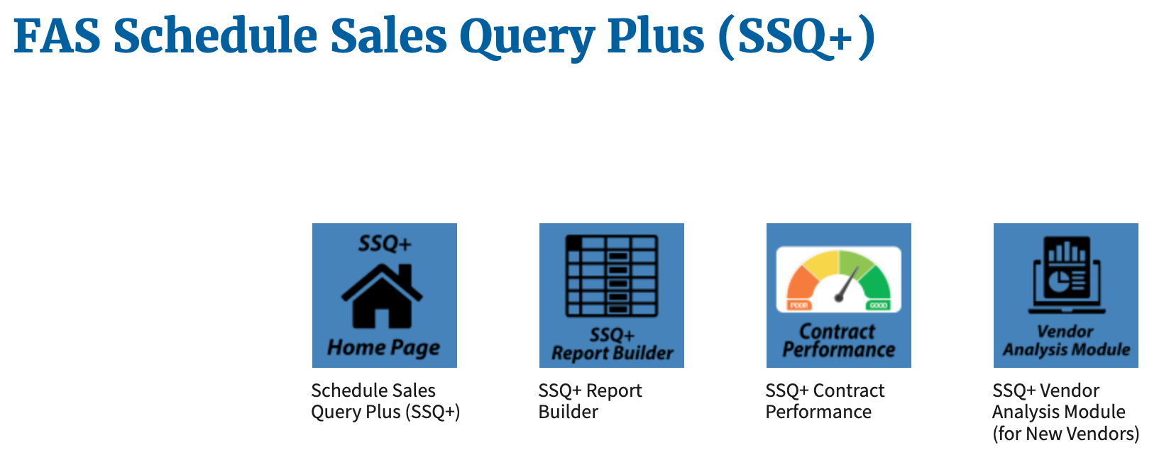
Schedules Sales Query Plus (SSQ+)
Designed to provide our suppliers with the figures they want and need
Depicts sales in both report and dashboard format

Slide 23
Schedules Sales Query
Plus (SSQ+) (cont)
Key report features include:
Ability to build a custom report to view MAS sales:
By fiscal year and quarter based on various level of details:
Product or Service
Governmentwide Category or Subcategory
Schedule Number and SIN
NAICS, Business Size, or Contract Number
Access to prebuilt dashboards that allow visibility into sales trends
https://d2d.gsa.gov/report/fas-schedule-sales-query-plus-ssq

Slide 24
The Solicitation

Slide 25
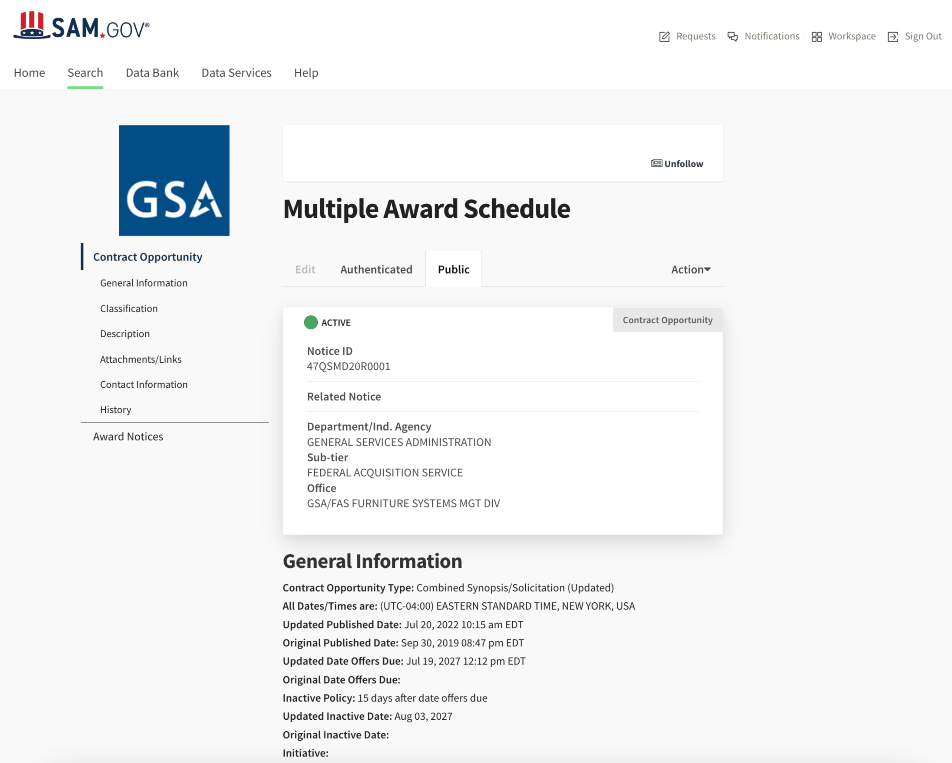
https://go.usa.gov/xSMJP
25

Slide 26
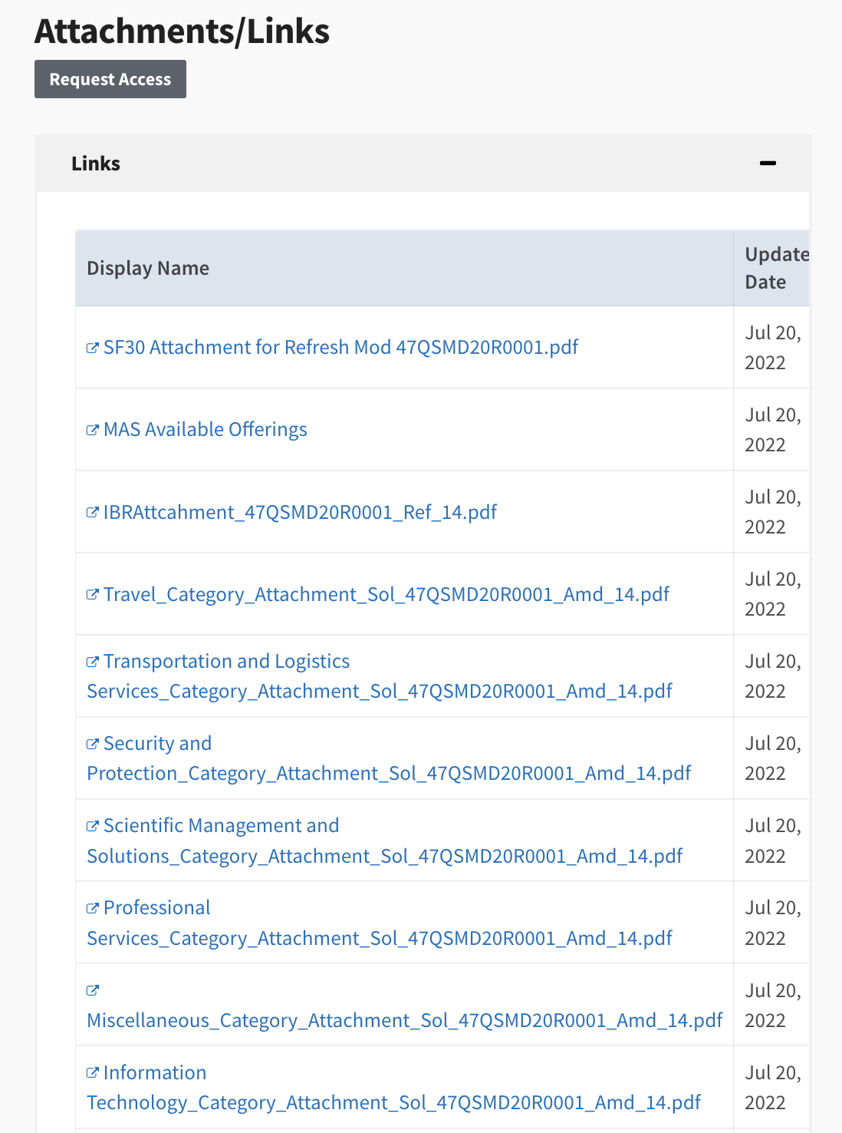
Attachments / Links
Available Offerings
Excel Sheet
Regulations by Ref.
PDF File
Category Attachments
26

Slide 27
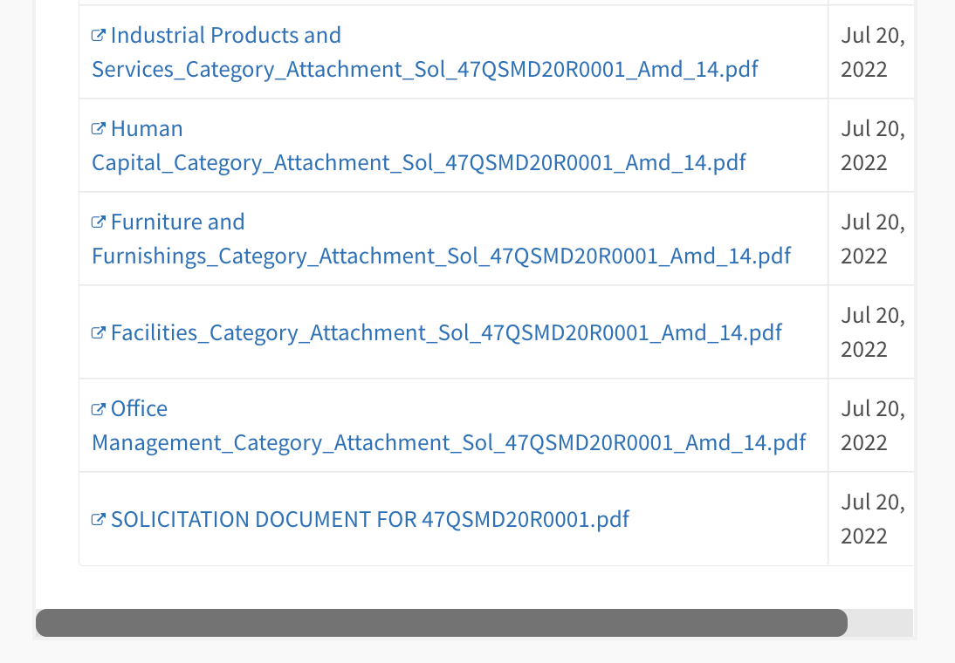
Base Solicitation
Category Attachments
27

Slide 28
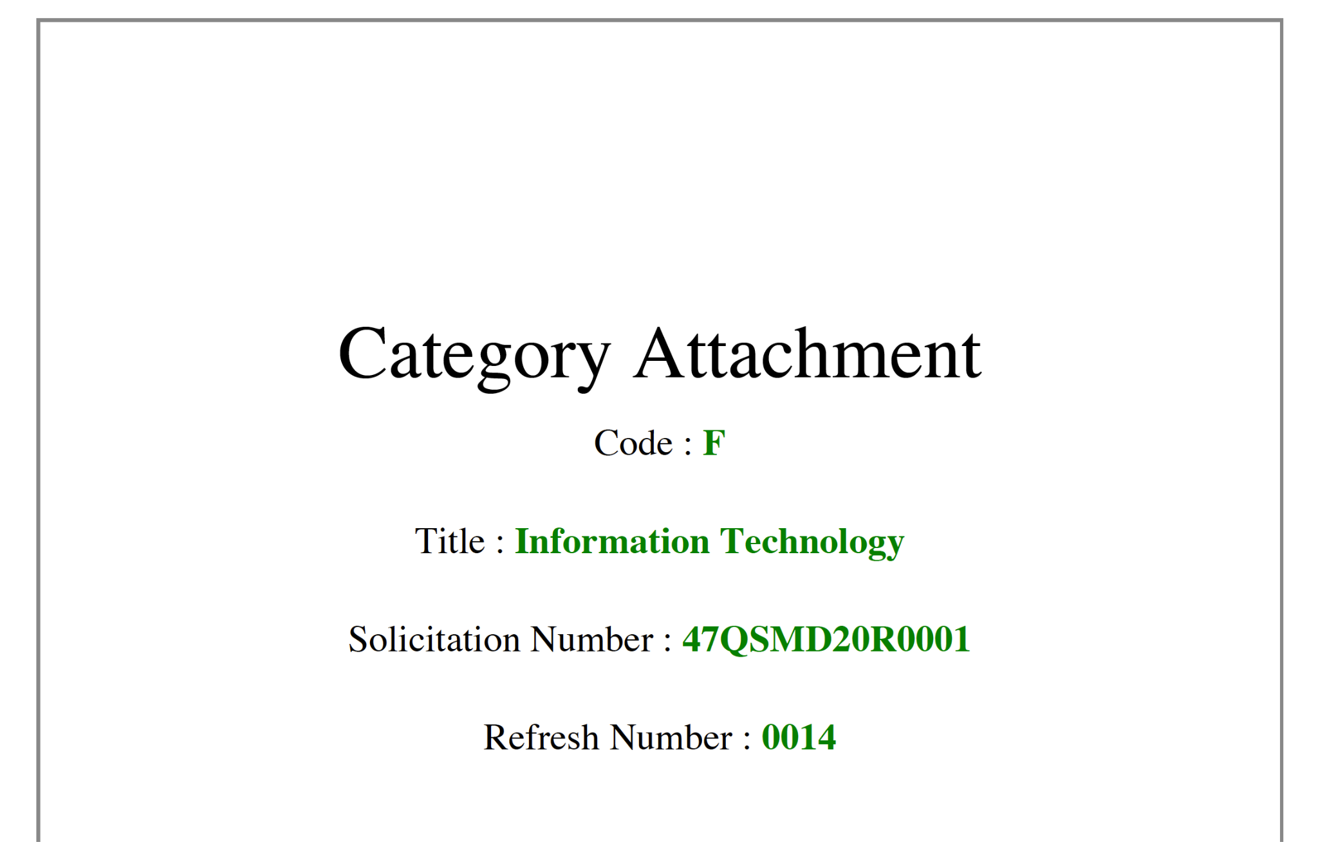
Category Attachment from SAM.gov
28

Slide 29
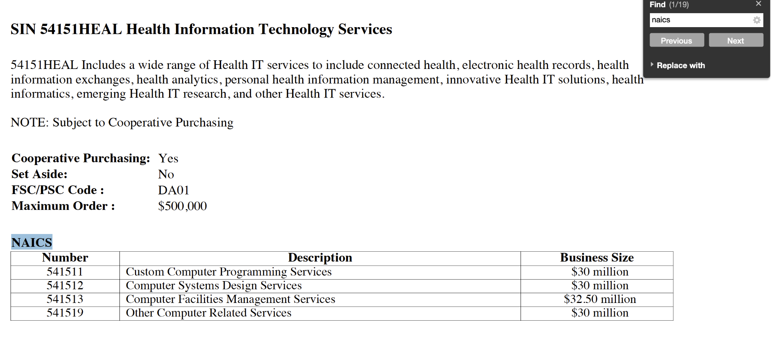
Search for “NAICS”
29

Slide 30
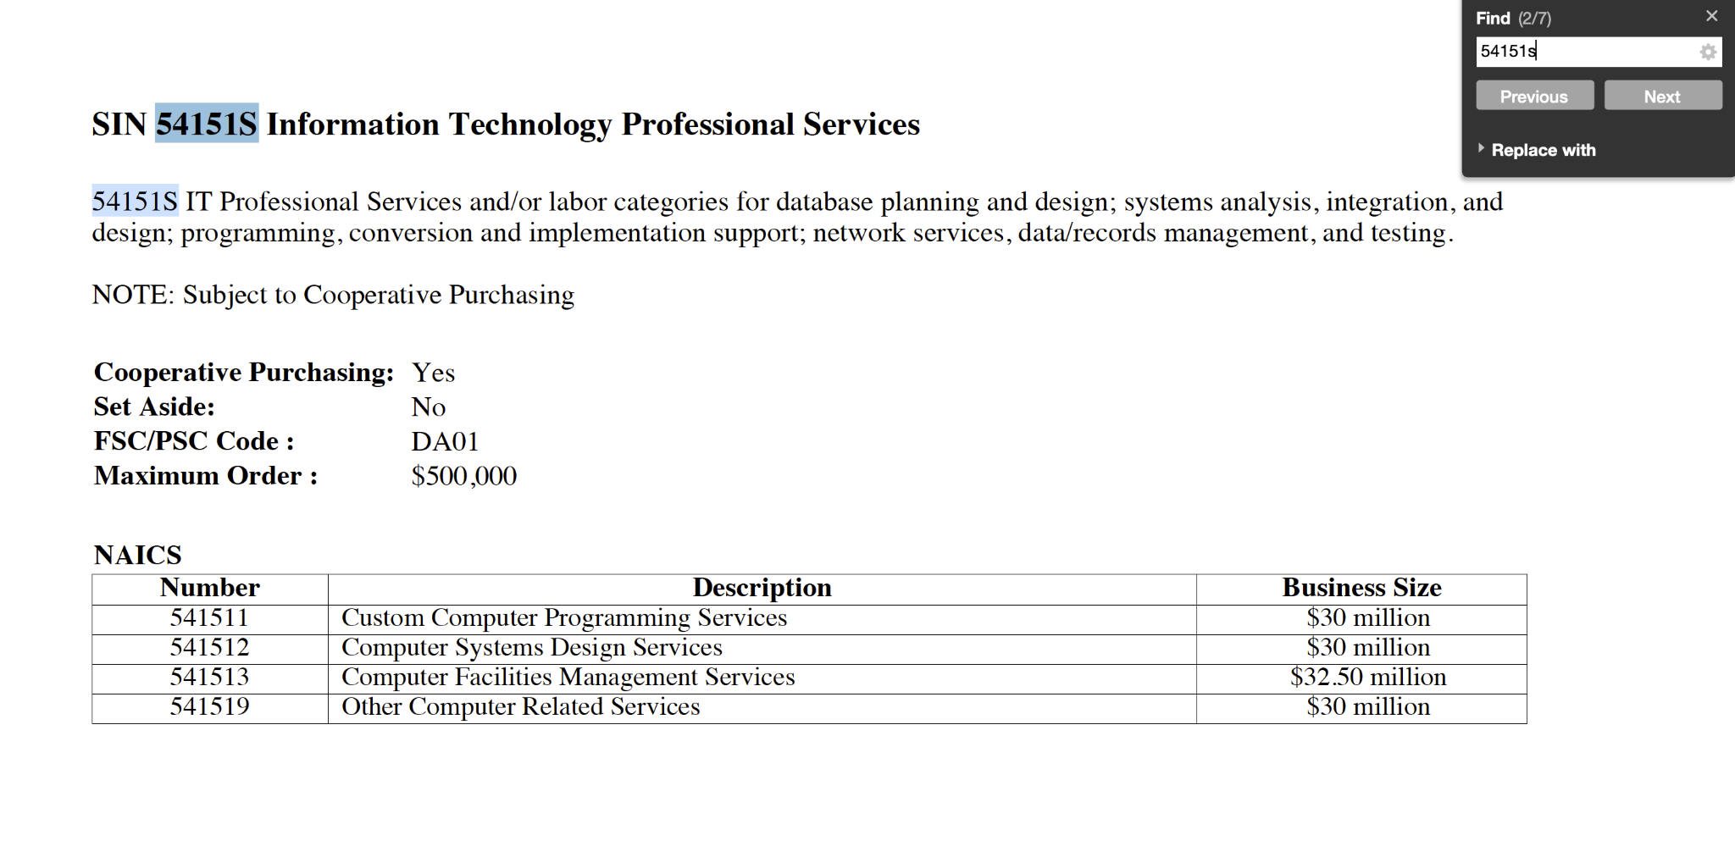
Search for SIN “54151S”
30

Slide 31
Evaluation Criteria Factor 1 - Corporate Experience
(A) A minimum of two (2) years of corporate experience is required
(B) Organization’s number of employees, experience in the field, and resources available to enable it to fulfill requirements
(C) Brief history of the offeror’s activities contributing to the development of expertise and capabilities related to this requirement
(D) Information that demonstrates the offeror's organizational (e.g. organizational chart, list of key departments) and accounting controls (e.g. processes / systems in place)
(E) Description of the resources presently in-house or the ability to acquire the type and kinds of personnel proposed
(F) Description of the marketing strategy to reach Federal ordering activities
(G) Description of the intended use of subcontractors
Evaluation criteria is contained in the MAS Solicitation Provision SCP-FSS-001

Slide 32
Evaluation Criteria Factor 2 - Past Performance
(A) Offerors with three (3) or more contractor performance assessment reports available in the federal Contractor Performance Assessment Reporting System (CPARS) must verify in eOffer that they have three (3) or more assessment reports available in CPARS that represent:
(1) Contracts or orders completed within three (3) years of the date of offer submission
(2) At least three (3) distinct orders and/or contracts
(3) Work similar in scope to products / services included in this solicitation
(B) Offerors that do not have any CPARS reports that meet the criteria in paragraph (A) must upload a list of three (3) relevant customer references and three (3) completed Past Performance Questionnaires (PPQ) to eOffer.
Evaluation criteria is contained in the MAS Solicitation Provision SCP-FSS-001

Slide 33
Evaluation Criteria Factor 3 - Quality Control
The offeror must provide a Quality Control narrative that addresses:
(A) A description of internal review procedures that facilitate high-quality standards
(B) Identification of individuals responsible for ensuring quality control
(C) Whether or not subcontractors are used and, if so, the quality control measures used to ensure acceptable subcontractor performance
(D) How potential problem areas and solutions are handled
(E) The procedures for ensuring quality performance when meeting urgent requirements
(F) How quality control will be managed when completing multiple projects for multiple agencies simultaneously
Evaluation criteria is contained in the MAS Solicitation Provision SCP-FSS-001

Slide 34
Evaluation Criteria Factor 4 - Relevant Project Experience
(Services Only)
For ongoing contracts with a base year and option years, at a minimum, the base year must have been completed
For multi-year task orders, at a minimum, the first year must have been completed
Note: Specific services may have additional requirements under Factor Four
Offerors must refer category specific instructions, for additional Factor Four requirements
Evaluation criteria is contained in the MAS Solicitation Provision SCP-FSS-001

Slide 35
Evaluation Criteria Pricing Proposal
Fair and Reasonable Pricing is determined at the contract level
Service Contract Labor Standards are incorporated into the contract annually
Pricing is consider Fixed Price with Economic Price Adjustments (EPAs) allowed
Pricing is inclusive of the Industrial Funding Fee
Evaluation criteria is contained in the MAS Solicitation Provision SCP-FSS-001

Slide 36
Startup Springboard
Startup Springboard aims to make it easier for newer companies (less than two years old) to submit an offer for a GSA MAS contract.
The program is geared towards new companies that do not meet the solicitation requirement of having two years of corporate experience or financial statements.
Through Startup Springboard, you may be able to:
Use your executives and key professionals experience to substitute for two years of corporate experience
Use key personnel project experience to substitute for relevant project experience
Provide financial documentation that demonstrates your company's financial responsibility instead of submitting two years of financial statements

Slide 37
The Offer

Slide 38
Items to Consider
Before Submitting an Offer
Minimum Sales Requirements: You must generate at least $25,000 in sales within the first 2 years of your GSA Schedule contract and at least $25,000 each year thereafter.
GSA may cancel your schedule contract in accordance with GSAR clause 552.238-73, if not meeting minimum sales criteria.
Lead Time: It may take up to 6 months to get a MAS contract, provided that the firm meets all evaluation criteria and has a successful negotiation.

Slide 39

SAM Registration and Certification
In order to do business with the federal government:
You must register for a Unique Entity Identifier (UEI) at the System for Award Management (SAM)
https://sam.gov/content/entity-registration
Registration is 100% Free!

Slide 40
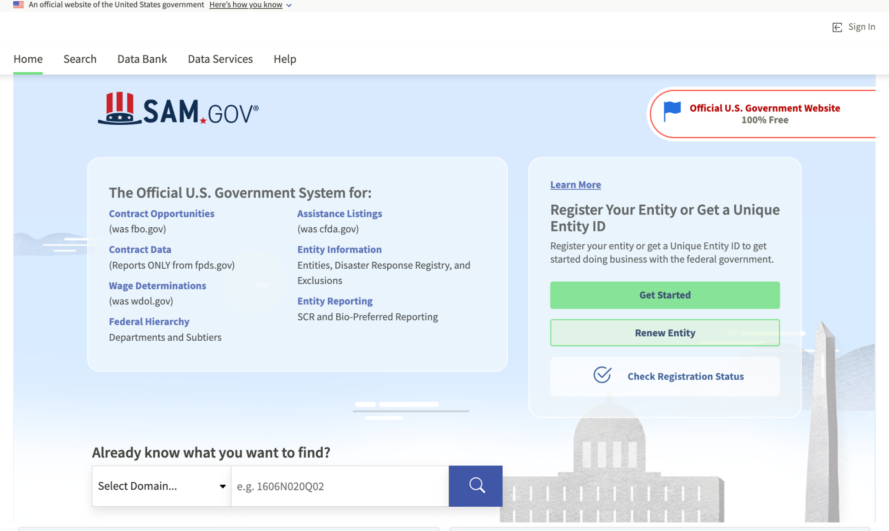
Registration and Certification

Slide 41
FAS ID
All contractors must register for the FAS ID multi-factor authentication to access the eOffer and eMod systems.
Please ensure that you are listed in SAM as one of the following points of contact:
Government Business POC / Alternate POC
Electronic Business POC / Alternate POC
Past Performance POC / Alternate POC

Slide 42
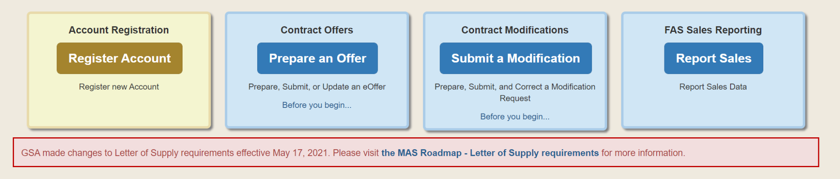
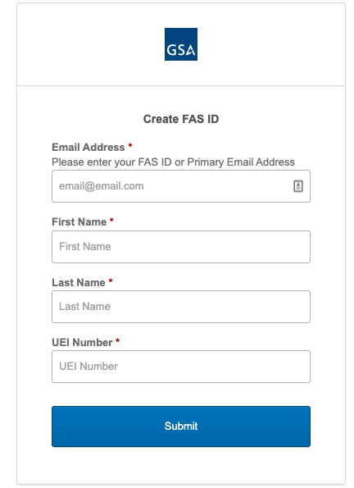
FAS ID
https://eoffer.gsa.gov/

Slide 43
Offer Preparation
After you have completed the preliminary training, registered, and familiarized yourself with the solicitation, you will start developing your proposal to submit to GSA.
As part of assembling your offer, you must complete the following forms, which are located at the Scope and Templates page at www.gsa.gov/masscopeandtemplates under “Required Templates to Submit Through eOffer (as applicable).”
Agent Authorization Letter
Letter of Supply
Price Proposal Template

Slide 44
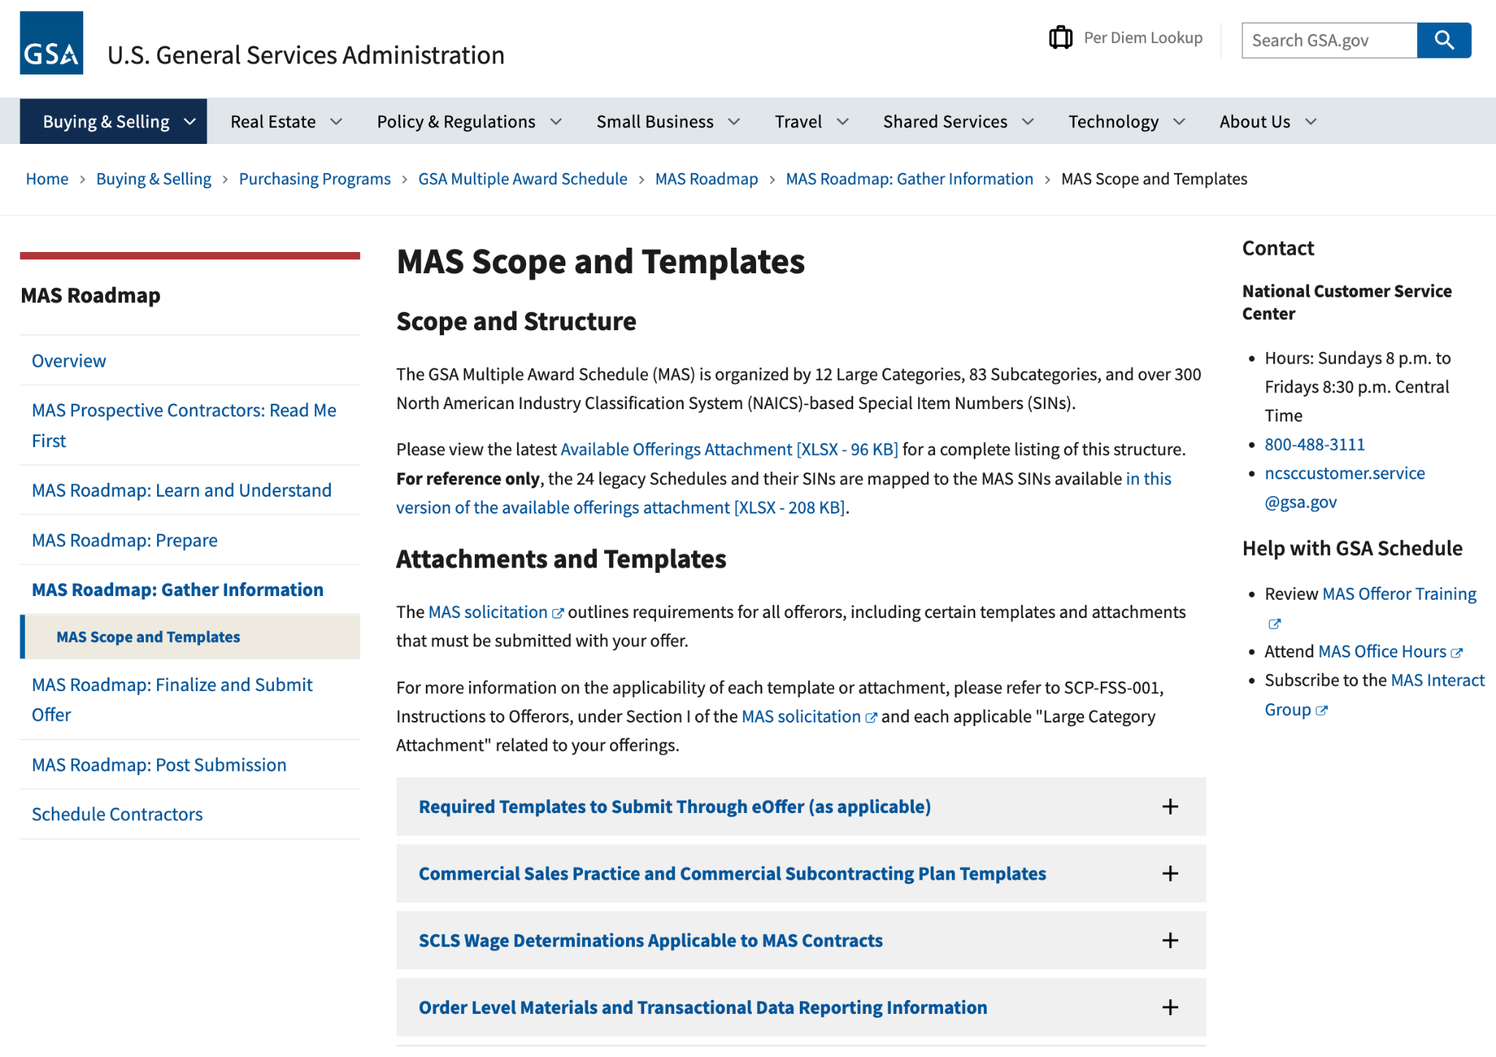
www.gsa.gov/masscopeandtemplates
44
Notes:
Rather than attach all requirements documents to FBO.gov, all required templates and information noted in the solicitation or in the category attachments is housed on the new GSA Available Offerings and Requirements page. This page contains documents that are part of the solicitation. They are organized by large category to make it easier for users to find information relevant to their offerings. Each document is also noted in the solicitation, so requirements are clear.

Slide 45
Offer Preparation (cont)
You will need to compile all the information below and submit it through the eOffer system.
You can find the forms and their descriptions at https://go.usa.gov/xSUaA.
Financial statements
Subcontracting plan
Technical proposal
Commercial Sales Practice-1 (CSP-1)
Professional compensation plan
Commercial price list
Previous cancellation and rejection letters
Price narrative with supporting documentation

Slide 46
Offer Submission
Submit your completed offer in GSA’s electronic eOffer system at https://eoffer.gsa.gov
After you submit your offer via eOffer, it will be assigned to one of our contracting professionals for review
Work directly with your assigned representative to clarify any questions or issues and negotiate pricing or other elements of your offer, if necessary
After review and negotiation, you will know whether you will receive a Schedule contract, based on the decision of the GSA Contracting Officer
Learn more about finalizing your offer at https://go.usa.gov/xHssV

Slide 47
The Resources

Slide 48
MAS Websites
GSA Interact Group - Multiple Award Schedules
Register for this Group to see all advance notices about upcoming MAS initiatives, training, webinars, etc.
https://interact.gsa.gov/groups/multiple-award-schedules
MAS Home Page: www.gsa.gov/schedule
MAS Roadmap: www.gsa.gov/masroadmap
Scope and Templates: www.gsa.gov/masscopeandtemplates

Slide 49
Helpful Links
GSA Training Events: www.gsa.gov/events
GSA Small Business: www.gsa.gov/smallbizresources
GSA Interact Small Business Group
https://interact.gsa.gov/groups/small-business-solutions
Association of PTACs: https://www.aptac-us.org/
Georgia Tech PTAC: https://gtpac.org/
Email: maspmo@gsa.gov

Slide 50



Helpful Links
www.gsa.gov/masroadmap
www.gsa.gov/schedule
www.gsa.gov/events
www.gsa.gov/smallbizresources
https://interact.gsa.gov/groups/small-business-solutions
Georgia PTAC - https://gtpac.org/
Email: maspmo@gsa.gov

Slide 51

Questions

