Slide 1
Welcome to the
Public Scoping Meeting
Environmental Impact Statement
for the
Sale of Plum Island, New York

Slide 2
PUBLIC SCOPING MEETING Sale of Plum Island, NY
Meeting Agenda
6:00 – 6:30 Open House
6:30 – 7:00 Presentation
7:00 – 8:00 Public Comment Session

Slide 3
PLUM ISLAND – RECENT HISTORY
In 2003, Plum Island was transferred to DHS.
USDA operates the Agricultural Research Service and the Animal and Plant Health Inspection Service (APHIS) at Plum Island.
Plum Island Animal Disease Center (PIADC) includes buildings, industrial facilities and equipment, roadways, utilities, specialized facilities, easements, and rights of way.
Additional assets on Plum Island include natural undeveloped land, the Plum Island Lighthouse constructed in 1869, and buildings and structures associated with the former Fort Terry.
DHS also maintains a 9.5-acre facility to support PIADC at Orient Point, New York which includes buildings, utilities, and ferry docking facilities.

Slide 4
U.S. GENERAL SERVICES ADMINISTRATION (GSA)
Real Property Utilization and Disposal Division of GSA
Responsible for managing the utilization and disposal of Federal excess and surplus real property
Provides real estate services for Federal agencies
Real estate consulting assistance
Transfer of excess properties for further Federal utilization
Disposals of surplus property
Expertise in complex Federal disposal process laws and regulations
Ensures the use of equitable and objective decision making and an open and transparent process

Slide 5
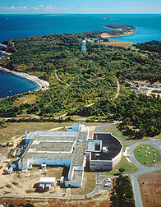
PUBLIC LAW 110-329 Section 540 of Consolidated Security, Disaster, Assistance and Continuing Appropriations Act of 2009
In 2008, U.S. Congress passed law
Directed GSA to sell at public sale all real and related personal property and transportation assets which support operations at Plum Island if the Department of Homeland Security (DHS) decided that a bio-containment laboratory (NBAF) be located at site other than Plum Island
In 2009, DHS made decision to locate NBAF in Manhattan, Kansas. PIADC will continue to operate until DHS constructs the new National Bio and Agro-Defense Facility (NBAF) in Kansas.
Sale to be subject to terms and conditions necessary to protect government interests and program requirements

Slide 6
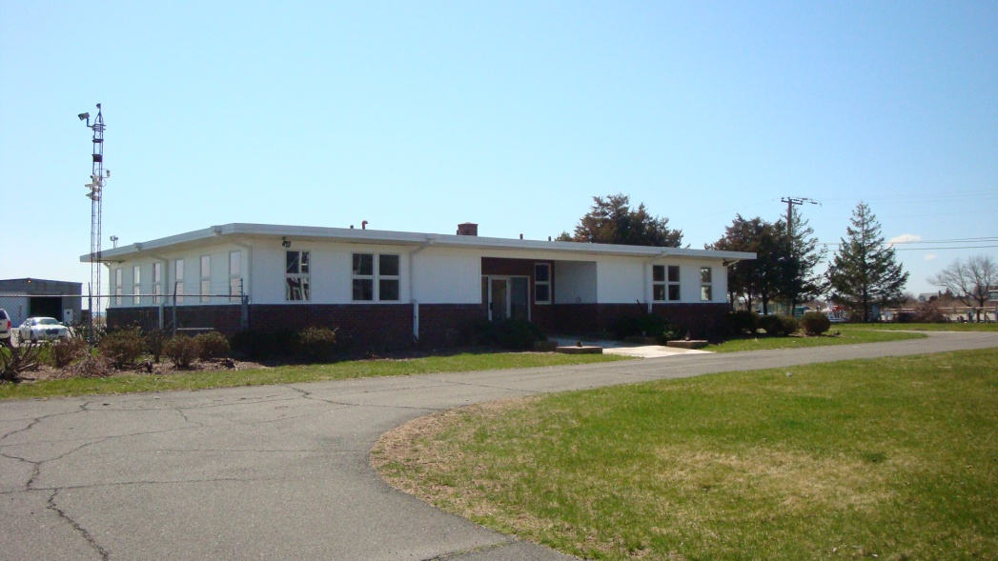
GSA RESPONSIBILITIES
GSA is the lead agency for all activities related to the characterization of environmental conditions and liabilities, marketing, and liquidation of Plum Island and the Orient Point facility
Primary Responsibilities:
Real Estate Due Diligence
Regulatory Compliance
Marketing & Sale
Sale Assets:
Plum Island
Orient Point Facility
Personal Property

Slide 7
REAL ESTATE DUE DILIGENCE
Understanding Capacities, Opportunities and Constraints
Comprehensive review of sale assets
Compilation and disclosure of all pertinent information
Real property
Infrastructure
Buildings
Utilities
Operating permits
Harbors and ferries
Personal property inventory

Slide 8
REGULATORY COMPLIANCE
Engaging in Environmental, Historic and Cultural Review
Regulatory framework guides and supports environmental, historic and cultural review of the property
National Environmental Policy Act (NEPA)
Historic eligibility/designations
Wetlands
Coastal zone considerations
Endangered species
Hazardous materials/substances

Slide 9
MARKETING & SALE
Establish marketing strategy for public sale
GSA will use its expertise to effectively market the property as one unit
In partnership with DHS, GSA will:
Engage nationally recognized real estate firm
Finalize marketing plan
Establish outreach office on Orient Point
Provide tours
Respond to stakeholder inquiries
Manage auction process

Slide 10
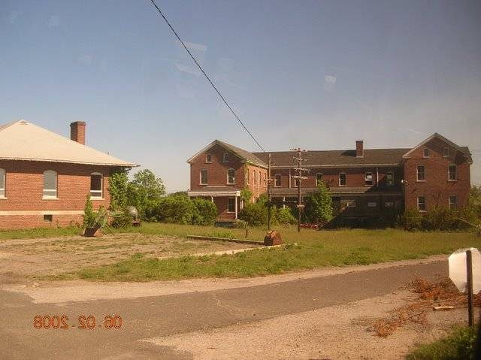
POST-SALE PROPERTY CONSIDERATIONS
Property will be subject to local zoning regulations when leaves federal ownership
GSA recognizes important role of local government
GSA is committed to continued engagement efforts with Town of Southold

Slide 11
WHY IS AN EIS BEING PREPARED?
An EIS was selected for this project because it provides the highest level of analysis with the greatest opportunity for input by interested parties before decisions and commitments are made.
Documentation for this level of analysis is comprised of a draft EIS and a final EIS, which includes:
Responses to agency and public comments
Record of Decision (ROD), signed by the Regional Administrator, that describes GSA’s final action decision.
Under NEPA, the purpose of this EIS is to examine the effects associated with the anticipated sale of Plum Island, New York and its support facility at Orient Point, New York.

Slide 12
PLUM ISLAND EIS – NEPA PROCESS
National Environmental Policy Act (NEPA), 1969
National charter for the protection of the environment.
Evaluates consequences of major federal actions that may affect the environment.
Environmental Impact Statement (EIS) Process
Scoping
Draft EIS distributed for public comment with public hearing.
Identifies, documents, and evaluates environmental effects.
Final EIS includes responses on comments to draft.
Decision makers consider findings and comments in selecting action(s).
Record of Decision (ROD) 30 days after final document is published.

Slide 13
PROPOSED ALTERNATIVES
No Action Alternative
Serves as a baseline for comparison
Cannot be selected -- does not meet the project purpose and need
Action Alternative
Consists of the public sale of Plum Island by GSA
DHS would continue operations until they are relocated to the new NBAF facility in Manhattan, Kansas
A reasonable range of land use options for the property would be identified and evaluated.

Slide 14
ACTION ALTERNATIVE – PROPOSED OPTIONS
Three Proposed Options for the Action Alternative:
Adaptive Reuse - Reuse of the existing improvements and infrastructure for commercial and other uses
Land use and zoning based on scenarios on other comparable, neighboring islands emphasizing low-density development
Similar to Option 2, land use and zoning based on scenarios on other comparable, neighboring islands emphasizing high-density development
Other options may be evaluated as a result of the scoping process.

Slide 15
RESOURCES TO BE EVALUATED
AREAS OF ANALYSIS
Biological Resources
Geology and Soils
Air Quality
Noise
Water Resources
Historic and Archaeological Resources
Hazardous Waste
Infrastructure
Land Use
Socioeconomics
Traffic and Transportation
Waste Management
Other Significant Resources

Slide 16
RESOURCES TO BE EVALUATED Natural Environment
Biological Resources
Threatened and endangered species
Wildlife and wildlife habitats
Coastal and marine resources
Geology and Soils
Changes to the island’s sole-source aquifer
Geotechnical limitations for new development

Slide 17
RESOURCES TO BE EVALUATED Natural Environment
Air Quality
Air pollutant levels due to new or increased activities
Noise
Noise impacts from new development
Water Resources
Impacts to island’s water supply sources
Water quality/wetlands
Additional stormwater runoff

Slide 18
RESOURCES TO BE EVALUATED Cultural Environment
Historic and Archaeological Resources
Known historic structures (on or eligible for the National Register of Historic Places), including the Plum Island Lighthouse and certain Fort Terry structures
Prehistoric/archaeological resources

Slide 19
RESOURCES TO BE EVALUATED Human Environment
Hazardous Waste
Ongoing/completed waste site cleanups
Infrastructure
Requirements for existing and potential water supply, sanitary sewer, natural gas, fuel oil, communications, and electrical lines
Upgrades to roads or ferry dock
Land Use
Designation of future land use zoning for Plum Island

Slide 20
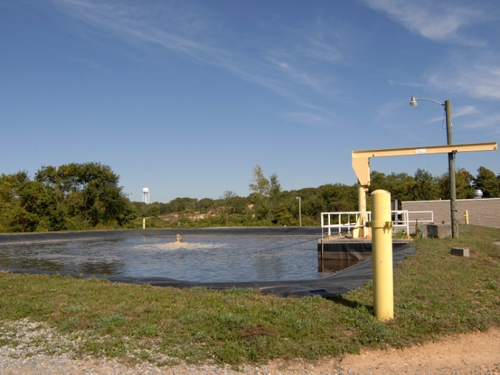
RESOURCES TO BE EVALUATED Human Environment
Socioeconomics
Impacts to local economy, medical services, schools, housing demand
Traffic and Transportation
Changes in traffic/commuting or transportation modes
Waste Management
Impacts to existing wastewater treatment facility
Solid waste management

Slide 21
PLUM ISLAND EIS – NEPA SCHEDULE
NOTICE OF INTENT
March 18, 2010
YOU ARE HERE
Scoping Comment
Period Ends
June 2, 2010
SCOPING PROCESS
May 2010
DRAFT EIS
Summer 2010
45-Day
Public Comment
Period
Respond to
Public Comments
Final EIS
Fall 2010
RECORD OF DECISION
At least 30 days
After Final EIS
Is Published

Slide 22
COMMENT SUBMISSION AND IMPORTANT DATES
Please complete a Comment Card and give it to one of the representatives.
Written comments and inquires can be submitted later to:
Phil Youngberg, c/o John Dugan
General Services Administration
10 Causeway Street, Room 925, Boston, MA 02222
Email: phil.youngberg@gsa.gov
Phone: 617-565-5709 Fax: 617-565-5720
Website: http://www.plumislandny.com
SCOPING COMMENTS ARE DUE JUNE 2, 2010
DRAFT EIS PUBLICATION DATE: SUMMER 2010

Slide 23
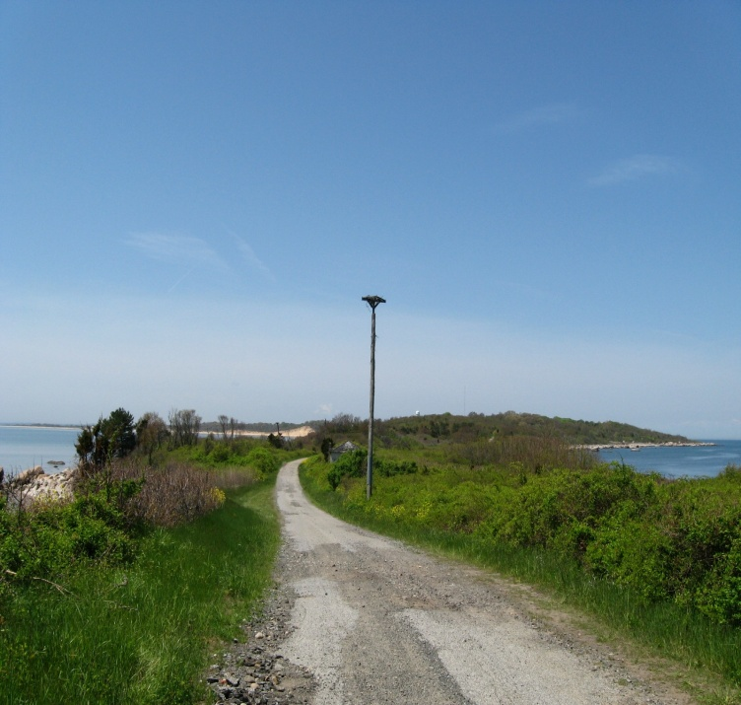
GSA CONTACTS
John Kelly john.kelly@gsa.gov
617.565.8094
Phil Youngberg phil.youngberg@gsa.gov
404.433.8393
John Dugan john.dugan@gsa.gov
617.565.5709
Gabrielle Sigel gabrielle.sigel@gsa.gov
617.565.5701
Press inquiries to be directed to:
Paula Santangelo paula.santangelo@gsa.gov
617.565.5777

