Slide 1
GSA FAS R9 NAVY/USMC
Virtual Industry Forum May 18, 2021

Slide 2
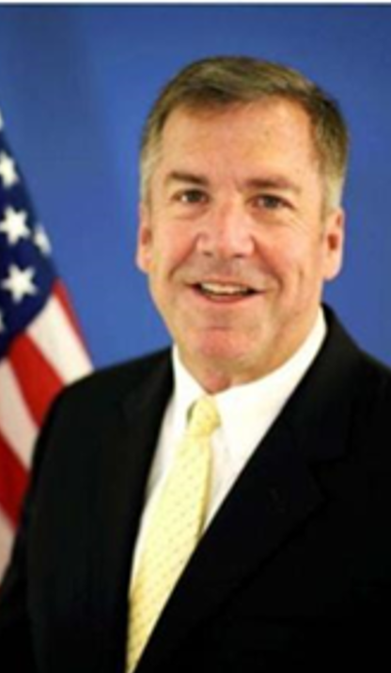
Welcome
Casey Kelley
GSA FAS Region 9 Commissioner
Navy / USMC Account Executive

Slide 3
Opening Remarks - 11:30 to 11:45 AM ET
Introduction & Welcome
Acknowledgements
Purpose / Goal(s) of Event
Event Overview/Format
Notes:
Introduce myself & welcome everyone
Share in-person event preferred yet technology enables >700 attendees
Thank
Steve Roberts and his team
GWAC/OASIS PMOs
Industry panelists
GSA panelists
All registered guests
State the purpose/goal(s) of the event:
Showcase the GSA CASE organization & how similar they are to industry
Use this forum as a launching pad to build rapport/relations with each other (GSA and industry)
Explore how we can collaborate better on how to increase the respective usage of GSA GWACs and OASIS contracts directly and/or through GSA AAS

Slide 4
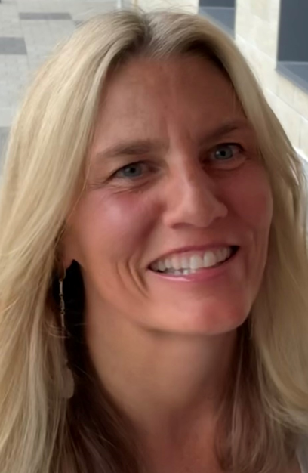
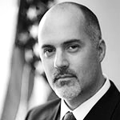
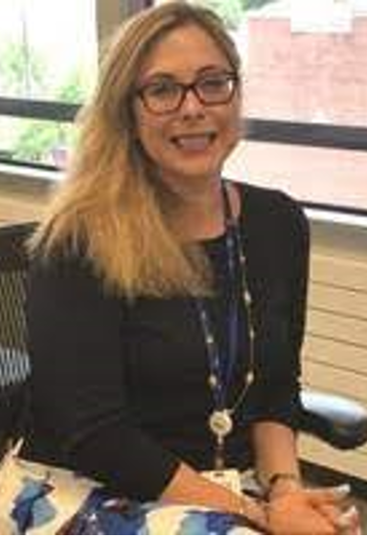
GSA CASE Leadership Panel - 11:45 AM to 12:30 PM ET
Erv Koehler
GSA FAS Assistant Commissioner (AC)
Customer and
Stakeholder Engagement
(CASE)
Jennifer Krook
GSA FAS Region 9
CASE Director (Acting)
Mark Carico
GSA FAS CASE
Navy/USMC
National Account Manager (NAM)
Kathleen Carroll
GSA FAS CASE
Navy/USMC
National Account Manager (NAM)

Slide 5
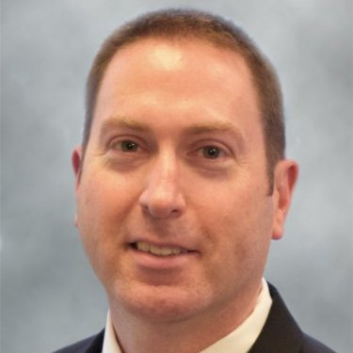
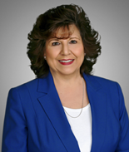
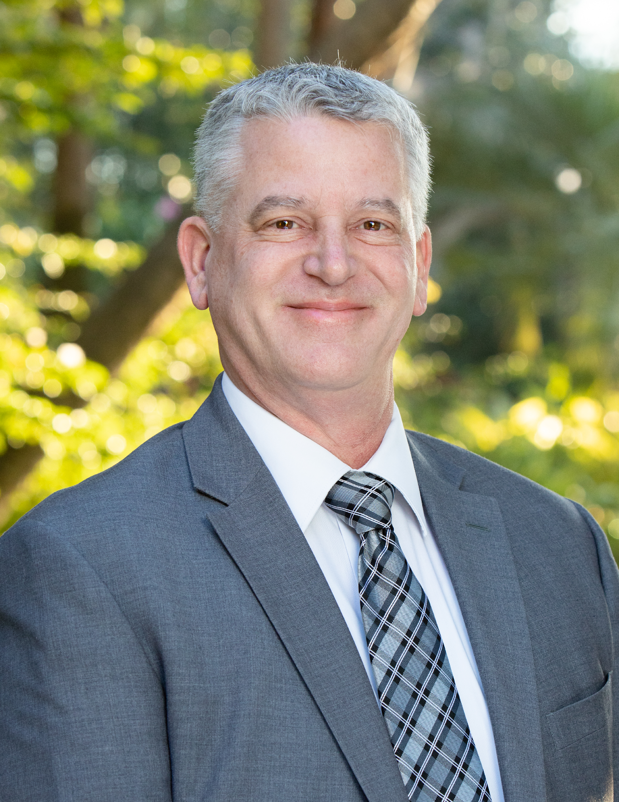
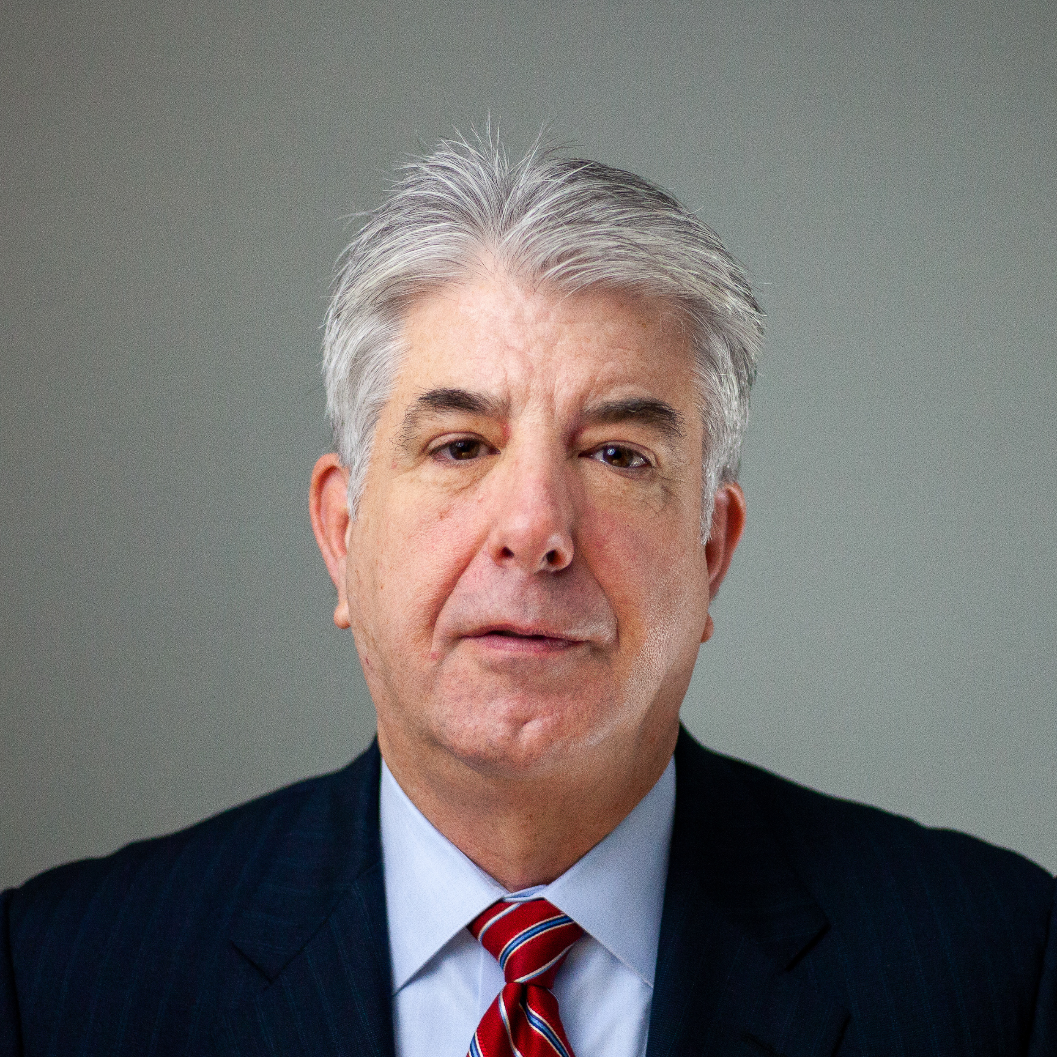
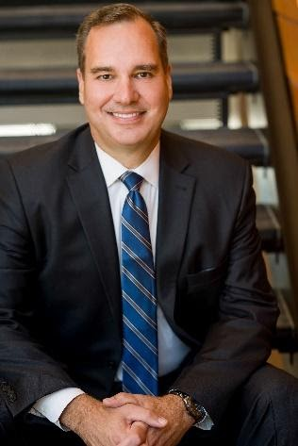
Industry Panel Session - 12:30 AM to 1:15 PM ET
Kyle Cormack
Director, IDIQ Capture & Services
Serco
Fran Litten
VP, Business Development
Immersion Consulting
Keith Harvey
Director
TACG
Arthur Mahony
President, Federal Programs
Manager, Navy Programs
The McHenry Management Group, Inc.
Mark Honecker
President, ITA Global Security
ITA International, LLC

Slide 6
Break / Rotation - 1:15 PM to 1:25 PM ET
Take 10 . . .

Slide 7
Breakout Room Rotations - 1:25 to 2:40 PM ET
Use Separate Unique Link Provided in eMail Confirmation
 | Alliant 2 Primes Breakout Room | OASIS UNR Primes Breakout Room | OASIS SB Primes Breakout Room | 8(a) STARS II/VETS 2 Primes Breakout Room
1:25 to 1:40 | Casey/Erv (GSA FAS R9 RC & CASE A/C | Mark/Kathleen (CASE Navy NAMs) | Jen/Charles + R9 CASE CONUS Team | Liz/Stacey + R9 CASE OCONUS Team
1:45 to 2:00 | Mark/Kathleen (CASE Navy NAMs) | Jen/Charles + R9 CASE CONUS Team | Liz/Stacey + R9 CASE OCONUS Team | Casey/Erv (GSA FAS R9 RC & CASE A/C
2:05 to 2:20 | Jen/Charles + R9 CASE CONUS Team | Liz/Stacey + R9 CASE OCONUS Team | Casey/Erv (GSA FAS R9 RC & CASE A/C | Mark/Kathleen (CASE Navy NAMs)
2:25 to 2:40 | Liz/Stacey + R9 CASE OCONUS Team | Casey/Erv (GSA FAS R9 RC & CASE A/C | Mark/Kathleen (CASE Navy NAMs) | Jen/Charles + R9 CASE CONUS Team
Note: 5 Minute Transition Between Each 15 Minute Breakout Session

Slide 8
Closing Remarks - 2:40 to 3:00 PM ET
Return to Original Link Provided in eMail Confirmation
Logistics Responding to All Questions Submitted via Chat During Panel Discussions/Breakout Rooms
Logistics Providing Presentations/Information from Breakout Sessions
Resources
GSA FAS Region 9: gsa.gov/r9
CASE: https://go.usa.gov/xHZvT
APPs Overview: https://go.usa.gov/xHZvb
MRAS: https://go.usa.gov/xHZvj
Locate a CSD: https://go.usa.gov/xHZfJ
GSA FAS R9 Assisted Acquisition Services: website

Slide 9
Thank you for attending!

