Slide 1
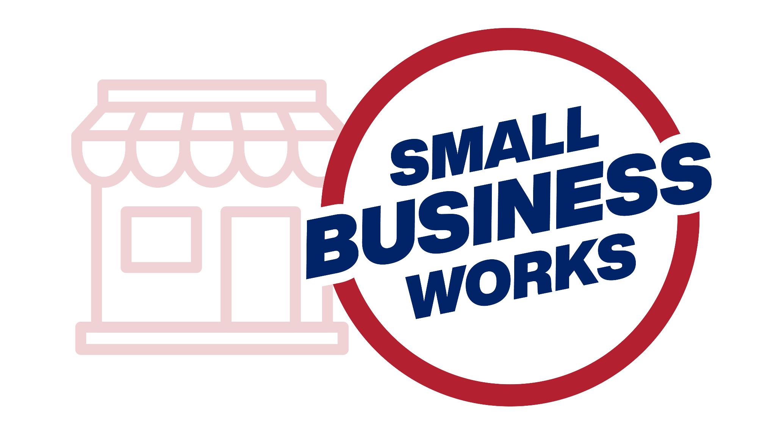
Small Business Works 2022:
Subcontracting Strategies for
Small Businesses
Day 1: July 26, 2022
U.S. General Services Administration

Slide 2
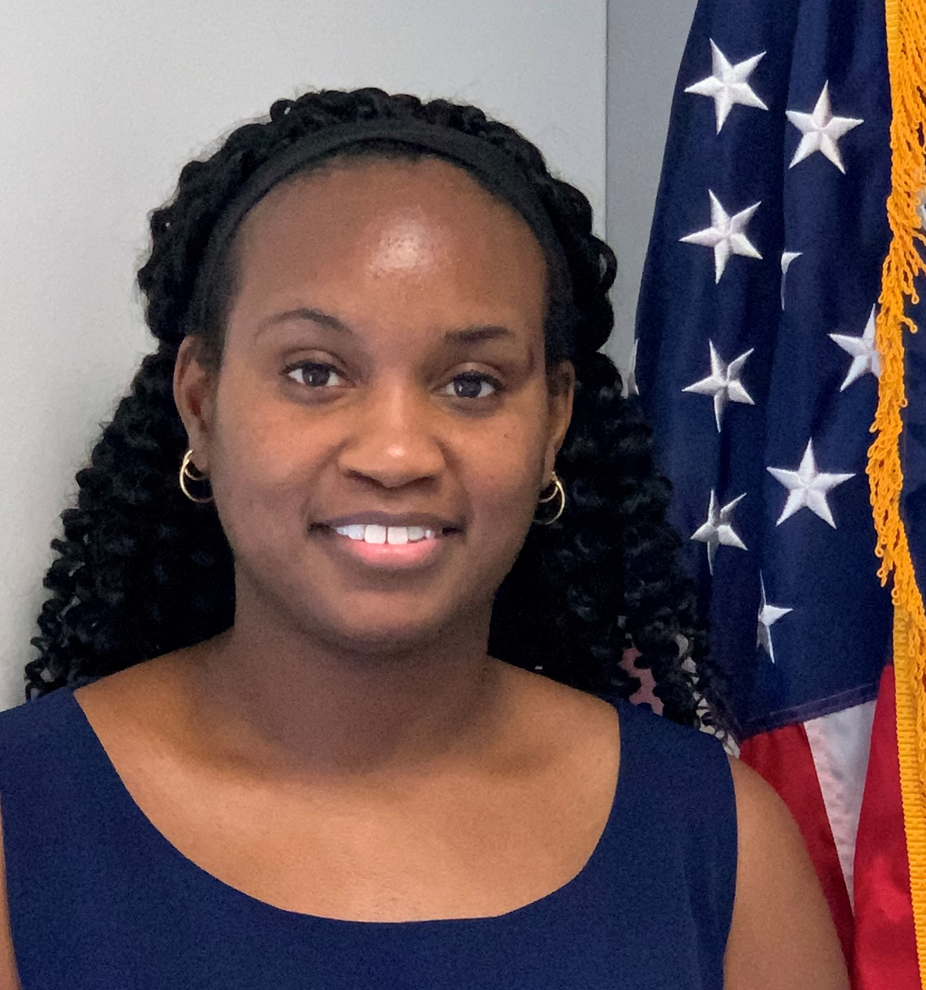
TODAY’S SPEAKERS
Carena Jackson
Subcontracting Program Manager
U.S. General Services Administration

Slide 3
TODAY’S SPEAKERS
Angela Terry
Senior Procurement Analyst
Office of Policy, Planning and Liaison
U.S. Small Business Administration
Notes:
Key Definitions:
Subcontract: As defined in Federal Acquisition Regulation (FAR 19.701), Subcontract means any agreement (other than one involving an employer-employee relationship) entered by a government prime contractor or subcontractor calling for supplies and/or services required for performance of the contract, contract modification, or subcontract.
Subcontractor means any supplier, distributor, vendor, or firm that furnishes supplies or services to or for a prime contractor or another subcontractor.
Federal Government’s Subcontracting Program: The federal government has detailed regulations under FAR 19.7 – The Small Business Subcontracting Program that guide the federal government employees, and contractors on the requirements to provide subcontracting opportunities to Small and socio-economic businesses. The United States Congress created the SB Subcontracting Program under the Small Business Act to ensure SB receives maximum practicable opportunity to participate in Federal Government contracts.
Therefore, small businesses should take time to read and get an understanding of the regulatory guidance.
Understanding the FAR is the key to a lot of the question many SB have regarding Federal Government contracting.
Subcontract Plan: Is required when a Federal government Prime contract is awarded at a specific dollar amount (threshold) and has subcontracting possibilities. The Subcontracting Plan outlines the products and services that SB will perform on the contract.
What are the FAR regulations that govern the Federal Government SB Subcontracts Program?
•FAR Subpart 19.7 Small Business Subcontracting Program
•FAR 52.219-8 Utilization of Small Business Concerns
•FAR 52.219-9 Small Business Subcontracting Plan
Limitations: Although the Federal government regulates the subcontracting program, we do not have the authority to prescribe the amount of subcontracting to a small business or to use a particular small business.
Benefits of being a subcontractor:
· Subcontracting could be your starting point into the Federal Government marketplace.
· The simpler, faster, and less burdensome way to get into the Federal Government marketplace is through subcontracting.
· Subcontracting allows an SB to work with the Federal Government indirectly.
· Subcontracting builds capacity and creates past performance.
· Allows more opportunities for small businesses.
Ways to become A federal government subcontractor:
· Locate a prime or subcontractor currently working on a federal government prime or subcontract that utilize what you supply
· Locate a firm that wants to establish a Team Arrangement for a government contract
o Team Arrangement as it relates to being a subcontractor is defined in FAR 9.601 (2) a potential prime contractor agrees with one or more other companies to have them act as its subcontractors under a specified Government contract or acquisition program if they win the prime contract.
With that being said, there is a key term a SB should know before entering the federal subcontract space
Bait and Switch
Providing information on a proposal but not being given the work once the contract has been awarded the contract.
Are you prepared to agree to the terms and conditions of a subcontract? Do you have the capacity, capability, and capital to perform a subcontract?
Financial Capital:
· What is your financial strength?
· Can you sustain the cost of the work and payroll on your own for 120 days if you have not received payment due to an issue because of schedule; improper documentation; sequestration; performance, or any other reason that might delay payment?
Capability:
· Do you have the proper experience? Have you done this before at the level of performance requested?
· Do you have the qualifications and certifications needed within your organization? If not do you have affiliates that have proven to be dependable with them? This is different than having access to affiliates with the qualifications that you have not worked with before.
· Quality requirements: If certifications or acknowledgements are required, will there be an added cost to your subcontracting business? See what additional fees may be involved with getting the needed certifications or acknowledgements, and how that will affect the ending subcontract price.
· Who can I affiliate, or partner with especially to find staffing resources for general and special skillsets? Know your potential subcontractors NAICS and product and services codes
Capacity to handle delays:
A delay can be caused by you, your suppliers or by other contractors
A delay in performing a subcontract may delay other projects you have in your pipeline.
Although you have no control over the delay caused by dependency (other contractors or work that must be done prior to you starting your work) these delays may cause you to be negligent if you do not prepare ahead of time. It would be good to have a contingency plan in place for resources such as staff, affiliates and suppliers in case delay occurs to ensure your performance is not negligent on any contract.
Performance Assessment:
A Federal Government’s prime contractor’s overall contract performance assessment is dependent on all subcontractors’ performance. Poor performance by any subcontractor costs more money and jeopardizes the reputation of the prime and subcontracting team and the trust in the acquisition team (for both government and industry) who selected the contractor.
Thus, a Subcontractor’s poor performance can give them a bad name in the industry.
SB Subcontractor Past Performance
SBA has issued a final rule on Past Performance Ratings for Small Business Joint Venture Members and Small Business First-Tier Subcontractors. This provision a past performance rating for work performed as a member of a joint venture or for work performed as a first-tier subcontractor when requested by the small business.
This past performance can be utilized to potentially satisfy the past performance requirement of a prime contract requirement. Thus, you want to ensure that you have performed as contractually agreed.

Slide 4
Subcontracting Strategy Overview
Subcontracting provides more opportunities for small businesses to participate in Federal Government contracting.
Notes:
Key Definitions:
Subcontract: As defined in Federal Acquisition Regulation (FAR 19.701), Subcontract means any agreement (other than one involving an employer-employee relationship) entered by a government prime contractor or subcontractor calling for supplies and/or services required for performance of the contract, contract modification, or subcontract.
Subcontractor[ means any supplier, distributor, vendor, or firm that furnishes supplies or services to or for a prime contractor or another subcontractor.
Federal Government’s Subcontracting Program: The federal government has detailed regulations under FAR 19.7 – The Small Business Subcontracting Program that guide the federal government employees, and contractors on the requirements to provide subcontracting opportunities to Small and socio-economic businesses. The United States Congress created the SB Subcontracting Program under the Small Business Act to ensure SB receives maximum practicable opportunity to participate in Federal Government contracts.
Therefore, small businesses should take time to read and get an understanding of the regulatory guidance.
Understanding the FAR is the key to a lot of the question many SB have regarding Federal Government contracting.
Subcontract Plan: Is required when a Federal government Prime contract is awarded at a specific dollar amount (threshold) and has subcontracting possibilities. The Subcontracting Plan outlines the products and services that SB will perform on the contract.
What are the FAR regulations that govern the Federal Government SB Subcontracts Program?
•FAR Subpart 19.7 Small Business Subcontracting Program
•FAR 52.219-8 Utilization of Small Business Concerns
•FAR 52.219-9 Small Business Subcontracting Plan
Limitations: Although the Federal government regulates the subcontracting program, we do not have the authority to prescribe the amount of subcontracting to a small business or to use a particular small business.
Benefits of being a subcontractor:
· Subcontracting could be your starting point into the Federal Government marketplace.
· The simpler, faster, and less burdensome way to get into the Federal Government marketplace is through subcontracting.
· Subcontracting allows an SB to work with the Federal Government indirectly.
· Subcontracting builds capacity and creates past performance.
· Allows more opportunities for small businesses.
Ways to become A federal government subcontractor:
· Locate a prime or subcontractor currently working on a federal government prime or subcontract that utilize what you supply
· Locate a firm that wants to establish a Team Arrangement for a government contract
o Team Arrangement as it relates to being a subcontractor is defined in FAR 9.601 (2) a potential prime contractor agrees with one or more other companies to have them act as its subcontractors under a specified Government contract or acquisition program if they win the prime contract.
With that being said, there is a key term a SB should know before entering the federal subcontract space
Bait and Switch
Providing information on a proposal but not being given the work once the contract has been awarded the contract.
Are you prepared to agree to the terms and conditions of a subcontract? Do you have the capacity, capability, and capital to perform a subcontract?
Financial Capital:
· What is your financial strength?
· Can you sustain the cost of the work and payroll on your own for 120 days if you have not received payment due to an issue because of schedule; improper documentation; sequestration; performance, or any other reason that might delay payment?
Capability:
· Do you have the proper experience? Have you done this before at the level of performance requested?
· Do you have the qualifications and certifications needed within your organization? If not do you have affiliates that have proven to be dependable with them? This is different than having access to affiliates with the qualifications that you have not worked with before.
· Quality requirements: If certifications or acknowledgements are required, will there be an added cost to your subcontracting business? See what additional fees may be involved with getting the needed certifications or acknowledgements, and how that will affect the ending subcontract price.
· Who can I affiliate, or partner with especially to find staffing resources for general and special skillsets? Know your potential subcontractors NAICS and product and services codes
Capacity to handle delays:
A delay can be caused by you, your suppliers or by other contractors
A delay in performing a subcontract may delay other projects you have in your pipeline.
Although you have no control over the delay caused by dependency (other contractors or work that must be done prior to you starting your work) these delays may cause you to be negligent if you do not prepare ahead of time. It would be good to have a contingency plan in place for resources such as staff, affiliates and suppliers in case delay occurs to ensure your performance is not negligent on any contract.
Performance Assessment:
A Federal Government’s prime contractor’s overall contract performance assessment is dependent on all subcontractors’ performance. Poor performance by any subcontractor costs more money and jeopardizes the reputation of the prime and subcontracting team and the trust in the acquisition team (for both government and industry) who selected the contractor.
Thus, a Subcontractor’s poor performance can give them a bad name in the industry.
SB Subcontractor Past Performance
SBA has issued a final rule on Past Performance Ratings for Small Business Joint Venture Members and Small Business First-Tier Subcontractors. This provision a past performance rating for work performed as a member of a joint venture or for work performed as a first-tier subcontractor when requested by the small business.
This past performance can be utilized to potentially satisfy the past performance requirement of a prime contract requirement. Thus, you want to ensure that you have performed as contractually agreed.

Slide 5
Marketing Strategies
Marketing strategy is a process that allows an organization to concentrate its limited resources on the most significant opportunities to increase sales and market share.
Notes:
Market Research Tips:
Marketing: When I say Marketing, I am not referring to “selling.” Marketing is planning a strategy to promote your product or service to gain interest and, influence of specific consumers/groups where the product/service can meet a need. Marketing is creating interest by demonstrating compatibility and solution to meet a need. Thus, you must be aware of the following:
Knowing the NAICS The North American Industry Classification System (NAICS) economic classification system used to classify economic activity. Know the NAICS of the industries that can benefit from your product or service and how your product / service fit into their business model? Identifying the NAICS of those you are prepared to do business with, allows you to strategically target ideal prospects and look for opportunities.
Knowing the marketplace: Identifying who, what & how
§ What type of work do you want to do? Targeted market
§ Who do you want to do it with? Affiliates
§ Who do you want to do it for? Customer
§ Who is buying: What agencies and contractors that have prime or subcontracts can utilize my product or service? These are also customers
§ Who is my target market currently buying from? Your competitors
Do your market research: Market research is collecting and analyzing information about capabilities and need within the market. Effective marketing requires in depth research into the buying habits of the potential customer.
· It is essential that the SB is knowledgeable of how their product / service specifically fits into the selected company’s business model, BEFORE reaching out to the customer.
· Thus, intelligence gathering is a vital part of marketing to effectively determine the right approach. Here are some suggestions
• Visit their website to obtain information that helps you understand a company better and give you a strategic advantage. SB can obtain valuable information from the website such as:
● The type of subcontract opportunities
● How to become a subcontractor (supplier, partner, etc..) or how to do business with the organization
● Existing suppliers
● Subcontractor requirements
● Events (where you can meet influencers)
● Identify what they need
Build Relationships: Relationships always matter, and relationships with Federal government suppliers are no exception, and first impressions are lasting.
Remember it is a Process. Thus, you will need to follow that company’s acquisition process verbatim.: New suppliers/subcontractors are an unknown. Unknowns represent · RISK in business.
· Thus, be willing to go through a cultivation process to gain trust. TRUST in an unknown's capacity to perform MUST BE EARNED.
· It is recommended that the SB develop a strategy to introduce themselves and inspire the firm to award them a subcontract by utilizing the information they have obtained through researching the organization’s processes, procedures and need.
· Remember your looking to form long-term relationships.
Pricing Tips:
Know the expenses to provide your company’s product and service:
• Winning a contract or an increase in sales, does not mean you have made a profit or covered your expenses.
• You must know the true cost to identify what you need to break even, make a profit or to make an intelligent decision to bid. So often I hear of subcontractors not being able to complete a contract because they did not bid correctly and no longer have the financial capacity to continue.
• However, tracking expenditures provides the data needed to make an intelligent decision
• Knowing the true cost allows you to bid accordingly, to the extent possible avoid cost overruns, shortages and make a profit.
• With prices increasing daily on many necessities be sure to factor in the cost of gas, mileage, salaries, insurance, lease payments, utilities, printing cost, software, hardware, attorney fees, postage charges and the delivery fees to accurately estimate cost
• Although the bidding process can be very competitive, remember that you need to make a profit.
Pricing Strategy Tools:
So many companies ask how much I should bid? Well of course you should bid enough to cover costs. It may also help to know what others have gotten paid for doing the same work which in most cases included a profit. The following tools will provide you with insight on what the government is asking the contractor to do and the contract award pricing. This data will provide you with insight on the type of products and services directly and indirectly related to an acquisition that you would need to identify pricing for.
FPDS-NG Ez-search: The Federal Procurement Data System (FPDS) is the central
repository of Federal government contracts.
● Statement of Work or performance Work statement
● Evaluation Information
● Contract types
● Contract Award amount
● Subcontract plan requirement
● Solicitation procedures
● Contract numbers to search CPARS for past performance insight
● Agency POC that can provide insight
● SOW
● Competitor information
Procurement Technical Assistance
● Subcontract pricing history: Find out what your competitors are charging for similar services by contacting a Procurement Technical Assistance Center (PTAC) to ask if it has any history of what subcontractors were paid for projects that required similar services.
You can also ask to look at a few past contracts to see what was required of the subcontractor, and to make a fair evaluation of the subcontract pricing structure
SAM.Gov Opportunities Domain: Provides procurement notices from federal contracting offices.
· Pre-solicitation Notices
· Solicitation Notice
· SOW
SubNet: The Small Business Administration's (SBA) Subcontracting Network System that bridges the gap between businesses seeking small businesses and small business seeking contracting opportunities.
· Ability to view pre-solicitation conference notices, solicitations, notice of sources sought (NSS) and requests for information (RFI)
· This will help to see the types of subcontracts per NAICS and view solicitation information to get an idea of other capabilities you may need but did not think of
· Obtain associated NAICS
· View SB Outreach events and attend for insight
· Identify Sources to contact obtain information
USA Spending: Allows you to search for recipients (contractors both prime and sub)
by NAICS, location and many other categories this will also help you to identify associated cost and a potential affiliate who can provide insight on pricing
Market Yourself: Be registered in all the portal’s used by your industry to locate contractors to include SBA’s Dynamic Small Business Search System and GSA’s System for Award Management (SAM) Entity Registration portal. Both Federal agencies and contractors search SAM and DSBS to find contractors to fulfill a need. SAM and DSBS are free databases. Your small business’ profile in SAM and DSBS is like a résumé. Creating a profile that’s accurate and appealing is important to winning a government contract.
Make sure to use accurate, descriptive terms about your business so that you will be easily identifiable in search queries by those seeking to locate small businesses
SAM.Gov Entity Registration portal allows you to provide:
· NAICS
· Identifies your business size for each NAICS based on your revenue and # of employees
· Socio-economic type
· Identify excluded businesses
· Location
· An active registration can be used to self-certify as a small business
Note: To be listed in DSBS, you must first register in the System for Award Management (SAM). Once SAM has validated you as a small business in a particular NAIC, once your registration is complete you will be entered in DSBS.
DSBS allows you to provide: You will need to obtain an account with SBA’s General Login System account from SBA at www.gls.gov to provide the following information to your profile:
· Capabilities Narrative
· Non-SBA Certifications
· Bonding Levels
· Type of Security Clearance and more
Follow-up: I hear many businesses representative say SB do not follow-up.
1. When you meet a firm, and they say to reach out to them, and you do but after several attempts with no response you stop. Do not stop send a monthly “im just checking in email” remember people are busy and my not need you at that time but may in the future.
2. A firm has invited you to bid on a contract and you do not. Have a proposal shell ready that you can update with specifics. This allows you to utilize your limited resources to respond to more bids often.
3. You bid and do not win. Contact the company and ask for feedback. This feedback will give you insight to their specific reasons and maybe industry practices.

Slide 6
Subcontract Possibilities Strategies
Subcontracting possibilities help you identify and connect with your target market.
Notes:
Definition:
Subcontract Possibility: A subcontract possibility is often confused with a subcontracting opportunity. A subcontract possibility is when there may be a need for a subcontractor, but the firm is not seeking a subcontractor. Such as a business that is seeking information (request for Information (RFI)), identifying vendor’s capabilities (Notices of Sources Sought (NSS)) or has a contractual requirement to subcontract to SB.
Subcontract Possibility Tips:
Assess all the information you have obtained about your competitor's performance and potential business partners' needs, analyze it with your capabilities and identify your competitive advantage.
Then research contracts in the NAICS that you can provide that service to,
o obtain contact information,
o and build a strategy to connect and identify which of them you want to start relationships with, to share and obtain insight, information. and assistance.
Subcontract Possibility Techniques:
SAM.Gov Opportunities Domain: Have procurement notices from federal contracting offices that provides insight to subcontract possibilities
· Pre-solicitation Notices-
· Solicitation Notice-
· NSS
· Justifications
· Agency POC that can provide insight
· SOW
· Evaluation Criteria
· Subcontract plan requirement
· Solicitation procedures
· Contract type
· Outreach events (under special notice)
· So much more
SAM.Gov Entity Information: Provide resource information
· NAICS
· Socio-economic type
· Names of businesses
· Location
USA Spending: Includes details about prime contractors and their subcontractors which allows you to search for recipients (contractors both prime and sub) in many categories to include
· NAICS
· Location
· Recipient type
· PSC
SubNet: The Small Business Administration's (SBA) Subcontracting Network System that bridges the gap between businesses seeking small businesses and small business seeking contracting opportunities.
· Ability to review conference notices, solicitations, notice of sources sought (NSS) and requests for information (RFI)
· By geographic area, NAICS or business name
· Identify NAICS in Your Target market
· Subcontract NAICS
GSA Forecasting of Contracts Opportunities: Provides information on expected federal contracting opportunities. The tool assists with acquisition planning by helping vendors learn about potential prime contracting opportunities early in the process. Users can easily filter the data by agency, location (place of performance), NAICS Code, contract type, and more. These tools are on the agency’s website look under Office of Small Disadvantage Business Utilization (OSDBU)
Subcontracting Directory: Use SBA, GSA and DOD post Subcontracting Directory and FPDS-ng’s Subcontract Plan standard report to get a listing of contractors who may be looking for subcontractors.
• The Directory is a great tool to:
• Pay close attention to the contract end date Get a listing of large business prime contractors who may be looking for subcontractors.
• Obtain contact information to review websites and get their protocol for subcontracting and links to other resources
• Prime contract NAICS
DSBS: is a one stop shop to:
o Identify potential small business contractors to affiliate with
o Identify other small businesses for teaming and joint ventures
o Identify Small business available capabilities
o Obtain email addresses to send information
Outreach events: Allows you to be face to face with those you can do business with
● SAM Opportunity Domain: Special Notices allows you to search for events
● Your potential partner websites have events and associations listed that you should research and view their events
● Industry Conferences and Tradeshows of your suppliers to meet other business

Slide 7
Subcontract Opportunities Strategies
Does your organization have the capacity, qualifications, certifications, and experience to accept an opportunity?
Notes:
A Subcontract Opportunity is when a Contractor has identified a need and is seeking a subcontractor
Subcontract Opportunities Tips:
● Make sure you understand the subcontract requirement, terms, and conditions, including payment.
● Follow the Bid instructions do not deviate
● Attach a self-certification for the NAICS code identified in the solicitation you will be submitting the bid to fulfill
● Ensure you have priced the work as bets as possible to at a minimum cover the cost to complete the project.
Subcontract Opportunities Strategy: All companies list their needs somewhere. You must identify were.
Company Website: A company’s website will either have the subcontract opportunity listed or where they list the need.
Industry opportunity and bidding sites: Businesses seeking subcontractors post subcontracting opportunities on popular business bidding sites
Government Opportunity sites:
• SAM.Gov Opportunity Domain: Federal Agencies seeking SB subcontractors post opportunities in SAM.
• SubNet: Search SubNet to identify subcontract opportunities: Businesses seeking SB subcontractors post subcontracting opportunities in Sub-Net.
• There is no cost to use Sub-Net.
• If you are a SB looking for subcontracting opportunities searching is easy and no log in is required. SBA encourages you to frequently visit the Sub-Net website to seek available subcontracting opportunities in your area of expertise that you would like to submit a proposal.
• Sub-Net is located at www.sba.gov/subnet
¨ Map Search
¤ Click on the Opportunity Search Type “Radio Button”
¤ Click on the State or Territory that represents the subcontract place of performance using the “Map or Drop-Down Menu”
¤ Search results will appear
¨ Advanced Search
¤ Click on the Opportunity Search Type “Radio Button”
¤ Enter the requested data in the Advanced Search Option Fields
¤ Click “Submit” and search results will appear

Slide 8
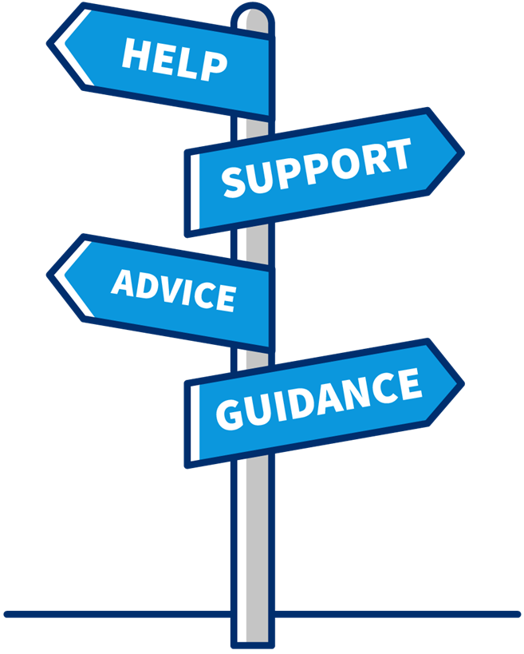
Assistance
There is someone to assist you, if you need it
Notes:
Assistance Tips:
Contact the Federal Agency Contracting Officer when a bait and switch or untimely payment issues arise
· Learn the regulation
o FAR 19.704(a)(12) – Assurance to use the pre-appointed
Small Businesses
o FAR 19.704(a)(13) - Communication with Contracting Officers
o FAR 19.704(a)(14) and (15) – Payment to SB Subcontractors
SBA’s Resources: Are responsible for providing businesses with the tools for enhancing and growing their businesses. SBA’s Federal Government suite of tools can help businesses understand how to navigate the requirements of obtaining federal contracts as a prime or subcontractor
o Learn how to plan, find, pursue, and win Federal Government contracts
o Gain an understanding of SBA’s Business Development Programs
o Provides policy guidance and oversight
o Serves as liaison and expedites issues
o Provide training and resources
• SBA Government Contracting Assistance:
• SBA District Offices
• Contracting Area Offices
• Area and District Directors
• Business Opportunity Specialist
• Procurement Center Representative
• Commercial Market Representative
• SBA’s Prime Contracts Manager
• SBA’s Subcontract Manager
• DSBS help: DSBS@sba.gov
• GLS help: GLS@SBA.gov
SBA’s learning Center: SBA's online learning programs are designed to empower and educate small business owners every step of the way
Find your SBA Resource contact information at www.sba.gov Federal Contracting
• Procurement Technical Assistance Center (PTAC): https://www.aptac-us.org/
• GSA’s IAE Systems help (SAM and FPDS): FSD.gov
• Agency OSDBUs: locate at agency website
• Procurement Technical Assistance Center (PTAC): https://www.aptac-us.org/
• Veterans Business Outreach Center (VBOC)
• Provides contracting resources for Veteran businesses

Slide 9
Links to Resources
Agency Recurring Procurement Forecasts: https://www.acquisition.gov/procurement-forecasts
DoD Prime Contractor Directory: https://business.defense.gov/Acquisition/Subcontracting/Subcontracting-For-Small-Business/
Dynamic Small Business Search (DSBS): https://web.sba.gov/pro-net/search/dsp_dsbs.cfm
GSA eLibrary: https://www.gsaelibrary.gsa.gov/ElibMain/home.do
GSA Forecast of Contracting Opportunities: https://hallways.cap.gsa.gov/app/#/dv/federal-business-forecast
GSA Subcontracting Directory: https://www.gsa.gov/small-business/register-your-business/subcontracting-and-other-partnerships

Slide 10
Links to Resources (cont.)
Procurement Technical Assistance Center (PTAC): https://www.aptac-us.org/
SBA Prime & Subcontracting: https://www.sba.gov/federal-contracting/contracting-guide/prime-subcontracting
Subcontracting Network (SubNet): https://eweb1.sba.gov/subnet/client/dsp_Landing.cfm
System for Award Management: https://sam.gov/content/home
USA Spending: https://www.usaspending.gov/
Veterans Business Outreach Center (VBOC): https://www.sba.gov/local-assistance/resource-partners/veterans-business-outreach-center-vboc-program

Slide 11
Questions?

Slide 12
Thank You!

