Slide 1


Small Business Works 2022:
Navigating Equity in Procurement
U.S. General Services Administration

Slide 2


What is SBA 8(a) Business Development Program, and the 7(j) Program?
Lisa J. Avila
Business Opportunity Specialist
U.S. Small Business Administration

Slide 3
What is the 8(a) Business Development Program?
A nine- year business development program, established by Congress in 1978 as Section 8(a) of the Small Business Act.
A business assistance program for small disadvantaged businesses controlled at least 51% by socially and economically disadvantaged individuals
Essential instrument for helping socially and economically disadvantaged entrepreneurs gain access to the economic mainstream of American society
The 8(a) Program offers training in business management & marketing (aka 7(j) Program)
Access to set- aside and sole source contracting opportunities
www.sba.gov
Source: The U.S. Small Business Administration (SBA)

Slide 4
Which Regulations Govern the 8(a) Program?
THE LAW: Began as a public law - named after Section 8(a) of the Small Business Act 1953 (Public Law 95-507 & 100-656)
http://www.sba.gov/content/small-business-act - full copy of the Small Business Act
SBA REGULATIONS: Governed by 13 CFR §124
www.ecfr.gov – click on “Title 13” and then “Part 124”
ADD’L FEDERAL REGULATIONS: Incorporated in the Federal Acquisition Regulations (FAR), under Part 19, Small Business Programs
www.ecfr.gov – click on “Title 48” and then “Part 19”
Source: The U.S. Small Business Administration (SBA)

Slide 5
Program Structure
Term of Participation
Year 1
2
3 Developmental Stage
4
Year 5
6
7 Transitional Stage
8
9
Continuation in the program depends on the firm’s sustained eligibility as a socially and economically disadvantaged owned and operated firm and continued compliance with the 8(a) BD participation agreement.
Source: The U.S. Small Business Administration (SBA)

Slide 6
Benefits of the 8(a) Program
Participants can receive sole-source contracts, up to $4.5 million for goods and services and $7.5 million for manufacturing
Competitive contract opportunities
8(a) firms can form joint ventures and teams to bid on contracts, enhancing the ability of the firm to perform larger prime contracts
Source: The U.S. Small Business Administration (SBA)

Slide 7
Counseling
Free, confidential, face-to-face business counseling and low-cost training
Help with business plans, financing, marketing, proposal writing, bonding, and more…
Counseling resources:
Small Business Development Centers (SBDCs)
SCORE
Veterans Business Outreach Centers (VBOCs)
Women’s Business Centers (WBCs)
Procurement Technical Assistance Centers (PTACs) – DOD Resource
Source: The U.S. Small Business Administration (SBA)

Slide 8
Questions to Ask Before Applying to 8(a)
Do I really want to work for the Federal government?
Do I meet the preliminary eligibility criteria?
Does my business have the past performance and financial capacity needed to succeed?
Do I have all the documentation to support my application?
Do I have the time and/or staff needed to market to the Federal government?
Is my firm “really” ready to perform on a federal contract?
Or am I just eligible for the program?
Source: The U.S. Small Business Administration (SBA)

Slide 9
Some Popular 8(a) Misconceptions
A consultant is required to fill out the 8(a) application - NO
Start up business can easily apply, be accepted and are ready for the program – Maybe, but that doesn’t mean you are READY
The Federal government will automatically give you contracts if you are 8(a) Certified – NO, NO, NO
An 8(a) Participant can automatically get an SBA loan – BIG NO
You Business Opportunity Specialist (BOS) will market your firm to the Federal agencies – ABSOLUTELY NOT
All small business are eligible to participate in the program - NO
Source: The U.S. Small Business Administration (SBA)

Slide 10
Helpful Websites
www.sba.gov – SBA Main Page
www.sba.gov/federal-contracting/contracting-assistance-programs/8a-business-development-program - 8(a) Program
www.sba.gov/dc – WMADO Webpage
www.certify.sba.gov 8(a) Application Webpage
www.asbdc-us.org – SBDC Webpage
www.aptac-us.org – PTAC Main Page
www.score.org – SCORE Main Page
www.usaspending.gov – USA Spending
Source: The U.S. Small Business Administration (SBA)

Slide 11
If you are ready to apply, go to
www.Certify.SBA.gov

Slide 12
Questions?

Slide 13
Management and Technical Assistance - 7(j) Program

Slide 14
What is the 7(J) Management and Technical Assistance Program?
The Small Business Act § 7(j); 15 U.S.C.A § 636(j); 13 C.F.R. § § 124.701-704 under sections 7(a)(11),7(j)(10) authorizes the Agency to provide management and technical assistance to 7(j) eligible individuals and small businesses.
Training is FREE to 7(j) eligible small businesses.
Management and technical assistance includes, one-to-many (groups/webinars), one-on-one consultant services, training, and specialized services.
Areas of assistance include - financial management, business and strategic planning, forecasting services, accounting/systems development, contract management and compliance, social media/marketing and information technology/cybersecurity. BIDSPEED is very popular.
Source: The U.S. Small Business Administration (SBA)

Slide 15
What are the Eligibility Requirements for the 7(j) Program?
To be eligible for 7(j) services, a small business owner must be:
Certified 8(a) participant
HUBZone certified small business
Economically disadvantaged women-owned small business-
Small business located in areas of high unemployment or low income
Small business owned by low-income individuals
Small business owners must ensure that they qualify as small under 13 CFR Subpart 121 – Small Business Size Regulations and located in urban or rural areas with a high proportion of unemployed or low-income individuals, or which are owned by such low-income individuals.
Source: The U.S. Small Business Administration (SBA)

Slide 16
Approved 7(j) Training Providers
Coley and Associates – www.coleysolutions.com
Service Area: Nationwide
Florida State Minority Supplier Development Council – www.fsmsdc.org
Service Areas: Florida, Washington, DC., Maryland, Virginia, etc.
National Center for American Indian Enterprise Development – www.ncaied.org Service Area: Nationwide
The Catalyst Center for Business and Entrepreneurship – www.catalystcenter.org
Service Area: Nationwide
Source: The U.S. Small Business Administration (SBA)

Slide 17
Approved 7(j) Training Providers (cont.)
NetQuarry, Inc. (market intelligence training) at www.netquarry.com – provides technical assistance to 7(j) eligible small businesses through a commercially available, online government business development platform called BIDSPEED to help firms improve their business development and capture management efforts.
Stover and Associates (Business Development Training) at www.stoverteam.com
Gabriel Enterprises (Training for 8(a) firms) at www.geconsultinggroup.com
Source: The U.S. Small Business Administration (SBA)

Slide 18
7(j) FY21 Performance Statistics
Businesses trained - 11,900
Value of Contracts Awarded - $4 Billion
Contracts Awarded – 2,396
Subcontracts Awarded – 268
New Teams – 291
New Financing / Traditional- Non-Traditional – 291
Jobs Created/Retained – 1,030
Source: The U.S. Small Business Administration (SBA)

Slide 19
Questions?

Slide 20
Thank You!

Slide 21
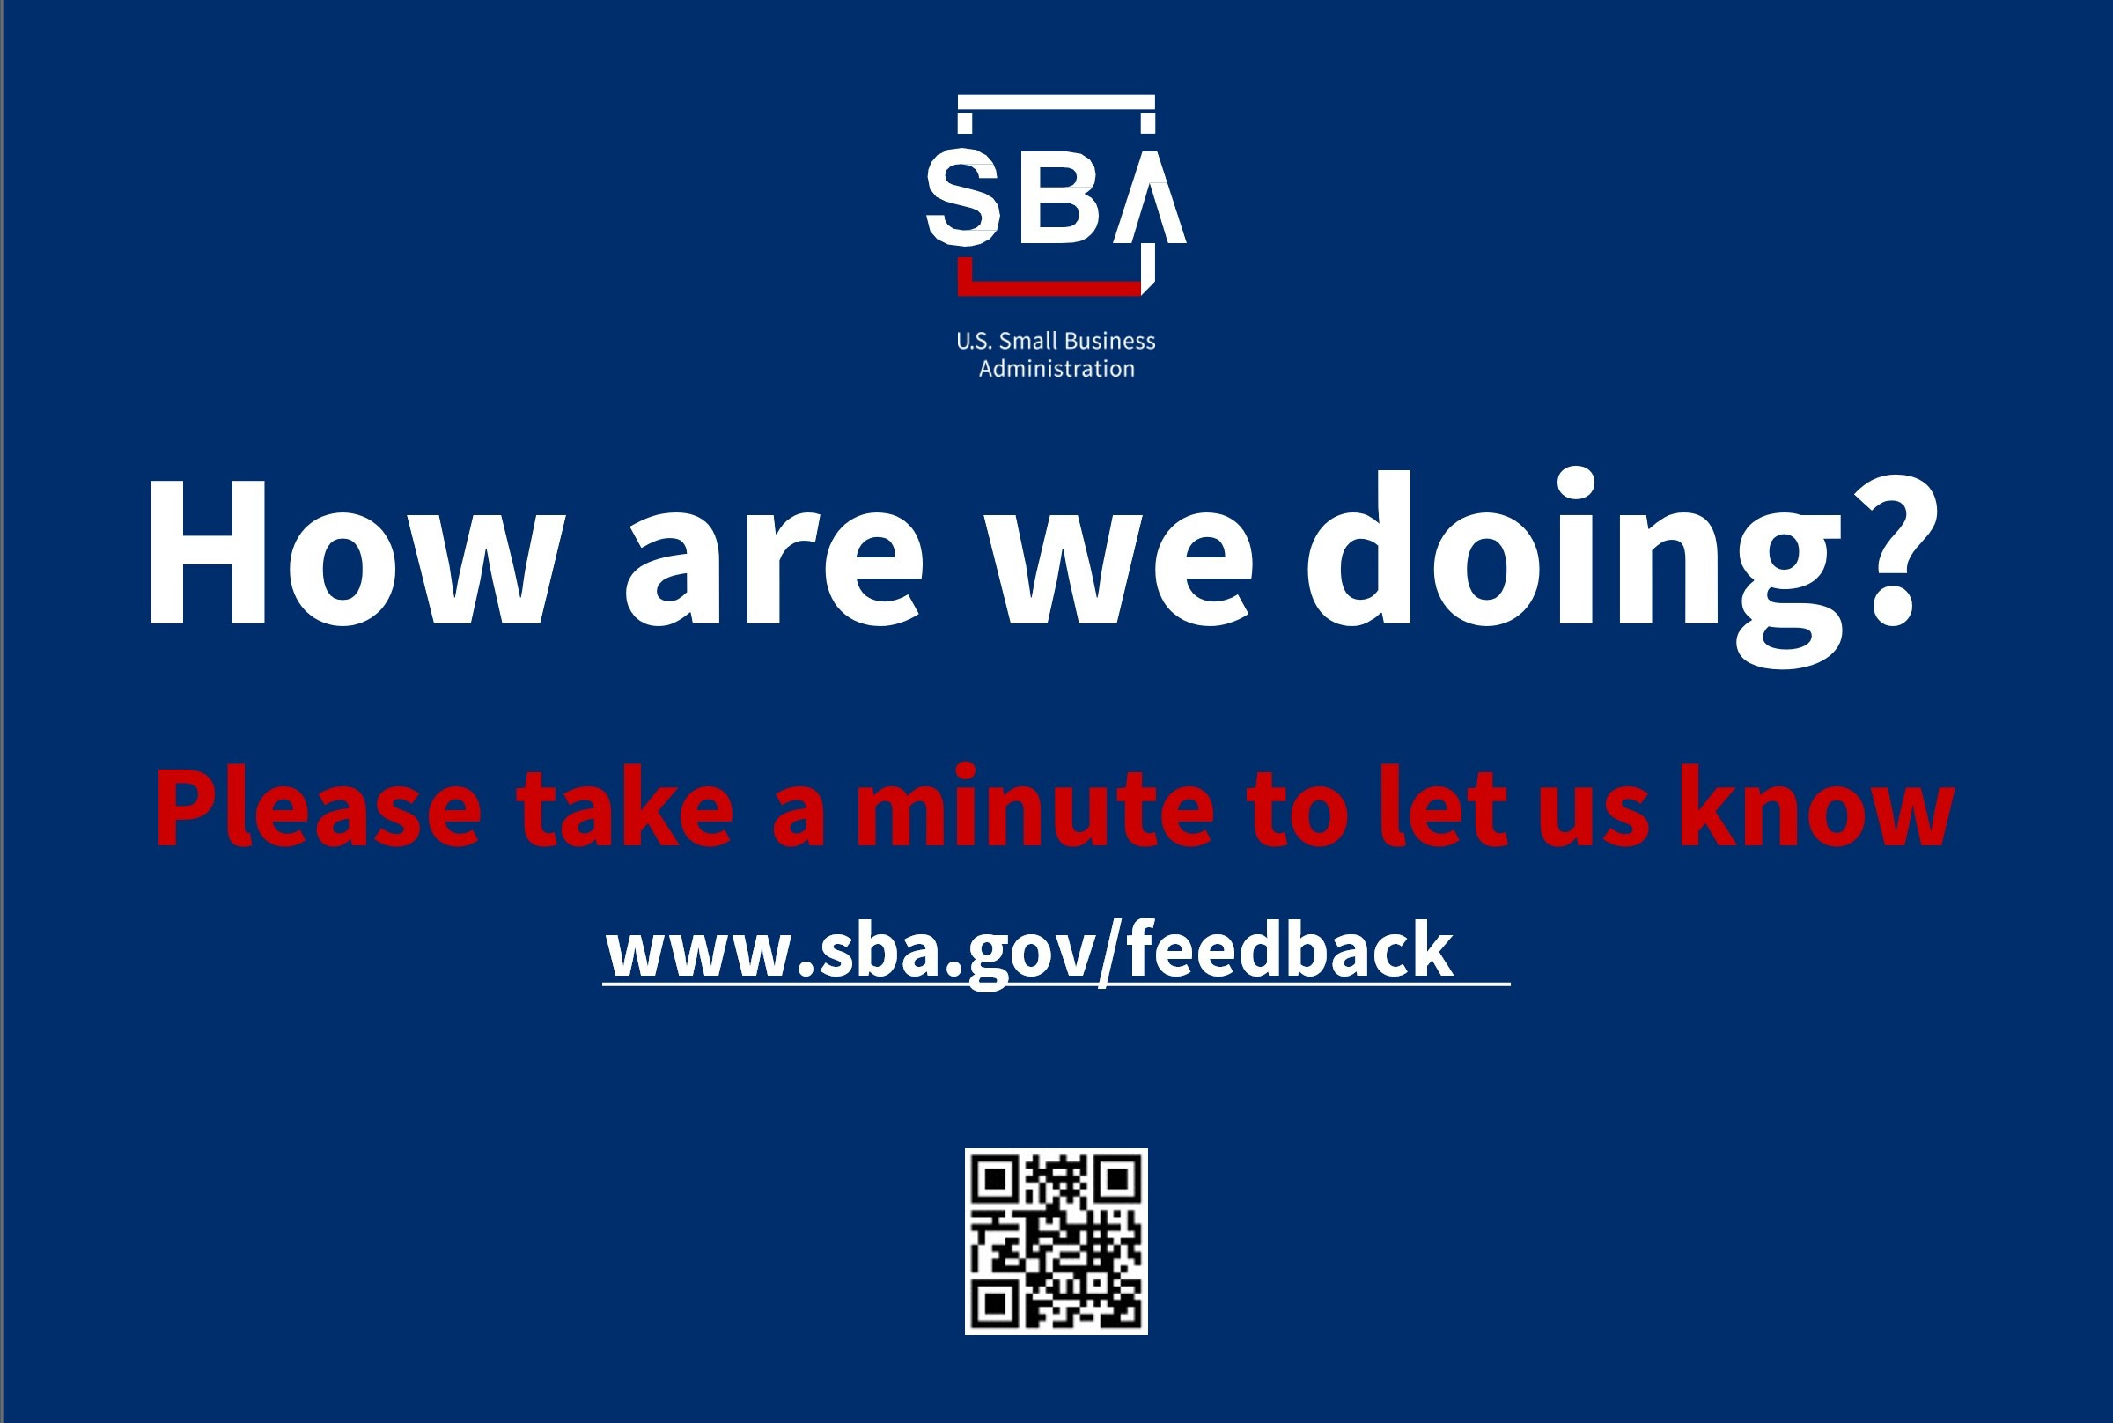
How are we doing?

