Slide 1
Before You Buy: How Better Market Research Leads to Better Acquisitions
Acquisition Training for the Real World
October 26, 2026
Notes:
Discover the critical role of market research in federal acquisitions. Learn when and how to conduct it effectively, and optimize your data collection methods for superior results. Explore the regulatory landscape of FAR Part 10 and understand its impact on key acquisition decisions, including planning, small business set-asides, commercial items, and contract type selection. Benefit from real-world scenarios, expert instruction, and practical tools from GSA's Market Research As a Service (MRAS).

Slide 2
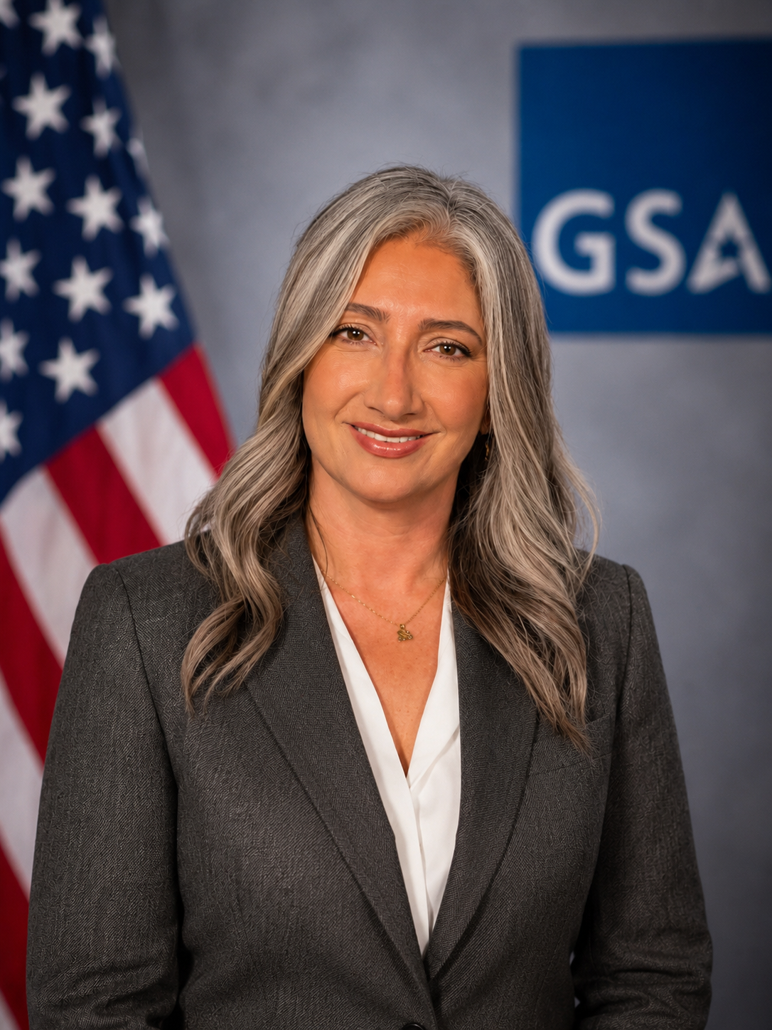
Presenter
Tiffany Shabanian
Market Research Analyst
rfi@research.gsa.gov

Slide 3

Agenda
Market Research and FAR Regulations
What Market Research Should Actually Answer
What is MRAS?
MRAS in Action: Fictional Case Study
MRAS Process Start to Finish
Common Market Research Mistakes
Market Research Quick Check and Toolkit
Upcoming Training
Helpful information

Slide 4

Market Research and FAR Regulations
www.acquisition.gov/far/part-10
Market research isn't just a FAR requirement, it’s how you find out whether your requirement, acquisition strategy, and contract vehicle actually make sense before you go to solicitation.
MRAS is considered a Smart Accelerator in the Practitioner Album
The FAR Overhaul outlines changes to Market Research policies.
Refer to FAR Parts and Agency Deviations for agency specific policies.
You can start Market Research as early as 18 months prior to contract award
Notes:
Move beyond finding vendors

Slide 5

Market Research and FAR Regulations cont.
www.acquisition.gov/far/part-10
WHEN to Conduct Market Research
Before developing new requirements documents.
Before soliciting offers above the Simplified Acquisition Threshold (SAT).
Before awarding task or delivery orders at or above the SAT.
HOW to Conduct Market Research
Request only the minimum information necessary from potential sources.
Engage industry fairly while maintaining procurement integrity.
Document findings based on the acquisition’s size and complexity.
USE the Results to Determine
Whether an existing governmentwide contract can meet the requirement.
Whether the requirement can be adapted to use an existing contract.
Whether commercial products or services are available or can be modified.
Whether only a nondevelopment item can satisfy the requirement.
Notes:
Move beyond finding vendors

Slide 6
What Market Research Should Actually Answer
Define the Requirement
Vague: The customer needs 100 cyber security engineers.
Improved: The Office of Cybersecurity Operations (OCO) requires contractor support for 100 full-time-equivalent (FTE) cybersecurity engineers to design, implement, and sustain security controls across the agency’s enterprise network and cloud environments. The contractor must reach full staffing of 100 cleared personnel no later than May 31, 2027, with phased onboarding.
Ask yourself what's wrong with this requirement?
What outcomes are required?
Is this a commercial service?
What does industry actually offer?
Is the NAICS appropriate?
What contract vehicles could support it?
Is there small-business capability?
Should this be labor-hour, T&M, or fixed price?
Is the scope overly restrictive?
That's what market research is supposed to help you figure out—before you release the solicitation.
Notes:
Move beyond finding vendors

Slide 7

What is MRAS
Market Research As a Service (MRAS) was created as a value-added support program to help federal, state, and local agencies efficiently meet FAR Part 10 market research requirements.
Services
Request for Information: Streamlines the RFI process and consolidates results into one report with visuals typically within 1-2 weeks.
Rapid Review: A comprehensive list of potential GSA solutions and contract information within 48-72 hours.
Product Market Research: Report with pricing data for thousands of GSA Advantage products within 48-72 hours.
Value Added Benefits
Completely FREE value-added service
Streamlines market research and reduces acquisition time
Aligns agency needs with GSA solutions
Identifies optimal business sizes and socioeconomics
Ensures FAR Part 10 compliance
Customizable RFI Survey
GSA Customer Service Director (CSD) support
Notes:
Move beyond finding vendors

Slide 8

Before You Solicit
Factor | Key question | Consider
Scope | Am I describing the requirement correctly? | Scope/PWS/SOW validation. GSA Scope Review
NAICS | What is the principal purpose? | Predominant component of the work; size standard and set-aside impact; consistency with the vehicle. MRAS can assist with category review
Vehicle | Is it within scope of an existing vehicle? | Labor categories and SIN fit; contract type allowed; ordering period and ceiling; vendor pool. MRAS can assist with category review
Competition | Who can do it, and are we limiting them? | Capability and capacity, not just registration; Rule of Two; restrictive requirements (clearances, certs, location). RFIs provide an overview of the marketplace
Commerciality | Is it sold in the commercial market? | FAR 2.101 definition; government-unique elements; commercial pricing basis; FAR Part 12 applicability. All MRAS RFIs ask vendors about their commerciality
Notes:
Opening (30 sec)
“Before we look at vendors or pricing, we have to be clear on scope. Scope is the foundation of market research. If it’s vague or overly broad, everything built on it, from the vendor list to the acquisition strategy, will be weak. There are four factors I want you to evaluate every time: NAICS, vehicle, competition, and commerciality.”
NAICS (40 sec)
“The NAICS code should reflect the principal purpose of the requirement, not every task in the SOW. It matters because it sets the small business size standard, which drives your set-aside analysis and your vendor universe. If the requirement mixes services, such as engineering, IT, and training, decide which component predominates. For our cybersecurity example, a computer systems design code is a likely fit, but always verify the current size standard on SBA.gov, because those change.”
Vehicle (40 sec)
“Next, does the requirement fall within the scope of an existing vehicle? Check whether the vehicle’s labor categories map to the roles in the SOW, whether it allows your contract type, and whether the ordering period and ceiling work. Ordering something outside a vehicle’s scope is a real compliance risk. Also look at how many qualified vendors sit on the vehicle, because a vehicle with few holders may not give you meaningful competition.”
Competition (50 sec)
“For competition, we’re looking for vendors who can actually perform, so think capability and capacity, not just who is registered in SAM.gov. Then turn the lens on ourselves: are our own requirements limiting the field? Restrictive clearances, certifications, locations, or an incumbent advantage can all narrow competition. In our example, 100 engineers in about five months may exceed any single small business’s capacity, so we’d want to ask whether teaming or a phased approach opens the market up.”
Commerciality (50 sec)
“Finally, commerciality. Is this a service of a type sold in the commercial marketplace? The definition is in FAR 2.101. This matters because it affects whether Part 12 procedures apply, what clauses and pricing data requirements you’ll have, and how you establish price reasonableness. Cybersecurity engineering is widely sold commercially, but the clearance and classified on-site work are government-unique, and we should document those elements.”
Close (30 sec)
“The key takeaway is that these factors aren’t independent. If we loosen the clearance requirement, the competition picture changes, the vehicle options change, and the commerciality analysis may too. As you do your research, keep revisiting scope rather than treating it as a box you check once.”

Slide 9

Beyond Finding Vendors
Questions market research should answer, and where MRAS can help
Can industry provide this?
GSA Advantage availability
Product Market Research
Am I describing the requirement correctly?
Scope, PWS and SOW validation
GSA Scope Review
Who can provide it?
Vendor landscape, socioeconomic factors, competition
Request for Information (RFI)
How should I buy it?
NAICS, contract vehicle, set-aside, acquisition strategy
Rapid Review
What am I missing?
Gaps, assumptions, commercial practices, emerging solutions
Request for Information (RFI)
Notes:
Market research is more than a vendor list. These are the five questions it should answer. Each one lines up with an MRAS service you can use. The service mapping here is a draft: confirm it matches how you describe each service before presenting.

Slide 10
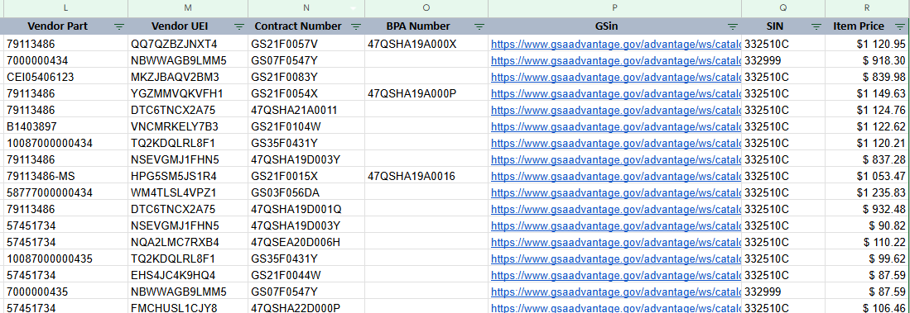
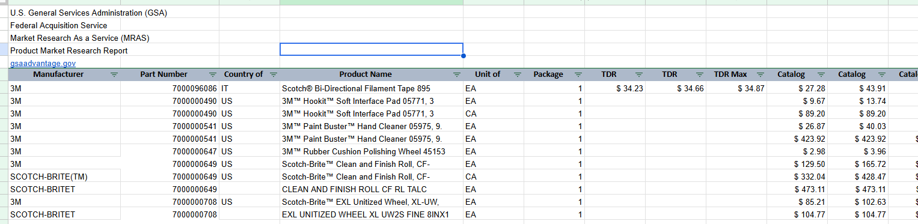
Product Market Research
Commodity market report on demand
Search thousands of part numbers or NSNs at once
Receive part number GSA Advantage! data quickly
****A list of part numbers/descriptions will need to be uploaded with your request

Slide 11
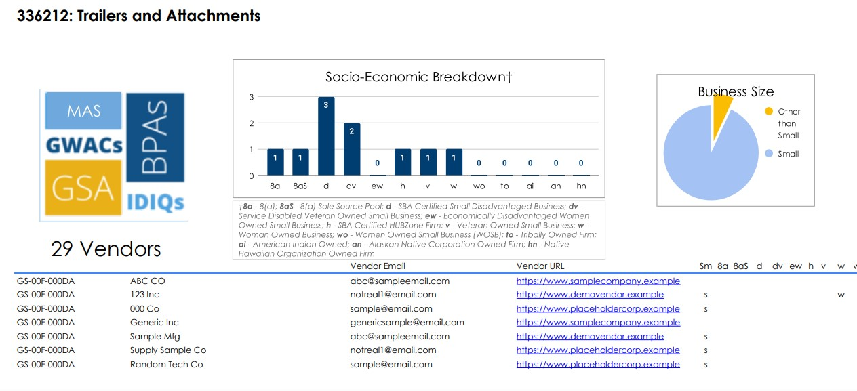
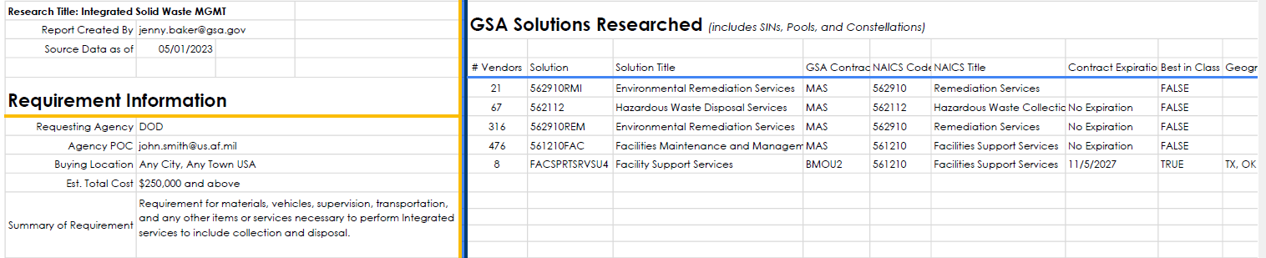
Rapid Review
Results within 48-72 hours
NAICS results based on the description of the requirement
Review of MAS and subcategories
Up to 5 applicable GSA contracts ranked by compatibility
Includes Best In Class GSA contracts

Slide 12
MRAS in Action: Start to Finish
A fictional case study: UPS maintenance and repair for 12 field offices
Notes:
Transition into the case study. Everything from here through the closing story slide follows one fictional requirement. Remind the audience it is made up, but the steps and screenshots are how the MRAS process works.

Slide 13

The Requirement Dana Starts With
Dana is a contracting officer at a (fictional) field operations agency
DRAFT REQUIREMENT, VERSION 1
What Dana is assuming
The contractor shall provide maintenance and repair services for uninterruptible power supply (UPS) systems at 12 field offices.
Emergency on-site response within 2 hours, 24/7/365, at every site
Technicians must be OEM-certified
Single nationwide award
“We've always bought it this way.”
!
!
“The incumbent is probably the only vendor who can do it.”
!
“I just need a simple RFI posted.”
Before she solicits, Dana asks MRAS what the market can actually do.
Fictional scenario for illustration
Notes:
Meet Dana, a contracting officer at a fictional field-operations agency. Her draft requirement looks reasonable at first glance. Ask the room: what questions would you ask? Then point out the three assumptions on the right. Dana's first instinct is to post an RFI. Her better move is to ask MRAS what the market can actually do before she solicits.

Slide 14
The MRAS Process, Start to Finish
1
Submit
2
Complete form
3
Tailor questions
4
RFI goes live
5
Review report
6
Build the PWS
Choose RFI on the MRAS Service Request Form
Upload the PWS, confirm NAICS and competition type
MRAS helps write yes/no, multiple choice and short answer questions
RFI posts on eBuy; vendors respond and include capabilities statements
Vendor POC, socioeconomic status, feedback and technical responses included
Use the findings to revise the PWS/SOW and define the acquisition strategy
MRAS recommends keeping RFIs open for at least two weeks.
RFI reports are generated within 24-48 hours.
Notes:
Give the roadmap once, then walk each step with Dana's story. Steps one through five are the MRAS request and RFI. Step six is where the findings turn into a better PWS and acquisition strategy. Typical timing for an RFI report is one to two weeks.

Slide 15
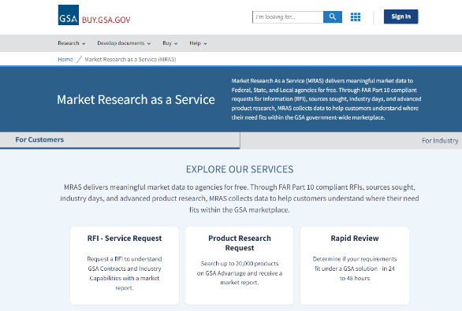
Step 1: Submit the Request
Dana picks a service at Buy.GSA.gov/MRAS
Product Market Research
Pricing data for up to 20,000 GSA Advantage products, 48–72 hours
Rapid Review
List of potential GSA solutions and contract information, 48–72 hours
Request for Information
Vendor feedback in one report with visuals, typically 1–2 weeks
Dana needs vendor input on response times, certifications and pricing, so she chooses the RFI.
Screenshot: MRAS service selection page buy.gsa.gov/mras
Notes:
Dana goes to Buy.GSA.gov/MRAS and selects a service. Walk through the three options briefly. She chooses the RFI because she needs vendor input on response times, certifications and pricing practices, not just a list of who holds a contract.

Slide 16
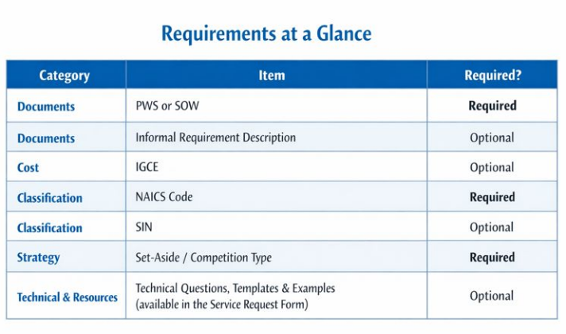
Step 2: Complete the Service Request Form
What Dana submits
Item | Dana's entry
PWS/SOW (required) | Draft PWS, finalized version 1
NAICS (required) | 561210FAC, to be validated in MRAS category review
Competition type (required) | Unrestricted, for now
IGCE (optional) | Included
SIN (optional) | Not sure; asks MRAS for help
Technical questions (optional) | Requests help drafting them
Attachment tips: upload finalized PWS/SOW version with no visible tracked changes, and keep unnecessary POC information out. Vendors respond through the survey link.
Fictional entries. Screenshot: MRAS Service Request Form requirements
Notes:
Three items are required: the PWS or SOW, the NAICS code and the set-aside or competition type. Dana is unsure of her SIN and asks for help drafting technical questions. Reinforce the attachment tips: finalized documents, no visible tracked changes, no unnecessary POC details.

Slide 17
Step 3: Tailor the Technical Questions
Good technical questions are tied to a decision. MRAS helps you develop them.
Dana's question | Format | Decision it informs
Can your company provide 24/7 emergency response for UPS systems? | Yes / No | Is 24/7 commercially available, or does it narrow the field?
Do your technicians hold OEM certifications for the UPS brands on the site list? | Yes / No | Is OEM certification realistic or restrictive?
What is the fastest response time you can commit to at all 12 sites? | Multiple choice | Where to set response tiers
How do you typically price preventive maintenance and repairs? | Multiple choice | Contract type: fixed price, T&M, or a mix
What would you change in this requirement to improve your ability to compete? | Short answer | What is overly restrictive or missing
Fictional scenario for illustration
Notes:
This is where Dana gets better acquisition intelligence. Every question is tied to a decision she needs to make. MRAS helps customers develop questions from the requirement, and a technical question template is available. Stress that a good question changes what you do next.

Slide 18
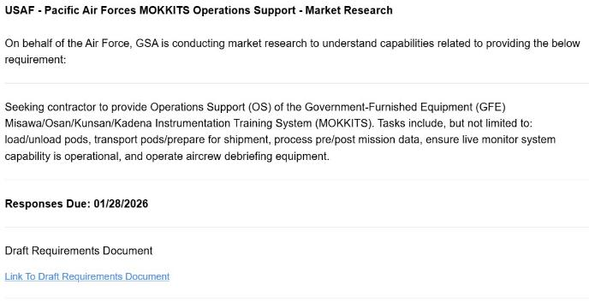
Step 4: The RFI Goes Live on eBuy
1
The requirement documents are linked right in the RFI
2
Vendors answer Dana's technical questions and share a capability statement
3
The survey also collects small business, socioeconomic data and optional feedback
Responses roll into one consolidated report.
Screenshot: example MRAS RFI
Notes:
MRAS posts the RFI and vendors respond through the survey. The requirement documents are linked, vendors answer the technical questions, and the survey collects small business and socioeconomic data. Responses are consolidated into one report.

Slide 19
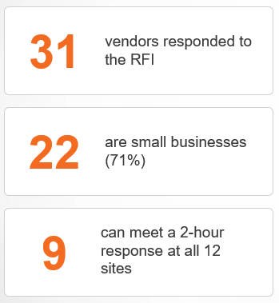
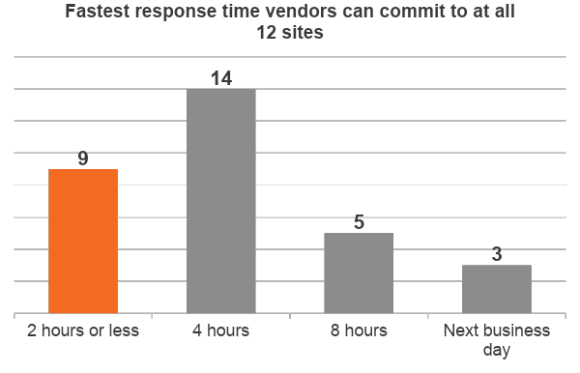
Step 5: What the Market Told Dana
Fictional data for illustration
Notes:
All numbers here are made up for the story. Thirty-one vendors responded and twenty-two are small businesses. Only nine can meet a two-hour response at all twelve sites. Dana's original requirement would have shut out most of the market.

Slide 20
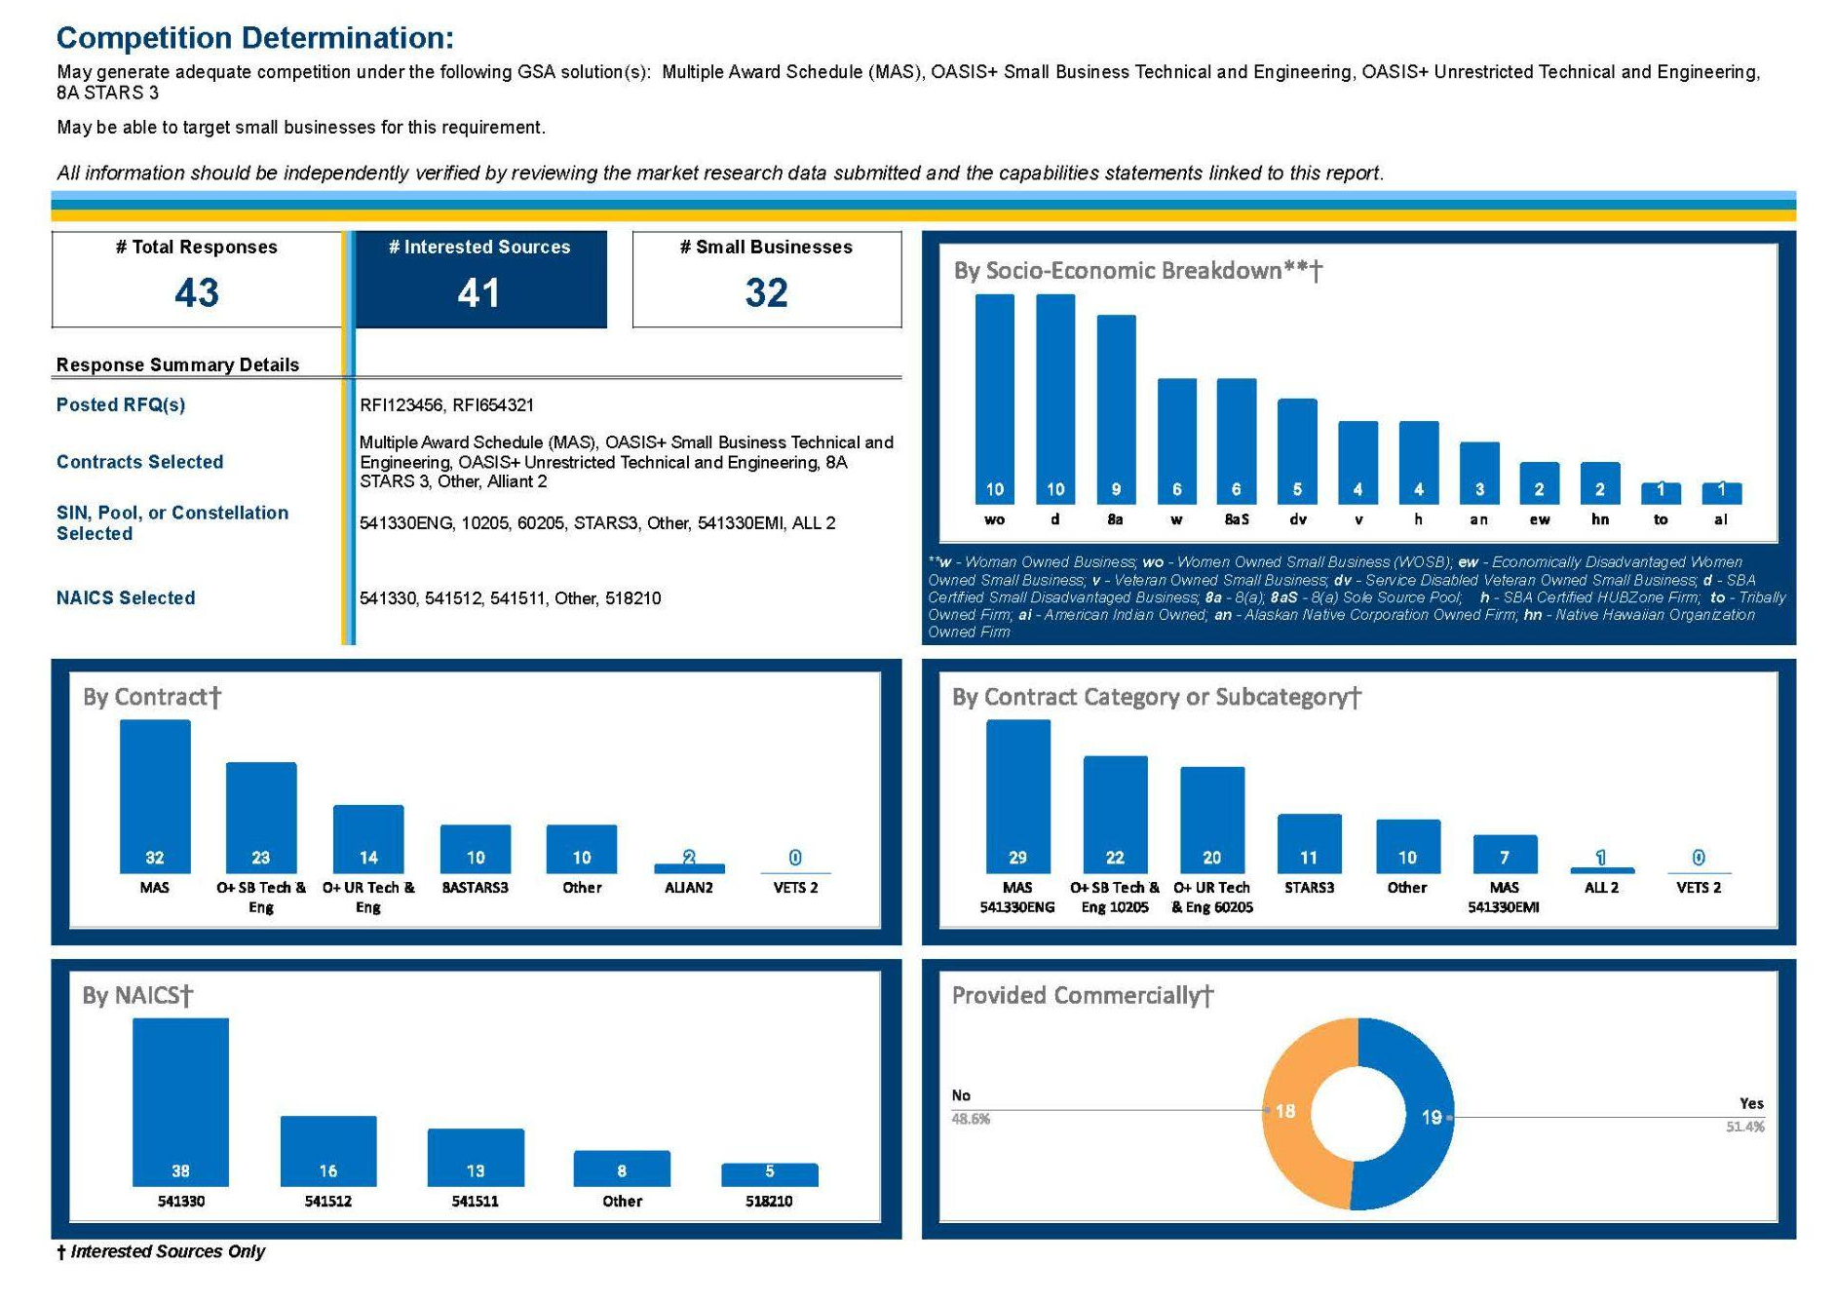
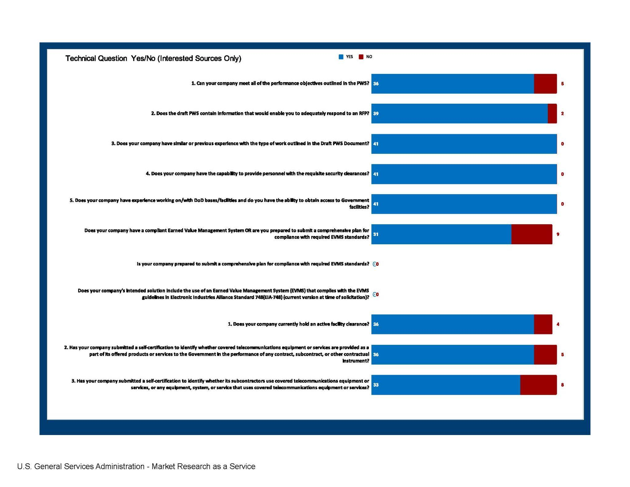
Step 5: The MRAS Report
What Dana gets in one report
GSA contract vehicles and socioeconomic designations
Summaries of the technical question responses
Screenshots: sample MRAS market research report
Notes:
The report consolidates everything: vendor points of contact, contract vehicles, socioeconomic designations, capability statements and summaries of the technical question responses. Dana uses it as her market research documentation. The screenshots are from an actual MRAS report format.

Slide 21
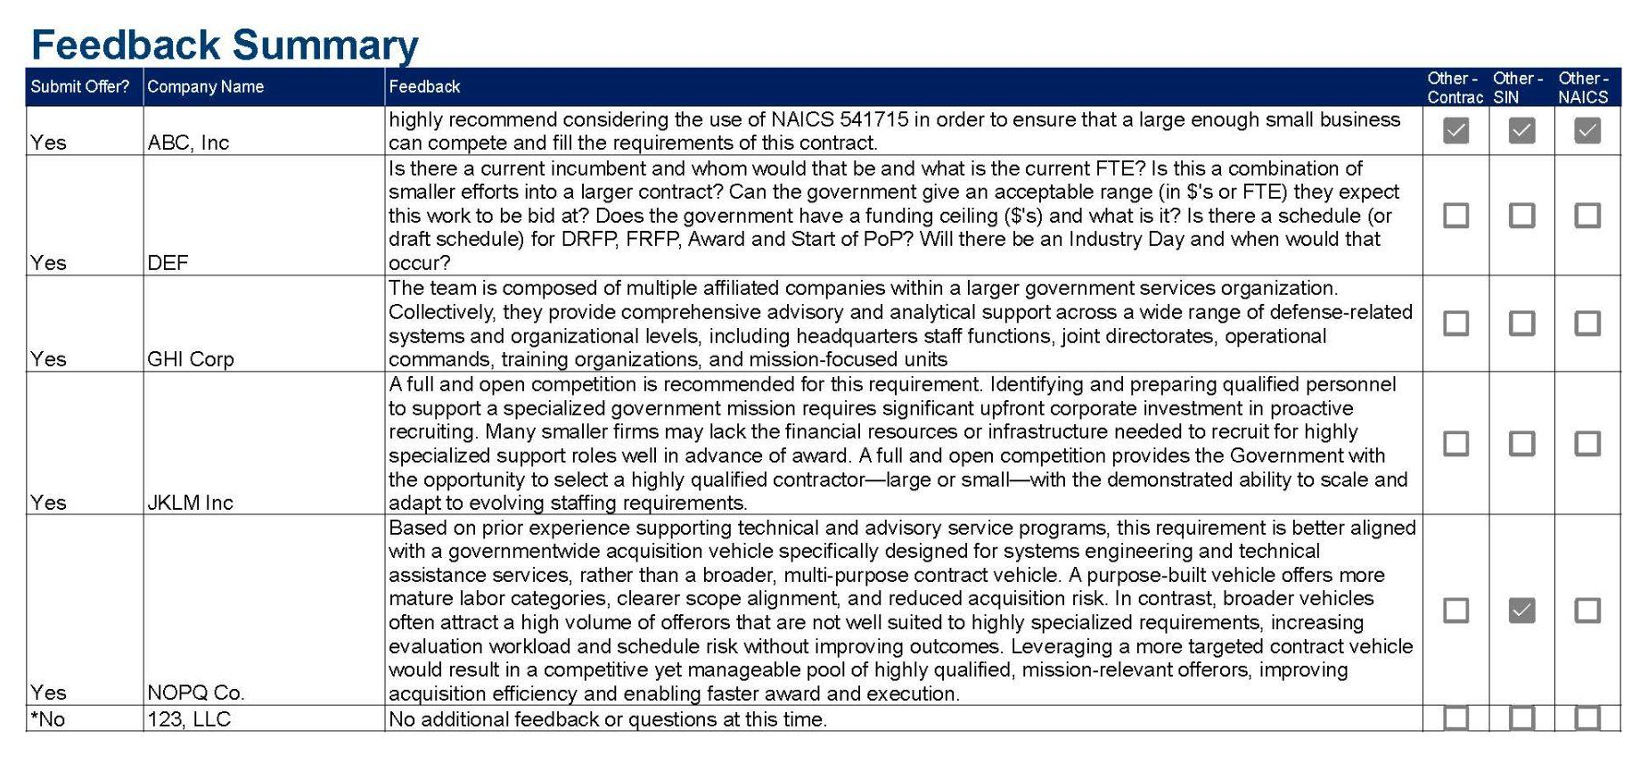
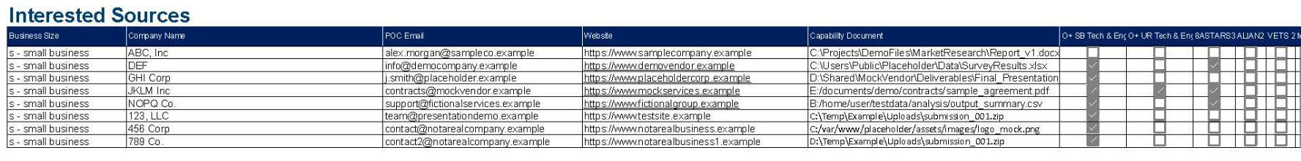
Step 5: The MRAS Report (Cont)
Step 5: The MRAS Report
What Dana gets in one report cont.
Vendor contacts and capability statements
Industry feedback on the draft PWS
Screenshots: sample MRAS market research report
Notes:
The report consolidates everything: vendor points of contact, contract vehicles, socioeconomic designations, capability statements and summaries of the technical question responses. Dana uses it as her market research documentation. The screenshots are from an actual MRAS report format.

Slide 22
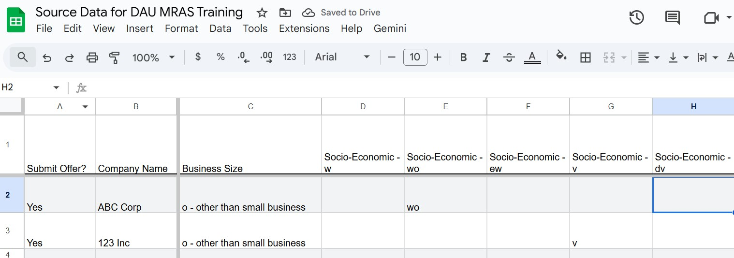
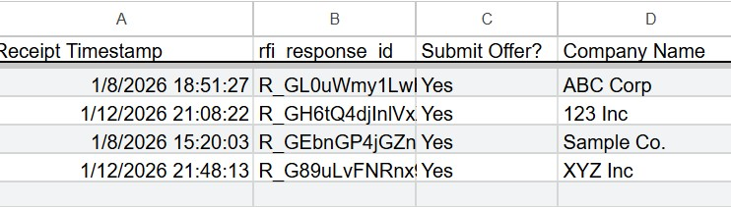
Step 5: The MRAS Report (Cont.)
Step 5: The MRAS Report
What Dana gets in one report cont.
An Excel file of all response data collected with each RFI
Dana can conduct her own analysis with the raw data provided with each RFI.
Screenshots: sample MRAS market research report
Notes:
The report consolidates everything: vendor points of contact, contract vehicles, socioeconomic designations, capability statements and summaries of the technical question responses. Dana uses it as her market research documentation. The screenshots are from an actual MRAS report format.

Slide 23
Step 6: The Findings Change the Strategy
Dana assumed | The market said | Dana's decision
2-hour response, 24/7, at all 12 sites | 9 of 31 can commit to 2 hours everywhere; 14 can commit to 4 hours | Tiered response: 2 hours at 3 critical sites, 4 hours elsewhere
OEM certification required | Only 6 of 31 hold every OEM certification; most use manufacturer-trained technicians | OEM-certified or manufacturer-trained technicians
One nationwide award | Most small businesses cover one or two regions | Evaluate regional awards to widen competition
One hourly-rate pricing model | Vendors usually price maintenance fixed price and repairs time-and-materials | Fixed price for maintenance; T&M with a ceiling for repairs
Unrestricted competition | 22 of 31 respondents are small businesses | Evaluate a small business set-aside (Rule of Two)
Fictional scenario for illustration
Notes:
This is the heart of the talk. Each row pairs an assumption with what the market said and the decision Dana made. Remind the audience that market research can change the requirement itself, and influence NAICS, set-aside strategy and contract vehicle. The set-aside call is Dana's to make with her contracting officer and small business specialist.

Slide 24
7. Developing the PWS from Market Data
PWS version 1: before MRAS
PWS version 2: informed by the report
The contractor shall provide maintenance and repair services for UPS systems at 12 field offices.
2-hour on-site response, 24/7/365, every site
OEM-certified technicians
Single nationwide award
Hourly rates
The contractor shall provide preventive maintenance and repair services for the UPS systems listed in Attachment A.
Response: 2 hours at 3 critical sites; 4 hours at 9 sites
OEM-certified or manufacturer-trained technicians
Regional awards under evaluation
Fixed price maintenance; T&M repairs with a ceiling
Every change traces back to a market research finding.
Fictional scenario for illustration
Notes:
Show how the evidence rewrites the PWS. Version one was built on assumptions. Version two traces every change to a finding from the report. Document the research in the acquisition file as FAR Part 10 requires, appropriate to the size and complexity of the acquisition.

Slide 25
The Results
1
Bad requirement
2
Assumptions
3
Market research
4
New information
5
Better strategy
6
Better outcome
UPS maintenance and repair, as first written
2-hour response, OEM-only, one nationwide award
MRAS RFI with tailored technical questions
31 responses on tiers, certifications and pricing
Tiered PWS, regional awards, set-aside evaluated
A requirement industry can price and more of the market able to compete
The deliverable isn't a list of vendors.
The deliverable is better acquisition intelligence.
Fictional scenario for illustration
Notes:
Close the case study. Bad requirement, assumptions, market research, new information, better strategy, better outcome. Land the key message: the deliverable isn't a list of vendors, it is better acquisition intelligence.

Slide 26
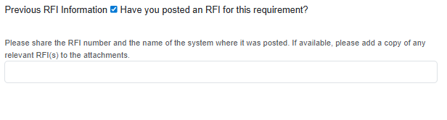
Beyond the RFI, linking to the RFQ
Customers can link a previously posted RFI when creating an RFQ in eBuy.
Sharing the RFI number gives vendors added context, improving their understanding of the requirement and acquisition lifecycle.
Notes:
In eBuy, customers can easily convert an RFI into an RFQ.
When creating an RFQ, you can indicate that a related RFI was previously posted by selecting the appropriate option and entering the RFI number.
This allows vendors to view the earlier market research, giving them greater context, strengthening their understanding of the requirement, and providing visibility into the acquisition lifecycle.

Slide 27

Common Market Research Mistakes
Here's what we see every week
!
“We've always bought it this way.”
Markets change. New vendors, products and commercial practices appear every year.
!
“The customer already knows the only vendor who can do it.”
One known source is not a tested market. Capability is not exclusivity.
!
“We just need a standard RFI posted.”
An RFI is a tool, not a strategy. Tailored questions are what make it useful.
!
“We don't need market research. We know what's out there.”
Assumptions stay untested until the market responds.
!
“Can you just tell me which GSA contract I should use?”
The right vehicle depends on scope, NAICS, SIN fit and competition. Research first.
Notes:
The MRAS reality check: five things we hear every week and why each deserves more research. Keep it light and conversational. Ask who has heard each one.

Slide 28
As Rules Evolve, Market Research Matters More
As acquisition rules and tools evolve, market research becomes even more important, not less.
Greater acquisition flexibility
Better-defined outcomes
Commercial solutions
Competition
Small business participation
Appropriate contract vehicles
Better use of emerging technologies
More informed acquisition strategy
Refer to the Revolutionary FAR Overhaul (RFO) and your agency's deviations for current policy.
Notes:
Connect MRAS to the modern acquisition environment. As the Revolutionary FAR Overhaul and new tools give the workforce more flexibility, good market research is what lets you use that flexibility well. Refer attendees to current FAR Part 10 text and their agency's deviations.

Slide 29

Market Research Quick Check:
if you can't answer these, you're probably not done
REQUIREMENT
Is the requirement clearly defined?
Are outcomes clear?
Are there unnecessary restrictions?
MARKET
Who provides this?
Is it commercially available?
How does industry normally provide it?
Are there emerging solutions?
ACQUISITION STRATEGY
Appropriate NAICS?
Small business opportunities?
Appropriate contract vehicle?
Appropriate contract type?
Appropriate scope?
VALIDATION
Did we test our assumptions?
Did we give industry enough information?
Did the research influence the strategy?
Notes:
Hand attendees the one-page Market Research Quick Check. Walk the four groups quickly. Close with the line on the slide: if you can't answer these questions, you're probably not done with market research.

Slide 30
Your Market Research Toolkit
GSA Market Expertise
GSA Market Expertise
Government Wide Category Managers
Other Acquisition Professionals
Internal SMEs
GSA’s Online Tools:
Market Research As a Service (MRAS)
Acquisition Gateway
Advantage
Buy.GSA.GOV
eBuy
eLibrary
Interact
Pricing Central
Search GSA Contracts
Notes:
Hand attendees the one-page Market Research Quick Check. Walk the four groups quickly. Close with the line on the slide: if you can't answer these questions, you're probably not done with market research.

Slide 31

What our Customers are Saying….
"I am very satisfied with this process,...I am extremely happy with the results and plan to utilize the services again....I will share this positive experience with other supervisors in my organization and encourage them to utilize these services as well. Great Job!"
"...the customer utilized the MRAS RFI process to determine their overall acquisition strategy. The MRAS program has proven to be a value added program!
"MRAS helped me avoid doing it the way it's always been done before."
“...I used MRAS and in 10 days, had 40 people respond. GSA then went over the report and did a deep dive to identify specific socioeconomic factors. It was very helpful!"
Notes:
Hand attendees the one-page Market Research Quick Check. Walk the four groups quickly. Close with the line on the slide: if you can't answer these questions, you're probably not done with market research.

Slide 32

MRAS Training
Effective Market Research (MRAS)
October 29th, 2026 at 1:00 pm ET
Click HERE to register
Notes:
Hand attendees the one-page Market Research Quick Check. Walk the four groups quickly. Close with the line on the slide: if you can't answer these questions, you're probably not done with market research.

Slide 33
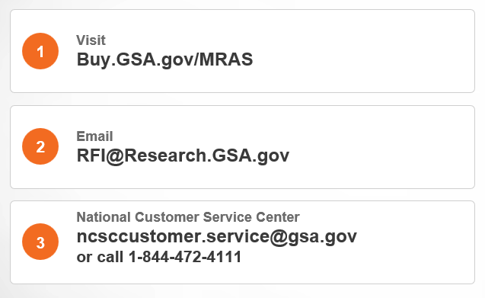
Get Started with MRAS
Bring your draft PWS.
We'll help you ask the right questions before you solicit.
CLICK HERE for the MRAS Service Request Form
Notes:
Close with how to reach MRAS. Encourage attendees to bring their draft PWS and start the conversation early; market research can start as much as 18 months before award.

Slide 34
Conclusion

