Slide 1

GSA Acquisition for the Real World
Increase Efficiency & Leverage SI with Buy.gsa.gov
Acquisition Training for the Real World
October 27, 2026
Notes:
Drew Intro

Slide 2


Agenda – PAW Venture
Agenda - Today’s PAW Venture
Today’s Trail Map
Meet the Mission — What is an ESD K-9 program?
Ask Before You Fetch — What does the customer need?
Sniff Out the Market — Using Buy.GSA.gov for market research
Who’s in the Pack? — Labor categories and level of effort
Put a Price on the Paws — Build the IGCE
Let AI Dig Deeper — Analyze and challenge the data
Best in Show — Final estimate and lessons learned
Throw Us a Bone — Q&A
Notes:
Drew To start and Kick it to Varuna
What is ESD and why are we using it as a FICTIONAL workflow - Its the Electronic Storage Detection (ESD) K9 program and its a specially trained police dog used by law enforcement to locate hidden digital storage devices during criminal investigations. However, we thought it would be a fun way to focus on our FURRY friends and showcase a workflow that is both challenging to complete and a bit fun too. It will help highlight the importance of establishing defensible labor categories, conducting research using known web tools available at the GSA and setting up the foundational steps to both cost and price analysis… both incredibly important to the establishment of an IGCE that protects both the government and vendor community.
Here’s what we’re going to cover today. (Read the main topics and introduce our next 2 speakers, Varuna and Keonia).
Pause
First, we’ll give you a quick update on what’s new with Buy.GSA.gov, including some of the tools and resources available to you.
Then we’ll walk through a few practical examples and case studies.
And most importantly, I want to introduce our guest speaker and main demonstrator for today, Keonia Cobbins.
Keonia, say hello to the people! < PAUSE >
Keonia and I each developed fictional IGCE scenarios using Buy.GSA.gov, but we approached them in slightly different ways.
One example uses the templates and tools already available on the site to help build out an IGCE.
The other goes a little deeper.
For that scenario, we pulled raw pricing data from Buy.GSA.gov and then used AI to help us analyze the data, compare pricing, and support the development of the IGCE.
Both approaches can add a tremendous amount of value, and we’re excited to show you how they work.
And one last thing—throughout today’s session, we’ll also have a few polling questions for you.
So keep an eye out, participate when you can, and we’ll use some of your responses as part of the discussion.
With that, let’s get started.

Slide 3




The Acquisition Pack
The Acquisition Pack
Toppa Cobbins: Project Manager
Mocha Singh: Contracting Officer Representative
Loki Carbone: Market Research Analyst

Slide 4
Questions from a Customer #1
Questions from a Customer
We are brand new to our agency and need help conducting market research - what’s all the bark about? we are dogone curious!

Slide 5

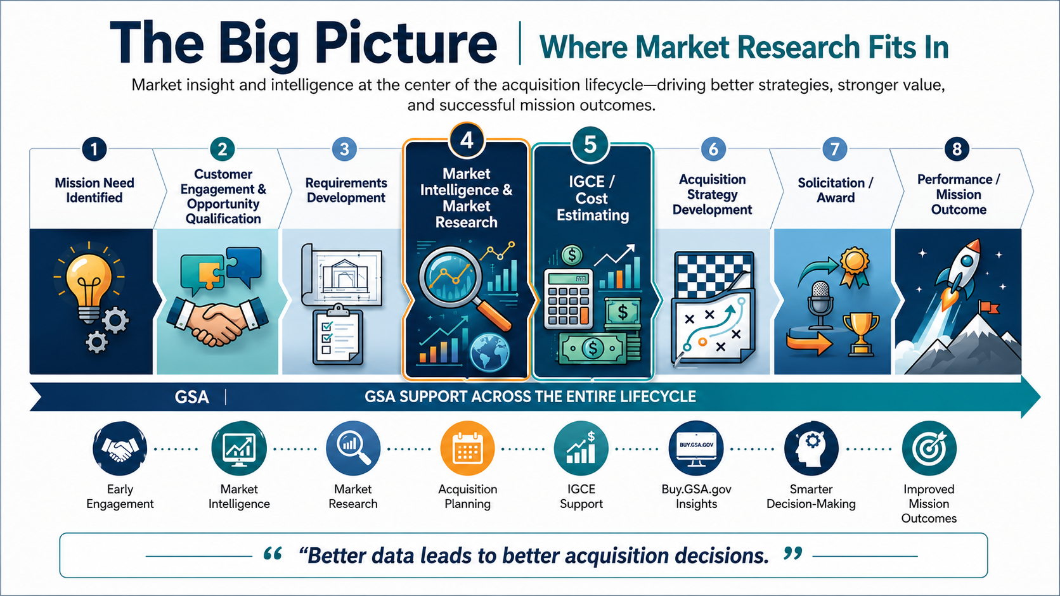
The Big Picture
Notes:
Thanks for asking!
This slide is overwhelming on purpose… its meant to show you the 3000 foot perspective of market research
Mike’s story about M1 Abrams tanks, and then the importance of good research for, it aids cost and price analysis, which are 2 entirely different things but equally as important! It protects the government and tax payer too…
Ask a question - answers received via chat
Where does MR fit in the grand scheme of things? What phase does it assist most? What can we do for you regarding MR…. we offer help, submit your requirements or questions when needed.
Now, this slide is supposed to look a little overwhelming.
Because we’re about to get into the core of today’s discussion—or maybe the galactic core of today’s Education Series.
Market research. Market intelligence. IGCE development. Cost estimating. Pricing.
They’re all connected.
[Pause / gesture toward center of slide]
And right at the center of this lifecycle is where we’re focusing today:
Market research and market intelligence… leading directly into the IGCE and cost estimate.
That placement is intentional.
Market research isn’t simply a compliance exercise. It helps us understand what the market can deliver, what agencies are buying, what pricing looks like, and what may be driving those costs.
My own personal experience… as a COR or CS we would be required to create a defensible cost breakdown for, in my cases, complex IT product development initiatives involving cloud based integration acquisition efforts… this required a complex solution.
There’s also an important FAR connection.
FAR Part 7 establishes acquisition planning requirements, and FAR Part 10 gives us the framework for conducting market research.
And the FAR recognizes that market research should be scalable. The extent can vary based on urgency, dollar value, complexity, and past experience.
For certain task and delivery orders, contracting officers may even rely on market research conducted within the previous 18 months, as long as it remains:
Current. Accurate. Relevant.
That’s a good standard for us to remember.
Because a strong IGCE shouldn’t be a guess—or simply a budget number.
It should be informed by what we know about the marketplace.
And that’s where tools like Buy.GSA.gov can help us turn pricing and market data into useful acquisition intelligence.
[Point to bottom of slide]
Which brings us to the takeaway at the bottom:
Better data leads to better acquisition decisions.
Now, let’s show you how to put that into practice.

Slide 6
Question from a Customer #2
Questions from a Customer
So tell us, what is buy.gsa.gov all about? Are there any cool, pawsome functions?

Slide 7
What’s in the Toolbox
What’s in the Toolbox?
1
Pricing Intelligence Suite
Index of main Buy.GSA.gov tool families
Pricing data and estimating support for market research and IGCE development.
Services Pricing Tool Kit (BETA)
Quick Rate
Prices Paid
BLS
IGCE
Acquisition Solutions Navigator
Training takeaway
2
Research and compare contracts, vendors, and acquisition pathways.
Compare Vehicles
Search Contracts
Search Vendors
Buy.GSA.gov is a connected workspace — not just a collection of links.
Document Tools
3
Find templates and build acquisition-related documents for the contract file.
Document Library
Document Builder
Project Center
Right tool, right moment: research → compare → estimate → document.
Interact
4
Connect with updates, communities, product notes, and shared knowledge.
Communities
@mentions
MRAS jump point
Notes:
Index of buy.gsa.gov tools:
Here is a grouping of what you will see today as we explore buy.gsa.gov
Pricing Suite
CALC+ Quick Rate; - which displays schedule prices - not-to-exceed ceiling prices
CALC+ Prices Paid; - which is a data source that displays prices paid information from all our GSA GWACs
CALC+ BLS; - this is where you can find wage rate information from the Dept. of Labor’s Bureau of Labor Statistics
CALC+ IGCE Tool - where you can build Independent Govt. Cost Estimates.
Acquisition Solutions Navigator
Compare Contract Vehicles - deployed in the summer of 2024, this capability allows users to compare entire contract vehicles
Search Contracts & Vendors - this capability lets users search for specific contracts by keyword, and get information about them.
Document Tools
Document Library - Browse hundreds of templates for useful contract and project documents.
Document builder - an up and coming tool that allows users to build documents based on previously loaded templates.
Interact - FAS’ homegrown social networking platform.

Slide 8
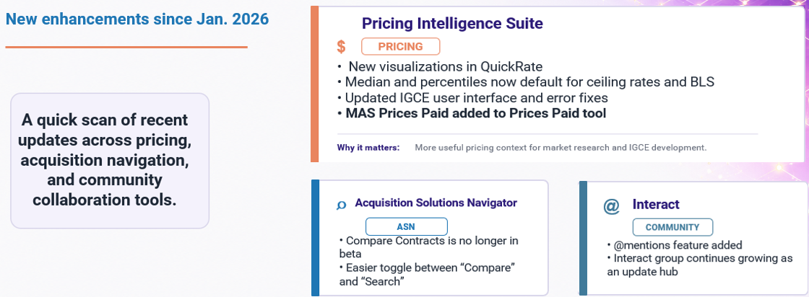
What’s New in Buy.GSA.gov
What’s New in Buy.GSA.gov?
Notes:
What’s new in buy.gsa.gov?
This slide is designed to be updated each quarter, with newly released capabilities. The next planned update is Oct. 2024.
We are working on its placement in the flow, so it is up to you where exactly you use it.
Pricing Intelligence Suite: https://buy.gsa.gov/interact/system/files/Pricing_Release%20Notes%2010-7-24.pdf
Prices Paid QR displays ‘Price’ data: The prices in the table of results no longer reflect the aggregated average price of sample set data. The value displayed is the actual price of invoices that reflect the exact same invoice value. The price column has been relocated to the far right side of the table after the Worksite column data.
The color scheme has been updated so as no longer to appear it is giving favorable placement to certain values over others.
Special characters are now usable in the project title field.
Defect Fixes:
Missing Data in the IGCE Labor Ceiling Rate Modal: Certain occupations were not initially loading data within the labor ceiling rates modal of the IGCE. This issue has been resolved so that a workaround such as searching for a different occupation first is no longer required.
IGCE Timestamps are not updated upon deletion: When an option period is deleted, the timestamp isn't updating unless the browser is refreshed. The issue has been resolved so that the timestamp will automatically update once an option period has been deleted.
Updated IGCE project titles are not reflected in the breadcrumb: When the project title is modified, it isn’t updated in the breadcrumb text unless the browser is refreshed. The issue has been resolved so that the breadcrumb is automatically updated once the project title is autosaved
ASN: It is easier to toggle between the “compare” and “search “functions.
The tool is no longer in beta. The data still shows the disclaimer.
Interact: One can now use the @ function for doing mentions.
For Trainers
We will endeavor to keep this as updated as possible with each iteration of buy.gsa.gov.
Release notes are posted on buy.gsa.gov itself, as well as the buy.gsa.gov Interact group.

Slide 9
Questions from a Customer #3
Questions from a Customer
Can we buy anything through buy?

Slide 10
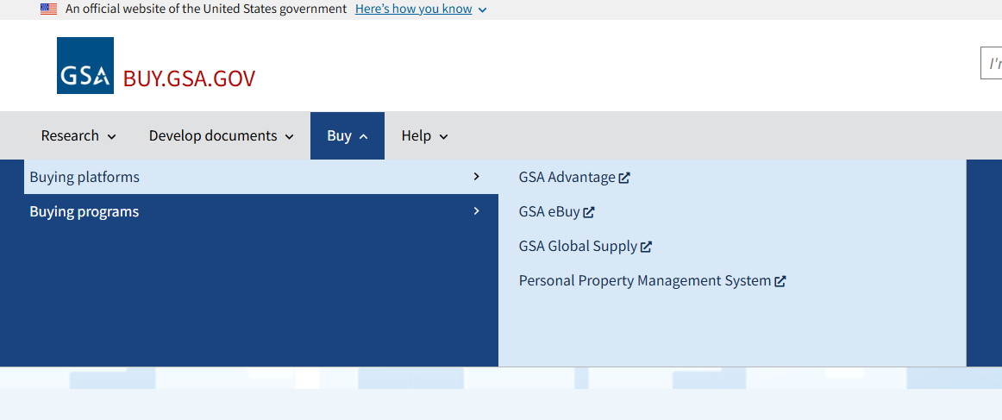

Can you buy anything via buy.gsa.gov
Can you buy anything via Buy.GSA.gov?
Buy.GSA.gov supports the buying journey — but it is not currently the checkout lane.
Current state
• The ability to purchase is part of the long-term product vision; the specifics are still being discussed.
• Today, the “Buy” section links users to buying platforms and buying programs.
Simple answer
Not directly today. Buy.GSA.gov helps users research, prepare, and connect to acquisition tools.
Takeaway: Use Buy.GSA.gov to research, estimate, and prepare — then move to linked buying platforms or programs when ready to purchase.

Slide 11
Buy.GSA.Gov approach to user research
buy.gsa.gov’s approach to user research
PLAN
A new functionality is built, but we don’t know how or if it works for our real users. We develop a usability test to learn.
IMPLEMENT
The product owner returns to their product team and prioritizes the findings.
RECRUIT
The HCD team reaches out to individuals who would use the functionality being tested and schedule sessions
DX Research Campaign
Cycle
Close collaboration with Product Owners enables quick implementation!!!
SHARE
Those findings are turned
into a formal report that is presented to the product
owner and shared with all interested parties.
TEST
The HCD team conducts 5-9 one-on-one interviews with customers. Customers share their screens and attempt to accomplish tasks they are given.
SYNTHESIZE
The HCD team refines the notes for each of these into actionable observations.

Slide 12
Fictional Case study

Slide 13
Questions from a Customer #4
Questions from a Customer
We are trying to create an ESD Program at the Federal Level. Can you help with this?

Slide 14
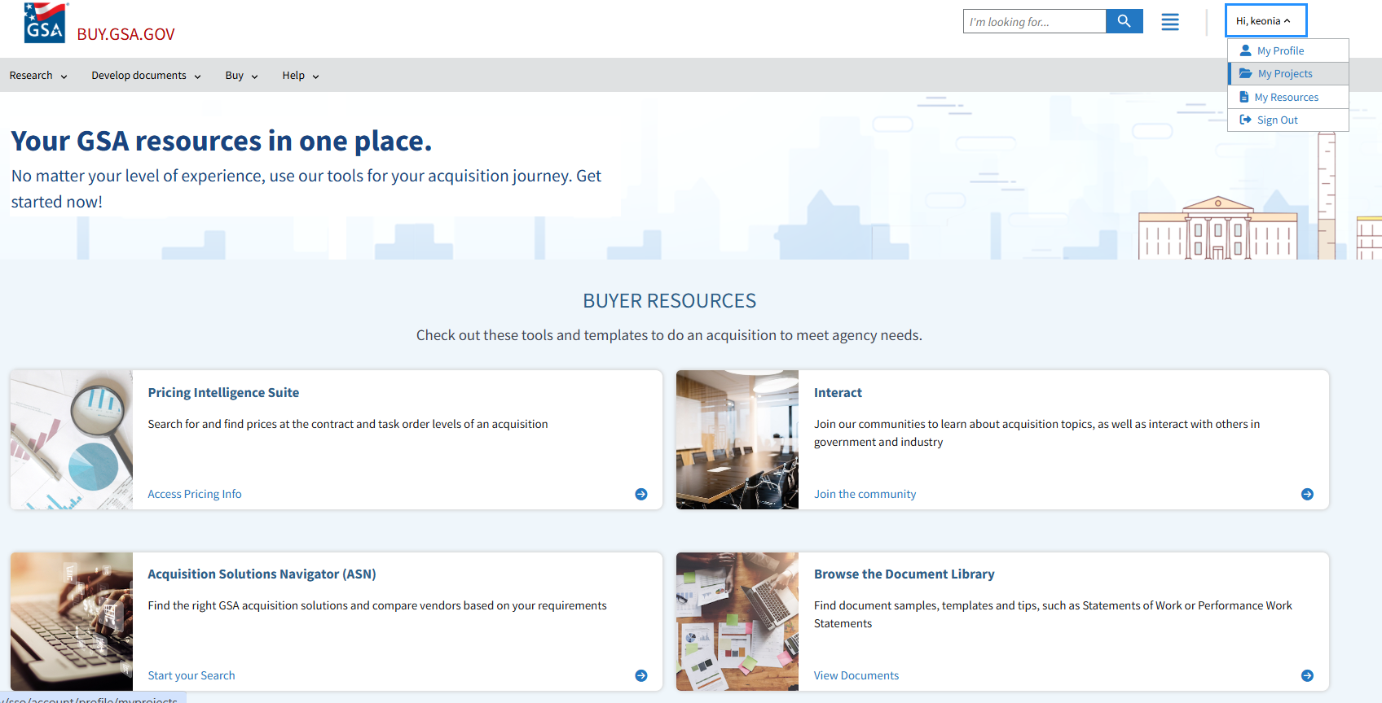
GSA Resource in one place

Slide 15
Project Center

Slide 16
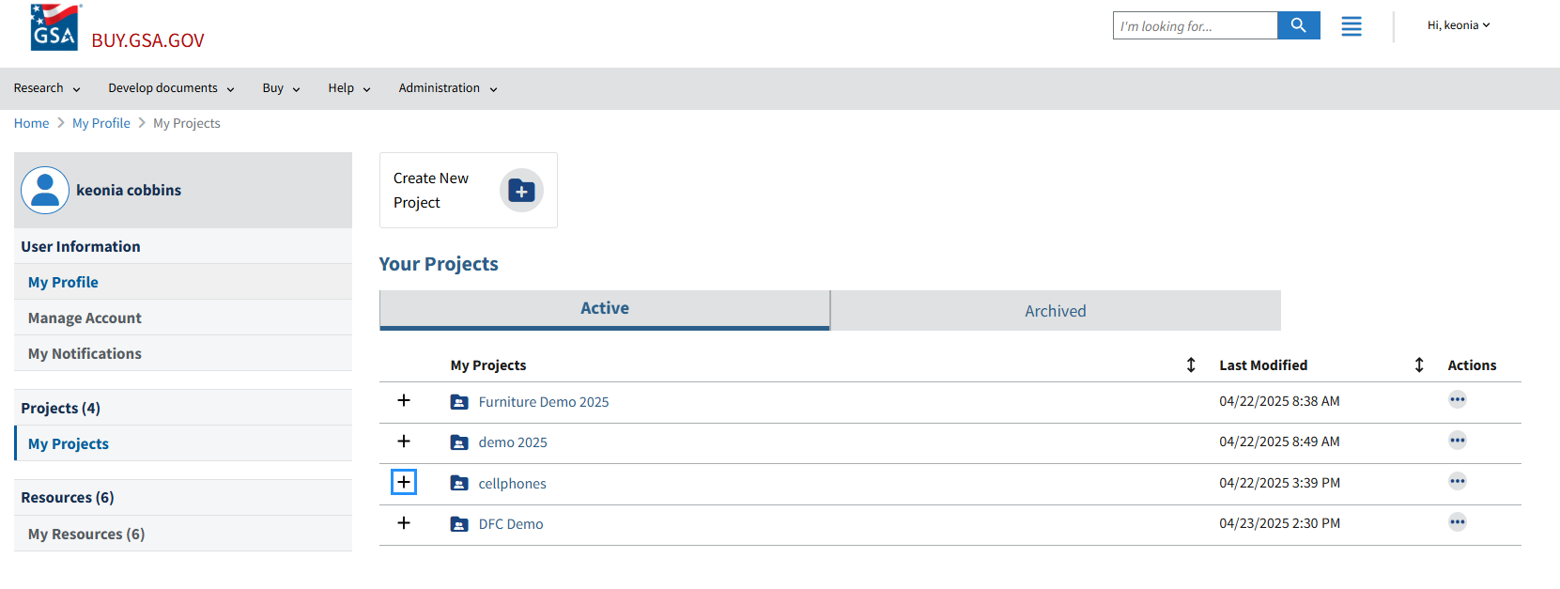
Buy.gsa.gov – My Profile

Slide 17
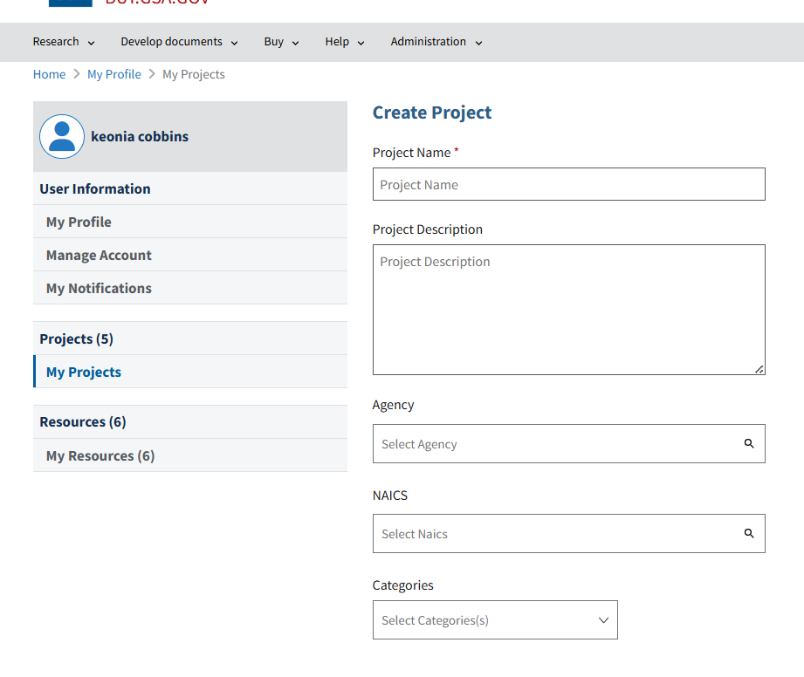
Buy.gsa.gov – My Projects

Slide 18
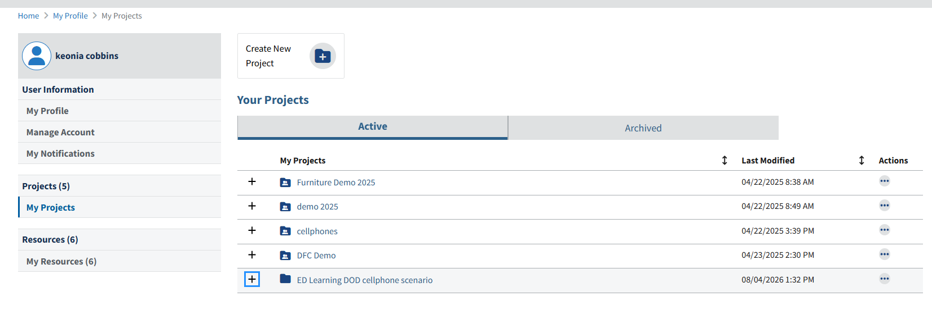
Buy.gsa.gov – My Projects (Cont)

Slide 19
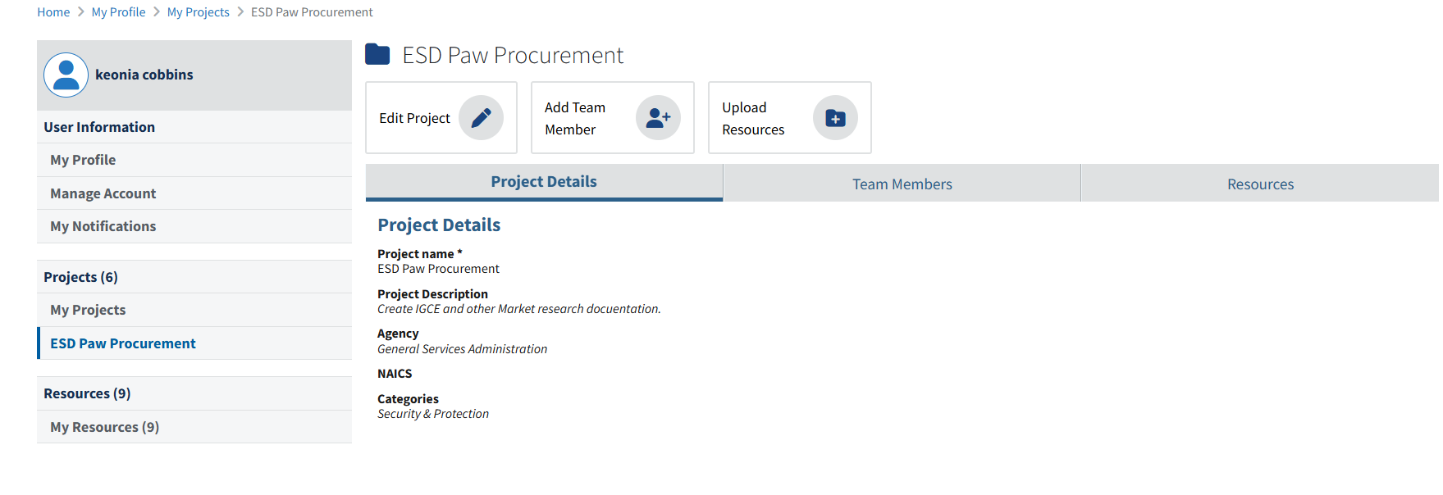
Buy.gsa.gov – ESD Paw Procurement

Slide 20
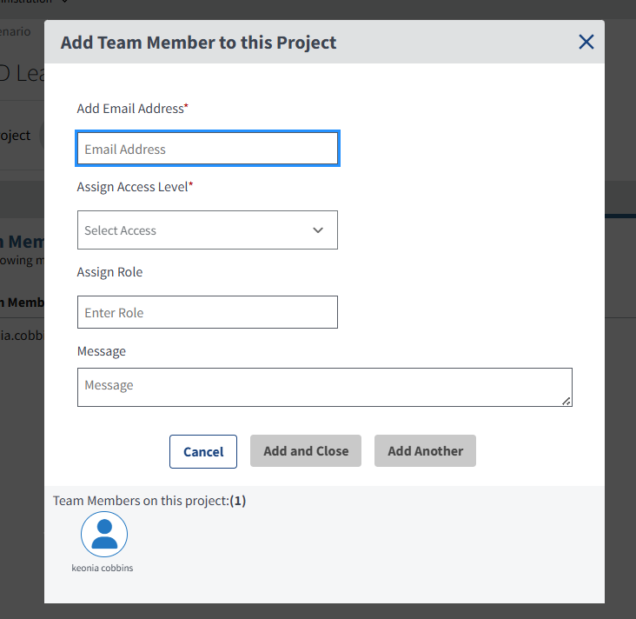
Buy.gsa.gov – Add Team Member

Slide 21
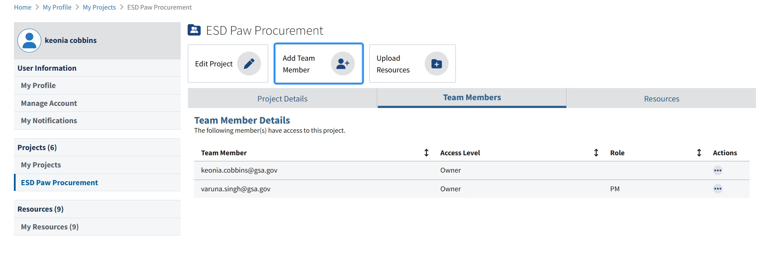
Buy.gsa.gov – Add Team Member (Cont)

Slide 22
ASN

Slide 23
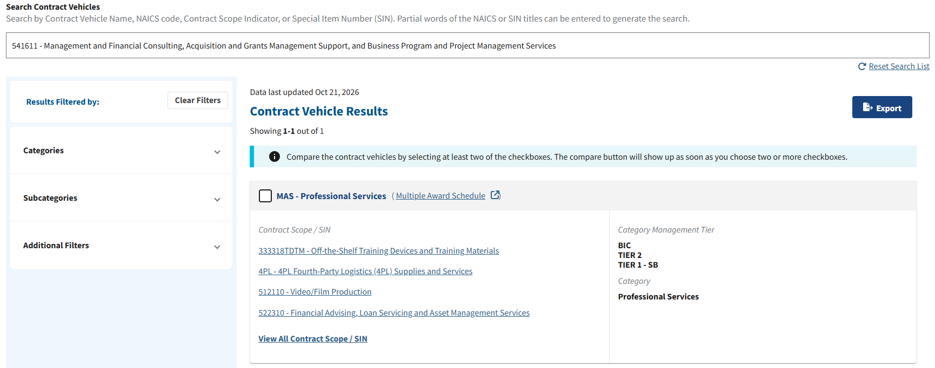
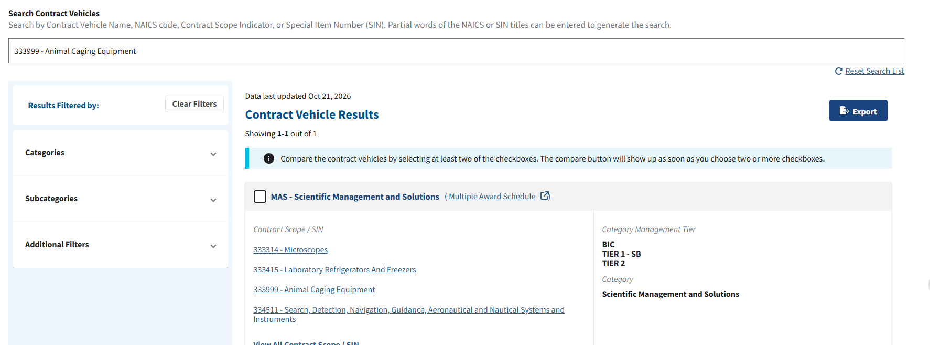
ASN - Contract Vehicle Results

Slide 24
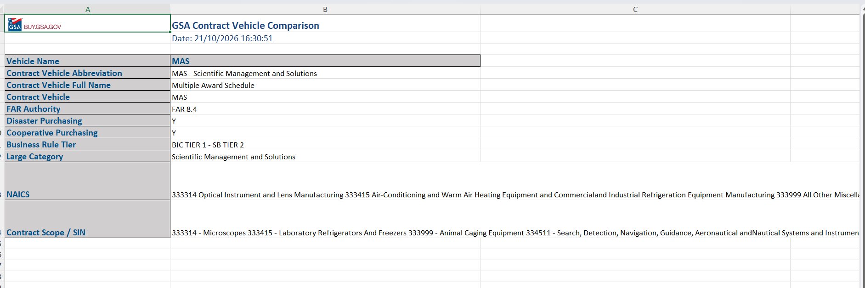
Contract Vehicle Comparison

Slide 25
Questions from a Customer #5
Questions from a Customer
Can you help the dog pack find a small business?

Slide 26
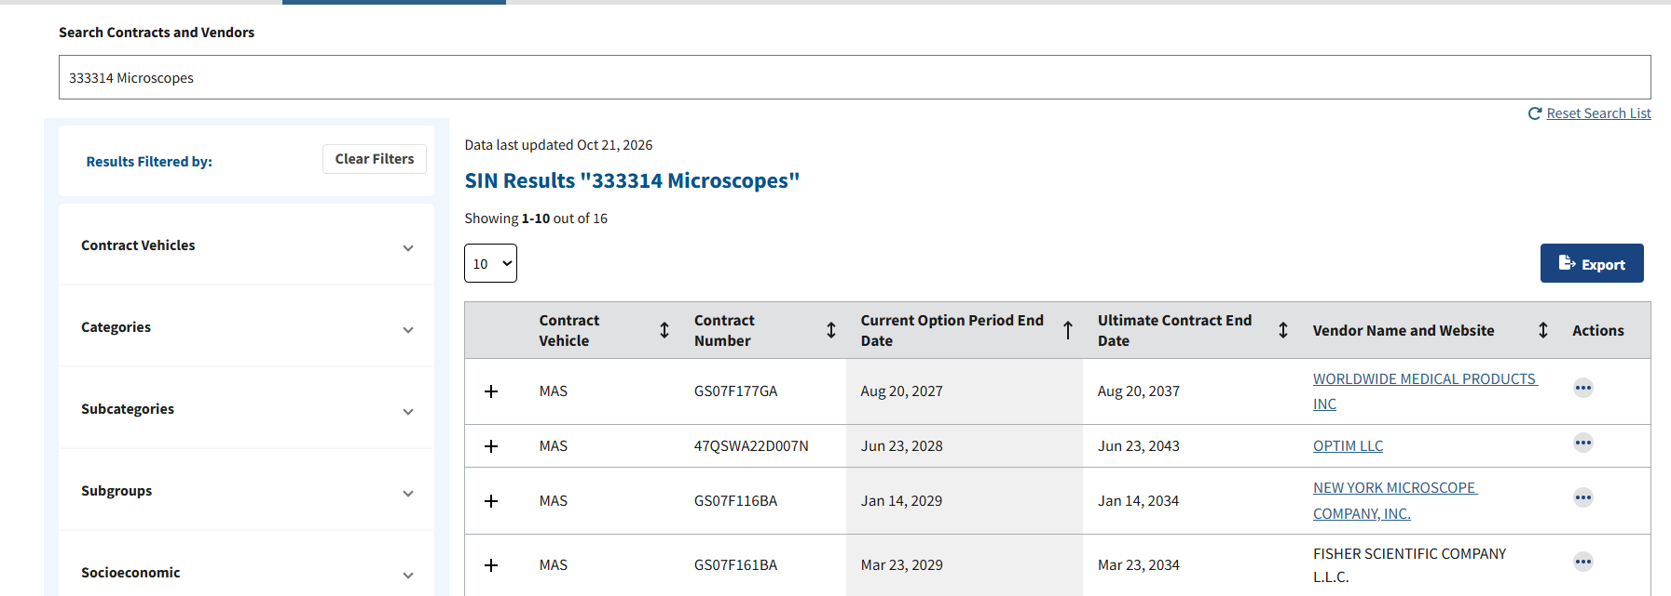
SIN Results 333314 Microscopes

Slide 27
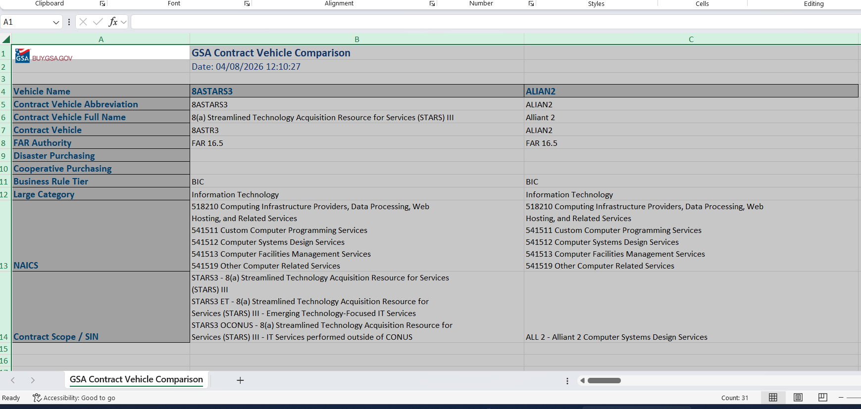
Contract Comparison - 8STARS3_ALIAN2

Slide 28
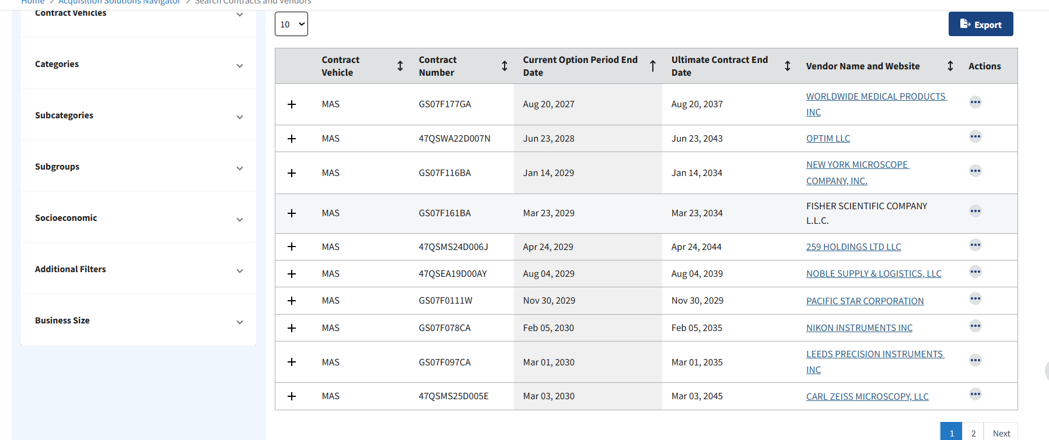
ASN MAS

Slide 29
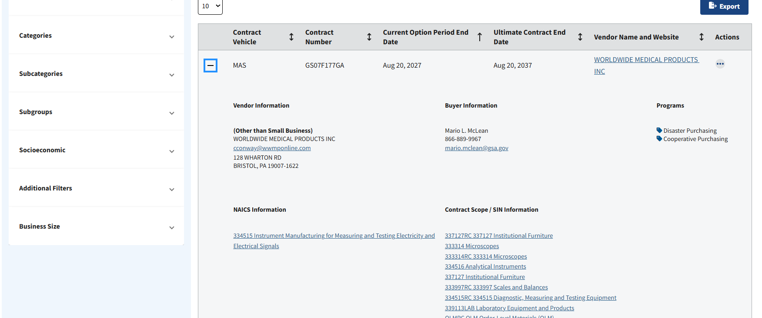
ASN MAS (Cont)

Slide 30
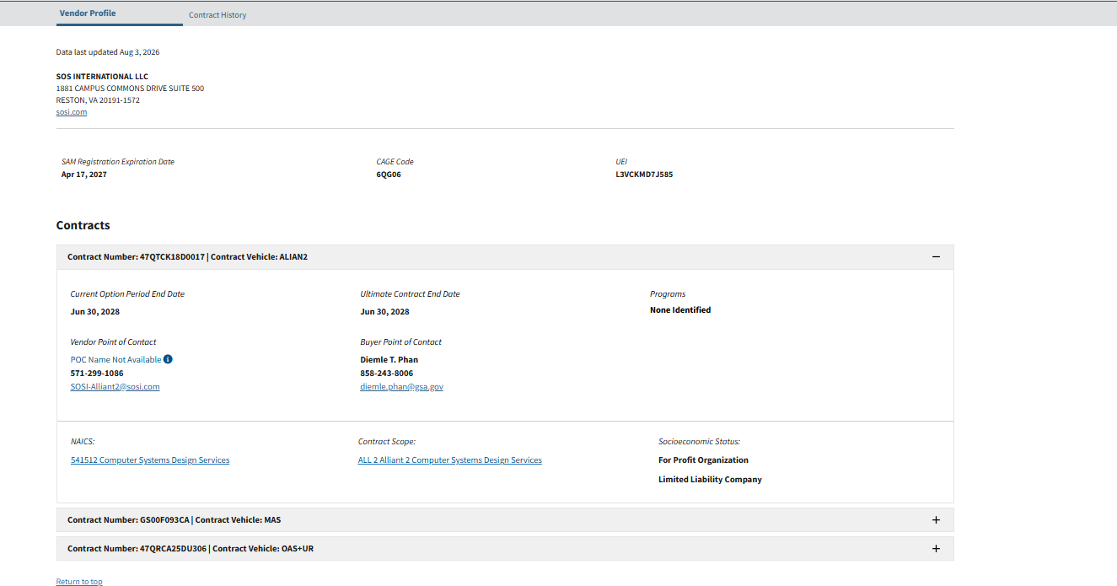
ASN MAS (Cont.)

Slide 31
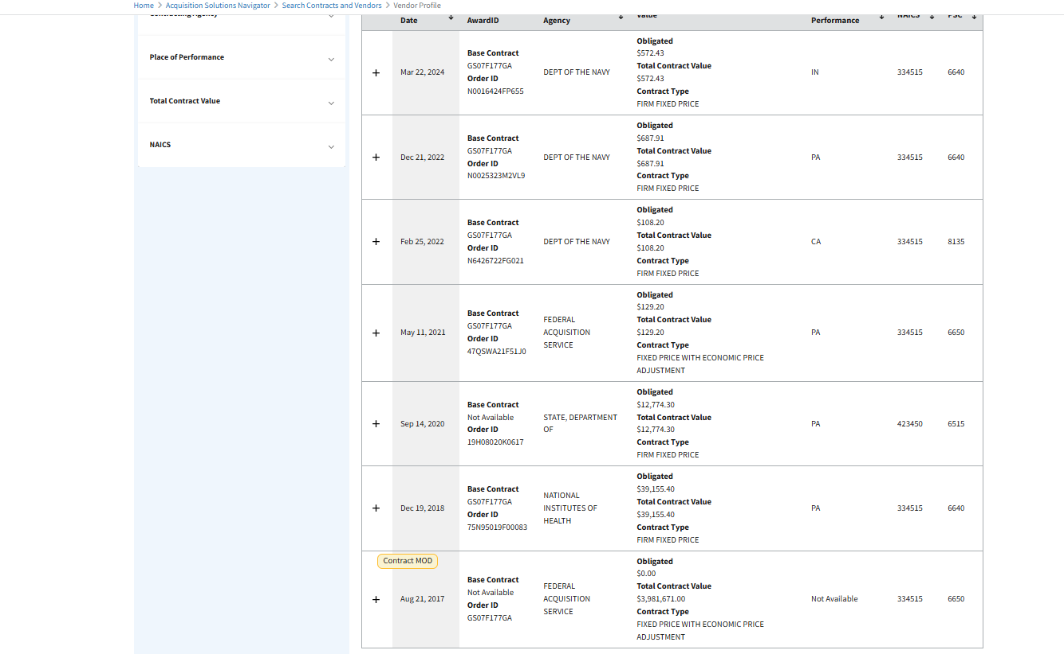
ASN MAS (Cont..)

Slide 32
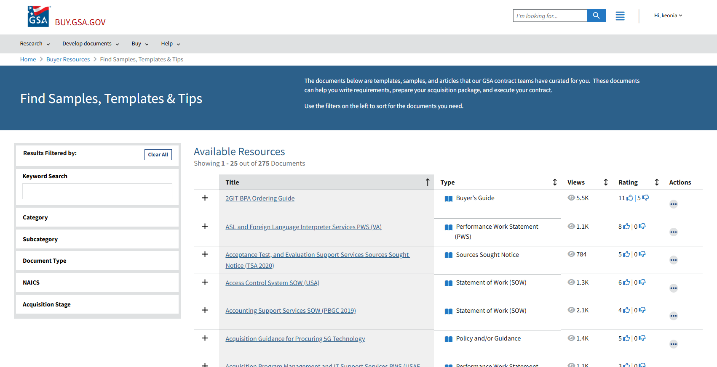
Buyer Resource Samples

Slide 33
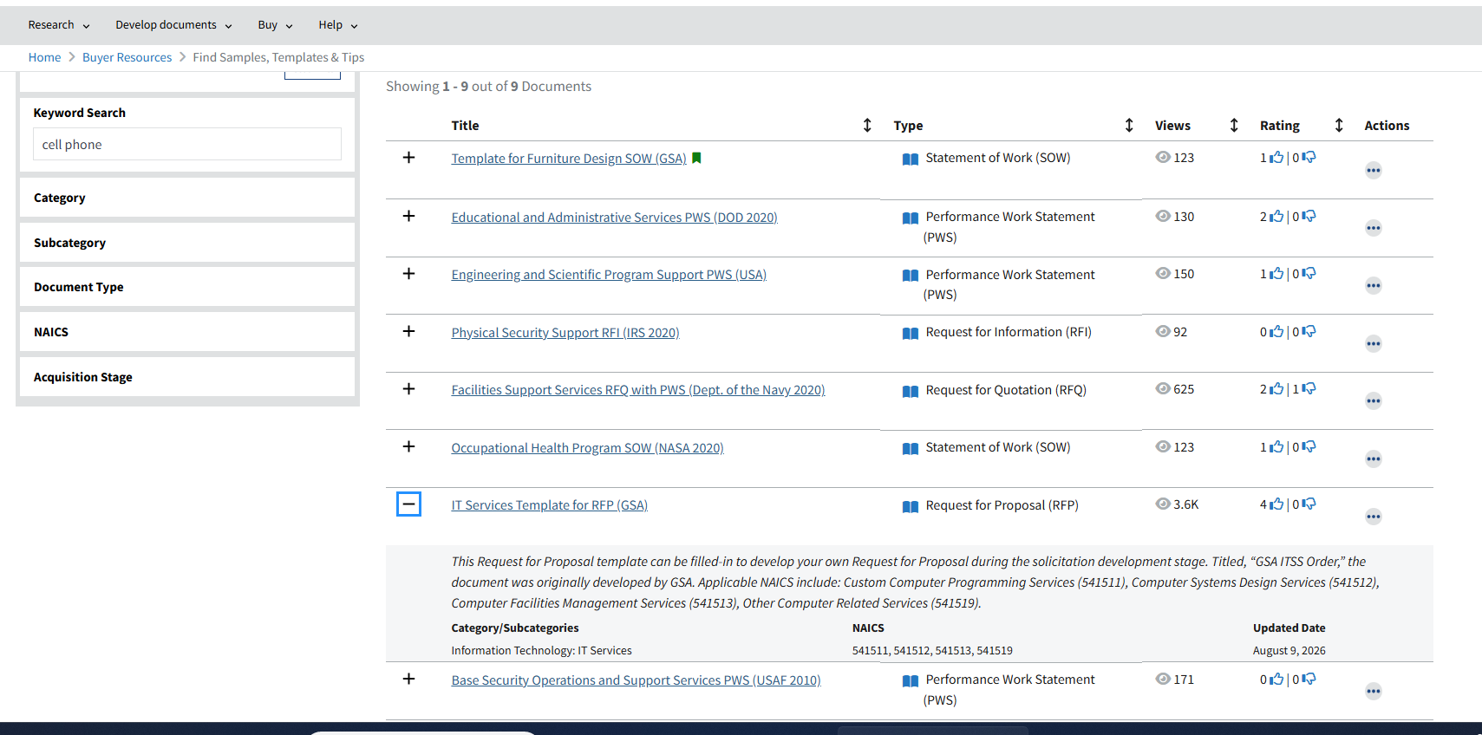
Buyer Resource Samples (Cont)

Slide 34
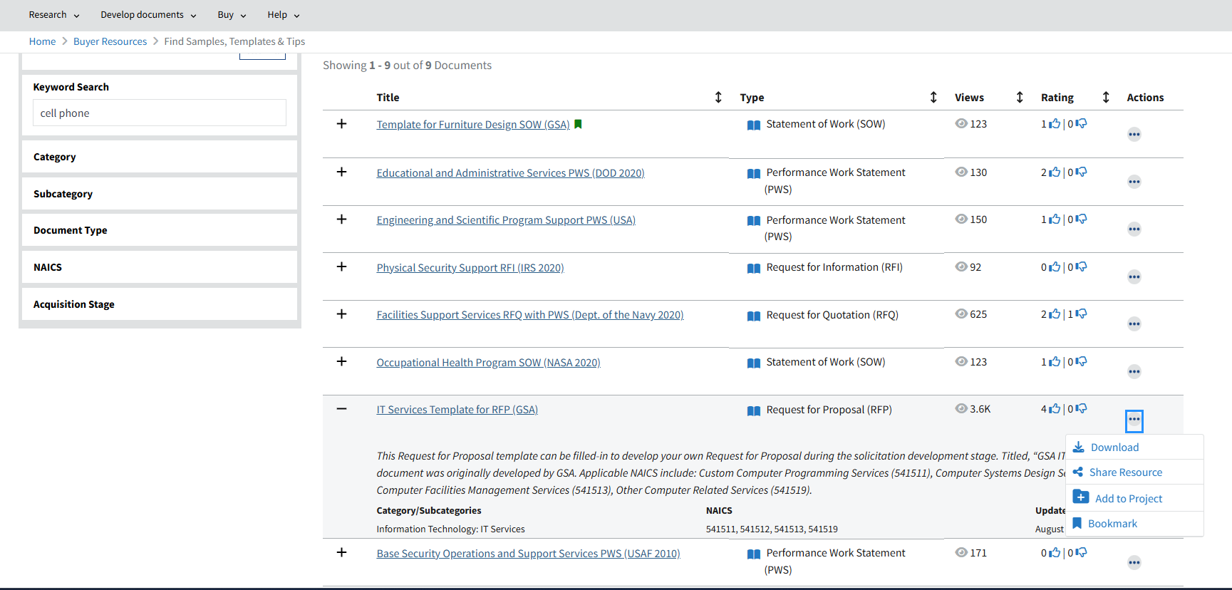
Buyer Resource Samples (Cont.)

Slide 35
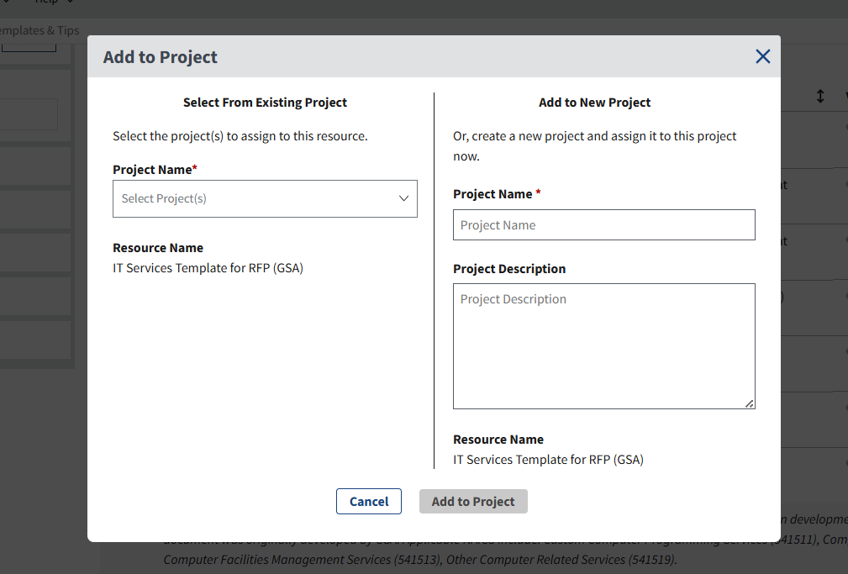
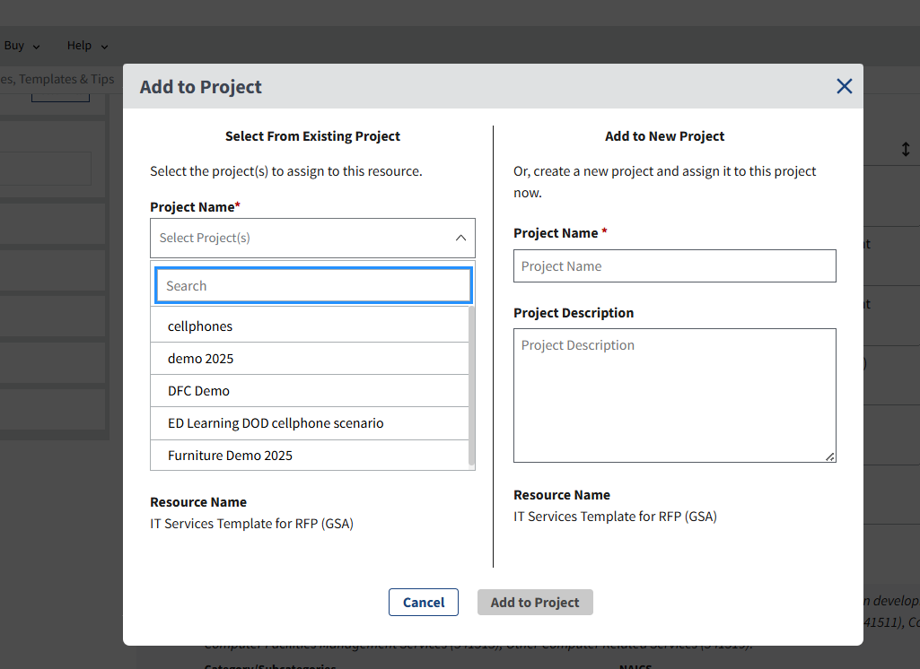
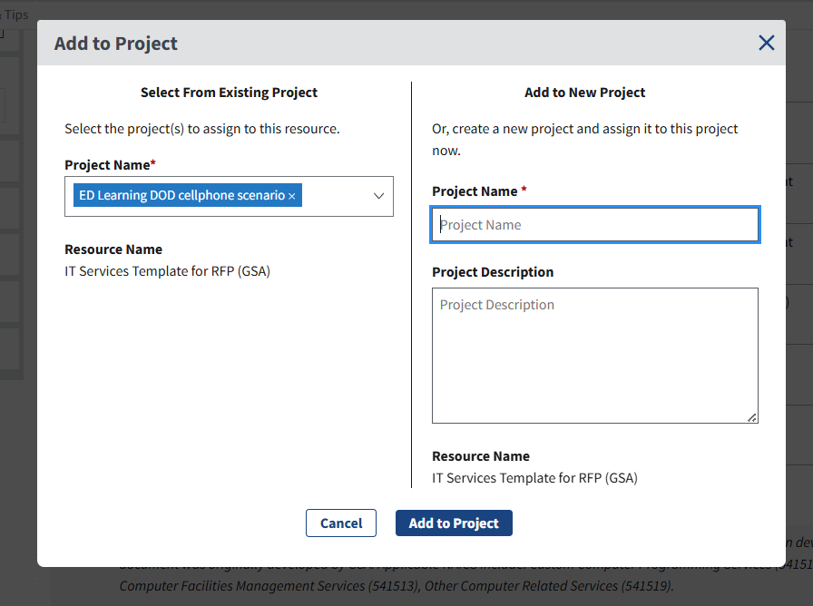
Project Center Add to Project

Slide 36
Document Builder

Slide 37
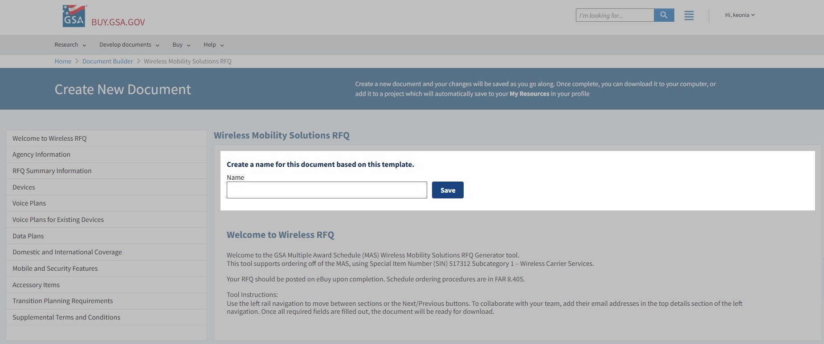
Create New Document

Slide 38
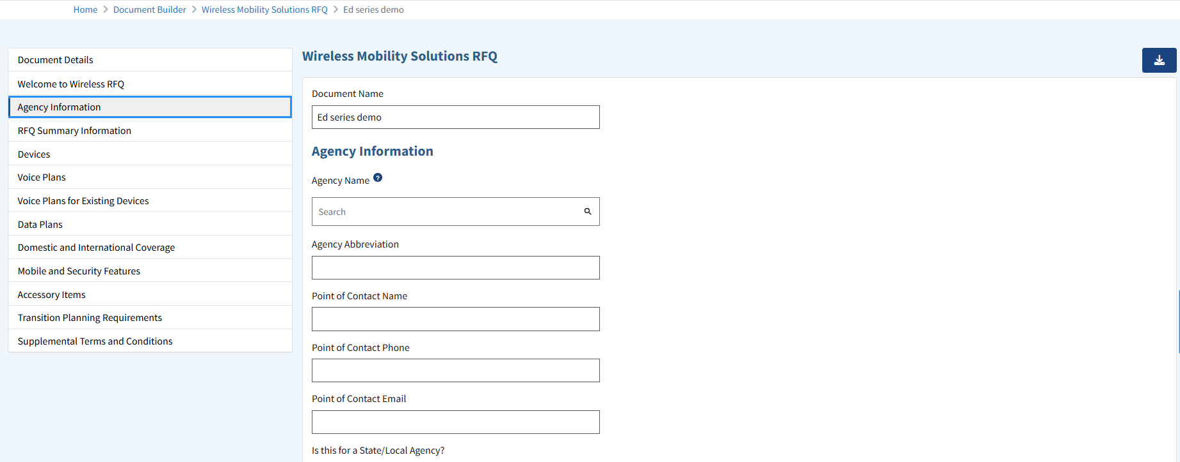
Wireless Mobility RFQ - Agency Information

Slide 39
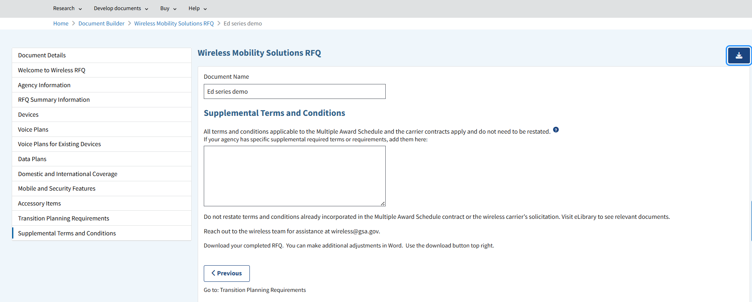
Wireless Mobility RFQ - Supplemental Terms

Slide 40
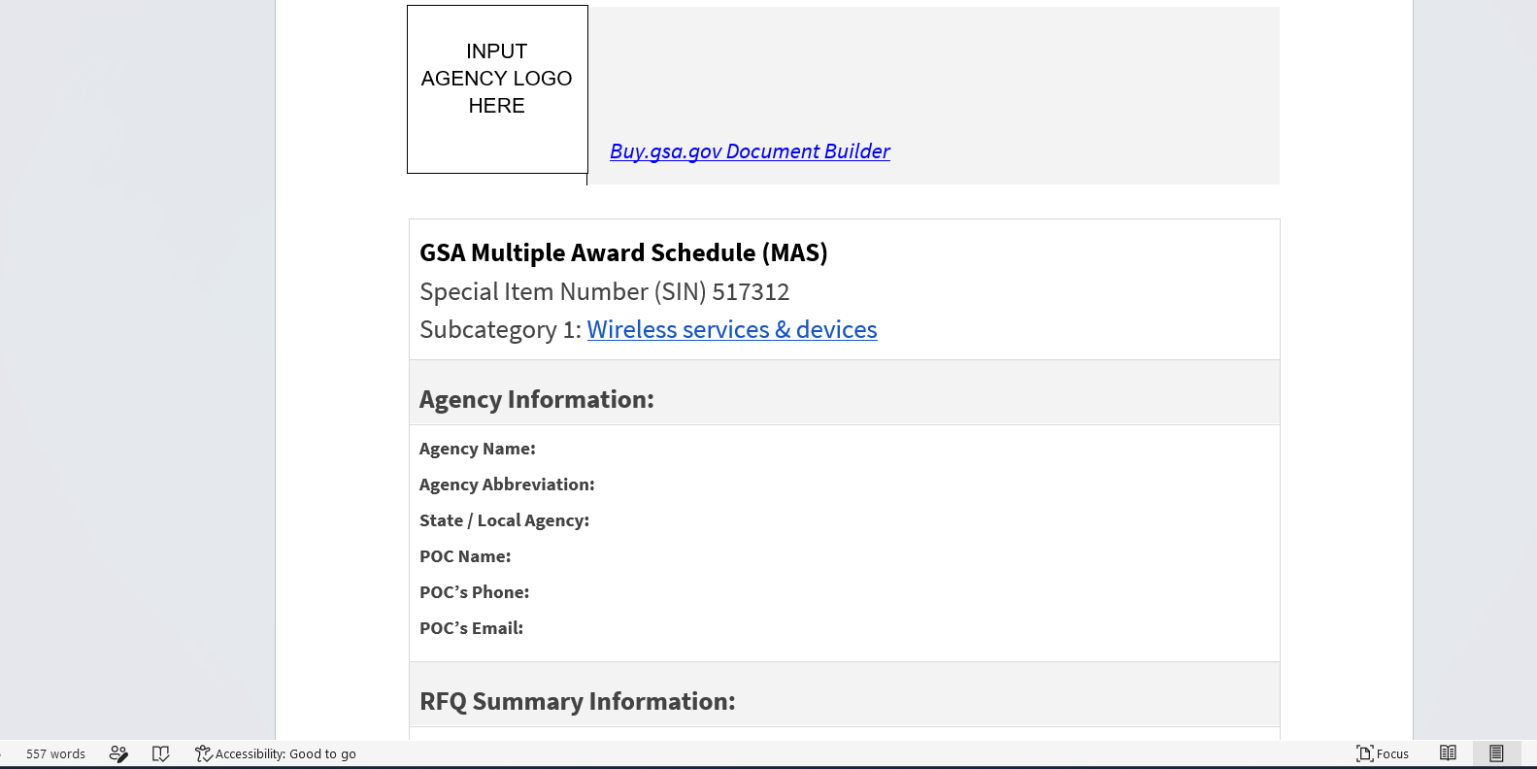
208 Wireless RFQ
208 Wireless RFQ

Slide 41
IGCE

Slide 42
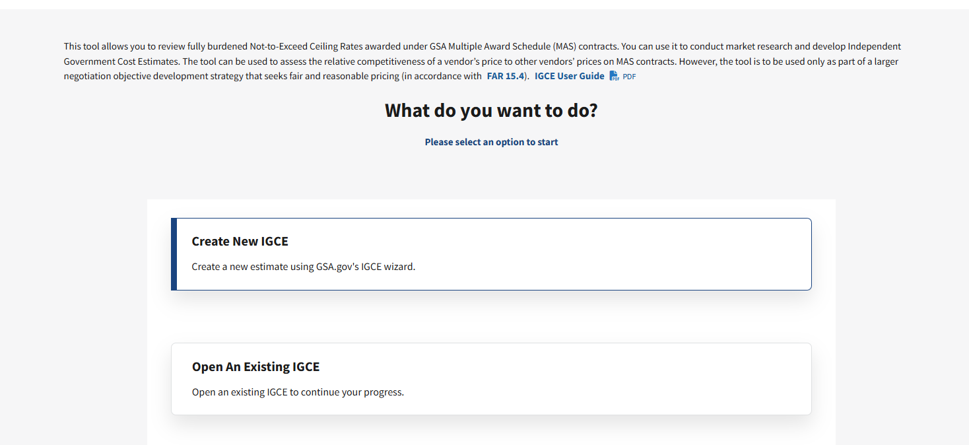
Create New IGCE

Slide 43
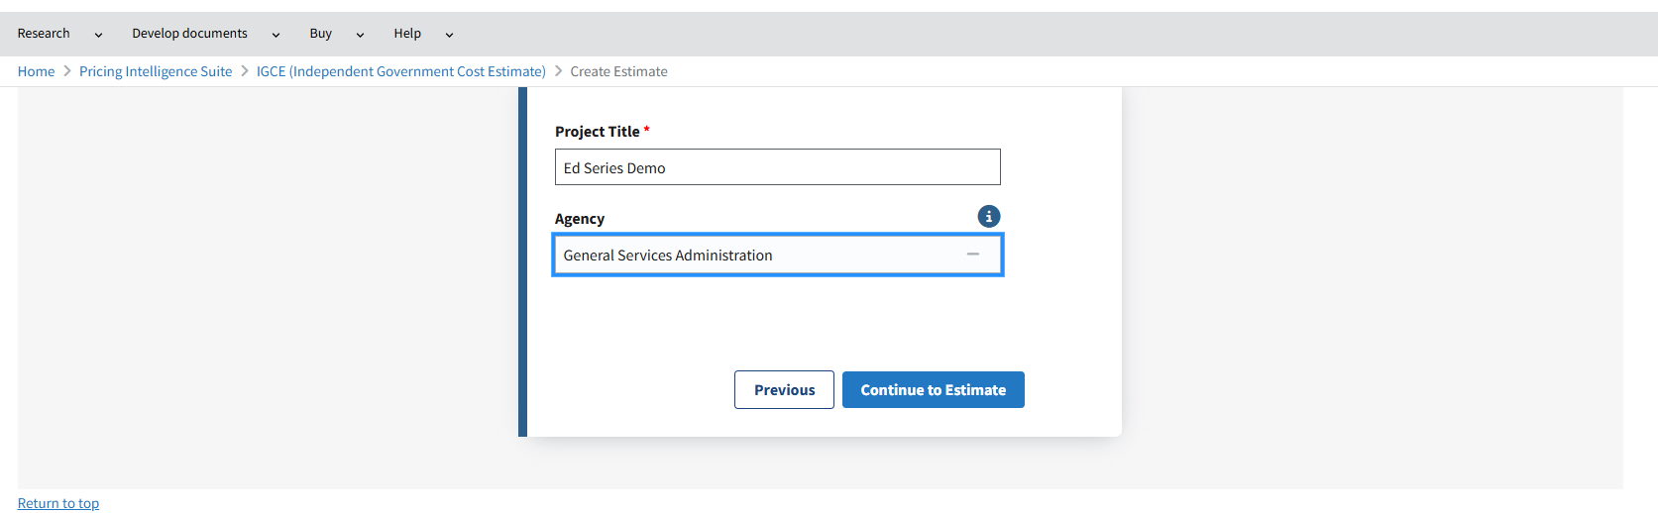
IGCE – Add Agency

Slide 44
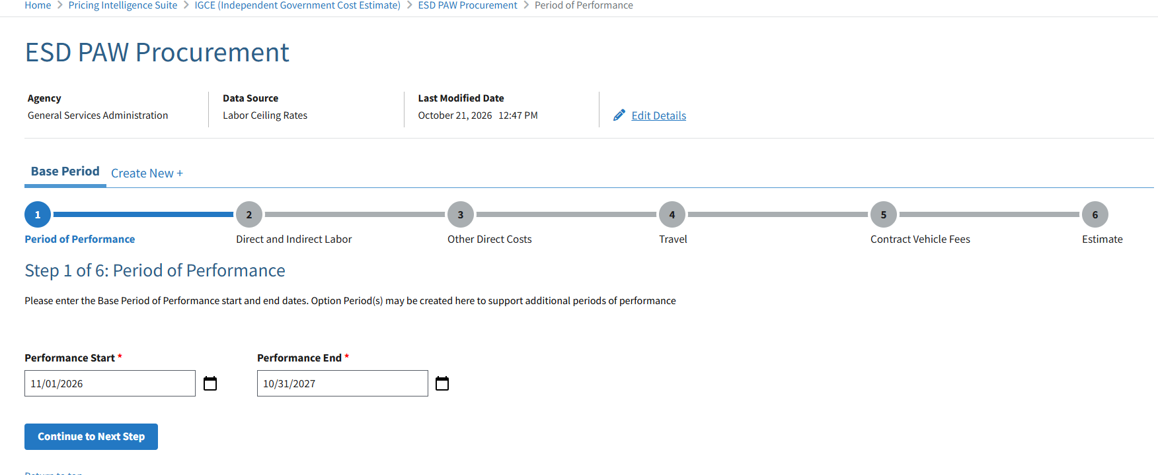
ESD PAW Procurement – Period of Performance

Slide 45
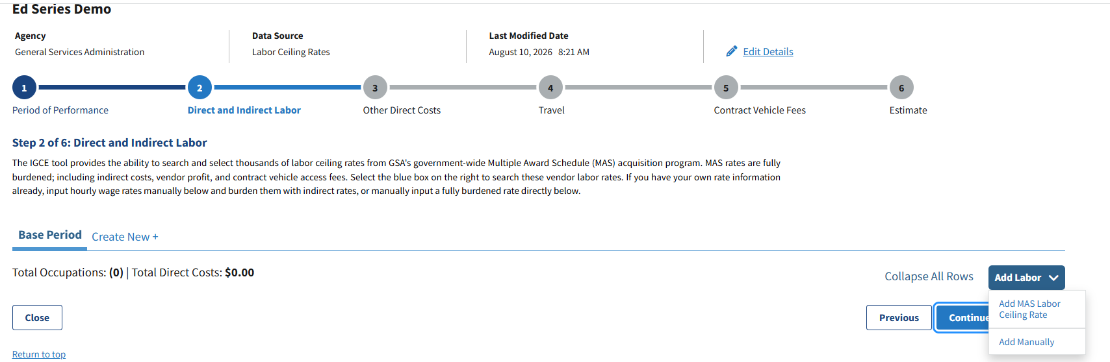
ESD PAW Procurement – Direct & Indirect Labor

Slide 46
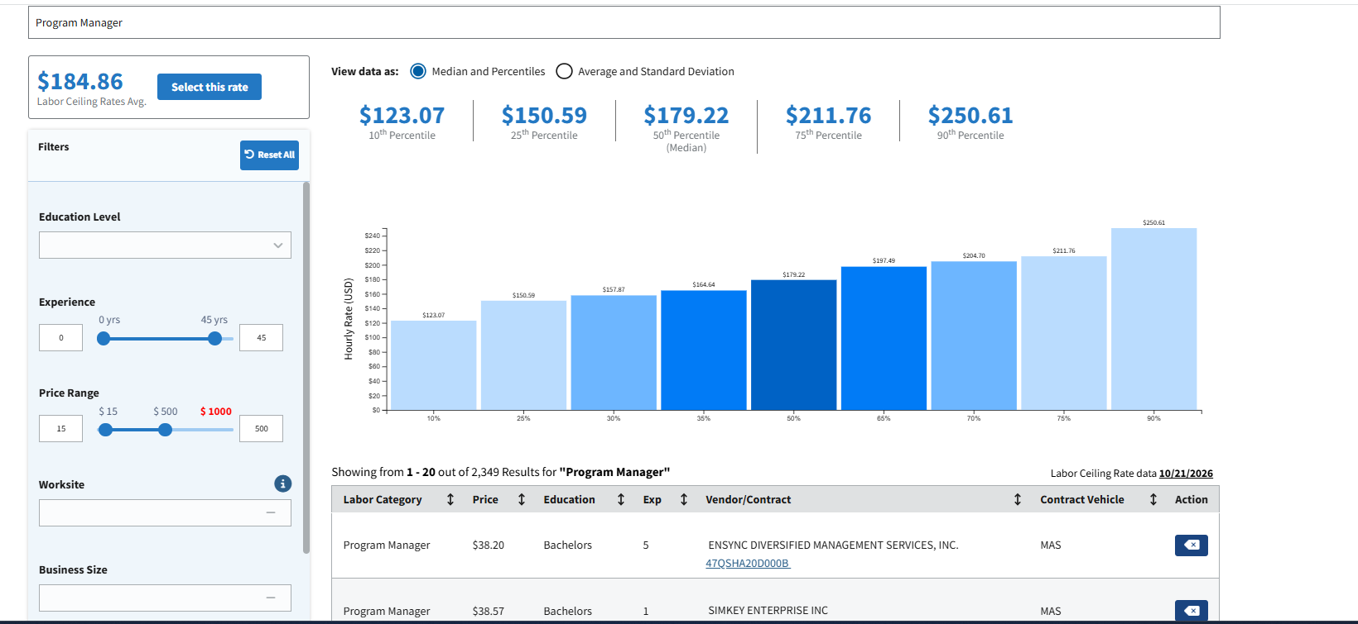
Program Manager Labor Ceiling Rates
Notes:
Consult the Vendor's Price Proposal: When reviewing contract proposals under SIN 132-53, look for vendors who have been awarded the Mobility-as-a-Service (MaaS) sub-category.1
Review Labor Descriptions: Examine the specific labor categories proposed by those vendors in their GSA Price Proposal Template (PPT). Look for categories that include functional responsibilities related to:
Logistics and inventory management
Helpdesk or technical support
Mobile device provisioning
Program/Project management
Verify SIN Requirements: Ensure the chosen labor categories align with the specific position descriptions provided in the vendor's approved contract.2
If you are currently developing a solicitation or modification, you should ensure that the vendors clearly define these logistics and support roles within their proposed labor categories to meet your specific distribution needs.2

Slide 47
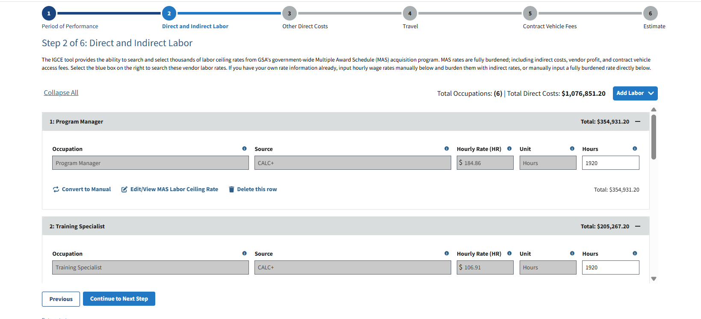
ESD PAW Procurement – Direct & Indirect Labor (Cont)

Slide 48
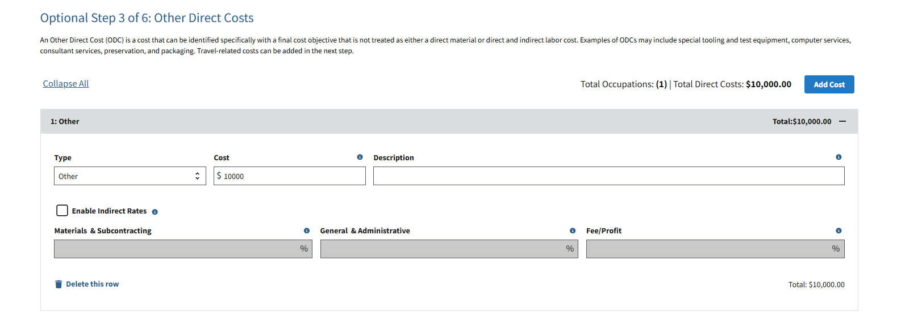
ESD PAW Procurement – Other Direct Costs

Slide 49
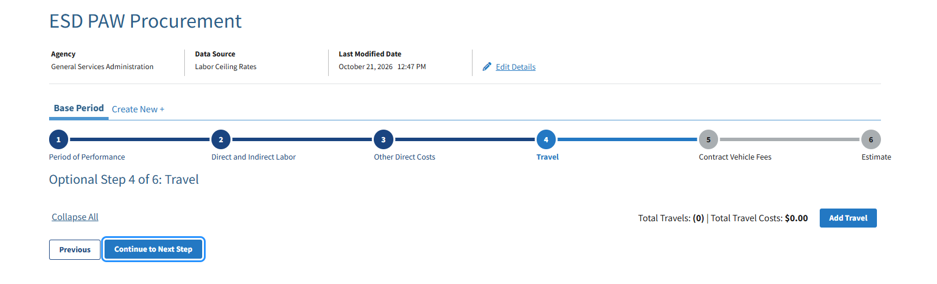
ESD PAW Procurement – Travel

Slide 50
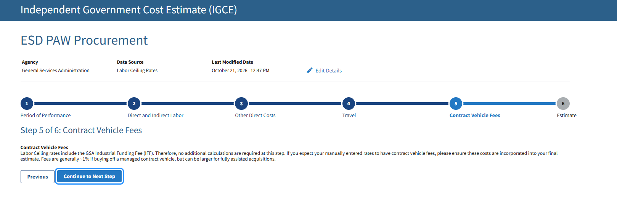
ESD PAW Procurement - IGCE

Slide 51
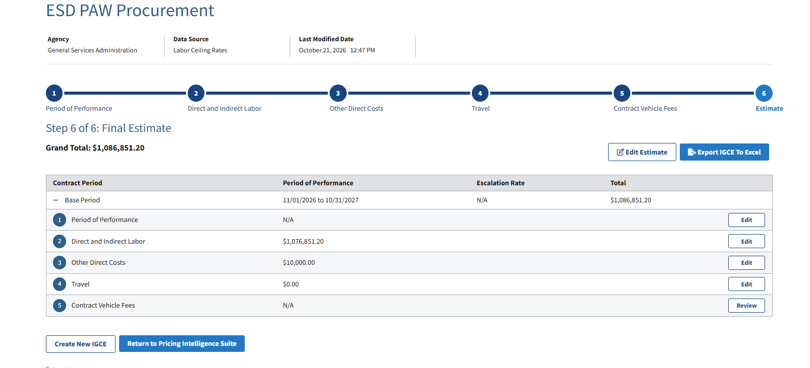
ESD PAW Procurement – Final Estimate

Slide 52
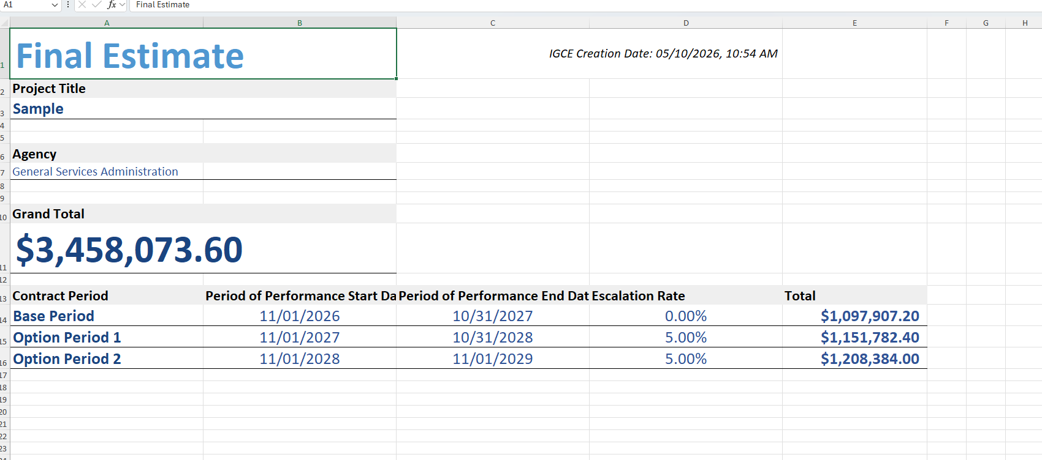
Final Estimate - Spreadsheet
Final IGCE

Slide 53
Questions from a Customer #6
Questions from a Customer
What if I can’t find the exact labor category I need?
What are we not thinking about?

Slide 54
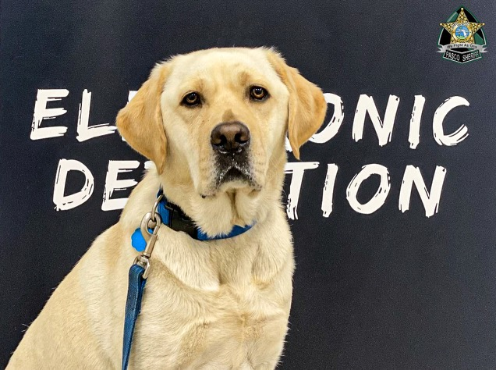
CASE Study Market Research in Action
Case Study: Market Research in Action
Build a more defensible IGCE using Buy.GSA.gov tools and SI-assisted prompts
FICTIONAL SCENARIO
Demo focus
ESD K9 IGCE Creation
Requirement → research → estimate → acquisition package
Today's workflow
01. Find template
02. Find vendors
03. Build IGCE
04. Enhance with SI
Document Library
ASN
CALC+ IGCE
Prompt support
Start with an existing template to frame the requirement.
Search contracts and vendors qualified to support services.
Create an estimate for labor categories and related support needs.
Use prompts to summarize findings, pressure-test assumptions, and strengthen documentation.
Outcome: a stronger market research package and IGCE that the contracting team can review, challenge, and refine.

Slide 55
Follow the Workflow
Follow the Workflow
LIVE EXERCISE
For best results, follow along in Buy.GSA.gov while we walk through the example.
Open
Find
Extract
Sanitize
Prompt
Compare
Edit
Doc
1
Choose the foundation
2
Pull the right data
Use your own requirement, or start with a prepared workbook/extract to keep the exercise moving.
Focus on comparable labor titles, levels, locations, qualifications, and unit pricing fields.
3
Remove sensitive fields
4
Use the prompt template
Delete vendor-identifying, proprietary, procurement-sensitive, or restricted data before using AI.
Run the step-by-step prompt, review the response, then challenge weak assumptions before re-running.
Pattern:
The same workflow works with a live Buy.GSA.gov extract or a pre-existing pricing workbook.
2

Slide 56
PAW Procurement IGCE
Paw Procurement IGCE
EXERCISE OVERVIEW
Build a defensible estimate from two kinds of market evidence.
Your Requirement
Participants will use a familiar requirement, extract relevant Buy.GSA.gov pricing data, sanitize it, and apply a guided AI prompt to compare ceiling-rate evidence against prices-paid evidence.
Buy.GSA.gov Data
SI-Assisted Analysis
Mission
Move from “I found a rate” to “I can explain and defend this planning rate.”
IGCE Rationale
Key idea: SI supports the analysis; the acquisition professional owns the judgment.
1

Slide 57
Compare – Don’t Combine
Compare — Don’t Combine
PRICING EVIDENCE
Ceiling rates and prices paid answer different questions. Treat them as separate evidence streams before recommending an IGCE rate.
Ceiling Rates
Prices Paid
IGCE Judgment
What is available/offered?
• Offered hourly rates
• Vendor labor categories
• Experience / education
• Site, clearance, business size
• Future-year pricing
What did agencies appear to pay?
• Observed hourly prices
• Occupation level
• Location and vehicle
• Sample size / observations
• Transaction evidence
What rate can we defend?
• Comparable evidence
• Outlier review
• Low / likely / high range
• Confidence level
• Methodology narrative
›
›
Prompt discipline
Ask SI to explain differences between offered rates and actual paid evidence — not to average them together.
3

Slide 58
Prompt Starter
Prompt Starter
COPY / ADAPT / RE-RUN
Use a guided prompt so the AI performs acquisition analysis instead of simple arithmetic.
As a federal acquisition pricing analyst supporting the creation of an IGCE I need your help analyzing the ceiling-rate evidence and prices-paid evidence separately. These data sources are included as separate tabs in this workbook. Do not combine them into a single average. Evaluate comparability by labor title, level, experience, education, location, vehicle, unit of measure, and sample size. Recommend a low / likely / high hourly planning rate, assign a confidence level, identify data limitations, and write a concise methodology narrative.
A
Ask for comparability scoring
B
Ask for rate reasoning
C
Ask for an editable narrative
Which records are close matches, partial matches, or weak matches to the target requirement?
Where does the recommended rate sit against ceiling percentiles and prices-paid observations?
Turn the analysis into plain-language IGCE support that a buyer can review and revise.
Reminder: sanitize first; document assumptions; keep the human in the decision loop.
5

Slide 59
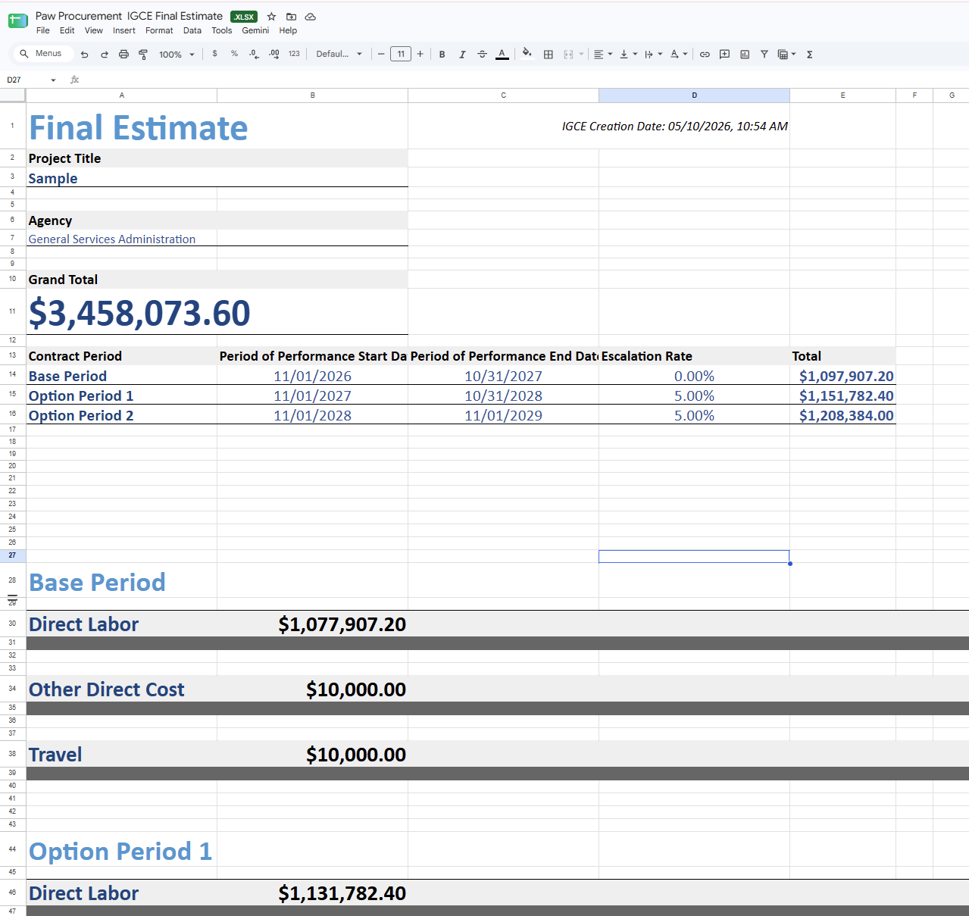
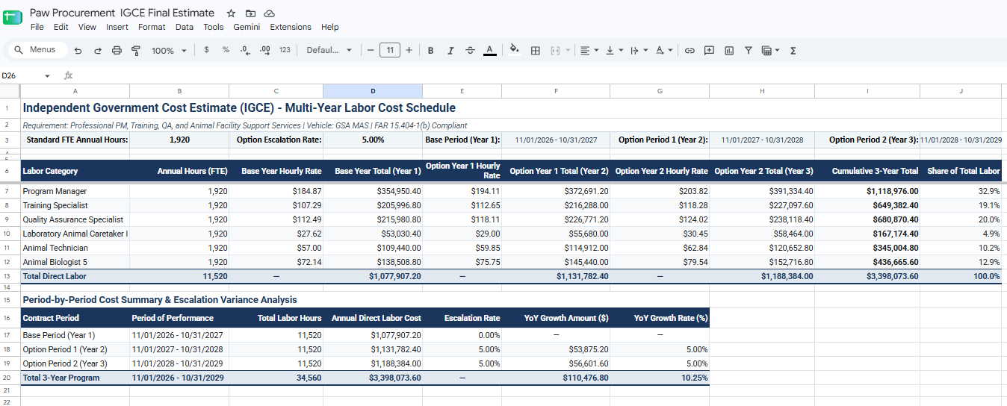
2 IGCE Products
2 IGCE Products
Buy.GSA.Gov Template
Gemini SI Product
Notes:
Highlight the difference between what Buy.GSA.gov produced versus what my own personal workflow using gemini created. Very similar, and I did export all the raw data for both ceiling and prices paid to create. Still, our numbers are different! Can anyone guess what’s missing? There is an easter egg hide within.
You guessed it… its ODCs!!!! Explain, why its vital, and what we can do to correct that issue as we create our IGCE

Slide 60
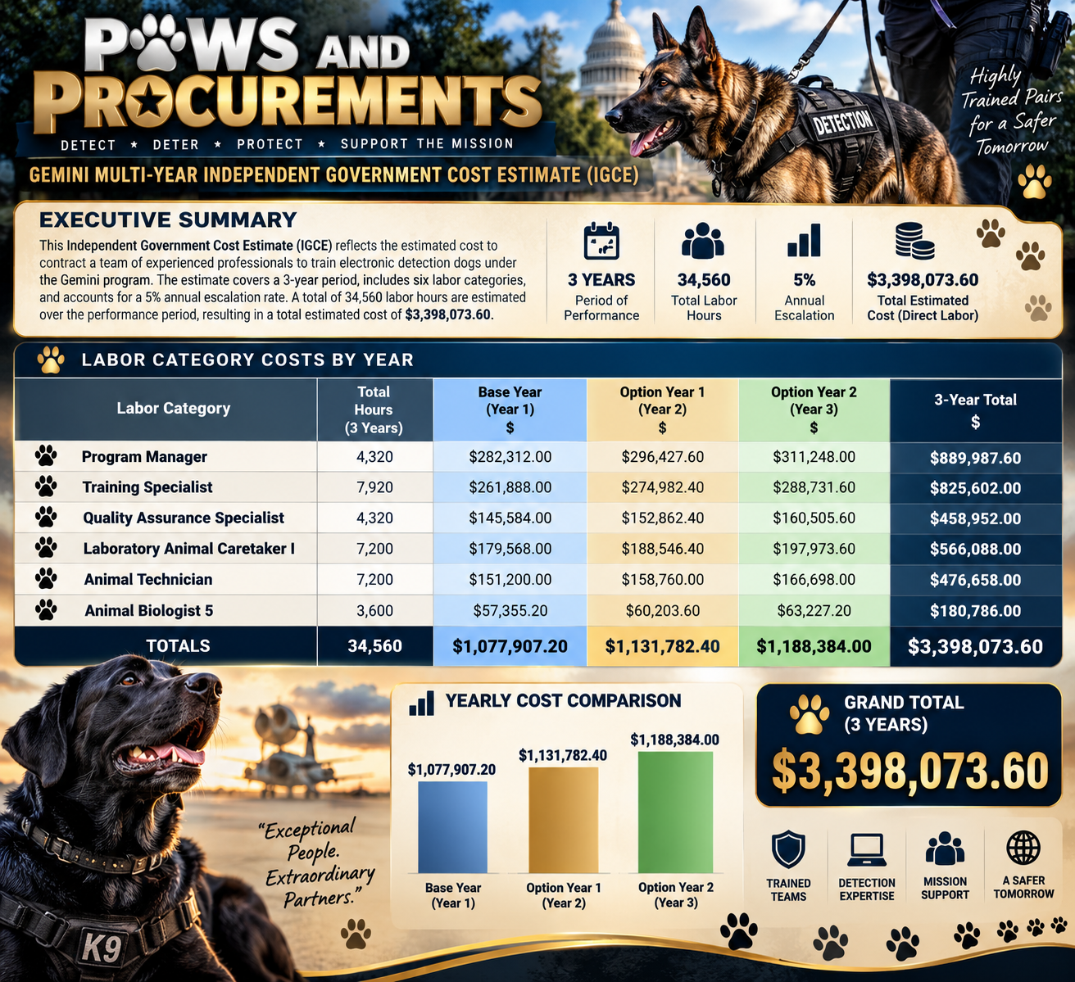
IGCE Visual Prototype
IGCE Visual Prototype

Slide 61
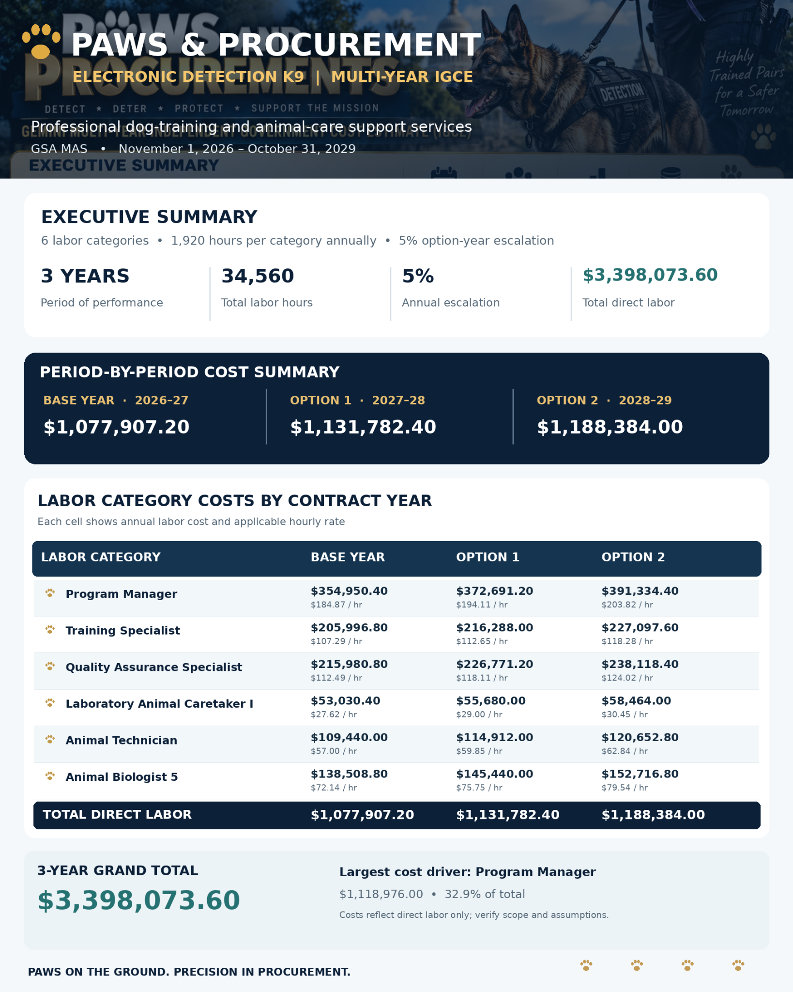
PAW Executive Summary

Slide 62
Practice Activities
Practice Activities
Hands-On GSA Tools
SCD Support & Collaboration
01. Build your First Template
02. Create a simple IGCE
03. Test the Ceiling, CALC, Prices Paid Portals
04. Submit your requirements review via MRAS
05. Test eBuy - Post your RFI/RFQ there today!
Questions or Need Help?
We are happy to meet and discuss your acquisition needs - feel free to reach out!
<fasdigitalsupport@gsa.gov>

Slide 63
Questions from a Customer #7
Questions from a Customer
I need help conducting market research - where should I start?
What do we need to create a defensible IGCE for niche services?
If the labor category doesn't exist, how can I justify the price?
If a service is niche or complex, how can Buy.GSA.gov help me? What other sources of data can I use?
Does it include kenneling or boarding?
Do we need recurring proficiency training?
What equipment or technology is required?
What is the period of performance, Where will the work occur?
Which costs are labor-based versus unit-based?
What assumptions are we making?
How can I use Buy.GSA.gov to find past awards or comparable procurements for similar services?
How do we filter or identify small business and socioeconomic vendors for this requirement on Buy.GSA.gov?
How should we account for and price Other Direct Costs (ODCs) like travel, materials, or specialized equipment in our estimate?
What are the latest enhancements and new features on Buy.GSA.gov that we should leverage for this market research?
How do current market research standards and practices generally apply to specialized or complex procurements?

Slide 64
Appendix
Appendix

Slide 65
Prices Paid

Slide 66
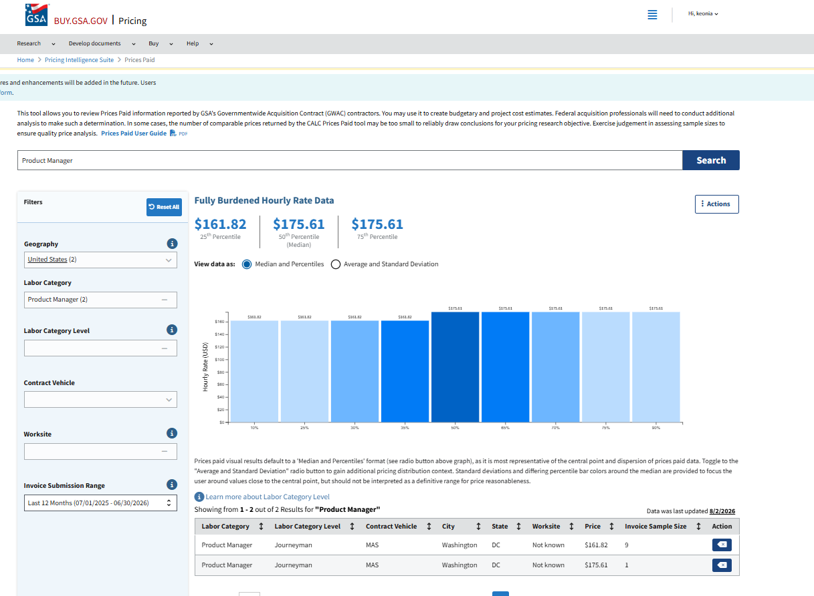
Fully Burdened Hourly Rate Date

Slide 67
Conclusion

