Slide 1

Federal Procurement Consolidation Training: Current State & Updates
Acquisition Training for the Real World
October 28, 2026

Slide 2


Presenters
Josilyn Reed
Event Coordinator
Customer Education Service Center
Jose Palos
Marketing Program Manager
Customer Education Service Center

Slide 3
Agenda
Agenda
Procurement Consolidation Overview
Implementation and Impact
Communication and Training Strategy
Q&A / Closeout

Slide 4
Procurement Consolidation Overview
Procurement Consolidation Overview
Josilyn Reed, Events Management Specialist

Slide 5




Procurement Consolidation: What is it?
Governance Framework
Procurement Consolidation is governed by Executive Order 14240 and the OMB Procurement Consolidation Implementation Plan.
Data & Savings
The effort asks agencies for data to help understand the big picture and identify where potential savings can be delivered.
Implementation Structure
The OMB implementation memo suggests there should be two major groupings to structure execution effectively.
FAR 8.104
Establishes prioritization of existing sources and contracts
Supports use of governmentwide acquisition and solutions
Aligns with Procurement Consolidation objectives
Will be reflected in future regulatory updates

Slide 6
Federal Procurement Consolidation Timeline
Federal Procurement Consolidation Timeline
Mar 20, 2025
Executive Order 14240: Eliminating Waste and Saving Taxpayer Dollars by Consolidating Procurement
Apr 8, 2025
Centralized Procurement Plans: GSA released template for agency plans
May 19, 2025
Plan Submission: Agencies submitted completed Centralized Procurement Plans to GSA Administrator
May 2025
Proposal Review: GSA began reviewing agency proposals to determine centralization suitability
Jul 18, 2025
OMB Guidance (M-25-31): Provided implementation guidance for EO 14240 across two main workstreams:
WS1: Consolidation Workstream | WS2: Centralize Workstream
Jul – Aug 2025
Data & Contract Analysis: GSA conducted additional reviews of agency submissions (WS2) and line-item analysis of FPDS data for consolidation opportunities (WS1)
Aug 2025 – Present
Agency Engagement & Implementation: Working with participating agencies on implementation steps (e.g. MOU’s, etc)
Notes:
Agency Engagment-Implementaion
Training
Performance of Procurement Consolidation
3 MOUS Signed-
DOS A

Slide 7


Two Workstreams
Two Workstreams
Workstream 1
Government-Wide IDVs and Shared Services
Agencies retain internal contracting authority while prioritizing the use of existing governmentwide contract vehicles and shared acquisition services.
Workstream 2
Assisted and Centralized Acquisition
Agencies may elect to receive centralized acquisition support from GSA for planning, strategy development, or contract execution.

Slide 8



Workstream 1: Government-Wide IDVs and Shared Services
Agency-Led Execution
Agency led execution providing many governmentwide vehicles.
Examples:
Schedules, GWACs, and Governmentwide IDIQs like OASIS+.
Shared Solutions
Offers a number of shared service solutions managing central support providing streamlined efficiency for agencies.
Examples:
GO.gov, Fleet, GSA SmartPay, City Pairs, etc.
Data & Guidance
The plan provides agencies with data, advisement, and recommendations.
Solutions are available to support agency objectives
Agencies determine how to meet consolidation targets

Slide 9



Workstream 2: Assisted Acquisition Solutions
Assisted Acquisition
Provides full assisted acquisition support to customer agencies.
Examples:
RWAs, requisitions, assisted acquisition services, etc.
FAS Portfolio & AAS
Within FAS, every business portfolio maintains an assisted acquisition version.
Largest Portfolio: AAS
High-dollar, high-complexity actions with dedicated contracting staff & program support (e.g., CORs).
OCAS
Customers consistently request support for non-complex acquisitions.
Common use products and services
Establishment of OCAS to fill the critical gap

Slide 10



Workstream 2: Operational & Transition Strategy
Opt-In Model
Unlike Workstream 1, solutions are offered strictly on an "opt-in" basis.
Provides assisted acquisition support directly as customer agencies ask for assistance.
Transition Intelligence
To ensure transition success, key focus areas are analyzed:
Overall federal marketplace
Contracts currently held by agencies
Renewal timelines for transition planning
Data-Driven Support
Leveraging procurement data to identify high-impact support opportunities.
Targeting assistance precisely where agencies need it most.

Slide 11
Why Procurement Consolidation
Why Procurement Consolidation?
The Problem: Contract duplication is occurring at scale across the federal marketplace
10,000+
Duplicative Contracts
$440M+
Annual Duplication Cost
600+
FTE Capacity Misallocated
Without realizing it, agencies are paying more to recreate solutions that already exist.
How This Happens: Agencies are unintentionally duplicating contracts when they:
Create new vehicles for common services or IT requirements
Negotiate with vendors already on existing government-wide contracts
Invest significant time and resources into contract development
Seek speed or flexibility outside of existing acquisition solutions
Notes:
Why Do We Need You to support consolidation!?? --- We’re not buying as one and taxpayers are not receiving benefits

Slide 12


How it works: Workstreams
How it works: Workstreams
GSA proposes a phased and iterative approach to achieve the savings envisioned by EO 14240, addressing the two concurrent workstreams described in OMB M-25-31.
WS1 - Retain Execution
Leverage Governmentwide Solutions
Increased use of government-wide contract vehicles or shared services.
GSA establishes contract solutions while agencies define their requirements and fulfill them by placing, managing, and administering their own orders.
Leverage GSA’s expertise in creating and managing gov-wide vehicles and shared services and working with agencies towards effectively using the solutions.
WS2 - Centralized Contracting
Utilize Centralized Contracting Services
Centralize procurement functions at GSA, where doing so promotes greater economy and efficiency.
Provides expanded contracting support to agencies needing additional procurement assistance.
Agencies can opt in to leverage GSA’s expertise and infrastructure for acquiring highly commercial, common goods and services.
Notes:
Lee

Slide 13

Workstream Benefits
WS1: Consolidated Contracts
Retain Execution. Leverage Solutions.
$176K Lifecycle Cost Savings
Est. admin savings per contract over 5 years (~$35K annually). Targets over $4B total.
Retain Authority: Agencies keep full contracting authority while prioritizing existing solutions.
Force Multiplier: Improved pricing via government-wide buying power.
Mission Accelerator: 30-day avg. timeline reduction per contract.
GSA Tools: Avg. 3 quotes per RFQ for manageable evaluation.
Socio-Economic Spend Targets:
37% WOSB 28% VOSB 58% Small Biz
WS2: Centralized Pathways
Utilize Centralized Contracting Services.
Competitive Services
Offering procurement services to federal agencies on a fee-for-service basis.
Extension of Your Team
Dedicated points of contact and a strong commitment to results.
Focus on Mission Critical
Enabling staff to focus on strategic procurements by shifting acquisitions to GSA.
Transparent Reporting & Savings
Visibility, accountability, and long-term sourcing leading to increased efficiency.
Notes:
2.3M (77,283 x 30) Cumulative lead-time days
WS 1 -
Reduce contract Duplication
Mitsu/Amber revisit the $4B number again (no impact on deck..but impact in research)
PALT FAS vehicles vs NOT FAS Vehicles comparison
--- if we have this, and take the number of procurements and times that
--- TOTAL Number of procurements across government that are NOT going through FAS vehicles X 30 (use Beck’s data source to identify # of PIIDs in WS1) .

Slide 14
Implementation and Impact
Implementation and Impact
Jose Palos, Marketing and Communications Program Manager

Slide 15
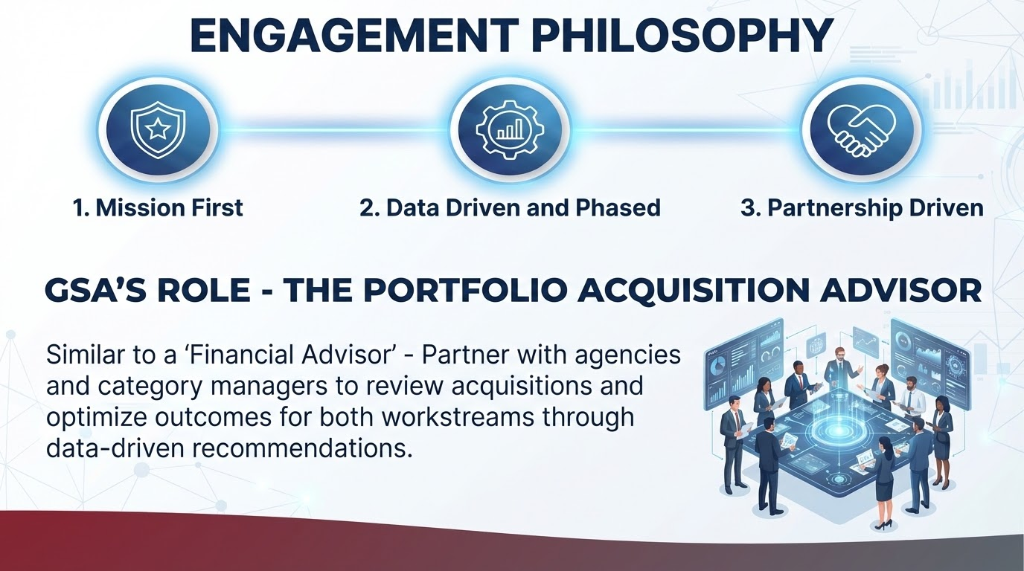
Engagement Philosophy
GSA’s ROLE - THE PORTFOLIO ACQUISITION ADVISOR
Similar to a ‘Financial Advisor’ - Partner with agencies and category managers to review acquisition and optimize outcomes for both workstreams through data-driven recommendations.

Slide 16





Agency Engagement
Establishing Open Communication Channels
Outreach for Holistic Agency Engagement
Agency Outreach to GSA for Support
We will collaborate with agencies individually to review spend and align solutions based on capacity and agreed timelines.
Key Focus Areas
Individual agency collaboration
Holistic spend review
Custom capacity & timeline alignment
We welcome customer agencies to reach out to GSA for holistic spend review or acquisition support in anticipation of cost savings and efficiency opportunities.
Direct Contact Channel customerengagement@gsa.gov

Slide 17
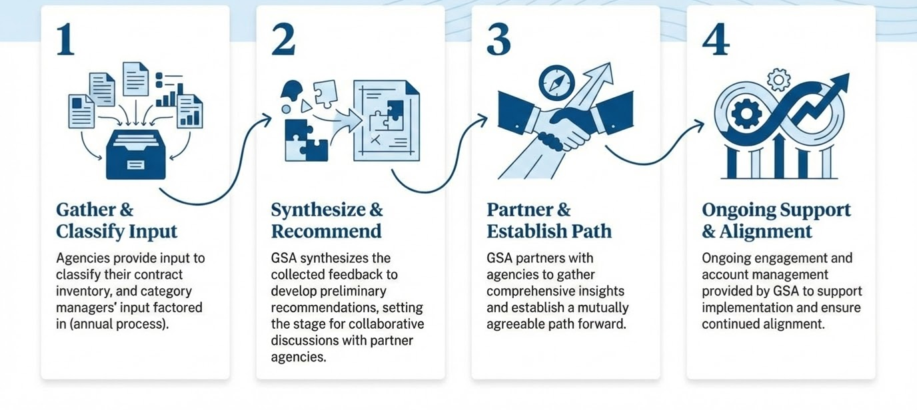
Engagement Process
Gather & Classify Input
Agencies provide input to classify their contract inventory, and category managers’ input factored in (annual process).
Synthesize & Recommend
Synthesizes the collected feedback to develop preliminary recommendations, setting the stage for collaborative discussions with partner agencies.
Partner & Establish Path
Partners with agencies to gather comprehensive insights and establish the path forward.
Ongoing Support & Alignment
Ongoing engagement and account management provided to support implementation and ensure continued alignment.

Slide 18
Impact of Successful Implementation
Short Term:
Achieve savings of over $1 billion
Drive administrative savings through process standardization as agencies place and manage their own orders, without creating overlapping contracts.
Eliminate Contract Duplication
Enable Demand Management
Reduce agency involvement in acquisition management, freeing resources to focus on mission priorities
Long Term:
On-going spend optimization achieving nearly $4B in savings
Reduce agency spending by leveraging consolidation and volume purchasing
Provide compliant acquisition solutions that save agencies time and money while directly supporting mission outcomes.
Cement through
  Revolutionary FAR Overhaul;
  Federal Management Regulations;
  Federal Travel Regulations ;
  President’s Management Agenda

Slide 19
Your Role
Consolidation is a team sport - Although a small group of people will work the engagement and transition plan:
  Consolidation requires the entire workforce's contributions and collaboration for success.
  Everyone's efforts ensure excellent service delivery as new customers join
  Onboarding more customers creates exciting new missions to support.
  This provides a great opportunity to impact service delivery across government
Greater Impact on Government’s Mission - as we on-board more spend and customers we will have new exciting missions to support and have the opportunity to have great impact in service deliver across the Federal Government.

Slide 20
Wins
Workstream 1 - Government-Wide IDVs and Shared Services
Projected savings from consolidation of 5 contracts is $64 M.
163 task orders totaling $228M agreed for transition to government-wide contracts for a pilot agency.
Create solutions to encourage customers to leverage governmentwide solutions
  OneGov: eg - Adobe, Google, Salesforce (70-90% discounts)
  Software as a Shared Services: Go.Gov ($2B)
Workstream 2 - Assisted and Centralized Acquisition
Centralized 908 contracts across Pilot Agencies (valued at ~$1.5B), achieving $6.5M in savings through increased visibility and reduced software license and support services spend.
Developed and deployed Automated Intake Tool to streamline procurement intake and triage

Slide 21
USE CASE: DOS
Department of State
Strategic Partnership and Alignment
MOU formalized for Procurement Transition Plan (PTP).
Aligned with EO 14240 and DOS mission priorities.
First agency to join GSA Procurement Consolidation pilot.
Led by CAO Rudy Strom, Deputy CAO Kyle Ilgenfritz, and SPE Sharon James.
$896M
Transition Actions
Identified 156 task orders ready for GSA contract vehicles.
$345.6M
Aligned Requirements
Previously uncredited requirements now recognized.
$1.986M
Cost Avoidance
Projected labor savings through efficient decision-making.
~76K Days
Admin Lead Time
Average of 30 days of administrative lead time saved per contract
Notes:
Formalized Strategic Partnership: GSA and the Department of State (DoS) formalized a strategic partnership via a Memorandum of Understanding (MOU) to implement a Procurement Transition Plan (PTP), aligning with Executive Order 14240.
Pilot Agency Success: DoS is one of only two agencies selected to pilot the Procurement Consolidation process with GSA, and is the first agency to sign an MOU formalizing this groundbreaking process.
Collaborative, Data-Driven Approach: GSA partnered with DoS's Chief Acquisition Officer (Rudy Strom), Deputy CAO (Kyle Ilgenfritz), and Senior Procurement Executive (Sharon James) to conduct a joint contract inventory analysis. Data was the primary driver for decisions, ensuring alignment on approach.
Repeatable Blueprint: The implementation strategy was designed to achieve significant long-term results while preventing operational interruptions, establishing a repeatable and scalable blueprint for other federal entities to convert regulatory policy into tangible execution.
Impactful Results and Metrics
Contracting Actions Transitioned: Identified $896 million in contracting actions suitable for transition to existing government-wide solutions on GSA vehicles.
Previously Uncredited Requirements: Identified $345.6 million in requirements already aligned with government-wide solutions but for which DoS was not receiving credit due to FPDS limitations.
Labor Savings and Cost Avoidance: The projected labor savings from transitioning these contracts totaled approximately $1.986 million in cost avoidance.
Mission Support: The effort is explicitly focused on supporting administration priorities and the State Department’s critical mission, positioning GSA as a crucial collaborator.

Slide 22
Communication and Training Strategy
Communication and Training Strategy

Slide 23
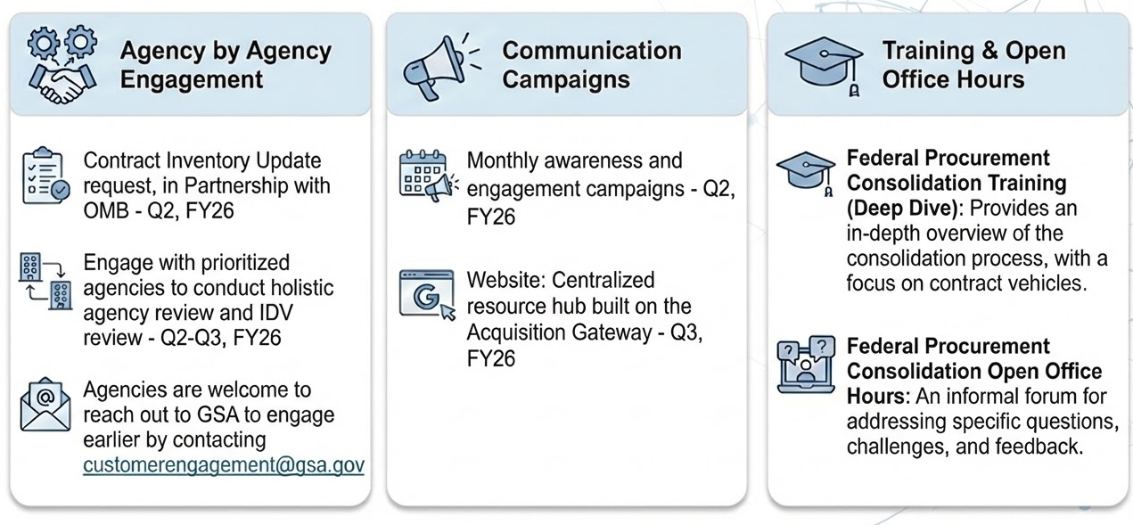
Communication and Training
Contract Inventory Update request, in partnership with OMB
Engage with agencies to conduct holistic agency review and IDV review
Agencies are welcome to engage earlier by contacting customerengagement@gsa.gov
Monthly awareness and engagement campaigns
Website: Centralized resource hub built on the Acquisition Gateway
Federal Procurement Consolidation Training (Deep Dive): Provides an in-depth overview of the consolidation process, with a focus on contract vehicles.
Federal Procurement Consolidation Open Office Hours: An informal forum for addressing specific questions, challenges, and feedback.

Slide 24
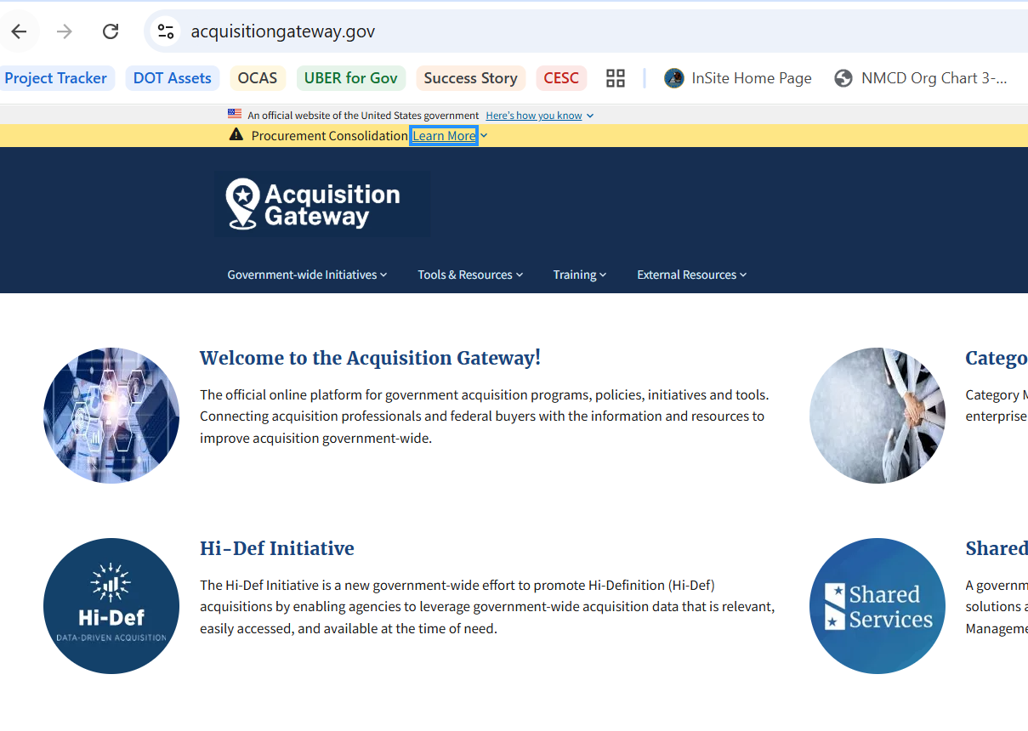
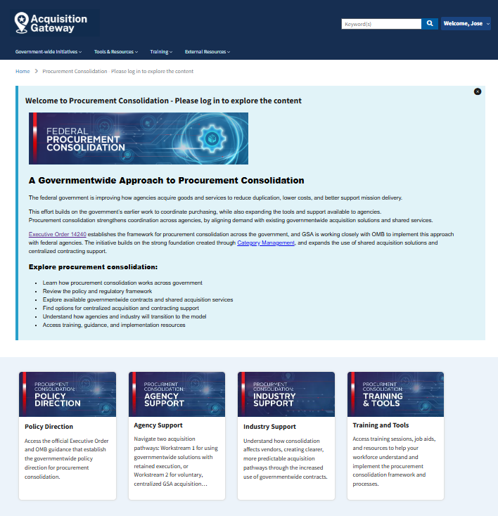
Procurement Consolidation Website
Acquisitiongateway.gov/procurement-consolidation

Slide 25

Next Steps Update
Forward Look — Upcoming Sessions
Future Look — Recurring Cadence
Procurement Consolidation Training: OCAS
October 27, 2026 | 1 PM EST
Every Other Tuesday
Procurement Consolidation Training @ 1 PM EST
Features specific GSA offerings supporting procurement consolidation
Each training session is worth 1 CLP
Open Office Hours
October 27, 2026 | 2 PM EST
Monthly
Open Office Hours @ 2 PM EST
Procurement Consolidation Training: GWAC
November 10, 2026 | 1 PM EST
Quarterly
Industry Training

Slide 26
Q & A
Q & A
Thank you for your time and participation!
Have Questions?
Reach out to our team at
customerengagement@gsa.gov
Resources
Visit the resource hub on the
Acquisition Gateway

Slide 27

Conclusion

