Slide 1
From Cluttered to Curated: Utilizing Personal Property for Inventory Management
Acquisition Training for the Real World
October 29, 2026

Slide 2
Personal Property:
Excess as the first source of supply

Slide 3
Table of Contents
01
Excess First!
02
Benefits
03
Examples

Slide 4

It’s the law!
…to consider excess first.

Slide 5



Benefits
Maximizes the return on Government dollars spent.
Minimizes expenditures for new procurement.
Stretches your budget!
Reduces environmental impact.

Slide 6

Plus…
Excess is
CHEAP CHEAP CHEAP!

Slide 7

Why?
Excess is no cost to request - so you can save money for your mission!
But:
Must remove at your cost
Cost of excess must not exceed cost of new

Slide 8
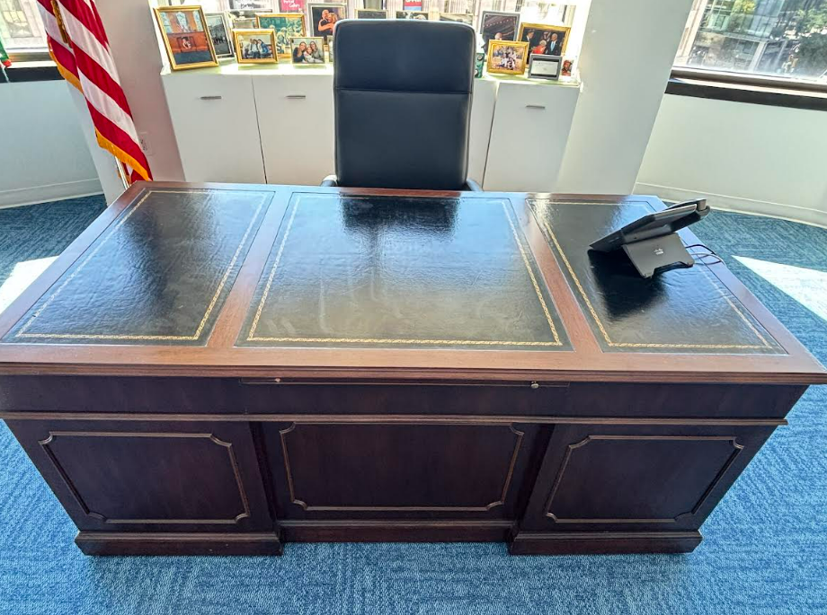
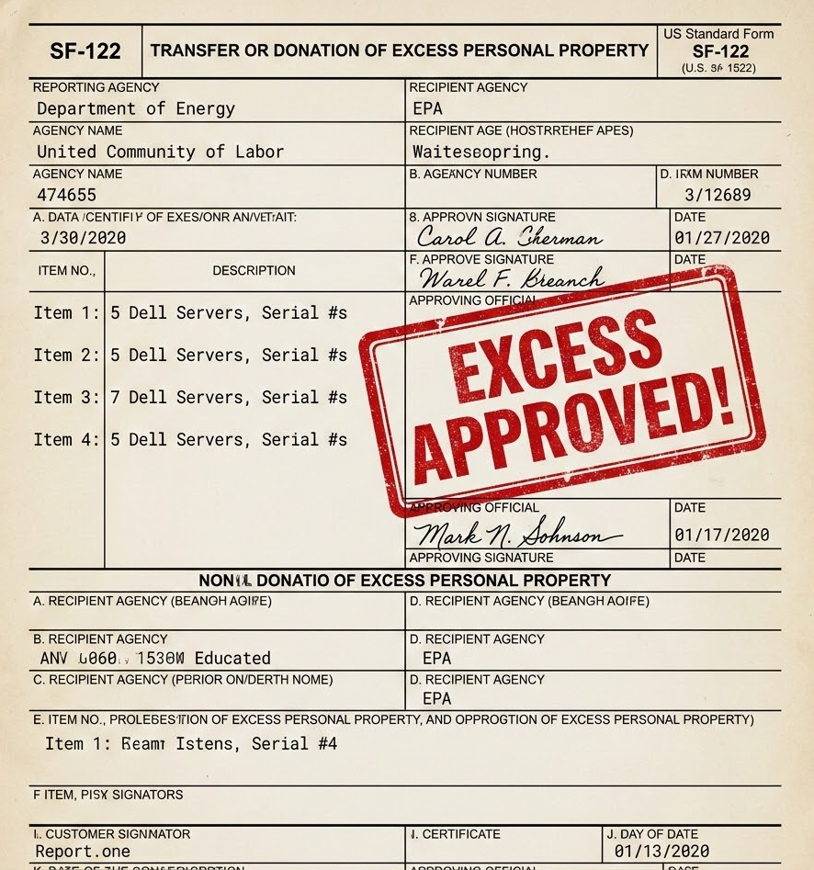
If it’s good enough for POTUS…
A former POTUS gave excess the “seal of approval” by securing this executive desk for use in their office.

Slide 9
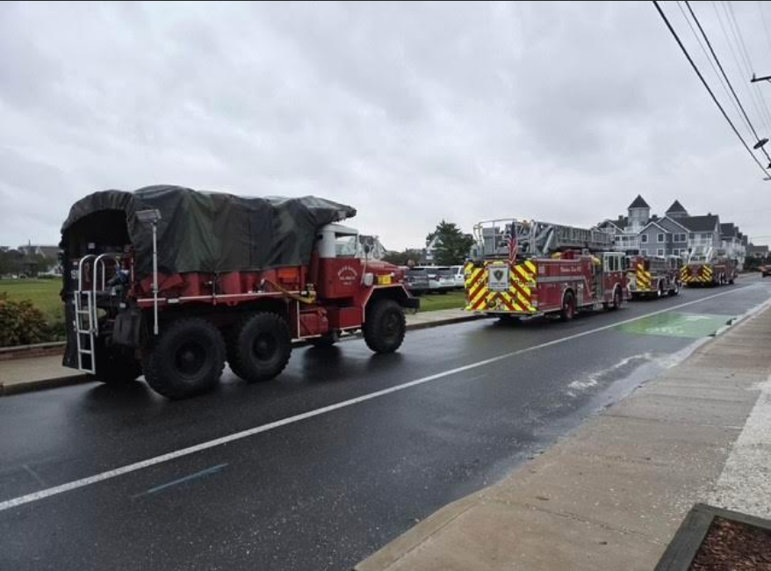
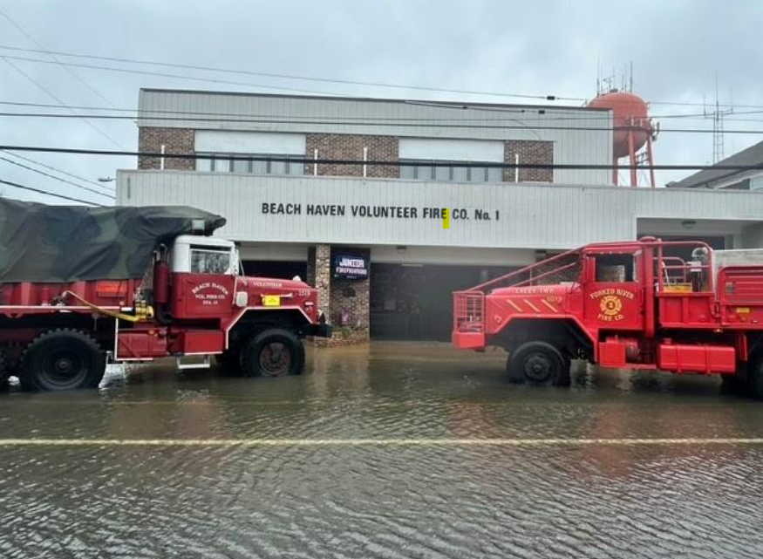
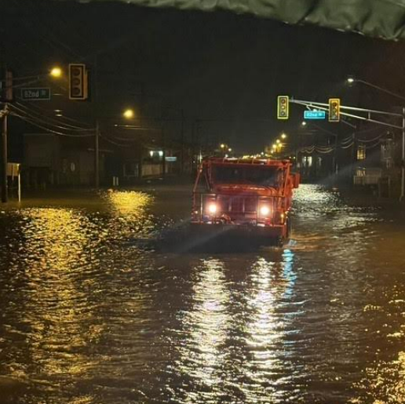
Federal Excess in Action
FEPP turned excess property into emergency impact during the October ‘26 New Jersey nor’easter, using excess trucks for critical emergency support.

Slide 10
I’m in! What’s next?
01
Contact your National Utilization Officer for access to PPMS.
02
Learn more or get training from your Area Property Officer.
03
Start searching and acquiring excess TODAY!

Slide 11

Deputy Director Information
Christina Shaw
Deputy Director, PPM
christina.shaw@gsa.gov

Slide 12
Exchange Sale Program Overview
What if Old Property Could Help Pay for What Comes Next?

Slide 13
Turning Aged Property into Buying Power
Exchange/Sale allows an agency to use the value of old personal property to help pay for similar replacement property.
Two options:
Exchange: Trade in old property for credit toward replacement
Sale: Sell old property and apply proceeds toward replacement
Authority: 40 U.S.C. § 503
Regulation: 41 CFR Part 102-39
“The simplest way to explain this to a customer is: if you have old property that needs to be replaced, and that property still has value, Exchange/Sale may allow you to use that value to reduce the cost of buying the replacement.”

Slide 14
Why Use Exchange/Sale
Cost savings.
Reduces the agency’s cost of replacing personal property
Allows the agency to retain more money for its mission
“Instead of treating old property as the end of the story, Exchange/Sale lets us make it part of the next chapter. The value of the old asset helps fund the new one.”

Slide 15
Two Ways to Use the Authority
Exchange:
Trade in the property
Receive credit toward replacement property
Transaction is between the agency and vendor
No GSA involvement
Sale:
Sell replacement property through GSA
Apply proceeds toward purchase of new property
GSA sales fee: $250 minimum

Slide 16
When NOT to Use Exchange/Sale
Key restrictions:
If estimated sale proceeds will be unreasonably low, such as less than $1,000
If the agency wants the property to screen through the surplus donation program
Sales proceeds/exchange credit may only be used to acquire like items (e.g., in the same Federal supply class).
“Exchange/Sale is for replacing property the agency already uses — not for generating revenue, bypassing donation screening, or creating a workaround.”

Slide 17
Ineligible Federal Supply Groups
FSGs under 41 CFR 102-39.20(a)(1) are ineligible exchange/sale:
10 — Weapons
  Exception noted for FSC 1005 when conducting exchange/sales with the original equipment manufacturer
11 — Nuclear ordnance
44 — Nuclear reactors, FSC Class 4470 only
68 — Chemicals and chemical products, except medicinal
84 — Clothing, individual equipment, and insignia
“Some categories are restricted or excluded. Check eligibility before promising the program to a customer.”

Slide 18
How Long to Obligate Proceeds
(Use it or Lose it)
Proceeds must be obligated:
During the fiscal year the item was sold, or
Within one fiscal year thereafter
If not used during that period, proceeds must be sent to the General Fund of the U.S. Treasury (41 CFR 102-39.30).

Slide 19
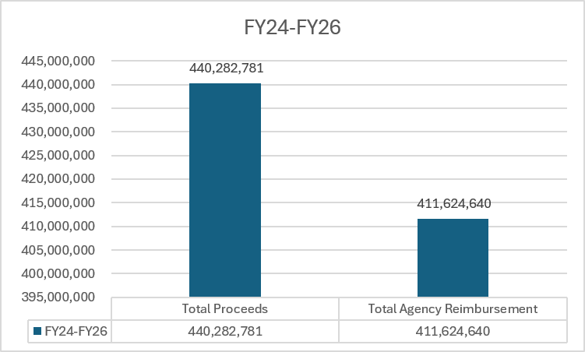
Exchange/Sale DOW Stats
Notes:
Total Agency: Line Items 2,970; Reimbursed 94%

Slide 20

Exchange/Sale Success Story
Our Western Zone is currently in its 13th year with one of its biggest recurring partnerships with the U.S. Army. For fiscal year 2024, we have completed auctions on 53 Black Hawks, with sales exceeding $68 million. The helicopters are demiled, requiring all military components be removed or modified to make the unit the same as a commercial equivalent. We coordinate with DOD Trade Security Controls to review our sales, vet the successful high bidders, and give final approval before we award the sales contracts. The Army receives the majority of the proceeds back, that’s 94%, to purchase replacements. Many of the Black Hawks sold to the public have been repurposed and put to use helping fight wildfires, and they have been also used for personnel transport, search and rescue, law enforcement, and medical evacuation.

Slide 21

Lead Property Disposal Specialist Information
Tara Hightower
Lead Property Disposal Specialist, PPM
tara.hightower@gsa.gov

Slide 22
Conclusion

