Slide 1
GSA’s Intelligent Edge: Utilizing AI (& RFO) for Performance and Industry Relevance
Portfolio Represented | June 16, 2026 4-4:30pm EST
Notes:
This training session explores how GSA is utilizing Artificial Intelligence (AI) within its operations and the significant process improvements witnessed as a result of these integrations. Participants will gain insights into industry relevance and learn to navigate the strengths and weaknesses of using Large Language Models (LLMs).

Slide 2



Presenters
Ryan Williams
Danielle Mouw
Ryan Palmer
Strategic Initiatives Specialist
ryan.williams@gsa.gov
RFO, AI & GSA PILOTS Lab
Danielle.Mouw@gsa.gov
USAi Lead
ryan.palmer@gsa.gov

Slide 3

📌When you think of the current FAR?
📌What Comes to Mind when you think of AI?
Notes:
Danielle

Slide 4
What is AI?
What is RFO?
And what this means for Industry in a Federal Acquisition Context?
Notes:
Danielle

Slide 5
Scope
Practical Operations
How AI works at a practical level
Acquisition Collaboration
How humans and AI work together in acquisition
AI-Enabled Buying
What RFO means for AI-enabled buying
Evaluation Cases
Acquisition use cases and examples under evaluation
Notes:
Danielle - tee up Ryan P.

Slide 6
AI as a Practical Technology
AI Is Not One Thing
Includes rules-based systems, predictive models, generative AI, and LLMs
LLMs Work With Language
They generate, summarize, classify, compare, and reason over text — but can be wrong
Model Choice Matters
Use the right tool for the task: rules, templates, predictive models, or LLMs
Context Drives Quality
Prompts, source documents, retrieved information, and user instructions shape outputs
Governance Sets Boundaries
Policy, privacy, security, records, evaluation, and human review define responsible use
Acquisition Impact
AI can support drafting, research, and review while humans remain accountable

Slide 7
Guiding Requirements
M-25-21
AI use must be governed, inventoried, risk-managed, and aligned to public trust.
M-25-22
AI acquisition must be competitive, performance-based, testable, and protected from vendor lock-in.
M-26-04 / EO 14319
LLMs must support truth-seeking, ideological neutrality, transparency, and user feedback.
EO 14179
Federal AI adoption should remove unnecessary barriers while advancing U.S. AI leadership.
Takeaway
Humans remain accountable; AI supports drafting, analysis, market research, and monitoring.
Lifecycle Expectation
Contract for testing, auditability, updates, performance monitoring, data rights, and an exit path.

Slide 8
Government Use of AI in Acquisition
Support Judgment
AI should support acquisition judgment — not replace it
Reduce Friction
Use AI for summarizing, solicitation review, requirements comparison, and market research
Keep Humans Accountable
Professionals validate outputs, make decisions, and document rationale
Choose the Right Tool
LLMs are not always best; rules, templates, or structured workflows may be better
Ground in Reliable Sources
Use policy, market data, contract files, and approved reference materials
Protect the Record
Track AI use, inputs relied on, outputs generated, and human review
Evaluate Before Scaling
Test for accuracy, bias, usefulness, privacy, and security before deployment
Monitor Over Time
Model behavior, policies, data, and vendor capabilities can change

Slide 9
Use Case Under Evaluation: Ensuring Accessibility in Solicitations
Section 508 Requirement
Section 508 requires federal Information and Communication Technology (ICT) to be accessible to people with disabilities.
GSA Evaluation
GSA is evaluating LLM capabilities to support its Solicitation Review Tool.
Goal
Help ensure accessibility requirements are included consistently across solicitations.
Potential Value
Faster review, clearer language, fewer missed requirements, and more consistent compliance support
gHuman Role: Acquisition and accessibility experts validate recommendations before anything is finalized

Slide 10
Generative Artificial Intelligence
Text Generation
Generative AI leverages a diverse array of pre-trained materials to produce output based on given input, utilizing knowledge acquired during training.
OCR Integration
Optical Character Recognition (OCR) converts images like PDFs into text, enabling AI training and content generation from digitized materials.

Slide 11




Examples of AI
Draft Formatting
Provide a previously-used SOW/PWS/SOO as a PDF with drafted requirements. AI formats them into the preferred structure, saving hours of reformatting.
Overcoming Writer's Block
When facing writer's block during requirement drafting, AI helps generate new ideas or expand upon initial concepts to keep progress moving.
11

Slide 12
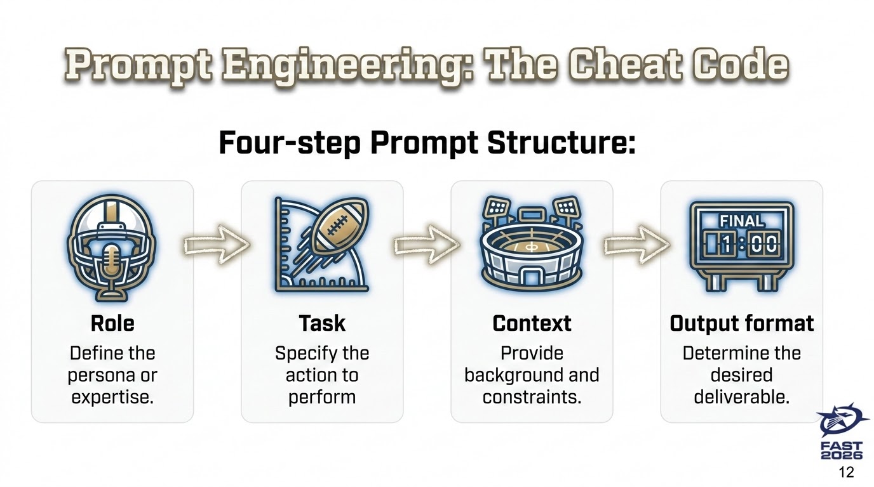
Prompt Engineering (Cheat Code)

Slide 13
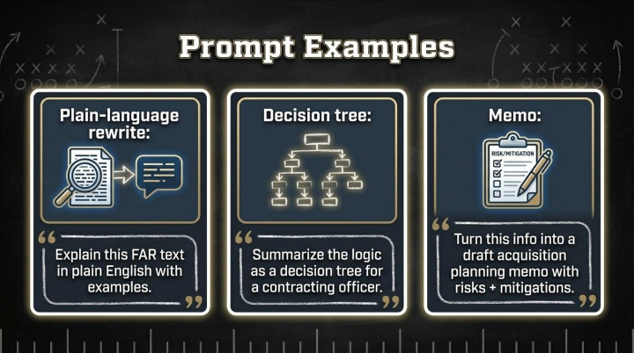
Prompt Examples

Slide 14
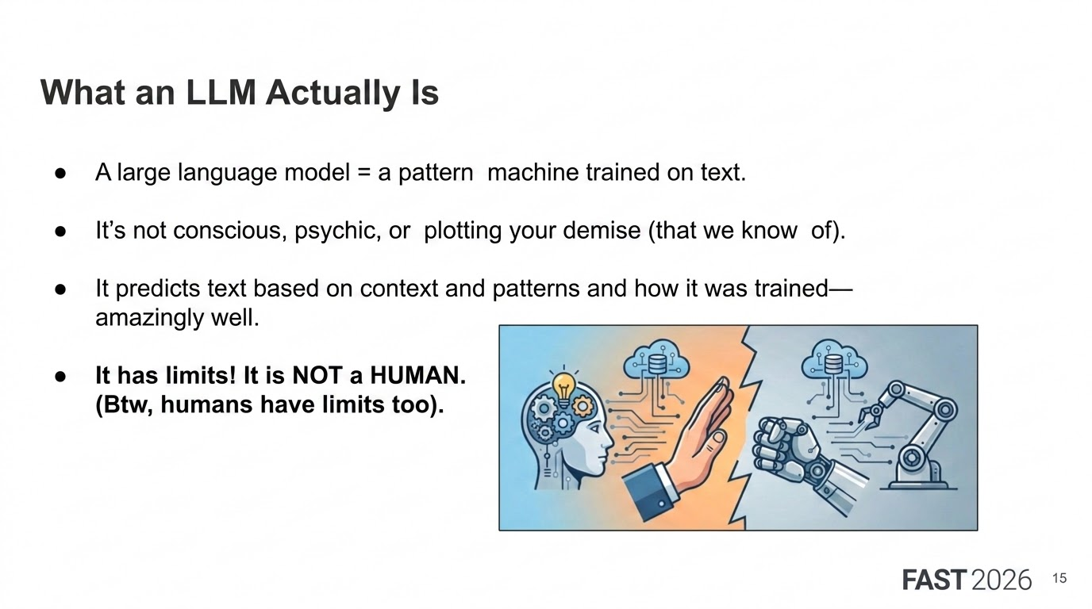
What an LLM Actually is

Slide 15
AI is NOT a HUMAN
Though…we humanize it a lot.
It is a pattern reader and it is only as strong as the data it is trained on.
Use as a tool to support your human knowledge, experience and insights about your work!

Slide 16
Large Language Models (LLMs)
AI Systems trained to generate human-like text
Examples:
  ChatGPT
  Gemini
  LlaMa
Fed use: Summarizing, drafting, market research, Q&A

Slide 17
When It Really Matters
Accuracy: Some models are more cautious
Speed: Some models respond faster
Security/Cost: Open models (like LLaMA) may be used internally
Memory: Long documents or chat history? ChatGPT Shines

Slide 18
What RFO & AI Mean for Federal Acquisition
Notes:
Danielle

Slide 19
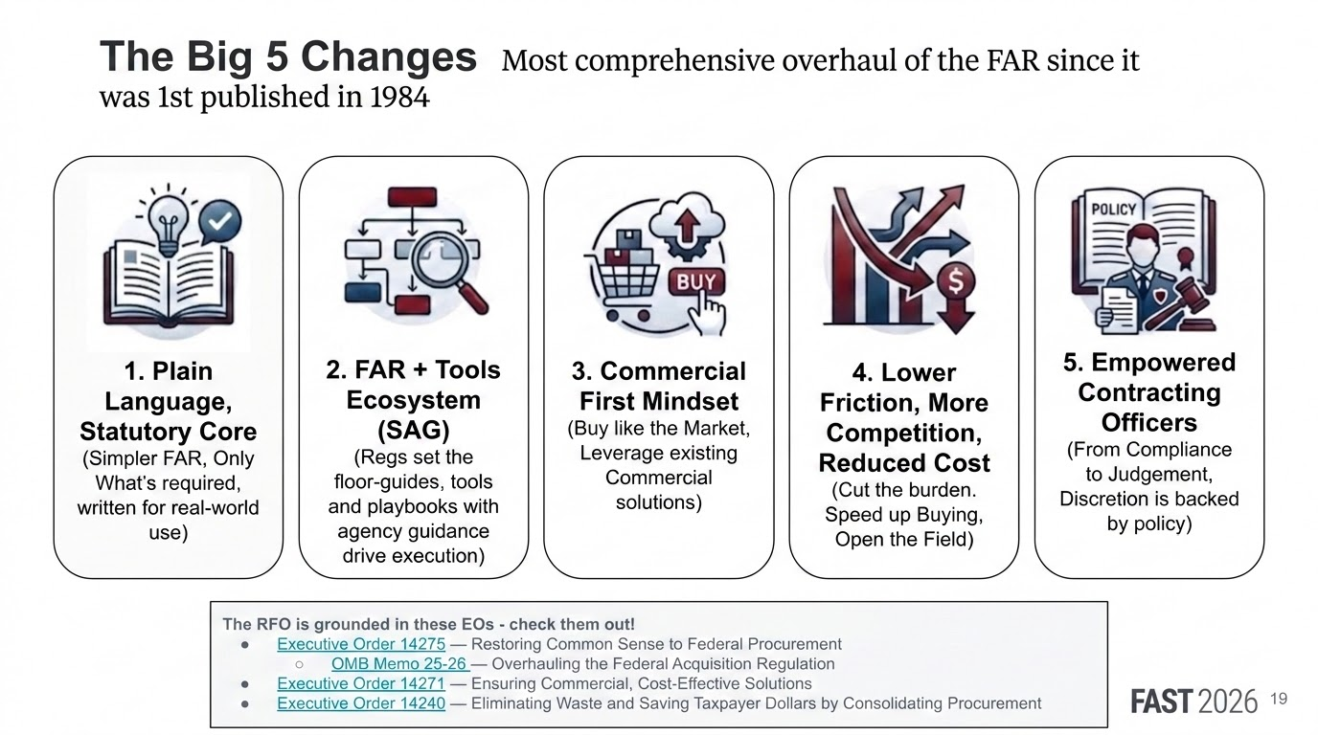
The Big 5 Changes

Slide 20
Acquisition Uses
Use Case | Suggested Model
Writing a draft SOO or PWS | Thinking
Summarizing a 50-page acquisition plan | Thinking or Standard
Answering questions from acquisition staff | Standard
Building a fast internal AI assistant | Fast
Market research using web data | Thinking + Web-enabled model
Quick rewriting or clarification of paragraphs | Fast or Standard

Slide 21
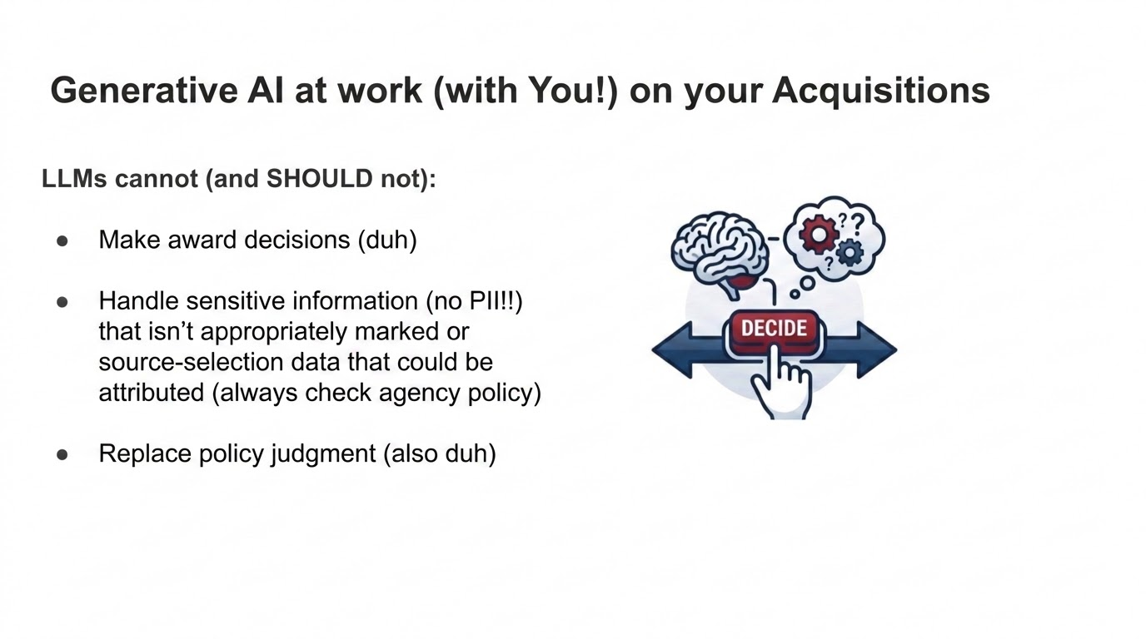
Generative AI at Work (With You)

Slide 22
Sample Prompt
Let's talk about prompting
You are helping Industry understand the Revolutionary FAR Overhaul and new Parts 10 and 12 source text below.
1. Explain the biggest changes in plain language.
2. ID what Contracting officers are now encouraged to do differently 3.Explain how Industry should adapt its approach to market research responses, capability statements, and proposal submissions.
4. provide 3 tactical “industry tips” based on the source material. Clearly distinguish regulatory requirements from business strategy
Please put into this format: FAR Says: CO Behavior Shift: Industry Implications
Pasted Source Text:
Notes:
10.000 Scope of part.
This part prescribes minimum requirements for conducting market research before procuring supplies and services. See section 887 of Public Law 114-92(41 U.S.C. 1703 note), 41 U.S.C. 3306(a)(1), 41 U.S.C. 3307, and 10 U.S.C. 3453.
10.001 Market research requirements.
(a) Agencies must describe their legitimate needs.
(b) Agencies must conduct market research appropriate to the circumstances before—
(1) Developing new requirements documents;
(2) Soliciting offers for acquisitions with an estimated value over the simplified acquisition threshold; or
(3) Awarding a task or delivery order over the simplified acquisition threshold.
(c) Agencies should engage in responsible and constructive exchanges with industry. Agencies may use different strategies and methods to gather information, so long as they comply with existing law and regulation and do not provide an unfair competitive advantage to particular firms or violate the procurement integrity requirements (see 3.104).
(d) When conducting market research, agencies must not ask potential sources to submit more than the minimum information necessary to make the determinations required in paragraph (f).
(e) Agencies must document the results of market research in a manner that suits the acquisition’s size and complexity.
(f) Agencies must procure commercial products and commercial services to the maximum extent practicable. Using the results of market research, agencies will determine, in the following order of priority, whether—
(1) A commercial product or commercial service on an existing governmentwide contract can meet the agency's requirements;
(2) The requirements could be modified so the agency could use an existing governmentwide contract;
(3) A commercial product or commercial service is available from another source;
(4) A commercial product or commercial service could be modified to meet the agency's requirements; or
(5) The requirement can only be satisfied by a nondevelopmental item.
10.002 Clause.
The contracting officer must insert the clause at 52.210-1, Market Research, in solicitations and contracts for noncommercial acquisitions over $7.5 million. This policy was established in 10 U.S.C. 3453(c).

Slide 23

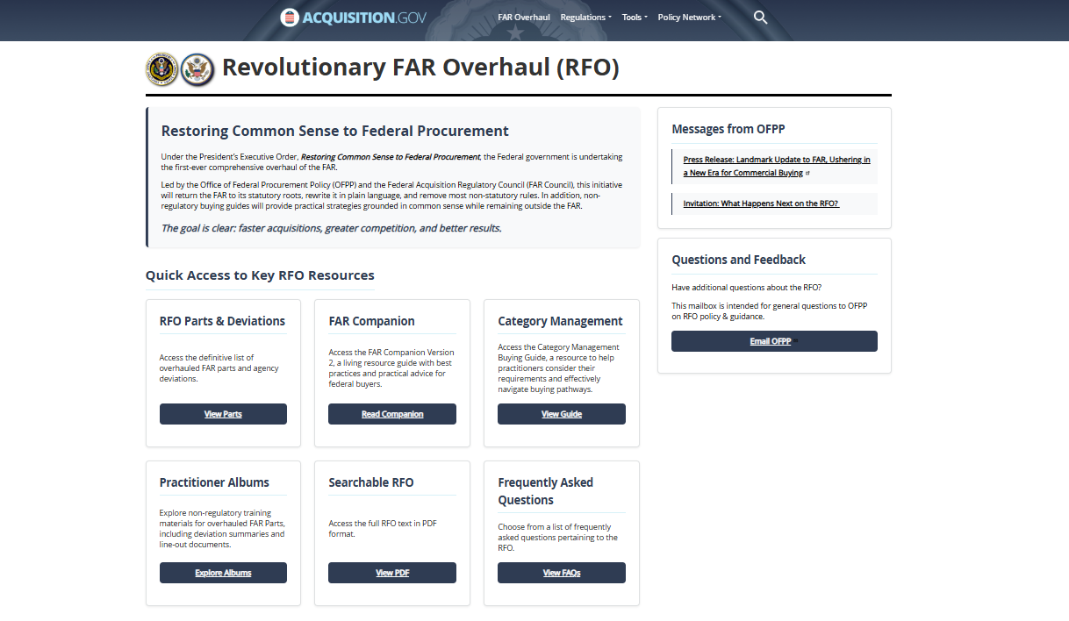
Navigating FAR Modernization - Source Information for Responsible AI Use
https://chat.gsa.usai.gov/ DEMO
Overhauled FAR parts and Agency deviations
Overhauled FAR parts and Agency deviations
FAR Companion
Practitioner Albums – Change Summaries and Resources
FAR Companion and Category Management Buying Guide
Practitioner Albums – Change Summaries and Resources
Central location for all RFO resources: https://www.acquisition.gov/far-overhaul
Notes:
Danielle

Slide 24
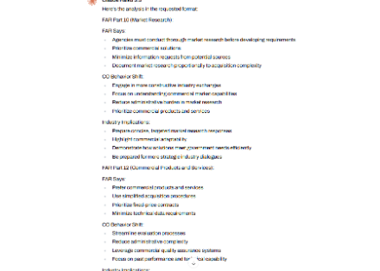
Sample Output
Tactical Industry Tips:
Invest in commercial-like proposal processes that highlight adaptability
Build comprehensive past performance documentation from commercial markets
Develop flexible pricing models that align with government's preference for fixed-price contracts

Slide 25
Industry - Important Takeaways
& Resources

Slide 26


AI Helps us Move Faster. RFO Helps Us Innovate. Industry Helps us Buy Smarter.
Revolutionary FAR Overhaul (RFO)
Marketplace Intelligence
Notes:
Danielle

Slide 27
Why This Matters for YOU
The FAR got Streamlined. By a lot.
Commercial practices matter more than ever!
Make your Solutions Easier to Understand and be Ready to Demo Capability
Acquisition is going to move FASTER - Early, Targeted Engagement Matters
The BEST news: People Using AI to by Smarter
AI accelerates the process -- HUMANs still drive decisions and ethics
Get Smart on Prompting:
Show its reasoning steps
List assumptions
Cite FAR text you provide
Ask you Questions before performing a task
Suggest Better Prompts

Slide 28
Thank You.
Q&A

Slide 29
GSA Trademark Icon

