Slide 1
Industry's Guide to Market Research As a Service (MRAS)
Tiffany Shabanian | June 16, 2026
Notes:
Please ** MAKE COPY TO EDIT**

Slide 2

Presenter
Tiffany Shabanian
Market Research Analyst
rfi@research.gsa.gov

Slide 3
Agenda
Market Research As a Service (MRAS) Overview
MRAS Value Proposition: What’s in It for You?
Available Services
How to Participate
Best Practices for Completing MRAS RFI Surveys
Key Tips, Reminders, and Resources

Slide 4
Solving the Acquisition Challenge
Market Research as a Service (MRAS) was created as a value-added support program to help federal, state, and local agencies efficiently meet FAR Part 10 market research requirements
Solving common acquisition challenges:
Time-consuming market research
Difficulty identifying qualified vendors
Finding GSA contract solutions
Need for stronger acquisition planning data
Centralizes and streamlines government market research using:
RFIs (Requests for Information)
Sources sought notices
Industry engagement
Product and pricing analysis
GSA contract data

Slide 5

What is Market Research as a Service (MRAS)?
Helps agencies understand the marketplace and available industry solutions
Provides insight into competition and business size categories for upcoming requirements.
Leverages industry feedback to support market research and informed acquisition decisions.
FAR Part 10 guides market research procedures.

Slide 6
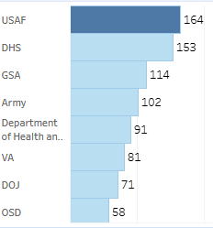
MRAS Growth
$78 Billion in MRAS RFIs awarded to GSA contract holders!
GSA as a Broker
GSA acts as a liaison between agency customers and industry partners
Industry partners receive both agency customer and GSA POC information
Partnering with customers to meet small business goals
Over 2,800 customers supported
Over 75 agencies served
Over 10,000 MRAS RFI surveys issued
Data as of 05/27/2026

Slide 7
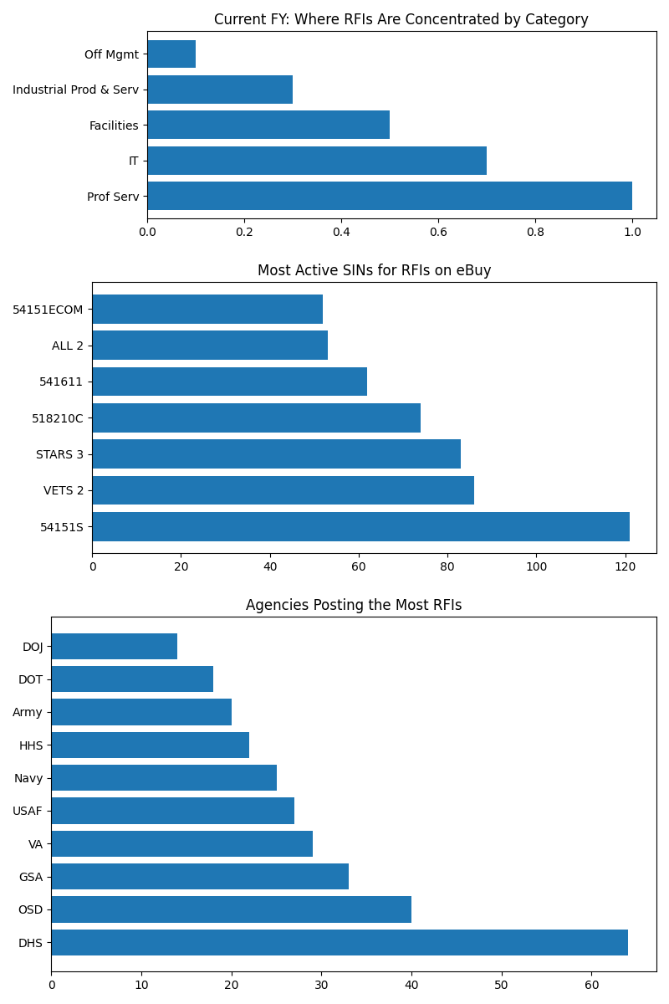
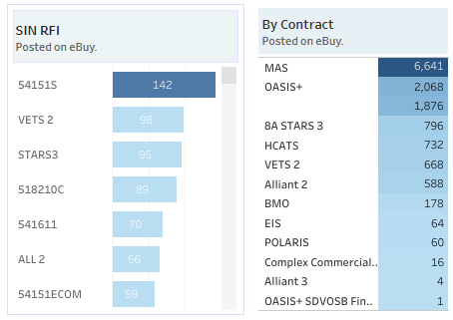
MRAS Value Add - What’s in it for Me?
Free Lead Sourcing: MRAS RFI notifications sent to GSA industry partners based on Contracts and Categories/SINs
*Data as of 5/27/2026

Slide 8
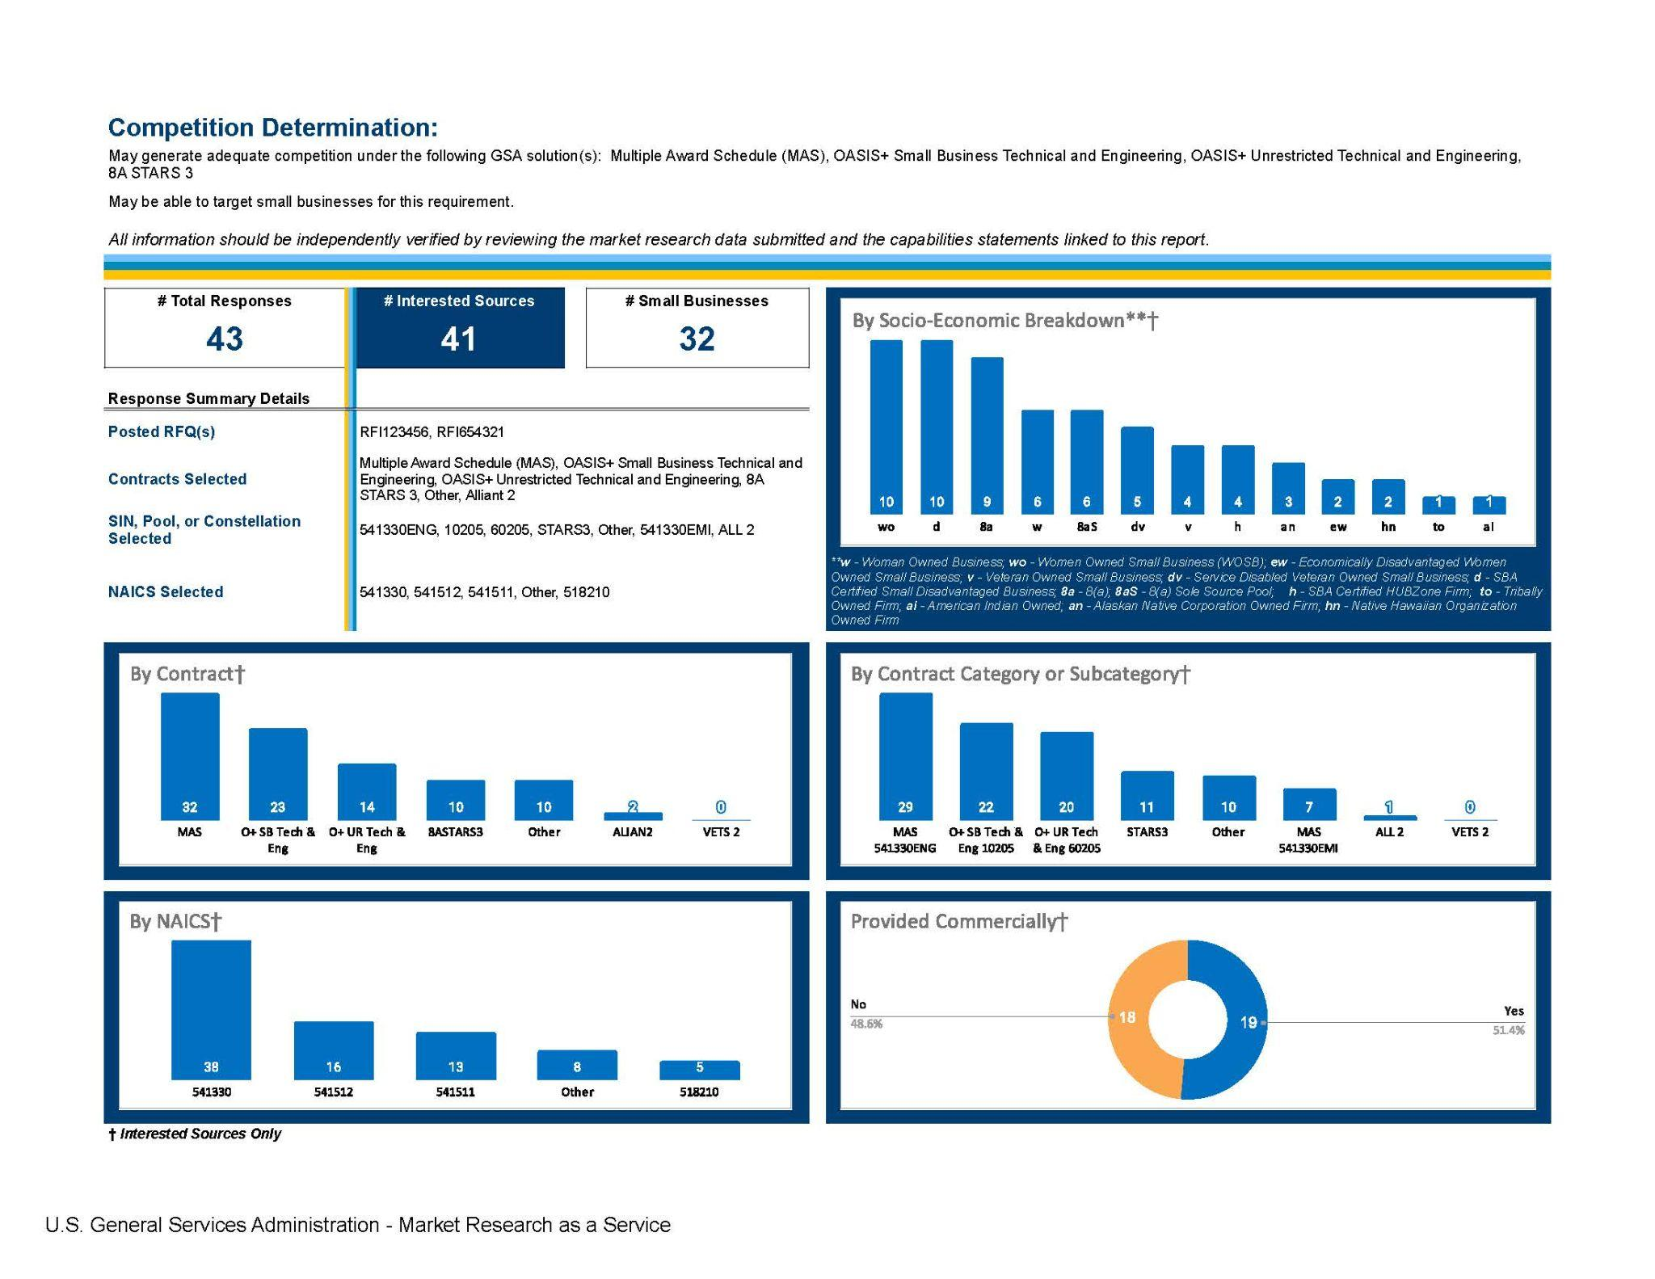
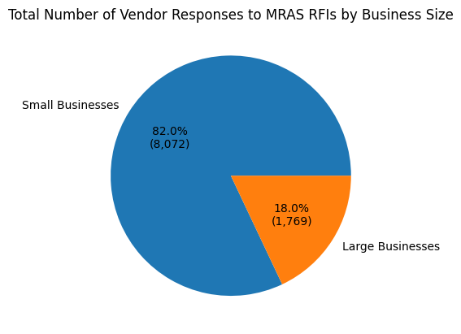
Highlighting Small Businesses
One column text box.
**Data as of 2/13/2026

Slide 9

MRAS Success Story
Customer: Department of Homeland Security
Requirement: Provide management, staffing, resources, and support services; including operational, administrative, financial, and budget assistance to FPS and field offices.
Results: RFI Posted to OASIS+ Small Business Management and Advisory Pool 10101. RFI resulted in 76 small business responses
Award: $3.5 million multi-year awarded to a Service-Disabled Veteran-Owned Small Business (SDVOSB)

Slide 10

Available Service Options
Product Market Research
Rapid Review
Request for Information
Market your capabilities by participating in the MRAS program today!
Report with pricing data for up to 20,000 GSA Advantage products within 48-72 hours.
A comprehensive list of potential GSA solutions and contract information within 48-72 hours.
Streamlines the RFI process and consolidates results into one report with visuals typically within 1-2 weeks

Slide 11
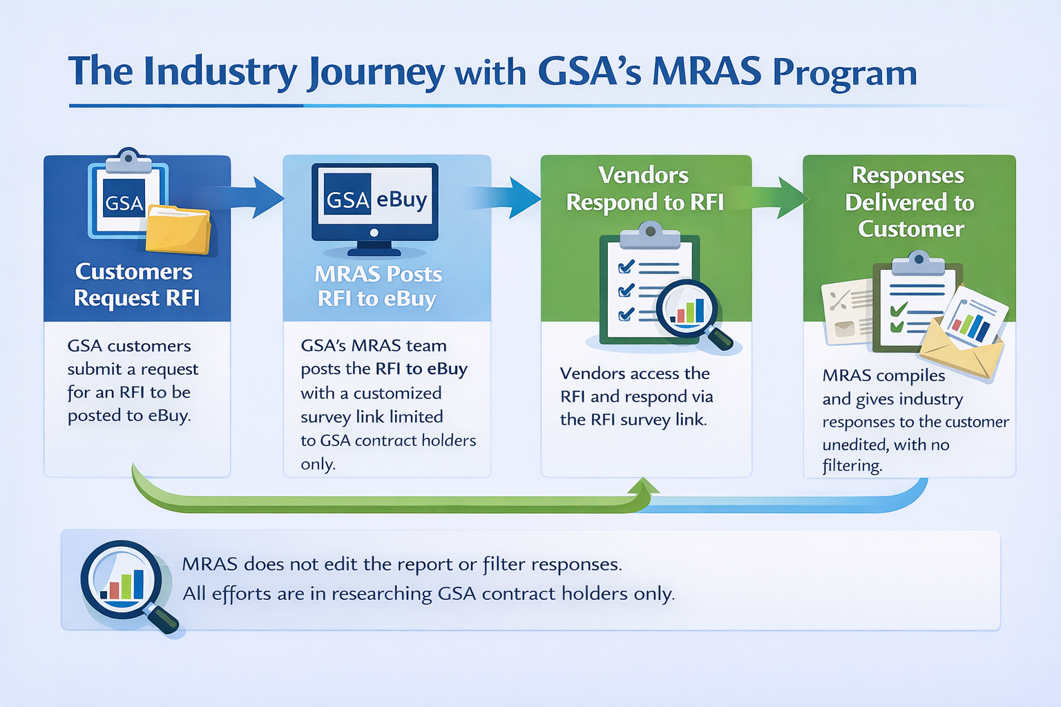
Industry Journey

Slide 12

How to find MRAS Surveys/RFIs
MRAS RFIs are posted in GSA eBuy under applicable SINs
Eligible vendors receive notifications through eBuy and rfi@research.gsa.gov
Submit responses through the survey link only
Keep GSA eLibrary contact information up to date
Check spam/junk folders for confirmation emails
Note: Not all RFIs posted on eBuy are MRAS RFIs

Slide 13
Tips for submitting
an RFI response

Slide 14
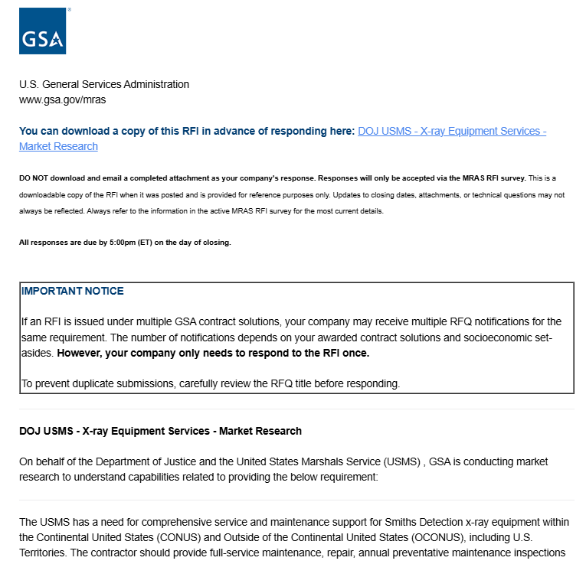
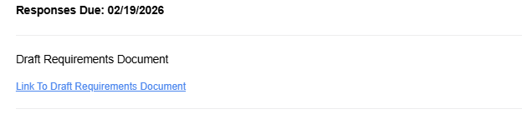
Survey Description
Download a copy of the survey including all questions.
Review the Scope description in the summary
Be sure to download any requirements attachments like the PWS or SOW

Slide 15

Using Socio-economic Designations
Accurately list your socio-economic designation as shown on your GSA contract, as customers use this information for set-asides.
Incorrect designations will prevent your company from seeing relevant opportunities in eBuy.
Omitting valid designations may reduce your chances of benefiting from set-asides and winning contracts.

Slide 16
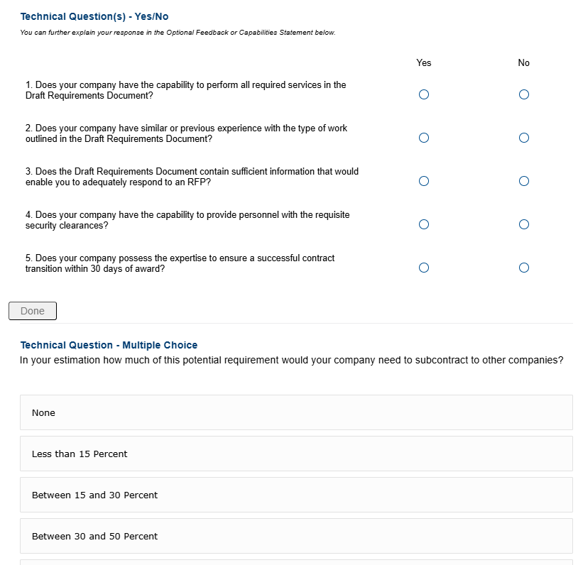

Technical Questions
You can expand on responses to technical questions in your capabilities statement

Slide 17
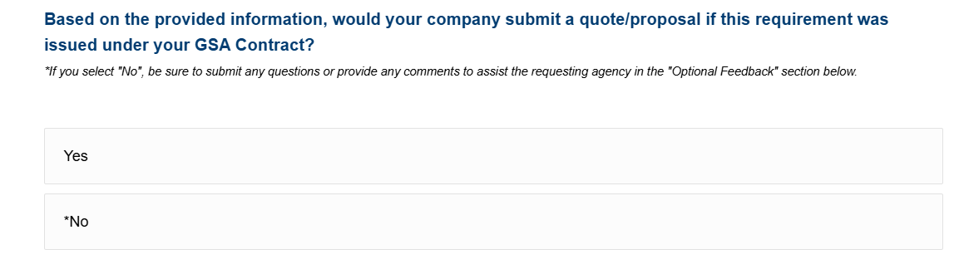

Offers
By selecting YES, your responses will be included in the report to the customer

Slide 18
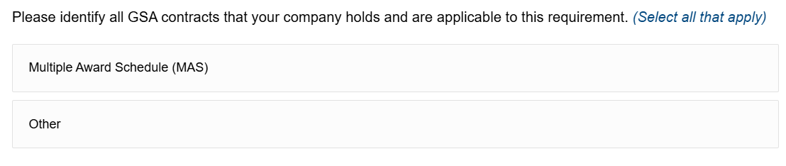
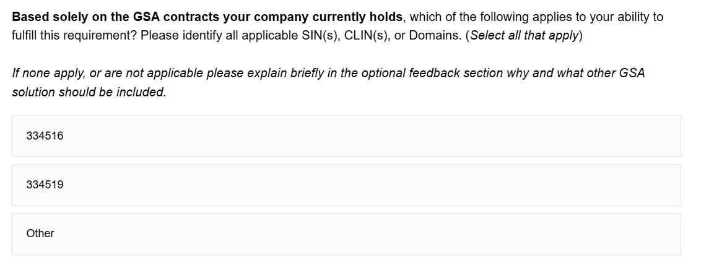
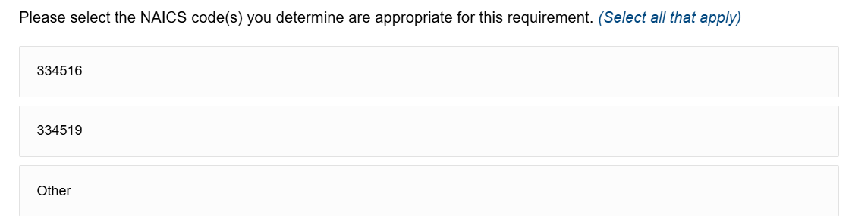
Contract/SIN/NAICS
When making your selection, be sure it relates to the scope of the requirement.
Multiple answers can be selected here.
Choose the SIN or NAICS most appropriate for the requirement

Slide 19
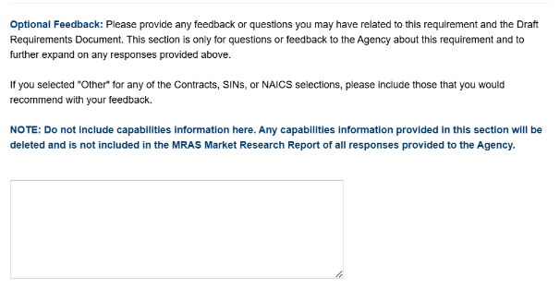
Feedback
Provide honest feedback about the survey
Include questions or concerns you may have about the PWS/SOW or requirement

Slide 20
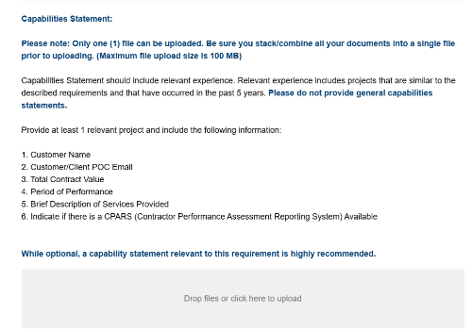
Capabilities Statement
Upload a capabilities statement with your survey response
Add a general capabilities statement URL in the “Company Information” section
Optional, but strongly encouraged
Include relevant experience and detailed technical capabilities
Combine all supporting documents into one file before uploading
Explain any “No” responses or technical limitations clearly

Slide 21

What Happens Next?
An email confirmation with a copy of your responses will be sent to you.
A market research report summarizing your responses and feedback is shared with agency acquisition professionals.
Within 7–10 business days of your response, you will receive the Customer Agency and GSA Customer Service Director's contact information via email for follow-up questions.
By submitting your response to the survey, you agree to have your information shared with other Government entities

Slide 22
Reminders
Submit your response through the RFI to ensure it is included in the final customer report.
No Extensions are granted: RFIs are meant to be streamlined. Respond with whatever information you have by the due date.
Do not email attachments to MRAS; they will not be included or forwarded. Send additional materials directly to the agency POC.
Agency POC information is provided by email (within 7–10 business days) to vendors that submit a response.
Submit questions in the Optional Feedback section. For questions related to the acquisition contact the agency POC directly.
Note: MRAS does not provide information on acquisition strategy or anticipated RFP release dates.

Slide 23
MRAS RFI Report

Slide 24
MRAS Executive Summary Report
Clear response data delivered to the customer agency.
All vendor responses are provided as received; unfiltered, unranked, and unexcluded.
MRAS supplies complete RFI data without directing vendor selection.

Slide 25
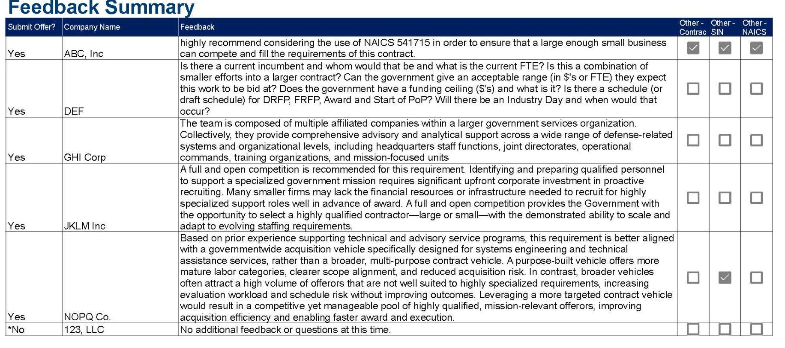
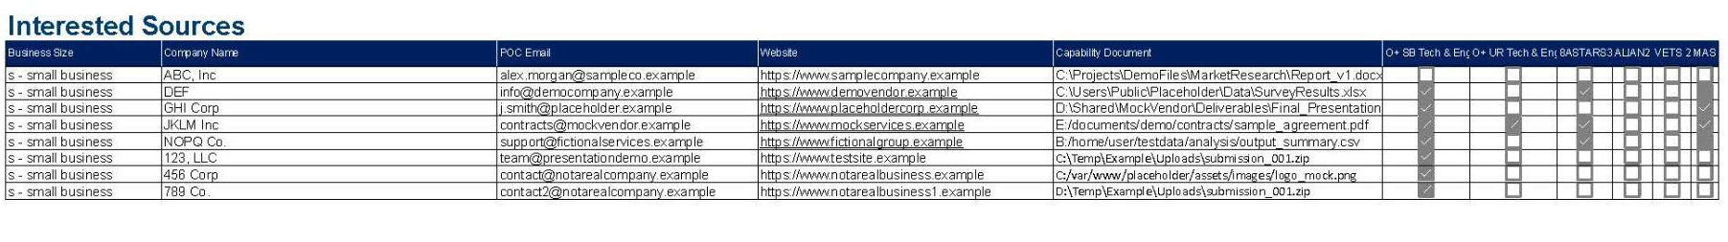
MRAS Feedback Summary

Slide 26
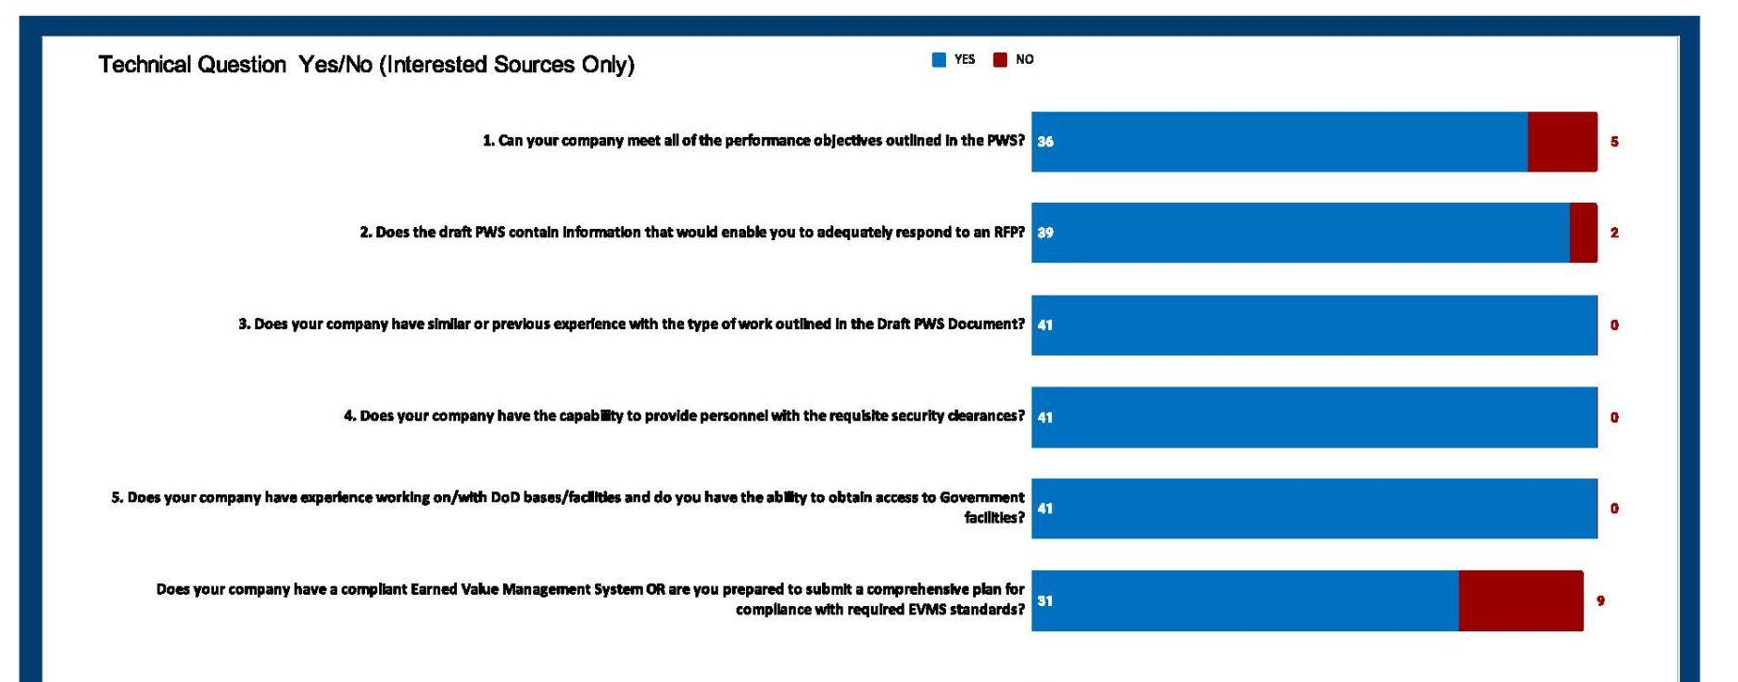
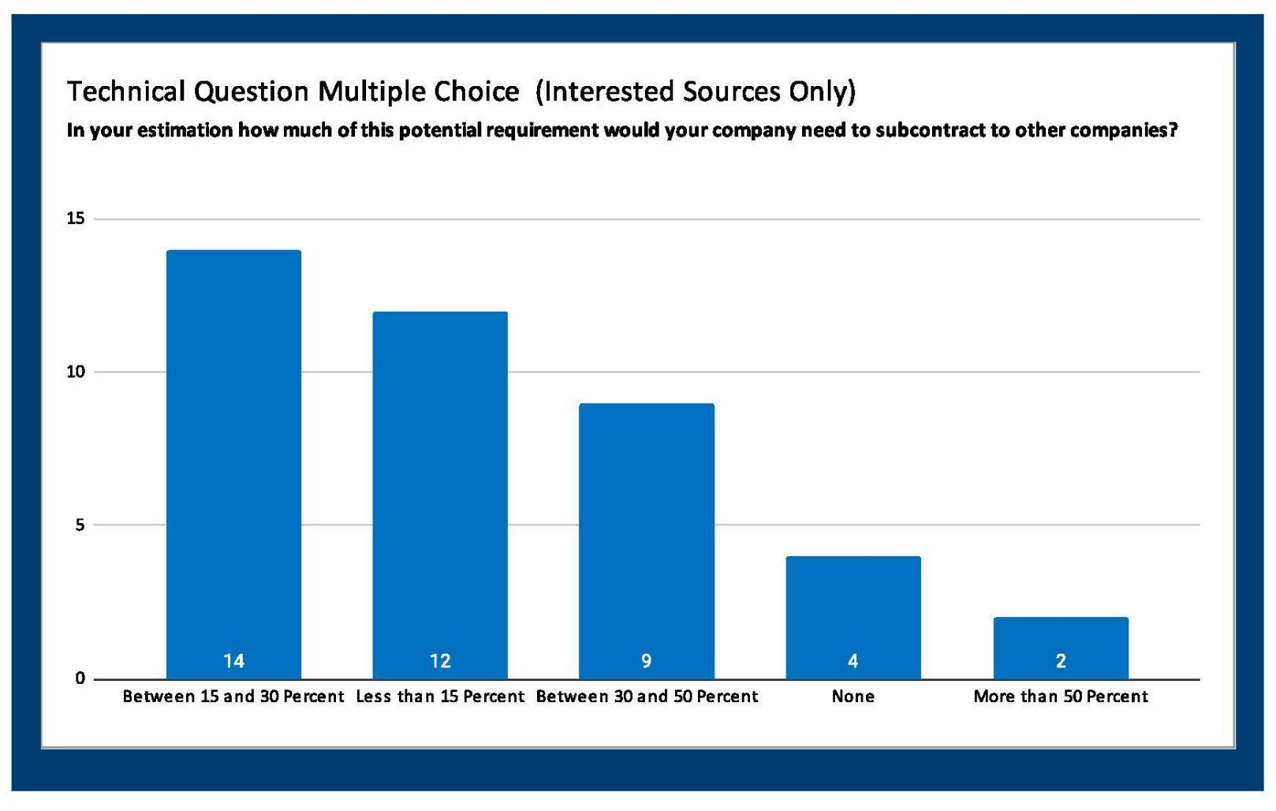
MRAS Technical Question Examples
One column text box.

Slide 27
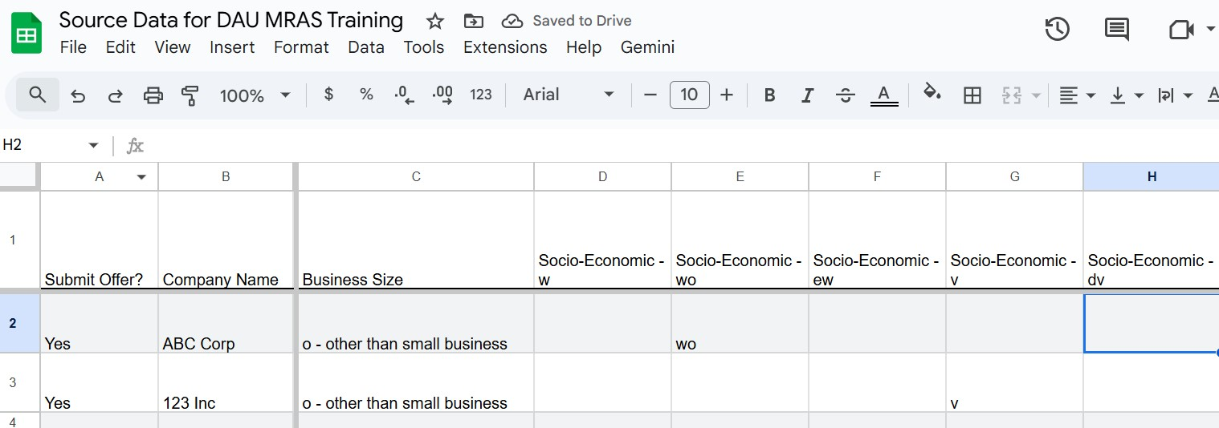
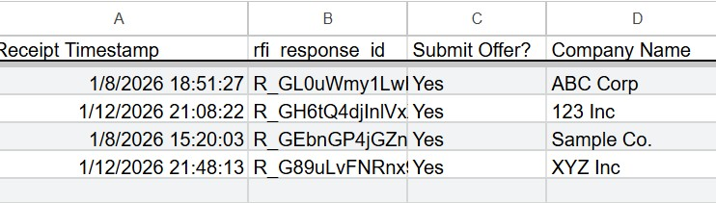
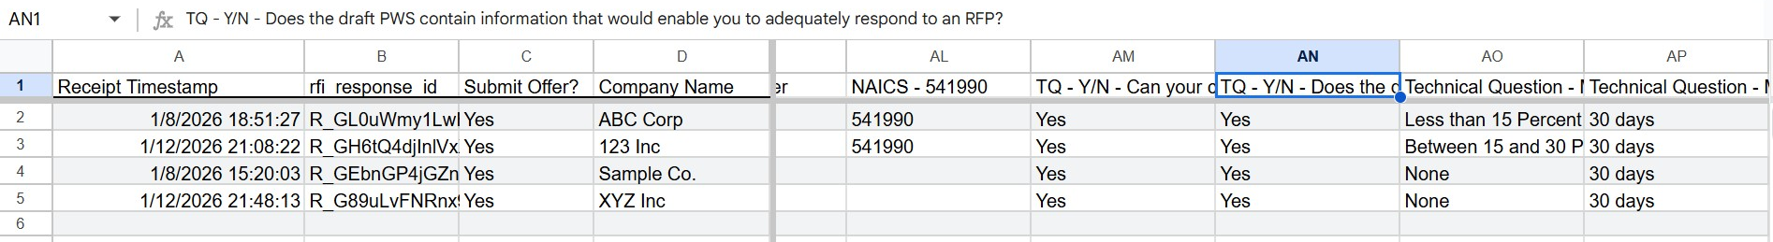
Source Data

Slide 28
The Results
Industry
Customer agency acquisition professionals
Visibility as a potential source in front of customers.
Access to GSA and Agency Points of Contacts.
Responses to RFIs lead to additional business
Data and visuals that can be included in reports to the Office of Small Business
Narratives for acquisition planning.
Comprehensive view of the marketplace (is competition/socio-economic participation likely).

Slide 29
MRAS Resources
For Assistance click: Industry Help Request Form
For any additional questions, email: RFI@Research.GSA.gov
Visit www.Buy.GSA.gov/MRAS for more information on GSA’s Market Research as a Service (MRAS)
Click HERE to sign up for future MRAS Industry Training

Slide 30
Thank You.

Slide 31
GSA Trademark Icon

