Slide 1
The Office of Centralized Acquisition Services (OCAS)
Nate Jordan | June 16, 2026
Notes:
Please ** MAKE COPY TO EDIT**

Slide 2
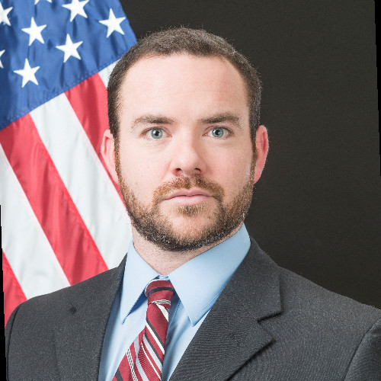
OCAS Presenter
Nate Jordan
Agency Liaison
IndustryGSAOCAS@gsa.gov

Slide 3
OCAS - Mission & Vision
Established in September, 2025, Office of Centralized Acquisition Services (OCAS) provides federal agencies with a contracting shared service option for procurement common goods and services.
The office supports the principles established by EO 14240 - Eliminating Waste and Saving Taxpayer Dollars by Consolidating Procurement.
Mission
Simplify how the federal government acquires common goods and services through a centralized, enterprise-wide approach.
Vision
  Provide direct contracting support for common goods and services.
  Partner with agencies to align procurement with mission objectives while simplifying the process.

Slide 4
OCAS - Our Credentials
30+
Agencies Supported
98
New contract awards in FY 26
OCAS has been supporting agencies since March, 2025
Our workforce is a dedicated service team with one entry point to funnel all your inquiries
Trusted partner for agencies navigating staffing gaps and procurement needs.
$71M
New contract award value in FY 26 YTD
86%
% awarded to Small Businesses FY 26 YTD

Slide 5
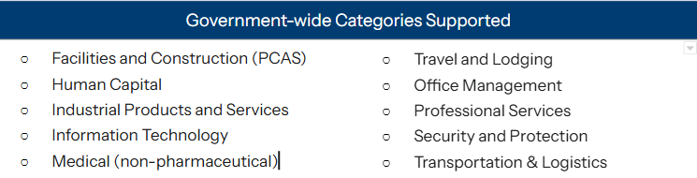
OCAS - What we Support
OCAS supports standard, mission agnostic requirements in all contracting categories.
Examples:
Enterprise software, mobile phones, laptops, GSA-owned building support, office furniture, financial services, landscaping, helpdesk services, janitorial supplies, tools/facilities services

Slide 6
OCAS - Key Features
Agency Opt-In Approach
Agencies are able to leverage OCAS contracting officer expertise and identify opportunities where centralized services can deliver the most value. This may include:
  Transitioning existing contracts to GSA when option periods remain, and/or
  Support new requirements across the acquisition lifecycle
Repetitive, Standard Contracts
The focus of OCAS work will be standard, repetitive contracts that take significant administrative time and do not vary by agency, examples include:
  Mobile phone purchases and maintenance
  Software license agreements
  Enterprise licenses and support services
  Readily available products/services where there are many vendors and lots of alternatives.
OCAS Contract Support
OCAS works in conjunction with agency program CORs to provide acquisition support, including:
  Solicitation development
  Acquisition strategy and associated documents
  Supporting the procurement process
  Source selection and proposal evaluation
  Vendor negotiation
  Awards
  Vendor and invoice management
Notes:
NATE
If there is one slide to share with your agency partners, this is the slide that describes some of the key features of OCAS:
OCAS provides an opt-in model for agencies that want to centralize acquisition services, offering flexibility while reducing procurement burden.
We’re staffed with experienced, FAC-certified Contract Specialists and Contracting Officers who work with agencies to identify opportunities to centralize and streamline procurements.
Whether an agency is transitioning existing contracts to GSA or developing new requirements, OCAS staff are prepared to provide end-to-end acquisition support.
OCAS focuses on common goods and services—standard, repetitive requirements that often consume significant administrative time and resources.
Again, think mobile device purchases, software licensing and renewals, enterprise licenses and support services, and other readily available products and services with a competitive vendor marketplace.
OCAS partners closely with agency program staff and CORs to deliver comprehensive acquisition support.
This includes solicitation development, acquisition strategy and supporting documentation, procurement execution, source selection and proposal evaluation, vendor negotiations, contract awards, and ongoing vendor and invoice management.

Slide 7
Industry Partnership
OCAS provides a centralized buying channel for industry to sell commercial, domestic, common goods and services, providing:
Predictable Forecasts
Transparency and Communication
Simplified, Standard Processes
Agency agnostic contracting practices
Centralized market intelligence on buyers, pricing, and purchasing timelines
Standard processes and terms
Consistent pricing expectations and a more efficient federal sales environment
Reach all participating federal agencies through OCAS
Collaborate with GSA category specialists to develop best-in-class solutions.
Insights on government-wide trends, policies, and spending patterns.
Clear, uniform guidance and compliance expectations from one source
Reduced account management and delivery expenses
Standardized GSA platforms that simplify selling and contract administration
Minimized barriers to entry make it easier vendors to compete and grow

Slide 8
Agency Partnerships
CFO Act Agencies
Defense Agencies
Commerce- International Trade Association (ITA)
Environmental Protection Agency (EPA)
Health and Human Services (HHS) - National Design Studio
Housing and Urban Development (HUD) & OIG
Office of Personnel Management (OPM)
Small Business Administration (SBA)
Air Force - Hill Air Force Base, AFLCMC/ROZ, Special Tactics and Training Squadron (STTS)
Defense Health Agency - Joint Pathology Center
Navy - Naval Facilities Engineering Systems Command (NAVFAC), Bureau of Medicine and Surgery (BUMED)
Small Agencies
Federal Mediation and Conciliation Services (FMSC)
Federal Mine Safety & Health Review Commission (FMSHRC)
Federal Permitting Improvement Steering Council (FPISC)
Gulf Coast Ecosystem Restoration Council (GCC)
National Indian Gaming Commission (NIGC)
National Mediation Board (NMB)
Northern Border Regional Commission (NBRC)
Office of Government Ethics (OGE)
Office of Special Counsel (OSC)
Pension Benefit Guaranty Corporation (PBGC)
Public Building Reform Board (PBRB)
U.S. International Trade Commission (USITC)
Notes:
NATE
This slide gives you a snapshot of the breadth of federal agencies we are actively supporting today—ranging from small, independent boards to large cabinet-level departments.
Our partners include agencies such as OPM, SBA, HUD, EPA, the Pension Benefit Guaranty Corporation, the National Mediation Board, and the Department of the Treasury. Each engagement is different, but the common thread is helping agencies navigate complex acquisition needs while staying focused on mission delivery.
Since OCAS is a new division in GSA we are currently in discussions with many federal entities such as: Air Force, Navy, Army, Department of Interior, etc. and those conversations continue to grow as agencies look for scalable and trusted acquisition support. As we move into the 3rd and 4th Quarter of FY 2026 we will be announcing pipeline reviews that will include opportunities for industry both from the Civilian and Defense Sectors. All upcoming pipeline reviews will be announced on the OCAS interact site at buy.gsa.gov/interact. As our industry partners, we know you have valuable insight to many government entities that could use support we do ask that you bring those to our attention. We are building OCAS to support to support agencies of all sizes and maturity levels, and we welcome opportunities to partner with any federal organization seeking acquisition assistance.

Slide 9
End of Presentation

