Slide 1
Master the Art of Reading Invoices
February 9th, 2024
Office of Integrated Marketing

Slide 2
Presenter
Eugene Hwang
Acquisition Project Management Specialist
Civilian Services Acquisition Workshops Program
Office of Professional Services & Human Capital Categories General Services Administration
eugene.hwang@gsa.gov

Slide 3
Topics
What is an invoice?
What details should the invoice have?
I got an invoice from my contractor - now what?
How do I interpret it? Does contract type drive this?
Should I pay my contractor or not? If not, what documentation do I need to put together to back this up?
What should I do next?
Notes:
Agenda

Slide 4
What is an invoice?
Notes:
Engage audience Invoice definition
Dictionary definition
Dictionary def - a list of good sent or services provided, with a statement of the sum due for these; a bill.
FAR definition
What should the invoice have

Slide 5
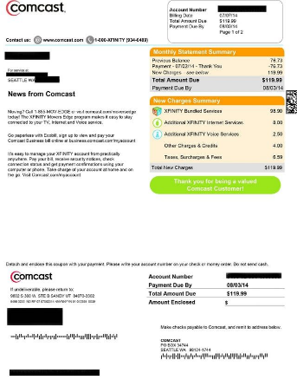
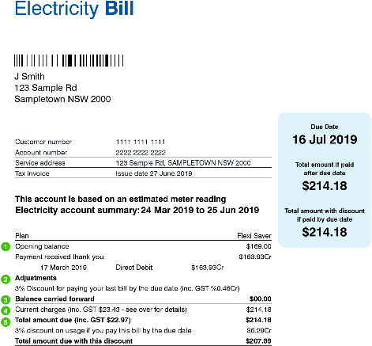
What is an invoice?
Notes:
Dictionary def - a list of good sent or services provided, with a statement of the sum due for these; a bill.

Slide 6
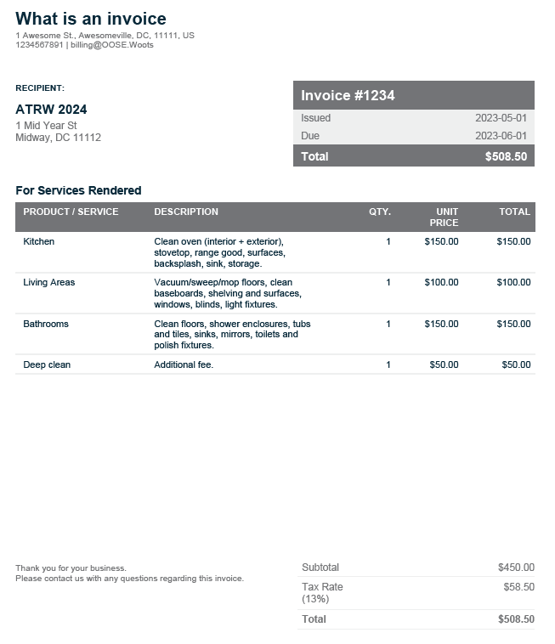
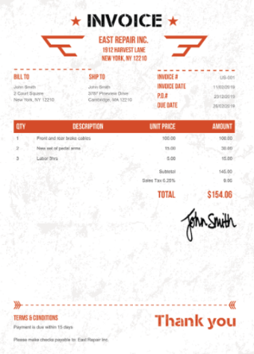
What is an invoice?
Notes:
What is invoice for Government and how does it look differ?

Slide 7
What is an invoice?
A list of good sent or services provided, with a statement of the sum due for these; a bill.
Invoice means a contractor’s bill or written request for payment under the contract for supplies delivered or services performed (see also "proper invoice").
Proper invoice means an invoice that meets the minimum standards specified in FAR 32.905(b).
Notes:
What is Invoice - FAR definition

Slide 8
What details should an invoice have?
Name and address of the contractor
Name and address of contractor official to whom payment is to be sent
Name, title, phone number, and mailing address of person to notify in the event of a defective invoice
Invoice date and invoice number
Project ID / Contract number or other authorization for supplies delivered including the order number and line item number
Description, quantity, unit of measure of supplies delivered or services performed
Unit price and extended price of supplies delivered or services performed
Shipping and payment terms (e.g., shipment number and date of shipment, discount for prompt payment terms). Bill of lading number and weight of shipment if shipped on government bill of landing
Any other information or documentation required by the contract
Terms of any discount for prompt payment offered
Does the Invoice include the ACT Number
Notes:
(b) Content of invoices. (1) A proper invoice must include the following items (except for interim payments on cost reimbursement contracts for services):
(i) Name and address of the contractor.
(ii) Invoice date and invoice number. (Contractors should date invoices as close as possible to the date of mailing or transmission.)
(iii) Contract number or other authorization for supplies delivered or services performed (including order number and line item number).
(iv) Description, quantity, unit of measure, unit price, and extended price of supplies delivered or services performed.
(v) Shipping and payment terms (e.g., shipment number and date of shipment, discount for prompt payment terms). Bill of lading number and weight of shipment will be shown for shipments on Government bills of lading.
(vi) Name and address of contractor official to whom payment is to be sent (must be the same as that in the contract or in a proper notice of assignment).
(vii) Name (where practicable), title, phone number, and mailing address of person to notify in the event of a defective invoice.
(viii) Taxpayer Identification Number (TIN). The contractor must include its TIN on the invoice only if required by agency procedures. (See 4.9 TIN requirements.)
(ix) Electronic funds transfer (EFT) banking information.
(A) The contractor must include EFT banking information on the invoice only if required by agency procedures.
(B) If EFT banking information is not required to be on the invoice, in order for the invoice to be a proper invoice, the contractor must have submitted correct EFT banking information in accordance with the applicable solicitation provision (e.g., 52.232-38, Submission of Electronic Funds Transfer Information with Offer), contract clause (e.g., 52.232-33, Payment by Electronic Funds Transfer-System for Award Management, or 52.232-34, Payment by Electronic Funds Transfer-Other Than System for Award Management), or applicable agency procedures.
(C) EFT banking information is not required if the Government waived the requirement to pay by EFT.
(x) Any other information or documentation required by the contract (e.g., evidence of shipment).
(2) An interim payment request under a cost-reimbursement contract for services constitutes a proper invoice for purposes of this subsection if it includes all of the information required by the contract.
(3) If the invoice does not comply with these requirements, the designated billing office must return it within 7 days after receipt (3 days on contracts for meat, meat food products, or fish; 5 days on contracts for perishable agricultural commodities, dairy products, edible fats or oils, and food products prepared from edible fats or oils), with the reasons why it is not a proper invoice. If such notice is not timely, then the designated billing office must adjust the due date for the purpose of determining an interest penalty, if any.
(c) Authorization to pay. All invoice payments, with the exception of interim payments on cost-reimbursement contracts for services, must be supported by a receiving report or other Government documentation authorizing payment (e.g., Government certified voucher). The agency receiving official should forward the receiving report or other Government documentation to the designated payment office by the 5 thworking day after Government acceptance or approval, unless other arrangements have been made. This period of time does not extend the due dates prescribed in this section. Acceptance should be completed as expeditiously as possible. The receiving report or other Government documentation authorizing payment must, as a minimum, include the following:
(1) Contract number or other authorization for supplies delivered or services performed.
(2) Description of supplies delivered or services performed.
(3) Quantities of supplies received and accepted or services performed, if applicable.
(4) Date supplies delivered or services performed.
(5) Date that the designated Government official-
(i) Accepted the supplies or services; or
(ii) Approved the progress payment request, if the request is being made under the clause at 52.232-5, Payments Under Fixed-Price Construction Contracts, or the clause at 52.232-10, Payments Under Fixed-Price Architect-Engineer Contracts.
(6) Signature, printed name, title, mailing address, and telephone number of the designated Government official responsible for acceptance or approval functions.
(d) Billing office. The designated billing office must immediately annotate each invoice with the actual date it receives the invoice.
(e) Payment office. The designated payment office will annotate each invoice and receiving report with the actual date it receives the invoice.

Slide 9
Invoice Details, cont’d
Current Billing Address Information
Invoice Date
Billing Number
Invoice Number
Task Order ID / PO Number
Bill to address
Remit to address
Notes:
(b) Content of invoices. (1) A proper invoice must include the following items (except for interim payments on cost reimbursement contracts for services):
(i) Name and address of the contractor.
(ii) Invoice date and invoice number. (Contractors should date invoices as close as possible to the date of mailing or transmission.)
(iii) Contract number or other authorization for supplies delivered or services performed (including order number and line item number).
(iv) Description, quantity, unit of measure, unit price, and extended price of supplies delivered or services performed.
(v) Shipping and payment terms (e.g., shipment number and date of shipment, discount for prompt payment terms). Bill of lading number and weight of shipment will be shown for shipments on Government bills of lading.
(vi) Name and address of contractor official to whom payment is to be sent (must be the same as that in the contract or in a proper notice of assignment).
(vii) Name (where practicable), title, phone number, and mailing address of person to notify in the event of a defective invoice.
(viii) Taxpayer Identification Number (TIN). The contractor must include its TIN on the invoice only if required by agency procedures. (See 4.9 TIN requirements.)
(ix) Electronic funds transfer (EFT) banking information.
(A) The contractor must include EFT banking information on the invoice only if required by agency procedures.
(B) If EFT banking information is not required to be on the invoice, in order for the invoice to be a proper invoice, the contractor must have submitted correct EFT banking information in accordance with the applicable solicitation provision (e.g., 52.232-38, Submission of Electronic Funds Transfer Information with Offer), contract clause (e.g., 52.232-33, Payment by Electronic Funds Transfer-System for Award Management, or 52.232-34, Payment by Electronic Funds Transfer-Other Than System for Award Management), or applicable agency procedures.
(C) EFT banking information is not required if the Government waived the requirement to pay by EFT.
(x) Any other information or documentation required by the contract (e.g., evidence of shipment).
(2) An interim payment request under a cost-reimbursement contract for services constitutes a proper invoice for purposes of this subsection if it includes all of the information required by the contract.
(3) If the invoice does not comply with these requirements, the designated billing office must return it within 7 days after receipt (3 days on contracts for meat, meat food products, or fish; 5 days on contracts for perishable agricultural commodities, dairy products, edible fats or oils, and food products prepared from edible fats or oils), with the reasons why it is not a proper invoice. If such notice is not timely, then the designated billing office must adjust the due date for the purpose of determining an interest penalty, if any.
(c) Authorization to pay. All invoice payments, with the exception of interim payments on cost-reimbursement contracts for services, must be supported by a receiving report or other Government documentation authorizing payment (e.g., Government certified voucher). The agency receiving official should forward the receiving report or other Government documentation to the designated payment office by the 5 thworking day after Government acceptance or approval, unless other arrangements have been made. This period of time does not extend the due dates prescribed in this section. Acceptance should be completed as expeditiously as possible. The receiving report or other Government documentation authorizing payment must, as a minimum, include the following:
(1) Contract number or other authorization for supplies delivered or services performed.
(2) Description of supplies delivered or services performed.
(3) Quantities of supplies received and accepted or services performed, if applicable.
(4) Date supplies delivered or services performed.
(5) Date that the designated Government official-
(i) Accepted the supplies or services; or
(ii) Approved the progress payment request, if the request is being made under the clause at 52.232-5, Payments Under Fixed-Price Construction Contracts, or the clause at 52.232-10, Payments Under Fixed-Price Architect-Engineer Contracts.
(6) Signature, printed name, title, mailing address, and telephone number of the designated Government official responsible for acceptance or approval functions.
(d) Billing office. The designated billing office must immediately annotate each invoice with the actual date it receives the invoice.
(e) Payment office. The designated payment office will annotate each invoice and receiving report with the actual date it receives the invoice.

Slide 10
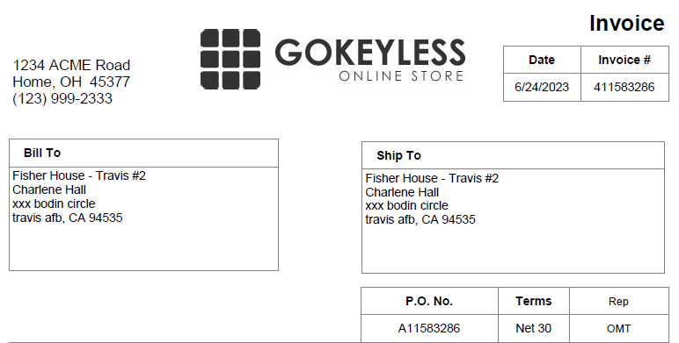
Invoice Details, cont’d
Notes:
Invoice Date
Billing Number
Invoice Number
Task Order ID / PO Number
Bill to address
Remit to address

Slide 11
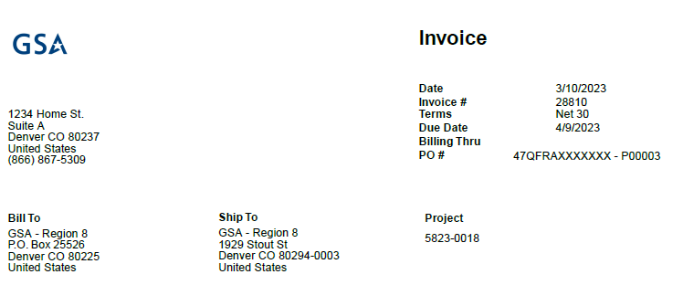
Invoice Details, cont’d
Notes:
Invoice Date
Billing Number
Invoice Number
Task Order ID / PO Number
Bill to address
Remit to address

Slide 12
Invoice Details, cont’d
Contract Information
Customer Number
Prime Contract Number
Project Number
Project Name
Period of Performance
Terms
Due Date
Billing Period Dates
Contract Value
Funded Value
Cost
Fees
Current Amount Billed
Cumulative Amount Billed
Totals
Notes:
Customer Number
Prime Contract Number
Project Number
Project Name
Period of Performance
Terms
Due Date
Billing Period Dates
Contract Value
Funded Value
Cost
Fees
Current Amount Billed
Cumulative Amount Billed
Totals

Slide 13
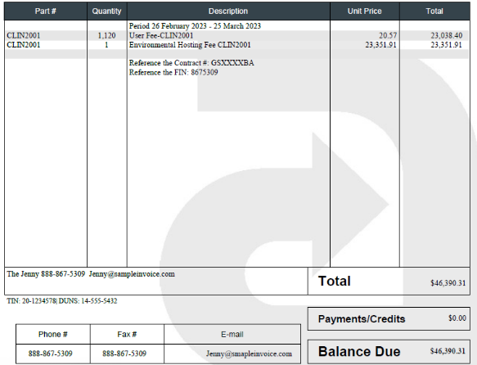
Invoice Details, cont’d
Notes:
Customer Number
Prime Contract Number
Project Number
Project Name
Period of Performance
Terms
Due Date
Billing Period Dates
Contract Value
Funded Value
Cost
Fees
Current Amount Billed
Cumulative Amount Billed
Totals

Slide 14
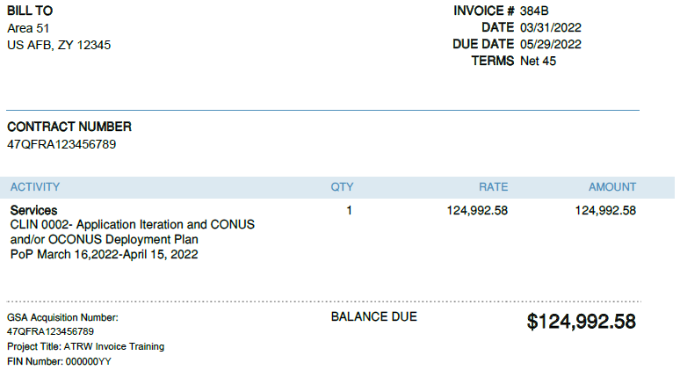
Invoice Details, cont’d
Notes:
Customer Number
Prime Contract Number
Project Number
Project Name
Period of Performance
Terms
Due Date
Billing Period Dates
Contract Value
Funded Value
Cost
Fees
Current Amount Billed
Cumulative Amount Billed
Totals

Slide 15
Invoice Details, cont’d
Detailed Billing Information
Contract Line Item Numbers (CLINs)
Labor Categories
Travel
Materials
Equipment
Training
Other Direct Costs (ODCs)
Material & Handling – G&A
Fee
Any Other Allowable Cost
Invoice Subtotals
Current Amount & Cumulative Amount
Not-to-Exceed (NTE) Amounts
Invoice Totals
Current & Cumulative Incurred Hours
Ceiling Hours/Rates
Notes:
CLINs
Labor Categories
Travel
Materials
Equipment
Training
Other Direct Costs
Material & Handling – G&A
Fee
Any Other Allowable Cost
Invoice Subtotals
Current Amount & Cumulative Amount
NTE Amounts
Invoice Totals
Current & Cumulative Incurred Hours
Ceiling Hours/Rates

Slide 16
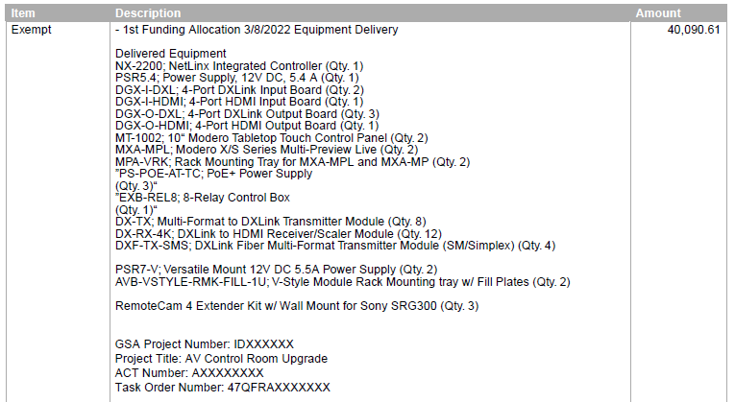
Invoice Details, cont’d
Notes:
CLINs
Labor Categories
Travel
Materials
Equipment
Training
Other Direct Costs
Material & Handling – G&A
Fee
Any Other Allowable Cost
Invoice Subtotals
Current Amount & Cumulative Amount
NTE Amounts
Invoice Totals
Current & Cumulative Incurred Hours
Ceiling Hours/Rates

Slide 17
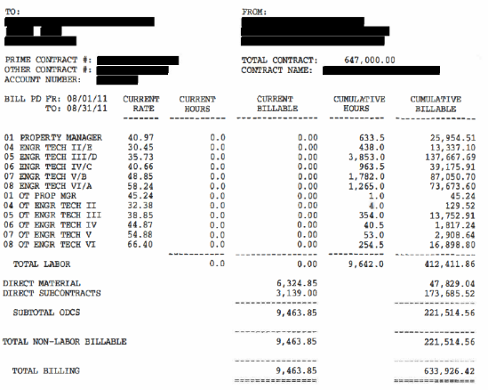
Invoice Details, cont’d
Notes:
CLINs
Labor Categories
Travel
Materials
Equipment
Training
Other Direct Costs
Material & Handling – G&A
Fee
Any Other Allowable Cost
Invoice Subtotals
Current Amount & Cumulative Amount
NTE Amounts
Invoice Totals
Current & Cumulative Incurred Hours
Ceiling Hours/Rates

Slide 18
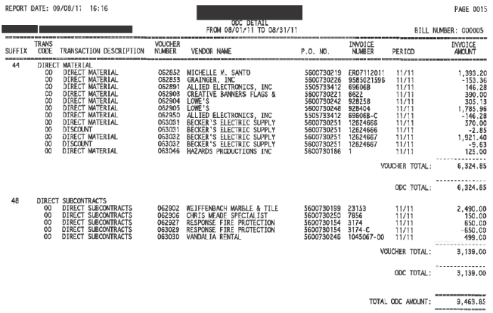
Invoice Details, cont’d
Notes:
Joy Comment: When receiving an invoice for ODCs, check for receipts. When receiving an invoice for subcontracted services, check attachments for invoice to contractor
CLINs
Labor Categories
Travel
Materials
Equipment
Training
Other Direct Costs
Material & Handling – G&A
Fee
Any Other Allowable Cost
Invoice Subtotals
Current Amount & Cumulative Amount
NTE Amounts
Invoice Totals
Current & Cumulative Incurred Hours
Ceiling Hours/Rates

Slide 19
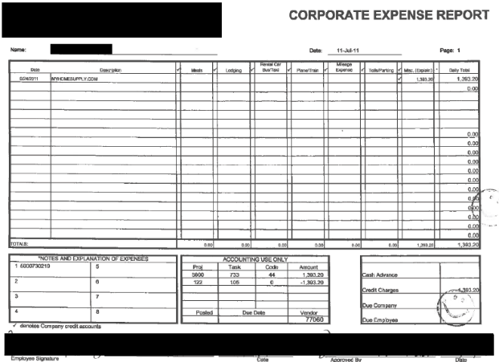
Invoice Details, cont’d
Notes:
CLINs
Labor Categories
Travel
Materials
Equipment
Training
Other Direct Costs
Material & Handling – G&A
Fee
Any Other Allowable Cost
Invoice Subtotals
Current Amount & Cumulative Amount
NTE Amounts
Invoice Totals
Current & Cumulative Incurred Hours
Ceiling Hours/Rates

Slide 20
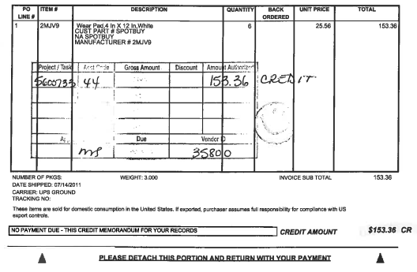
Invoice Details, cont’d
Notes:
CLINs
Labor Categories
Travel
Materials
Equipment
Training
Other Direct Costs
Material & Handling – G&A
Fee
Any Other Allowable Cost
Invoice Subtotals
Current Amount & Cumulative Amount
NTE Amounts
Invoice Totals
Current & Cumulative Incurred Hours
Ceiling Hours/Rates

Slide 21
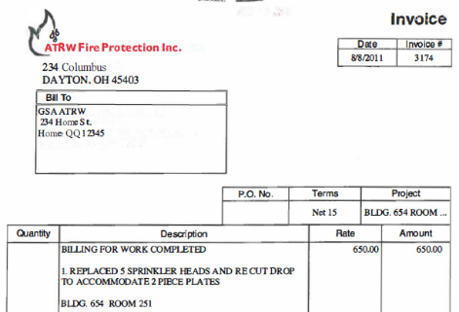
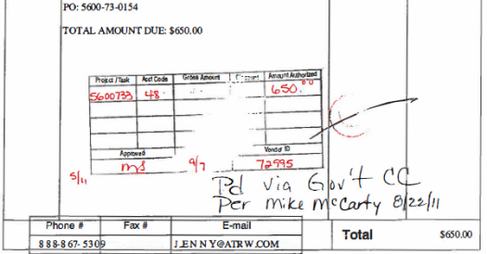
Invoice Details, cont’d
Notes:
Joy Comment: with services like this, check the contract terms & conditions for what data should be included on the invoice. Do we want the contractor to reference Work Orders?
CLINs
Labor Categories
Travel
Materials
Equipment
Training
Other Direct Costs
Material & Handling – G&A
Fee
Any Other Allowable Cost
Invoice Subtotals
Current Amount & Cumulative Amount
NTE Amounts
Invoice Totals
Current & Cumulative Incurred Hours
Ceiling Hours/Rates

Slide 22
Invoice Details, cont’d
FAR 15.204-1 Uniform Contract Format
Section G - Contract Administration Data
Contracting and Administrative Authority
Invoice Instruction
Invoice Submission
Invoice Requirement
Section H - Special Contract Requirements
Travel Authorization Requests
Tools and Other Direct Costs (ODCs)
Notes:
Joy

Slide 23
I got an invoice from my contractor - now what?
Is it accepted or reviewed? Who reviews?
What is your role - COR/PM/CO responsibility
What needs to reviewed and validated?
Rates
Travel
Receipts, etc.
Acceptance form - DD250, Receipt, Travel Pre-authorization
Notes:
Joy
Interpret/review the submitted invoice is IAW contract T&C
Joy
How to coordinate with CO on invoice rejection/partial

Slide 24
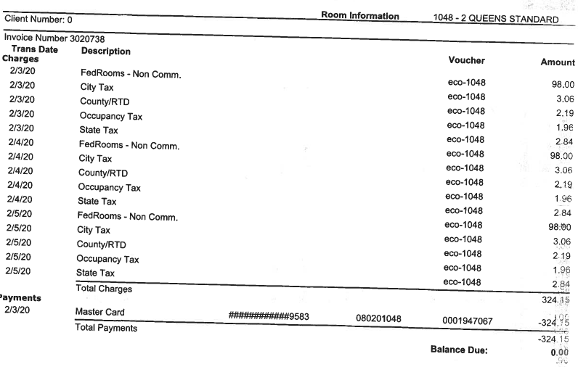
Copy of Invoice
Notes:
Joy
DD250

Slide 25
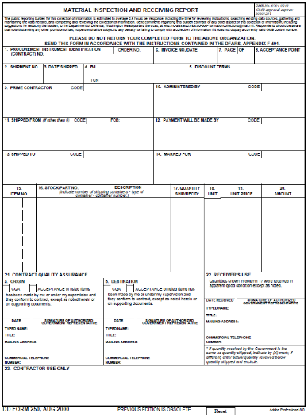
Copy of Invoice
Notes:
Joy
DD250
DoD Example

Slide 26
I got an invoice from my contract - now what?
All invoices are targeted to be processed within 7 calendar days.
Day 1 - Invoice Submission
Day 5 - COR & PM review, make recommendations
Day 7 - CO approval/rejection/partial acceptance
Prompt Payment Act
In most cases, when an agency pays a vendor late, the agency must pay interest.
The Prompt Payment interest rate for January 1, 2024 – June 30, 2024 is 4.785%.
Notes:
Joy
GSA - 7 days target
FAR designates invoice payment due date - The 30 th day after the designated billing office receives a proper invoice from the Contractor
Joy adjustment: Day 5 - COR & PM review acceptance -> Day 5 - COR & PM review, make recommendations
Joy adjustment: Day 7 - CO approval/rejection -> Day 7 - CO approval/rejection/partial acceptance

Slide 27
How do I interpret it? Does contract type drive this?
Firm Fixed Price (FFP) Contract
Cost-Reimbursement (CR) Contract
Time and Materials (T&M) Contract
OCD/Travel
Notes:
Eugene

Slide 28
How do I interpret it? Does contract type drive this?
Firm Fixed Price Contract
Confirm total amounts invoiced by invoice-level and a breakdown by CLIN free of math errors and confirm sufficient funding (not exceeding)
Confirm monthly surveillance / inspection report has been received from client IAW the contract.
Notes:
Eugene

Slide 29
How do I interpret it? Does contract type drive this?
Cost-Reimbursement Contract
Confirm labor categories/skill level invoiced are authorized on contract
Labor category is listed
Verify the rates are in accordance with IAW the contract
Are overtime costs being incurred?
Confirm current monthly and total cumulative amounts.
Labor Rates and Labor Hours are less than Not To Exceed the limits established by the Contract
Award fee, fixed fee is in accordance Award Fee Determination Plan (AFDP) established by the Contract, as applicable, and does not exceed ceiling
Facilities Capital Cost of Money (FCCOM) adjusted out of award fee pool
Last Option Period Fixed Fee is withheld if above 85%
Review documentation provided by subcontractor (when necessary)
Notes:
Eugene
Joy Comment: Award Fee should already be known at this point, as it was determined in the periodic Award Fee Report

Slide 30
How do I interpret it? Does contract type drive this?
Time and Materials Contract
Confirm labor categories invoiced are authorized on the Contract from the MAS or BPA.
Were taxes included on the invoice? If so, reject invoice.
Labor Rates and Labor Hours are less than Not To Exceed the limits established by the Contract
Monthly and total cumulative hours worked are listed
Total amounts invoiced by CLIN are accurate, free of errors, and less than or equal to funded ceiling amounts
Notes:
Joy Comment: If your contract incorporates Technical Direction Letters (TDLs), recommend itemizing completed TDLs on the invoice. Specify in the T&Cs what data will be required (completion date, TDL #, etc.)

Slide 31
How do I interpret it? Does contract type drive this?
ODC/Travel
Each Travel Authorization Request (TAR) associated with invoiced travel has been approved
Maximum applicable JTR/FTR is listed and has not been exceeded
General and Administrative (G&A) fee is in accordance with Contract (if applicable)

Slide 32
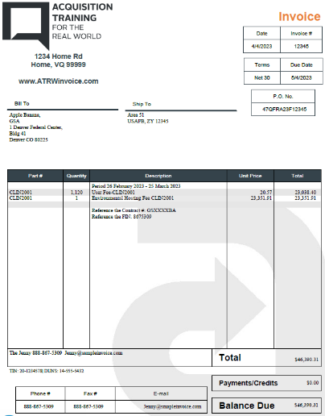
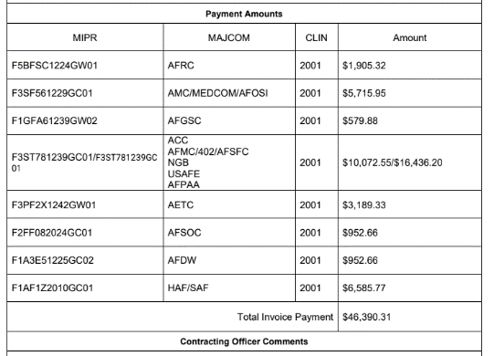
Sample Invoices
Notes:
Invoice example - multiple Funds single CLIN

Slide 33
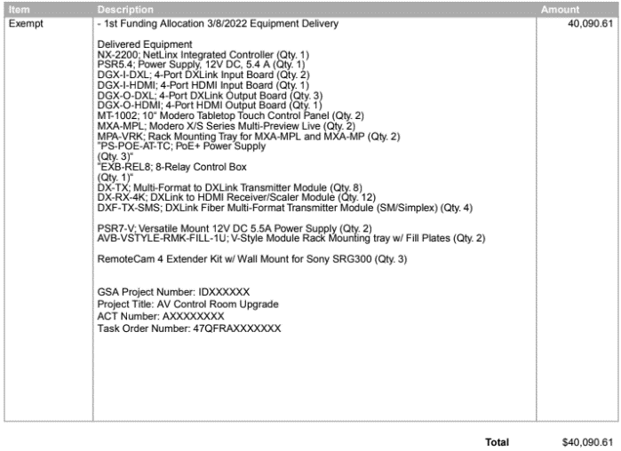
Invoice Description

Slide 34
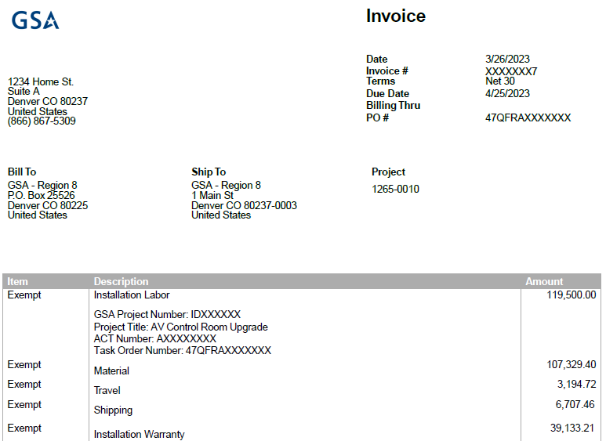
Invoice Information - Sample

Slide 35
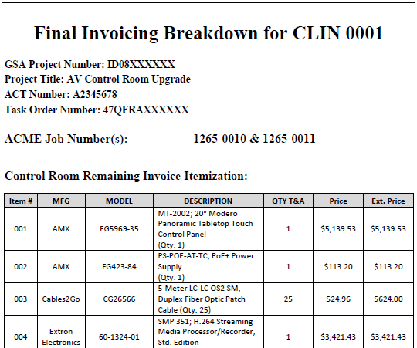
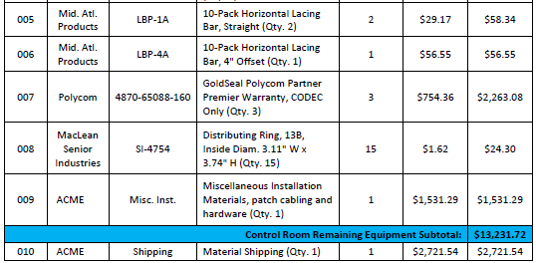
Sample Invoices – Shown by CLIN
Notes:
Joy Comment: Even though these examples are all screenshots/PDFs, there’s nothing precluding you from allowing spreadsheets as attachments/supporting documentation. This can make it simpler when calculating totals and visibility into the formulas used

Slide 36
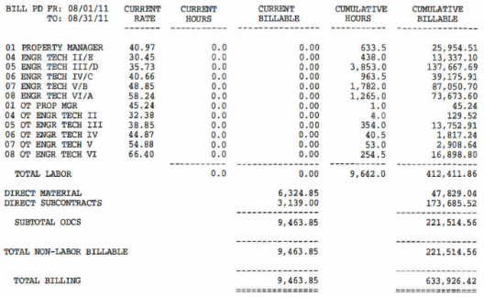
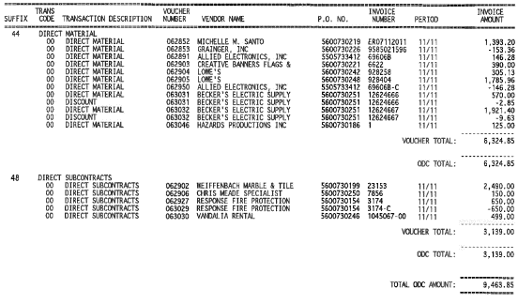
Labor Category Invoice Pricing - Examples
Notes:
Joy Comment: take a close look at the Labor Categories; these make a difference. They should be specified in the contract T&Cs

Slide 37
Should I pay my contractor or not? If not, what documentation do I need to put together to back this up?
Invoice Checklist
CO approval/rejection/partial acceptance
Correspondence, correction comments/directions
QASP - Surveillance - Contractor Discrepancy Report
Notes:
See if invoice checklist is uploaded to Acq Gateway

Slide 38
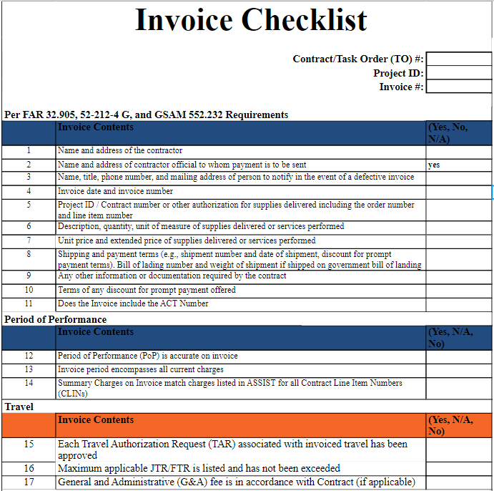
Invoice Checklist
Notes:
GSA ASSIST
COR reviews and accepts in system. PM reviews and validates, sends to CO for final authorization.

Slide 39
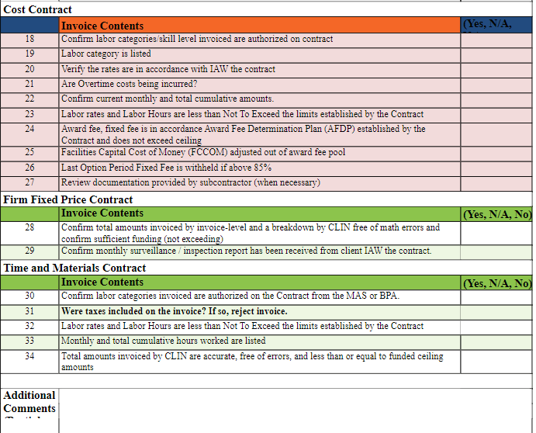
Invoice Content by Contract Type - Example
Notes:
GSA ASSIST
COR reviews and accepts in system. PM reviews and validates, sends to CO for final authorization.

Slide 40
Sample of Client and GSA Receipt and Acceptance
Notes:
GSA ASSIST
COR reviews and accepts in system. PM reviews and validates, sends to CO for final authorization.

Slide 41
What should I do next?
Approval/rejection workflow/process
Contract Line Item Numbers (CLINs)
MIPR/Funding document/LOA allocation(s)

Slide 42
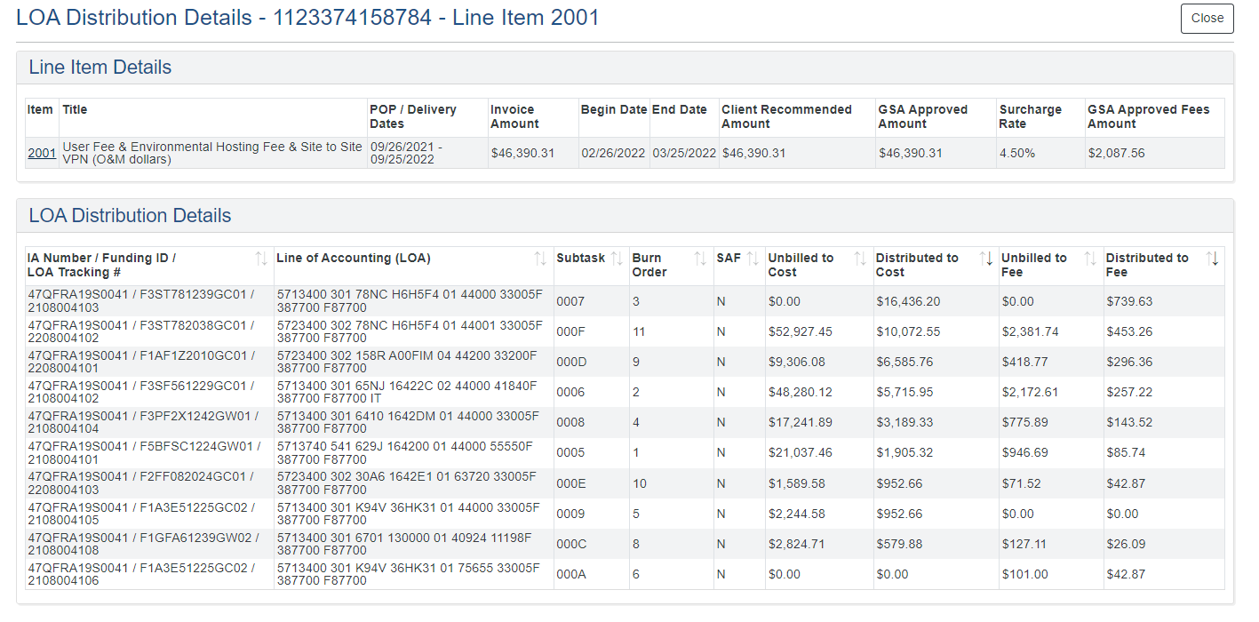
Line of Accounting Distribution Details
Notes:
Example of GSA this is not same for all agencies

Slide 43
Invoiced amount is higher than warrant - GSAM
Q: Can CO approve invoices that are above their warrant?
It is acceptable for any contracting officer, regardless of warrant level, to approve invoices for any amount.
GSAM 532.7202 Submission and processing of invoices or vouchers.
Your agency may have different internal policy, please check internal SoP or Procurement Analyst
532.7202 Submission and processing of invoices or vouchers.
(a) Contractors should be required to submit invoices or vouchers to the contracting officer. The date on which the
contracting officer receives the invoice or voucher will be used to determine interest penalties for late payments. The
contracting officer, or designee, must review the processing of invoices or vouchers before payment to determine if the items
and amounts claimed are consistent with the contract terms and represent prudent business transactions. The contracting
officer must ensure that these payments are commensurate with physical and technical progress under the contract. If the
contractor has not deducted questionable amounts from the invoice or amounts required to be withheld, the contracting
officer is responsible for making the required deduction, except as provided in 532.7203.
(b) Subject to 532.7201, the contracting officer should note approval of any payment on (or attached to) the invoice
or voucher submitted by the contractor, then forward the invoice or voucher to the appropriate contract finance office for
retention after certification and scheduling for payment by a disbursing office.
Notes:
This is example of GSA - check with your own agency policy (not to spend too much time)
Reduce to link and focuse

Slide 44
Poll
1. What is your current role in acquisition administration?
- COR
- PM
- CO/CS
- TPOC
- Other
2. Do you currently review/pay invoice? (Yes/No)
3. What do you find most challenging with invoice processing?
- Reading invoice
- Validating work completion
- Documentation
- Other
4. Would you change anything about the invoices and attachments that are submitted to you for review?
- Yes
- No
- N/A

Slide 45
Questions???

Slide 46
Resources

Slide 47
Civilian Services Acquisition Workshops
Eugene Hwang
Acquisition Project Management Specialist
CSAW Facilitator

Slide 48
Civilian Services Acquisition Workshop (CSAW)
Civilian Services Acquisition Workshop (CSAW):
A facilitated workshop built around a specific acquisition and its multi-functional integrated project team (IPT). The workshop walks the complete team through the performance-based acquisition (PBA) process from beginning to end.
Notes:
The Civilian SAW (CSAW) initiative was proposed by a member of the the Professional Services Interagency Team who had experienced the benefits of the approach. As a result, GSA (in partnership with OFPP) began research into CSAWs.

Slide 49
Service Offerings
Flagship 5-day workshop (for most teams)
Understanding Performance Based Acquisition training course (1.5 CLPs)
CSAW Webinar Series - Videos available at CSAW Youtube
PWS / QASPs Reviews
CSAW Facilitator Certification Program
**Facilitated Issue/Challenge Resolution for procurements (ex. acquisition team and policy office disagree on small business strategy)
Buy.GSA.gov/Interact (for training courses offered)
Additional info available at GSA.gov/CSAW or csaw@gsa.gov
Notes:
https://buy.gsa.gov/interact/community/208/activity-feed

Slide 50
AAS APEX 1

Slide 51
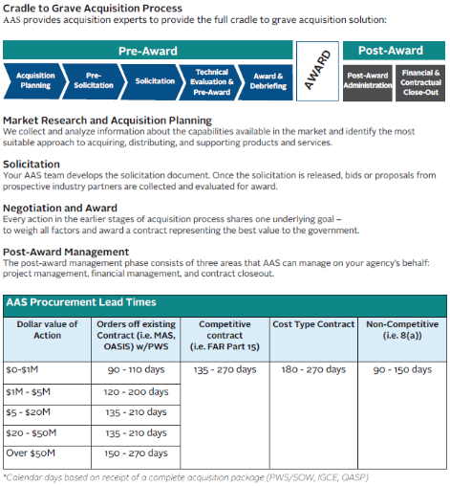
Assisted Acquisition Services Available
Contact AAS: region8aas@gsa.gov | (720) 656-1876

Slide 52
Thank You!
Office of Integrated Marketing

