Slide 1

Deeper Dive into the Revolutionary FAR Overhaul (RFO)
Acquisition Training for the Real World Winter 2026
Office of Government-wide Policy, January 29, 2026
Notes:
ATRW
: Deeper Dive into the Revolutionary FAR Overhaul (RFO) 1/29/2026Join our Acquisition Training for the Real World session in order to:
Receive a brief recap of session 1
Learn of key FAR changes that impact practice (part 7, 8 - light on FSS given separate session, 12, 15, 16) at high level
Learn about resources available (CoP, Office Hours, Coaching, RFO Workshop)

Slide 2


FAR Overhaul Presenter
Stephen Carroll
GSA Acquisition Policy Division Director
Stephen.Carroll@gsa.gov
Monica Taylor
RFO Practitioner Workstream
Monica.Taylor@gsa.gov
Notes:
Receive a brief recap of session 1
Learn of key FAR changes that impact practice (part 7, 8 - light on FSS given separate session, 12, 15, 16) at high level
Learn about resources available (CoP, Office Hours, Coaching, RFO Workshop)

Slide 3
The Revolutionary FAR Overhaul
Session 1 Recap - The RFO
Comprehensive overhaul of the Federal Acquisition Regulations (FAR), which was first published in 1984.
The RFO initiative:
Returns the FAR to its statutory roots;
Rewrites it in plain language;
Removes non-statutory rules (unless essential for sound procurement); and
Creates non-regulatory buying guides that provide practical strategies grounded in best practices.
Notes:
Monica

Slide 4
Core Theme of the RFO
Session 1 Recap - The Theme
What’s a major theme from these EOs?
Increased use of the governmentwide contracts for commercial products and services, such as Federal Supply Schedule ordering procedures (GSAR 538.71) and ordering procedures for multiple-award Governmentwide contracts (FAR 16.507)
Executive Orders and OMB Memos:
Executive Order 14275 — Restoring Common Sense to Federal Procurement
OMB Memo 25-26 — Overhauling the Federal Acquisition Regulation
Executive Order 14271 — Ensuring Commercial, Cost-Effective Solutions
Executive Order 14240, Eliminating Waste and Saving Taxpayer Dollars Dollars by Consolidating Procurement
Notes:
Monica

Slide 5
Clear Direction to Source within Federal Marketplace First
Session 1
Recap - Commercial First
RFO 10
"Agencies must procure commercial products and commercial services to the maximum extent practicable and prioritize procuring commercial products and commercial services on an existing governmentwide contract".
RFO 12
“If commercial products or commercial services that meet agency needs are available from any priority source identified in part 8, including existing contracts awarded for Governmentwide use (e.g., the Federal Supply Schedules and Governmentwide acquisition contracts), procure the commercial products or commercial services from that source.”
EO 14271 - Ensuring Commercial, Cost-Effective Solutions in Federal Contracts
“Agencies shall procure commercially available products and services, including those that can be modified to fill agencies' needs, to the maximum extent practicable”
RFO 8
Must use existing governmentwide contracts and BPAs that are “required use” and must* consider existing governmentwide contracts and BPAs that are otherwise part of Category Management principles.
Notes:
Monica

Slide 6
The RFO
Session 1 Recap - Where are we today?
49 Model Deviations were issued to allow immediate use while formal rulemaking proceeds.
Agency Implementation
Agency adoption varies - Implementation contingent on agency-issued deviations.
Codified FAR
RFO
Phase 1
Model deviations
Agency issued deviations
Phase 2
Rule-making
New codified FAR
Codified FAR
Issue class deviations to immediately adopt and use overhauled FAR.
Conduct formal rulemaking to codify streamlined regulations.
Notes:
Monica

Slide 7

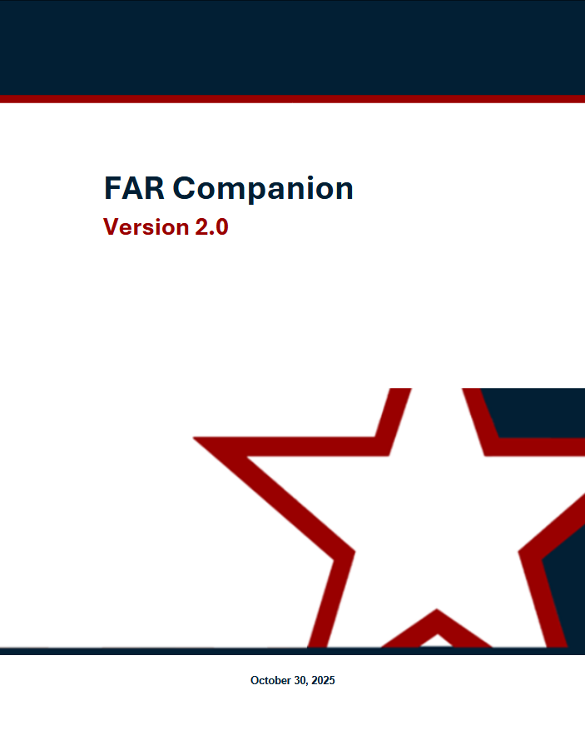
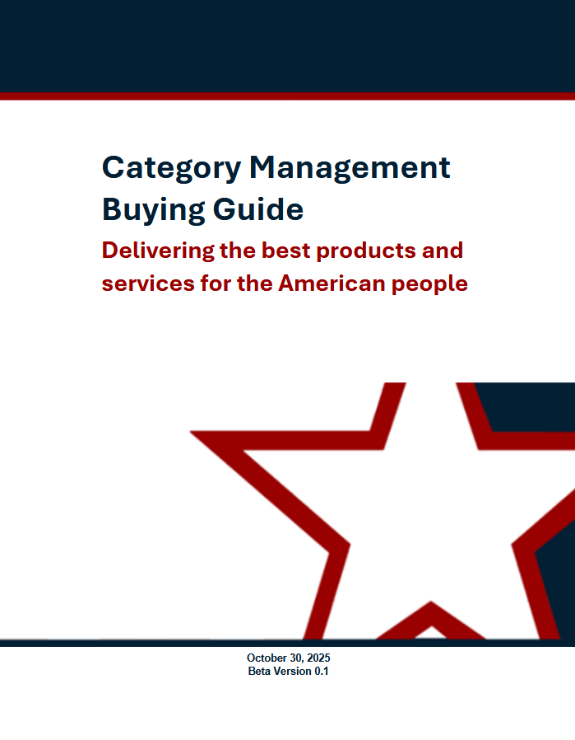
The RFO part 2
Session 1
Recap - The New Framework
The RFO
FAR Framework
REGULATORY
NON-REGULATORY
Streamlined FAR
Agency Regulations
FAR Companion*
Category Management Buying Guide*
* Living resources that will be regularly updated to reflect evolving best practices and the changing way that commercial supplies and services are purchased.
Notes:
Monica

Slide 8
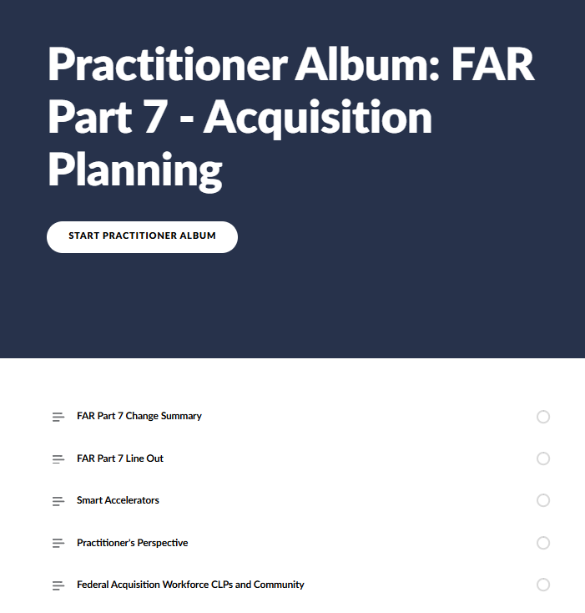
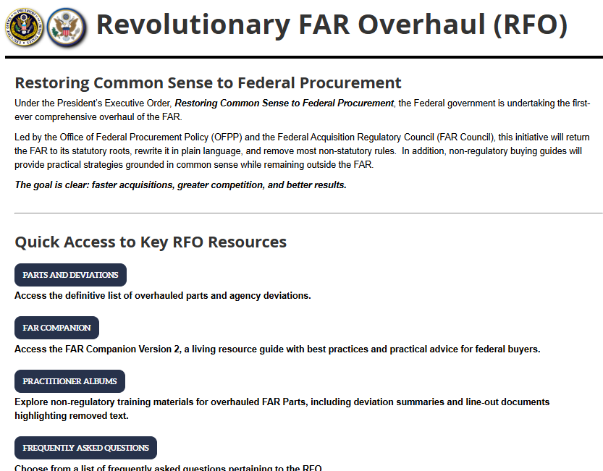
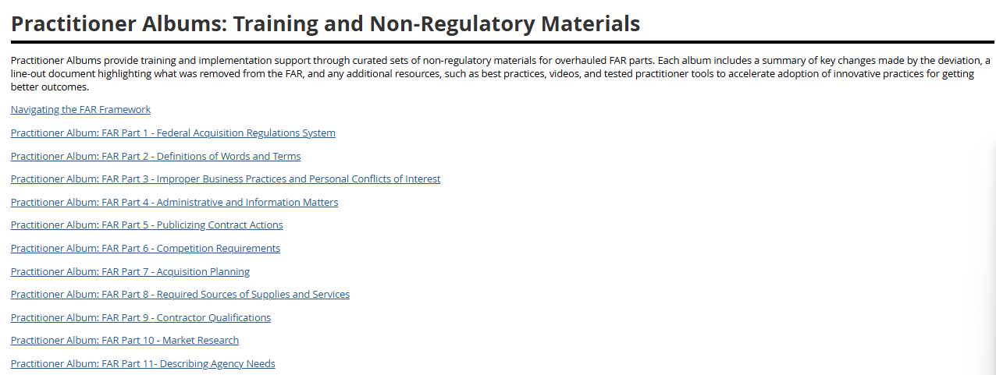
Enhanced Flexibilities & Practitioner Resources
Deeper Dive
Just-in-time resource providing during the RFO
Practitioner Albums provide:
Change Summary
Line-out
Smart Accelerators
Practitioner's Perspective
Access to CLPs and Community
Earn CLPs!
Notes:
Monica

Slide 9
ENHANCED FLEXIBILITIES
RFO parts 7, 19, 538 (GSAR), 12, 16, 15
Changes that Impact Practice
Notes:
Monica

Slide 10
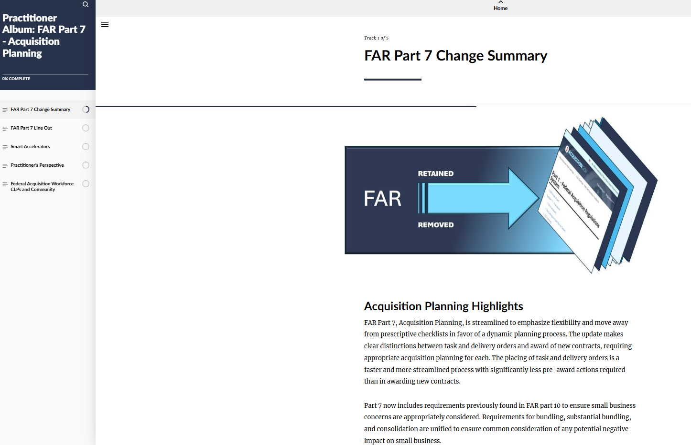
RFO Part 7, Acquisition Planning
Changes that Impact Practice
RFO part 7 is streamlined to emphasize flexibility and move away from prescriptive checklists in favor of a dynamic planning process.
Mandates that agencies establish procedures for determining when a written or oral plan is needed and lists high-level outcomes that planning must promote:
Acquisition of commercial products or services
Full and open competition
Selection of appropriate contract type
Use of existing contracts
There is no one-size fits all approach. Apply critical thinking skills while mapping a strategy appropriate to your requirement and performance environment.
Notes:
Stephen

Slide 11
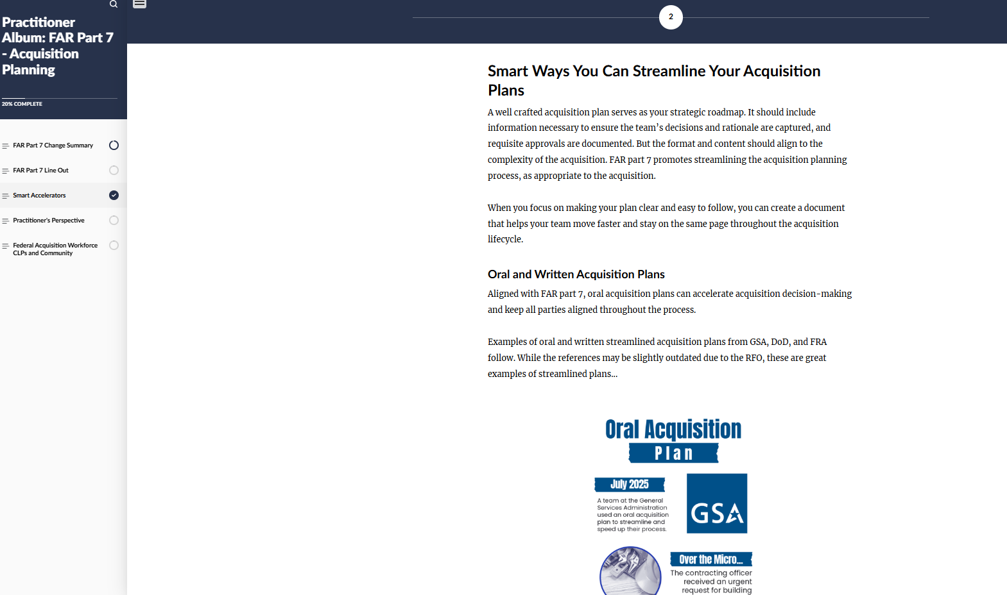
RFO Part 7 Smart Accelerators
Changes that Impact Practice
Within the Practitioner Album, you will find:
Ways you can streamline your acquisition plans
Examples of oral and written streamlined acquisition plans from GSA, DoD, and FRA. While the references may be slightly outdated due to the RFO, these are great examples of streamlined plans.
Practitioner Perspective
Acquisition techniques, previous Smart Accelerators and Warfighting Acquisition University and Federal Acquisition Institute resources
You can also find best practices within the FAR Companion.
Notes:
Stephen

Slide 12
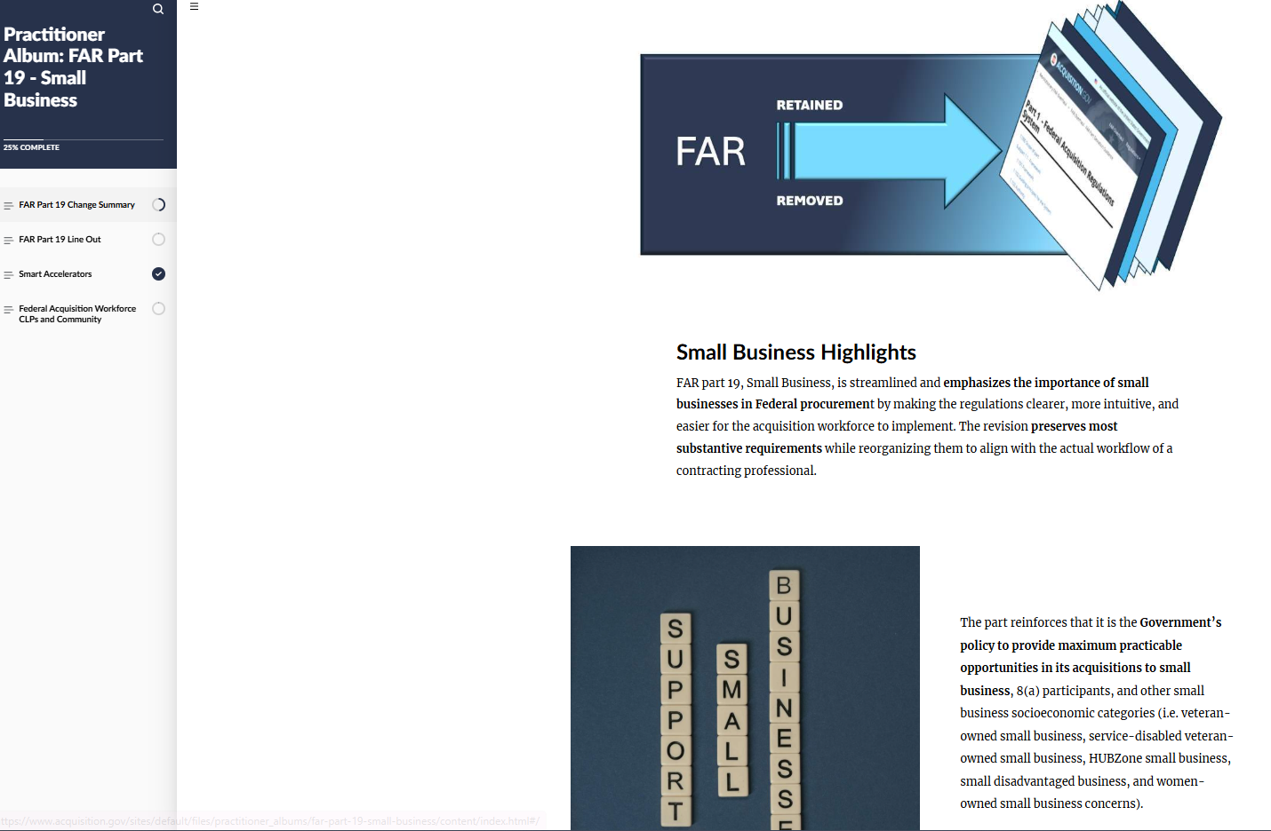
RFO Part 19, Small Business Programs
Changes that Impact Practice
RFO part 19 is streamlined and emphasizes the importance of small businesses in Federal procurement by making the regulations clearer, more intuitive, and easier for the acquisition workforce to implement.
RFO Part 19 now clearly states that the “Rule of Two” above micro-purchase threshold applies to open market contract awards.
The “Rule of Two” does NOT apply to orders under multiple award contracts.
For the 8(a) program, when an acquisition is below the competitive threshold (19.108-7(a)(2)), usually $4.5M, contracting officers must first try conducting the acquisition as a competitive 8(a) order using SBA-approved government-wide contracts before proceeding with a sole source 8(a) award.
The Practitioner Album provides ways you can encourage small business participation in acquisitions.
The Contracting Officer is encouraged to consider, but has the discretion to decide, whether or not to set aside an order under multiple-award contracts for small business concerns. This discretionary decision does not serve as a basis of protest.
A requirement is automatically released from the 8(a) program if the follow-on will be set aside under the HUBzone, SDVOSB, or WOSB programs. Release does not have to be formally requested in this situation.
Notes:
Stephen

Slide 13
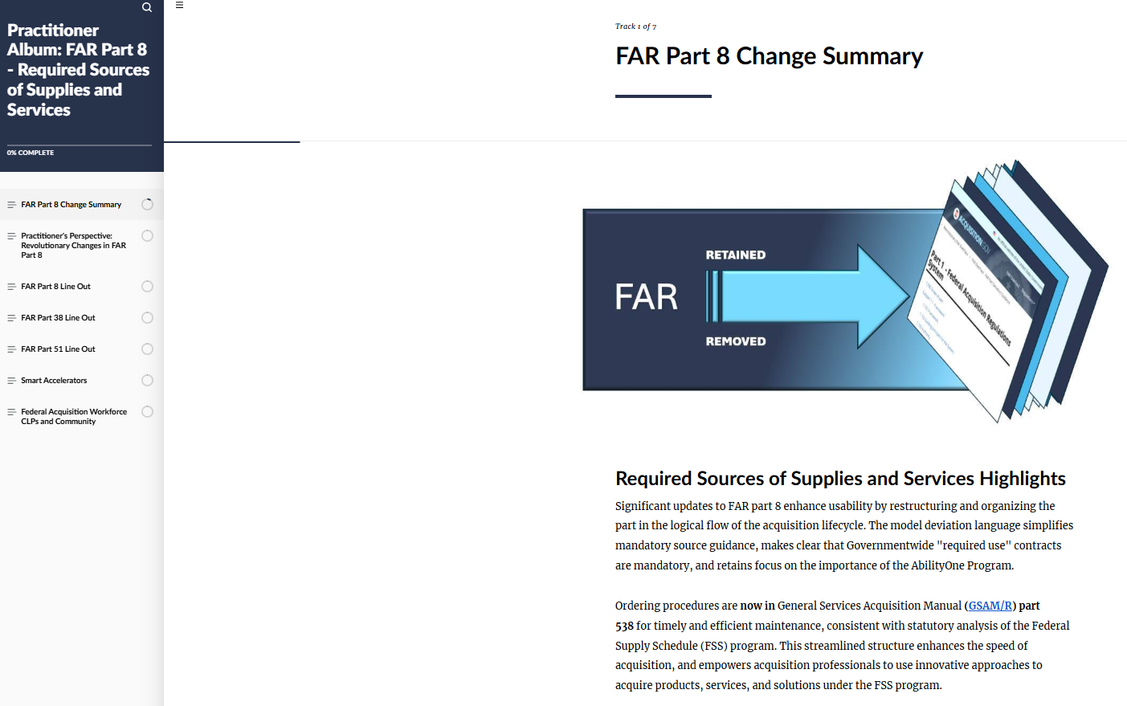
RFO Part 8, Required Sources of Supplies and Services
Changes that Impact Practice
RFO part 8 enhanced usability by restructuring and organizing the part in the logical flow of the acquisition lifecycle.
Ordering procedures are now in General Services Acquisition Regulation part 538 for timely and efficient maintenance, consistent with statutory analysis of the Federal Supply Schedule (FSS) program.
FAR part 8 has been significantly updated, creating opportunities to streamline buying processes.
Notes:
Stephen

Slide 14
RFO 8.4 / GSAR 538 FSS Ordering Enhanced Flexibilities
Changes that Impact Practice
Flexibility RFQs should be used irrespective of dollar value or type of requirement document. | RFO Citation GSAR 538.7102-2(a) Placing FSS orders and establishing FSS BPAs
Streamline your RFQ process – Parts 5, 6, 14, 15, 16, and 19 do not apply. No requirement for formal evaluation plans, scoring, or a competitive range prior to engaging with vendors. | GSAR 538.7102-2(a) FSS program.
Opportunity for further adoption of tested innovative techniques and to create new RFQ approaches. | GSAR 538.7102-2(a) Placing FSS orders and establishing FSS BPAs FC 8.401 Periodic Table of Acquisition Innovations (PTAI) procedures for FAR part 8 RFQ streamlining.
Follow parts 4, 7, 10, and 11 to the extent necessary. | GSAR 538.7102-2(b)(1) Placing FSS orders and establishing FSS BPAs
Single-award Blanket Purchase Agreements (BPAs) restrictions lifted. Select the strategy that aligns with your requirement. | GSAR 538.7104-1(b) Placing FSS orders and establishing FSS BPAs
Notes:
Stephen

Slide 15
RFO 8.4 / GSAR 538 FSS Ordering Enhanced Flexibilities
Changes that Impact Practice
Flexibility 6. Streamlined ordering procedures established for multiple-award BPAs can include soliciting all BPA holders or as many holders as practicable. | RFO Citation GSAR 538.7104-4(a)(4)(ii)(B) FSS Blanket purchase agreements.
7. Award the order to the quoter that represents the best value. No longer required to consider “lowest overall cost alternative” or consider the level of effort/skill mix when awarding task order or BPAs. | GSAR 538.7102-2(b)(4) Placing FSS orders and establishing FSS BPAs FC 8.401 Best value determinations under FAR part 8.
8. Document the file to the extent necessary to support the award decision. | GSAR 538.7102-2(b)(5) Placing FSS orders and establishing FSS BPAs
9. Contractors should request a brief explanation of the award within 3 days (aligns with debriefing timelines in Part 15). | GSAR 538.7102-2(b)(6) Placing FSS orders and establishing FSS BPAs
Notes:
Stephen

Slide 16
RFO 8.4 / GSAR 538 FSS Ordering Enhanced Flexibilities
Changes that Impact Practice
Flexibility 10. Discretion to set-aside orders and seek additional discounts. | RFO Citation GSAR 538.7102-2(c)(1) Placing FSS orders and establishing FSS BPAs
11. Separate determinations not required under FSS order or BPA awards. | GSAR 538.7102-2(d)(2) Placing FSS orders and establishing FSS BPAs
12. Simplified ordering procedures addressing commoditized services (e.g., capability-as-a-service, subscriptions) and order-level materials (OLMs). | GSAR 538.7103-2(a) Acquisitions valued above the micro-purchase threshold, but not above the simplified acquisition threshold (SAT).
13. Increased flexibility to include open market order-level materials in an FSS order and to allow contractor access to government supply sources. Previously, contractor use of Government supply sources under FAR Part 38 was largely restricted. | GSAR 538.7104-2 Order-level materials.
Notes:
Stephen

Slide 17
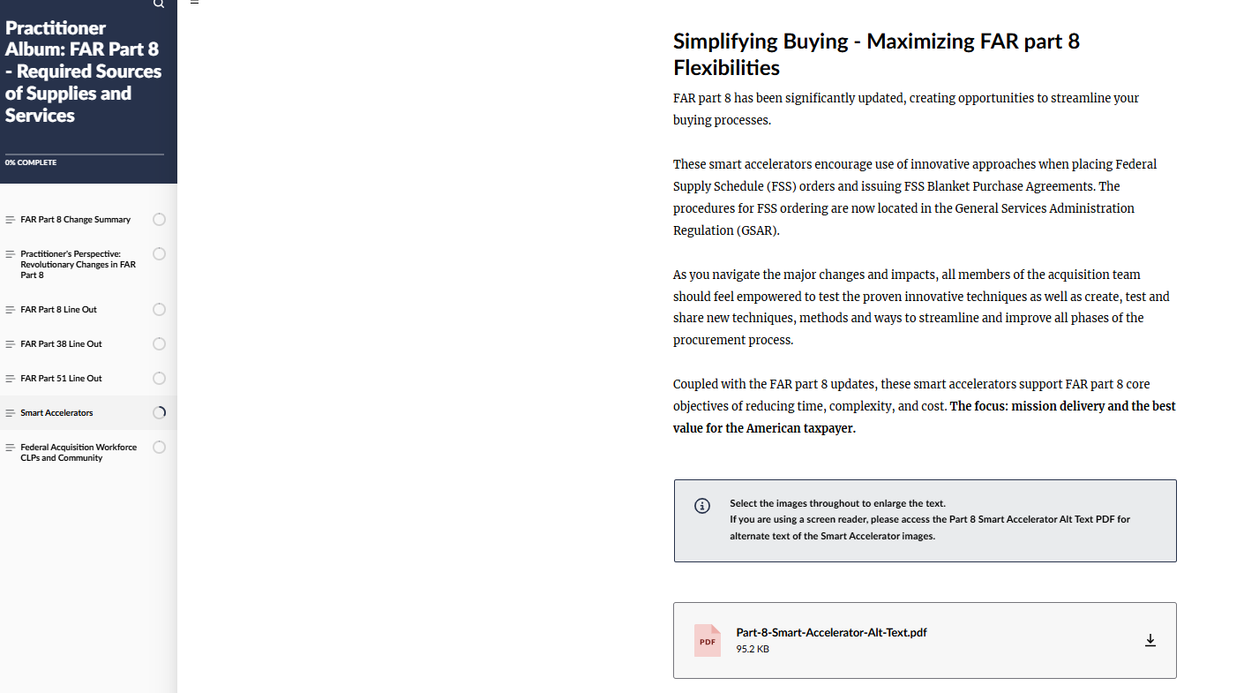
RFO Part 8 Smart Accelerators
Changes that Impact Practice
Ways you can maximize RFO part 8 flexibilities
Ways to use the Periodic Table of Acquisition Innovations (PTAI) for pre-award refinement, streamline your evaluation documentation, and post-award transparency and feedback
Practitioner's Guide to Navigating AbilityOne
Practitioner Perspective Job Aid
Acquisition techniques and previous Smart Accelerators
You can also find best practices within the FAR Companion.
Notes:
Stephen

Slide 18
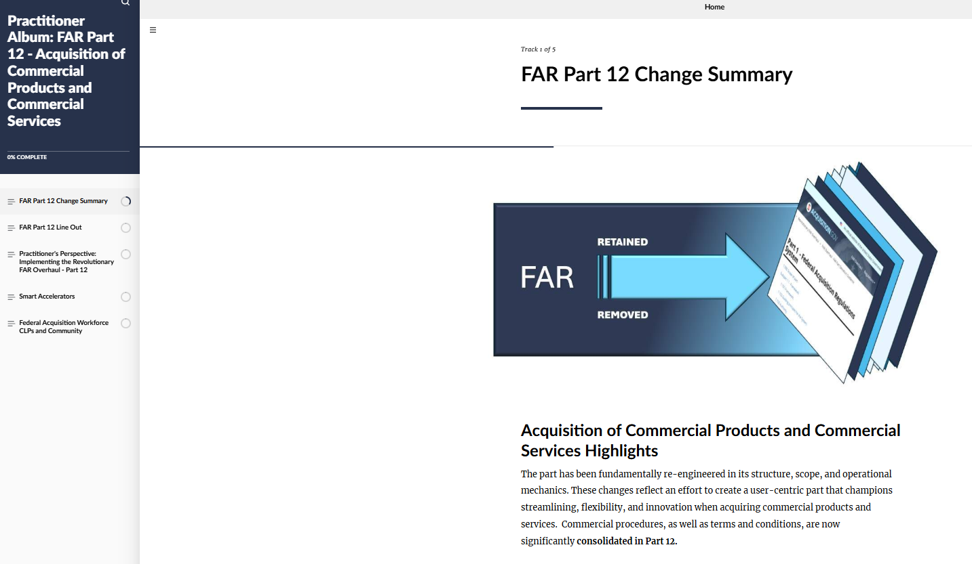
RFO Part 12, Acquisition of Commercial Products and Commercial Services
Changes that Impact Practice
Commercial procedures, as well as terms and conditions, are now significantly consolidated in RFO part 12.
Changes reflect an effort to create a user-centric part that champions streamlining, flexibility, and innovation when acquiring commercial products and services.
FAR part 12 has been significantly updated, creating opportunities to modernize and streamline commercial buying.
Notes:
Monica

Slide 19
RFO Part 12 Enhanced Flexibilities
Changes that Impact Practice
Flexibility Consolidated simplified procedures (formerly FAR part 13.5) under the streamlined commercial rules of FAR part 12. Provides efficient pathways for commercial buys. Emphasis on innovation and innovative approaches that align with FAR 1.102, Guiding Principles. | RFO Citation FAR 12.201-1 Simplified procedures.
Efficient and minimally burdensome evaluation and broad CO discretion regarding the acceptance of late quotations. | FAR 12.203(c) Evaluations.
Evaluation plans, scoring, or competitive range are not required. Quotation evaluation is not subject to FAR part 15. | FAR 12.203(c)(2) Quotations.
Enables the use of FAR part 12 commercial procedures for construction that meets the commercial definition, significantly streamlining the acquisition process. | FAR 2 Definitions FC 12.001, Selecting the appropriate contracting method for commercial construction
Notes:
Monica

Slide 20
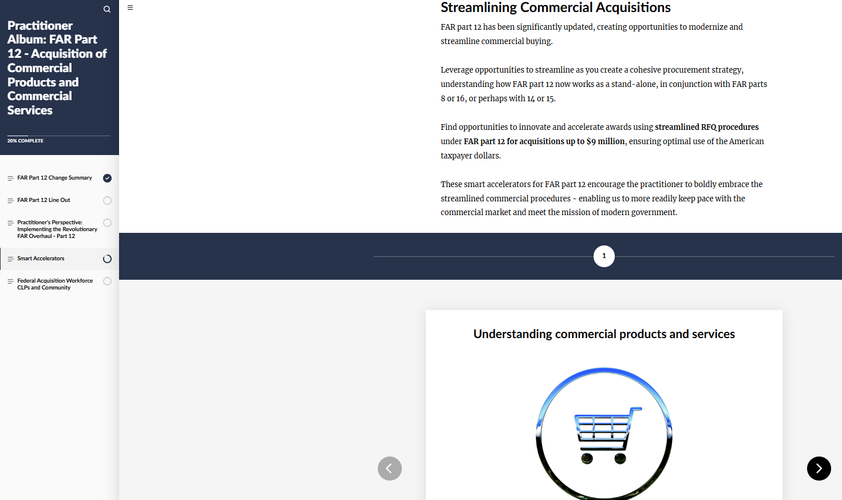
RFO Part 12 Smart Accelerators
Changes that Impact Practice
Understanding commercial products and services
Commercial Acquisition Resources and Tools
Previous Smart Accelerators and Acquisition Techniques
You can also find best practices within the FAR Companion.
Notes:
Monica

Slide 21
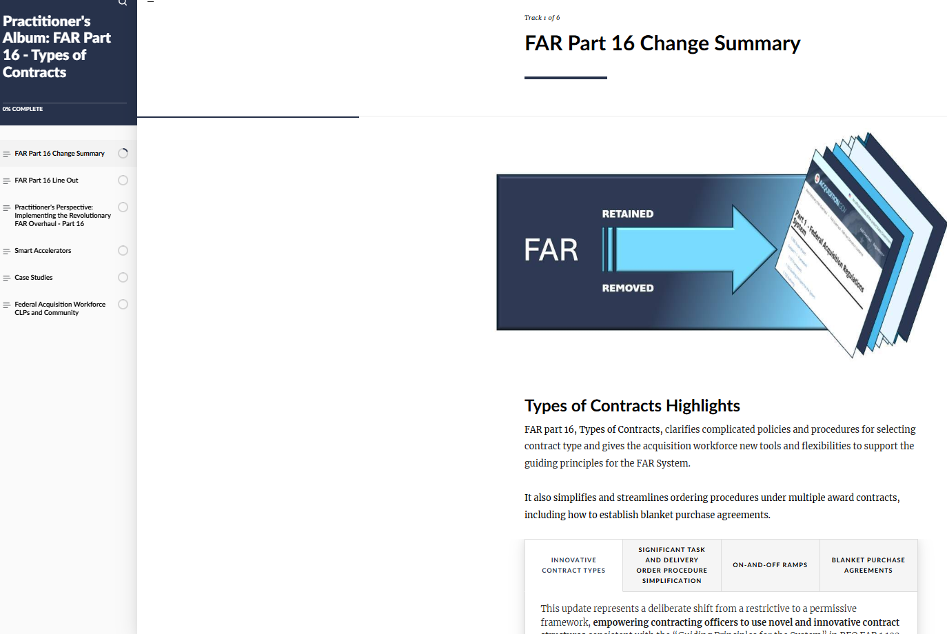
RFO Part 16, Acquisition Planning
Changes that Impact Practice
RFO part 16, Types of Contracts, clarifies complicated policies and procedures for selecting the contract type and gives the acquisition workforce new tools and flexibilities to support the guiding principles for the FAR System.
Think creatively and craft innovative solutions that will meet your mission needs - whether it’s through the use of an innovative contract type or a simplified and creative ordering procedure under an IDIQ contract.
Notes:
Monica

Slide 22
RFO Part 16 Enhanced Flexibilities
Changes that Impact Practice
Flexibility A new contract type is permitted as long as it promotes the best interest of the government. This update represents a deliberate shift from a restrictive to a permissive framework, empowering contracting officers to use novel and innovative contract structures. | RFO Citation FAR 16.101 Policies.
New contract types such as Firm-Fixed Unit Price (FFUP) and consumption-based contracts were introduced into the FAR Companion for you to potentially leverage! | FC 16.2 Firm-Fixed-Unit-Price (FFUP) contract. FC 16.2 Consumption-based contracting.
Opportunity to leverage on-ramps and off-ramps now formally included the FAR to maintain a competitive pool! | FAR 16.504-4 On-ramps and off-ramps. FC 16.504-4 On-ramps and off-ramps.
Fair opportunity procedures have been updated to establish common principles designed to enhance flexibility and reduce burden in order placement under multiple award indefinite delivery vehicles. | FAR 16.507-2 Fair opportunity procedures.
Notes:
Monica

Slide 23
RFO Part 16 Enhanced Flexibilities.
Changes that Impact Practice
Flexibility To maximize efficiency, buyers are encouraged and empowered to use innovative approaches when placing orders. | RFO Citation FAR 16.507-2(a)(2) Fair opportunity.
Ordering activities are not required to develop formal evaluation plans, score offeror responses or quotations, or establish a competitive range before communicating with interested parties. This allows COs to use streamlined procedures and engage in robust dialogue with potential awardees to refine requirements and obtain the best possible value. | FAR 16.507-2(a)(3) Fair opportunity.
You can now establish a BPA against an IDIQ! | 16.507-2 Fair opportunity procedures.
Streamlined ordering procedures - fair opportunity reengineered! | 16.507-3 Orders valued above the micro purchase threshold but not above the SAT. 16.507-4 Orders valued above the SAT but not above $7.5 million.
Notes:
Monica

Slide 24
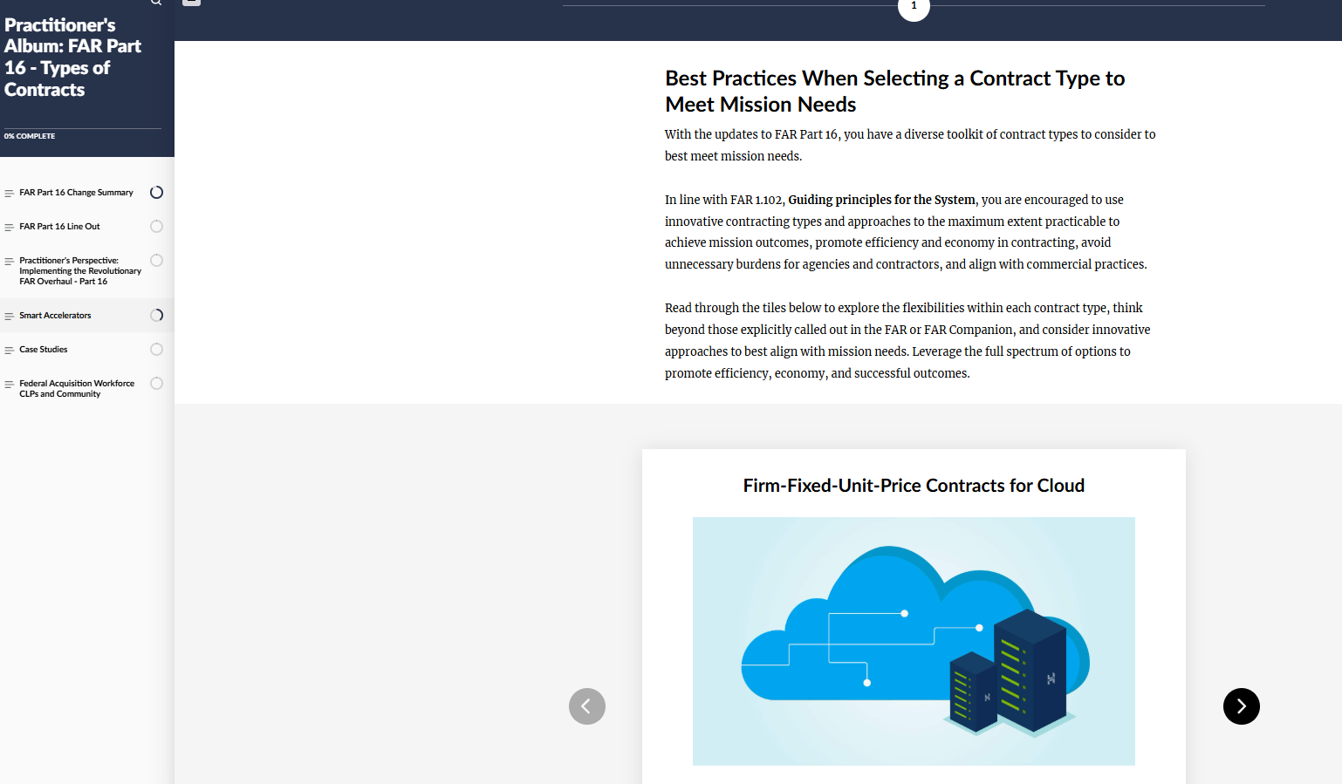
RFO Part 16 Smart Accelerators
Changes that Impact Practice
Best Practices When Selecting a Contract Type to Meet Mission Needs
Firm-Fixed-Unit-Price Contracts for Cloud
Outcome-Based Contracting
Use Cases, Resources, and Tools
Video and Job Aid
Previous Smart Accelerators and Acquisition Techniques
You can also find best practices within the FAR Companion.
Notes:
Monica

Slide 25
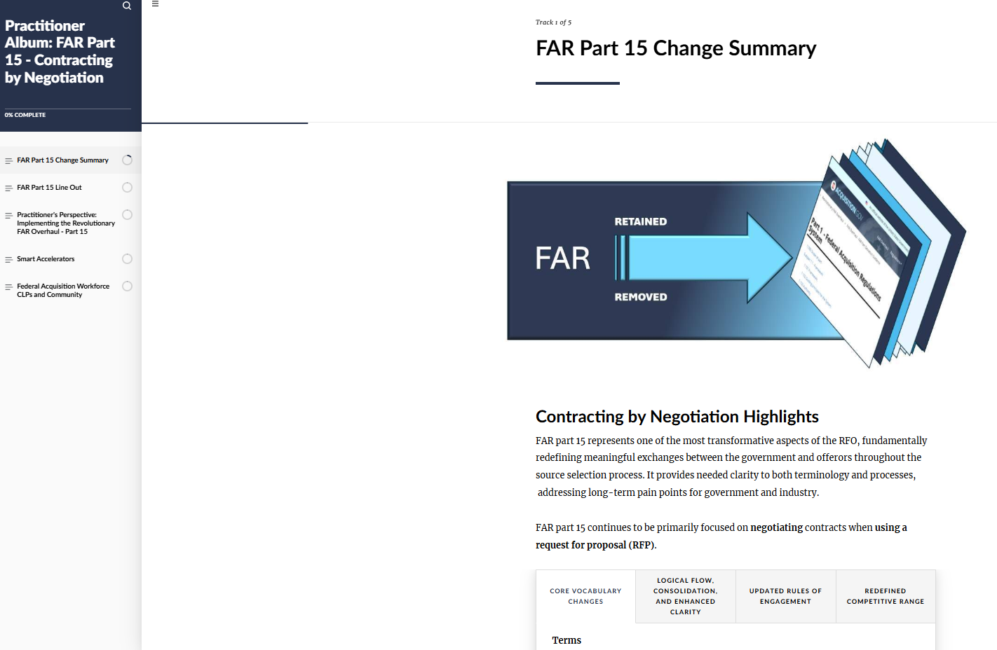
RFO Part 15, Contracting by Negotiation
Changes that Impact Practice
RFO part 15 represents one of the most transformative aspects of the RFO, fundamentally redefining meaningful exchanges between the government and offerors throughout the source selection process.
FAR part 15 equips acquisition professionals with a streamlined framework for negotiating contracts.
Notes:
Stephen

Slide 26
RFO Part 15 Enhanced Flexibilities
Changes that Impact Practice
Flexibility Clarifications permitted at any time after receipt of proposals through contract award, regardless of whether or not negotiations occur. Clarifications do not permit offerors to revise their proposals. | RFO Citation FAR 15.202(a)(2) Clarifications.
Competitive range is redefined as the group of proposals that the contracting officer determines best suited for negotiation. | FAR 15.204-1 Establishing a competitive range.
Discussions reframed as negotiations, and contracting officers are authorized to conduct negotiations with offerors within the competitive range as necessary (meaning can conduct multiple rounds with offerors within the competitive range as needed, without needing to conduct the same number of rounds with all offerors within the competitive range). | 15.204-2 Competitive negotiations.
Notes:
Stephen

Slide 27
RFO Part 15 Enhanced Flexibilities.
Changes that Impact Practice
Flexibility Definitions of deficiency and proposal revision updated. | RFO Citation 15.001 Definitions. Deficiency is any part of an offer that does not conform to a material requirement of a RFP. A material requirement is one that affects price, quantity, quality, or delivery, or that the RFP requires to be met at the time of proposal submission. Proposal revision is a change to material elements of a proposal made after the RFP closing date, at the request of or as allowed by a contracting officer, as the result of negotiations.
Introduction of Highest Technically Rated with a Fair and Reasonable Price (HTR-FRP) introduced as part of the best value continuum. | FAR 15.103-3 Highest technically rated with a fair and reasonable price approach.
Notes:
Stephen

Slide 28
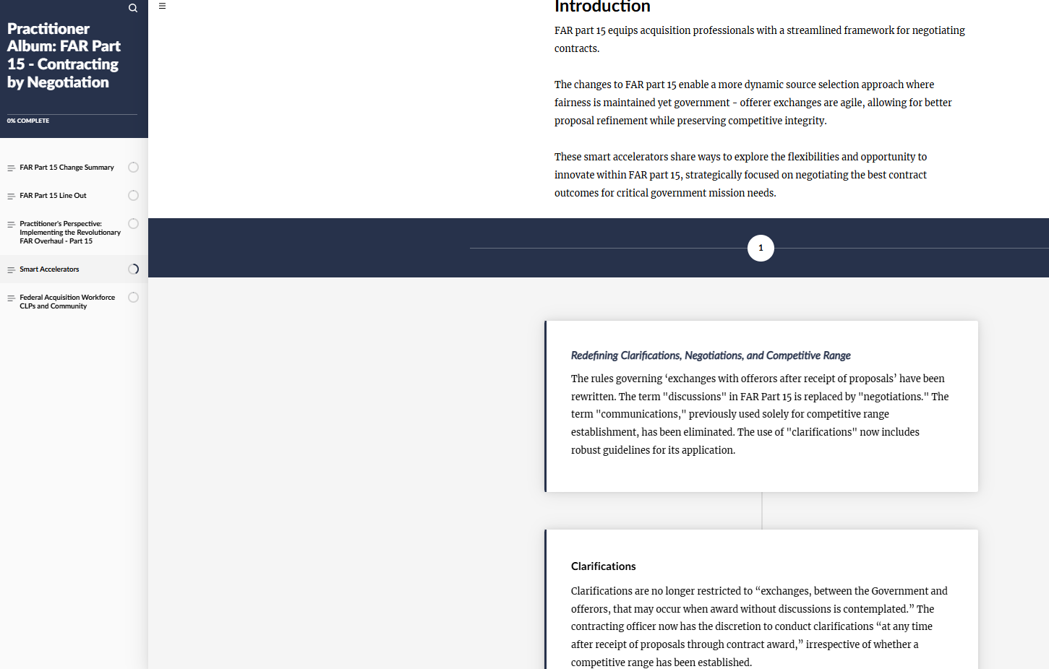
RFO Part 15 Smart Accelerators
Changes that Impact Practice
Ways to explore the flexibilities and opportunity to innovate within FAR part 15
Expansion on FAR part 15 definitions
Best Value Continuum
Videos, Resources, and Tools
Previous Smart Accelerators and Acquisition Techniques
You can also find best practices within the FAR Companion.
Notes:
Stephen

Slide 29


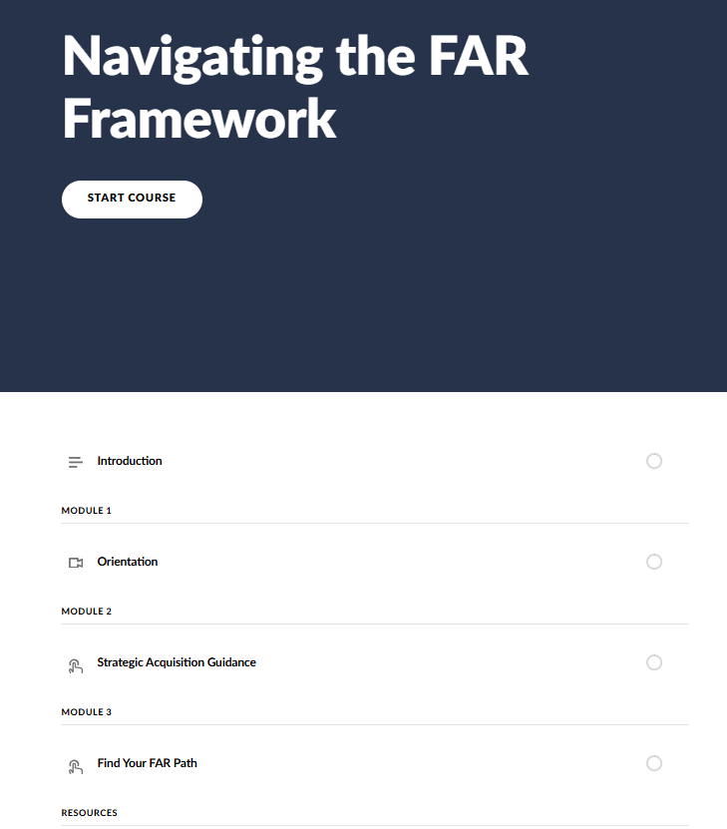



Additional Practitioner Resources
Empowering the AWF
FAR Forward Community of Practice on CSOD
Share your lessons learned with the federal acquisition community.
FAR Forward Open Office Hours
Hear timely updates, gain practical lessons, and take part in live Q&A with peers.
Previous recordings available at the RFO Training Resources Playlist in CSOD.
Your Agency Acquisition Labs (or Agency Acquisition Innovation Advocates) and the SAG Testing team.
Test new practices and new approaches. Your work and feedback will inform the regulatory and non-regulatory resources.
RFO Comparison Tool
Notes:
Monica

Slide 30
Thank You!
Questions?

Slide 31
31

