Slide 1
National Action Plan 6 Listening Session
October 9, 2024

Slide 2
General Logistics
This meeting is being recorded and will be posted publicly at www.gsa.gov/usopengov
Ideas will be compiled and submitted as a response to the National Action Plan 6 RFI
The chat box is for in-meeting informal discussions, link sharing, and general back-and-forth
Closed Captioning can be turned on by going to the bottom of the screen, clicking on the arrow ^ next to Closed Caption, and choosing “Show Subtitle”
Notes:
This meeting is being recorded and will be posted publicly at www.gsa.gov/usopengov

Slide 3


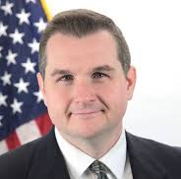
Welcome
Daniel Schuman
Chairperson of the Open Government Federal Advisory Committee & Executive Director of the American Governance Institute
Denice Ross
Deputy U.S. Chief Technology Officer, White House Office of Science and Technology Policy
Daniel Pomeroy
Deputy Associate Administrator for the Office of Technology Policy, U.S. General Services Administration

Slide 4


Open Government Partnership
The Open Government Partnership is based on the idea that an open government is more accessible, more responsive, and more accountable to citizens, and that improving the relationship between people and their government has long-term, exponential benefits for everyone.
Through the Partnership, members at the national and local level and thousands of civil society organizations work together to co-create two-year action plans with concrete steps – commitments – across a broad range of issues.
77 countries | 400+ action plans
150 local members | 5,000+ commitments

Slide 5
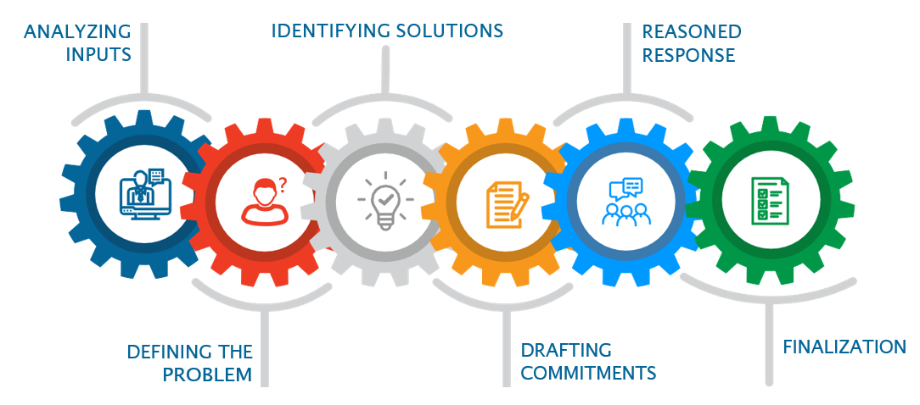
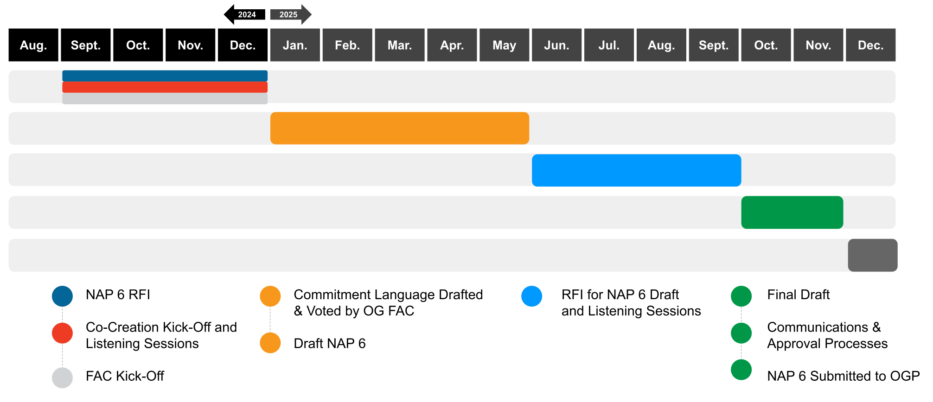
Action Plan Development
NAP 6 DEVELOPMENT WORKING TIMELINE

Slide 6
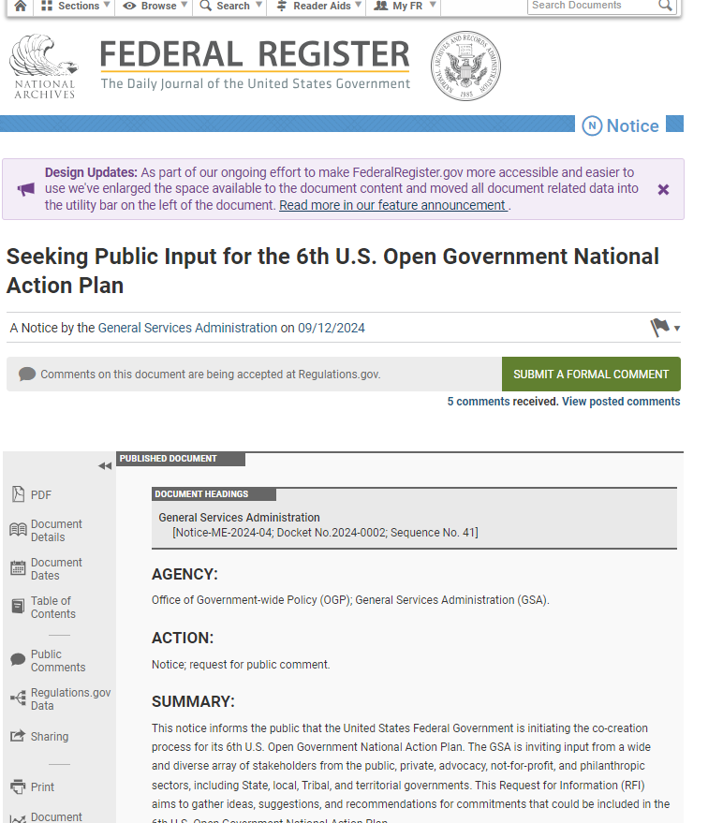
U.S. 6th Open Government NAP RFI
The NAP 6 RFI is open for comment on the Federal Register and on Regulations.gov
Search “Docket GSA-GSA-2024-0016”
Seeking ideas, suggestions, and recommendations for NAP 6 commitments
Comments due by Tuesday, November 12 at 11:59 PM ET
Please consider sharing with your friends, colleagues, networks, and communities!
Notes:
The NAP 6 RFI (https://www.federalregister.gov/documents/2024/09/12/2024-20702/seeking-public-input-for-the-6th-us-open-government-national-action-plan) is open for comment on the Federal Register and on Regulations.gov (https://www.regulations.gov/document/GSA-GSA-2024-0016-0001)

Slide 7
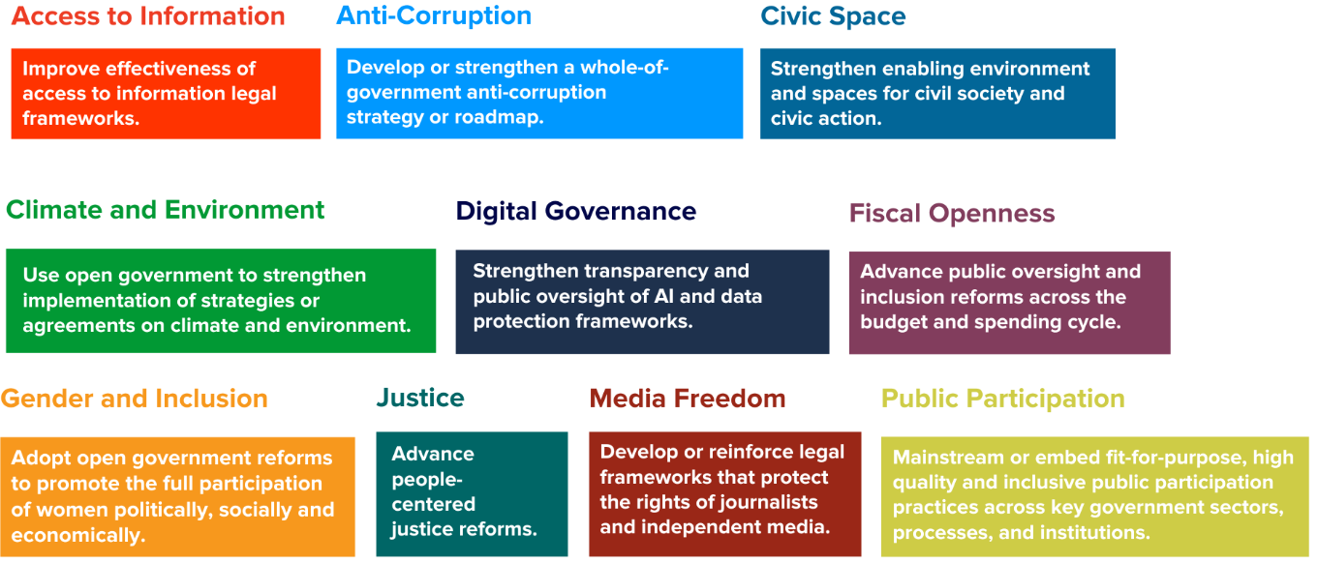
Open Government Themes
Learn more: https://www.opengovpartnership.org/the-open-gov-challenge/
Notes:
Those challenges are Challenge 1: Access to Information - Improve effectiveness of access to information legal frameworks.
Challenge 2: Anti-Corruption - Develop or strengthen a whole-of-government anti-corruption strategy or roadmap.
Challenge 3: Civic Space - Strengthen enabling environment and spaces for civil society and civic action
Challenge 4: Climate and Environment - Use open government to strengthen implementation of strategies or agreements on climate and environment.
Challenge 5: Digital Governance - Strengthen transparency and public oversight of AI and data protection frameworks.
Challenge 6: Fiscal Openness - Advance public oversight and inclusion reforms across the budget and spending cycle.
Challenge 7: Gender and Inclusion - Adopt open government reforms to promote the full participation of women politically, socially and economically.
Challenge 8: Justice - Advance people-centered justice reforms.
Challenge 9: Media Freedom - Develop or reinforce legal frameworks that protect the rights of journalists and independent media.
Challenge 10: Public Participation - Mainstream or embed fit-for-purpose, high quality and inclusive public participation practices across key government sectors, processes, and institutions.
Learn more: https://www.opengovpartnership.org/the-open-gov-challenge/

Slide 8
What Makes a Good Commitment?
Ambition
Relevance
SMART
Stretches the government beyond its current state of practice
Significantly improves the status quo
New initiative or improves on existing reforms
Clearly advances one or more of the following open government principles:
Transparency
Accountability
Participation
Technology and Innovation
Specific
Measurable
Answerable
Relevant
Timebound

Slide 9
Listening Session

Slide 10
Listening Session Guidelines
Use the raise hand feature to be called on in order
3 minutes per speaker limit
Stay on topic - please keep comments focused on NAP 6 and open government themes
Be respectful - no interrupting or personal attacks. See commenting policy for guidelines.
Notes:
. See commenting policy (https://www.regulations.gov/document/GSA-GSA-2024-0016-0002)for guidelines.

Slide 11
What We’re Looking For:
TRANSPARENCY
+
PROBLEM IDENTIFICATION
EXISTING WORK
ACCOUNTABILITY
+
What problems can open government address?
What solutions can fix these problems?
What is being done inside or outside of government that can be expanded or enhanced?
PARTICIPATION
ACCESS TO INFORMATION | ANTI- CORRUPTION
CIVIC SPACE | CLIMATE AND ENVIRONMENT
DIGITAL GOVERNANCE | FISCAL OPENNESS
GENDER AND INCLUSION | JUSTICE
MEDIA FREEDOM | PUBLIC PARTICIPATION
INNOVATIVE APPROACHES
RESOURCES & RECOMMENDATIONS
What innovative approaches or emerging technologies could the government explore?
Are there reports, collections of recommendations, and landscape analyses that can inform NAP 6?

Slide 12

Questions?

Slide 13
Civil Society ListServ
Instructions to join the public-facing GSA Open Gov mailing list:
Send an email opengov-civ-subscribe-request@listserv.gsa.gov and include “Join: OpenGov-Civ” in the subject line.
Reply “OK” to the auto-generated message you receive within 48hr.
You will get a second auto-generated message letting you know that you have joined the OpenGov-Civ ListServ
Notes:
Send an email opengov-civ-subscribe-request@listserv.gsa.gov and include “Join: OpenGov-Civ” in the subject line.

Slide 14
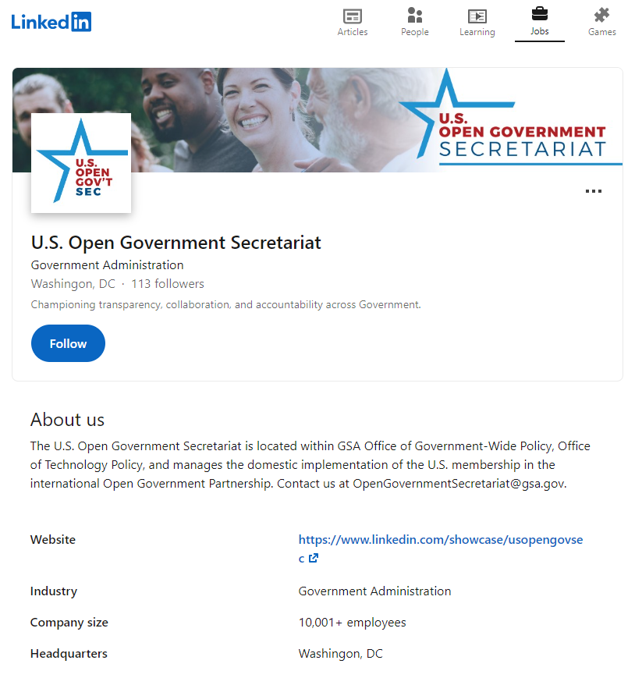
U.S. Open Government Secretariat LinkedIn
Follow us: https://www.linkedin.com/showcase/usopengovsec
Notes:
Follow us: https://www.linkedin.com/showcase/usopengovsec

Slide 15
Thank You!
Contact us at opengovernmentsecretariat@gsa.gov
Notes:
Contact us at opengovernmentsecretariat@gsa.gov

