Slide 1

Marketing Your GSA Contract:
What You Should Know!
Paula L Mensah
Procurement Analyst, GSA, OSDBU
U.S. General Services Administration

Slide 2
Agenda
GSA OSDBU Overview
Setting up your Multiple Award Schedule (MAS) Contract for Success
  Managing your contract
  Educating your employees
  Creating a capabilities statement
Marketing your MAS Contract
  Marketing Tools & Resources
  Market Research
Finding Opportunities
  Responding to RFQs & RFIs
  Contractor Teaming Arrangements (CTAs)
  Forecast Tools
  SAM.gov
Tips for Success!

Slide 3

GSA Overview
GSA’s mission is to deliver value and savings in real estate, acquisition, technology and other mission support services across the Federal government.
GSA is the Federal government’s procurement expert, helping other agencies acquire space, products, and services needed from commercial sources.
The Public Buildings Service, (PBS), provides real estate space, architecture, interior design, and construction to Federal agencies.
Our Federal Acquisition Service (FAS) delivers a vast number of commercial goods and services, at the best value, across government.

Slide 4
GSA OSDBU Overview
According to the Small Business Act as amended by Public Law 95-507, the Office of Small & Disadvantaged Business was established to:
  Advocate, within each Federal Executive Agency, for the maximum practicable use of all designated small business categories within the Federal Acquisition process.
  Ensure inclusion of small businesses as sources for goods and services in Federal acquisitions as prime contractors and subcontractors.
  Manage the small business utilization programs for OUR respective organization.

Slide 5
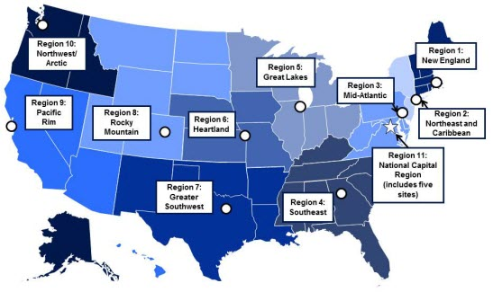
GSA OSDBU OVERVIEW
GSA’s Regional Offices
Region 1: Boston, MA
Region 2: New York, NY
Region 3: Philadelphia, PA
Region 4: Atlanta, GA
Region 5: Chicago, IL
Region 6: Kansas City, MO
Region 7: Ft. Worth, TX
Region 8: Denver, CO
Region 9: San Francisco, CA
Region 10: Tacoma, WA
Region 11: Washington, DC

Slide 6
Setting up your Multiple Award Schedule (MAS) Contract for Success

Slide 7
Managing Your MAS Contract
I have a Multiple Award Schedule Contract – NOW WHAT?
Is your schedule contract information current?
  Review GSA Advantage and eLibrary profiles
Review your approved FSS Price List
Does your website identify your GSA Schedule contract?
Add a direct link from your company website to your eLibrary profile
Use of the GSA Starmark© logo

Slide 8
Managing Your MAS Contract cont.
Educating Your Employees
Marketing Team
                Learn of and seek out contracting opportunities
                Promote the MAS contract
Sales Team
    Learn who can use the contract
    Know the contract terms and conditions
    Federal Supply List Experts
Accounting Team
Set up a tracking system for MAS orders
    Know the accounting/reporting requirements for MAS contracts
    Track subcontracting spend (large businesses only)

Slide 9

Federal Supply Schedule Price List
- When you are awarded a GSA Schedule contract, you are required to prepare, print, and distribute a document called the Federal Supply Schedule (FSS) Price List.
- When designing your FSS price list, it is best to keep it simple and short.
- A one-page flyer covering only the required 26 points specified in your contract is usually best.
- The price list must be distributed to a Customer Mailing List provided to you by the Contracting Officer.
- When mailing the FSS Price List to your prospective customers, be sure to include your capabilities statement and other literature about your product or service.

Slide 10
Managing Your MAS Contract cont.
Capabilities Statement
Why do I need a Capabilities Statement?
It’s required by most Government Agencies/Primes when responding to a RFQ
May help you stand out among competitors
What do I include in my Capabilities Statement?
Contact Information
Core Competencies
Differentiators
Past Performances
Company Data
List of Pertinent Codes & Data

Slide 11
Marketing Your MAS Contract

Slide 12
Marketing Your GSA Contract
Steps to Developing Leads in the Federal Market
What contracts are set to expire that I can compete for in the future?
Who are my competitors? Who holds the current contract?
How much are they buying? Have they awarded any set-asides?
Which Federal agency’s are purchasing my product or service?
The Unknown can cause Frustration & Disappointment

Slide 13
Let the Data Refine Your Overall Strategy!
Marketing Your GSA Contract
Use Data to Develop a Targeted Strategy
Choose the Right Event to Attend
Maximize Time at Matchmaking Events
Know which Agency Forecast Tools to Use
Become More Efficient
And much more!

Slide 14



Tools to Conduct Market Research
Utilize these tools for your market research:
Latest GSA contract award information
Assess your competition
Offers published sales data of schedule contract sales
SIN Sales
Contractors already on schedule
Ability to assess the size and potential of your target market
A repository of all government transactions/receipts over $3,500
Information reported from 90 plus agencies.
https://www.gsaelibrary.gsa.gov
https://d2d.gsa.gov/report/fas-schedule-sales-query-plus-ssq
https://www.fpds.gov/fpdsng_cms/index.php/en/
Consider the buying trends and forecasted sales for your product/service

Slide 15


Tools to Conduct Market Research
Additional Tools for marketing and research
BUY.GSA.GOV
Vendor Support Center
Research contract maintenance
Reporting contract sales
Purchase Order Portal
Reduces the cost of finding government business opportunities
Helps establish new business relationships
Increases sales potential by becoming more aware of new business opportunities
Interact
Collaborate with Federal Clients
Stay informed
Build relationships
https://vsc.gsa.gov/vsc/
https://buy.gsa.gov/interact/about-interact

Slide 16
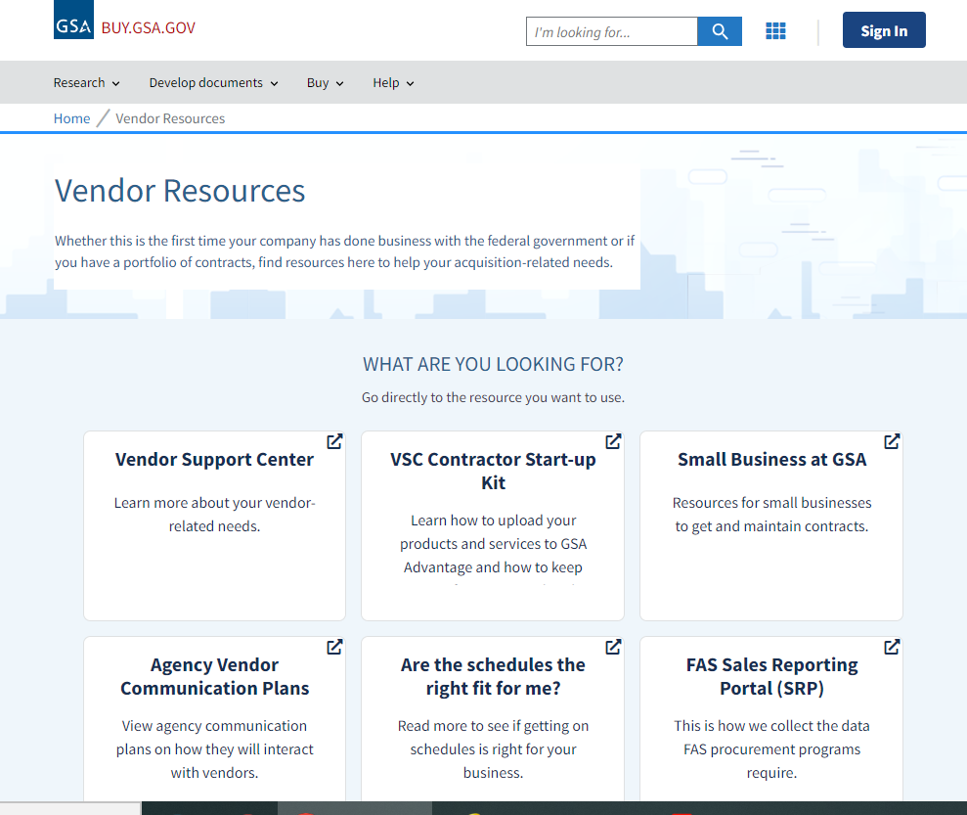
Hidden title

Slide 17
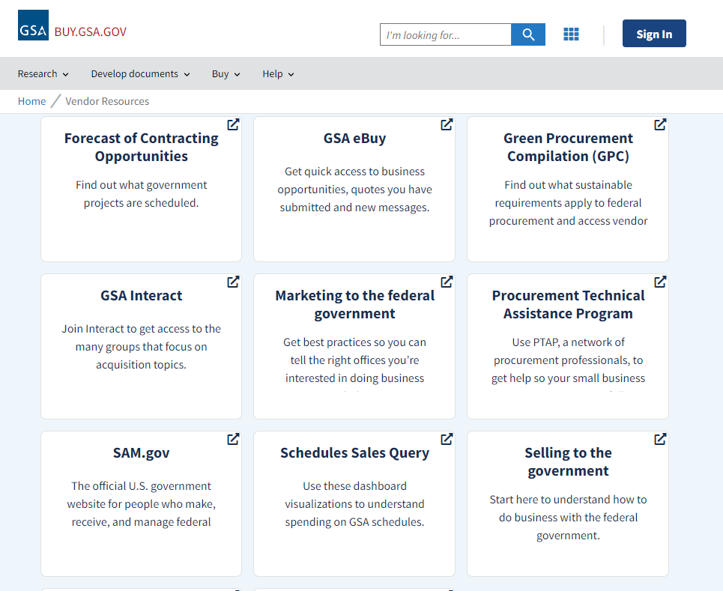
Hidden title

Slide 18
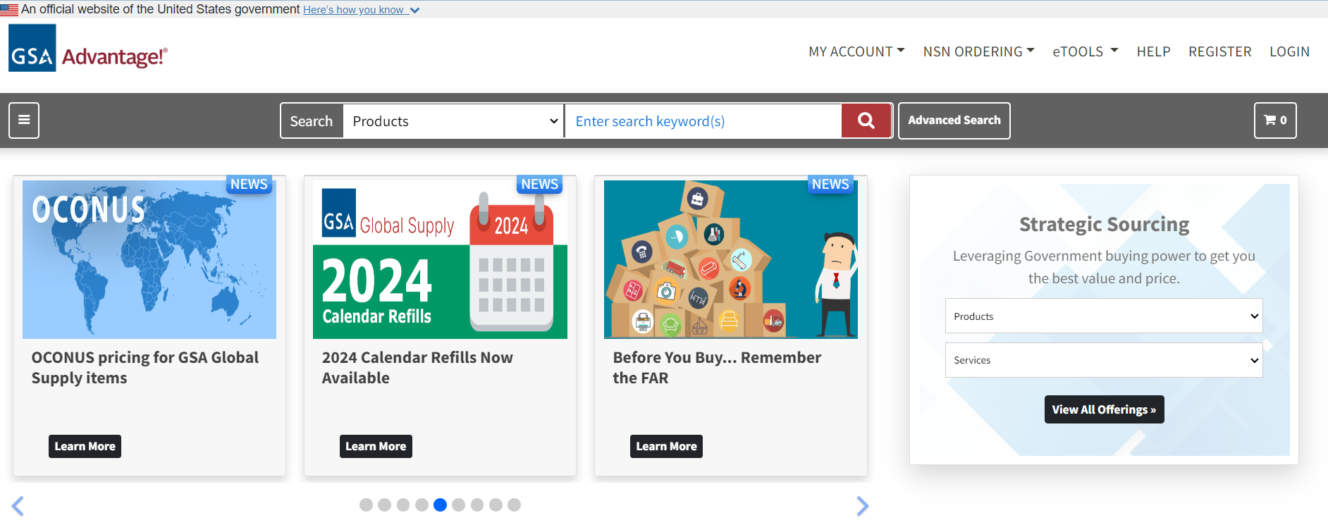
Submit Your Electronic Catalog to GSA Advantage!
GSA Advantage!® is the online shopping and ordering system that provides access to thousands of contractors and millions of supplies (products) and services.
Government buyers can search for the products they need, compare prices and product information, and place their orders.
As a GSA Schedule contractor, you are required to submit your electronic company catalog to GSA Advantage! no later than six months after your contract award.
You can submit your electronic company catalog into the GSA Advantage! system by using the Schedule Input Program (SIP) software, available for downloading at the GSA Vendor Support Center (VSC) web site.

Slide 19
FPDS-NG Overview
What’s reported to FPDS-NG? Agencies are required to report on all contract actions using appropriated funds whose estimated value is $3,500 or more as specified in FAR 4.6 Contract Reporting.
Where the data is from: Contracting Officers enter the procurement data directly or the data is fed from 90+ agency contract writing systems.
Oversight: Operated by GSA IAE with Governance from Acquisition Committee for eGov, Procurement Committee for eGov, Financial Assistance Committee for eGov and IAE CCB
For more details visit: www.fpds.gov

Slide 20
What is needed to use FPDS?
Your Product Service Code (PSC)
1. Industry Classification used to identify specific types of industry.
2. North American Industry Classification System (NAICS) is a broad classification
3. The NAICS is what you do
NAICS
1. PSC’s can help you narrow down exactly what your business does
2. PSC’s are specific and can yield better data for market research and analysis
3. Your PSC is how you are doing it
PSC

Slide 21
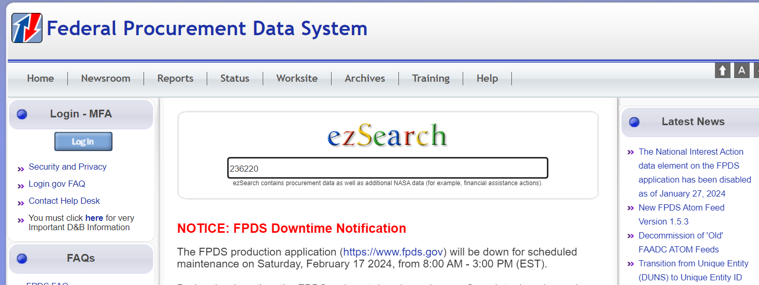
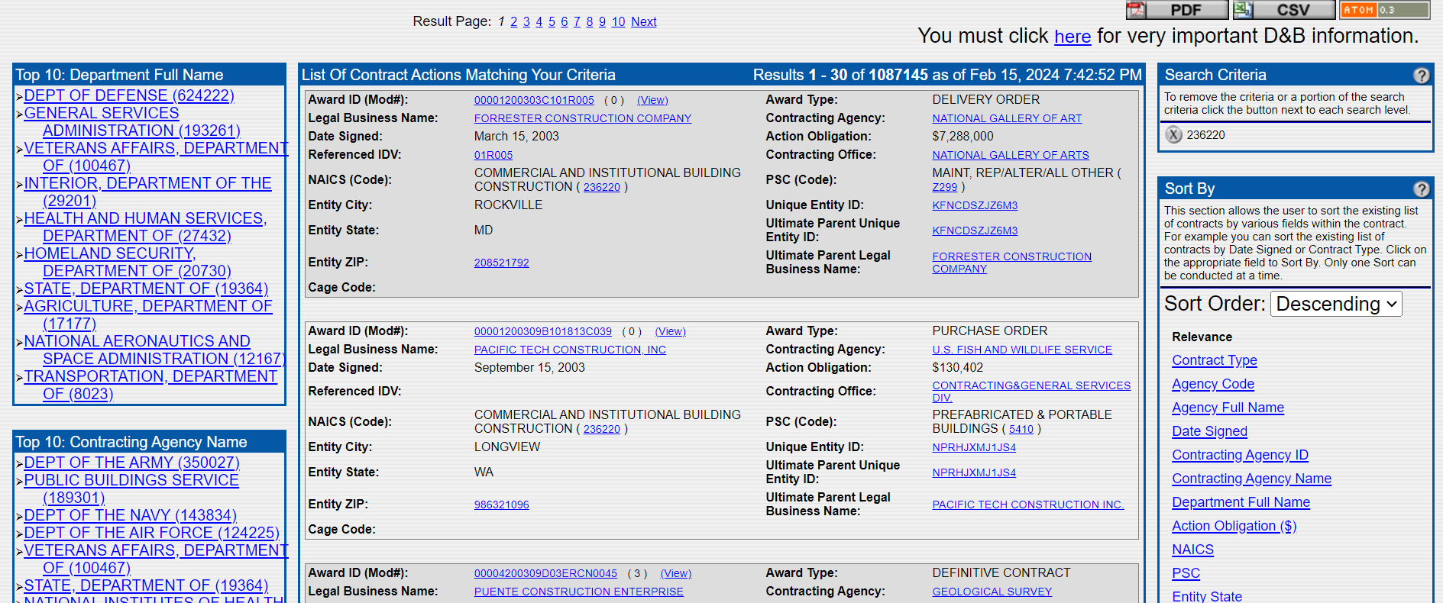
FPDS-NG

Slide 22
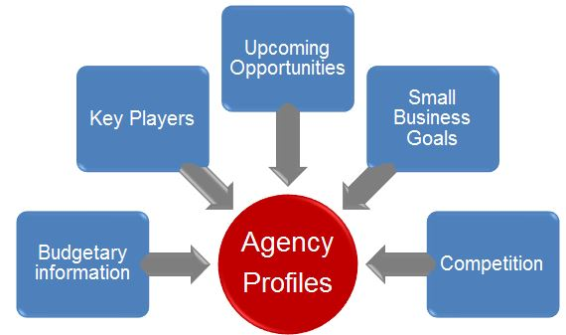
Hidden title

Slide 23
FINDING OPPORTUNITIES

Slide 24
GSA EBuy
Responding to RFIs & RFQs

Slide 25
Request for Information (RFI)
RFI –is a technique to promote early exchange of information with industry
  RFIs are used to gather information about contractors:
    Market Research
    Gauge interest
  RFIs are not:
    Solicitations
    Required for award

Slide 26
RFI - What to Expect
No Standard Format
Short response time
Overview of Government’s Need
Allows Questions from Industry
Follow Instructions outlined in RFI
Clearly state Interest – Will you submit an Offer?
Business Size (i.e. SB, 8(a),SDVOSB,WOSB,HUB)
Primary NAICS – Assure it aligns with Government need in RFI
Identify CTA or Subcontractor

Slide 27
RFI Tips
DO:
Respond Timely
Ensure response is complete
Focus of the requirement
Be specific (agencies, contract numbers, figures, dates, tasks, roles)
DON’T:
Underestimate the importance of your response
Make assumption

Slide 28
Request for Quote (RFQ)
RFQ – a solicitation under simplified acquisitions procedures which requires submission of a quotation.
RFQ’s include:
Statement of Work
Specifications/Bill of Materials
Evaluation Criteria
Price, Delivery and Payment Terms

Slide 29
RFQ Tips
Read, Read and Read
  Instructions to Offerors, PWS/SOW, Eval criteria
Respond Timely
Ensure response is complete - Quotes do not establish a binding contract agreement with the Government. The contract is established when the contractor accepts the Government’s subsequent offer to work by Signing the quote or order
Evaluate whether this opportunity is finically worthwhile
Remember – lowest cost is paramount!
Be specific (agencies, contract numbers, figures, dates, tasks, roles)
Ask questions early!

Slide 30

Contractor Teaming Arrangements (CTA)
A Contractor Team Arrangement (CTA) allows two or more GSA MAS vendors to work together in order to meet agency requirements
CTA permits vendors to complement each other and allows the team to compete for orders they might not qualify for independently
CTAs can apply to offerings within the same MAS Category or can be combined across two or more Large Categories
Customers benefit from a CTA by obtaining a total solution, rather than making separate buys from two or more vendors

Slide 31
Contractor Teaming Arrangement Facts
The CTA Agreement document is developed by the team partners and submitted to the buyer as part of the response to solicitation.
CTA’s may be established in advance of any known requirement or after requirements are identified
The CTA Agreement should contain the elements identified by GSA (e.g. identify all team members, MAS Contract numbers, tasks to be performed , pricing, etc.
Each team member is responsible for tracking and reporting its own sales in accordance with the terms and conditions of the MAS contract and responsible for paying the related IFF
Small business set-asides - If you are competing for a contract set aside for small businesses, all team members must meet the socioeconomic status and the limitations on subcontracting at FAR 52.219-14 apply.

Slide 32
Contractor Teaming Arrangement Benefits
Government buyers can:
  Get a total solution
  Satisfy socioeconomic procurement goals
GSA Schedule contractors can:
  Compete for Schedule orders for which they wouldn't otherwise qualify
  Increase their market share and become more competitive
  Reduce risk by sharing responsibilities with other team members
  Focus on the supplies and services that best match their company's resources and strengths
  Find greater success as a small and/or disadvantaged business

Slide 33
Additional Resources for Finding Opportunities
FORECAST OF CONTRACTING OPPORTUNITIES
GSA Forecast of Contracting Opportunities Tool
Agency Recurring Procurement Forecasts
SAM.GOV Contracting Opportunities

Slide 34
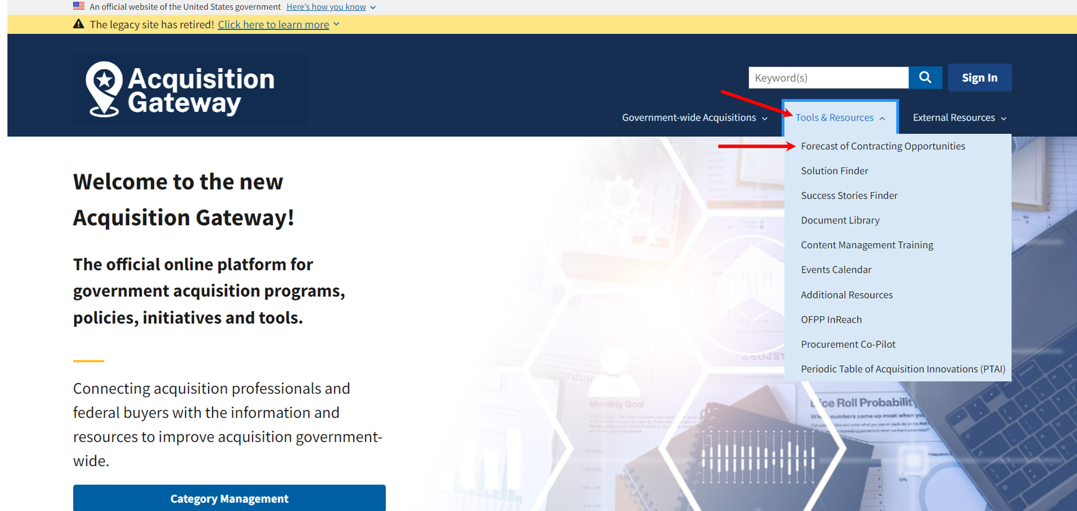
Forecast of Contracting Opportunities
How to Access the Forecast Tool:
Background:
Launched in March 2016
Focuses on acquisition planning and increases awareness of potential prime and subcontracting opportunities.
The goal is to help both GSA buyers and vendors easily communicate around potential contracting opportunities.
Currently, six Federal agencies use the tool: GSA, U.S. Office of Personnel Management, Dept. of Interior, Dept. of Labor, Department of Veterans Affairs and U.S. Small Business Administration. More to come…
The goal is to have all Federal agencies use the tool.
For more details visit: https://www.acquisitiongateway.gov/forecast

Slide 35
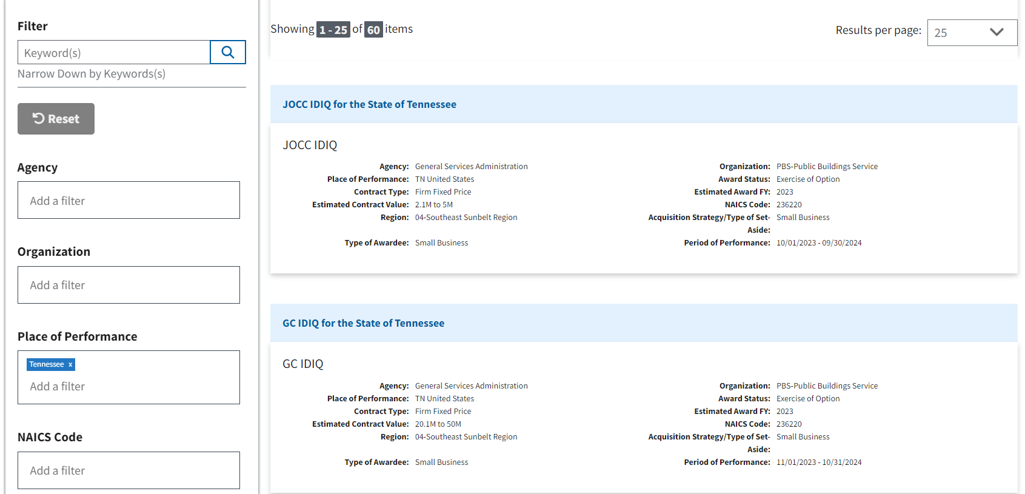
Forecast of Contracting Opportunities

Slide 36
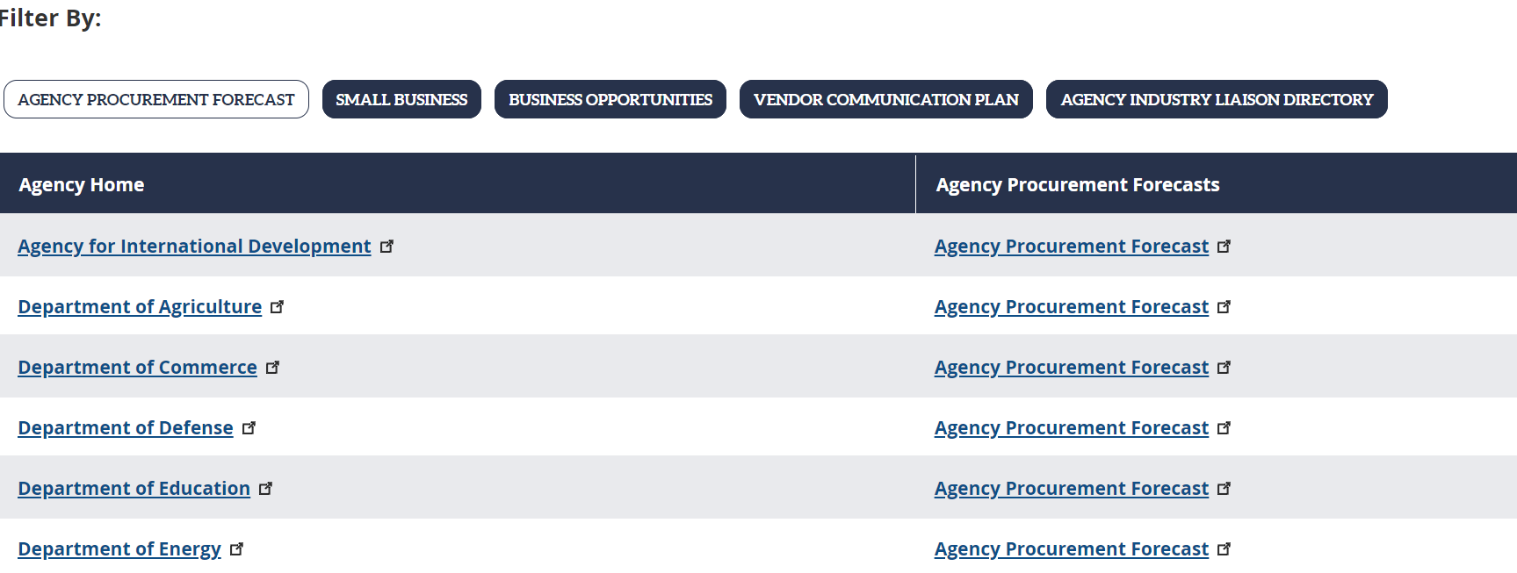
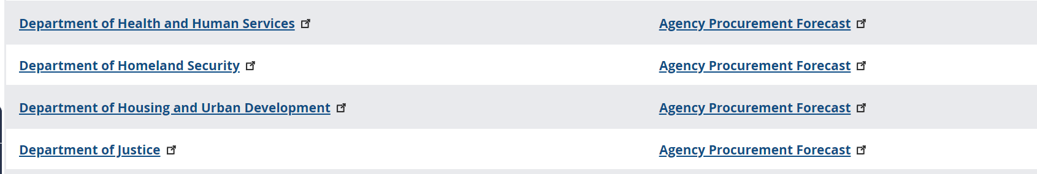
Agency Recurring Procurement Forecasts

Slide 37
SAM.GOV

Slide 38
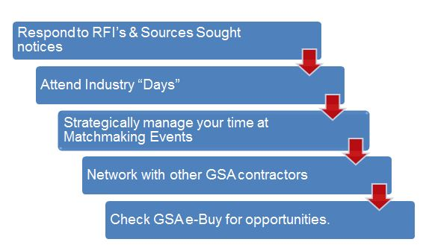
Tips for Success

Slide 39




Additional Resources
www.gsa.gov/events
www.gsa.gov/small-business

Slide 40
QUESTIONS ?

Slide 41
Survey
Your feedback is valuable to us. Please take a moment to share your thoughts by completing a brief survey. Your input helps us improve and tailor our future sessions. Thank you in advance for your time!
SURVEY LINK: https://feedback.gsa.gov/jfe/form/SV_3IZ5gNQDCTtnWlw

