Slide 1
Beyond the RFO and AI: Workforce Readiness for Modernization as the Missing Mandate in Acquisition Transformation
Bea Dukes, PhD | Danielle Mouw
August 24, 2026 @ 2 p.m. ET

Slide 2


Presenters
Replace with
Photo
Replace with
Photo
Bea Dukes, PhD
GSA Acquisition Career Manager
Beatrice.Dukes@gsa.gov
Danielle Mouw
RFO Team & GSA PILOTS Program
Danielle.Mouw@gsa.gov

Slide 3
Strategic Outcomes
Understand how the convergence of RFO and AI strategically impacts the acquisition system.
Recognize workforce readiness as a critical factor in acquisition modernization.
Examine whether the workforce is prepared for RFO principles-based, AI-enabled mission execution.
Explore collaboration and actions necessary to strengthen readiness before modernization efforts outpace workforce capability.
Notes:
This is the learning OBJ slide

Slide 4
Beyond the RFO and AI
Workforce Readiness ~ Acquisition Modernization
When Rules Become Less Prescriptive and Tools Become More Capable
+
+
AI-Enabled Tools
Changed Rules
Workforce Readiness
MISSION SUCCESS

Slide 5
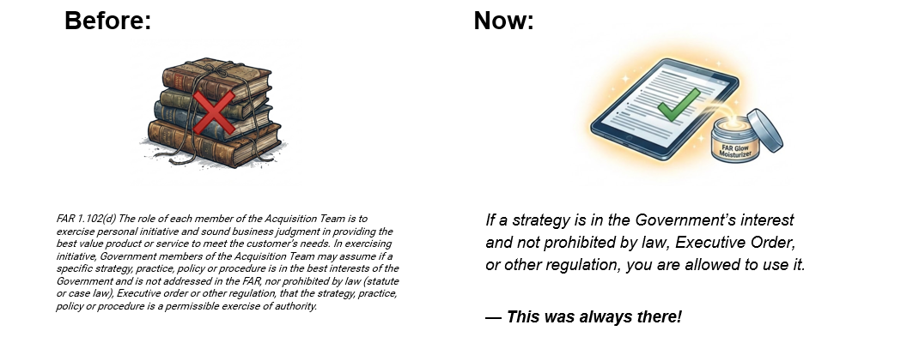

Interactive
📌 Have you ever received a physical copy of the FAR?
Notes:
Danielle will ask this one

Slide 6
The Revolutionary FAR Overhaul (RFO)
"Restores CO discretion for faster acquisitions, greater competition, and better outcomes for mission delivery."
The RFO Story
Most comprehensive overhaul of the Federal Acquisition Regulations since 1984.
The RFO Initiative:
Statutory Roots: Returns the FAR back to its core legal mandate.
Plain Language: Rewritten completely for clarity and real-world use.
Streamlined Rules: Removes burdensome non-statutory regulations.
Practical Guides: Non-regulatory buying guides with best-practice strategies.
Grounded in Executive Policy
The RFO directly aligns with recent Executive Orders & Memo:
Executive Order 14275
Restoring Common Sense to Federal Procurement
OMB Memo M-25-26
Overhauling the Federal Acquisition Regulation
Executive Order 14271
Ensuring Commercial, Cost-Effective Solutions
Executive Order 14240
Eliminating Waste and Saving Taxpayer Dollars

Slide 7
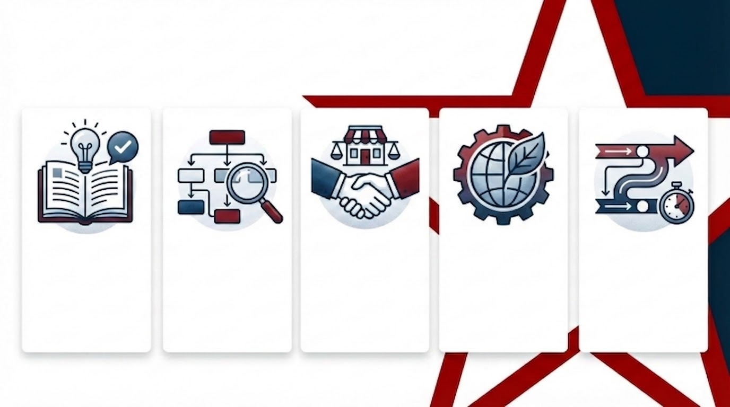
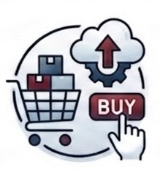
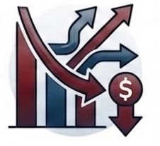
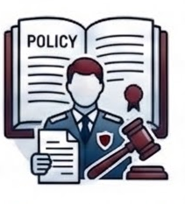
RFO: The Big 5 Changes --- New Rules and Tools!
RFO: The Big 5 Changes
1. Plain Language, Statutory Core
(Simpler FAR, Only What’s required, written for real-world use)
2. FAR + Tools Ecosystem (SAG)
(Regs set the floor-guides, tools and playbooks with agency guidance drive execution)
3. Commercial First Mindset
(Buy like the Market, Leverage existing Commercial solutions)
4. Lower Friction, More Competition, Reduced Cost
(Cut the burden. Speed up Buying, Open the Field)
5. Empowered Contracting Officers
(From Compliance to Judgement, Discretion is backed by policy)
Notes:
Danielle leads. Walk the five shifts of the Revolutionary FAR Overhaul.
TPs: RFO 1 - Federal Acquisition Regulations System: Implements a new Framework that restores discretion to the CO
RFO 7 - Acquisition Planning & RFO 10 - Market Research: Encourage COs to right size their Market Research documentation and Acquisition Planning approaches to the risk of the procurement.
Emphasize early planning, streamlined procedures for common contract types, mandatory small business considerations, and comparative analysis for equipment acquisitions to ensure the most advantageous approach for the Government.
Prioritize procuring commercial products and commercial services on an existing governmentwide contract".
RFO 8 - Required Sources of Supplies and Services: Sets the Source! Ordering procedures for the FSS are now in GSAR 538.71 & More Discretion over Competition and Strategy.
Must use existing governmentwide contracts and BPAs that are “required use” and must* consider existing governmentwide contracts and BPAs that are otherwise part of Category Management principles.
RFO 12 - Acquisition of Commercial Products & Services: One Commercial FAR Part for Streamlined Flexibility.
“If commercial products or commercial services that meet agency needs are available from any priority source identified in part 8, including existing contracts awarded for Governmentwide use (e.g., the Federal Supply Schedules and Governmentwide acquisition contracts), procure the commercial products or commercial services from that source.”
RFO 16 - Types of Contracts: Part 8 Sets the Source. Part 16 sets the Contract. You Decide the Approach
RFO 19 - Small Business: Small Business Rules Clarified-Rule of Two & Open Market

Slide 8




Workforce Empowerment
Workforce Empowerment & Modernization
+
=
AI Integration
Leveraging advanced artificial intelligence and capable modern tools.
Revolutionary FAR Overhaul (RFO)
Re-engineering standard acquisition procedures.
Innovation for Practitioners
Creating modern, agile outcomes on the frontlines.
Notes:
Regulatory Change + Technological Change = Acquisition Workforce Enablement and Modernization

Slide 9
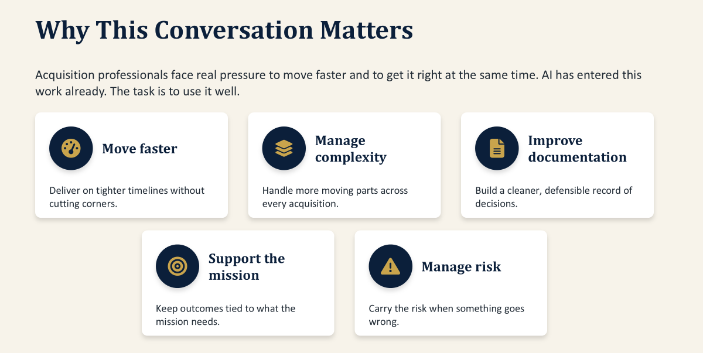
Why This Conversation Matters

Slide 10
Pivotal Moment
Pivotal Moment
WHERE WE STAND
RFO
AI
System transformations
Workforce readiness
Mission outcomes
WORKFORCE
READINESS
MISSION
OUTCOMES
Why this moment differs from every previous acquisition reform.

Slide 11
Two major changes, arriving together
SECTION 2
The rules are changing
The tools are changing
• RFO shifts work from prescription to principles.
• Flexibility, judgment, and mission focus move to the center.
• The question moves from “did you follow the steps” to “can you defend the decision.”
• AI can research, summarize, analyze, draft, compare, and organize.
• Tasks that consumed afternoons now take minutes.
• Capacity grows fastest for whoever learns to direct it.
“So if the procedures become leaner…
what fills the space?”
The rulebook is thinner, at the same time, the toolbox is getting smarter.
That combination rewards judgment and exposes its absence.

Slide 12

New Rules & Tools for AI in Federal Acquisition
M-25-21
M-25-22
M-26-04 / EO 14319
AI use must be governed, inventoried, risk-managed, and aligned to public trust.
AI acquisition must be competitive, performance-based, testable, and protected from vendor lock-in.
LLMs must support truth-seeking, ideological neutrality, transparency, and user feedback.
EO 14179
Takeaway
Lifecycle Expectation
Federal AI adoption should remove unnecessary barriers while advancing U.S. AI leadership.
Humans remain accountable; AI supports drafting, analysis, market research, and monitoring.
Contract for testing, auditability, updates, performance monitoring, data rights, and an exit path.
GSA AI Use Case Types (CIO 2185.1C): Defines four distinct AI use case types: Capability Assessment, GSA Pre-approved Application, Research and Development, and Production or Production- Intent.

Slide 13

Say the quiet questions out loud
Put your answers in chat!!!
SECTION 3
?
Is AI going to replace my job?
“If you have wondered whether AI threatens your value, you are not behind. Like many of us, you are paying attention.”
?
What happens to my value when AI can do some of my work?
?
What skills will still matter?
?
How do I know when to trust AI?
?
What am I accountable for if AI helped produce the work?

Slide 14
New Strategic Partner
What shifts to AI, what stays human
AI handles the volume work
Humans keep
• Research and gathering
• Summaries and first drafts
• Side-by-side comparisons
• Organizing volumes of information
• Judgment, context, and ethics
• Accountability and verification
• Stakeholder relationships
• Every consequential decision
“AI can draft the document. AI cannot own the decision.
The Acquisition Professional’s signature remains accountable.”

Slide 15
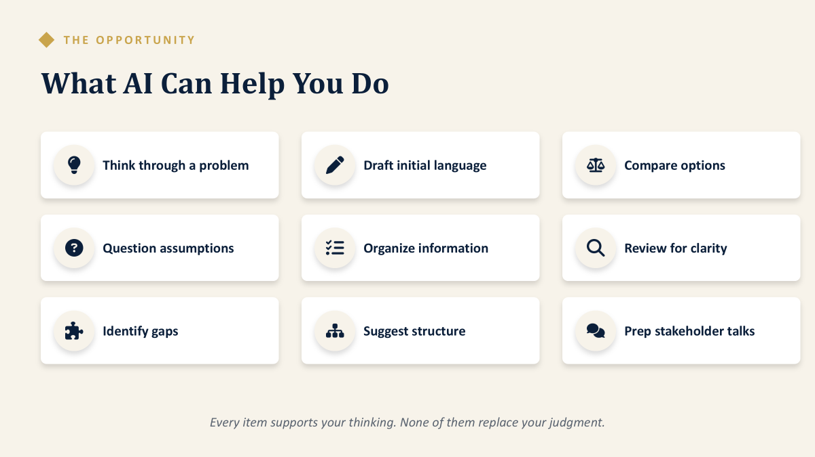
What AI Can Help You do

Slide 16
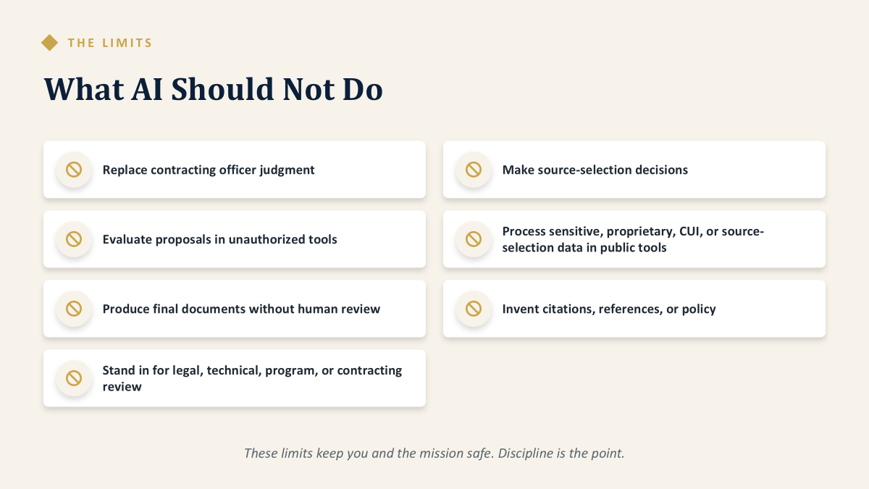
What AI Should Not Do
Notes:
Hallucinations,Bias,Drifting

Slide 17
Interactive
✓
?
Completed the training
Ready for what is coming
“Training tells you what changed. Readiness determines what you do about it.”

Slide 18
What readiness actually means
People are prepared, capable, confident, supported, and accountable enough to perform effectively when the work, rules, tools, expectations, or operating environment change.
1
2
3
4
5
Prepared
Capable
Confident
Supported
Accountable
You know what changed, and why
You can do the new version of the work
You will act without a script
Time, tools, and a safe place to practice
You own the outcome, tool-assisted or not
Readiness is not what you know.
Readiness drives the action you take when the ground shifts under what you already know.

Slide 19
Readiness Use Case
Same transcript, different readiness examples
CO 1
CO 2
“Where is the new template?”
“What is the objective?”
• Waits for guidance that is not coming back.
• Weeks pass. The requirement sits.
• Identifies the mission need and weighs options.
• Documents the reasoning, and moves.
Identical training records.
The difference is not in the transcript; readiness is the driving force!

Slide 20
Readiness is not any of these
INPUT
INPUT
INPUT
INPUT
INPUT
Training completed
Certification held
Rules known
Tool access
AI proficiency
An input, not an outcome
A standard met on a known map
The starting line, not the finish
A login is not capability
Prompting is not judgment
All five are inputs. Readiness is the outcome!
“A certificate validates training completion.”
Readiness shows up when professionals leverage the new knowledge
to manage an acquisition situation that was not in the syllabus.

Slide 21
The scholarship behind the ‘readiness’ discussion
SECTION 4
SYSTEM
Sociotechnical systems theory
Trist & Bamforth, 1951
The tools and the people are one system. Upgrade one without the other, and both degrade.
LEADERSHIP
Adaptive leadership
Heifetz, 1994
Checklists fix technical problems. Adaptive challenges are only fixed when people change how they work.
INDIVIDUAL
Readiness for change
Armenakis, Harris, & Mossholder, 1993
Adoption happens when five beliefs land: it is needed, it is right, we can do it, leaders mean it, it benefits me.
Three levels, three bodies of research, one conclusion: readiness is built, not assumed.

Slide 22
Readiness is a journey, not a training event
SECTION 4
1
2
3
4
5
→
→
→
→
Awareness
Understanding
Practice
Confidence
Integration
I know something is changing
I know what it means for my work
Tried where mistakes are affordable
I can do it without a safety net
It is simply how I work now
Stages 3 and 4 are where readiness is actually built, and the stages most often skipped.
“Nobody becomes ready in a webinar. People become ready through reps.”

Slide 23
Making practice safe
SECTION 4
What individuals can do
What leaders must do
• Practice new approaches on low-stakes tasks first.
• Ask questions in the open. Each one frees five quietly stuck colleagues.
• Share what worked, and what fell short.
• Create sandboxes, drills, and mock requirements.
• Protect practice time on the calendar.
• Treat practice mistakes as tuition, not failure.
• Model the behavior. Visible use grants permission.
If the first time, your team uses a new RFO authority, is on a real world, critical acquisition,
that can sabotage workforce readiness.

Slide 24
Five things to start this month
SECTION 5
1
Judgment Is the Job
Your reasoning becomes the record.
2
Work With the Machine
Assign AI the assembly work. Keep the judgment work.
3
Verify Before You Rely
AI output is a draft input. Accountability does not transfer.
4
Practice Before the Pressure
Build skill in low-stakes settings first.
5
Bring Your Team Along
The least ready critical role sets the pace.

Slide 25
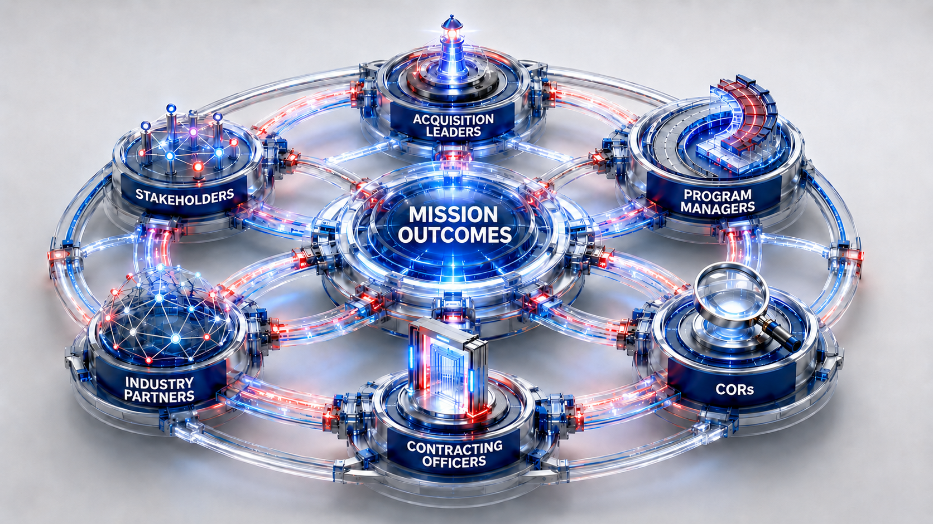
The Modernized AI-Enabled, RFO Acquisition Ecosystem

Slide 26
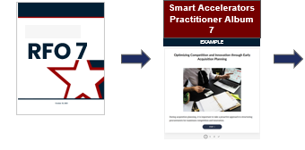
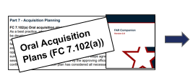
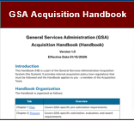
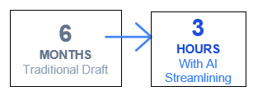
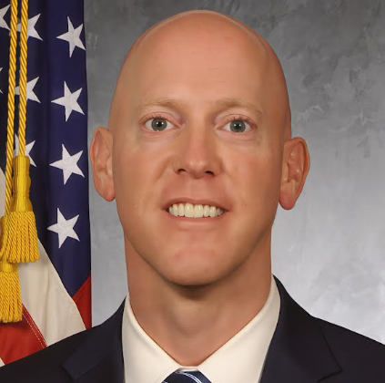
Use CASE: RFO 7
Use Case: Elements of an Oral Plan
GSA Federal Acquisition Service IT Requirements Oral AP
What are you buying?
What is the acquisition history?
What is the dollar value?
What is the period of performance (including options)?
What are your market research findings?
Sources
Competition…
Planned contract type
Performance-based outcomes
Small business participation
Pre-existing contracts
What are the anticipated source selection procedures?
LPTA, Tradeoff, HTR-FRP, Other
What are the anticipated evaluation criteria?
Risks/other considerations?
Ronald Gordon & Team, FAS AAS (ASSIST)
Notes:
FCL-GSA-FAR-0001: Fast Track your Acq - the Oral AP method (OGP, PBS) Course 🧭
FCL-GSA-FAR-0004: The Revolutionary FAR Overhaul (RFO) & What it Means for your Acquisition Strategy
FCL-GSA-FAR-0005: RA: When Can I Use Generative AI to Help Draft My Requirements in the Context of the New RFO?

Slide 27
Judgment is now the requirement vs. checklist-based compliance
THE PRINCIPLE
Substantiating the acquisition decision
Legacy FAR: prescriptive rules, evidence-based compliance
RFO: judgement rules, quality-based, data-informed discretion, likely the new defense.
ASK YOURSELF
IN THE NEXT 30 DAYS
Could someone reconstruct why we chose this approach from what we entered into the file?
For your next significant RFO-based acquisition decision: test writing your own reasoning note: objective, options, choice, and why.
Under prescriptive rules, compliance was the defense.
Under flexible principles, your reasoning is the defense.
Document, per local guidance.

Slide 28
Work with the Machine
THE PRINCIPLE
Treat AI as a capable junior teammate, not a rival.
Competing on volume work wastes your value.
Leveraging it appropriately drives efficiency and capacity.
ASK YOURSELF
IN THE NEXT 30 DAYS
How can I leverage the machine?
What part of this task actually requires my judgment?
Pick one recurring low-risk task.
Run it weekly with an approved AI tool.
Track time saved and errors rate.
Analyze data over time.
The tools and algorithms will generate the data.
Acquisition professionals make the mission-critical decisions!

Slide 29
Verify Before You Rely
TAKEAWAY 3 OF 5
THE PRINCIPLE
AI can be confidently wrong.
AI can produce polished text whether or not the facts underneath are sound.
As an acquisition professional (PM, CO, or COR), your name is in the .contract file
ASK YOURSELF
IN THE NEXT 30 DAYS
What did I check?
How would I validate that I checked the output?
Build a multi-point verification habit: acceptable use and review output for applicability with the specific acquisition.
Trust is earned!
Verify AI output before making high value decisions!
Notes:
Example: a COR spot-checks an AI summary of contractor performance data against source deliverables before it enters the record.

Slide 30
Practice Before the Pressure
TAKEAWAY 4 OF 5
THE PRINCIPLE
Confident performance under pressure is not learned in awareness briefings
Workforce performance with new tools comes from testing and experimenting in safe spaces.
ASK YOURSELF
IN THE NEXT 30 DAYS
Where is the safe place that I can safely test a new RFO authority or a new AI-integration?
Block one hour each week for deliberate practice with a new RFO authority or approved tool.
Explain or debrief it like a meeting with a program partner or a senior leader.
Consider these as flight simulator experiences!

Slide 31
Readiness = Leading and Influencing Change
THE PRINCIPLE
One brilliant early adopter can influence an entire office.
One change-resistant, influential teammate can stall it.
Navigating change is shared work.
ASK YOURSELF
IN THE NEXT 30 DAYS
Who on my team is change-resistant or perhaps quietly frozen?
What do they need: information, practice, or permission?”
Hold conversation(s) built around the quiet questions.
Then pick at least one experiment to run together
Pair the experimenters with those less ready to change.
The team-based mission outcomes always exceed what either would generate alone.
Celebrate the wins! Learn from the experiences!

Slide 32
The bottom line
CLOSING
“When the rules become less prescriptive
and the tools become more capable,
workforce readiness
becomes the deciding factor
in acquisition performance.”
Ready is a choice you make before you need it. Let’s make readiness our choice today!

Slide 33






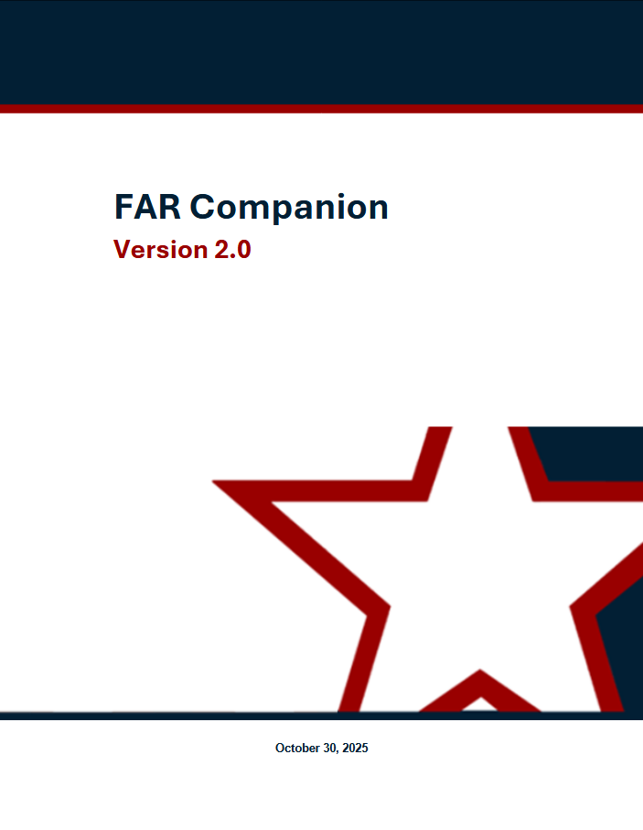

RFO Practitioner Resources
AI in Acquisition
Prompt Engineering Credential
Generative AI Guide 💡
Prompt Library
CoP: aicop@gsa.gov
GenAI Google Space
Testing & Coaching
RFO, AI & Beyond
GSA Only: PILOTS Training ⚙️
Govwide: Federal Innovation Labs
Email: SAGTesting@gsa.gov
Communities of Practice
TechAcq CoP 💻
TECHACQ-COP@listserv.gsa.gov
AIAs Directory
AIA Council Directory
FAR Forward Alliance
FAR Forward in CSOD
PILOTS Program
GSA PILOTS Program Community
By the FAR/GSAR Part
Acquisition.gov for RFO Parts 🏛️
RFO Practitioner Albums 📚
FAR Companion & Buying Guide 📘
DOW Comparison Tool
OASIS BPA Kit & GWAC Toolkit
Use Cases Knowledge Repository
Office Hour Events
FAR Forward Alliance: Register
Open Office Hours: Register
Supervisors Hours: Register
DOW Connect Live 🎙️
PILOTS Monthly Hour (by invite)
RFO
Notes:
Danielle will cover briefly resources PILOTS makes available to GSA and beyond

Slide 34
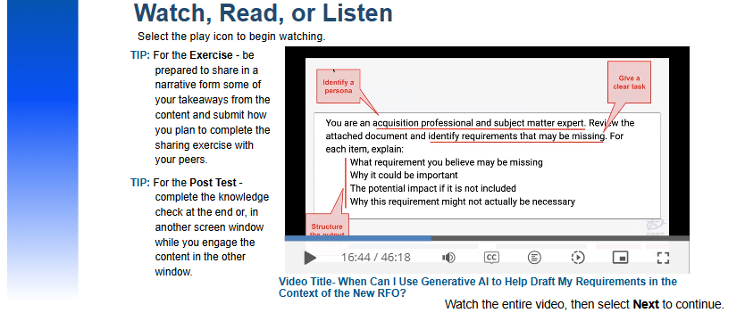
New Courses Monthly! FAR, GSAR, & AI in Acquisition Training
FAI CSOD for CLPs
Navigating the FAR Framework Course (FAI) 🧭
FCN 306: Negotiations in a Non-Competitive Environment Course (FAI, OGP) 🧭
FCL-GSA-FAR-0001: Fast Track your Acq - the Oral AP method (OGP, PBS) 🧭
FCL-GSA-FAR-0002: GSA IMPACT: The New FAR 8 & GSAR 538.71 (OGP) 🧭
FCL-GSA-FAR-0003: Deep Dive of GSA's MAS Program & RFO Part 8 Flexibilities (OGP, FAS) 🧭
FCL-GSA-FAR-0004: The Revolutionary FAR Overhaul (RFO) & Acquisition Strategy
FCL-GSA-FAR-0005: RA: When Can I Use Generative AI to Help Draft My Requirements? 💡
RFO High Intensity Immersive Training (HIIT) Workshops: RFO HIIT - Foundation (FAI, OGP) 📌
GSA RFO/RGO Pillars L&L Series
FAI CSOD RFO Playlist
▶RFO & AI Course: Prompt Demos
Watch, Read, or Listen
Select the play icon to begin. Complete the knowledge check to earn CLPs.
Notes:
Danielle will cover briefly resources PILOTS makes available to GSA and beyond

Slide 35
Conclusion

