Slide 1
GSA eBuy Essentials: Your Path to Acquisition Excellence!
Michael Jordan | August 28, 2026

Slide 2
Presenter
Michael Jordan
Procurement Analyst
Office of Centralized Acquisition Services

Slide 3
What are we going to cover today?
Introduce eBuy
Who uses eBuy and what types of requests get created
How it has been making people’s lives easier for two decades
What programs and contracts does it support?
Register and request
How to register for a FSA ID and/or link your PIV/CAC card
How to choose a contract and select sources
Completing the request details and posting the request
Amend, award, and afterwards
How to amend requests and address questions
How to review quotes and make an award notification
How to archive or reissue requests
Wrap up and questions
Post presentation discussion and/or follow-up in more detail as needed

Slide 4



What are the key takeaways?
What eBuy is, what are the benefits of using it, and where it fits in FAS’ acquisition toolbox?
How to use eBuy to request information, proposals, and/or quotes?
Ideas for marketing eBuy to your customers, clients, and/or contract holders!

Slide 5
Introducing eBuy
How eBuy helps you with your work?

Slide 6

Have you ever found yourself…
Need information, proposal, quote for products and/or services but have no idea where to start?
Wonder whether a large quantity purchase would enable you to get a better unit price?
Want feedback on requirements or help identifying sources of supply?
Notes:
“Selling eBuy”
This slide describes common tasks that buyers perform on eBuy and how the tool can help them accomplish their missions.
Extra Notes For Trainers
This slide and the next one is intended to allow you to articulate just how valuable eBuy can be. You are connecting with your audience by asking them if they have ever had to do things (that we all know they probably have had to do) and how much eBuy can help.
Remove these trainer notes if you are presenting with visible notes.
You should absolutely customize these two slides to your audience because it can really help you make an early connection.
This type of slide has proven very effective for piquing the interest of customers who may not be familiar with just how much eBuy can do.

Slide 7



You can do that with eBuy!
Services!
Volume Discounts!
Market Research!
eBuy was designed with services in mind; post your requirement and the details around your request to get responses
eBuy makes it easy for you to compete for volume discounts and sellers can easily offer discounts beyond their normal contract price
Post draft requirements or requests for information to help find sources and/or get feedback for a future procurement

Slide 8
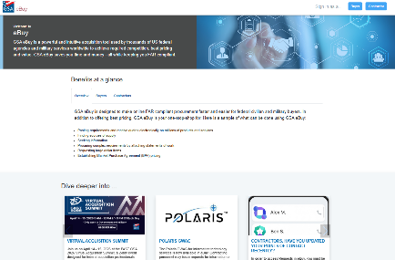
Who can use eBuy?
As a buyer
Federal agency buyers have full access to request information, proposals, and/or quotes on all listed contracts
State & Local agency buyers may post requests under Cooperative Purchasing and/or Disaster Recovery solutions
Native & Tribal users may use the tool in tandem with the authority they have
As a seller
GSA contract holders under MAS, MAS BPAs, MACs, GWACs, and other IDIQs as loaded may respond to requests posted under the categories their contracts cover

Slide 9

eBuy is Everything
Dental Assistant Services
Dell computers & laptops
Cleaning supplies
Laptops with & without docking stations, monitors
Fire alarm monitoring & inspections
Network fiber installation/replacement
150 pairs of Reebok boots
BLM-CO CAM HVAC chiller system repair
Conference room upgrade
S66 T4 Bobcat skid steer loader with snowblower attachment
Interior painting of walls & ceiling
Radiology, Nuclear Medicine & Healthcare Services
High Resolution Inductively Coupled Plasma Mass Spectrometer (HR-ICP-MS)
eBuy is for most of EVERYTHING!
40,272 RFP/Qs closed | ~$28B awards | 15,773 SB set-asides
9
Notes:
Examples of Requests:
eBuy is used for an incredible variety of requests across a lot of contract vehicles. Anything from shoes, to sleds to services to installations to painting and more.
Extra Notes For Trainers
If you know what your audience is interested in, this is a great opportunity to research similar requests. Some audiences respond very well to being shown that something they want is already being competed.
This is also an opportunity to talk up other tools like buy.gsa.gov libraries where statements of work can be found.

Slide 10
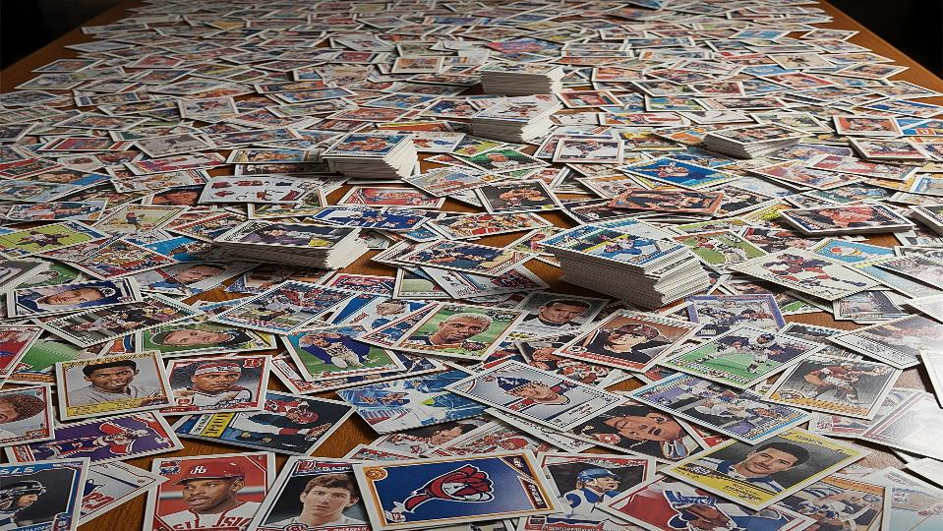
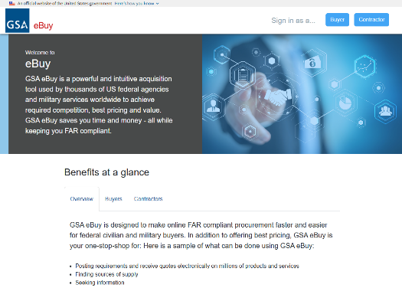

FY2025 Statistics
Activity
RFP/Qs: 40,272 | Proposals/Quotes: 125,848 | 3+: 12,786
Top Users
1) Air Force | 2) GSA | 3) Navy | 4) Army | 5) OSD
Highlights
Awards >$1M: 81 | SB set-asides: 15,773
Breakdown
MAS/VA: 81% | MAS BPAs: 15% | MACs: 2.5% | GWACs: 1.5%
eBuy is the MVP
10
Notes:
FY 2025 Statistics for eBuy Activity
This slide lays out at a high level what kind of activity has run through eBuy in terms of quotes and by vehicle.
Extra Notes For Trainers
This slide is a great opportunity to sell how broad the appeal of buying and/or selling through eBuy is.
Inspiration – make eBuy stats look like a baseball card
RFQs closed (we use “closed” instead of “created” because actions can be taken on them.
Total quotes received
Est. award value
Categories purchased
Top 3 agency buyers

Slide 11
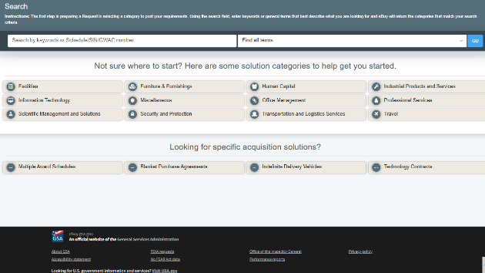
Summary
What eBuy is and who can use it
An online marketplace for government buyers to request information, proposals, and/or quotes from GSA contract holders
Who can use it, and when
Federal, State & Local, and Native & Tribal buyers in accordance with their respective purchasing authority
Holders of GSA contracts such as GWACs, MACs, and/or MAS can respond to an RFI/P/Qs
Business volume
Steady activity, billions in estimated awards, and still an average of 3 proposals/quotes per request

Slide 12
Accessing eBuy
Your FSA ID, Advantage, and/or PIV/CAC Cards

Slide 13
How to register?
Register for your FSA ID
A secure centralized credential for logging into multiple GSA systems (including eBuy and Advantage)
Uses an email address and a password, and then additional information depending on the application
Enter your email at one of the many entry points such as eBuy or buy.gsa.gov
  If you have a FSA ID, you’ll be carried through to collect additional information
  If your email address is not associated with a FSA ID, you will complete the registration
Register through GSA Advantage
eBuy registration goes through GSA Advantage screens
Identify whether you are a federal or state user and fill out the form as prompted
Complete the email “handshake” and set up multi-factor authentication
Register your PIV/CAC card
You must register the card first (initially or afterwards) before you can use it to log in
Click the “register PIV/CAC card” link in Advantage member information and select the certificate
Confirm the certificate and you may now use the “Sign In with PIV/CAC card” in future

Slide 14
Overview of the eBuy request process
Select a request type
Do you want to receive information (RFI), proposal (RFP), or quote (RFQ)?
Choose a contract and find your sources
Multiple Award Schedules (MAS) and the categories and subcategories
GWACs (8a Stars III, Alliant 2, Alliant 3, Polaris, VETS 2), MAC (OASIS+), or Telecommunications (EIS, CS3)
MAS Blanket Purchase Agreements (BPAs) (2GIT, GSS IT Products, MRFS2, NPA, Printer, RUGGED, SCRIPTS)
Enter details, and post
Give your request a title and details, configure contract and award type, and set a close date
Enter line item data, add attachments, and select a place of performance or delivery
Post, and wait for responses to come in
Amend, evaluate, and award-notify
Make amendments or upload answers to questions received
Review responses as they come in, and make an award notification after the request closes
Save the request in your history to reissue later if you need to

Slide 15
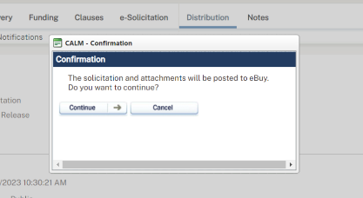
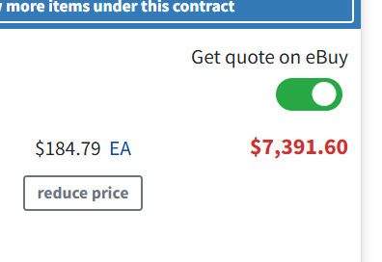
Alternative eBuy entry points
From CALM via eBuy Connect
Use CALM to initiate a solicitation and compete it on eBuy then bring responses back into CALM
From an Advantage shopping cart
Toggle “Get a quote on eBuy” from the cart. Selected items are pre-populated in eBuy for you!

Slide 16
Walking Through eBuy
A step by step demonstration

Slide 17
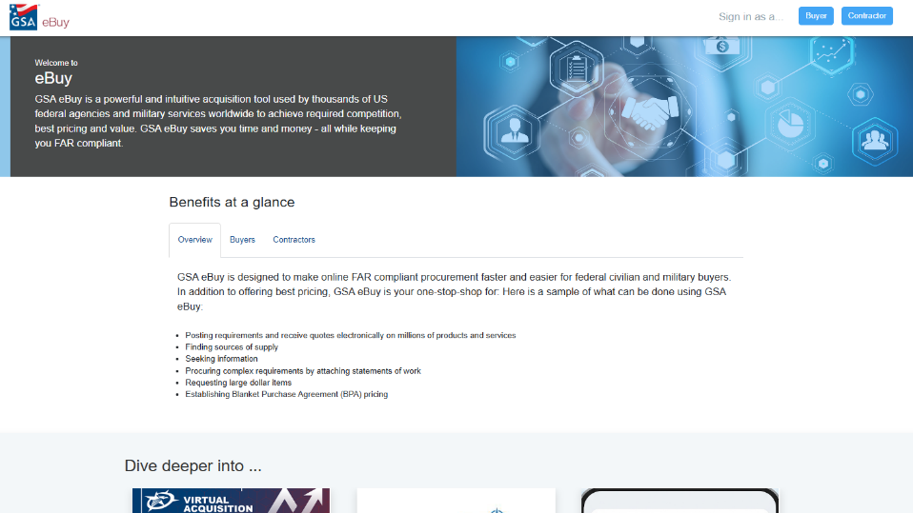
https://www.ebuy.gsa.gov/ebuy/

Slide 18
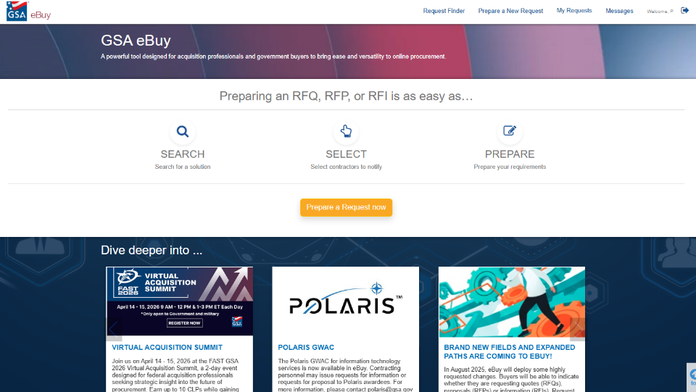
GSA eBuy Continues

Slide 19
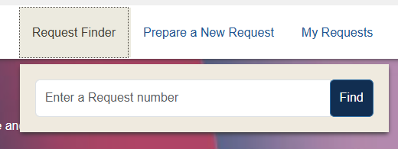
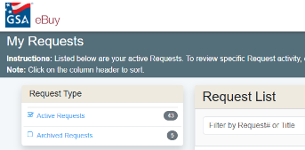
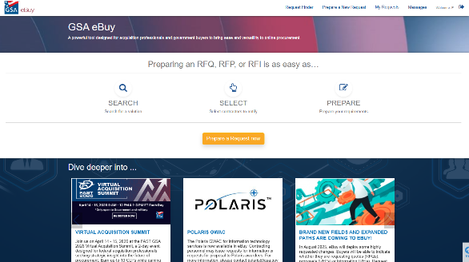
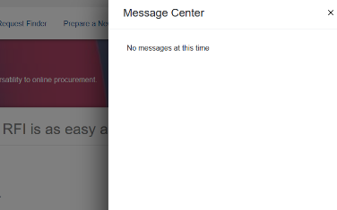
GSA eBuy Requests

Slide 20
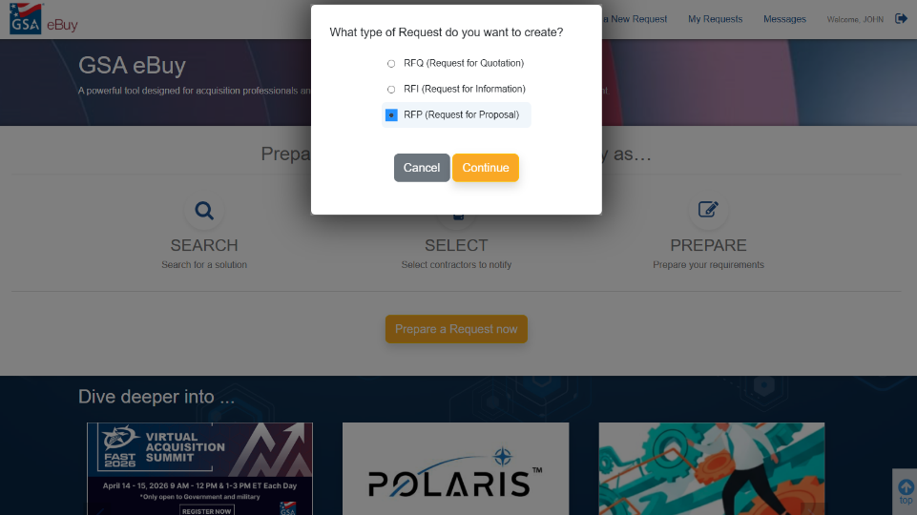
Create a Request

Slide 21
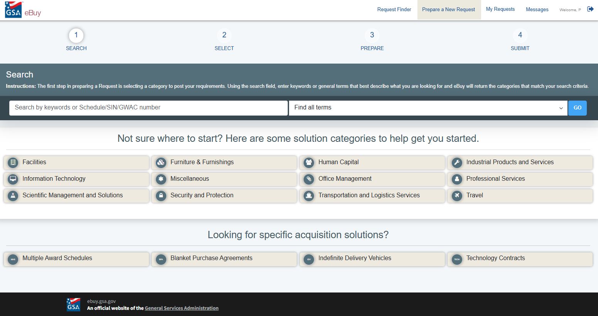
Search by Keywords

Slide 22
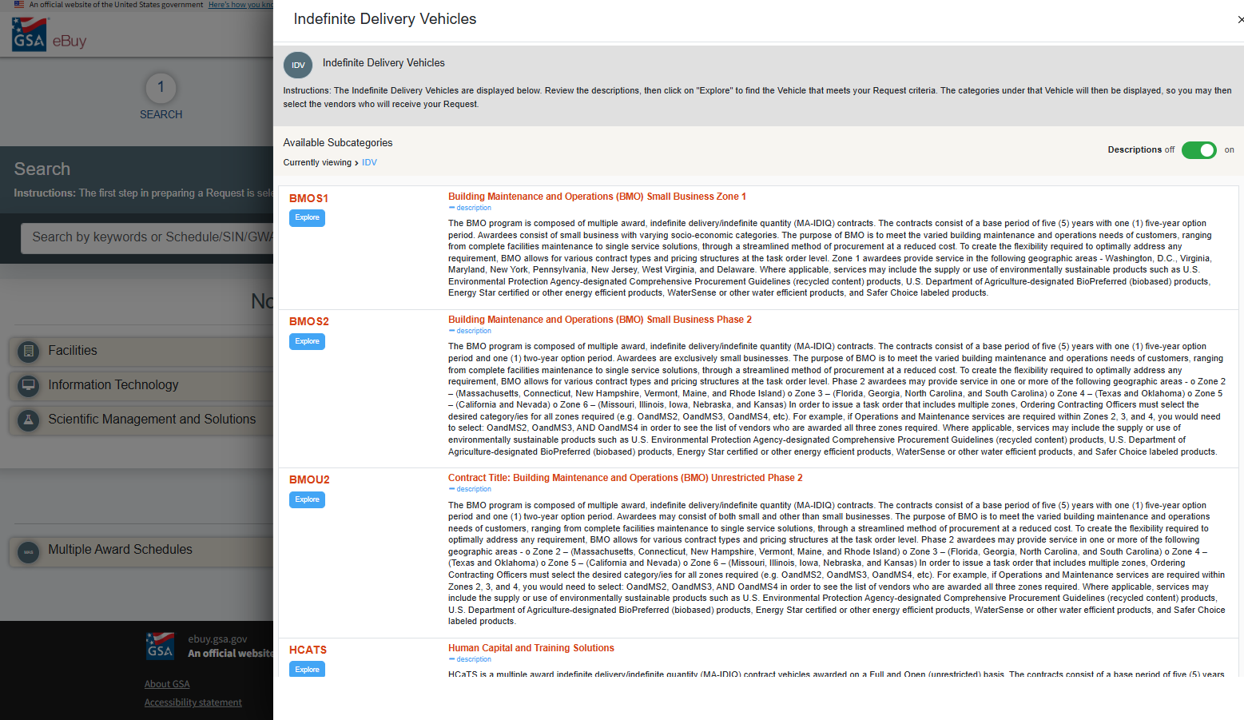
Indefinite Delivery Vehicles

Slide 23
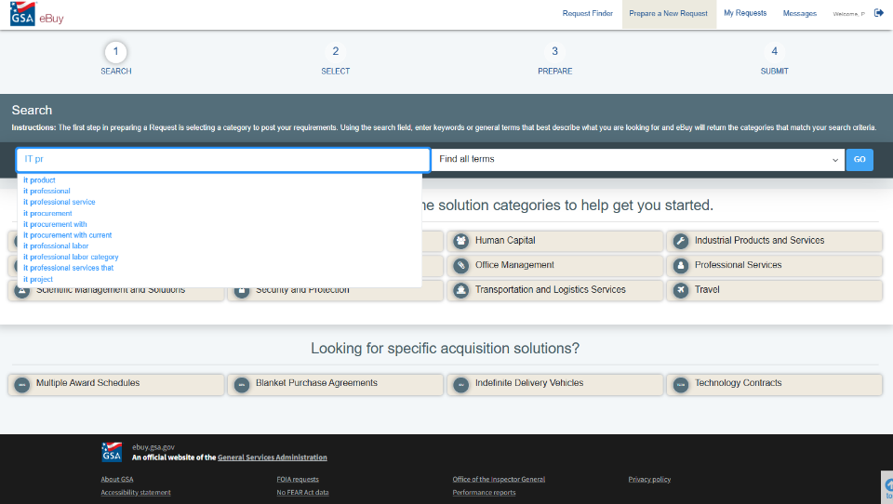
Search

Slide 24
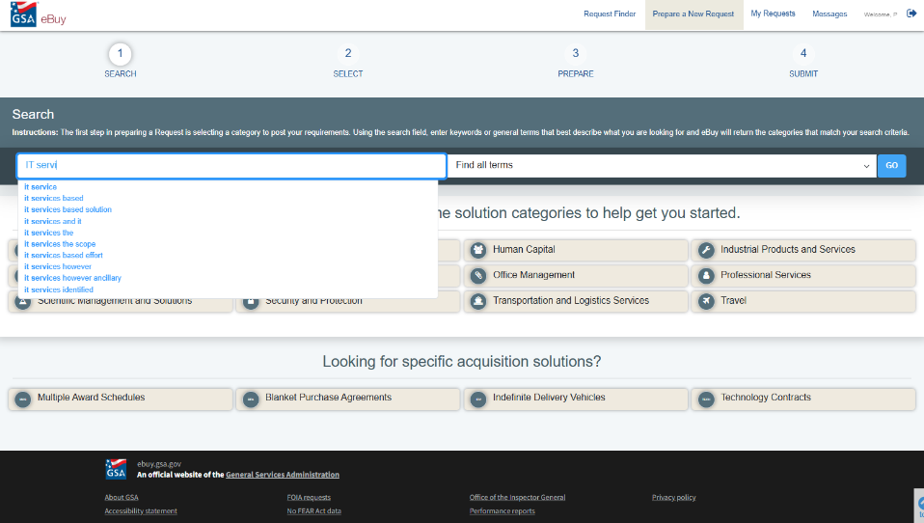
Search for IT Services

Slide 25
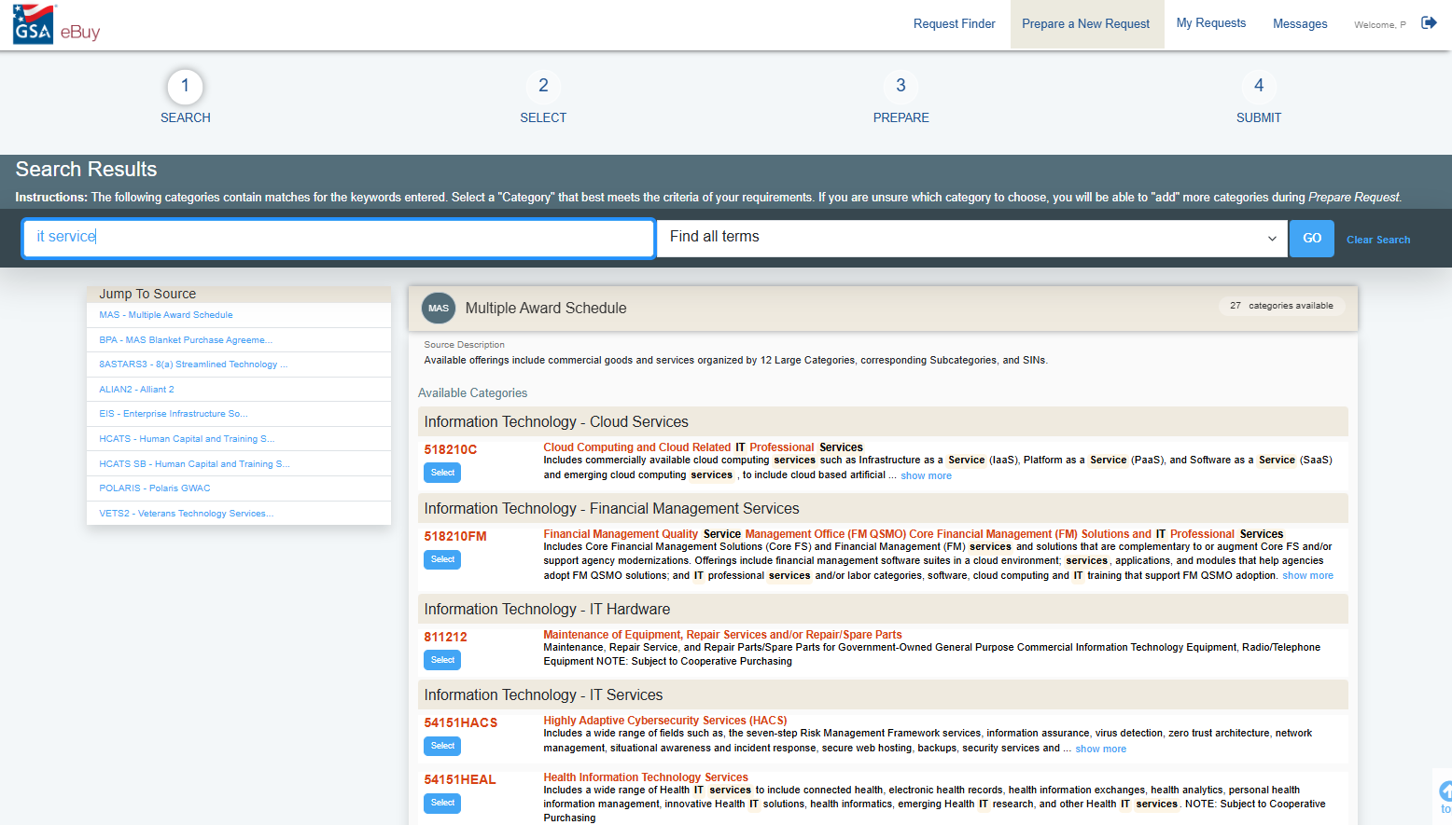
Search Results

Slide 26
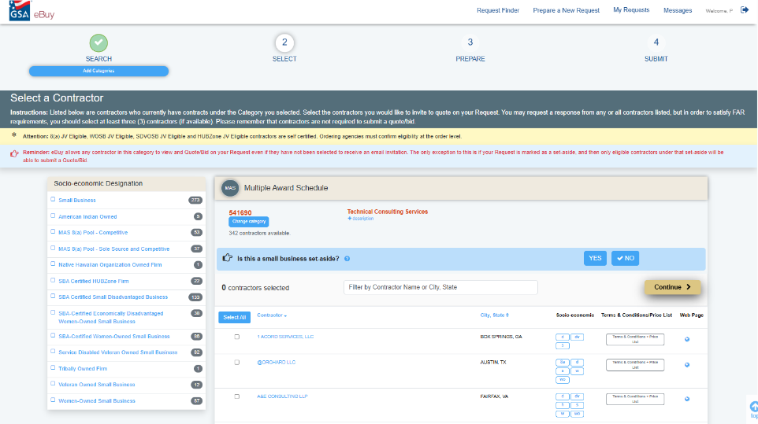
Review Results

Slide 27
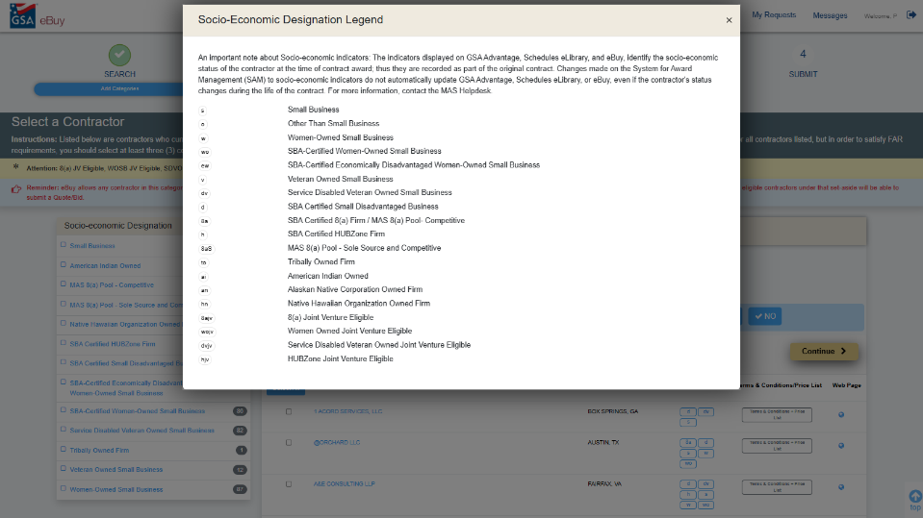
Socio-Economic Legend

Slide 28
Additional Resources
eBuy
Buyer User Guide
Market Research As a Service
MRAS Service Request Form
GSA Scope Review Request Form

Slide 29
Thank You

Slide 30
GSA Starmark Logo

