Slide 1


The Monday Morning Problem
The Monday Morning Problem
Turning AI Experiments into
Acquisition Capability
Ryan Williams
Danielle Mouw
Andrea Azarcon Heller
August 24, 2026 @ 11am EST

Slide 2




About the Presenters
About the Presenters
Ryan Williams
AI Comms Lead
ryan.williams@gsa.gov
Danielle Mouw
RFO Team & GSA PILOTS Program
Danielle.Mouw@gsa.gov
Andrea Azarcon Heller
Generative AI Program Manager
andrea.azarcon@gsa.gov

Slide 3
Objectives for Today
Objectives for Today:
01
Understand how AI supports core federal acquisition tasks across the Lifecycle.
02
Recognize critical policy, governance, risk, and data security standards for AI tool usage.
03
Apply practical frameworks like Action-Result-Context for effective AI prompting.
04
Evaluate outputs critically using human-in-the-loop review.
05
Identify opportunities for you to put this knowledge into action on the job
Notes:
Ryan

Slide 4

The Acquisition Inflection Point
The Acquisition Inflection Point
The Daily Demands
• A procurement package to review
• FAR questions to verify
• A market research summary to draft
The AI Inflection
Stakeholders asking, “Can AI help with this?”
One big concern: “Can I actually trust it?”
Put your answers in chat!!!
Notes:
Danielle; Which of these feels most familiar?

Slide 5
First Thoughts on AI
Discussion - First Thoughts on AI in the Workplace
What is the first thing that comes your mind when you hear about AI in the federal workplace?
Put your answers in chat!!!
Notes:
ANDREA: So, when you heard this session was going to include AI — what was your first thought.
Don't answer yet. I'm going to answer for you.
(beat)
Some of you thought: "Is this going to replace my job."
Some of you thought: "I hope nobody puts sensitive data into one of these things."
Some of you thought: "We can barely get our WiFi in the office to work what are we doing talking about artificial intelligence."

Slide 6
AI in Federal Acquisition
Guiding Policy for AI in Federal Acquisition
M-25-21
M-25-22
M-26-04 / EO 14319
AI use must be governed, inventoried, risk-managed, and aligned to public trust.
AI acquisition must be competitive, performance-based, testable, and protected from vendor lock-in.
LLMs must support truth-seeking, ideological neutrality, transparency, and user feedback.
EO 14179
Takeaway
Lifecycle Expectation
Federal AI adoption should remove unnecessary barriers while advancing U.S. AI leadership.
Humans remain accountable; AI supports drafting, analysis, market research, and monitoring.
Contract for testing, auditability, updates, performance monitoring, data rights, and an exit path.
GSA AI Use Case Types (CIO 2185.1C): Defines four distinct AI use case types: Capability Assessment, GSA Pre-approved Application, Research and Development, and Production or Production-Intent.
Notes:
Andrea
Policy slide. I know. Try to stay awake—I promise this isn’t just reading memo titles out loud. Think of this slide as the permission and guardrails slide, even if you’re scared.
It says: don't break anything, don't trap us in a single-vendor subscription we can't escape, and please—for the love of the taxpayer—be honest about what the AI is actually doing.
Think of AI as a very smart, very fast intern who occasionally hallucinates and lies to your face. You are the boss. You sign the paper. If the AI hallucinates a FAR citation, that is on you. Double-check its math.
At GSA, we have four buckets for AI projects (CIO 2185.1C). Think of this like doing laundry. Ideally you wouldn’t a delicate silk shirt in with your gym socks if you want to get either actually clean. Don’t treat a high-stakes 'Production' application like a low-stakes 'Sandbox' test. Know which pile your project belongs in. And if you don’t, ask.

Slide 7

AI Demo
The AI Demo Is Not the Hard Part…
Integrating AI into Business Processes
The real challenges are:
• Alignment with policy
• Pain Point resolution (today’s fires!)
• repeatable, structured workflow
• A trusted, helpful digital assistant
• A fully compliant acquisition process
• A capability the workforce will actually adopt
RFO Changes the Question
Old Way:
“Am I allowed to try this?”
Better Way under RFO:
“Is the risk on this procurement low or high? How can I right size the documentation, streamline evaluation, and use my discretion to meet the mission?”
Notes:
Ryan - left
Danielle - right
Add’l notes:
Bottom Line: We have the Cover! We have the Technology Tools! We need more Use Cases to Grow Confidence and Share Best Practices
RFO empowers teams to:
• Exercise business judgment & plan smarter
• Remove friction & build workforce trust

Slide 8
FAR Overhaul
The Revolutionary FAR Overhaul (RFO)
Core Philosophy
The Revolutionary FAR Overhaul (RFO) introduces a "With You, Not To You" approach to federal contracting.
This overhaul provides the necessary cover for acquisition professionals to confidently exercise their business judgment.
The goal is to encourage teams to plan smarter, not harder, utilizing modern flexibilities to design appropriate human oversight and build workforce trust without regulatory fear.
Flexibility & Implementation
By stripping away non-regulatory lines and outdated prescriptive guidance, the RFO empowers contracting officers with unprecedented flexibility.
New Implementation Toolkit
And a new Toolkit to Support Implementation
AI-Augmented Discretion
AI as one way to augment your discretion to streamline your approach
Notes:
Danielle

Slide 9
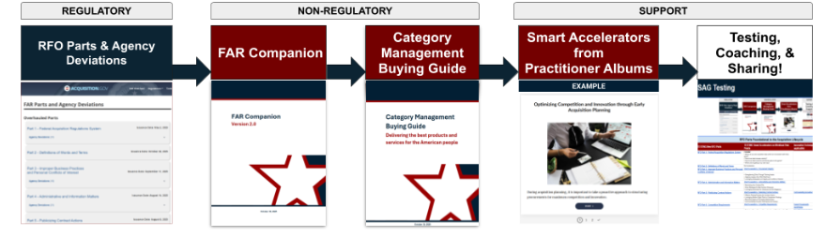

New RFO Framework
New Regs are Your Cover; New Tools Support Innovation
NEW RFO Framework gives us Regulatory vs. Non Regulatory Guidance + Agency Support Tools
Under the new RFO Framework, you have new Regulations and Agency guidance giving you cover to use your Discretion and all new Best Practice Tools, like the FAR Companion to help you meet the mission.
The RFO is grounded in these EOs - check them out!
Executive Order 14275 — Restoring Common Sense to Federal Procurement
  OMB Memo 25-26 — Overhauling the Federal Acquisition Regulation
Executive Order 14271 — Ensuring Commercial, Cost-Effective Solutions
Executive Order 14240 — Eliminating Waste and Saving Taxpayer Dollars by Consolidating Procurement
Notes:
Danielle

Slide 10
Generative AI Landscape
Navigating the Generative AI Landscape
Authorized Internal Tools
Third-Party Applications
Agency-approved platforms are secured for federal data and safe for everyday acquisition tasks.
Warning: Utilizing external, unvetted third-party AI tools introduces significant security and compliance risks.
Before adopting any new third-party application, teams must establish a familiarization case and undergo proper security vetting to ensure federal data remains protected.
Notes:
Ryan
The "Shadow IT" Warning: Look, I know that shiny new AI tool you found on the internet looks cool, but unless it's on our 'Approved' list, it’s basically a security bonfire waiting to happen. If you're putting agency data into unvetted tools, stop. Just… don't.
The "Authorized" Advantage: We have internal, agency-approved tools for a reason. They’re like our secured, fenced-in backyard. You can play, experiment, and do your work there without worrying that you’re accidentally leaking sensitive data to a server in a basement somewhere.
The "Vetting" Reality Check: If you absolutely *must* use a tool that isn’t on the list, your agency has a vetting process. It’s not just red tape—it’s the digital equivalent of making sure the tool isn’t going to steal your wallet and sell your identity.

Slide 11
Choosing your LLM
Acquisition Uses & Choosing your LLM
Use Case
Suggested Model
Writing a draft SOO or PWS
Thinking
Summarizing a 50-page acquisition plan
Thinking or Standard
Answering questions from acquisition staff
Standard
Building a fast internal AI assistant
Fast
Market research using web data
Thinking + Web-Enabled
Quick rewriting or clarification of paragraphs
Fast or Standard
Notes:
Ryan

Slide 12
Prompting 101
PROMPTING 101: Action-Result-Context (ARC) Model
Mastering generative AI requires turning vague requirements into precise, actionable instructions using the Action-Result-Context (ARC) Model.
01. ACTION
Define the exact task you want the AI to perform.
02. RESULT
Specify the desired output format and tone.
03. CONTEXT
Provide the necessary background/source information and constraints.
By structuring prompts with the ARC framework, contracting officers can consistently generate high-quality, relevant outputs.
Notes:
Andrea
This might look familiar. This is also how our Center of Excellence for Outcome-Based Contracting recommend you write requirements. Which this kind of is, in a way.

Slide 13


Persona Adoption
Unlocking AI with Persona Adoption
Unlocking AI's full potential for Performance Based Contracting involves utilizing advanced prompting techniques like persona adoption. Assigning a specific persona to the AI drastically alters the tone and accessibility of the output.
John Mulaney Persona
Engaging & Energetic Summaries
For example, prompting the AI to explain a complex acquisition strategy in the voice of John Mulaney can yield highly engaging, energetic summaries.
'Bluey' Character Persona
Plain-Language Simplicity
Alternatively, asking it to explain a concept like a 'Bluey' character ensures plain-language simplicity, making dense federal requirements easily understandable.
Notes:
Andrea
I like to be edu-tained. Life is short. What personas would be useful for you in your work? Share in the chat
Transition to live demo

Slide 14
Real-World Impact
Real-World Impact (DoD Case Study & GSA PILOTS Test)
DORA Bot (DoD Case Study)
Oral APs (GSA PILOTS Test)
Policy & Solicitation Samples
91%
3 HOURS
Key Guardrails & Actions
Transparency Language
Language around AI transparency in procurement process.
Time Reduction
With AI Streamlining
60 MINUTES Manual Process
5 MINUTES With DORA Bot
6 MONTHS Traditional Draft
3 HOURS With AI Streamlining
Capability Evaluation
Evaluation Criteria language that emphasizes capability.
Successfully reduced the cycle time required for responsibility determinations.
Streamlines AP creation, allowing contracting teams to process complex documentation with unprecedented speed.
Notes:
Danielle
These are real and we didn’t make these up.

Slide 15
AI Solicitation
AI Solicitation Clause Discussion
Some defense solicitations now include language saying the Government may use internal AI tools to help:
Summarize proposal content
Check compliance with solicitation requirements
Flag possible strengths, weaknesses, or risks
The clauses also make clear that:
AI is only a support tool
Government personnel make all evaluation and award decisions
Proprietary information will be protected
Tools will operate in a secure environment and not send data externally
Example
“The Government may use internal Artificial Intelligence (AI) tools to assist in the administrative review and analysis of proposals, such as by summarizing content or verifying compliance with solicitation requirements. However, the use of AI is strictly for support purposes; all decisions are inherently governmental functions that will be made exclusively by Government personnel. The Government is committed to protecting all Company proprietary information, and any AI tool used will operate in a secure environment, consistent with all applicable data protection regulations, and will not transmit data to external systems."

Slide 16
AI is NOT a HUMAN
AI is NOT a HUMAN…though we humanize it all the time
THE HUMAN ILLUSION
Though we tend to humanize AI interactions, it lacks consciousness, empathy, and genuine understanding.
PATTERN RECOGNITION
AI is fundamentally a pattern reader. Its outputs are only as strong, accurate, and unbiased as the historical data it is trained on.
DECISION SUPPORT
Treat AI as an assistive tool to augment—not replace—your professional knowledge, expertise, and insights.
Notes:
Ryan
The "Human Illusion" (The Creepy Factor): "Let's be real: we are hard-wired to make friends with anything that talks back to us. But stop it. This thing doesn't have a soul, it doesn't have a gut feeling, and it definitely doesn't care about your project deadline. It’s just math—fancy, fast, shiny math—pretending to be a person.
The "Pattern Recognition" (The Autocorrect on Steroids): "AI isn't ‘thinking’ about your acquisition strategy. It’s basically the world’s most sophisticated game of ‘Guess the Next Word.’ It’s a pattern-matching machine. If it sounds smart, it’s only because it read a lot of smart stuff, not because it’s having an epiphany. If you feed it bad data, you get bad results. It’s ‘garbage in, garbage out’—but faster.
The "Decision Support" (The Calculator Metaphor): "Treat this like a calculator for words. You wouldn’t ask your calculator to do your taxes and then blindly sign the return, right? Same here. You are the brains; the AI is just the glorified spell-check.

Slide 17
Verify and Verify
Verify, Verify, Verify
THE CRITICAL RISK
AI as a guide, not a crutch.
A critical risk in acquisition is AI hallucination, particularly regarding fabricated Federal Acquisition Regulation (FAR) citations.
AI 'SANITY CHECK'
Mitigation & Explanation
Practitioners must employ the AI 'sanity check' by explicitly asking the model to explain its underlying assumptions and cite its sources.
INDEPENDENT VERIFICATION
Regulatory Decisions
Contracting officers must independently verify every FAR reference generated by AI, ensuring decisions are based on actual, current federal statutes.
Notes:
Danielle
The "Confident Liar" Problem: AI is not a research database; it is a text-generation engine. It can produce highly convincing, professional-sounding content that contains fabricated information—including fake Federal Acquisition Regulation (FAR) citations. If the AI provides a regulation you haven't personally verified, assume it might be incorrect.
The "Receipts" Rule: Don't just take the AI's word for it. Make it 'show its work.' If the AI gives you a regulation, make it provide the specific reference. If it can’t give you the link or the exact subsection, treat it like it’s making it up—because it probably is.
Final Accountability: If you put a hallucinated FAR clause in a solicitation and it gets protested, you can’t tell the GAO, 'But the bot said it was okay!' You are the Contracting Officer. You own the signature, you own the research, and you own the risk.

Slide 18


Practitioner Resources
PILOTS: From Experimentation to Capability
AVAILABLE PRACTITIONER RESOURCES & Coaching on RFO & AI applied to your Acquisitions
Community of Practice & CLPs
Training, Testing & Coaching
Office Hours & Best Practice Sharing
  AI adoption and workflow integration
  RFO flexibilities and practical applications
  Prompt engineering best practices
Get a Coach! Get Tools!
Get Confident!
Danielle Mouw
RFO Team & GSA PILOTS Program
Danielle.Mouw@gsa.gov
Need Program Guidance?
As you begin integrating these tools, remember to leverage the RFO Team and GSA PILOTS Program for dedicated guidance.

Slide 19
Pop Quiz
Pop Quiz: Takeaway & Challenge
Question 1
Who remains fully legally accountable for an AI-generated FAR citation in a procurement package?
Answer: The human Contracting Officer.
Question 2
What framework helps structure high-quality AI prompts?
Answer: The ARC Model - Action, Result, Context.
Question 3
Can you put unvetted third-party tools to work on sensitive federal data?
Answer: Strictly no!
Takeaway Challenge
Try writing one ARC prompt this week!

Slide 20
Q and A Time
Q&A Time (or Coffee Break)

Slide 21

Appendix
Appendix

Slide 22






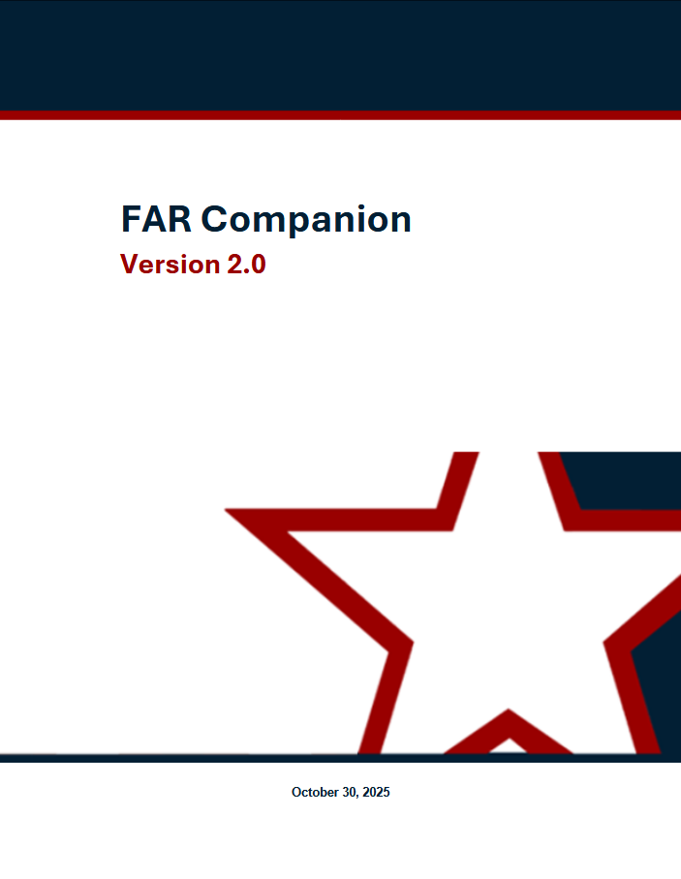

Pilots RFO Resources
RFO Practitioner Resources
AI in Acquisition
Prompt Engineering Credential
Generative AI Guide 💡
Prompt Library
CoP: aicop@gsa.gov
GenAI Google Space
Testing & Coaching
RFO, AI & Beyond
GSA Only: PILOTS Training ⚙️
Govwide: Federal Innovation Labs
Email: SAGTesting@gsa.gov
Communities of Practice
TechAcq CoP 💻
TECHACQ-COP@listserv.gsa.gov
AIAs Directory
AIA Council Directory
FAR Forward Alliance
FAR Forward in CSOD
PILOTS Program
GSA PILOTS Program Community
By the FAR/GSAR Part
Acquisition.gov for RFO Parts 🏛️
RFO Practitioner Albums 📚
FAR Companion & Buying Guide 📘
DOW Comparison Tool
OASIS BPA Kit & GWAC Toolkit
Use Cases Knowledge Repository
Office Hour Events
FAR Forward Alliance: Register
Open Office Hours: Register
Supervisors Hours: Register
DOW Connect Live 🎙️
PILOTS Monthly Hour (by invite)
RFO
Notes:
Danielle will cover briefly resources PILOTS makes available to GSA and beyond

Slide 23
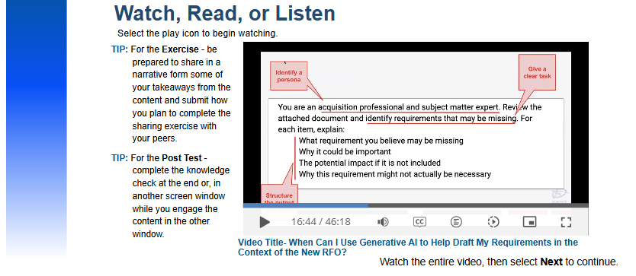
New Courses Monthly! FAR, GSAR, & AI in Acquisition Training
FAI CSOD for CLPs
Navigating the FAR Framework Course (FAI) 🧭
FCN 306: Negotiations in a Non-Competitive Environment Course (FAI, OGP) 🧭
FCL-GSA-FAR-0001: Fast Track your Acq - the Oral AP method (OGP, PBS) 🧭
FCL-GSA-FAR-0002: GSA IMPACT: The New FAR 8 & GSAR 538.71 (OGP) 🧭
FCL-GSA-FAR-0003: Deep Dive of GSA's MAS Program & RFO Part 8 Flexibilities (OGP, FAS) 🧭
FCL-GSA-FAR-0004: The Revolutionary FAR Overhaul (RFO) & Acquisition Strategy
FCL-GSA-FAR-0005: RA: When Can I Use Generative AI to Help Draft My Requirements? 💡
RFO High Intensity Immersive Training (HIIT) Workshops: RFO HIIT - Foundation (FAI, OGP) 📌
GSA RFO/RGO Pillars L&L Series
FAI CSOD RFO Playlist
▶RFO & AI Course: Prompt Demos
Watch, Read, or Listen
Select the play icon to begin. Complete the knowledge check to earn CLPs.
Notes:
Danielle will cover briefly resources PILOTS makes available to GSA and beyond

