Slide 1
Understanding Performance Based Acquisition
Writing Better Requirements &
Performance Standards
Kelly Osvold | 28AUG2026

Slide 2
AGENDA
1 Performance-Based Acquisition Primer
2 5 Keys to Writing Better Requirements
3 Understand the “Why” and “What”
4 Frame the High-Level Scope
5 Document and Define Results
6 Use ARC Model for Requirements
7 Establish Standards
8 Use Plain Language
9 QASP

Slide 3
What is PBA?
Performance-based Acquisition (PBA) means an acquisition structured around the results to be achieved as opposed to the manner by which the work is to be performed. FAR 2.101

Slide 4

Are agencies required to use a PBA?
YES.
When acquiring services, including acquisition of commercial services using the procedures in part 12, agencies must —
Use performance-based acquisition methods to
the maximum extent practicable
FAR 37.101-1

Slide 5
Key Elements of a Performance-Based Acquisition (PBA)
A Performance-Based Acquisition should include:
A Performance Work Statement (PWS) or Statement of Objectives (SOO) that focuses on the desired outcomes rather than prescribing how the work will be performed.
Measurable performance standards for every requirement, with clearly defined Acceptable Quality Levels (AQLs).
Appropriate performance incentives, when beneficial, to encourage innovation and reward high-quality performance.
A Quality Assurance Surveillance Plan (QASP) that defines how the Government will monitor, assess, and document contractor performance.

Slide 6
5 Ways to Write Better Requirements
1………
Understand the
“What” and the “Why” - not just “How” you’re buying
2………
Frame the Scope to ensure high-level clarity of your needs
3………
Document and define your expected results for each task area
4………
Use Action, Result, Context (ARC) method to turn results into requirements
5………
Establish performance standards for every requirement to ensure transparency and accountability

Slide 7
Understand what you are buying and why

Slide 8
What are the Differences?
Element | Performance-Based Acquisition (PBA) | Outcome-Based Contracting (OBC)
Definition | Structured around results; defines what is needed, not how | Evolved model; payment tied strictly to defined business outcome/mission success
Focus | Service levels, outputs, and quality (for example: “99% uptime”) | Strategic impact and long-term results (for example “reduced failure rate”)
Mechanism | Uses Performance Work Statements (PWS) and Quality Assurance Surveillance Plans (QASP) | Risk-sharing, shared responsibility; payment upon outcome delivery
Goal | Efficiency, accountability, and flexibility for contractors to innovate (often fixed-priced) | Aligns vendor profits with the customer’s success and total value creation
Context | Heavily used in government services (PBSA) | Used for complex, high-value contracts where ultimate result is critical

Slide 9
Continuum
x
Prescriptive
(and/or Ambiguous)
Developing
Mature
Outcome-
Driven
and Innovative
Tasks are described in excessive detail, or conversely, are unclear
The focus is on instructing contractors how to perform the work, rather than what results to achieve
This approach stifles innovation
A performance Work Statement (PWS) exists in name, but the emphasis remains heavily on outputs
Performance standards are included, but are typically narrow (often limited to timeliness)
Incentives are rarely used
or are poorly aligned with desired outcomes
Requirements are clearly defined with desired results as the central focus
Each requirement is linked to specific performance standards
Incentives are used in a balanced way to encourage superior performance
Requirements are directly connected to the overall mission outcomes
Standards and incentives
are precisely aligned with those outcomes
Contractors are granted flexibility to design and implement solutions, operating within established guardrails

Slide 10
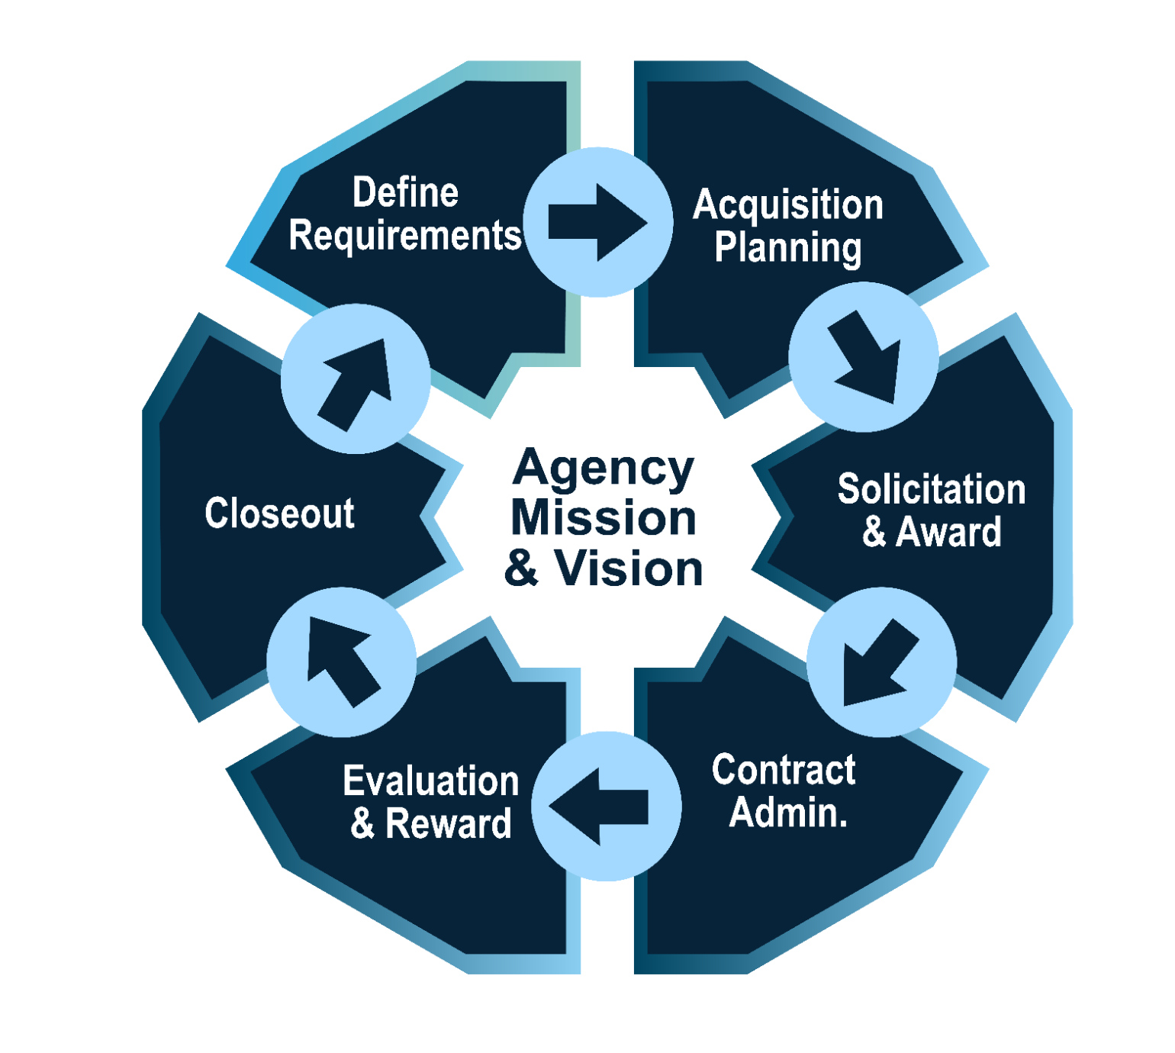
Mission and Vision
The requirement to tie federal government acquisitions to their mission is established in the Federal Acquisition Regulation (FAR) Part 7, Subpart 7.1 (Acquisition Planning).
Specifically FAR 7.102 Policy, which states that acquisition planning must be done to ensure the Government meets the needs in the most effective, economical, and timely manner.

Slide 11
Frame the scope

Slide 12

What goes into building a house?
Design
Administration/Permitting
Foundation
Framing
Roofing
Flooring
Electrical
Plumbing
Drywall/Glass
Painting
Finishing
Cabinetry/Appliance
Landscaping

Slide 13
High Level Objectives (HLOs)
High-Level Objectives (HLOs) translate an organization's vision into clear, outcome-focused goals for each task area. They define what the organization seeks to achieve and why it matters, providing direction for acquisition planning, performance management, and execution.
When developing HLOs, consider these guiding questions:
Why are you doing this? (Purpose)
Why is it important? (Significance)
What positive outcome will it produce? (Expected benefit)
What are you ultimately trying to achieve? (Desired future state)
A well-written HLO should:
Focus on outcomes rather than activities
Be clear, measurable, and actionable
Communicate the value and impact of the work
Align task execution with organizational goals

Slide 14
HLO template
For [Task Area], [Organization] seeks to
[desired outcome] by [approach or purpose], resulting in [expected benefit], while advancing [long-term aspiration].

Slide 15
Examples of a HLO
For Media and Entertainment Relations, NASA seeks to provide accurate and transparent representation of its work to promote positive media coverage and strengthen public understanding in a timely manners.
For Data Analysis & Modeling, OAR seeks the highest scientific integrity in its data analysis and modeling to support OAR programs and EPA's mission.
For Media and Entertainment Relations, NASA seeks to transparently provide an accurate representation of NASA's work that earns positive media coverage in a timely manner.
For Enterprise Service Desk Support, USMS HQ OPS seeks timely resolution of issues; a one-stop shop for IT user support regardless of staff location or technology boundaries.

Slide 16
Examples of a HLO (cont.)
For Transition Support, NTIA seeks a smooth transition of the contract to the next provider at the end of the contract period of performance (POP) with no loss in capability or data to avoid negative developmental or operational impact.
For Policy & Regulation Support, EPA seeks high quality, unbiased, and cost-effective policy and regulatory support for effective rulemaking and public hearings, to support EPA’s mission.
For Digital Media & Oversight, NASA seeks to grow agency audiences using innovative technologies, creating a continuous cycle of engagement and feedback consistent with agency messaging.

Slide 17
Define Expected Results

Slide 18

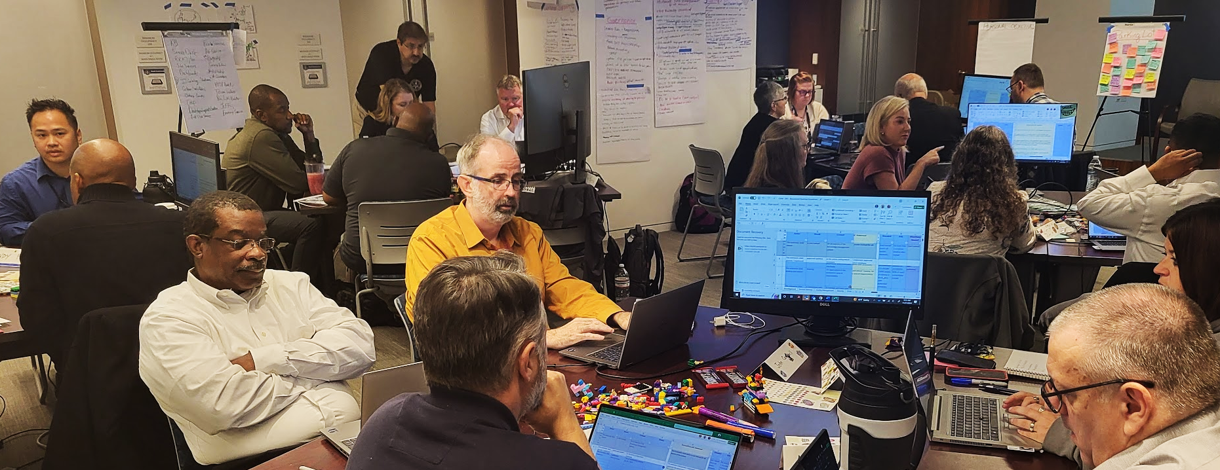
USMS Workshop Example

Slide 19
Use ARC to Turn Results into Performance Requirements

Slide 20
Components of an ARC Method
RESULT
Defines the desired deliverable, outcome,
or function.
Answers the “what” question.
ACTION
A clear, active verb describing the specific task or performance required.
Examples:
Conduct
Draft
Provide
Maintain
CONTEXT
Provides critical information for understanding.
Often follows a preposition.
Examples:
Under what conditions?
With what inputs?
For whom?
Where?

Slide 21
Why use the ARC Method?
Clarity and Objectivity
The structured format helps eliminate vague or ambiguous language, making the requirements clear, specific, and measurable
Focus on Outcomes
It shifts the focus from the process (how) to the desired results (what), allowing contractors the flexibility to innovate and use their expertise to determine the most cost-effective and efficient method
Basis for Evaluation
Well-defined ARC statements enable the government to assess work performance against measurable standards, which is crucial for the Quality Assurance Surveillance Plan (QASP)
By using the ARC method, you can write more effective PWS statements that clearly communicate government expectations and lead to better outcomes

Slide 22
Breakdown of the ARC Statement
Element | Example Phrase | Explanation
Mandatory Language | “the contractor shall” | Establishes a binding requirement
Action | “draft” | The specific verb describing the task
Result | “meeting read-aheads” | The desired deliverable or outcome
Context | “with inputs gathered from key government personnel” | Provides necessary details on how to perform the action (who provides the inputs)
The full statement
The contractor shall draft meeting read-aheads with inputs gathered from key government personnel.

Slide 23
ARC Example 1
ARC Example
1➜
Original statement:
The contractor shall train system end users on how to use the system.
Revised statement(s):
The contractor shall provide training to end-users on how to use the system.
The contractor shall deliver a user manual for all aspects of the system.
Note: Everything following a preposition is context. Examples of prepositions: to, for, by, with, around, on, under, so (that), after, through, of at, in, between

Slide 24
ARC Example 2
ARC Example
2➜
Original statement:
The contractor shall be required to create or implement approaches to gather internal or external agency data through data collection, surveys, or questionnaires.
Revised statement:
The contractor shall create data collection methodologies (for internal or external data used in support of agency projects and programs.

Slide 25
ARC Example 3
ARC Example
3➜
Original statement:
Assistance shall be provided for the conduct of logistical support meetings.
Revision to focus on outcomes:
C.4.4.1
The contractor shall schedule meetings to include all necessary stakeholders and a clear purpose and agenda
C.4.4.2
The contractor shall record meeting minutes for all support meetings
C.4.4.3
The contractor shall draft meeting read-aheads that include inputs gathered from key government personnel

Slide 26
Establish
Performance Standards
& AQLs

Slide 27
Requirements and Standards
A requirement is incomplete without a corresponding standard. Every requirement should clearly define how performance will be measured.
Define expectations for quality, not just timeliness.
Use commercial or industry standards whenever possible.
Conduct market research to validate your draft requirements and performance standards.
Include standards and Acceptable Quality Levels (AQLs) in the Performance Work Statement (PWS).

Slide 28



Defining Quality Performance Standards
To define quality standards, it is helpful to first visualize the completely unacceptable outcome and then write its reverse.
Unacceptable Outcome | Acceptable Outcome (inverse)
Incomplete deliverables or data | Complete deliverables with all required data
High error rate or low accuracy | Low error rate with high accuracy (example: >99%)
Poorly written or confusing documentation | Clear, concise, and well-structured documentation
System with frequent failures or downtime | System with high availability and minimal downtime
Writing Quality Standards
When defining quality, think about the unacceptable outcome, then write the inverse to create a clear performance standard.

Slide 29
Steps to Develop Performance Standards
Define the required outcome
  Clearly state the result
Select measurable metrics
  Determine the indicator (for example: speed, accuracy, quantity)
Set the standard (AQL)
  Determine the threshold for acceptable performance (for example: “95% of calls answered within 30 seconds”
Align with QASP
  Ensure the QASP directly corresponds to the performance standards and outlines how the government will verify them
Establish incentives
  Pair standards with incentives (positive for exceeding, negative for failing) to drive better performance

Slide 30
Use Plain Language

Slide 31

Ambiguity in Writing
Ambiguity uses vague, indefinite, or uncertain terms
Avoid phrases that cannot be quantified or measured
Refrain from using words that suggest personal services
Never use terms that leave too much discretion to the contractor
Minimize using qualifying phrases that modify contractor actions

Slide 32
Write for Clarity
Make your content easy to read and easy to understand.
Make your content easy to read and easy to understand.
Use short sentences.
Break up information with bulleted or numbered lists.
Use tables when comparing information.
Highlight key points with bold, italics, or underlining when appropriate.
Write for your specific audience.
Balance technical accuracy with plain language.
Assume you're writing for a vendor who has never worked with your agency before.
Avoid government jargon and unnecessary acronyms.

Slide 33

Common Pitfalls to Avoid
Writing Task-level detail
  Do not turn a PWS into a prescriptive Statement of Work (SOW)
Vague Standards
  Avoid ambiguous terms like “best”, “properly,” or “timely,” which are hard to measure
Unrealistic Expectations
  Setting 100% compliance on all task may be impractical and lead to higher costs

Slide 34
Resources

Slide 35
Core Functions
Acquisition Facilitation Lab (the Lab)
Civilian Services Acquisition Workshops (CSAW)
Specialized Facilitation as a Service (FaaS)
Outcome-Based Acquisition Support
Knowledge, Innovations and Tools (KIT)
Outcome-Based Training & Outreach
On-Demand Resources
Requirements Development AI and Digital Innovations

Slide 36
CoE Workshops
Purpose
Develop the mission, measurable objectives, performance requirements, and performance-based acquisition strategy for the [Agency Requirement], along with a high-level roadmap for successful execution.
By the end of the workshop, participants will:
Understand the Performance-Based Acquisition (PBA) process and its key steps.
Explore the tools, resources, techniques, innovative approaches, and best practices for executing
the requirement.
Collaborate through facilitated activities to develop draft performance-based acquisition documentation.
Create a high-level roadmap for implementing the performance-based acquisition.
Build consensus on key decisions, priorities, and the path forward.

Slide 37

About Civilian Services
Acquisition Workshop (CSAW)
Assemble the right team through pre-workshop engagement with executive sponsor(s) and the project manager.
Participate in a structured, facilitated workshop tailored to the team's specific needs while guiding participants through each step of the acquisition planning process.
Collaboratively define the mission, vision, high-level objectives, and critical success factors.
Identify market research needs, high-level risks, key stakeholders, and a communication strategy.
Develop and refine performance requirements, including associated performance standards, Acceptable Quality Levels (AQLs), and the quality assurance approach.

Slide 38
CSAW Outcomes
The workshop results in:
Reduced lead times and improved acquisition planning.
Stronger team collaboration and healthier team dynamics.
Greater stakeholder participation and faster decision-making.
A shared understanding of the mission, objectives, and desired outcomes.
Improved project management through better planning and alignment.
Better performance outcomes driven by clear, measurable requirements and expectations.

Slide 39
Client Feedback
“
“
We have a distributed team so it was good to get most of us together in one place to get to know one another. The facilitated discussions helped us get consensus - and in a relatively efficient chunk of time (dedicated time away from our regular workplaces made it easier to concentrate / buckle down than if we tried to do this in-between all the other meetings, emails, and distractions.)”
NOAA (2024)
One of the best, if not the best acquisition workshop I have ever attended in 30 plus years of federal government experience. This workshop has truly empowered us as ONE TEAM moving forward to build our next support contract.”
VHA (2024)

Slide 40
Client Feedback 2
“
“
Not only did this workshop give us tools to use going forward, but it also gives us a common standard to point to and hold each other accountable to if the team begins going in a direction that is counter to PBA.”
EPA (2022)
This workshop provides a logical systematic approach to developing the PWS. As a CO it can be difficult to explain to a program office how requirements documents should be drafted without trying to draft it ourselves. This approach implements a collaborative approach which will help guide an IPT through development of the document.”
USGS (2024)

Slide 41
Client Feedback 3
“
“
This workshop will provide us with a much-needed cognitive framework (we will finally have a template for the requirements development). Also, we are now more aware of functional area covered by this contract - you broke the silos for us. I really really liked this workshop. Thank you SO MUCH!”
NASA (2023)
Great training content and well executed sessions. The CSAW team showed up with great knowledge of our planned acquisition and had the expertise to challenge our assumptions and push us and better define our requirements and performance measures. They inspired important conversations within the team that lead to important insights.”
DOI (2022)

Slide 42
Review & Close

Slide 43


Contact
Jonathan Evans
Supervisory Portfolio Manager & Principal Facilitator
Kelly Osvold
Senior Facilitator
Send questions or feedback to: csaw@gsa.gov

Slide 44
Conclusion

