Slide 1
FAR Overhaul Policy Updates — Spotlight on Commercial Buying Practices & BPAs
Monica Taylor, Jimmy Abyad & Danielle Mouw
August 25, 2026 @ 2 p.m. ET

Slide 2
Objectives for today:
1
Understand where RFO and related rulemaking efforts stand today and what they mean for acquisition teams.
2
Recognize how evolving policy direction supports greater flexibility, discretion, and smarter acquisition planning.
3
Explore how performance-based acquisition, BPAs, and commercial-first strategies can streamline the buying process.
4
Identify key resources, learning opportunities, and communities available to support implementation.
5
Leave with a clearer sense of practical next steps for applying RFO concepts in day-to-day acquisition work.
Notes:
Description:
This session will provide an up-to-date snapshot of FAR overhaul policy updates, including the latest developments in rulemaking and emerging regulatory flexibilities. Participants will gain clarity on common practitioner questions related to Performance-Based Acquisition, Blanket Purchase Agreements (BPAs), and Commercial First regulatory shifts. The session will also highlight available Communities of Practice, training opportunities, and Office Hour events designed to support the acquisition practitioner community.

Slide 3



Presenters
Monica Taylor
RFO Practitioner Workstream
Jimmy Abyad
RFO Practitioner Workstream
Danielle Mouw
RFO Team & GSA PILOTS Program
Danielle.Mouw@gsa.gov

Slide 4
Where are we today? The FAR Overhaul
49 Model Deviations were issued to allow immediate use while formal rulemaking proceeds.
Agency Implementation - Agency adoption varies - Implementation contingent on agency-issued deviations.
Original Codified FAR
Phase 1
Model deviations
Agency issued deviations
Phase 2
Rule-making
New codified FAR
Issue class deviations to immediately adopt and use overhauled FAR.
Conduct formal rulemaking to codify streamlined regulations.

Slide 5
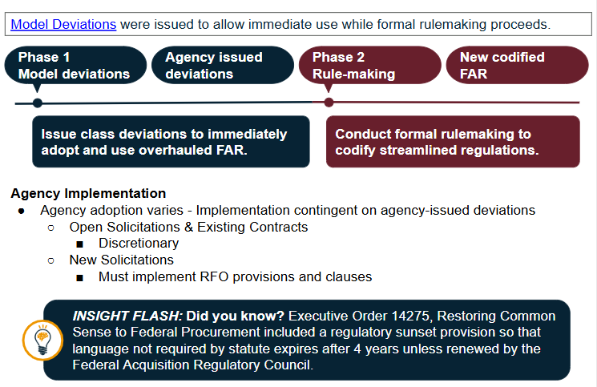
Model Deviations

Slide 6

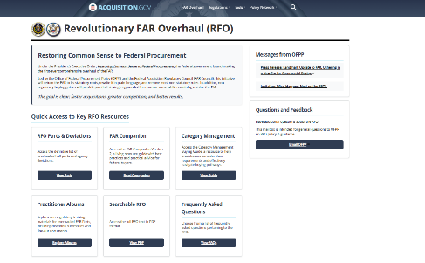
A New Hub +Toolkit Modernization Live Demo
A New Hub + ToolKit Modernization
- Live Demo
Overhauled FAR parts and Agency deviations
FAR Companion and Category Management Buying Guide
Practitioner Albums – Change Summaries and Resources
Central location for all RFO resources: https://www.acquisition.gov/far-overhaul

Slide 7
The Revolutionary FAR Overhaul (RFO)
Restores CO Discretion for faster acquisitions, greater competition, and better outcomes for mission delivery.
The Revolutionary FAR Overhaul (RFO) Story
Do you remember when the FAR was a Book?
  Most comprehensive overhaul of the Federal Acquisition Regulations since it was 1st published in 1984
The RFO initiative:
  Returns the FAR to its statutory roots;
  Rewrites it in plain language;
  Removes non-statutory rules (unless essential for sound procurement); and
  Creates non-regulatory buying guides that provide practical strategies grounded in best practices.
The RFO is grounded in these EOs - check them out!
Executive Order 14275 — Restoring Common Sense to Federal Procurement
  OMB Memo 25-26 — Overhauling the Federal Acquisition Regulation
Executive Order 14271 — Ensuring Commercial, Cost-Effective Solutions
Executive Order 14240 — Eliminating Waste and Saving Taxpayer Dollars by Consolidating Procurement

Slide 8

What’s Changed? Top Questions. Key RFO Parts.
RFO
RFO 1 - Federal Acquisition Regulations System: Implements a new Framework that restores discretion to the CO
RFO 7 - Acquisition Planning & RFO 10 - Market Research: Encourage COs to right size their Market Research documentation and Acquisition Planning approaches to the risk of the procurement.
Emphasize early planning, streamlined procedures for common contract types, mandatory small business considerations, and comparative analysis for equipment acquisitions to ensure the most advantageous approach for the Government.
Prioritize procuring commercial products and commercial services on an existing governmentwide contract".
RFO 8 - Required Sources of Supplies and Services: Sets the Source! Ordering procedures for the FSS are now in GSAR 538.71 & More Discretion over Competition and Strategy.
Must use existing governmentwide contracts and BPAs that are “required use” and must* consider existing governmentwide contracts and BPAs that are otherwise part of Category Management principles.
RFO 12 - Acquisition of Commercial Products & Services: One Commercial FAR Part for Streamlined Flexibility.
“If commercial products or commercial services that meet agency needs are available from any priority source identified in part 8, including existing contracts awarded for Governmentwide use (e.g., the Federal Supply Schedules and Governmentwide acquisition contracts), procure the commercial products or commercial services from that source.”
RFO 16 - Types of Contracts: Part 8 Sets the Source. Part 16 sets the Contract. You Decide the Approach
RFO 19 - Small Business: Small Business Rules Clarified-Rule of Two & Open Market

Slide 9


Performance Based Contracting
& the new FAR 37 - Service Contracting & the FAR Companion
assignment At a Minimum, FAR says…
Default to performance-based methods where practicable.
Use SOOs to invite offeror-driven solutions.
Focus the PWS on outcomes, not level of effort.
Make performance standards meaningful and measurable.
settings Far Companion Guides on How to Do It
Use outcome-based contracting to move beyond rigid PWS structures.
Build flexibility through adaptive frameworks.
Encourage joint problem-solving over adversarial management.
Use shared risk/reward to align incentives.
Plan continuity up front to avoid service gaps.

Slide 10




Streamlined Commercial Buying & BPAs!
The commercial overhaul of FAR parts 12, 8, and 16 updates:
Commercial Buying
Policy centralized in Part 12 for streamlined flexibility.
Streamlined ordering procedures for commercial buys.
Required Sources
Greater emphasis and use of governmentwide contracts & BPAs.
Broader authority to establish BPAs to meet agency missions.
Contract Types
More flexibility on contract types to support custom approaches.
Encourages innovative, results-oriented methods.
10
Notes:
Description:
This session will provide an up-to-date snapshot of FAR overhaul policy updates, including the latest developments in rulemaking and emerging regulatory flexibilities. Participants will gain clarity on common practitioner questions related to Performance-Based Acquisition, Blanket Purchase Agreements (BPAs), and Commercial First regulatory shifts. The session will also highlight available Communities of Practice, training opportunities, and Office Hour events designed to support the acquisition practitioner community.

Slide 11
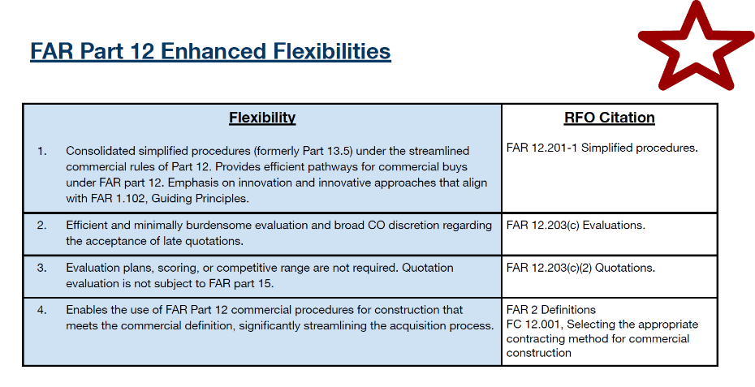
FAR Part 12 Enhanced Flexibilities

Slide 12
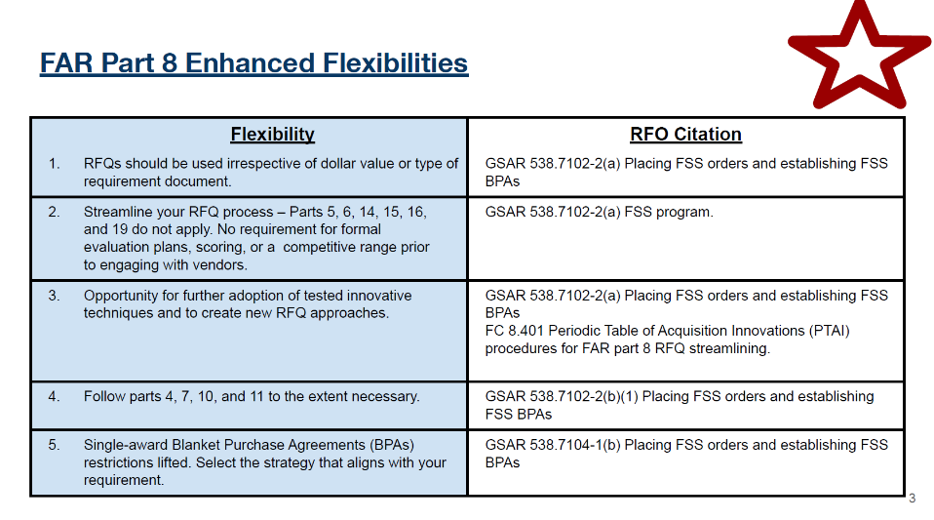
FAR Part 8 Enhanced Flexibilities
& Spotlighting BPA Flexibilities!

Slide 13
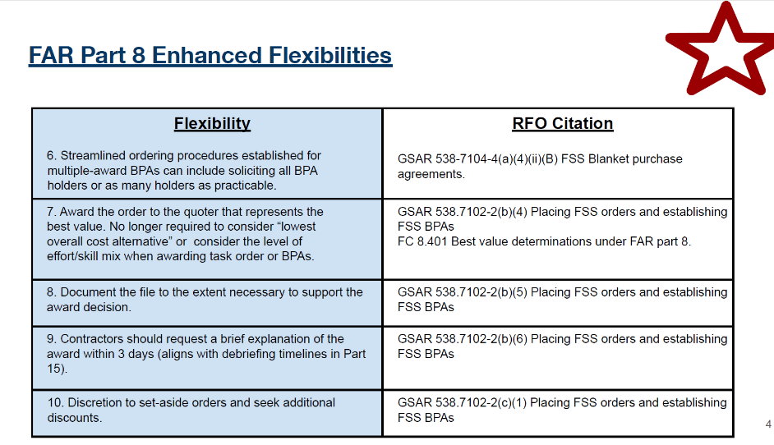
FAR Part 8 Enhanced Flexibilities cont.

Slide 14
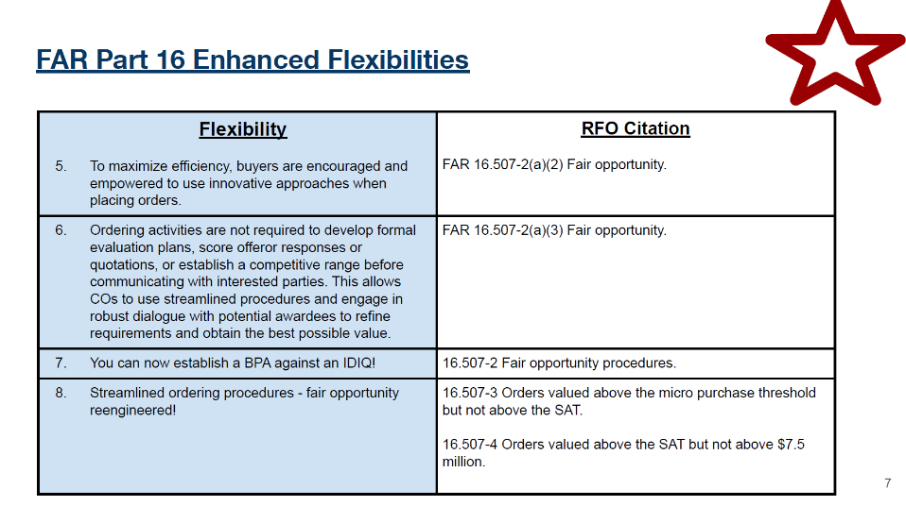
FAR Part 16 Enhanced Flexibilities

Slide 15
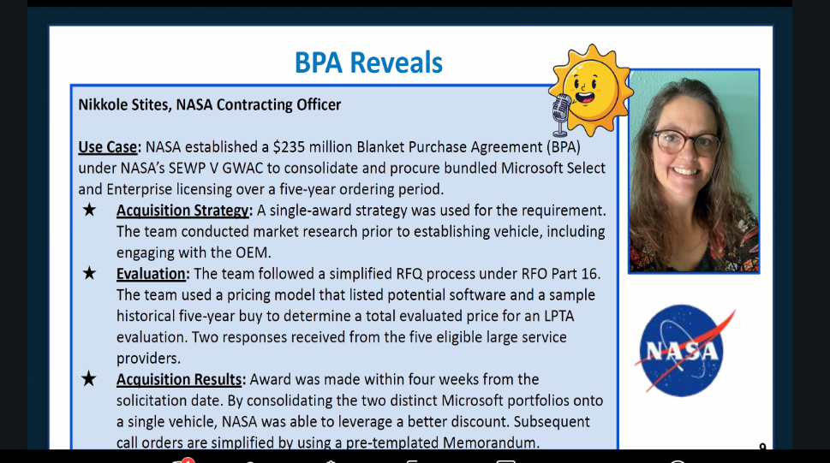
BPA Reveals

Slide 16

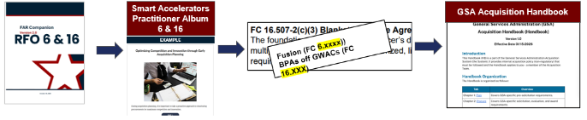



GSA PILOTS Use Case RFO 6 & 16: Fusion Procurement + Spotlight on BPAs off MACs!
This flexibility involves a single solicitation for several award areas and leveraging precompeted vehicles!
RFO Flexibilities & Smart Accelerators Jackie and Krystal are Testing with Us (clip 📹 ):
RFO 7 & GSA Handbook Flexibility: Oral Acquisition Plan
Accelerator Part 6: Fusion solicitation: 5 Support Areas
Solicited through One Solicitation
Mix of Single-award BPAs & Multiple-award BPAs
RFO 16 & GSA Handbook Flexibility: BPA off ALLIANT
Accelerator Part 6: Multi-Phased quote submission and evaluation
Discretion with RFO 19: Variety of strategies for small business
participation, including setting aside to all socioeconomic categories
& to make the decision when we have all the quotes in,versus
promising a small bus set aside upfront
Accelerator Part 39: Advisory Down-Selects
RFO 15 (used in 8) Flexibility: Highest Technically Rated Offeror with Reasonable Quote (in lieu of price)
RFO 6, 7, 8 Flexibility: Rates Only for Pricing Evaluations
RFO 8 & 15 Accelerator: Confidence Ratings
RFO 16: On/off ramping
Monica Taylor, RFO Coach
Krystal Zoufaly, TTS
Jackie McGlone, TTS
Notes:
Danielle & MOnica

Slide 17
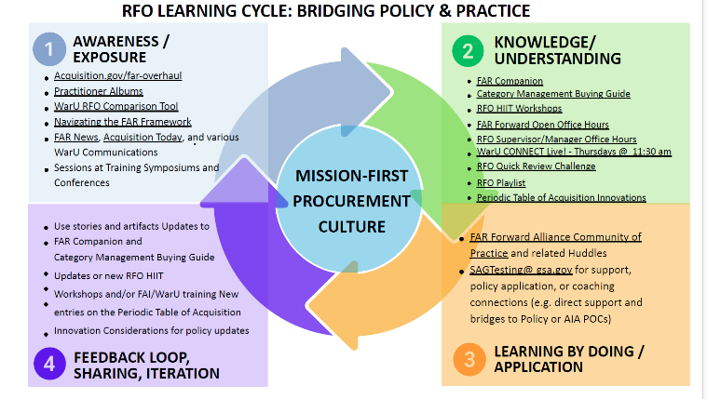
RFO Learning Cycle: Bridging Policy & Practice

Slide 18




GSA’s Acquisition Sandbox: PILOTS
Transitioning from Experimentation to Capability
To support your ongoing journey, several resources are available. Practitioners are encouraged to utilize these practical tools directly within your workflows:
AVAILABLE PRACTITIONER RESOURCES & Coaching on RFO & AI applied to your Acquisitions
Community of Practice & CLPs
Training, Testing & Coaching
Office Hours & Best Practice Sharing
+ AI adoption and workflow integration
+ RFO flexibilities and practical applications
+ Prompt engineering best practices
Get a Coach! Get Tools! Get Confident!
Danielle Mouw
RFO Team & GSA PILOTS Program
Danielle.Mouw@gsa.gov
Need Program Guidance?
As you begin integrating these tools, remember to leverage the RFO Team and GSA PILOTS Program for dedicated guidance.
Notes:
Danielle

Slide 19
Conclusion

