Slide 1
GSA’s Federal Fleet Solutions & GSA’s GSS Desktops and Laptops BPA
Stephanie Gresalfi, Josh Ramos and Otis Frazier| August 27, 2026

Slide 2
GSA’s Federal Fleet Solutions

Slide 3

Stephanie Gresalfi
Director, Offering Support
stephanie.gresalfi@gsa.gov

Slide 4
GSA Fleet’s Cost-Effective Solutions
local_shipping Vehicle Purchasing
Mandatory Source
Greater Buying Power: Volume purchasing, standardized processes, and streamlined ordering deliver significant savings over the vehicle lifecycle
Expert Vehicle Solutions: Engineering support helps agencies meet applicable requirements and develop mission-specific vehicle configurations.
event_available Short Term Rental
Non-Mandatory
Flexible Vehicle Access: Rent vehicles for up to 120 days and equipment for up to 365 days to meet seasonal, surge, or emergency requirements.
Fast, Convenient Ordering: Reduce procurement complexity with highly competitive pricing and convenient 24/7 ordering.
vpn_key Vehicle Leasing
Non-Mandatory, Best in Class Service • Global Operations
Predictable, Competitive Rates: Full-service leasing provides transparent, all-inclusive rates averaging 30% below commercial leasing and 13% below agency-owned fleet costs.
Greater Mission Focus: GSA manages vehicle lifecycle support, reducing administrative workload and allowing agencies to remain focused on mission priorities.
build Managed Services
Supporting Agency-Owned Fleets
Simplified Fleet Management: Centralized support and integrated billing through GSAFleet.gov reduce contracting and administrative burden. More solutions on the horizon!
Advanced Telematics: Agencies receive competitive pricing, installation support, and seamless integration with Geotab’s FedRAMP-authorized platform.
Notes:
optional slide instead of current slide 3
Figures are based on purchases, inventory and awards in GSAFleet.gov on Sept.30 of each FY
Benefits of Vehicle Purchasing:
Single efficient marketplace for suppliers - results in significant discounts and process savings
Compliance with FAR and other Regulations
Consolidated demand
Contracting officers / engineers with deep understanding and experience buying automotive products
Benefits of Leasing:
See Slide 3
Benefits of STR:
Avoids the cost of purchase, ownership and disposal
Guarantees the exactly right resource whenever it is needed

Slide 5
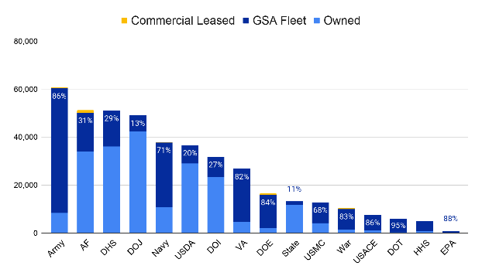
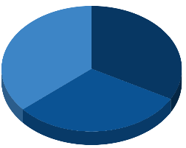
Current State of the Federal Fleet
Ownership Breakdown
Federal Fleet Inventory Breakdown
Postal Service
GSA Fleet Leased
255,341* (36.2%)
230,778
(32.9%)
215,530*
(30.8%)
Agency-Owned
*Source: 2025 Federal Fleet Report

Slide 6
GSA Leasing
Non-Mandatory

Slide 7
Strategic Advantage with GSA Fleet
GSA Fleet Leasing transforms vehicle management from an administrative burden into a strategic advantage, enabling agencies to focus on their wide ranging missions across the United States.
A shared services model aligns with government-wide efficiency goals and enables fleet optimization to mission-critical, highly utilized assets.
GSA Fleet’s Leasing program is results driven, accountable, transparent and leads to greater economies of scale.
Agencies can transition, or consolidate their vehicles to leasing today!
Agency Benefits: guaranteed vehicle replacements, operational savings, flexibility in fleet size and configuration, streamlined/all-inclusive maintenance, repair, vehicle disposal service and fleet card management to include fraud, waste and abuse support.
Notes:
Christie

Slide 8

Maximizing Value and Efficiency
payments Financial & Value
speed Mission Readiness
build Operational Support
Budget Predictability
Leasing converts unpredictable, fluctuating repair costs into a stable, predictable line item.
Transparent Rates
All-inclusive leasing rates provide a transparent cost that accounts for key vehicle expenses.
Strategic Remarketing
Maximizes resale proceeds, driving down the overall total cost of ownership.
Modern & Reliable Fleet
Maintain a safe, dependable fleet that minimizes downtime and supports mission continuity.
Flexible Fleet Solutions
Easily scale fleet size and adjust configurations to meet fluctuating mission demands.
Greater Mission Focus
GSA manages acquisition, freeing agency staff to focus on core mission priorities.
Automated Reporting
Integrated reporting, telematics, and fleet card data provide timely insights and stronger oversight.
Maintenance Support
Benefit from dedicated local support networks and unified accident management.
Dedicated Local Support
GSA Fleet Service Representatives provide hands-on expertise for day-to-day operations.

Slide 9
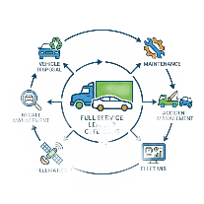
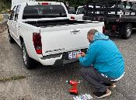

GSA Vehicle Consolidation
Asset Transfer
Comprehensive GSA Fleet Support
GSA Replacement Commitment
Interagency asset transfer of the vehicle to GSA’s ownership.
Agencies retain use and custody of vehicles.
Access GSA’s full suite of vehicle management services
Lease payments begin.
GSA & agencies optimize fleets in support of agency missions.
GSA funds and manages vehicle replacements going forward.

Slide 10






Recent Vehicle Consolidations
Real consolidations occur regularly with operational continuity documented and zero mission disruption
February 2025
Consolidated 1,200+ U.S. Navy police and admin vehicles in Japan, part of the broader 4,800+ Navy effort, now 69% GSA-leased fleet and rising.
May 2025
Consolidated 21 Theater Logistics Support Center - Europe vehicles, contributing to the growing 5,000+ vehicle fleet supporting the U.S. military across Europe.
March 2025
Social Security Administration (SSA) consolidated remaining agency-owned vehicles, becoming 100% GSA-leased fleet-wide.
May 2025
Department of Education consolidated remaining agency-owned vehicles, becoming 100% GSA-leased fleet-wide.
May 2025
Consolidated 21 U.S. Navy vehicles in Tacoma, WA, part of the broader 4,800+ Navy effort.

Slide 11


Customer Verbatims
“GSA makes it easy. Fleet Managers just need to speak with their FSRs to get the process going.
Most agencies keep their vehicles until the wheels fall off. In our experience, we get new vehicles usually within 2.5-5 years of consolidating.
Hardest part is selling it to agency leadership. Once you do that, you’ll wish you did it sooner”
-David Jackson, VA HQ Fleet Manager
“Overall, the consolidation process strengthened Navy’s fleet management capabilities, improved cost transparency, and equipped personnel with the tools and expertise needed to manage vehicles more efficiently under the GSA Fleet leasing model.”
-Liz Walter, Navy HQ Fleet Manager

Slide 12
GSA’s Short Term Rental Program
Non-Mandatory

Slide 13
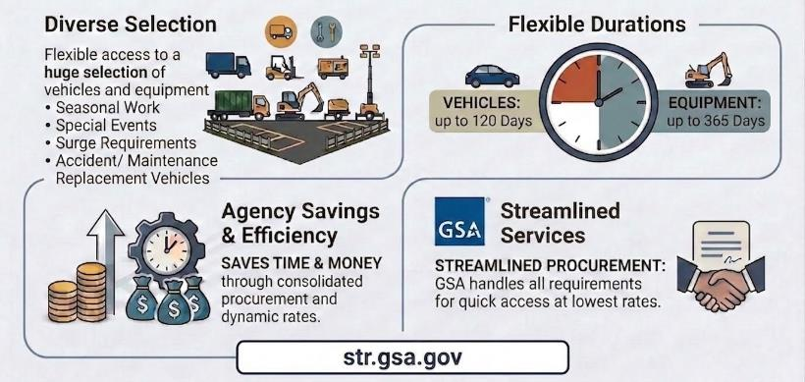
Short Term Rental Overview

Slide 14
GSA Managed Services
Non-Mandatory

Slide 15
Services for Agency Owned Vehicles
GSA offers a la carte vehicle services for agency owned vehicles
GSAFleet.gov Platform
GSA expertise & trust
Integrated Billing
No procurement necessary
A system already housing agency inventory data
Telematics available today at prices below commercial & MAS pricing
More solutions on the horizon
Telematics Service Offering | Price per Vehicle
GSA Managed Services (AO) Telematics GSA’s Monthly Subscription Price | $15.50
Multiple Award Schedule (MAS) Geotab Monthly Subscription Price | $16.24

Slide 16
Potential Future Fleet Services
Accident Management
Emissions Management
Enhanced Fleet Management Information System
Fleet Services Card and Loss Prevention
Maintenance Management
Marshalling/Accepting new vehicles
Recall Management
Sales (Remarketing)
State Plate Management
Tolling Solutions
Email Fleetsolutions@gsa.gov for more information or to provide feedback on which solutions to launch next!
Notes:
Connie launch poll
Presenter: Steph
Building on the initial success of telematics, we've identified several other potential areas where we believe GSA Fleet can provide significant value to you, our customers." These are areas in most cases, areas where we support our leasing customers today. You’ll see tolling solutions on here as well. A service we would also extend to leasing customers.
GSA OGP will include a QR Code for the poll/survey to fill out after the meeting for those that didn’t fill it out or weren’t able to attend.

Slide 17
Contact Us
Reach out to the GSA Fleet Team for more information:
Stephanie Gresalfi, Director, Offering Support Division, GSA Fleet
Stephanie.Gresalfi@gsa.gov
Jon DiPasquale, Branch Chief, Offering Management Branch, GSA Fleet
Jonathan.DiPasquale@gsa.gov
GSA Fleet Consolidation Mailbox: gsafleet-consolidation@gsa.gov
Notes:
Validate Fleet Data & Share
Verify vehicle-level Agency-Owned vehicle data and share with GSA
GSA will provide a Rate Quote
Agree to Lease
Decide on scope
Secure buy-in and begin change management
Sign agreement with GSA to Lease
Prepare to Lease with GSA
Identify current Billing Office Account Codes (BOACs) or Treasury Account Symbols (TAS) for new BOACs to support consolidated leases
Work with GSA to Create Customer Leasing Accounts as necessary
Schedule/Encourage Teams to attend GSA Fleet Leasing 101 Training
Transition Vehicle to GSA
Work with GSA to schedule inspections and transition vehicles to Leasing
Provide GSA with new vehicle requirements

Slide 18
Questions?

Slide 19

GSA’s End User Device BPAs
Hardware Division Webinar
Presenters: Otis Frazier, Joshua Crews
August 27, 2026

Slide 20
Training Agenda
The following End User Device (EUD) Blanket Purchase Agreements (BPAs) are available on AdvantageSelect:
01
Governmentwide Strategic Solutions (GSS) for Desktops and Laptops BPAs
02
Rugged End User Device BPAs
03
Governmentwide Printer BPAs

Slide 21
End User Device BPAs - Who can use them?
Federal civilian agencies
Department of Defense/War
State & local governments
Tribal & territorial governments

Slide 22



GSS Program: The Blueprint for EUD BPAs
End User Device BPAs - Key Benefits
Compliance Benefits
All GSA EUD BPAs build on legal and regulatory compliance as a core foundation:
TAA Compliance: Built-in controls verify TAA compliance of OEM products.
Section 889: Strictly prohibits unauthorized telecom/video surveillance gear.
Kaspersky Restriction: Active safeguards prevent the procurement of restricted software.
C/SCRM Surveillance: Vetted vendors maintain approved supply chain risk plans.
BPA Program Advantages
Leveraging GSA's pre-competed framework streamlines delivery and optimizes costs:
Guaranteed Savings: Contractual requirements mandate quantifiable discounts beyond standard MAS pricing.
Streamlined Buying: Pre-established pricing allows rapid orders without additional competition.
Customizable Systems: Base devices easily scale with memory, SSD, GPU, or rugged peripherals.
Authorized Resellers: Procure directly from secure, vetted small business partners.

Slide 23
BPA Program Framework
GSA’s GSS BPAs - Fundamentals
What Are They?
EUD BPAs leverage Best-in-Class SINs: Pre-competed single award BPAs for Dell and HP.
Standard Configurations: Brand name or equal laptops/desktops meeting V11 GSS standards.
Period of Performance (POP): September 4, 2022 to September 3, 2027.
What Is Available?
Full Breadth of Products: Complete access to Dell and HP products meeting V11 GSS specifications.
Customizable Options: Base machines can be configured to meet unique agency hardware specifications.
Specialized Services: Tailored options for custom imaging, OCONUS shipping, and specialized security.

Slide 24

GSS Program History & Governance
GSS History and Governance
01
02
03
Establishment
Established in 2015 as a governmentwide program to address purchase fragmentation and price variability.
Managed by the Office of Management and Budget (OMB) and Workstation Category Team.
Standard Base
Consolidated several hundred unique models into nine standard configurations:
• 3 Laptops
• 4 Desktops
• 1 Tablet
• 1 Thin Zero Client
Core WCT & V11
Collaborative governance: GSA, NASA SEWP, NIH CIO-CS, and Army CHESS.
V11 is the active technical standard to support enterprise-level baseline requirements.
6

Slide 25

GSS Program History & Governance
Before & After GSS
Before GSS (Legacy Challenges)
No standard configurations for desktops, laptops, tablets, or thin clients.
No pre-configured computers loaded on contracts to save acquisition time.
Fragmented purchasing across agencies, causing widespread price variability.
Did not fully leverage the government's buying power and scale.
Limited transactional data that was very difficult to extract or analyze.
After GSS (Program Benefits)
Nine standard configurations established covering 80% of end-user device use cases.
Pre-competed, pre-configured vehicles that allow easy and fast ordering.
Consolidated government demand driving lower, highly competitive pricing.
Flexible customization options and bundled accessory services available.
Detailed transactional data easily accessible to improve category management.

Slide 26

GSS Program History & Governance
GSS BPAs Fundamentals
What Are They?
• Single-Award BPAs: Pre-competed for Dell and HP.
• Brand Name or Equal: Laptops & desktops meeting V11 GSS standards.*
• Period of Performance: Sept. 4, 2022 – Sept. 3, 2027.
* PROGRAM UPDATE: Due to DRAM market conditions, GSS V10 qualified specs are temporarily added to existing offerings to meet agency acquisition needs.
What Is Available?
• Full Product Breadth: Complete access to Dell and HP devices meeting V11 specs.
• Customizable Base Units: Configurable models to support custom imaging, OCONUS shipping, and specialized needs.
26

Slide 27

GSS Program History & Governance
Consolidating Procurement
Alignment with Executive Order 14240
Simplifying the buying process across government to ensure maximum resource efficiency and ease of use.
Reducing contract overlap to eliminate visual and financial redundancies across federal agencies.
Focusing on core missions by delegating commodity IT procurement workflows to pre-competed GSA frameworks.
FY26 Q4 Buying Event Announcement
Event Launch: September 2, 2026. Customers can purchase all standardized models.
Catalog Readiness: GSA AdvantageSelect updates completed by August 31, 2026.
Recent BPA Modifications: MAS IT contract single award and recent BPA modifications were updated in August fo this year.
Pricing & Volume Discounts
Recently updated prices are based on single-unit purchases. Additional volume discounts remain a possibility and can be negotiated with contractors for larger quantities.

Slide 28
GSS Program History & Governance
GSS BPAs - Competition & Pricing
Is Additional Competition Required?
No additional competition required under these established BPAs.
Built-in compliance in accordance with FAR 8.405-3(c)(1) single-award procedures.
Streamlined procurement that saves significant administrative time and effort.
BPA Pricing & Discounts
Base quantity of one is the starting point for standard baseline BPA pricing.
Additional volume discounts can be dynamically negotiated with contractors for larger orders.
Buying Events establish special time-limited pricing windows for maximum savings.
28

Slide 29
GSS Program History & Governance
GSS BPA Options & Device Bundles
Customizable Hardware Options
Base specifications serve as the "floor," not the "ceiling," allowing extensive upgrades.
Core component upgrades include high-capacity SSDs, advanced CPUs, expanded RAM, and powerful GPUs.
Rapid SKU deployment via the GSA FAStLane process adds new parts within 24 to 72 hours.
Peripherals & Lifecycle Services
Bundled peripherals such as monitors, docks, and cases are supported at a standard 2-to-1 ratio.
Tailored lifecycle services offer 4 or 5-year warranty upgrades, custom imaging, and asset tagging.
Direct distribution provides warehousing, specialized overpacking, and ship-to-site readiness.

Slide 30
GSS Program History & Governance
GSS BPAs Benefits
Procurement & GSA Support
Streamlined procurement process that creates significant administrative time savings.
Fair & reasonable pricing determined at the task order or contracting officer level.
GSA support resources available, including order management and prices paid reporting.
Device & Vendor Value
Customizable GSS V11 devices tailored to meet specific agency and stakeholder requirements.
Vetted small businesses acting as authorized resellers that source directly from OEMs.
Supply chain security assured via approved Cybersecurity Supply Chain Risk Management (C-SCRM) plans.

Slide 31
GSS Program History & Governance
GSS BPAs - Multiple Ways to Buy
Procurement Strategies
GSA Advantage! allows for rapid direct buying utilizing a Government purchase card.
Agency RFQs can be issued for efficient and competitive task order award fulfillment.
Requisition Orders offer structured channels to acquire systems under pre-competed frameworks.
Optimizing Acquisitions
Agency Catalog Creation helps standardize custom configurations and baseline pricing enterprise-wide.
Internal Compliance is critical; always follow internal agency guidelines and approval processes.
Streamlined Awards through pre-competed options dramatically minimize overall delivery lead times.

Slide 32

GSS Program History & Governance
Agency Catalog Creation
Catalog Setup & Pricing
Requirements Planning: Agency provides estimated quantities & configurations for the FY.
Volume Discounts: Resellers leverage these estimates to negotiate deeper pricing cuts with OEMs.
Bespoke Catalog: Partners build a dedicated, agency-specific e-catalog with standard configurations.
Operational Efficiency
Rapid Ordering: Once live, the agency cuts direct orders against the catalog without further competition.
Enterprise Standardization: Standardizes custom configurations and locks baseline pricing enterprise-wide.
5-Day Procurement: Upfront setup takes ~90 days but reduces subsequent delivery order times to ~5 days.

Slide 33
GSS Program History & Governance
Sample Customer e-Catalog
e-Catalog Setup & Access
Approved Devices: Agency VAR creates a dedicated, custom-configured portal for authorized hardware.
Secure Role Definition: Supports agency email logins, user roles, and organizational permissions.
Strategic Alignment: Aligns ordering scope with internal agency procurement guidelines and technical baselines.
Cart Management & Analytics
Saved Carts: Allows procurement teams to park, save, and forward configurations for review and approval.
Collaboration: Enables seamless sharing of customized configurations within the program agency.
Data Reporting: Provides immediate, real-time access to ongoing transaction data and acquisition metrics.

Slide 34


GSS Program History & Governance
Ordering Best Practices
Configuring & Sourcing
Detailed Specs: Include complete product descriptions with OEM defined part numbers and names.
TAA Constraints: Apple products are not available on GSS because they do not meet TAA requirements.
"Or Equal" Specs: Identify alternative compliant systems to allow standard equivalent products.
Acquisition & Review
Adequate Lead Time: Provide 14+ days for complex multi-OEM configurations instead of the 5-day default.
Bundled Solutions: Describe high-level systems to permit flexible non-TAA accessory components.
Open Market Items: Explicitly indicate willingness to accept open market options for minor components.

Slide 35
GSS Program History & Governance
Ordering Best Practices (2 of 2)
Maximizing Value & Additions
Ask for Additional Discounts: Pricing on GSA Advantage! represents single-unit purchases. Negotiate with contractors for deeper discounts on larger volume orders.
On-Demand Product Additions: If a required IT solution is missing, vendors can utilize GSA FASt Lane to quickly add SKUs directly to their contracts before award.
Active Platform Engagement: Buyers are highly encouraged to officially document finalized procurement decisions as "Award" or "Not Award" within eBuy.
Streamlining Simple Acquisitions
Micro-Purchase Efficiency: Acquisitions below the micro-purchase threshold using a Government Purchase Card (GPC) do not require formal, structured RFQs.
Direct Click-and-Buy: Search, compare certified IT hardware or software products, and complete transactions directly inside GSA Advantage!.
Procedural Compliance: Ensure all standard volume discount requests and purchase operations strictly follow agency-level guidelines and FAR 8.402(f).

Slide 36
Rugged BPAs: Overview & Categories
GSA’s Rugged BPAs
Rugged BPAs: Overview & Categories
Program Overview & Benefits
Established in 2018 to assist SOCOM with rugged device standards. This program simplifies how government agencies purchase ruggedized hardware under single-award blanket purchase agreements while securing key advantages:
💰 Cost Savings
Aggregates enterprise demand to manage spend and maximize procurement efficiency.
✅ Compliance Ready
Incorporates approved NIST-based Cybersecurity Supply Chain Risk Management (C-SCRM) plans.
⚡ Speed to Award
Leverages FAR 8.405-3(a)(6) single-award procedures to drastically reduce timelines.
Device Categories & Partners
Offers 32 IT hardware products across five standardized configurations from core partners including Rugged Dell, GETAC, and Panasonic:
Rugged & Semi-Rugged Laptops (clamshells, notebooks)
Convertible Workstations (detachable 2-in-1 systems)
Rugged Tablets (2-in-1 tablet or convertible format)
Rugged Handheld Devices (for extreme field mobility)
Eligible Users:
Federal, DoD/War, state, local, tribal, & territorial entities.

Slide 37

GSA's Rugged BPAs
Rugged BPAs: Acquisition Framework
Acquisition Strategy & Authority
The value of a single marketplace for Rugged IT products outweighs ongoing competition, reducing administrative complexity.
Ordering Procedures: Built on FAR 8.4 streamlined procedures, enabling direct orders with no additional competition required.
BPA Establishment: Three single-award BPAs established under MAS SIN 33411 in accordance with FAR 8.405-3(a)(6).
Sourcing Integrity: Secure procurement through vetted small business VARs sourcing directly from OEMs.
Program Period & History
The framework guarantees long-term stability and standardized technical requirements across the federal landscape.
Period of Performance (POP): March 19, 2023 through yearly option renewals until March 18, 2028.
Framework Heritage: Established in 2018 based on robust GSS program value frameworks to assist SOCOM with rigorous ruggedized device standards.
Spend Management: Leverages category management and strategic sourcing principles to continuously maximize value and reduce costs.

Slide 38
Governmentwide Printer BPA
Overview
This BPA was established under GSA’s Multiple Award Schedule IT Category to simplify how government agencies purchase printers and related equipment.
Eligible Users:
Federal, state, local, tribal and territorial governments, agencies and organizations
Contract Type:
Single-award blanket purchase agreement
NAICS Codes:
33411, 811212, 511210
💰Cost Savings
Leverages government-wide buying power for significant volume discounts
✅Compliance Ready
Meets current procurement policies and strategic sourcing requirements
🗲 Speed to Award
Agency catalogs reduce acquisition time to approximately five (5) days
Overview

Slide 39
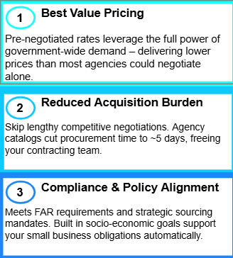
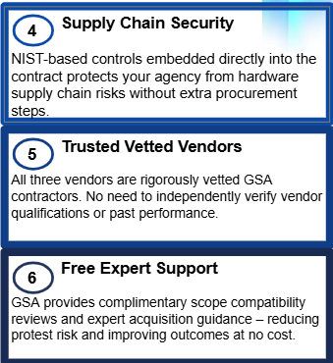
Why Buy Through the Printer BPA?

Slide 40
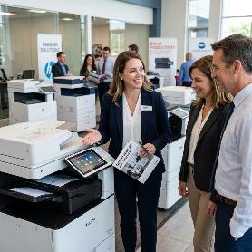
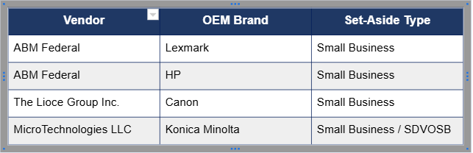
Approved Resellers
Current BPA Vendors
All four awards are designated small business set-asides, supporting socio-economic goals.

Slide 41

How To Buy
Order through GSA Advantage Select
Choose a pre-configured printer
Add approved options if needed
Add it to your shopping cart
Checkout of your cart when done
Contact our vendors directly:
http://gsa.gov/printers

Slide 42
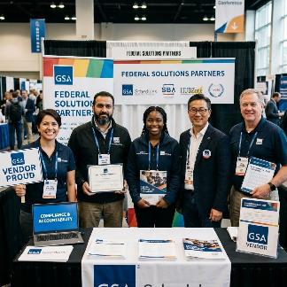
Reasons to Choose GSA
Vendor accountability
Provide accurate catalogs
Monthly sales reporting
Offer current models only
Stakeholder support and order fulfillment

Slide 43

Webinar Conclusion & Support
ADS Hardware Division - Wrap Up
Leverage pre-competed Advantage Select BPAs to ensure regulatory compliance, maximize cost savings, and streamline device deployment.
Key Takeaways
Full Compliance: Built-in TAA, Section 889, Kaspersky restrictions, and robust C-SCRM plans.
Guaranteed Value: Deeper volume discounts beyond standard GSA MAS Schedule pricing.
Rapid Ordering: Drastically reduce procurement lead times down to approximately 5 days.
Need Support?
The Office of Category Management Hardware Division is here to assist with configuration planning, agency e-catalogs, and order management support.
Contact the ADS Hardware Team:
workstations@gsa.gov

Slide 44
GSA Starmark Logo

