Slide 1

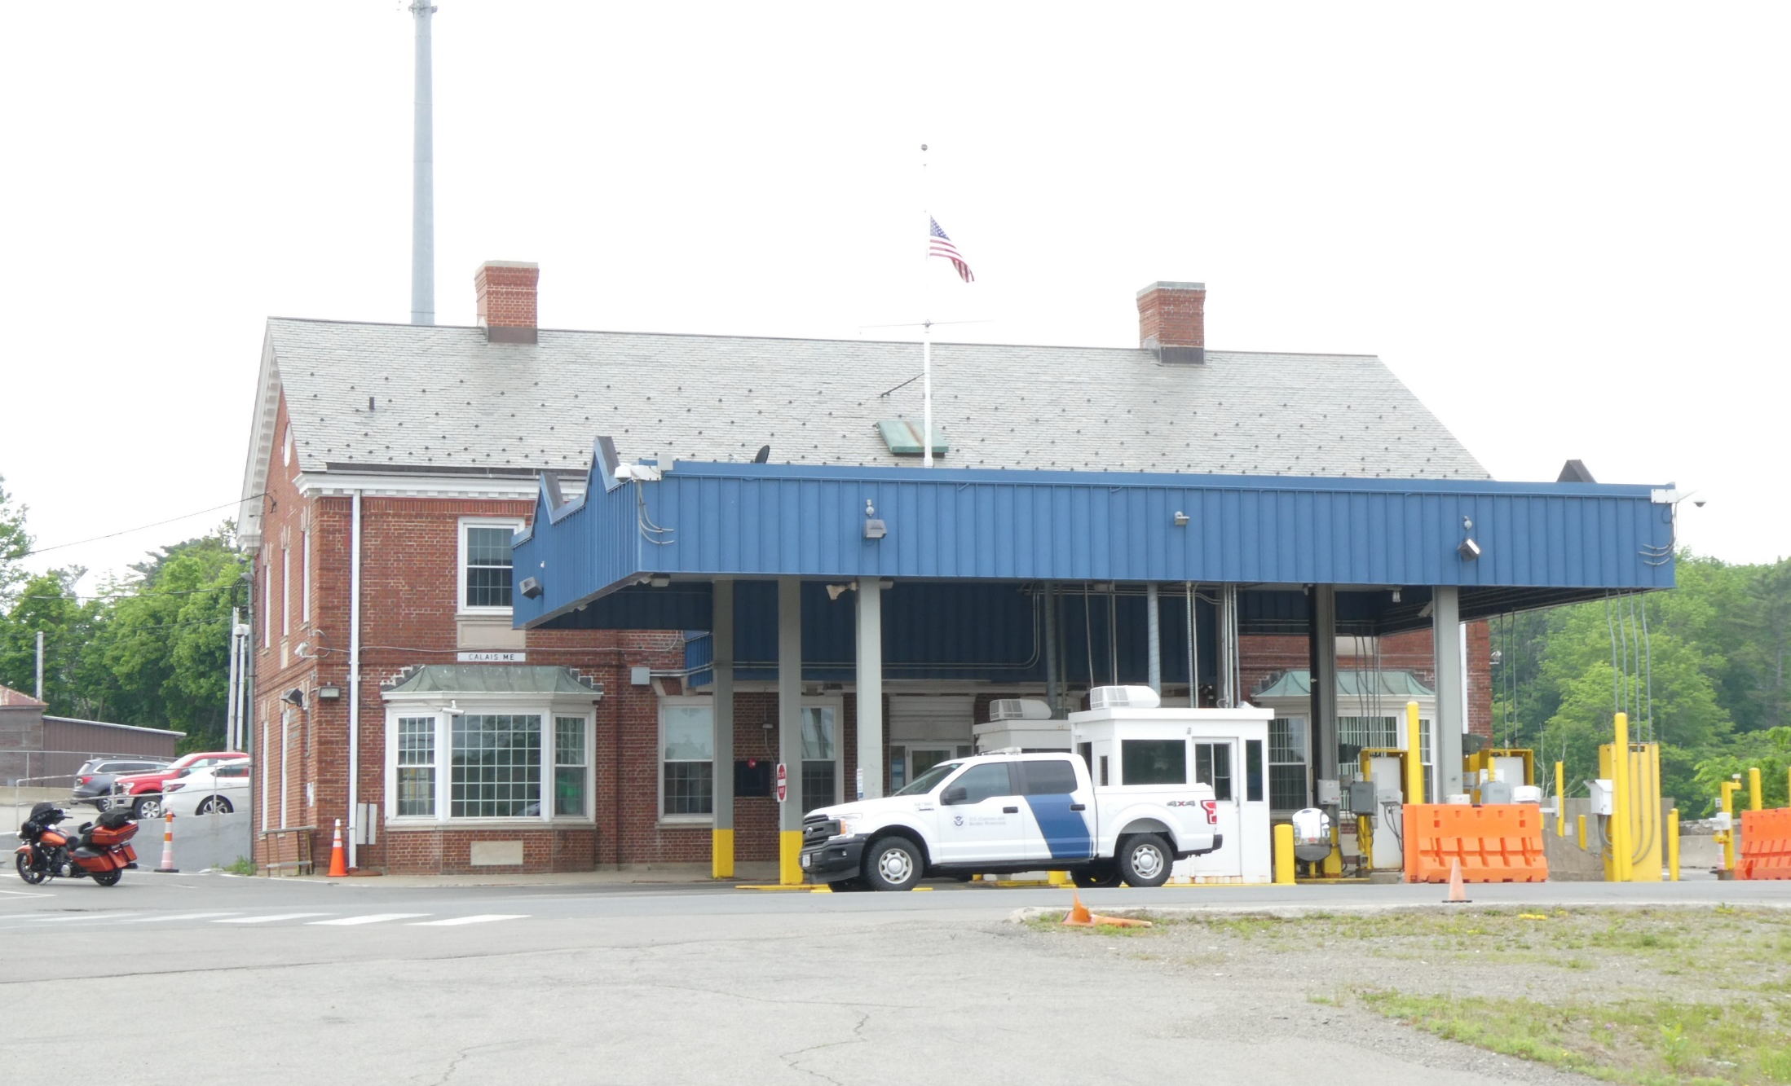
U.S. General Services Administration
Land Port of Entry Modernization Project
Calais Ferry Point, ME
National Environmental Policy Act
Public Scoping Meeting #2
April 25, 2024

Slide 2
Meeting Agenda
Welcome and Introductions
Purpose of the Meeting
Project Information and Background
National Environmental Policy Act (NEPA) Overview and Process
Project Study Area
Submitting Public Comments

Slide 3
Introductions
Tina Sekula, JMT, Associate Vice President, Environmental Planner
Li Wang, GSA, Project Manager
Missy Mertz, GSA, NEPA Specialist
Sara Massarello, GSA, Realty Specialist
Adriene Delozier, JMT, Senior Associate, Environmental Planner

Slide 4
What is the purpose of this meeting?
Scoping is an early public involvement process to help determine which issues the Environmental Assessment (EA) will address. GSA welcomes public input on the resources and issues that are important to consider for this project. Today we will:
Provide a project update
Describe the NEPA Process
Inform you of the next steps in the NEPA Process
Provide you with information on how to make comments on the project

Slide 5
Purpose & Need
The purpose of this project is to modernize the Calais Ferry Point LPOE to improve the operational efficiency, safety, and security for U.S. Customs and Border Protection (CBP) personnel and cross-border travelers. The existing facility can no longer adequately support the mission requirements of CBP.
Deficiencies at the LPOE fall into two categories:
Limited Capacity
Existing building’s condition and available space allocations

Slide 6
First Public Scoping Meeting
The first Public Scoping Meeting was held on June 13, 2023 at the Maine Indian Education Center in Calais, ME. Comments submitted during and after the meeting included the following themes:
Environmental Concerns-
  Water quality concerns/ concerns related to the St. Croix River
Traffic and Circulation -
  Change in LPOE building footprints and/or LPOE site area
  Changes to surrounding roads
Hazardous Materials
General Requests for additional information

Slide 7
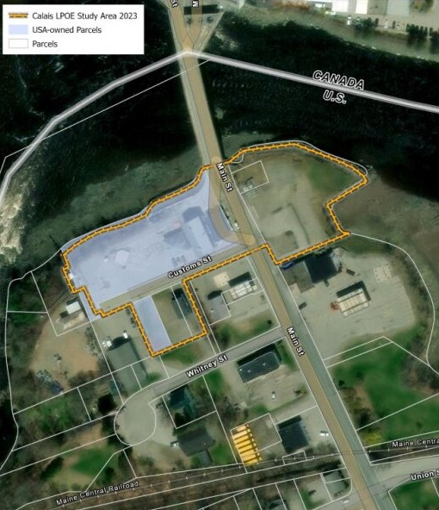
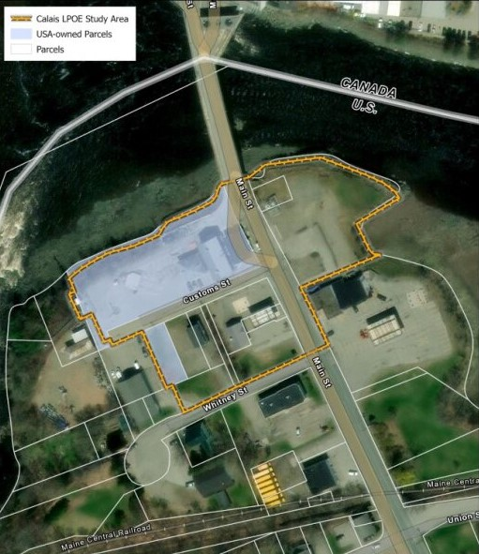
NEPA Study Area
Since the initial Public Scoping Meeting in June 2023, the Study Area for the modernization efforts has expanded (see below). The updated Study Area now extends south to Whitney Street.
2023 Study Area
2024 Study Area

Slide 8
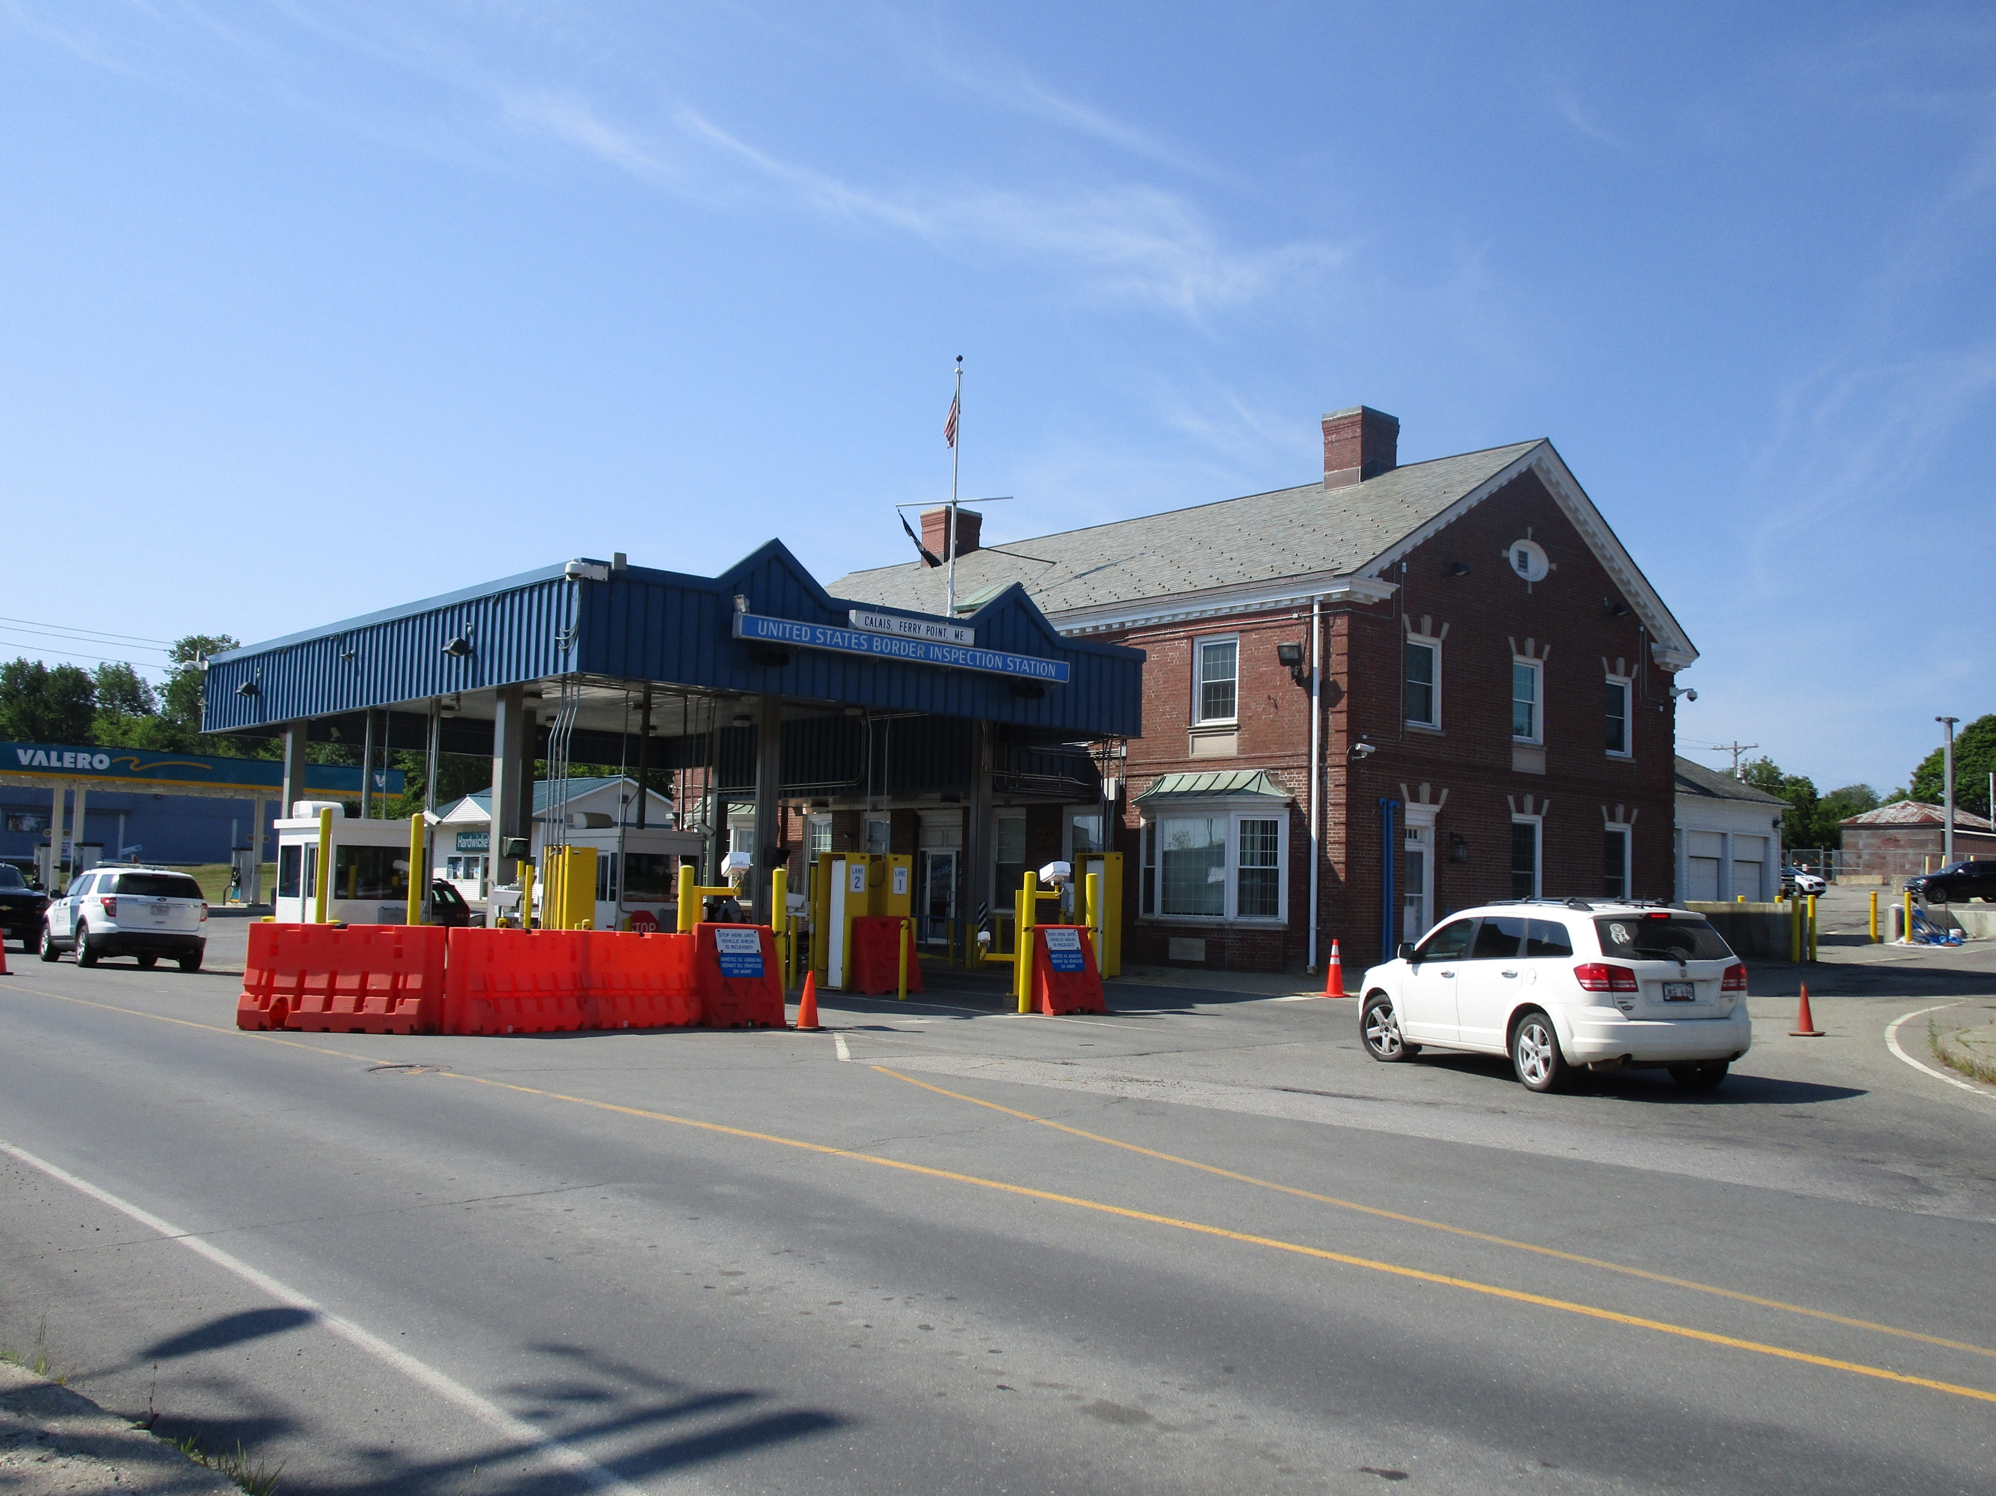
Project Information

Slide 9
Anticipated Schedule
We are Here
Plan | Design | Construct
NEPA Complete: Winter 2024/2025 | Start: Spring 2023 Complete: Summer 2025 | Start: Fall 2025 Complete: Winter 2029

Slide 10
National Environmental Policy Act (NEPA)
National Environmental Policy Act (NEPA) of 1969 established a national policy for the protection of the environment
  Requires federal agencies to evaluate the potential environmental impacts that could result from a proposed action
  Engages the public in the decision-making process
  Goal is to inform decision makers and the public of potential environmental impacts before a decision is made

Slide 11
Environmental Assessment (EA) Timeline
Initiate NEPA Scoping
Public Scoping Period
Draft EA
Public Comment Period for EA
Final EA and NEPA Decision Document
We are Here
Public Comment Opportunities

Slide 12

Documenting Existing Conditions (the Affected Environment)
The EA will include a description of the resources that may be impacted by the proposed action. Examples of the resource areas we anticipate to be analyzed are:
Climate Change
Socioeconomics
Environmental Justice
Noise
Cultural Resources
Biological Resources
Water Resources
Utilities
Traffic & Public Transportation
Floodplains

Slide 13

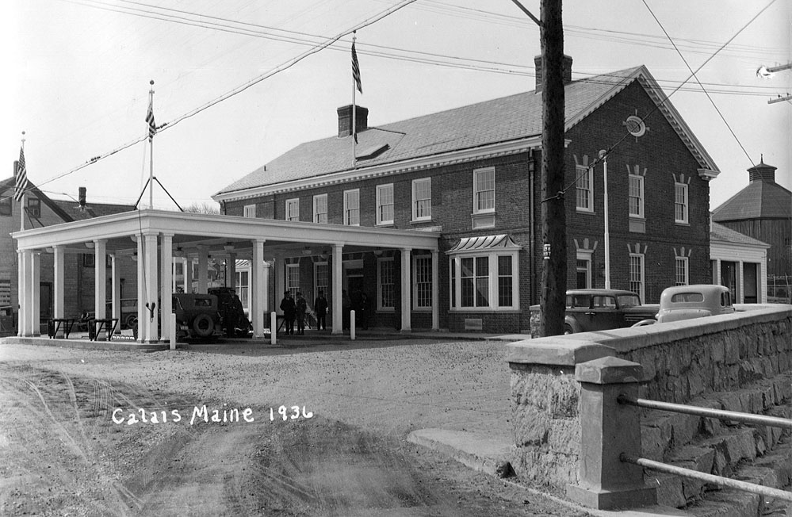
Affected Environment: Cultural Resources
Section 106 of the National Historic Preservation Act of 1996 (NHPA) requires GSA to consider the effects of federal undertakings on historic properties.
Step 1: Initiate Section 106
Step 2: Establish the Area of Potential Effect (APE)
Step 3: Identify Historic Resources
Step 4: The potential effects of identified historic resources are evaluated.
Step 5: If there are potential adverse effects, GSA will explore measures to avoid, minimize, or mitigate those effects.

Slide 14
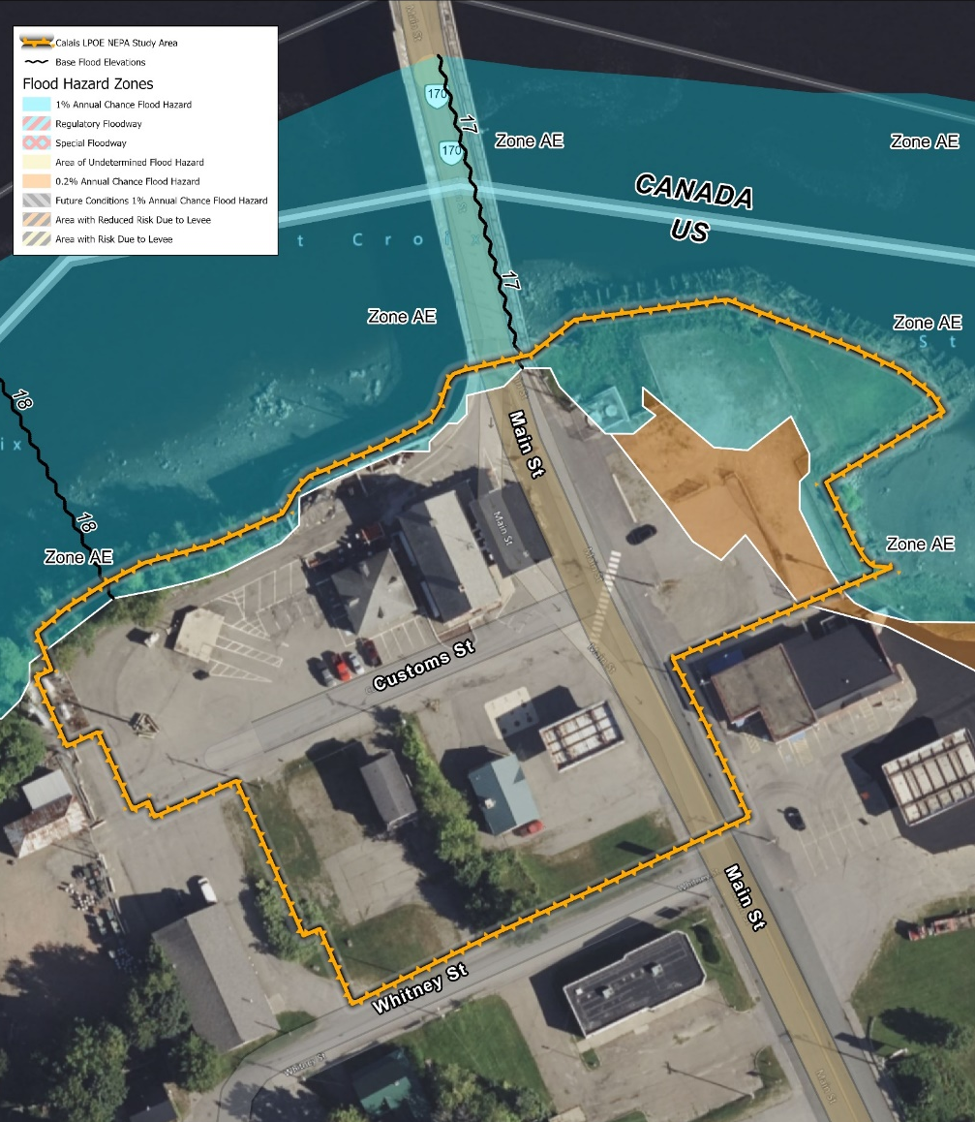
Affected Environment: Floodplains
The Study Area is partially located within Zone AE, a high-risk area for flooding and located within the 100-year and 500-year floodplains.
EO 11998 (Floodplain Protection) requires federal agencies to avoid or minimize development in the floodplain except where there are no practicable alternatives.
GSA is required to attempt to locate all structures outside of the floodplain area in compliance with federal regulation and GSA’s Floodplain Management Desk guide and P100.

Slide 15
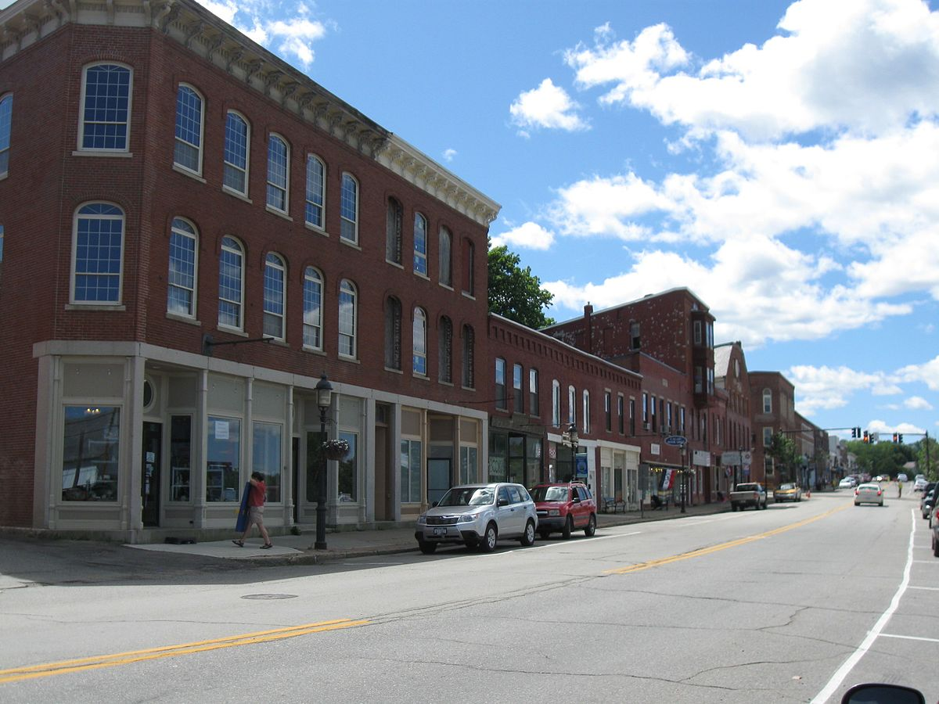
Affected Environment: Community
Potential acquisition of land within the NEPA Study Area may cause the following:
Closure of Citgo Gas Station on the west side of Main Street
Discontinuance (closure) of Customs Street
Realignment of Main Street.
Intermittent/ temporary closures of the LPOE during winter, off-peak hours may be necessary during construction.

Slide 16



Tell us what you think!
Written Comments must be submitted by May 31, 2024.
In Person: Fill out a comment form and leave it here with us tonight or have your comment recorded by our stenographer.
Send written comments to:
U.S General Services Administration
Attention: Li Wang, Project Manager
Thomas P. O’Neill, Jr., Federal Building
10 Causeway Street, 11th Floor Boston, MA 02222-1077
Send email to:
calaisferrypoint.lpoe@gsa.gov
Reference
“Calais Ferry Point LPOE EA”
in the subject line

Slide 17
Commenting Etiquette
Please utilize the microphone
Say and spell your first and last name at the start of your comment.
Remain quiet while others are speaking for stenographer.
Verbal comments will be held to a 2-minute time limit.
If time allows, participants may be permitted to speak again after all commenters have had the opportunity to speak. Additional comments can also be submitted in writing.
A recording of the meeting will be made available, and your comments will be included in the administrative record.
THANK YOU FOR YOUR PARTICIPATION!

Slide 18


