Slide 1
ETSNext Overview
January 2022
presented by
ETSNext PMO

Slide 2
E-Gov Travel Service (ETS) Overview
How GSA fits into the Travel and Expense (T&E) Civilian Space
Government Sector T&E
The civilian Government spends over $10B* annually on travel expenditures
Travel administration costs between $300-600M per year
ETS constitutes 88% market share of civilian addressable spend
Government Standardization Efforts
OMB approved T&E Business Standards (Nov 2020)
T&E & Financial Management (FM) standard data element & transaction set mapping (2022)
GSA Supporting Agencies’ Goals
Maximize Value of Federal Spending
Category Management
Benchmark and Improve Mission Support Services
*Historical Spending - Pre-Covid
1

Slide 3
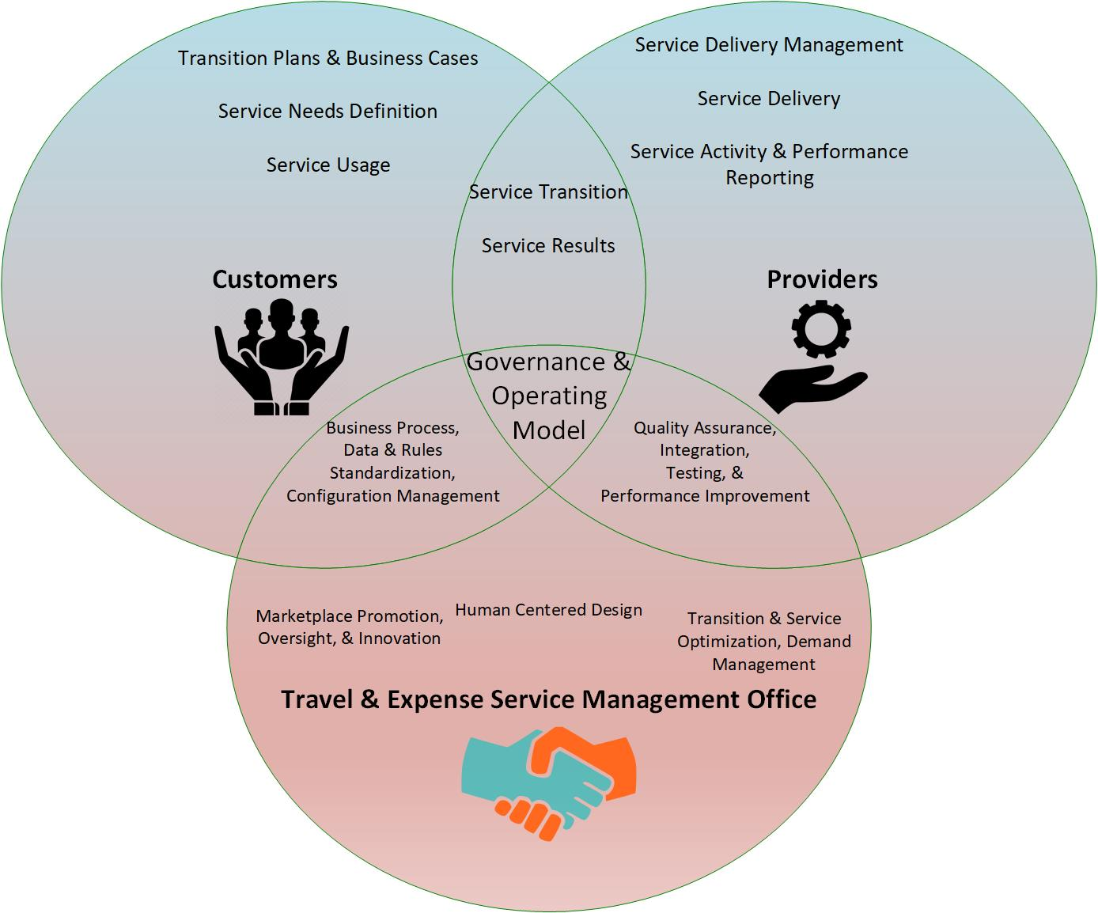
ETSNext Objectives & Vision
Vision:
To broker partnership with industry & agencies to acquire and deliver a single enterprise, centrally-delivered travel and expense (T&E) end-to-end service that meets government-wide T&E Core and Optional Services needs.
Objectives:
Transition Seamlessly to New T&E Services
Streamline Travel & Expense Services
Offer Data-Driven, Transparent Service Model Performance
Measure Sustainability
2

Slide 4
ETSNext Marketplace Offerings
The ETSNext PMO envisions 4 categories of Marketplace Service Offerings available to agencies through the Catalog
T&E Optional Services
and Solutions
Additional services and
solutions that are
complementary to Core T&E
Travel & Expense solution offered
in a FedRAMP environment
Core T&E
ETSNext Marketplace
Service Offerings
T&E Optional Services
and Solutions
T&E Support Services
Data Center Infrastructure management
Core Service release testing and management
Security management
Continuity of Operations
Solutions offered by the ETSNext PMO to meet a range of T&E needs
T&E
Platform Services
3

Slide 5
Why T&E Business Standards Matter
It’s OMB approved - November 2020
Culmination of a cross-government effort to create Business Use Cases, Business Capabilities, & Standard Data Elements
First time the government is going to market with a common Business Process and set of Business Standards (requirements)
First time the government is coordinating directly with the Financial Management community on interface standards
Standard Integration, Standard File Formats, Standard Data Elements, Standard Transaction Sets (Integration)
T&E Business Standards will be used as the basis for ETSNext requirements
https://ussm.gsa.gov/fibf-travel/
https://ussm.gsa.gov/fibf-fm/
4

Slide 6
ETSNext Communications
Please visit and sign up for our E-Gov Travel Service (ETS) Next Industry site on
GSA’s Interact
https://interact.gsa.gov/group/e-gov-travel-service-ets-next-industry-community
ETSNext Request for Information (RFI)
Released December 9, 2021
Questions due January 27, 2021
Only need to address questions applicable to your solution(s)
Travel & Expense Business Standards Industry Sessions
Recorded sessions available for review on Interact
5

Slide 7

Logo
6

