Slide 1
FAST 2024
Securing Emerging Tech: Safeguarding the Future
April 24th, 2024, 1:00-4:30 PM EST

Slide 2
Today’s Agenda (all times eastern)
1:00p | 1:05p | Welcome and Opening Remarks
1:05p | 1:15p | Keynote Address
1:15p | 1:40p | GSA’s Role in Acquisition - Customer Partnership Fireside Chat
1:40p | 2:30p | Emerging Technology Trends
2:30p | 2:40p | 10 Min Break
2:40p | 3:10p | Navigating the Cybersecurity Requirements Landscape
3:10p | 3:45p | Customer Tools for Success
3:45p | 3:50p | Event Ends

Slide 3
Keynote Address

Slide 4
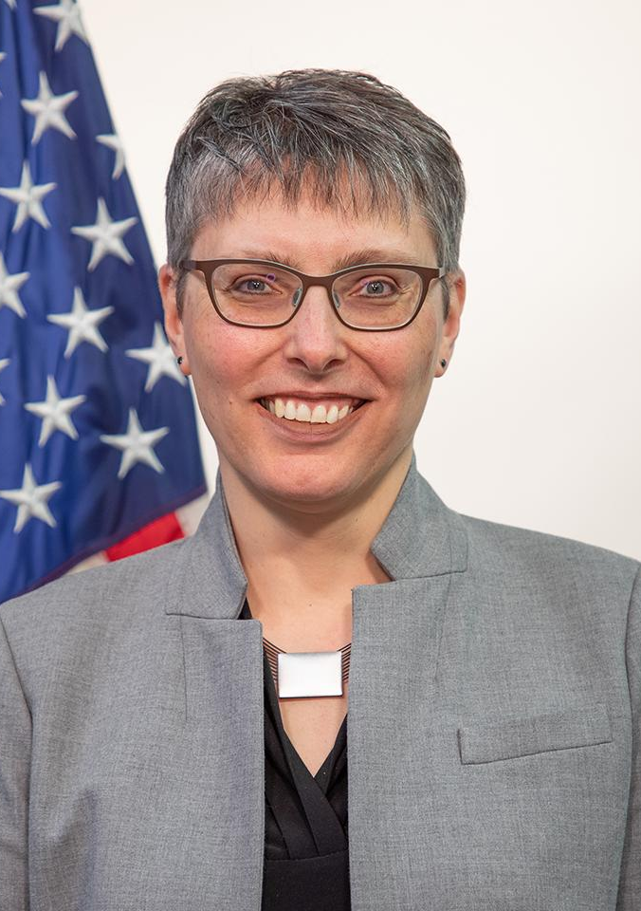
Keynote Address
Laura Stanton
Assistant Commissioner
Office of Information Technology Category

Slide 5
Laura Stanton
Assistant Commissioner
GSA Office of Information Technology Category
laura.stanton@gsa.gov
For more information, visit: gsa.gov/FAST

Slide 6
GSA’s Role in Acquisition: Customer Partnership Fireside Chat

Slide 7
GSA’s Role in Acquisition - Fireside Chat
Lawrence Hale
Deputy Assistant Commissioner
Office of Information Technology Category
Mike Duffy
Associate Director
Cybersecurity Division, CISA

Slide 8
Lawrence Hale
Deputy Assistant Commissioner
lawrence.hale@gsa.gov
Mike Duffy
Associate Director, Cybersecurity Division, CISA
michael.duffy@cisa.dhs.gov
For more information, visit: gsa.gov/FAST

Slide 9
Emerging Technology Trends

Slide 10
Last-minute changes prevented inclusion of these slides.
Such is the nature of emerging tech…it changes quickly!
Find these slides on our resource page, at gsa.gov/FAST

Slide 11
Emerging Technology Trends
Udaya Patnaik
Michael Berkholtz

Slide 12
Udaya Patnaik
udaya.patnaik@gsa.gov
Michael Berkholtz
michael.berkholtz@gsa.gov
For more information, visit: gsa.gov/FAST

Slide 13
Break

Slide 14
Navigating the Cybersecurity Requirements Landscape

Slide 15
Navigating the Cybersecurity Requirements Landscape
Rosa Underwood
Senior Cybersecurity Advisor
Office of Information Technology Category

Slide 16
The Headlines
“Russia-linked hacking group suspected of carrying out cyberattack on Texas water facility, cybersecurity firm says”
“Michigan healthcare organization says ransomware breached data of 185,000”
“Idaho National Nuclear Lab Targeted in Major Data Breach”
“CISA says US government agency was hacked thanks to ‘end of life’ software”
“Fraud Alert: Fake Government Requests for Quotes”
“Frontier Communications shuts down systems after cyberattack”

Slide 17
The Numbers
More than 2,200 Cybersecurity Attacks daily
40%
Increase in Cyber-Attacks Targeting Government Agencies between March and May 2023
43%
of cyber attacks are aimed at small businesses, but only 14% are prepared to defend themselves
$10.5 trillion
Cybercrime will cost companies worldwide annually by 2025
600% Increase in number of supply chain attacks

Slide 18
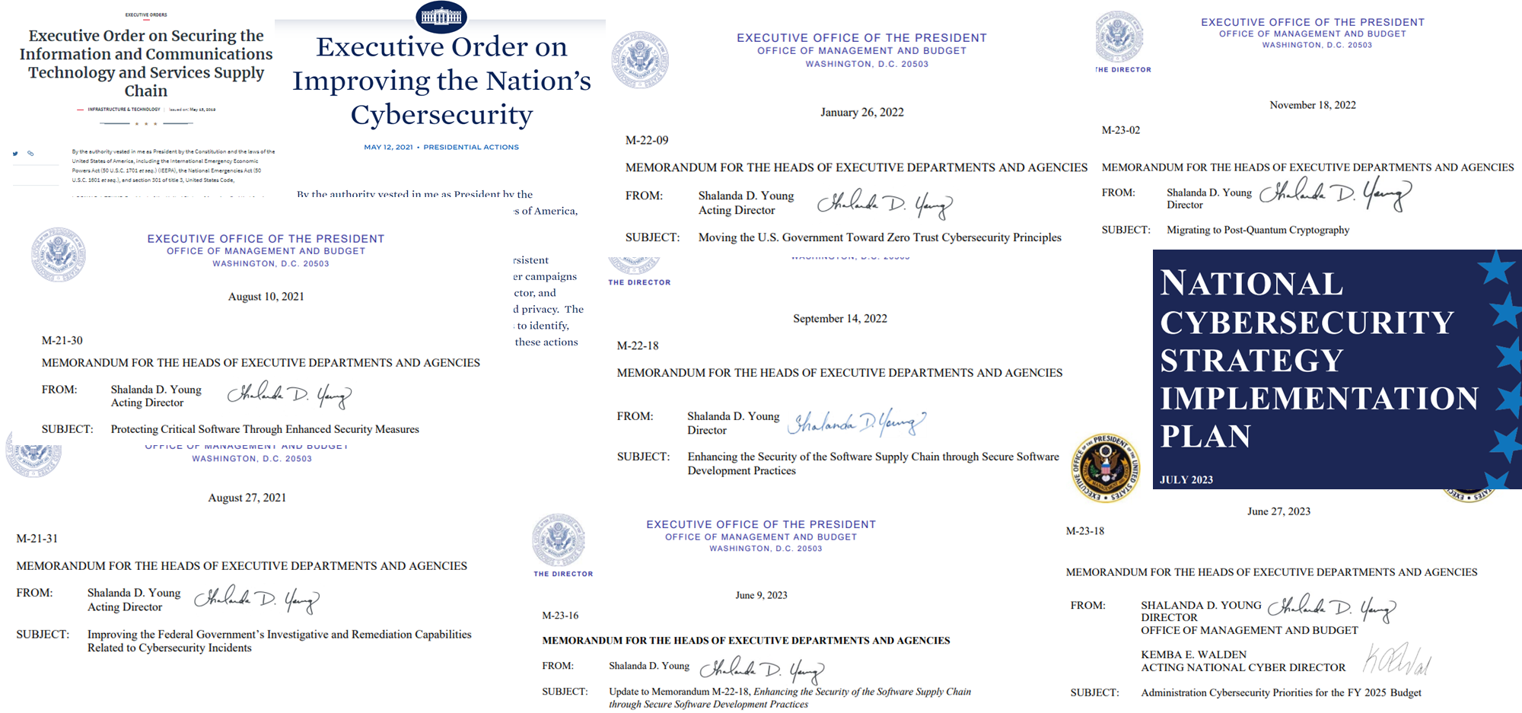
Cybersecurity is a Priority

Slide 19
Critical infrastructure Sectors
Chemical Sector
Commercial Facilities Sector
Communications Sector
Critical Manufacturing Sector
Dams Sector
Defense Industrial Base Sector
Emergency Services Sector
Energy Sector
Financial Services Sector
Food and Agriculture Sector
Government Facilities Sector
Healthcare and Public Health Sector
Information Technology Sector
Nuclear Reactors, Materials, and Waste Sector
Transportation Systems Sector
Water and Wastewater Systems Sector
Presidential Policy Directive 21 (PPD-21), Critical Infrastructure Security and Resilience (February 2013), established national policy on critical infrastructure security and resilience advancing a national unity of effort to strengthen and maintain secure, functioning, and resilient critical infrastructure.

Slide 20
“Never trust, always verify.”
Zero Trust
Network security model that accounts for both external and internal threats
Departure from the ‘castle and moat’ theory
Data-centric security model
A security approach to ensuring that malicious insiders and outsiders cannot access information they are not authorized to access
X

Slide 21
A More Secure and Resilient Federal Ecosystem
Stay informed!
Think before you click
Implement security controls and monitor for changes, adapting often to the ever-changing threat landscape and new technologies
Follow Governance, Risk, and Compliance(GRC) best practices
Utilize the many resources available to you
Explore strategies to prepare your organization for what’s to come
Participate in the Rulemaking Process
Ask Questions

Slide 22
Resources
Empowering Small and Medium-Sized Businesses (SMB): A Resource Guide for Developing a Resilient Supply Chain Risk Management Plan
Moving the U.S. Government Towards Zero Trust Cybersecurity Principles
Make a difference. Submit your comments and let your voice be heard.
NIST Trustworthy & Responsible Artificial Intelligence Resource Center (AIRC)
Quantum-Readiness: Migration to Post-Quantum Cryptography (PQC)
Shifting the Balance of Cybersecurity Risk: Principles and Approaches for Security-by-Design and -Default
Hardware Bill of Materials (HBOM) Framework for Supply Chain Risk Management
U.S. Securities and Exchange Commission (SEC) Cybersecurity Resources and Information
The False Claims Act
Cyber Essentials
Small Business Cybersecurity Corner
Manage your business
Cybersecurity for Small Business
Guides and templates for Federal, state, local, and tribal governments

Slide 23
Thank you!

Slide 24
Rosa Underwood
Senior Cybersecurity Advisor
rosa.underwood@gsa.gov
For more information, visit: gsa.gov/FAST

Slide 25
GSA Customer
Tools for Success

Slide 26
Customer Tools for Success
Dave Dehon
Customer Service Director
GSA
Joshua Ramos-Crews
Business Development Specialist
CSSD

Slide 27
When customer agencies want to…
And need to quickly, compliantly and at a fair price purchase
They use ITC’s best-in-class vehicles like…
And use ITC’s acquisition support services like…
Modernize and upgrade IT systems
Add new data and analytics capabilities
Improve system security
Build customer-facing digital experiences
IT Professional Services
Cybersecurity
Software / SaaS
Platforms / PaaS
Infrastructure / IaaS
Hardware
Telecom
Identity, Credential, and Access Mgmt Services
Multiple Award Schedule (MAS) IT Category
Governmentwide Acquisition Contracts (GWACs)
Blanket Purchase Agreements (BPAs)
In-house SMEs
Buying guides
Reusable templates
Contract language
Market research
Training

Slide 28
IT Security and Solutions
Some Key Areas of IT Security and Emerging Technology Solutions
Zero Trust Architecture (ZTA)
HACS SIN, Cloud SIN, EIS, GWACs (Alliant 2, VETS 2 & 8(a) STARS III), & more!
Cybersecurity Supply Chain Risk Management (C-SCRM)
HACS SIN, ICAM Tools SIN, CDM Tools, IT Professional Services SIN, GWACs (Alliant 2, VETS 2 & 8(a) STARS III), & more!
Post-Quantum Cryptography (PQC)
EIS (managed services)
HACS SIN
Artificial Intelligence (AI)
8(a) STARS III (Emerging technologies)
Alliant 2
SIN 561422 (Automated contact center solutions)
Notes:
This slide displays some GSA’s key areas of IT Security and some of our emerging technology solutions. You may find a comprehensive list of solutions within resources found on the associated GSA webpages (linked on this slide).
ZTA
GSA-Offered Zero Trust Architecture (ZTA) Products, Services, and Solutions
· 2GIT PRODUCTS
· 8(a) STARS III
· ALLIANT 2
· Automated Contact Center Solutions SIN 561422
· Cloud SIN 518210C
· Commercial Satellite Communications Solutions SIN 517410
· Complex Commercial SATCOM Solutions (CS3)
· Electronic Commerce and Subscription Services SIN 54151ECOM
· Enterprise Infrastructure Solutions (EIS)
· Highly Adaptive Cybersecurity Services SIN 54151HACS
· Homeland Security Presidential Directive 12 Product and Service Components SIN 541519PIV
· Identity, Credentialing and Access Management SIN 541519ICAM
· IT Professional Services SIN 54151S
· Public Key Infrastructure Shared Service Providers Program SIN 541519PKI
· Purchasing of New Electronic Equipment SIN 33411
· SmartBUY Blanket Purchase Agreement
· Software Maintenance Services SIN 54151
· Software SIN 511210
· VETS 2
· Wireless Mobility Solutions SIN 517312
C-SCRM
GSA-Offered Cybersecurity Supply Chain Risk Management (C-SCRM) Products, Services, and Solutions
Supply Chain Risk Illumination Tools Available on GSA Contract Vehicles Agencies can leverage GSA technology purchasing programs when looking for C-SCRM specific and/or related products, services, and solutions with additional requirements to meet their C-SCRM needs. These include:
Multiple Award Schedule (MAS):
· Highly Adaptive Cybersecurity Services (HACS) Special Item Number (SIN) 54151HACS
· Identity, Credential, and Access Management (ICAM) Tools SIN 541519ICAM
· Continuous Diagnostics and Mitigation (CDM) Tools (note that the former CDM Tools SIN retired in 2022, but these tools are now available through the Best-in-Class IT Hardware and Software SINs).
· Mobile Identity Management SIN 517312
· IT Professional Services SIN 54151S
· Data Breach Response & Identity Protection Services (IPS) SIN 541990IPS
· Risk Assessment and Mitigation Services SIN 541990RISK
Governmentwide Acquisition Contracts (GWACs):
· ALLIANT 2
· Veterans Technology Services (VETS) 2
· 8(a) Streamlined Technology Acquisition Resource for Services (STARS) III
PQC:
Post-Quantum Cryptography (PQC)
· Enterprise Infrastructure Solutions (EIS)
· Highly Adaptive Cybersecurity Services SIN 54151HACS
AI
Artificial Intelligence (AI)
· 8(a) STARS III (Emerging technologies)
· ALLIANT 2
· Automated Contact Center Solutions SIN 561422

Slide 29
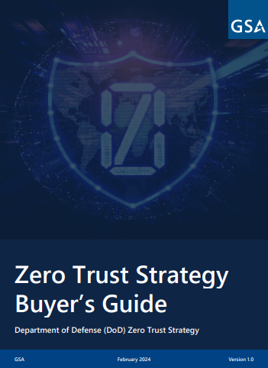
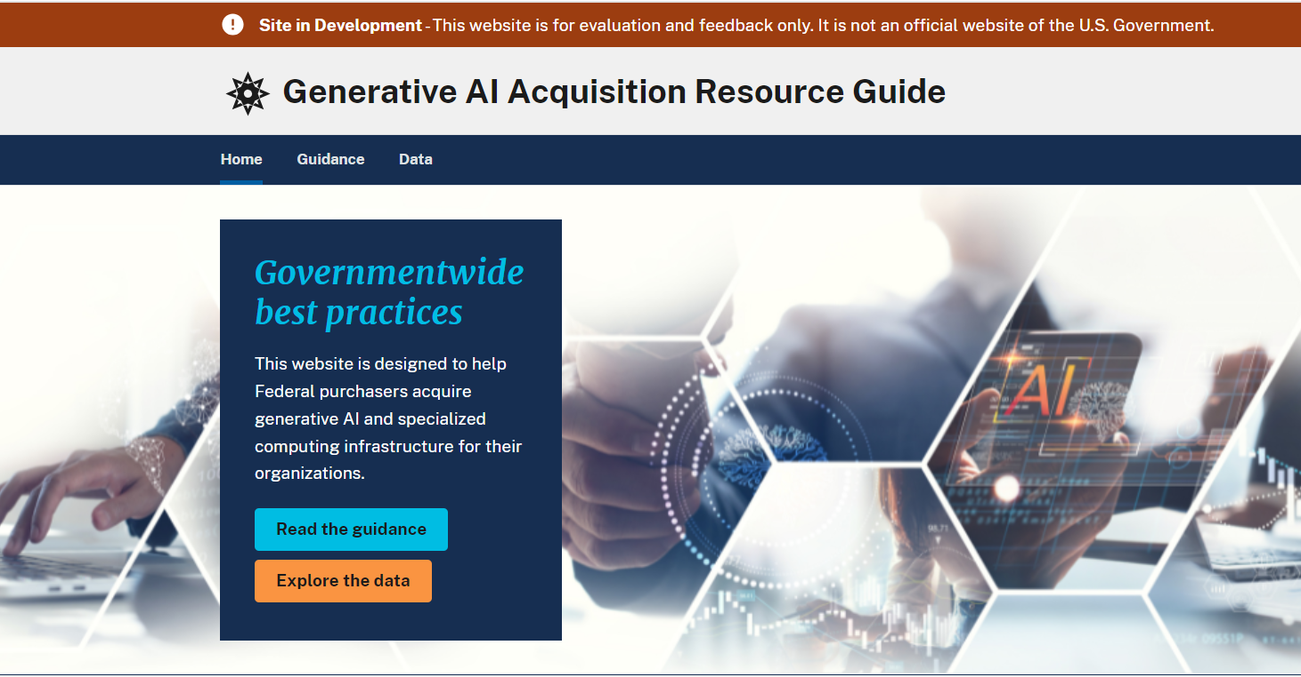
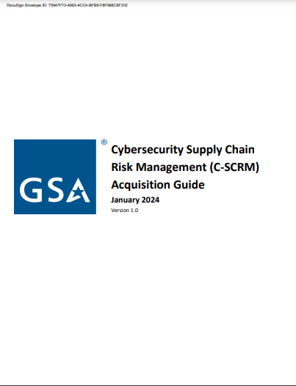

Slide 30
FY 2023 Data
$38.1B
$1.55B
Total spend through ITC
Agency savings from using ITC vehicles
$8.3 B
$594M
Spend directed to small businesses
State and local spend

Slide 31
Upcoming GSA Training
Future GSA trainings: https://www.gsa.gov/events
Quarterly ITC trainings:
Overview of GSA MAS ITC Pre-Award and Offer Preparation
GWAC Training: Alliant 3, VETs 2, MAS and 8a STARS3
2GIT & GSS BPA
How Do I Keep My GSA MAS Contract Compliant

Slide 32
GSA Customer
Tools for Success

Slide 33
buy.gsa.gov
Overview and Live Demonstration
Notes:
Introduction
Good Day and thank you everyone for attending today.
My name is Gregory Chaney. I am one of your CASE Education Division Program Analyst and I will be presenting you with an overview of Buy.GSA.gov.
The second half of this instructional block will cover the “FAS Policy Library” housed within Buy.GSA.Gov and that will be presented by Brennan Conaway following this overview.
We have a team of the Buy.GSA.gov product owners offering support for today’s training. They will be serving as our resident SME and providing Q&A support. If you have any specific questions during the presentation, please enter those questions in the Q&A POD only.

Slide 34
Agenda
Access & Overview
Registration & Profile
What IS Buy, really?
Overview of Buy tools
Q&A
Notes:
Agenda
Today we will discuss:
Access to and provide an overview of Buy.GSA.gov… which you will hear me refer to as “Buy” throughout today’s training.
We’ll talk about registration and profile creation
Then we’ll learn what Buy actually versus what you might have heard
I’ll provide you with an overview of Buy’s tools via a live demonstration
… and maybe leave some space for Questions and Answers
On the next slide, you’ll see a breakdown of the Buy tools we’ll discuss later on. Some of these you might have used before and there are now all houses conveniently on the Buy.GSA.gov site.

Slide 35
Agenda
Overview of Buy Tools
1
Pricing Suite
CALC+ QuickRate
CALC+ Prices Paid
CALC+ BLS
CALC+ IGCE Tool
2
Acquisition Solution Navigator (ASN)
3
Buy.GSA.gov Document Tools
Document Library
Document Builder
4
Interact
Notes:
Agenda
There are 11 total tools on the Buy site. Here are the 4 major tools we’ll talk about today:
Pricing Suite
CALC+ Quick Rate; - which displays schedule prices - not-to-exceed ceiling prices
CALC+ Prices Paid; - which is a data source that displays prices paid information from all our GSA GWACs
CALC+ BLS; - this is where you can find wage rate information from the Dept. of Labor’s Bureau of Labor Statistics
CALC+ IGCE Tool - where you can build Independent Govt. Cost Estimates.
Due to time constraints we’ll only be demonstrating two of the pricing suite tools today but we’ll learn what each one does.
Acquisition Solution Navigator
Document Library & Document Builder
Interact

Slide 36
Access and Overview

Slide 37
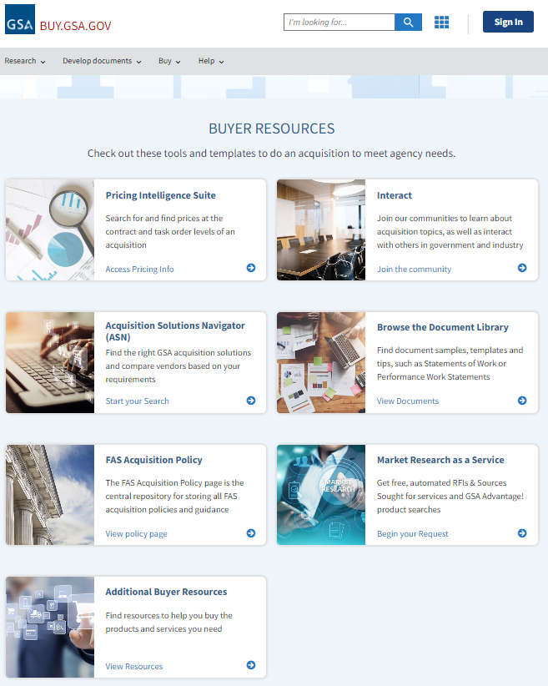
Buy.gsa.gov
Your GSA resources in one place.
Notes:
Navigate the site.
This is what you’ll see when you navigate to the landing site for Buy.GSA.gov.
You’ll see information and tools arranged in tiles, tabs, and menus. And today, I’m going to give you a basic orientation of the site itself.
But first, I wanted to point out these tools are regularly being updated. We encourage your feedback. If you have input / suggestions on how to make them better, please submit them to DX@gsa.gov (Don’t worry about copying that down now… I’ll have that address for you on a slide at the end of this block of the presentation)

Slide 38
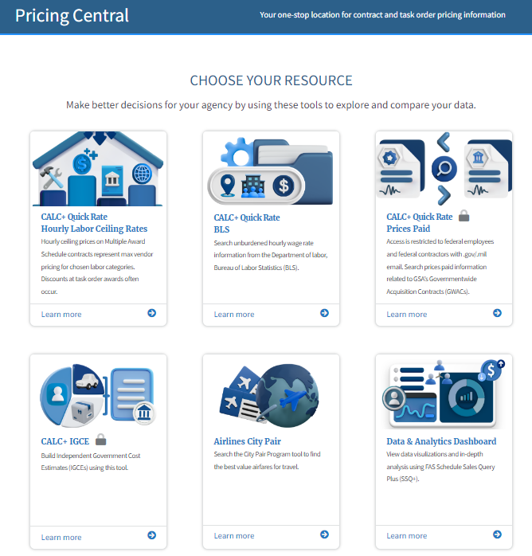
Open to All vs. Registration Required
Notes:
Restricted vs. Open Access
Let’s look at access to Buy.
There is a simple answer to these questions: “Who uses these tools on Buy?” “Who were they curated for?”
Everyone. Everyone can use Buy. The tools were intended to be used by industry and government employees.
There are NO industry specific tools.
That being said, there are tools that are only accessible to users after registration.
For example, in order to use the functionality of the Interact site, you have to be a registered member to post to the platform or ask questions of the community forums. Although, view access is granted to everyone who visits the various forums found on the Interact site.
Another example would be that certain pricing suite tools contain data that only authorized federal users can access. This means that a GSA vendor can be registered for the Buy.GSA site but not be granted access to the restricted tools under the pricing suite.
This will be clearer when we get to the demonstration portion of this presentation.

Slide 39
Registration and Profile

Slide 40
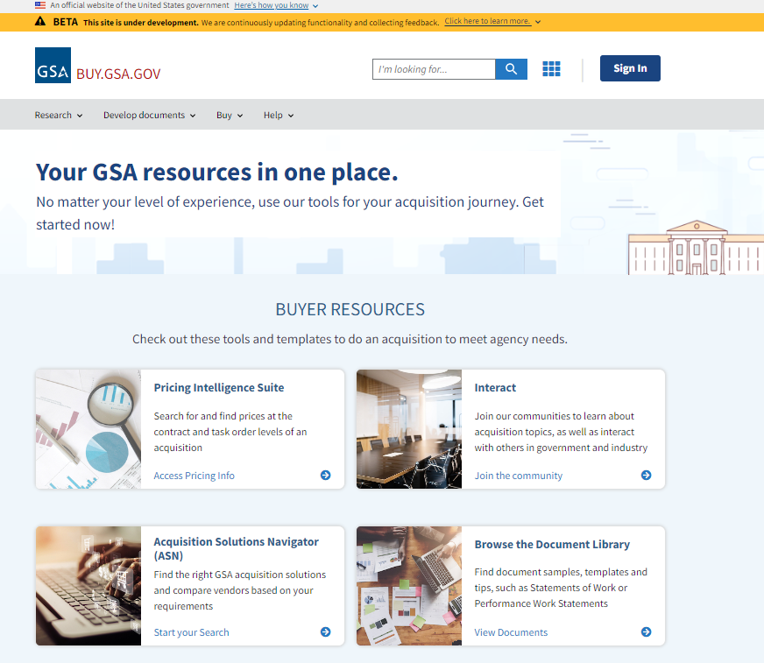
Sign In Required
Notes:
Registration & Profile
Now that we know there are some benefits to being registered - like gaining more access to tools - let’s talk briefly about how to register and the types of registration.
To register, select the “sign-in” button from the top right on the home page.

Slide 41
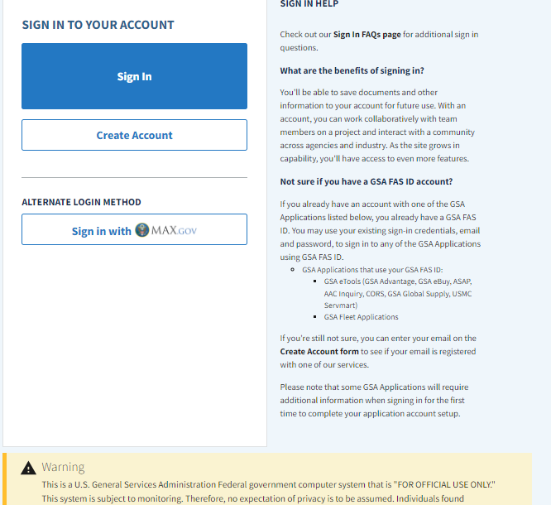
Sign In Required
Notes:
Registration & Profile
From here, registration is pretty straight forward.
Select “Create Account” or sign in using your PIV or government CAC card.

Slide 42
Registration Types
 | Submit Domain & Profile | Additional Process
Industry
Federal Government
State & Local
Contractor
Yes
Select “Industry”
Yes
Yes
Validated by Admin
Yes
Sponsor Needed
Notes:
Buy will automatically ensure data is accessed appropriately by restricting access at the time of registration.
Regardless of your registration type, everyone submits a domain and a profile (click)
Industry just fills out the profile and selects “industry.”
Federal government user registration will be validated by their email domain (.mil/ .gov) We are aware of certain special exceptions (e.g. smithsonian.edu)
State and Local users requesting access will be validated by our IT system admin.
Contractors will need a whitelist request to access certain parts.. and a Sponsor who will need to fill out additional fields and our IT system admin will approve or reject the request.

Slide 43
Benefits of a Buy Profile
Access
Save Resources
Interact Groups
Pricing Suite
FAS Acquisition Policy Library
Interact
Documents
Projects
Team Collaboration
Join
Participate
Save posts
Create content
Notes:
Profiles
The benefits in creating a profile are:
Some parts of Buy require being logged in, before you can view the data.
You also have the Ability to save resources to your account (e.g.
Whether that be documents that you made in the Doc/ Lib. or Doc. Builder.
You can organize your content under “projects”
Work collaboratively with teammates on a project
There is also benefit in Interact:
Join groups, participate in groups, save posts
Create content

Slide 44
What is Buy, really?

Slide 45
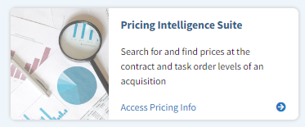
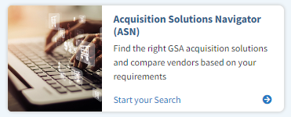
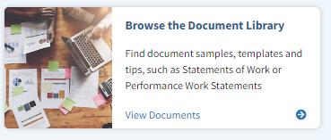
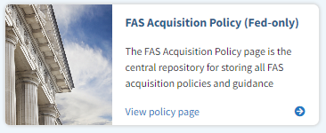
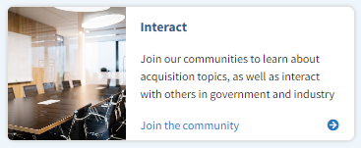
Buy is…
PRE-SOLICTIATION
Market Research
Acquisition Toolbox
Community of Acq Professionals
Notes:
What IS Buy, really?
Buy is PRE-SOLICITATION. All the stuff up front. Research, IGCE, pricing… and there’s CALC which is kind of an exception in that it can be used to fact check proposals. You can use it to determine fair and reasonable.
Buy is MARKET RESEARCH.
Like the Acquisition Solutions Navigator (ASN) is designed to help users do market research by searching NAICS, SIN, Vendor Name, (UEI) Unique Entity Identifier or Contract Number… and our government contract database will provide recommendations.
Buy is a literal ACQUISITION TOOLBOX.
There are a lot of features here that people are NOT aware of. Between all the major tools, we’ve given you the ability to research vendors, SINs, NAICs, descriptions, pricing related to various services and then templates and documents that you can use to jump start your acquisition file. So, Buy is all your GSA resources in one place. All these tools you need, conveniently located.
And then Buy is also a COMMUNITY of ACQ PROFESSIONALS.
Of course, I’m talking about Interact. It’s an online community and forum for industry, federal buyers, and other stakeholders to connect and communicate.
The pricing suite is extremely popular. As of Jan. 2024, CALC+IGCE is over 50% of the traffic on Buy.
ASN has Usability features focused on conducting market research... features like (1) comparing functionalities, (2) export capabilities, and (3) navigation to and between other buy.gsa.gov market research tools.. And all of that is built right into the tool. ASN is focused on market research and curating a plan for a procurement. The ASN tool allows users to search for a need and filter down to a niche set of results based on your requirements. So, there are use cases where a user wants a pull or full list of offerings for other analytic or research purposes, see references to eLibrary or the SAM.gov DataBank (FPDS report builder).
“How is the ASN Contract History page different from the SAM.gov DataBank (FPDS Report Builder)” - The ASN Contract History page is focused on market research in a central location to allow a user to minimize the need to conduct searches across a variation of systems while still not getting their needs met. The contract history page was designed for market research and represents a specially curated set of information that GSA customers typically reference from FPDS when conducting market research. In the case where a user is looking for a full list of FPDS contract history or desires to develop a customized report, that user should utilize the SAM.gov DataBank for Contract Data
“How is ASN different from eLibrary?” – eLibrary is also under the purview of the Buy team, and is the GSA rolodex of contract offerings. It is designed to be the catalog of all offerings available.

Slide 46
Overview of Buy Tools

Slide 47
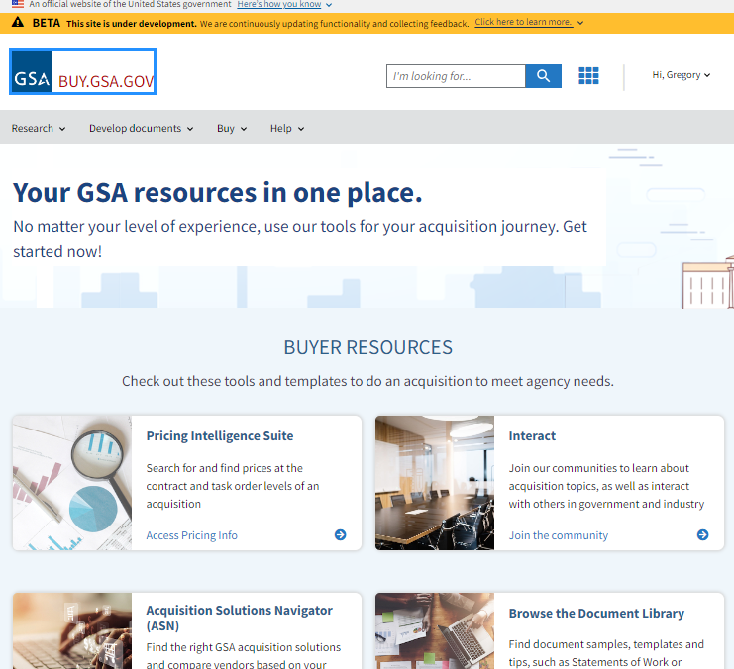
Buy.gsa.gov
Your GSA resources in one place.
Notes:
Navigate the site.
Understanding the tiles, tabs, breadcrumbs, menu… basic orientation of the site itself.
These tools are regularly being updated. If folks have input / suggestions on how to make them better, please submit them to DX@gsa.gov

Slide 48
Buy.gsa.gov: Visit, Explore, and Contribute
GSA is building a better digital experience!
Browse the document library to help quickly find curated samples & templates to jumpstart your requirements development
Use the new project center to collaborate and manage projects
Explore the advanced search engine (keywords, NAICS, SINS)
We welcome your input. Participate in usability testing!
Email the team at DX@gsa.gov
Notes:
Buy.gsa.gov: Visit, Explore, and Contribute
We have mockups and wireframes for our pricing tools that need your eyes on them! E-mail DX@gsa.gov to get involved.
Project Center: collaborate and manage projects across agencies securely!

Slide 49
Questions?
Don’t know where to start?
Wish there was someone to help?
Contact a GSA Customer Service Director (CSD)
Find YOUR CSD here: gsa.gov/CSD
For more information, visit: gsa.gov/FAST

Slide 50
Q & A

Slide 51
Thank You
Notes:
Thank You
Thank you for your time!

Slide 52
Dave Dehon
Customer Service Director for Dept of Labor Accounts
david.dehon@gsa.gov
Joshua Ramos-Crews
Business Management Specialist
joshua.crews@gsa.gov
For more information, visit: gsa.gov/FAST

Slide 53
Thank you for your participation!
For more information, visit: gsa.gov/FAST

