Slide 1


Small Business Needs Big Cybersecurity
AN OFFERING IN THE BLUE CYBER SERIES:
Version 21 Apr 2022
#9 in the Blue Cyber Education Series
Notes:
Photo source Photo by: Air Force photo | VIRIN: 201002-F-ZX772-001.JPG https://www.afnwc.af.mil/News/Photos/igphoto/2002520957/

Slide 2
The importance of Cybersecurity for Department of the Air Force Small Businesses
As small businesses drive innovation and support the Department of the Air Force (DAF) missions with cutting-edge technologies, it is vital we work together to protect DAF sensitive data and networks. Failure to protect our sensitive data will put service members and military missions at risk. We must match the aggressiveness of our cyber adversaries with radical teamwork to bring our small businesses up-to-speed in the most modern methods for comprehensive protection of DAF sensitive data and networks.
The DAF CISO Office Blue Cyber education series is the early partnership with the Defense Industrial Base (DIB) which enables small businesses to bake-in cybersecurity and move forward at the speed of innovation. Pairing small businesses with the most modern cyber protection methods in the industry, better positions DIB small businesses to protect sensitive information and networks just soon as they have a contract to innovate for the DAF. Small businesses are equally vulnerable to cyber threats and may have fewer resources than larger businesses with which to counter cyber threats. The key to protecting our DAF Airmen and Guardians in the exercise of their missions is getting an early start embracing our common cybersecurity and data protection goals by working together to create layered cyber defenses for the DIB small businesses.
This presentation will take you through the vital areas of cybersecurity collaboration for small businesses.

Slide 3
Federal Acquisition Regulation (FAR) and DFARS
Even if your contract is not DOD – there will be similar requirements
Small Business contracts contains many FARS and DFARS, you must study them at length. These are not all of them, but these are some key security requirements.
What is a DFARS? The Defense Federal Acquisition Regulation Supplement (DFARS) contains requirements of law, DoD-wide policies, delegations of Federal Acquisition Regulation (FAR) authorities, deviations from FAR requirements, and policies/procedures that have a significant effect on the public.
DFARS Clause 252.239-7010
Cloud Computing Services
FAR Clause
252.204-21
Basic Safeguarding
of Covered
Contractor
Information Systems
DFARS Clause
252.204-7012, Safeguarding Covered Defense Information and Cyber Incident Reporting
DFARS Clause 252.204-7008 Compliance with safeguarding
covered defense information controls
DFARS Clause 252.204-7019/7020
NIST SP 800-171 DoD Assessment Requirements.
DFARS Clause
252.204-7021
Cybersecurity Maturity Model Certification Requirement

Slide 4
DFARS Clause 252.239-7010 ― Cloud Computing Services
Applies when a cloud solution is being used to process data on the DoD's behalf or DoD is contracting with Cloud Service Provider to host/process data in a cloud
Ensures that the cloud service provider:
  Meets requirements of the DoD Cloud Computing Security Requirements Guide
  Use government-related data only to manage the operational environment that supports the Government data and for no other purpose
  Complies with requirements for cyber incident reporting and damage assessment
DFARS Clause 252.204-7012, Safeguarding Covered Defense Information and Cyber Incident Reporting, applies when a contractor intends to use an external cloud service provider to store, process, or transmit covered defense information in the performance of a contract. DFARS Clause 252.204-7012 requires the cloud service provider to meet security requirements equivalent to those established for the Federal Risk and Authorization Management Program (FedRAMP) Moderate baseline.
Notes:
https://www.acq.osd.mil/dpap/dars/dfars/html/current/252239.htm
Definition. “Cloud computing,” as used in this provision, means a model for enabling ubiquitous, convenient, on-demand network access to a shared pool of configurable computing resources (e.g., networks, servers, storage, applications, and services) that can be rapidly provisioned and released with minimal management effort or service provider interaction. This includes other commercial terms, such as on-demand self-service, broad network access, resource pooling, rapid elasticity, and measured service. It also includes commercial offerings for software-as-a-service, infrastructure-as-a-service, and platform-as-a-service.
Government-related data means any information, document, media, or machine readable material regardless of physical form or characteristics that is created or obtained by a contractor through the storage, processing, or communication of Government data. This does not include contractor's business records e.g. financial records, legal records etc. or data such as operating procedures, software coding or algorithms that are not uniquely applied to the Government data.
Government data means any information, document, media, or machine readable material regardless of physical form or characteristics, that is created or obtained by the Government in the course of official Government business.
FedRamp Moderate Baseline description https://www.fedramp.gov/assets/resources/documents/FedRAMP_Security_Controls_Baseline.xlsx
Question
Q99: Can you clarify when DFARS Clause 252.239-7010 applies to cloud computing services and when DFARS Clause 252.204-7012 applies?
A99: DFARS Clause 252.239-7010, Cloud Computing Services, applies when a cloud solution is being used to process data on the DoD's behalf, or DoD is contracting with a Cloud Service Provider to host or process data in a cloud. DFARS Clause 252.239-7010 requires the cloud service provider to comply with the DoD Cloud Computing Security Requirements Guide and to comply with requirements for cyber incident reporting and damage assessment.
DFARS Clause 252.204-7012, Safeguarding Covered Defense Information and Cyber Incident Reporting, applies when a contractor intends to use an external cloud service provider to store, process, or transmit covered defense information in the performance of a contract. DFARS Clause 252.204-7012 requires the cloud service provider to meet security requirements equivalent to those established for the Federal Risk and Authorization Management Program (FedRAMP) Moderate baseline.

Slide 5
FAR Clause 52.204-21 Basic Safeguarding of Covered Contractor Information Systems
Safeguarding requirements and procedures
(1) The Contractor shall apply the following basic safeguarding requirements and procedures to protect covered contractor information systems. Requirements and procedures for basic safeguarding of covered contractor information systems shall include, at a minimum, the following security controls:
- The FAR lists 15 security controls, which are considered basic cyber hygiene
(2) Other requirements. This clause does not relieve the Contractor of any other specific safeguarding requirements specified by Federal agencies and departments relating to covered contractor information systems generally or other Federal safeguarding requirements for controlled unclassified information (CUI) as established by Executive Order 13556.
Flow-down the requirement
The Contractor shall include the substance of this clause, including this paragraph (c), in subcontracts under this contract (including subcontracts for the acquisition of commercial items, other than commercially available off-the-shelf items), in which the subcontractor may have Federal contract information residing in or transiting through its information system.
Notes:
https://www.acquisition.gov/far/52.204-21-0

Slide 6

DFARS Clause 252.204-7012,
Safeguarding Covered Defense Information and Cyber Incident Reporting
Report cyber incidents
Submit malicious software
Facilitate damage assessment
Safeguard covered defense information
Notes:
https://business.defense.gov/Portals/57/Safeguarding%20Covered%20Defense%20Information%20-%20The%20Basics.pdf
https://www.acq.osd.mil/dpap/dars/dfars/html/current/252239.htm#252.239-7012

Slide 7
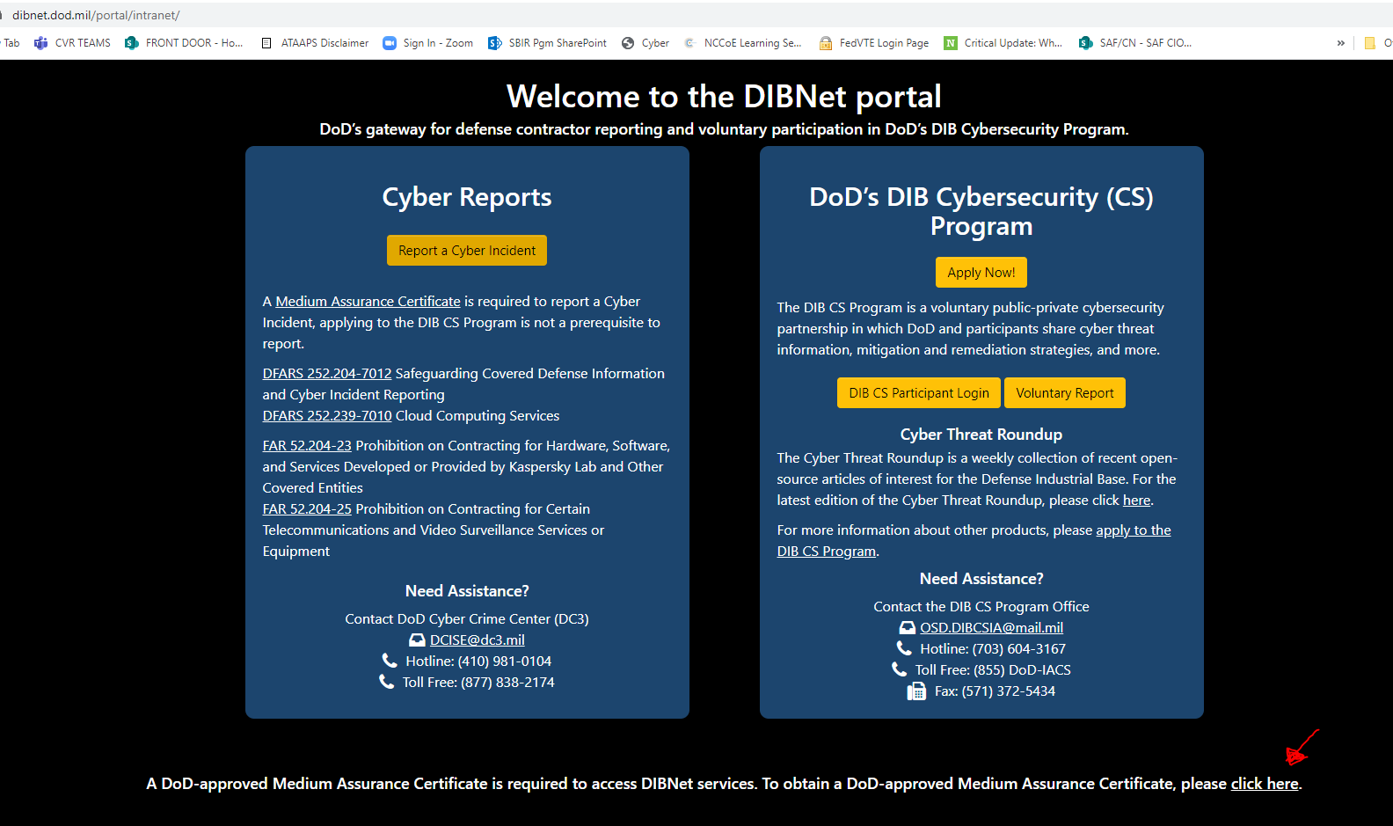
Welcome to the DIBNet portal
https://
dibnet.dod.mil
DISTRIBUTION C. Distribution authorized to U.S. Government Agencies and their contractors
Notes:
Red Arrow – it will take 72 hours to get the Medium Assurance Certificate – go ahead
DOD DIB CS is for contractors working with Classified contracts. An unclassified contractor pilot is underway – more news in January 2022

Slide 8
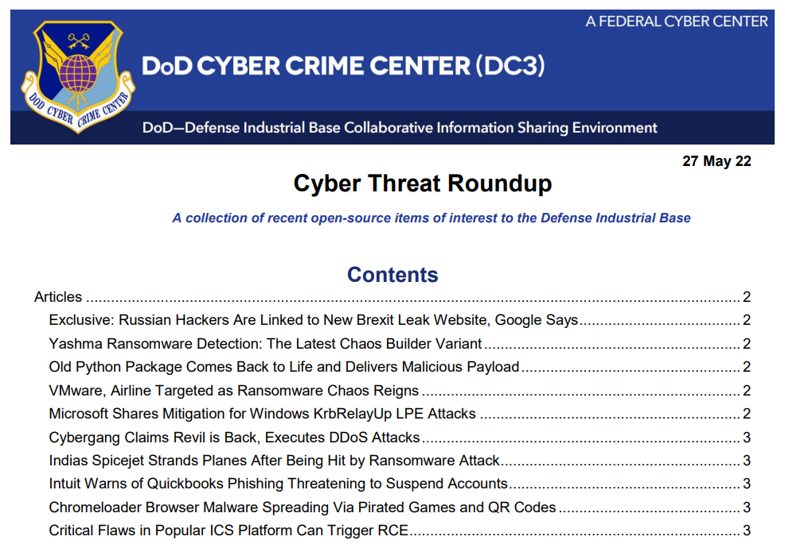
Distribution Statement A: Approved for public release. Distribution is unlimited. Case Number: AFRL-2021-3218, 22 September 2021.
Notes:
https://dibnet.dod.mil/portal/rest/jcr/repository/collaboration/sites/intranet/web%20contents/site%20artifacts/public-content/Cyber%20Threat%20Roundup.pdf

Slide 9
Safeguard Covered Defense Information (CDI)
To safeguard covered defense information contractors/subcontractors must implement NIST SP 800-171, Protecting CUI in Nonfederal Information Systems and Organizations
The covered contractor information system shall be subject to the security requirements in National Institute of Standards and Technology (NIST) Special Publication (SP) 800-171
  The Contractor shall implement NIST SP 800-171, as soon as practical, but not later than December 31, 2017.
  The Contractor shall submit requests to vary from NIST SP 800-171 in writing to the Contracting Officer, for consideration by the DoD CIO
Notes:
https://www.acquisition.gov/dfars/252.204-7020-nist-sp-800-171-dod-assessment-requirements.
Will the DoD monitor contractors to ensure implementation of the required security requirements?
The DFARS rule does not add any unique/additional requirements for the DoD to monitor contractor implementation. Nor does the rule require “certification” of any kind, either by DoD or any other firm professing to provide compliance, assessment, or certification services for DoD or Federal contractors. The DoD will not recognize 3rd party assessments or certifications. By signing the contract, the contractor agrees to comply with the terms of the contract. The contractor’s system security plan (SSP) – required by NIST SP 800-171 - documents how the organization meets, or plans to meet, the NIST SP 800-171 requirements. When requested by the requiring activity, the SSP (or elements of the SSP) may be used to demonstrate implementation of NIST SP 800-171 or to inform a discussion of risk between the contractor and requiring activity.
https://business.defense.gov/Portals/57/Safeguarding%20Covered%20Defense%20Information%20-%20The%20Basics.pdf

Slide 10
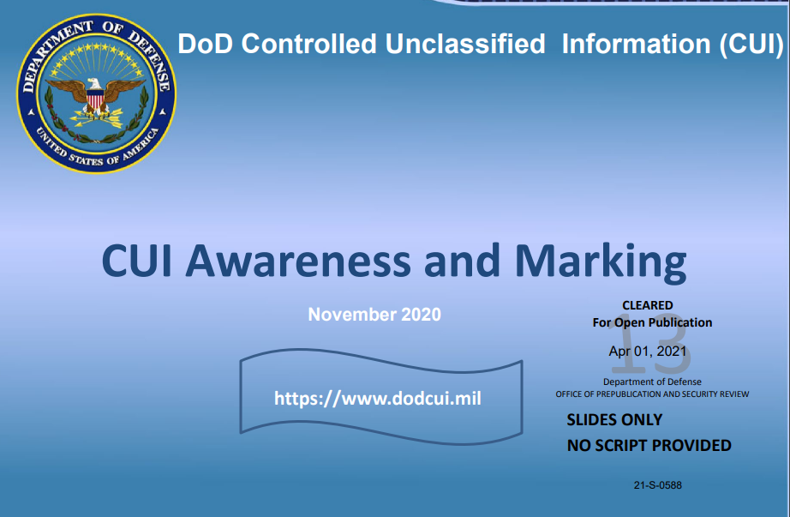
Safeguard CDI: What is CUI?
The DOD CUI Registry and detailed training on what constitutes CUI is available from the DOD at this link: https://www.dodcui.mil
Notes:
https://business.defense.gov/Portals/57/Safeguarding%20Covered%20Defense%20Information%20-%20The%20Basics.pdf
Who is responsible for identifying and marking covered defense information? The DoD requiring activity is responsible for identifying covered defense information (CDI) in accordance with DoD procedures for identification and protection of controlled unclassified information found in DoDM 5200.01 Vol 4, DoD Information Security Program: Controlled Unclassified Information (CUI). The requiring activity is also responsible for determining the appropriate marking for the CDI in accordance with the procedures for applying distribution statements on technical documents found in DoDM 5200.01 Vol 4 and DoDI 5230.24, Distribution Statements on Technical Documents. The requiring activity must document in the Statement of Work that CDI is required for performance of the contract, and specify requirements for the contractor to mark the CDI developed in the performance of the contract
CUI Training https://www.cdse.edu/documents/student-guides/IF141-guide.pdf
SUBJECT: Strategically Implementing Cybersecurity Contract Clauses https://www.acq.osd.mil/dpap/pdi/cyber/docs/USA000261-19%20USD%20Signed%20TAB%20A.pdf
HIPPA and PII

Slide 11
Can I give my contractor CUI?
DFARS 7012 “Adequate Security” quote red added for emphasis
… (b) Adequate security. The Contractor shall provide adequate security on all covered contractor information systems. To provide adequate security, the Contractor shall implement, at a minimum, the following information security protections:
…
(1) For covered contractor information systems that are part of an Information Technology (IT) service or system operated on behalf of the Government, the following security requirements apply:
(i) Except as provided in paragraph (b)(2)(ii) of this clause, the covered contractor information system shall be subject to the security requirements in National Institute of Standards and Technology (NIST) Special Publication (SP) 800-171, “Protecting Controlled Unclassified Information in Nonfederal Information Systems and Organizations” in effect at the time the solicitation is issued or as authorized by the Contracting Officer.
(ii)(A) The Contractor shall implement NIST SP 800-171, as soon as practical, but not later than December 31, 2017. …
Notes:
https://www.acq.osd.mil/dpap/dars/dfars/html/current/252204.htm#252.204-7012
https://www.acq.osd.mil/dpap/dars/dfars/html/current/252204.htm#252.204-7020 = DFARS 7020 NIST SP 800-171 DOD ASSESSMENT REQUIREMENTS
https://www.acq.osd.mil/dpap/pdi/cyber/docs/NIST%20SP%20800-171%20Assessment%20Methodology%20Version%201.2%20%206.24.2020.pdf

Slide 12
Answer today: Can I give my contractor CUI? You need to ask.
Yes, if:
The decision to share CUI is a risk-based decision based upon a conversation with the contractor regarding if they are ready to provide adequate protection to DoD CUI.
There is not a cut and dried answer rubric.
CUI protection is a shared responsibility between the DoD and industry.
Adequate security will vary depending on the nature and sensitivity of the information on any given non-DoD information system.
See DFARS 252.204-7012 “Safeguarding Covered Defense Information and Cyber Incident Reporting, December 2019,” “Section b”, for a description of “Adequate Security”
If you need help with this decision, please contact your Program or Wing cybersecurity office. Also, Kelley Kiernan from the DAF CISO Office is available to talk with you. Keep your contracting officer informed of your activities.
This question is being studied across the DOD – check back for an updated answer

Slide 13
DFARS Clause 252.204-7008 Compliance with safeguarding
covered defense information controls
States “By submission of this offer, the Offeror represents that it will implement the security requirements specified by NIST SP 800-171, … not later than December 31, 2017.
If the Offeror proposes to vary from any of the security requirements specified by NIST SP 800-171 …, the Offeror shall submit to the Contracting Officer, for consideration by the DoD Chief Information Officer (CIO), a written explanation of:
  Why a particular security requirement is not applicable
  How an alternative but equally effective, security measure is used to compensate for the inability to satisfy a particular requirement and achieve equivalent protection.
  An authorized representative of the DoD CIO will adjudicate offeror requests to vary from NIST SP 800-171 requirements in writing prior to contract award. Any accepted variance from NIST SP 800-171 shall be incorporated into the resulting contract.
Notes:
https://www.law.cornell.edu/cfr/text/48/252.204-7008

Slide 14
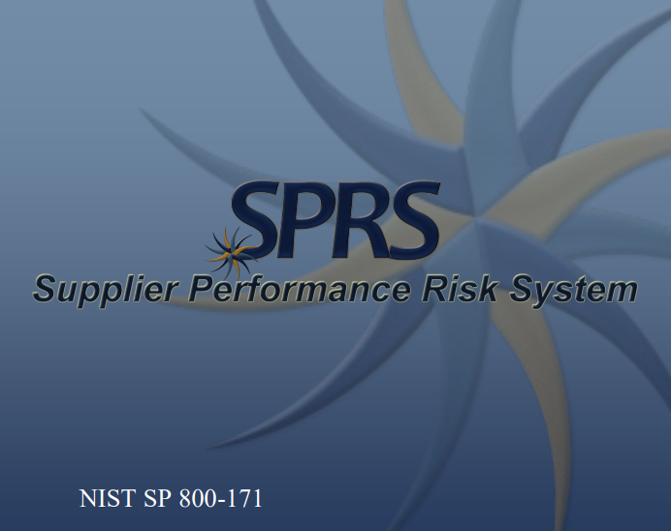
DFARS Clause 252.204-7019/7020
NIST SP 800-171 DoD Assessment Requirements.
Self-Assessment
photo
Submit information to SPRS.CSD.DISA.MIL
Flow the Requirement Down
Update your Self-Assessment
Notes:
https://business.defense.gov/Portals/57/Safeguarding%20Covered%20Defense%20Information%20-%20The%20Basics.pdf

Slide 15
The Requirement in DFARS Clause 252.204-7019/7020
NIST SP 800-171 DoD Assessment Requirements
In order to be considered for award, if the Offeror is required to implement NIST SP 800-171, the Offeror shall have a current assessment for each covered contractor information system that is relevant to the contract.
A Basic Assessment, which is a self-assessment assigned a low confidence level (because it is self-generated) is:
  Based on the Contractor’s review of their system security plan(s) associated with covered contractor information system(s)
  Conducted in accordance with the NIST SP 800-171 DoD Assessment Methodology

Slide 16
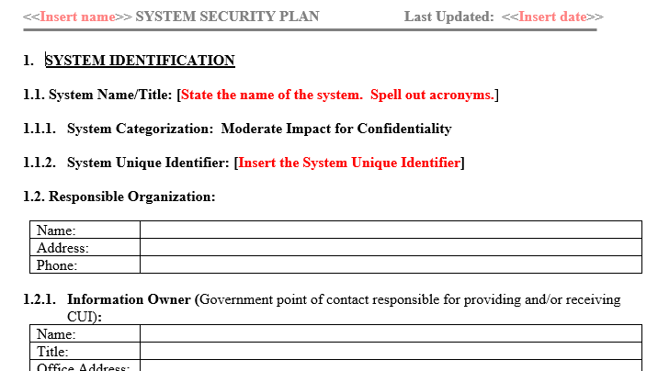
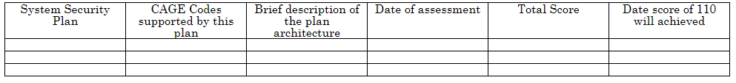
NIST SP 800-171 System Security Plan (SSP)
Optional Template available on NIST.Gov
Optional Template to record the Plan of Action on NIST.gov

Slide 17
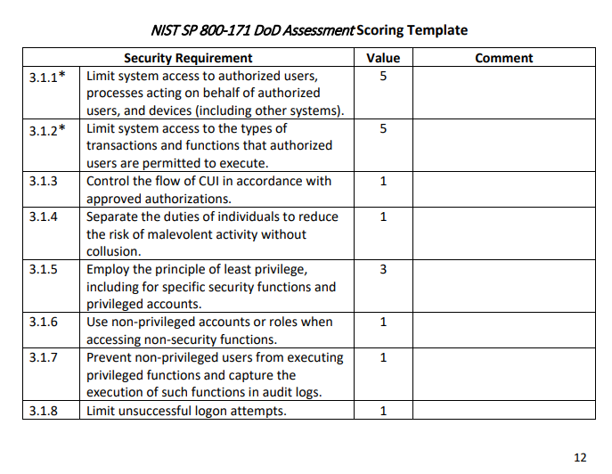
Not all of the NIST SP 800-171 security requirements are equal
The NIST SP 800-171 DoD Assessment Methodology identifies 42 security requirements that, if not implemented, could lead to significant exploitation of the network, or exfiltration of DoD CUI.
These high-risk security requirements are with 5 points in the DoD scoring rubric.
For example, Failure to limit system access to authorized users (Requirement 3.1.1) renders all the other Access Control requirements ineffective, allowing easy exploitation of the network
For example, Failure to control the use of removable media on system components (Requirement 3.8.7) could result in massive exfiltration of CUI and introduction of malware.
Notes:
NIST SP 800-171 DoD Assessment Methodology Link https://www.acq.osd.mil/dpap/pdi/cyber/docs/NIST%20SP%20800-171%20Assessment%20Methodology%20Version%201.2.1%20%206.24.2020.pdf

Slide 18
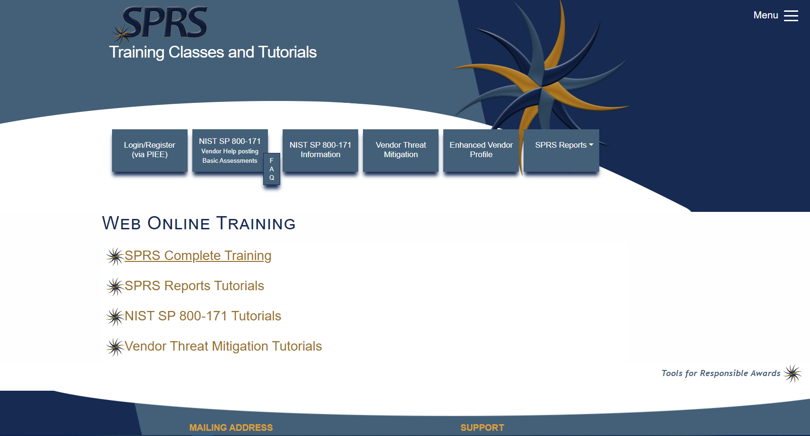
How to enter a Basic Assessment Data into SPRS
Post or email your business’ summary level scores of a current NIST SP 800-171 DoD Assessment to SPRS for all covered contractor information systems relevant to the contract.
Your entry consists of
  A system security plan (NIST SP 800-171 item 3.12.4) supporting the performance of a DoD contract—)
  Summary level score (e.g., 95 out of 110, NOT the individual value for each requirement) using the NIST SP 800-171 DoD Assessment Methodology
  Date that all requirements are expected to be implemented (i.e., a score of 110 is expected to be achieved) based on information gathered from associated plan(s) of action developed in accordance with NIST SP 800-171
The SPRS website offers numerous training videos which will help you get an account and make your entry
Notes:
Image source from https://www.sprs.csd.disa.mil

Slide 19
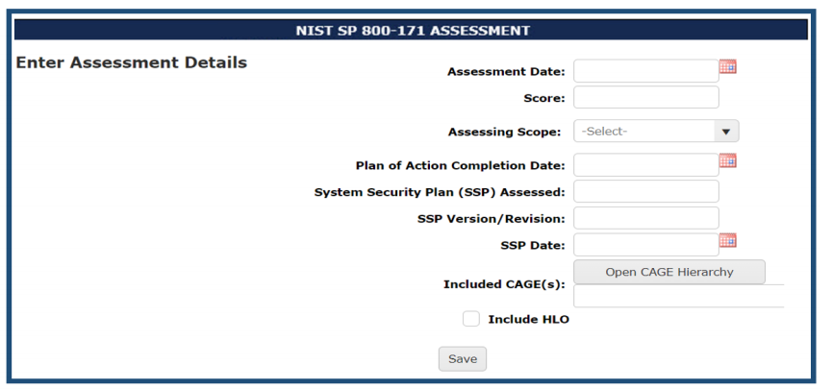
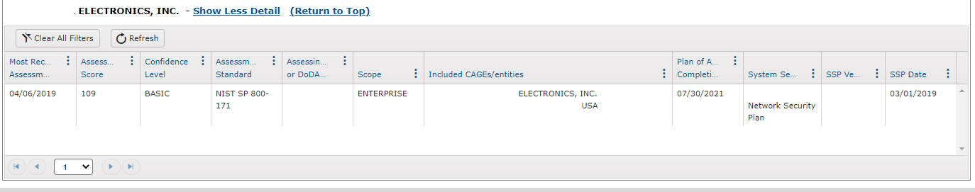
How to enter a Basic Assessment Data into SPRS
SPRS Basic Assessment data entry fields
Example output
of SPRS Basic Assessment

Slide 20
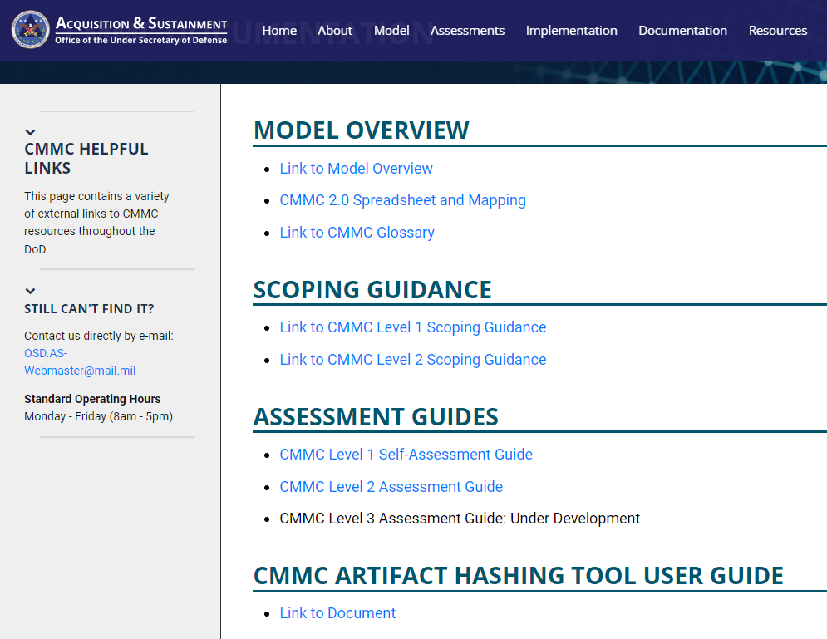
New Documentation Guides
https://www.acq.osd.mil/cmmc

Slide 21
DFARS Clause 252.204-7021
Cybersecurity Maturity Model Certification Requirement
This DFARS is under review and it’s status will not be known until early 2023 at the earliest.
Until then, compliance with and full implementation of DFARS Clause 252.204-7012, “Safeguarding Covered Defense Information and Cyber Incident Reporting” is sufficient.
For more information on the new version of CMMC, see this great webinar by the DCMA Director John Ellis. https://www.preveil.com/resources/webinar-john-ellis-on-cmmc-2-0/
Stay up-to-date at www.acq.osd.mil/cmmc/
Notes:
https://www.acquisition.gov/dfars/252.204-7021-cybersecurity-maturity-model-certification-requirements.

Slide 22
New Documentation Guides
https://www.acq.osd.mil/cmmc

Slide 23
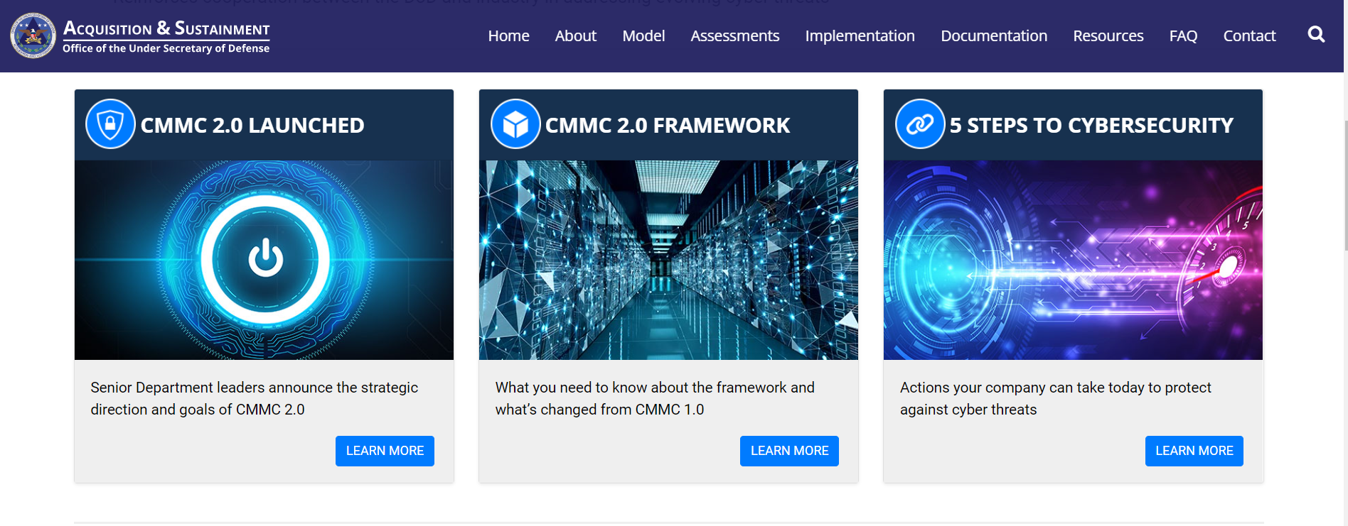
Distribution Statement A: Approved for public release. Distribution is unlimited. Case Number: AFRL-2021-4521, 22 Dec 2021
www.acq.osd.mil/cmmc

Slide 24
AN OFFERING IN THE BLUE CYBER SERIES:
Air Force and
Space Force CISO
Blue Cyber
Small Business Contractor Cybersecurity Initiative
3 May 2022
Notes:
Photo source Photo by: Air Force photo | VIRIN: 201002-F-ZX772-001.JPG https://www.afnwc.af.mil/News/Photos/igphoto/2002520957/

Slide 25
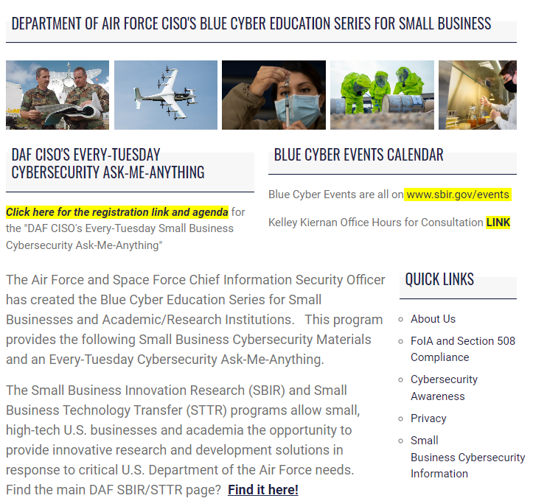
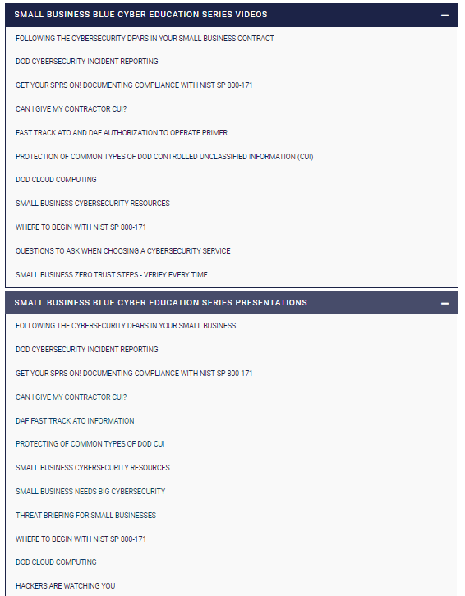
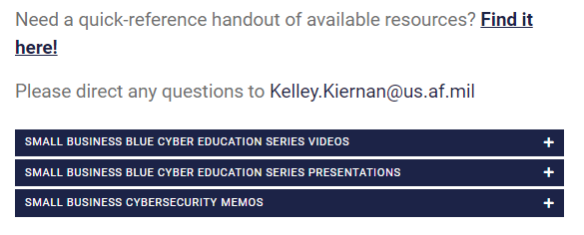
The Blue Cyber Education Series for Small Businesses on the
DAF CISO webpage www.safcn.af.mil/CISO/Small-Business-Cybersecurity-Information/
Daily Office Hours for answering/researching your questions about Small Business cybersecurity and data protection!
Every Tuesday 1pm EST, dial in for the Small Business Cybersecurity Ask-Me-Anything. Register in advance for this Zoom Webinar: https://www.zoomgov.com/webinar/register/WN_6Gz84TQGRvm6YHMSVyE0Qg
40 Total Presentations

Slide 26
Blue Cyber Education Series
  Blue Cyber is outreach to contractors and academic/research institutions to ensure they are aware of the cybersecurity requirements in their contracts and all the national resources available to them.
  Blue Cyber goal and mission: Ensuring no Small Business contractor or potential contractor is sitting with any cybersecurity or information protection question.
  Blue Cyber provides resource information for Small Business contractors to help them reach NIST SP 800-171 and CUI-protection compliance
  Forty, short, ultra-relevant cybersecurity presentations on the modern Blue Cyber webpage providing outreach to Small Businesses on their cybersecurity requirements as Contractors; final products are ultra-modern 3-5 minute videos.
  Every-Tuesday, Cybersecurity Ask-Me-Anything, 1pm Eastern presentations, speakers and your questions answered every-Tuesday. Registration link on the Blue Cyber webpage or sbir.gov/events
  Daily Office Hours to provide cybersecurity and resource counseling email Kelley.Kiernan@us.af.mil for access to Office Hours each day.

Slide 27
Blue Cyber Content
Following the Cybersecurity DFARS
DoD Cyber Incident Reporting
Get your SPRS On – DOD Self-Assessment of NIST SP 800-171
Can I give my Contractor CUI? You have to Ask.
Fast Track ATO – ATO Primer
Small Businesses Cyber Resources for Success!
DoD Cloud computing
DIB Unclassified Small Business Cyber Threats Briefing
C-SCRM Primer
SB needs Big Cybersecurity
Where to begin with NIST SP 800-171?
Hardening MS Windows for 800-171
Common Types of CUI Information
Questions to ask an IT service provider
FAR Clause 252.204-21 /pro CMMC Level 1
Zero Trust Steps for Small Businesses
Privacy - future
Encryption Primer for NIST SP 800-171
Policies and Procedures for NIST SP 800171
Proposed CMMC 2.0 Explained

Slide 28
Blue Cyber Collaboration
Army, Navy, SOCOM, DHS, NSA, CISA
MDA, NGA, DARPA, DISA, DTRA, DLA, GSA
AFOSI/DC3, DCISE, DOD IG, NSA
Microsoft, Google and AWS
DOD CIO-CMMC PMO
JAIC
DAU, MIT, COGR, APLU, Educause,
CYBERWERX, SpaceWERX
SBA, DOD SB, DAF SB Offices
DAF T3 Partnership Intermediaries
NIST, DCMA, DIBCAC
Air Force Concepts, Development Mgt Office
of Commercial and Economic Analysis
American Association of Community Colleges
State of CA Governor's Office for Innovation, Federal Lab Consortium, AUTM Association of University Technology
DOD OLDCC - Local Defense Community Cooperation
SAF/CN, SAF/SB, SAF/AA, SAF/CN, SAF AQC
NISN, AFWERX, Army Futures Command, NAVALX
LM, EXOSTAR,
DAF Authorizing Officials

Slide 29
Blue Cyber Demand Signal
Over 5.8K Air Force/Space Force Small Businesses supported since inception April 2021
Over 9K Small Businesses supported since inception April 2021
1,076
Started Tracking by Service
Found 9.5K DAF SB emails
Blue Cyber Initiation
Blue Cyber FOC/Now all public events

Slide 30
Blue Cyber Boot Camp – 16 March 2022
Six hours of Blue Cyber content and Guest Speakers
1,078 Registrants
  76% Small Businesses
    100% under 400 employees
    60% under 50 employees
    51% USAF or USSF
626 Unique Attendees – which, because the webinar license limit was 500 attendees, means that people stayed on the queue and joined all day long
  258 Post Event Survey participants
    95% “Yes” – “Would you Recommend Blue Cyber to other Small Businesses?”
    92% “Yes” – “Did you find the material interesting and useful?”
    41% “Yes” - “Do you need help with your Small Business Cybersecurity? (email Kelley.Kiernan@us.af.mil)”
An email went out at 1030 EDT to all Registrants with a registration link for A Second Blue Cyber Boot Camp scheduled for 20 April 2022

Slide 31
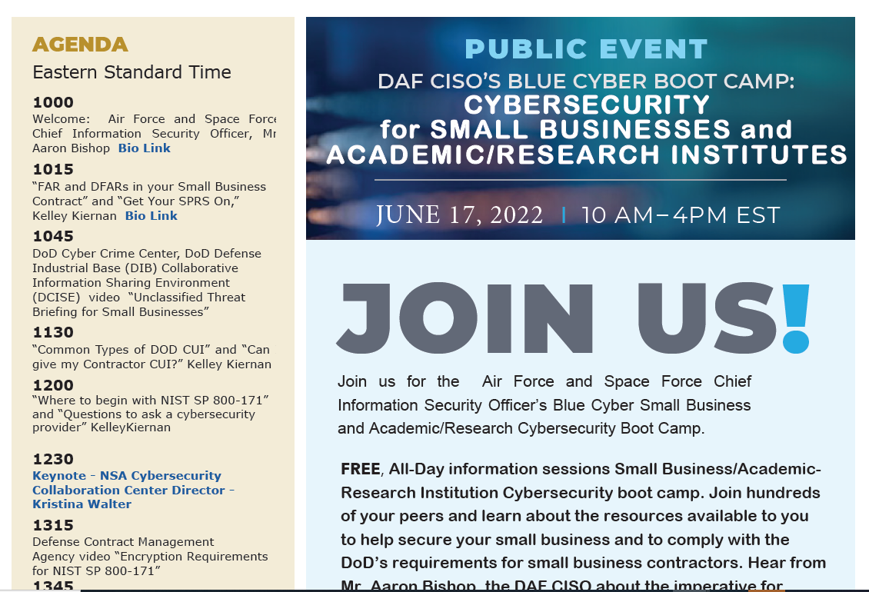
Distribution Statement A: Approved for public release. Distribution is Unlimited. Case Number: AFRL-2022-2176 9 May 2022

Slide 32
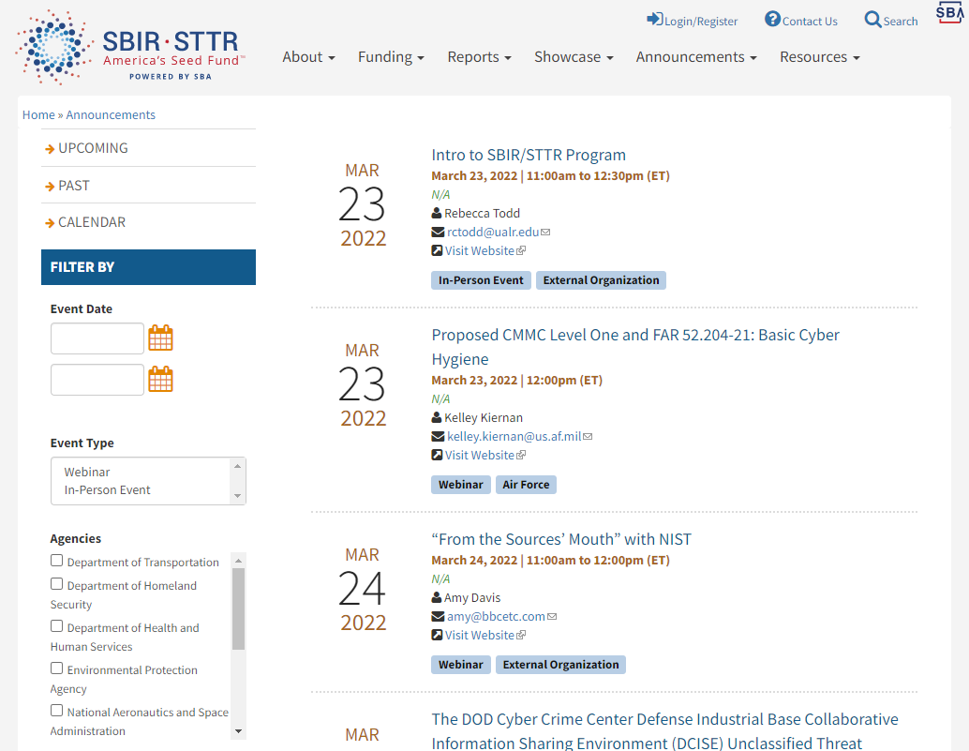
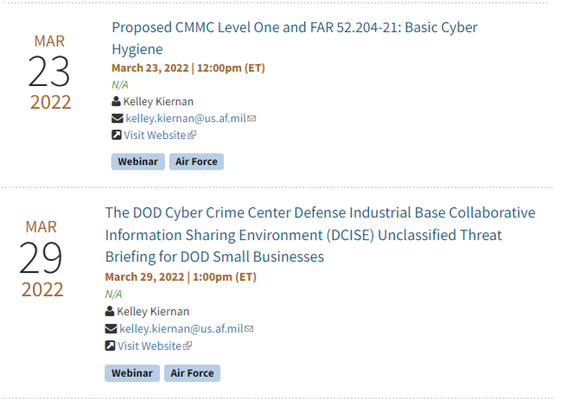
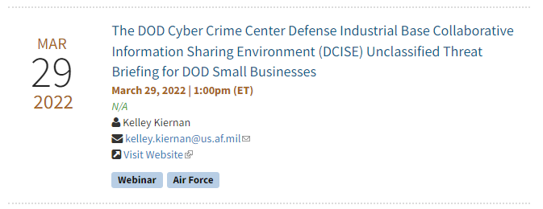
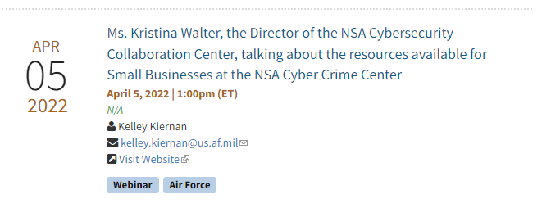
DAF CISO Events are on SBA’s Event Site

Slide 33
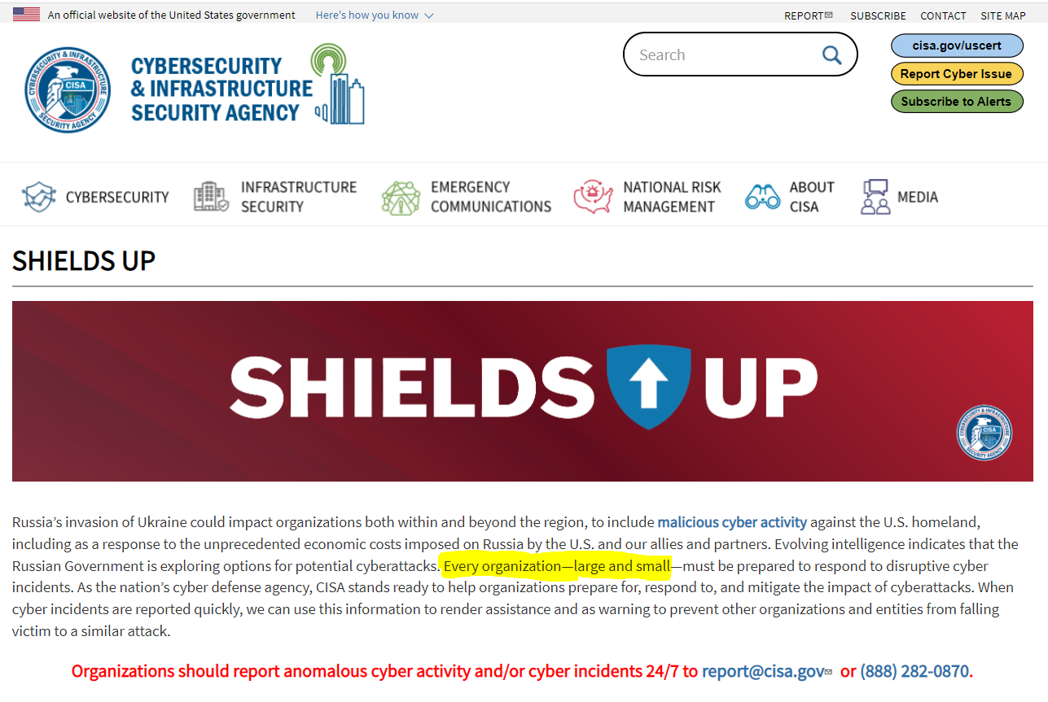
Maintaining Vigilance During Increased Threat Potential
TLP:WHITE
CISA continues to conduct extensive outreach to emphasize importance of remaining vigilant
New Webpage on www.CISA.gov
Encourage all stakeholders to take proactive stance to ensure resiliency in the event of a cyber incident
In response to increased geopolitical tensions and Russian threat potential, CISA created the Shields Up site to promote heightened cybersecurity
Learn more at: https://www.cisa.gov/shields-up
All organizations should report incidents and anomalous activity to CISA and/or the FBI via your local FBI field office or the FBI’s 24/7 CyWatch at (855) 292-3937 or CyWatch@fbi.gov.
awareness and emphasize near term steps to improve resiliency for any U.S. Organization
J.D. Henry
April 18, 2022
10

Slide 34
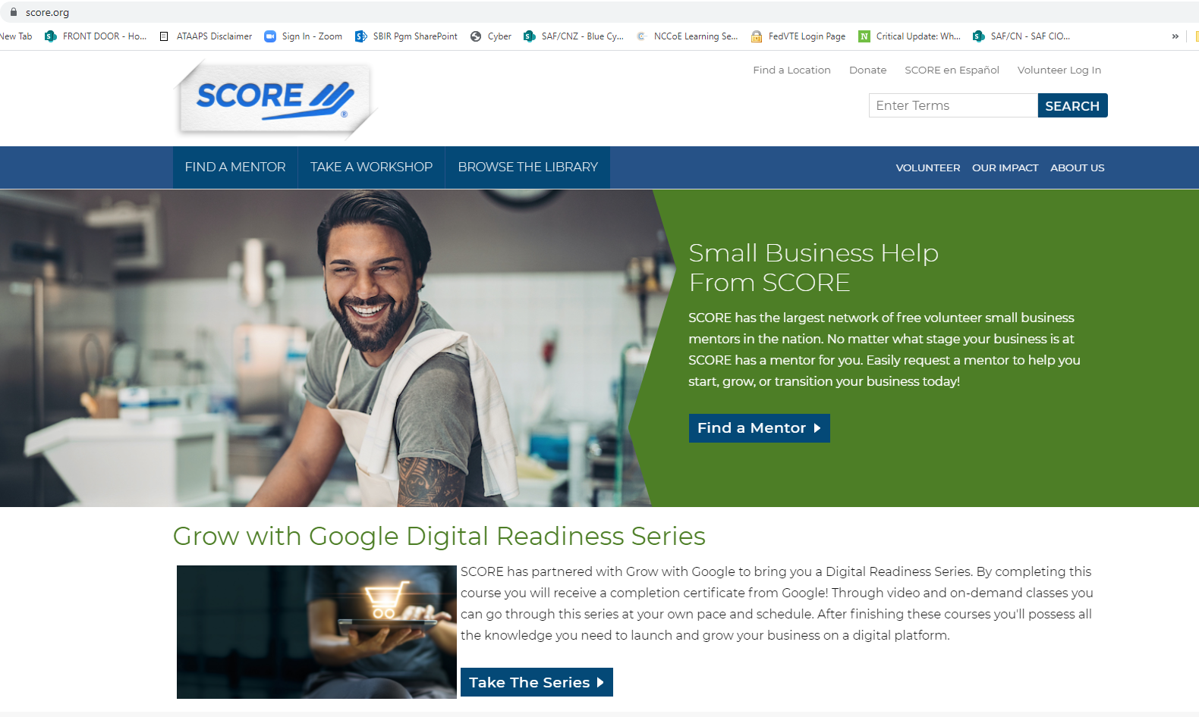
Slide title
Notes:
www.score.org

Slide 35
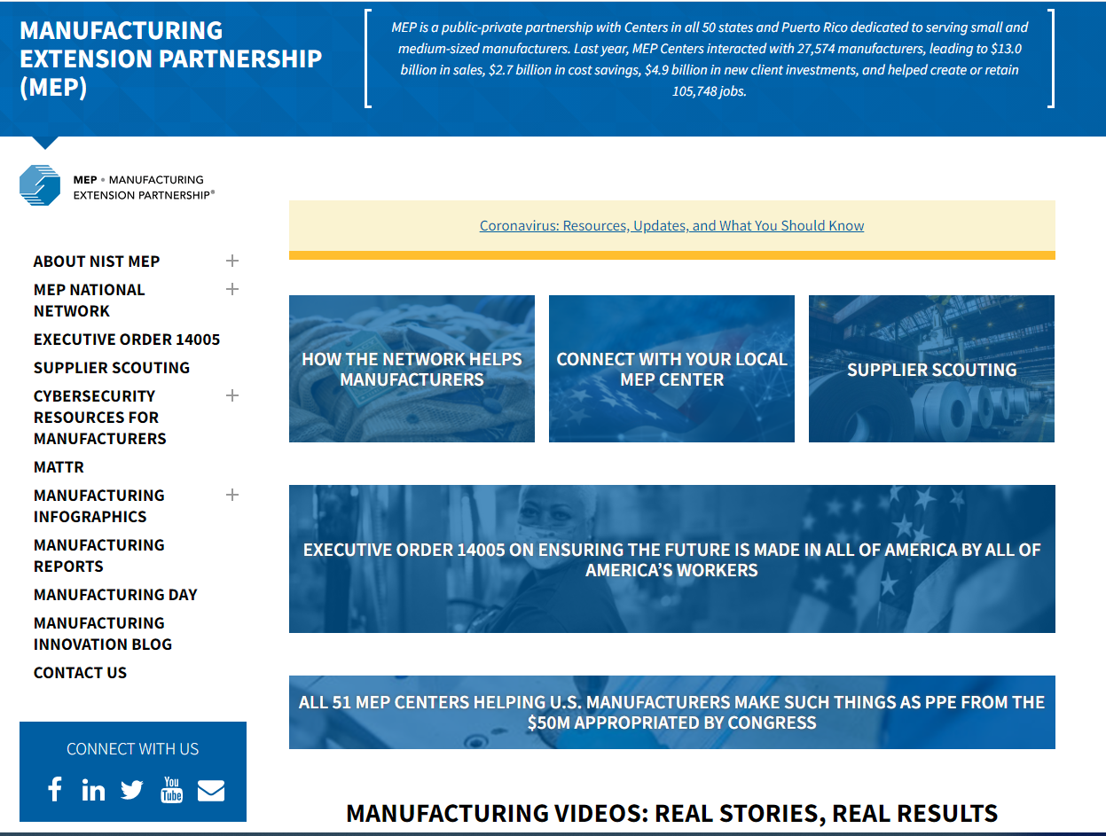
www.nist.gov/mep
www.nist.gov/mep
Notes:
www.nist.gov/mep

Slide 36
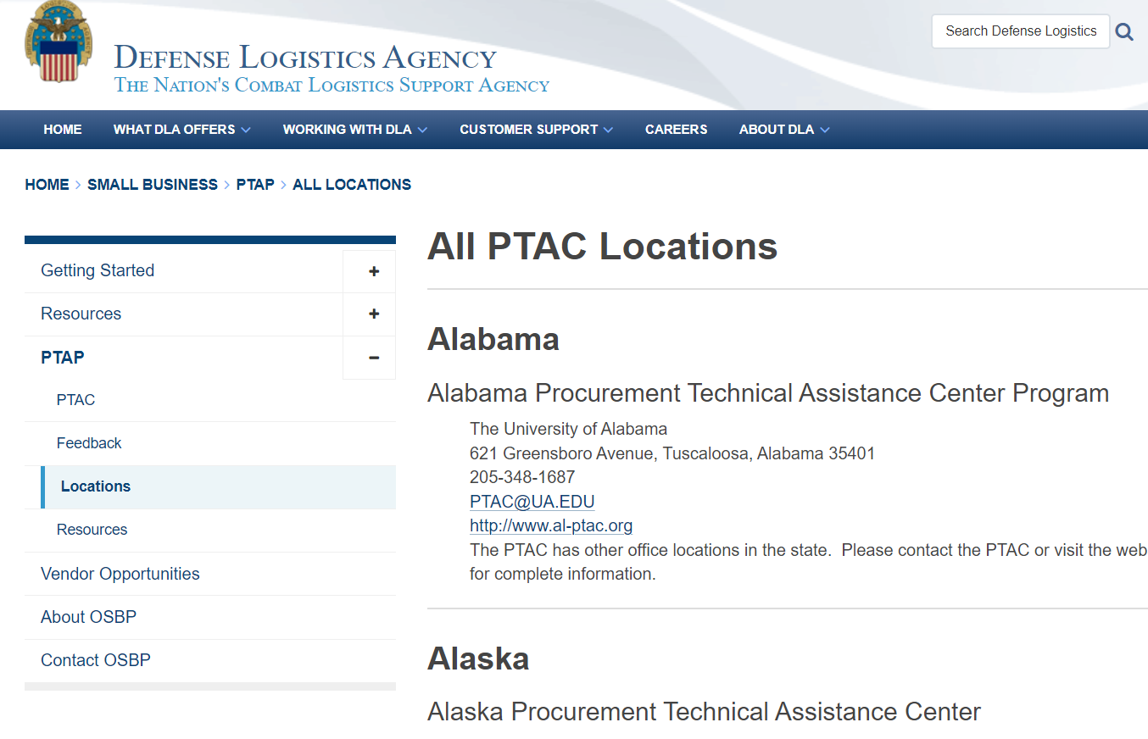
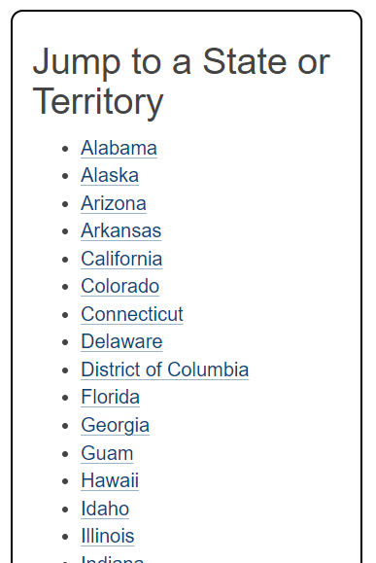
All PTAC Locations
www.dla.mil/Small-Business/PTAP/All-Locations/

Slide 37
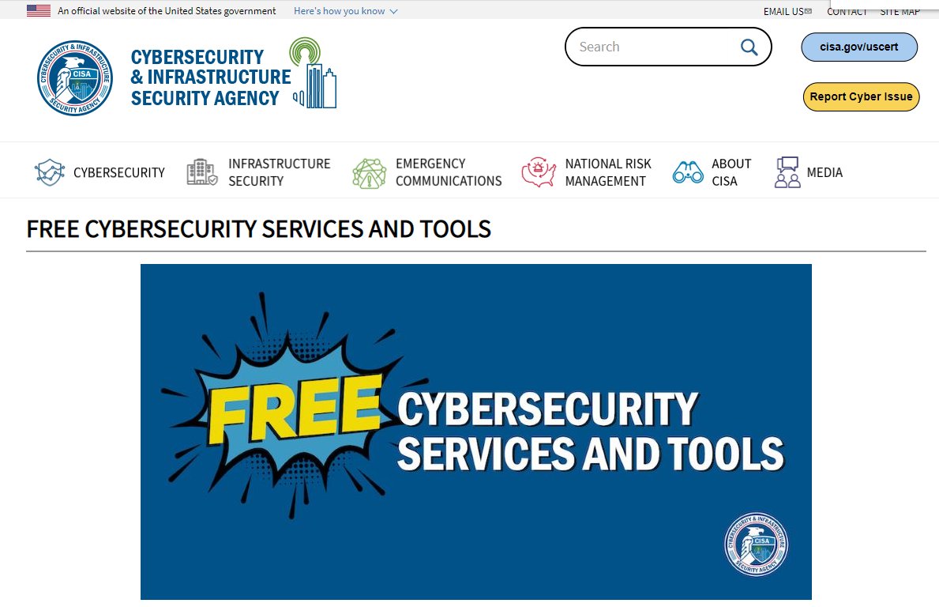
When it’s time to get strong anti-virus
www.cisa.gov/free-cybersecurity-services-and-tools
Notes:
https://www.cisa.gov/uscert/ncas/tips/ST04-005
https://www.cisa.gov/free-cybersecurity-services-and-tools

Slide 38
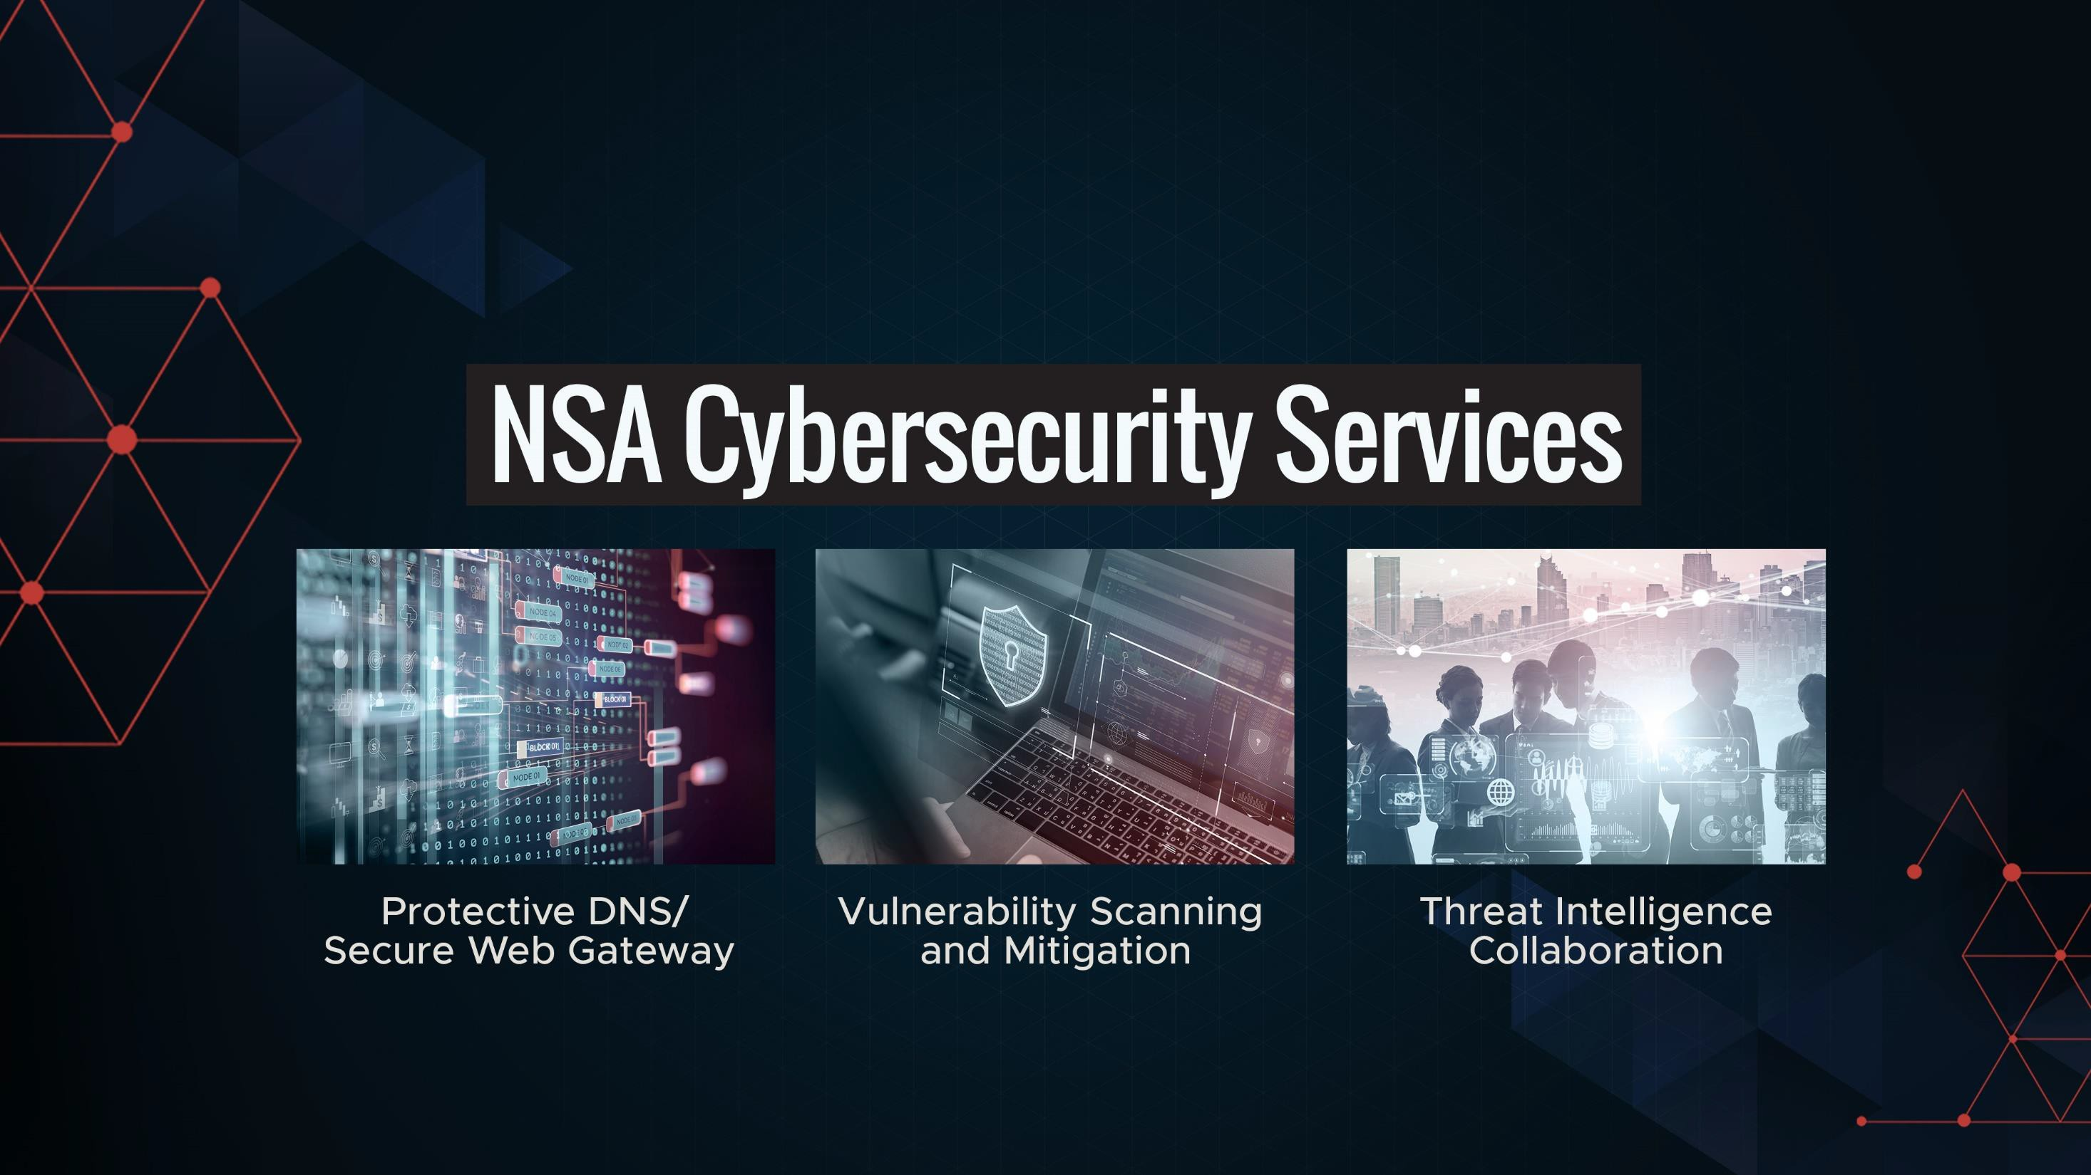

NSA Cybersecurity Services

Slide 39

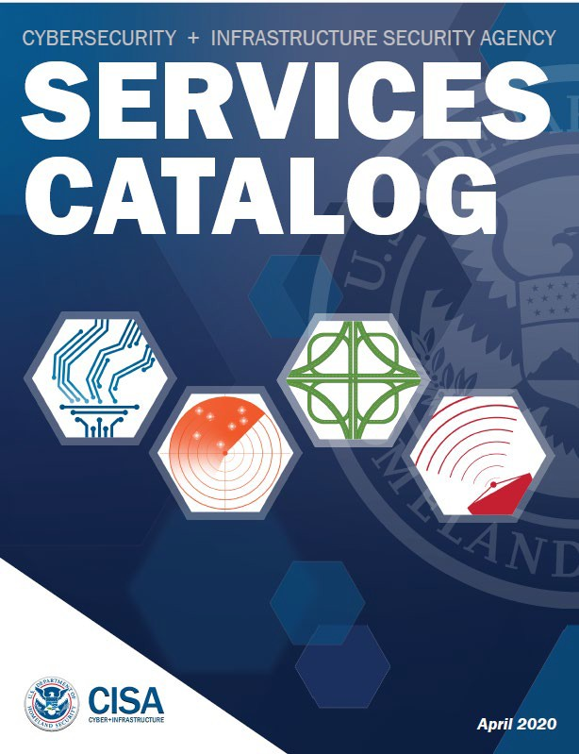
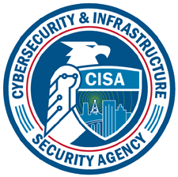
Cybersecurity Services
TLP:WHITE
CISA Cybersecurity Services
Vulnerability Scanning
Remote Penetration Testing
Phishing Campaign Assessment
Web Application Scanning
External Dependencies Management
Cyber Resilience Review
& more
For more information on these services, visit
www.cisa.gov/publication/cisa-services-catalog
-or
https://www.cisa.gov/cyber-resource-hub
J.D. Henry
April 18, 2022
11

Slide 40
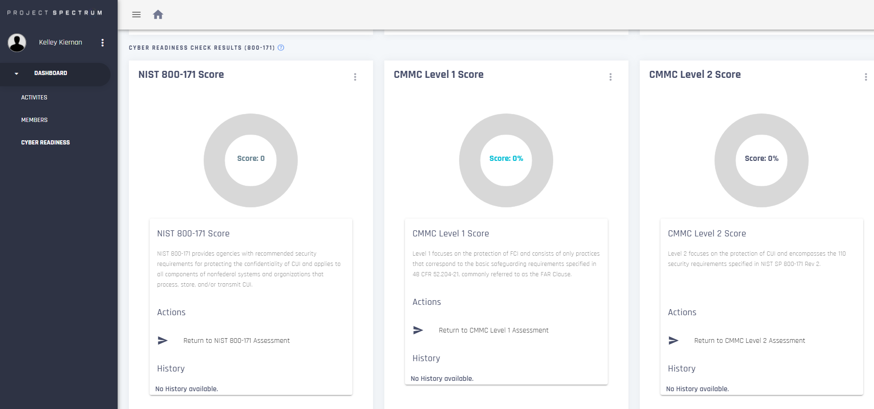
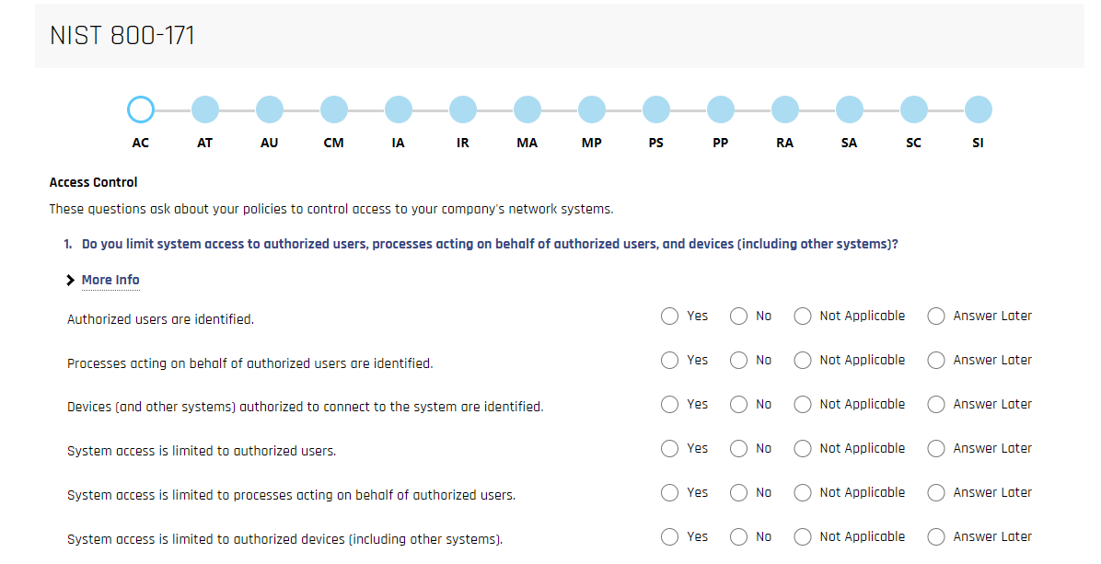
www.projectspectrum.io/#/
www.projectspectrum.io/#/

Slide 41
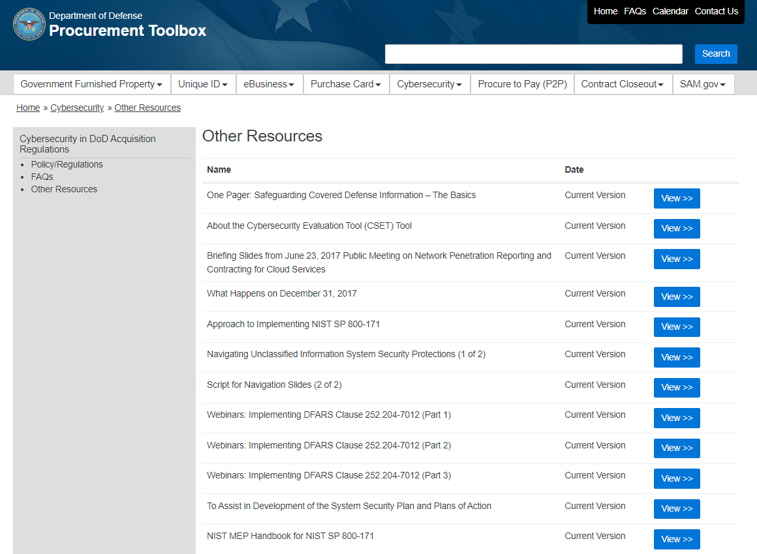
Department of Defense Procurement Toolbox
Notes:
https://dodprocurementtoolbox.com/site-pages/cybersecurity-other-resources

Slide 42
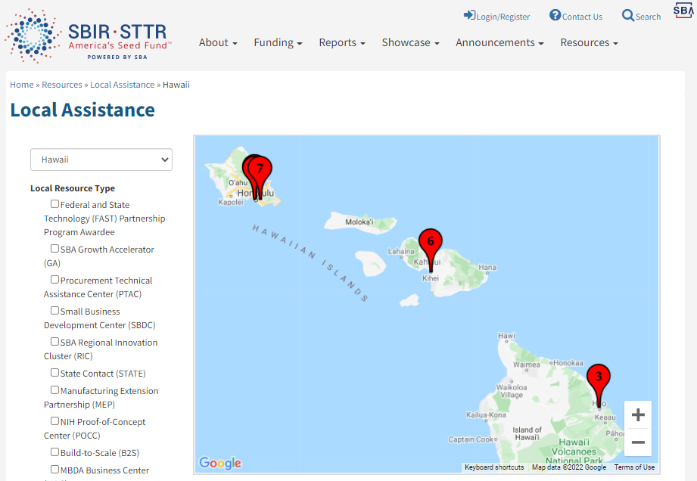
www.sbir.gov/local-assistance
Notes:
www.sbir.gov/local-assistance
www.dla.mil/SmallBusiness/PTAP/
https://business.defense.gov/Portals/57/Documents/Webcast%20%20PTAP.pdf?ver=N89R8wNm7TU%3d
What PTACs Provide at No Cost: • Training related to contracts with DoD, other federal agencies, state and local govts • Identify prime & subcontracting opportunities • Prime-specific subcontractor training • Understanding procedures, requirements, rules, statutes, clauses and regulations • Registrations: SAM, DSBS, DLA’s DIBBS, WAWF etc. • Preparing and submit
A Government Partner • Knowledge of local small business communities and their capabilities for effective market research • Collaborate with government for outreach to industry • Refer a business for one-on-one assistance • Team for specific assistance, e.g., matchmaking events for certain commodities or procurements, agency-specific requirements training, pre-solicitation conferences, pitch days, identify and train subcontractor sing bids & proposals • Assist with cybersecurity self-assessment and CMMC • Facilitate introductions, collaboration opportunities

Slide 43
Everybody Handles Federal Contracting Information!
Walk Through of the FAR 52.204-21 and proposed CMMC Level 1
Tuesday, July 26 at 1-3 pm EDT
Monthly Event
Register here: https://www.zoomgov.com/webinar/register/WN_6Gz84TQGRvm6YHMSVyE0Qg
The Blue Cyber Director, Kelley Kiernan will cover the 15 security requirements in the proposed CMMC Level 1 and FAR 52.204-21, which comprise basic cyber hygiene for your small business.
More information from Kelley.Kiernan@us.af.mil

Slide 44
Air Force and Space Force Cybersecurity Boot Camp
DAF CISO Small Business and Academic/Research Contractor and Potential Contractors
TBD mid-August, 10am - 4pm EDT
Monthly “Big” Event
Registration link will be on the Blue Cyber website
Join hundreds of your peers at the Cybersecurity Boot Camp. Come away having heard powerful speakers and learning what cybersecurity steps are necessary to protect your intellectual property and DoD Sensitive Data.
More information from Kelley.Kiernan@us.af.mil

Slide 45
Any Questions?
This briefing is not a substitute for reading the FAR and DFARS in your contract.
This presentation and other presentations in the DAF CISO Blue Cyber Educational Series and be found on the DAF CISO webpage: https://www.safcn.af.mil/CISO/Small-Business-Cybersecurity-Information/
Please provide questions, feedback or if you just want to talk about your cyber security /data protection questions to Kelley.Kiernan@us.af.mil
  Daily Office Hours for answering/researching your questions about DAF Small Business cybersecurity and data protection!
Every-Tuesday at 1pm EST, dial in for the DAF CISO Small Business Cybersecurity Ask-Me-Anything. Register in advance for this Zoom Webinar: https://www.zoomgov.com/webinar/register/WN_6Gz84TQGRvm6YHMSVyE0Qg

