Slide 1
Innovation in Source Selection
January 31, 2024
Office of Integrated Marketing

Slide 2
New to Source Selection
Refresher/Haven’t done SS in a while
Looking for help/guidance/resources
Poll

Slide 3
The *Abridged* Mostly True History of Source Selection in the Federal Government
Notes:
Ryan/Andrea
Andrea will share screen during live demo
QASP 1: USPTO Sample - https://hallways.cap.gsa.gov/app/#/doclib?filter%5Btype%5D%5B0%5D=1773&document=78388
This one is basic but good
Shows basic elements of QASP
Doesn’t show actual performance metrics
QASP 2: Army Contracting Command Template - https://hallways.cap.gsa.gov/app/#/doclib?filter%5Btype%5D%5B0%5D=1773&document=4380
This is a template
Good resource if you want to use it
Can build off of it
Allows you to reuse multiple times
Again non-specific
Important again to note that like last time, creates special section for performance measurements
QASP 3: NASA QASP for Software - https://buy.gsa.gov/docviewer?id=1931&docTitle=nasa%27s%20quality%20assurance%20plan%20for%20software&docType=112
UTM Link for Kelly Chat: https://buy.gsa.gov/docviewer?id=1931&doctitle=nasa%27s%20quality%20assurance%20plan%20for%20software&doctype=112?utm_campaign=atrw_fall2023&utm_medium=referral&utm_source=zoom
Most specific QASP example yet
Love the key abbreviations list
Structured nicely with table of contents, makes it easier to read despite length
Details organizational structure
Details more of the evaluation and review criteria
Would love to see an attachment that includes the review and criteria sheet to see how it is laid out
But, we can take best practices from all three and combine them
Goes to show how general and QASP can be, but it must fit your acquisition needs

Slide 4
In the beginning, someone decided that arbitrarily picking a Contractor was probably not the in the best interest of the Federal Government (i.e., best use of taxpayer dollars) and regulations were created. In other words, if there is a Federal regulation about something, that usually means however it was done in the past wasn’t exactly aboveboard. The End.

Slide 5
What Do You Want For Dinner?
Building Your Evaluation Criteria
What do you want for dinner? Get the requirements. No seriously, GET THE REQUIREMENTS. You can’t make a decision if you don’t know what your customer wants. It’s even worse when you discover THEY don’t know what they want!
Once you know your customer’s wants, now is the time to pick their brains and find out what they don’t want: are they allergic to anything? which places did they hate? Try not to let them get away with “I’ll eat whatever” because that rarely ends well. In life and in procurements.
Sort the options into definable categories: quality, performance, capability, schedule, etc. You’re defining the evaluation criteria for the requirements.

Slide 6
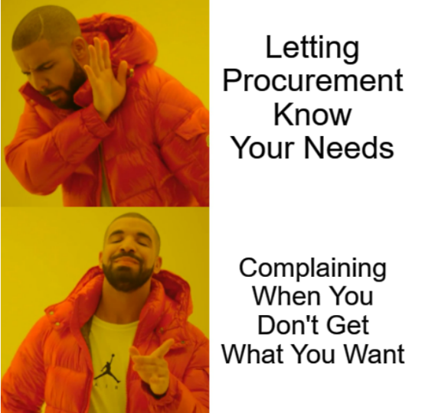
Let Procurement Know Your Needs

Slide 7
Deciding How to Evaluate
How complex is the requirement?
How many criteria do you have?
Select your best option

Slide 8
AcquisitionGateway.gov gives you several options to choose from, some you may have heard of in previous AFTRW training and some may be completely unheard of. Don’t worry, they’re explained in detail here:
Periodic Table of Acquisition Innovations - Evaluations
Following is what one hopes to be a memorable discussion of what these are and how they could apply to your procurement.

Slide 9
Comparative Evaluation - Apples to Apples, Oranges to Oranges

Slide 10
Confidence Ratings - Do or Do Not, There Is No Try

Slide 11
Down Selects - Where You Wanna Eat? You Sure?

Slide 12
Oral Presentations - Mom/Dad, This is My Plan to Get A Car With Your Money

Slide 13
Technical Demonstrations - Hold My Coffee While I Press This Button

Slide 14
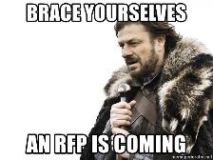
Document! Document! Document!
Building a Source Selection Plan
Who will be your evaluators? Let them know, make sure they are on board and aware of the time commitment. Get signed NDAs from them.
Clearly spell out the evaluation criteria. Clearly spell out your evaluation methodology. Get stakeholder buy-in, draft it up for the solicitation/RFP.

Slide 15
Time to Make the Donuts
Source Selection Evaluation Board
The Due Date for proposals has come and now it’s time to make the donuts. Since cooking is an art and baking is a science and donuts are baked (fried)...
Gather your ingredients (SSEB members and proposals), set your oven (book their calendars), and start mixing (evaluating) according to the recipe.
This last step is very important for a fair, impartial, and most importantly - technically audit proof - evaluation: You MUST follow the recipe exactly. No shortcuts, no substituting ingredients. Whatever you said you were going to evaluate and however you said it would be evaluated is exactly what you have to do.

Slide 16
Questions???

Slide 17
Resources

Slide 18
Thank You!
Office of Integrated Marketing

