Slide 1
MCP Hackathon
Sample Deliverable Deck

Slide 2
The Challenge: Accessing Critical Public Health Data
Public health researchers, data analysts, and policy makers need access to the CDC PLACES dataset, the most comprehensive source of local health data in the United States, covering chronic disease risk factors, health outcomes, and preventive services for all 50 states, DC, and 500+ cities. However, accessing this data programmatically is fraught with challenges:
1. Fragmented Data Architecture
The CDC PLACES API is organized into separate endpoints for each combination of geography and year. To access obesity data for counties in 2023, you query one endpoint; for census tracts in 2022, you query an entirely different endpoint. This means:
Researchers must know or discover 24+ different API endpoints (6 release years, 4 geographic levels)
Cross-year or cross-geography comparisons require orchestrating multiple API calls manually
No unified interface exists to abstract away this complexity
2. Significant Reporting Lag
The underlying data is two years behind the release year. PLACES Release 2025 contains data from the 2023 Behavioral Risk Factor Surveillance System (BRFSS). This temporal disconnect creates confusion:
Users must mentally map "2025 release" to "2023 data"
Documentation often doesn't clearly state which data year corresponds to which release
Comparing trends requires tracking both release years and actual data years
3. Inconsistent Measure Availability
Not all health measures are collected every year, and determining which measures are available for which years is complex:
Some measures (e.g., High Blood Pressure, Cholesterol Screening) are collected only in odd years
Others (e.g., Teeth Lost, Sleep, Dental visits) are collected only in even years
Certain measures were discontinued after specific releases (Kidney Disease after 2023, Cervical Cancer Screening after 2023)
New measures appear unexpectedly (Loneliness was added in 2025)
There is no centralized, machine-readable index of measure availability by year
4. Manual Lookup Overhead
Before making any API request, users must:
Consult documentation to find the correct endpoint for their geography/year combination
Check whether their measure of interest was collected that year
Understand the data year vs. release year distinction
Construct properly formatted queries with correct parameter names

Slide 3
The Solution: an MCP Server for CDC PLACES
The CDC PLACES MCP server eliminates these barriers by providing:
A unified interface that abstracts away endpoint complexity
Automatic lookup of the correct API endpoint based on year and geography
Built-in validation that prevents invalid measure/year combinations
Local caching of the measure availability matrix for fast, offline lookups
Natural language access through MCP-compatible AI assistants like Claude
Users can now ask simple questions in plain English and receive accurate, properly sourced data without needing to understand the underlying API architecture.

Slide 4
Server Design Overview
Architecture Overview
The CDC PLACES MCP server is built using FastMCP (a Python framework for Model Context Protocol servers) and follows a modular, maintainable design pattern. The server acts as an intelligent middleware layer between AI assistants and the CDC PLACES API, abstracting away complexity and providing validation.

Slide 5
Server Design: Key Technical Decisions
1. Local Lookup Table Strategy
Decision: Maintain a local CSV file mapping measures, years, and data releases
Location: src/places/data/places_year_measureid_lookup.csv
Rationale:
Zero network dependency for lookups, validation happens instantly
Offline development capability without API access
Single source of truth for measure availability across releases
Easy to update when CDC releases new data (just update CSV)
Version controlled alongside code for complete reproducibility
Implementation: The get_release_for_year() utility function reads this CSV at runtime using pandas, finds the measure row, and scans release columns to determine which endpoint to use.
# Example: Find which release has CSMOKING data for year 2023
release = get_release_for_year("CSMOKING", "2023")
# Returns: "places_release_2025"

Slide 6
Server Design: Key Technical Decisions
2. Modular Tool Architecture
Decision: Each MCP tool defined in its own file within src/places/tools/
Structure:
src/places/tools/
|--- __init__.py # Central registration
|---get_cdc_places_data.py # Single-location queries
|---area_summary_stats.py # Multi-location aggregation
Rationale:
Separation of concerns: each tool is independently testable
Easy extensibility: adding new tools doesn't require modifying existing ones
Clear ownership: tool logic, validation, and documentation co-located
Registration pattern: tools register themselves with the MCP server through a clean register(mcp) interface

Slide 7
Server Design: Key Technical Decisions
3. Type-Safe Enum for Measures
Decision: Use Python Enum for all 45 health measure IDs
Location: src/places/models.py
class MeasureID(str, Enum):
CSMOKING = "CSMOKING"
DIABETES = "DIABETES"
OBESITY = "OBESITY"
# ... 42 more measures
Benefits:
Auto-completion in MCP clients: users see valid options
Type validation at the API boundary: invalid measures rejected before API call
Self-documenting: available measures visible in one place
IDE support: developers get autocomplete when working with measure IDs

Slide 8

MCP Server Demo

Slide 9
MCP Server Evaluation - Setup
The CDC PLACES MCP server uses Arize Phoenix, an open-source LLM observability and evaluation platform, to systematically measure the server's performance across multiple dimensions. The evaluation framework assesses how well the agent retrieves accurate health data and whether it appropriately stays within its defined scope.
Key Components
Test Dataset: places-eval-0
  A curated set of 10 test queries designed to validate diverse aspects of the server's capabilities
    Tests all 5 geography types (state, county, census tract, ZCTA, places)
    Covers 9 different health measures across categories
    Spans multiple years (2018-2023) to validate temporal lookup logic
    Includes both single-value queries and aggregate statistical queries
    Tests edge cases (disambiguating locations, comparing measures)
Agent Integration: CDCPlacesAgent
  A LangChain-based agent that connects to the MCP server via HTTP transport and is instrumented with Phoenix for observability
    System prompt versioning: Loads prompts from prompts/system_prompt_v01.txt
    HTTP transport: Agent connects to a running MCP server instance (not stdio)
    Phoenix instrumentation: All LangChain calls automatically traced to Phoenix
    Async/sync bridge: Wraps async agent execution for Phoenix's synchronous experiment API
Evaluation Judges (LLM-as-Judge)
  The evaluation framework uses two LLM-based judges powered by Claude 4.5 Sonnet to assess agent responses
    Correctness (match_expected_response): Determine if the agent's response matches the expected answer
    Relevance/Scope (check_answer_scope): Verify the agent stays within its defined scope

Slide 10
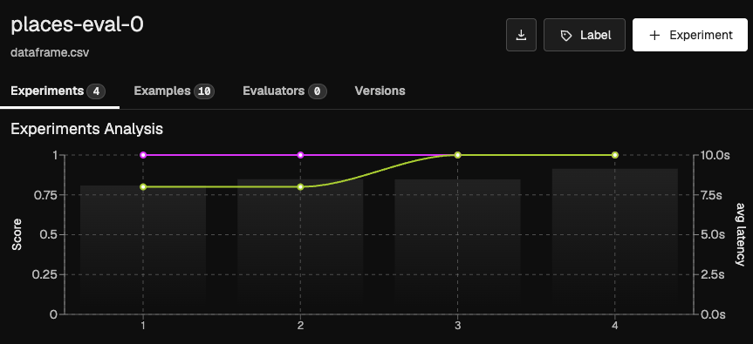

MCP Server Evaluation - Results
Agent scored 100% on third evaluation run
Average latency of 9.1s and token usage of 4.6k

Slide 11
Security Considerations
Public Data, Public API
The CDC PLACES MCP server operates exclusively with publicly accessible health data from the CDC's open data portal (data.cdc.gov). This foundational design choice significantly simplifies the security model:
No Authentication Required
No credentials stored: The server makes unauthenticated requests to public CDC endpoints
No secrets management: No API keys, tokens, or passwords needed
No user data collected: The server is stateless and does not store or process user queries
Security Inherited from Upstream
The server's security posture inherits directly from the CDC's public API infrastructure:
Data confidentiality - Not applicable, all data is public domain
Access control - Not required, CDC endpoints are openly accessible
Data integrity - Validated by CDC; server acts as pass-through
Transport security - TLS 1.2+ enforced for all HTTPS requests to data.cdc.gov
Rate limiting - Handled by CDC's API infrastructure
Data freshness - CDC updates data annually; server reflects current CDC data
Attack Surface
The server's minimal attack surface consists of:
MCP Protocol Endpoint (stdio or HTTP)
  Risk: Malicious queries could attempt to extract unintended data or cause denial of service
  Mitigation: Input validation via Pydantic models, enum-based measure IDs, Literal types for parameters
Outbound HTTP Requests
  Risk: Server could be abused to make requests to unintended endpoints
  Mitigation: All API endpoints hardcoded in config.py, no user-supplied URLs
Lookup Table Integrity
  Risk: Corrupted CSV could cause incorrect endpoint routing
  Mitigation: Version-controlled CSV, test coverage validates lookup logic
Out of Scope
This security model assumes:
The server is used to access CDC PLACES data only (as designed)
Users trust the CDC as the authoritative data source
The server is deployed in environments where network egress to data.cdc.gov is permitted

Slide 12
Lessons Learned and Recommendations
1. Local Lookup Tables Beat Runtime Discovery
Observation: The CDC PLACES server uses a local CSV file (places_year_measureid_lookup.csv) to map measures and years to API endpoints, rather than querying the API to discover available data at runtime.
Recommendation: Create a local "data availability matrix" as code rather than relying on runtime API discovery. For federal datasets with complex release schedules (multiple years, geographies, or measure availability patterns), invest in building and maintaining a structured lookup table. This pays dividends in reliability, testability, and developer experience.
2. Explicit Parameter Design Improves AI Agent Ergonomics
Observation: The server uses strongly-typed, explicit parameters with Pydantic models (Enums for measure IDs, Literal types for options) rather than flexible string-based parameters.
Recommendation:Encode dataset domain knowledge into types, not documentation. For federal datasets with controlled vocabularies (measure codes, geographic identifiers, time periods), use Enums and Literal types extensively. This shifts validation left, improves AI agent performance, and creates a single source of truth for valid parameter combinations.
3. Dual-Tool Strategy: Simple Retrieval + Aggregation
Observation: The server provides two distinct tools rather than one flexible "query everything" interface
Recommendation: Design tools around user intent, not just API capabilities. For federal datasets covering large geographic or temporal scopes, provide separate tools for single-entity retrieval and bulk aggregation. This improves performance, clarifies the agent's reasoning process, and enables better error handling for each use case.

