Slide 1
It’s Still Good - Managing the Disposal of Personal Property
January 29th, 2024
Office of Integrated Marketing

Slide 2
Poll Q’s
I have Personal Property disposal (managing the disposition) experience (select one)?
None
1 ~ 5 years experience
5 + years experience
I have excess Personal Property acquisition experience?
True
False
Where to go for Personal Property Management info (select one)?
PPMS.gov
GSA.gov/property
Agency National Utilization Officer
All the above
I would like to know more about Personal Property Management (select all that apply):
Disposal
Acquisition
Public Auction
Transfer
Donation

Slide 3
Five Steps of Property Disposal

Slide 4
Five Steps of Property Disposal
Internal Screening
Varies by Agency
Excess
(Transfer to Federal Agency; 14-21 days)
PPMS
Surplus
(Donate to eligible recipients)
Sales
(Sell to public; 30-45 days)
No Value
(Separate disposal course)
Notes:
There are Five steps of Property Disposal
This presentation is going to focus on the responsibilities of the property custodian during the middle three stages, which all occur in PPMS.
The complete disposal process takes approximately 60-90 days.

Slide 5
1: Internal Screening

Slide 6
Internal Screening
Follow your agency’s internal procedures
Contact your National Utilization Officer (NUO) with questions
Some agencies use PPMS
GSA-supported internal screening program built into PPMS
Register for live training on internal screening here:
gsa.gov/events
Find User Guides here: ppms.gov
Notes:
This is Internal to the agency who currently has possession of the property.
-You will need to follow your agencies internal procedures. Screening times vary.
-You will want to contact your National Utilization Officer or NUO with any questions. The NUO is the internal expert on property disposal matters and manages any internal policies as well as grants access to the PPMS system.
Some agencies use PPMS for a GSA-supported internal screening experience.
-We are offering trainings on PPMS internal screening for relevant customers agencies, so please take the separate course (registration info @ gsa.gov/events)

Slide 7
2: Excess Screening

Slide 8
How do I know if my property is in PPMS?
If your agency uses PPMS for internal screening:
You’ll get an email when your items start excess screening (no action required)
If your agency does NOT use PPMS for internal screening:
You’ll need to report your property into PPMS
Notes:
If you are using PPMS for internal screening, you will get an email when your item(s) start excess screening. It is for your awareness only and no action is needed.
If you select “Drop after internal screening” then the items will be returned to your agency without going to PPMS
Otherwise, Items will automatically roll over from internal screening to PPMS
If your agency does not use PPMS for internal screening, you will need to report the property on GSAXcess, either using the batch or manual process.

Slide 9
What do the Notifications Mean?
Email | Notice of Allocation to Holding Activity | Signed Property Denial Notice | Completely Approved Transfer Order
What It Means | GSA has allocated your property to a requesting agency | GSA or your approving official has denied the allocation | GSA and the requesting agency Approving Official have approved a request for your property
What you Need to Do | Nothing | Nothing; do NOT transfer the property | Coordinate property removal with the receiving agency.
Notes:
We will go through all the notifications, what they mean and what you need to do after receiving them one by one.
-The first notification is the Notice of Allocation to the holding activity. What that means is GSA has allocated your property to the requesting agency. You do not need to do anything at this stage.
-The other notification you can receive is GSAxcess signed property denial notice. That means GSA or your approving official has denied allocation. You don’t need to do anything except be sure that you don’t transfer the property.
-The other notification is the completely approved transfer order. What that means is that GSA and the requesting agency approving official have approved a request for you property. What you need to do then is coordinate property removal with the receiving agency.

Slide 10
Sample Email:
Completely Approved Transfer Order
Notes:
When you receive this email, the completely approved and SIGNED SF-122 will be attached. The requesting agency has been given your contact information as listed in the email to coordinate removal. If the contact information is NOT correct, notify the APO listed in the email.
To see what items are on this transfer order, you can open the attachment (PDF).

Slide 11
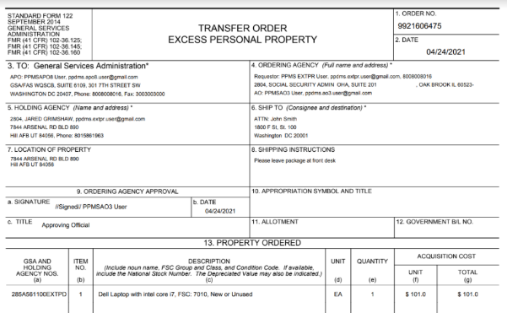
How do I read a Completely Approved Transfer Order?
Notes:
When you open the PDF there are some important areas to review:
On the right side of the TO, you will see the ordering agency information- it should match up with the people contacting you to coordinate removal.
In the middle of the page is the property ordered - this includes information about your items, like the Item Control Number, the quantity approved for transfer, and the item description. Make sure this information is accurate.
At the bottom will be GSA’s signature- you MUST have this signature in order for you to release the property. If the signature block is blank, DO NOT release the property and contact GSA.

Slide 12
How do I read a Completely Approved Transfer Order? (Continued)
At the bottom will be GSA’s digital signature and a date- you MUST have this signature in order to release the property.
Notes:
At the bottom will be GSA’s digital signature and a date- you MUST have this signature in order for you to release the property. If the signature block is blank, DO NOT release the property and contact GSA.

Slide 13
3: Surplus Property

Slide 14
How do I know when my property is “surplus”?
Surplus Release Date (SRD): The date when Federal screening is completed
If no Federal agency has requested the item by the SRD, the property item is considered surplus property:
If an eligible entity has requested the item for donation, the property remains in “surplus”until the donation is complete
If no one has requested the item, the property moves on in the disposal process (usually, to GSA Sales)
Notes:
Surplus property is also handled in PPMS. An item becomes surplus when it completes excess screening. If a State Agency or public airport has requested your item, it will “Freeze” in PPMS once it completes excess screening. The status will update to “Surplus” to indicate that GSA is going to allocate your item to an eligible recipient.

Slide 15
What is different in the Surplus stage?
Emails: Same emails as Excess
SF-123 for Surplus (versus SF-122 for Excess)
What it means: Property is donated to:
Donees of the Surplus Donation Program (through the State Agencies for Surplus Property, or SASPs); or
Public airports
What you need to do: Same as excess (only release property once you have completely approved TO)
Notes:
In the surplus stage, you will receive the same notifications as in the excess stage, however in the surplus stage there will be a different form number. It will be SF 123 for surplus versus the SF 122 for excess.
What that means is, the property at this stage will either go to donees of the surplus donation program through the State Agencies for Surplus Property or the SASPs, or it can go to public airports.
You follow the same actions as you would during the excess stage - only release property once you have completely approved TO.
For donations through the SASP, you’ll also need the distribution document (which tells you which donee is receiving the property) before you can release the property

Slide 16
Questions during the Excess or Surplus stage?
Contact your GSA Area Property Officer (APO)
Property disposal specialists assigned by location
Assist federal and nonfederal recipients and SASPs.
Find your APO at gsa.gov/apo.
Notes:
If you have questions during either the excess or surplus stages, you will want to contact your GSA Area Property Officer, or APO.
APOs are assigned geographical areas and you can find your APO on the link provided on this slide.

Slide 17
4: Sales

Slide 18
How do I know when my property is in Sales?
Email: GSA Sales is Preparing Your Item for Auction
What it means:
Your property has completed screening in PPMS
It is available to sell (but not for sale yet)
What you need to do for GSA Sales:
Verify your contact information and item location
Make sure all items are still available and as described
Notes:
When your property finishes excess/ surplus screening (and no one selects it), you will receive a notification titled "GSA Sales is Preparing Your Item for Auction"
This is a system generated email sent to the property "custodian" listed in PPMS
Sometimes custodians misinterpret this email as property being actively offered on auction, when in fact the email simply serves to inform that the property has completed all Government screening and is available to sell.
A GSA SCO will then follow up to verify your contact information and the description prior to putting the item up for sale.

Slide 19
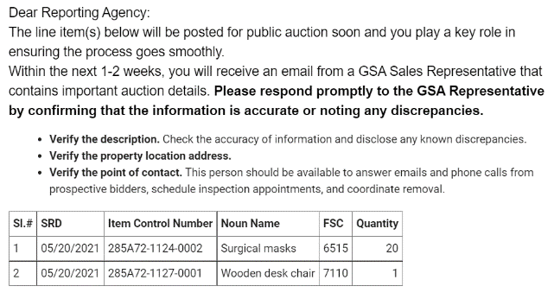
Sample Email
Notes:
If your item goes to GSA Sales, this is the email you will get.
If you DID NOT elect GSA Sales as your Sales center, you will get a separate email indicating that your item has gone to the Sales center of your choosing (and include the name of the Sales Center).

Slide 20
How will I know that my property is ready to be sold?
Email: Time Sensitive: Approve Auction Listing(s)
What it means:
Your property has been lotted for sale and needs your review
What you need to do:
Review the information for accuracy
Approve/ Disapprove the lot
Notify your Sales Contracting Officer if any changes are needed
Notes:
When you receive the email, you will need to login to PPMS and review the information.
Verify:
-Property Location
-Description
-Photos/ Attachments
-Point Of Contact information
-Availability during proposed inspection times
Notify your Sales Contracting Officer or SCO if there are any changes that need to be made- their contact information will be in the email notification.

Slide 21
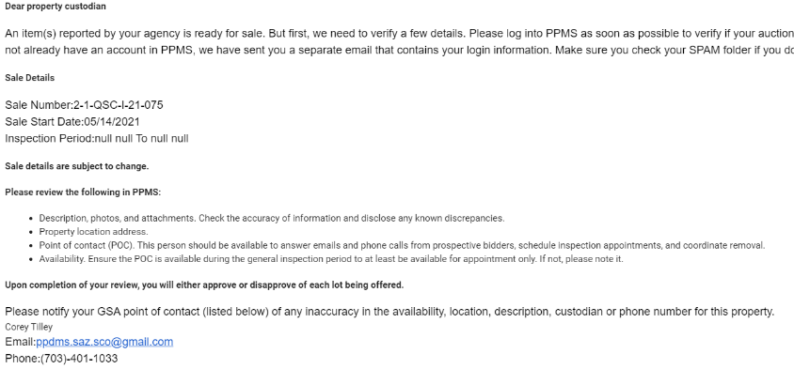
Sample Email: Item is ready for sale
Notes:
Highlight on the screenshot:
-Sale start date (emphasize time sensitive nature)
-SCO contact information

Slide 22
When do I disapprove my lot?
You are not available during the inspection time
There is incorrect information (QTY, description, POC, reserve price etc.)
Items are no longer available
The sale duration needs to be adjusted
You want to add extra information:
Back up POC
Special removal / inspection instructions
Extra photos/ description information
Property won’t be available to release until a later date

Slide 23
How do I provide these updates to my SCO?
When you disapprove, you will be required to include a note with the reason for disapproval.
Be clear and precise in your note to the SCO!
Reduces need for follow up
Allows the SCO to make the changes and post to Auction without sending for re-approval (for minor changes)
This process works to:
Reduce claims / questions from the general public.
Increase the number of bidders and total proceeds.
Notes:
We will show this live during the “Demo” of the presentation

Slide 24
How will I know if my property sells?
Notification: Purchaser's Receipt and Authority to Release Property
What it means: The purchaser paid for the property and has 10 business days to remove the property
Extension can be granted if requested
ONLY the SCO can grant an extension
Notes:
Once you property sells and is paid for, you will receive a notification called a Purchaser’s Receipt.
At this point the purchaser has 10 business days to remove the property. Extension can be granted, but only by the SCO.

Slide 25
How is property removal handled at the Sales stage?
Do not release property without Purchaser's Receipt
At pick up:
Verify the identity of the purchaser with a Government-issued photo ID
Have the purchaser sign the receipt and leave it with you for proof of pick up
Upload a copy of the signed receipt in PPMS and indicate the item has been removed (DO NOT indicate removal until the item has been picked up!)
If the property is NOT picked up or partially picked up: notify the SCO
Notes:
Update to match PPMS functionality

Slide 26
Questions during the Sales stage?
You can check the status of your items anytime in PPMS
Contact the Sales Contracting Officer (SCO) listed on your email notification or item listing
Notes:
You can always check the status of the sales stage in PPMS
In PPMS, your item will have an SCO assigned as soon as it rolls into Sales. You can see the SCO assigned by viewing th

Slide 27
PPMS Demo

Slide 28
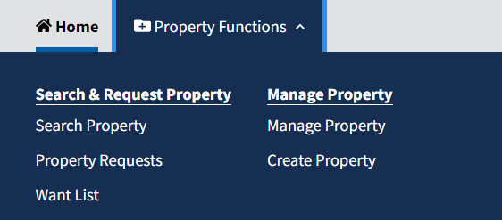
How can I find my active property listings?
Notes:
Go to “Manage Property” - all property listings in screening (excess/ surplus) or sales will display. You can sort by item name, report date, SRD, item status or ICN.
Statuses (list):
-Draft
-Internal Screening
-Excess Screening
-Surplus Screening
-Available (for lotting in GSA Sales)
-Lotted (in GSA Sales)

Slide 29
How can I edit my active property listings?
The property reporter and the Point of Contact can edit your listings until the item has been requested or lotted (then you need to contact GSA)
Notes:
Go to “Manage Property”
Locate the Item that needs to be edited
Click “edit”

Slide 30
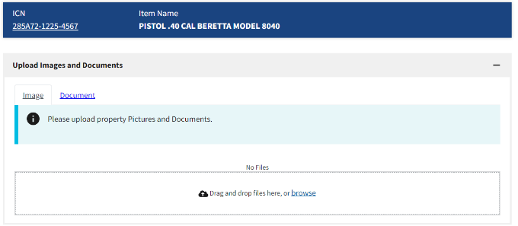
How can I add pictures/ documents?
Notes:
Go to “Manage Property” and find your item
Click “Upload”
Select “Image” or “document” and click “Browse” to upload

Slide 31
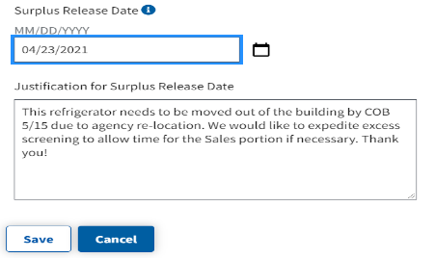
How can I request expedited screening?
Once an item has screened for 3 days in PPMS, you can request expedited screening if it has not been requested!
Notes:
Go to “Manage Property” and click “Edit”
Scroll down to “Surplus Release Date” and click “Request Change”
Select new date
Provide justification
Click “Save”
PPMS then notifies APO to approve/ modify/ deny the request
You will get an email notification when
the request is processed

Slide 32
My item has been requested. How do I check the status of the request?
Notes:
You can tell a property item is requested because:
the edit button is grayed out AND
you should receive an email notification once GSA allocates.
To check in on your item:
Click on the ICN to view the Property Data Sheet
Scroll down to the bottom to view Property Requests
Here, the status is “allocation confirmed” which means GSA has allocated but the approving official has NOT approved and GSA has not requisitioned.
The property can ONLY be released once you have the email notification “Completely Approved Transfer” and the Requisition Details is fill in.

Slide 33
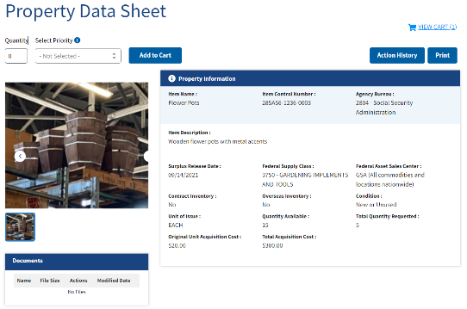
How do I download a Completed Transfer Order?
Notes:
Go to “Manage Property” and find your item (can search by ICN)
Click on the item control number
On the item data sheet, the SF 122 or 123 is available to download

Slide 34
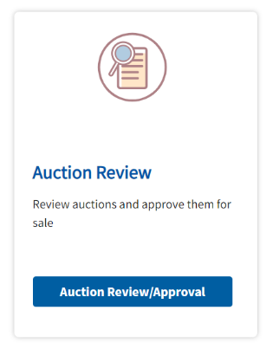
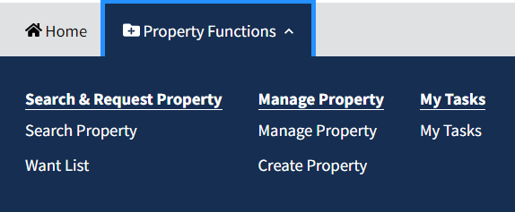
How do I review my items before Auction?
Notes:
Go to Property Functions > My Tasks > Auction Review/ Approval

Slide 35
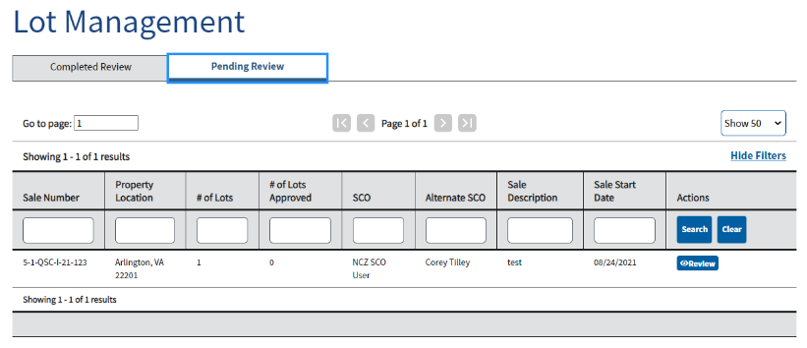
How do I review my items before Auction? Pt. 1
Notes:
Click “Pending Review.” Once you find the Sale you’d like to review click “Review”
You MUST receive an email notice telling you to login and review before you can see items pending review. Sales items are not automatically lotted.

Slide 36
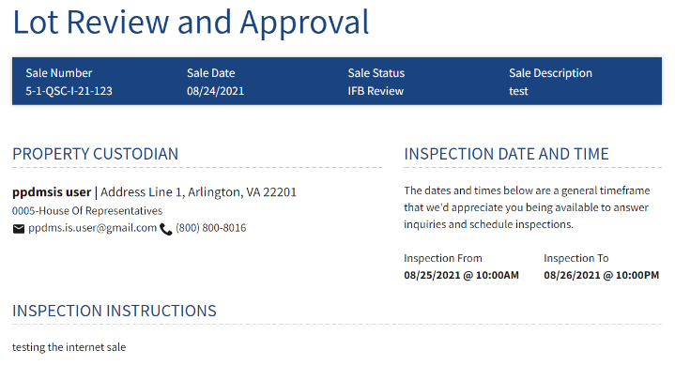
How do I review my items before Auction? Pt. 2
Notes:
At the top of the review page, you see the overall summary information for the sale, including sale number, property custodian information, and the inspection date and time.

Slide 37
How do I review my items before Auction? Pt. 3
Notes:
Click on the “+” icon to see the lot details and approve the lot

Slide 38
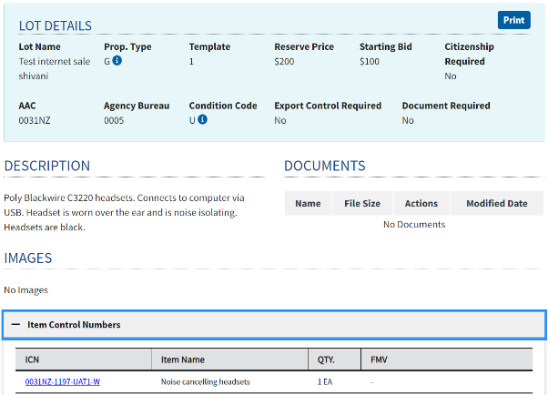
How do I review my items before Auction? Pt. 4
Notes:
The lot details drop down displays specific information about the lot, including reserve price, condition code, lot description, and any images or documents.

Slide 39
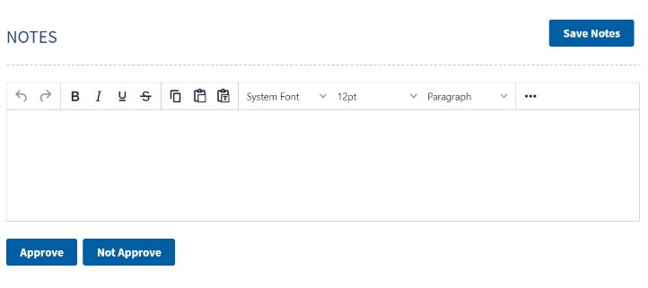
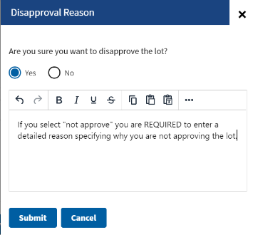
How do I review my items before Auction? Pt. 5
Notes:
Add any notes and click “approve” or “not approve” for each lot
If you click “not approve” you are required to enter a reason that will be sent to the SCO (see slides 21/22)

Slide 40
How do I upload a copy of the purchaser’s receipt?
Go to “My Tasks”
Click on the Sale / Lot
Click “Upload Purchaser’s Receipt”
Upload a signed copy of the purchaser’s receipt
Indicate item has been removed (only do this once the item has ACTUALLY been removed!)

Slide 41
How do I get an extra copy of paperwork associated with my item?
Whether you need an SF-122, SF-123, or Purchaser’s Receipt, it’s all in one place: the Property Data Sheet!

Slide 42
Questions???

Slide 43
Resources

Slide 44
If I have a problem, what do I do?
If something in PPMS is not working as expected:
Clear your temporary cache and refresh (F5)
If the issue remains:
Take a screenshot that captures your issue
Include relevant information (browser, what you were doing that triggered the error, etc.)
Send to the help desk OR ppms@gsa.gov
If you need help using PPMS:
Check out our on-demand YouTube training videos (1-5 min on specific functions)
Look at the user guide
Take a live training class
Contact your APO

Slide 45
Exchange/Sale and Reimbursable Property
Exchange/Sale: Property not excess to the needs of your agency but eligible for replacement; the sale proceeds are used to pay for the replacement (See FMR 102-39) .
Reimbursable: Includes property that your agency has specific statutory authority to retain net sales proceeds when sold (See FMR 102-38.295).
Surplus Reimbursable (Surplus Sales Proceeds Retention): Property that is excess, but if sold, the agency desires a portion of the sales proceeds to offset its costs of care and handling pending sale. Note: agencies do not receive reimbursement for property that is transferred to another agency or donated to an eligible recipient. If reimbursed, an agency may only retain its costs directly related to the sale of property and remaining funds must be deposited as miscellaneous receipts in the U.S. Treasury (See FMR 102-38.295(b)).

Slide 46
Disposal Condition Codes
Condition Code | Description
New/Unused (1) | New or unused condition; Can be used immediately without modifications or repairs
Usable (4) | Shows some wear; Can be used without significant repair.
Repairable (7) | Unusable in its current condition; Can be economically repaired.
Salvage (X) | Repair or rehabilitation is impractical and/or uneconomical; Has value excess of its basic material content
Scrap (S) | Has no value except its basic material content.
Notes:
For more information on A&D, please take our full A&D course or reach out to your local GSA Area Property Officer.

Slide 47
Thank You!
Office of Integrated Marketing

