Slide 1
Small Business Works 2022:
Market Research as a Service (MRAS) for Acquisition Workforce
U.S. General Services Administration

Slide 2
Effective Market Research
Tiffany Shabanian tiffany.shabanian@gsa.gov
Program Manager, Market Research as a Service
General Services Administration
Kristy Wilbur kristy.wilbur@gsa.gov
Branch Chief, Market Research as a Service
General Services Administration
Kevan Kivlan kevin.kivlan@gsa.gov
Director, Customer and Stakeholder Engagement
General Services Administration

Slide 3
Agenda
Overview - Market Research As a Service (MRAS)
Why Research?
Benefits and Objectives
Program Successes
MRAS Service Offerings
MRAS Success Story
RFI Survey
Market Research Report Walkthrough
MRAS Resources
Upcoming Training

Slide 4
What is MRAS
MRAS uses the latest research techniques to help agencies visualize the competition and socioeconomic responses that they can expect if they use GSA’s acquisition vehicles

Slide 5
Why Research
To gain knowledge.
To make informed decisions.
To drive mission capabilities.
To remain relevant, gain efficiency, and innovate.
To ensure regulatory compliance, understand market constraints, and recognize opportunities.

Slide 6
MRAS Value-Added Benefits
Streamlines market research
Reduces acquisition time
Aligns Agency needs with GSA contracts and solutions
Identifies the business size appropriate for the requirement
FAR Part 10 Compliant
Continuous support from your local GSA Customer Service Director
Promotes category management
Fast Targeted FAR Compliant Continued Support Category Management

Slide 7
MRAS Objectives
Our objective is to make research easier, more efficient, and modern.
We serve by providing them data to make better decisions.
We own the data, share the data, and re-use the data.
We give industry a voice.
We make research easy
We track our own data.
We measure quality through the voice of our clients.
We are driven by outcomes to create Government-wide efficiency and taxpayer savings.

Slide 8
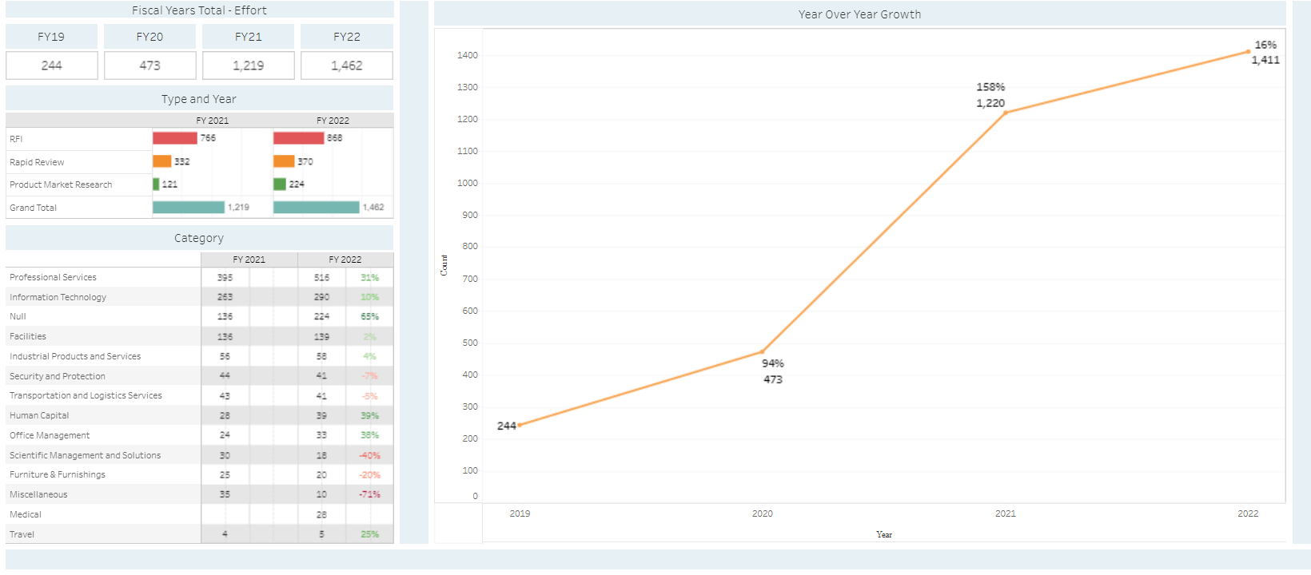
MRAS Program Successes
About 50% of MRAS Opportunities are Awarded to GSA Contracts

Slide 9
Available Service Options
GSA Advantage Product Market Research
Search up to 20,000 items on GSA Advantage at once
Rapid Review
Identifies if your requirement fits the scope of existing GSA acquisition solutions in 24-48 hours.
Request for Information/Market Research Report
Streamlines the RFI process and consolidates the results into one report with visuals.
Products
Services
Industry Outreach
Let GSA connect you with our industry partners to discuss your current MRAS RFI.

Slide 10
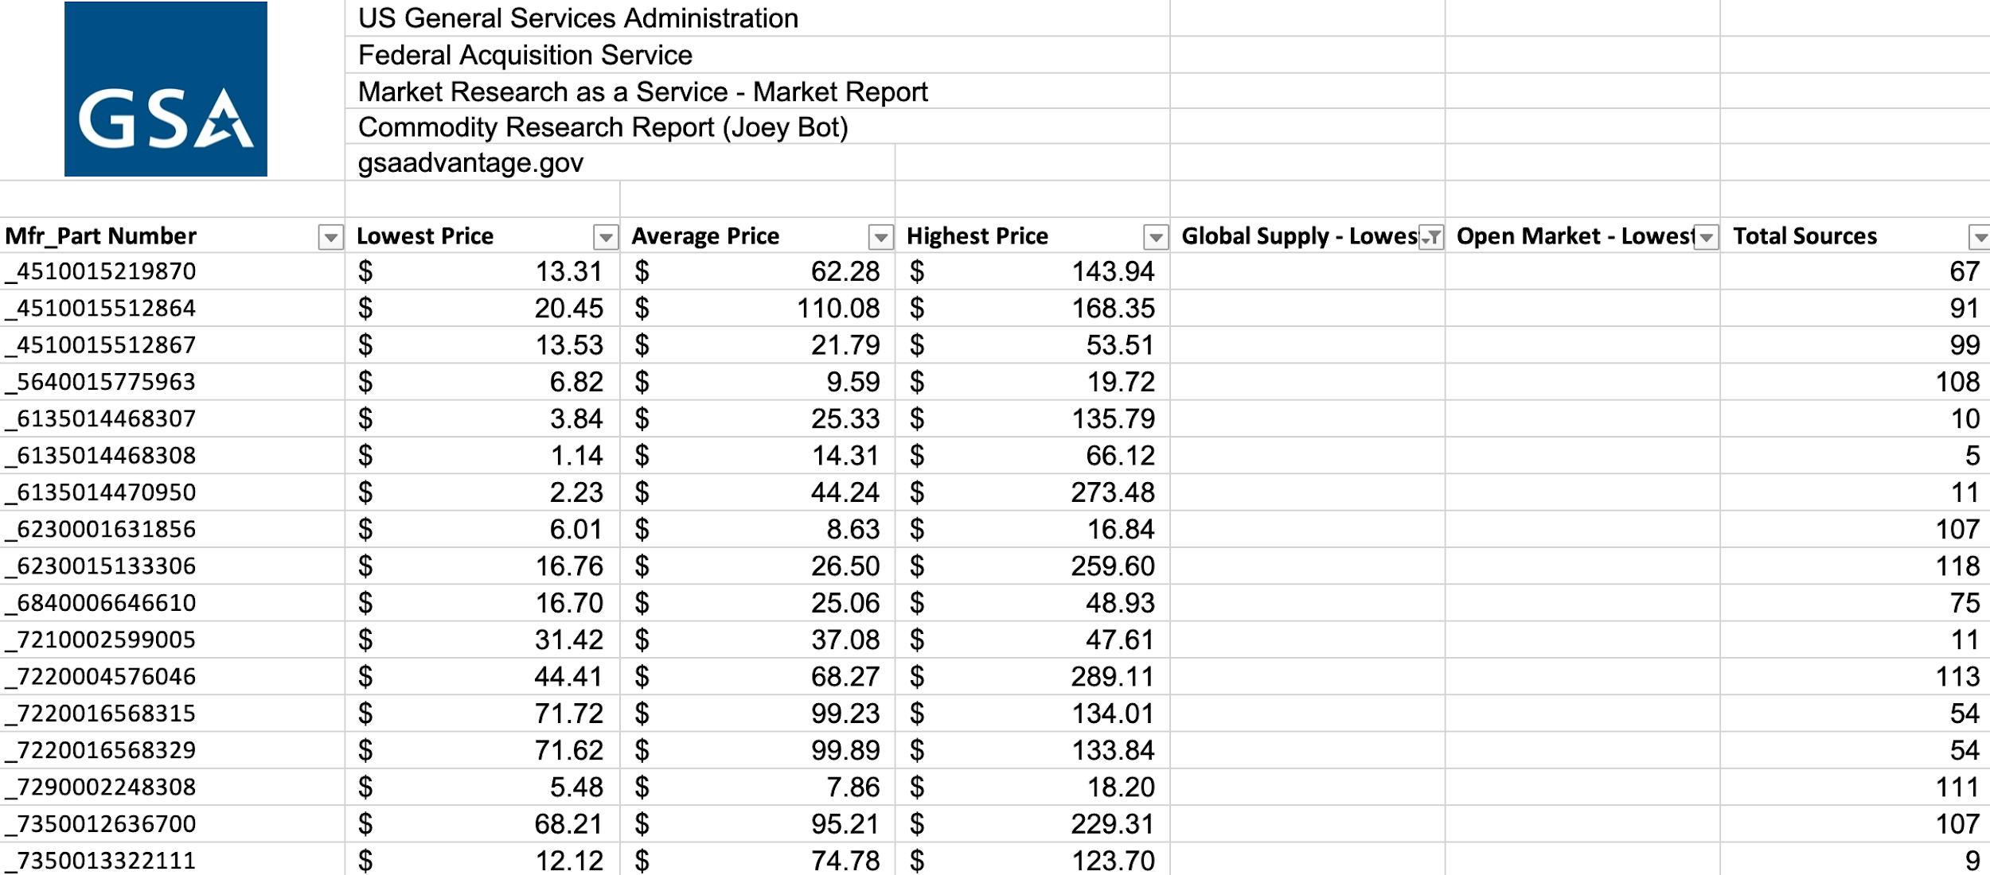
Product: GSA Advantage! Multiple Part Number Search & Market Research
Search up to 20,000 parts at once
Search part numbers and receive all the GSA Advantage! data in one market report
Provides an enhanced search and the ability to build part number based market reports quickly
MRAS provides a commodity market report available on demand!

Slide 11
MRAS Rapid Review
Market Research results in 48 hours or less
Results based on keywords in description
Review of Multiple Award Schedule and subcategories
GSA contracts ranked by compatibility, including BIC GSA contracts

Slide 12
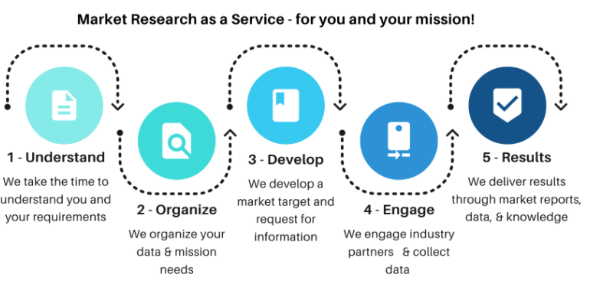
Easy Steps to Transform Your Requirement

Slide 13
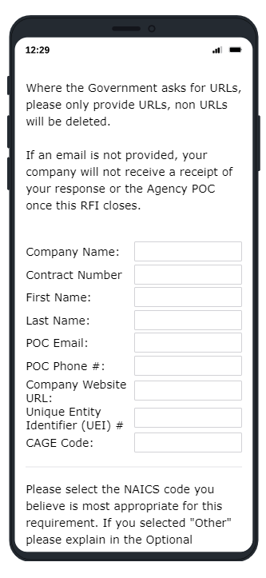
How We Research
Use commercially available software to streamline the process
Ask purposeful questions with visualizations and creating data sets in mind
Use videos, websites, demos, manuals, and more
Ask yes or no questions, ranges, pre-set percentages, and more

Slide 14
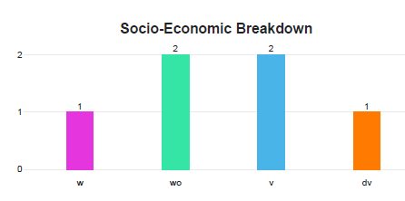
Demonstrating Results
MRAS Market Research Reports provide:
A comprehensive Market Research Report
Socio-Economic Outlook
Summary of Industry Feedback
Narratives to leverage Acquisition Planning

Slide 15
Success Story
Customer: Department of the Navy
Requirements: The Navy Cloud Service Management Organization seeks industry support for cloud migrations efforts. This includes the development, design, security, and operation of the NECE.
Results:
Market report within 2 weeks, identifying 37 small businesses.
The MRAS market research report helped to define their acquisition strategy.

Slide 16
MRAS RFI Survey

Slide 17
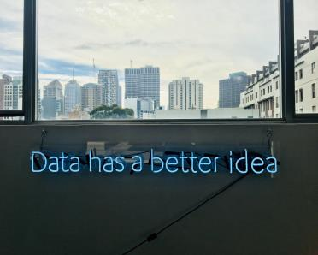
The Results
A Market Report
Visuals and Data to include in reports to Small Business
Narratives to leverage for Acquisition Planning
Feedback from Industry Partners
An outlook on whether competition and socio-economic participation is likely

Slide 18
MRAS Market Research Report
The report provides a recommendation based on the number of respondents and the contracts researched.
The report lists the GSA Contracts Researched in the RFI survey.

Slide 19
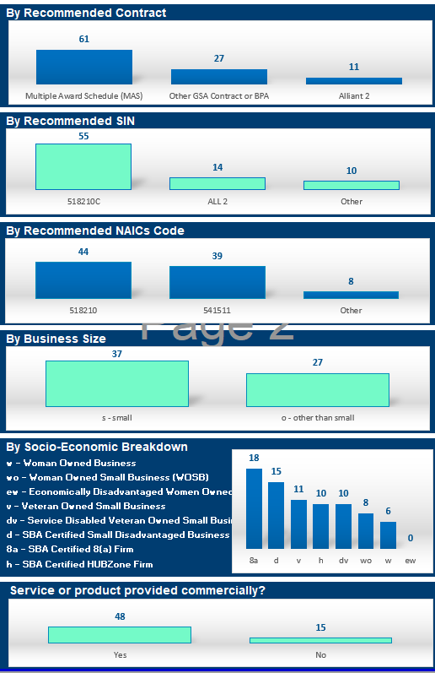
MRAS Market Research Report
Summarizes number of interested parties by GSA contract vehicle
Summarizes number of interested parties that are small or other than small businesses
Summarizes the socio-economic designations of interested parties

Slide 20
MRAS Market Research Report
The report summarizes the vendors responses to the technical questions

Slide 21
MRAS Market Research Report
The report provides a directory of interested parties and their POC information.

Slide 22
MRAS Market Research Report
The report summarizes the responses to the technical questions asked in the survey.

Slide 23
MRAS Market Research Report
The report includes a link to the vendor’s capabilities statement for download.

Slide 24
MRAS Market Research Report
We summarize feedback from Industry to ensure the requirement is clearly stated.

Slide 25
MRAS Resources
Work closely with your local GSA Customer Service Director which can be found at gsa.gov/csd.
Visit gsa.gov/mras for additional information on the MRAS Program or upcoming training sessions.
If you have specific questions about submitting a Market Research Request or one you have recently submitted, email us at rfi@research.gsa.gov.

Slide 26
Upcoming Training
Effective Market Research
Learn why market research is conducted, when and how to conduct market research; the regulatory nature of FAR Part 10 and how it ties into other decisions such as acquisition planning (FAR Part 7) small business set-asides, commercial items, contract type selection and more, and how to get better results by making your data collection methods easier. Course will use real life scenarios, examples from GSA’s market research initiatives, tools, experts, and more. This is a one (1) CLP credit course.
July 28, 2022 1:00 pm - 2:00 pm ET
August 25, 2022 1:00 pm - 2:00 pm ET
Visit www.GSA.gov/Events to register and for more information.

Slide 27
Questions?

Slide 28
Thank You!

