Slide 1
Small Business Works 2022:
Navigating Equity in Procurement
U.S. General Services Administration

Slide 2
NASA Scientific and Engineering Workstation Procurement (SEWP) and How Do They Buy?

Slide 3
What is SEWP?
SEWP
Multi-award suite of Government-Wide Acquisition Contracts
Over 140+ Contract Holders / Over 110+ Small Businesses
Each Contract Holder has a $20B ceiling
Annual Revenue $10.5B
Utilized by every Government Agency
Contract Vehicle for Information Technology Products and Services
Program Management Office (PMO) to provide support and information throughout the Acquisition Process

Slide 4
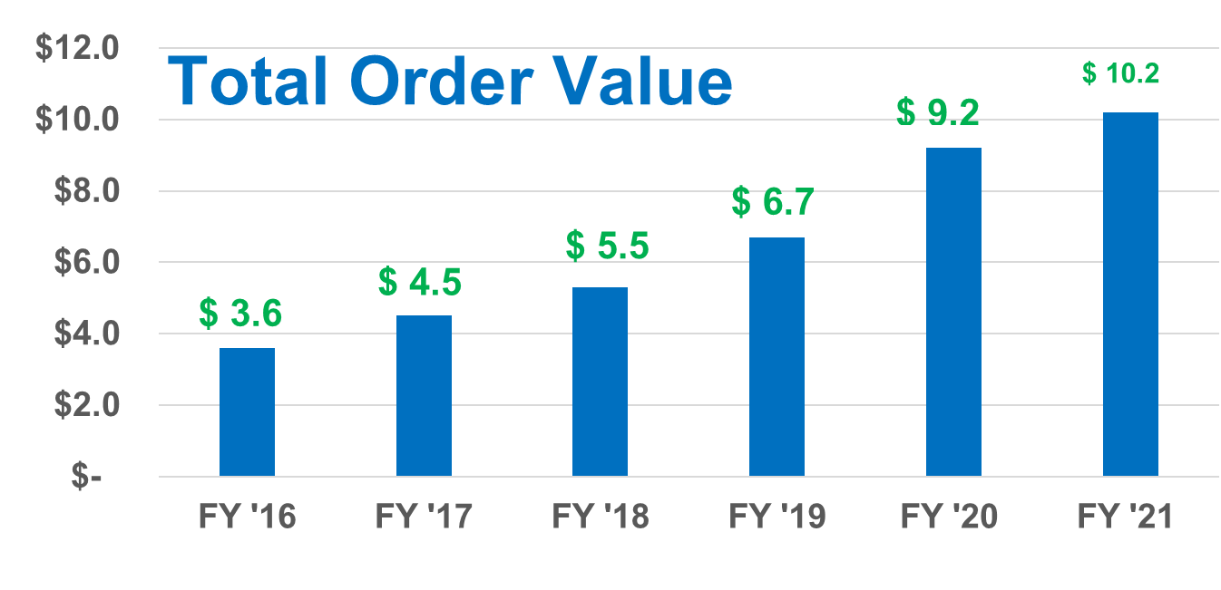
SEWP Growth

Slide 5
SEWP by the Numbers
140+ PRIME CONTRACT HOLDERS INCLUDING 110+ SMALL BUSINESSES
SEWP V
Current Figures… see “SEWP Snapshot”
Thousands of Providers including Cisco, Apple, Dell, HP, IBM, NetApp, EMC, APC, VMware, Microsoft, Oracle, etc.
Millions of Unique Products & Product Based Services
SEWP V began on May 1st, 2015
10 year contracts (5 year base contract w/ 5 year option)

Slide 6
SEWP IS A SOLUTIONS CONTRACT PRODUCTS AND SERVICES
Information Technology & Networking | Computer Hardware, Tablets Network Appliances: Routers, Modems, VOIP, Storage, Security
Software & Cloud | Software Virtualization and Cloud Computing XaaS (e.g. SaaS=Storage as a Service)
Mobility & Communications | Telecommunication Devices & Monthly Service
Supporting Technology | Scanners, Printers, Copiers, Shredders Associated Supplies & Accessories Sensors
AV/Conferencing | A/V Equipment and Accessories TVs, Display Monitors, Projectors & Screens
Services | Maintenance / Warranty Site Planning / Installation Product Based Training Product Based Engineering Services

Slide 7
What Makes SEWP Hot?
SPEED: Products/Solutions/Providers added within hours!
CUSTOMER SERVICE: Gold standard
FEE: Current fee 0.34% for products and/or services
AGENCY CATALOGS
TRACKING & COMMUNICATION: Tracking of all orders which provides feedback to contract holders and customers throughout process.
REPORTING: Customizable Agency reports
SUPPLY CHAIN RISK MANAGEMENT
ONLINE TOOLS: Easy to use tools available 24x7
FASST TEAM

Slide 8
SEWP V Snapshot: as of June 2022
263K+ Orders Placed
$45.7B+ Value of Orders Placed
Small Business Usage
All Small Business = 80%
HUBZone = 13%
SDVOSB = 33%
VOSB = 35%
EDWOSB = 2%
WOSB = 22%

Slide 9
SEWP V Top Issuing Agencies: June 2022
Agency | Total Amount | # Orders
Department of Defense | $10.20B | 23000
Department of Veterans Affairs | $7.90B | 27700
Department of Justice | $3.75B | 17700
Department of the Navy | $3.53B | 21800
Department of Treasury | $2.72B | 8500
Department of the Air Force | $2.42B | 20800
Department of State | $2.10B | 20700
Department of Commerce | $1.65B | 26400
Department of Health and Human Services | $1.53B | 6740
Department of Energy | $1.20B | 9750
Next 6:
United States Department of Agriculture
Department of the Interior
Department of Homeland Security
National Aeronautics and Space Administration
Department of the Army
General Services Administration
*97 Cabinet-level and Independent Agencies have utilized SEWP V

Slide 10
FASST
Federal
Agency
Strategic
Support
Team
FASST provides guidance on IT Procurements that are:
Strategic
Complex
Significant in size
Contact SEWP to arrange an onsite meeting for your Agency

Slide 11
Industry Relations Team
Investments – Innovations – Emerging Technologies
Educate, consult, guide (Government & Industry)
In person for top tier companies
Attends meetings for individual companies
Monthly WebEx session for general audience
Industry Events
Contract Holder Capability Matrix

Slide 12
Industry’s Role

Slide 13
Industry’s Role
5 Ways Industry is Involved:
Add Products/Services Under Existing Contracts(Provider)
Partner/Team/Assist Contract Holders
Purchase from Existing Contracts
Compete for a SEWP Prime Contract
Novate an existing SEWP Contract Holder

Slide 14
Industry’s Role (cont.)
Add Products and Services to Existing Contracts:
Provider: Any company that has any product and/or services on one or more SEWP V contract.
Currently over 8000 SEWP provider companies
20+ added weekly
“Provider” of IT Products / Services
Work with one or more Prime Contract Holders to request product addition
Business case is negotiated between Prime and Provider
A Prime Contract Holder must first request acceptance of Provider
Check is made by SEWP to ensure products in scope
After a Provider is accepted:
All Primes may add products from the Provider
Products added through Technology Refreshment process
Provider may have a central POC to review whether a Contract Holder is an Approved Reseller

Slide 15
Industry’s Role (cont.)
Team with Existing Prime
Some Contract Holders team with companies on a business-to-business basis.
Examples of why a Contract Holder would Partner
Increase access to Products/Services/Solutions
Increase locality presence
Provide access to a specific customer or agency
Teaming partner DOES NOT have a SEWP contract
Access to SEWP Contract Holder applications and resources are only available to the Prime including quoting tool
Orders remain between Government and the Contract Holder
Contract Holder is ultimately responsible for all Government interactions

Slide 16
Industry’s Role (cont.)
Purchase from Existing Contracts
Approved Support Service Contractors may Utilize SEWP Contracts as part of their Government Contract.
Authorization Letter from Support Service Contractor’s CO/KO (Contracting Officer)
Authorization required on an individual support service contract basis
List of Approved Support Service Contractors available on SEWP website

Slide 17
Industry’s Role (cont.)
Compete for a SEWP Prime Contract
SEWP V Contracts are 5 year w/ 5 year option (5/1/15-4/30/25)
Follow-on (SEWP VI) activities and information
All Official Information provided through the SAM.gov Contract Opportunities site (beta.sam.gov) and the SEWP website (www.sewp.nasa.gov)
Time frame typically begins 1.5 to 2 years prior to end of current contracts
Formal RFP / Proposal competitive process
Extensive Requirements based on SEWP Solutions-based structure and scope

Slide 18
Industry’s Role (cont.)
Novate an Existing Prime Contract
A novation of an existing Contract Holder shall comply with FAR 42.12 requirements.
The Contracting Officer responsible for processing and executing a novation shall be determined based on FAR 42.1202 – Responsibility for Executing Agreements
All novation packages are required to comply with FAR 1204 – Applicability of Novation Agreement.
Novation will not be processed until the transferee SAM.gov information is current

Slide 19
SEWP V to SEWP VI
SEWP V – effective ordering period ends April 30, 2025
SEWP VI Re-compete efforts have begun
What should Industry be doing prior to recompete?
Market Research being conducted with the goal to incorporate all socio-economic designations within the SEWP contract structure

Slide 20
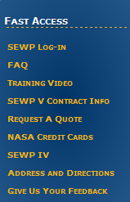
For more information:
http://www.sewp.nasa.gov
Frequently Asked Questions

Slide 21
Questions?

Slide 22
Thank You!

