Slide 1
Regional Forecast of Contract Opportunities
Small Business Works 2023
U.S. General Services Administration

Slide 2
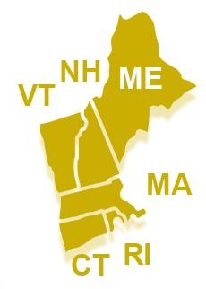
Region 1
New England Region
Forecast of Contract Opportunities

Slide 3
Regional Leadership
Acting Regional Administrator & PBS Regional Commissioner
Glenn Rotondo
Competition Advocate
Matthew Bailey
R1 Acquisition Management Division Director
James Adamo
Regional OSDBU
Jerry Smith
jerry.smith@gsa.gov

Slide 4
New England Forecast Opportunities
Total 2023 Opportunities
76 Contract actions in the Planning and the Drafting solicitation stages
Planned Order of Magnitude Broken Down by Minimum Value
(Does Not Include Bipartisan Infrastructure Law Contracts)
Below $150K 29
$150K to $250K 15
$251K to $500K 10
$501K to $1M 10
$1.1M to $2M 8
$2.1M to $5M 1
$5.1M to $10M 1
$20.1M to $50M 1
$50.1M to $100M 1
Acquisition Gateway (gsa.gov)

Slide 5
New England IDIQ for General Construction Services
Geographical Location
(3) Zonal opportunities and separate vehicles in New England for Construction Services in:
North (Maine, New Hampshire, Vermont)
Boston (Massachusetts)
South (Southern Massachusetts, Rhode Island, and Connecticut)
Ordering Limitations & Periods
Maximum Ordering Limit, $125 Million
Task Order Limits: $4,000,000.00
Solicitation Milestones
Currently estimated to release the Request for Proposal in late November
Small Business Set-Aside is anticipated
To begin on or about October 1, 2023
Base and 4, 1 Year Option Periods (5 year total)

Slide 6
Vermont Land Ports of Entry (LPOE)
Five (5) Bipartisan Infrastructure Law (BIL) projects in Vermont.
Estimated magnitude of construction:
Highgate Springs: ($155M - $185M)
Alburg Springs: ($10M - $35M)
Beebe Plain: ($15M - $45M)
Norton: ($15M - $45M)
Richford: ($15M - $45M)

Slide 7
Vermont LPOE
Contract Construction Management as Advisor has been awarded to two companies because Highgate Project is very complicated.
For Highgate:
APSI Construction Management
For the rest of Vermont:
CBRE Heery, Inc.

Slide 8
Maine Land Ports of Entry (LPOE)
Five (5) Bipartisan Infrastructure Law (BIL) projects in Maine.
Estimated magnitude of construction:
Coburn Gore: ($75M - $105M)
Calais-Ferry Point: ($25M - $50M)
Fort Fairfield: ($25M - $55M)
Limestone: ($10M - $35M)
Houlton: ($15M - $45M)

Slide 9
Maine LPOE
Contract Construction Management as Advisor has been awarded to:
Jacobs

Slide 10
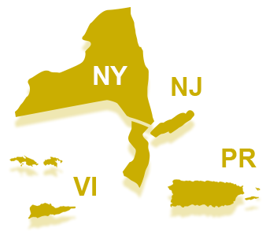
Region 2
Northeast and Caribbean Region
Forecast of Contract Opportunities

Slide 11
Regional Leadership
Regional Commissioner
Michael Gelber
Competition Advocate
Warren Hall
R2 Acquisition Management Division Director
David McDonald
Regional OSDBU
Jemeek Morris
jemeek.morris@gsa.gov

Slide 12
Multiple Award A/E IDIQ for Puerto Rico and USVI
NAICS: 541310 - Architectural Services
Procurement Method: Open Market - New Contract
Estimated Award FY Quarter: FY23 Q4
Expected Competition: Full and Open Competition
GSA anticipates the award of 3 IDIQ contracts
Expected Set Aside: Small Business - Total
Maximum Ordering Limitation (Maximum Contract Value): $15,000,000
Award Status: Planning (Sources Sought: 47PC0223Q0002)

Slide 13
GC - Trout River LPOE
NAICS: 236220
Procurement Method: Open Market - New Contract
Estimated Award FY Quarter: FY23 Q4
Expected Competition: Full and Open Competition
Expected Set Aside: No Set-Aside Used
Estimated Magnitude of Construction: Between $15,000,000 and $25,000,000
Award Status: Planning (Sources Sought: 47PC0323N0002)

Slide 14
GC - Rouses Point LPOE
NAICS: 236220
Expected Procurement Method: Open Market - New Contract
Estimated Award FY Quarter: FY23 Q4
Expected Competition: Full and Open Competition
Expected Set Aside: No Set-Aside Used
Estimated Magnitude of Construction: More than $10,000,000
Award Status: Planning (Sources Sought: 47PC0323N0001)

Slide 15
Wetland Mitigation Services - Rouses Point LPOE
NAICS: 237990
Procurement Method: Open Market - New Contract
Estimated Award FY Quarter: FY23 Q4
Competition: Full and Open Competition
Set Aside: No Set-Aside Used
Estimated Magnitude of Construction: Between $500,000 and $1,000,000
Award Status: Solicitation: 47PC0323N0003

Slide 16
Wetland Mitigation Services - Trout River LPOE
NAICS: 541620
Expected Procurement Method: Open Market - New Contract
Estimated Award FY Quarter: FY23 Q4
Expected Competition: TBD
Expected Set Aside: Small Business - Total
Estimated Magnitude of Construction: Between $100,000 and $250,000
Award Status: Planning

Slide 17
Syracuse Consolidated O&M
NAICS: 561210
Expected Procurement Method: GSA Schedules
Estimated Award FY Quarter: FY23 Q4
Expected Competition: TBD
Expected Set Aside: TBD
Award Status: Planning

Slide 18
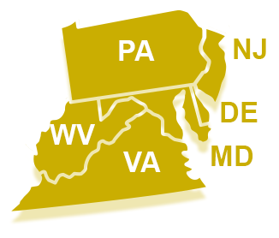
Region 3
Mid-Atlantic Region
Forecast of Contract Opportunities

Slide 19
Regional Leadership
Regional Commissioner
Joanna Rosato
Competition Advocate
Tom Lyman
R3 Acquisition Management Division Director
Doreen Waltrich
Regional OSDBU
Helena Koch
helena.koch@gsa.gov

Slide 20
Clarksburg Courthouse Prospectus Project
Project Title & Location
Clarksburg Courthouse Prospectus Project located in Clarksburg, WV
Magnitude of Construction
$25 Million - $100 Million
Anticipated Solicitation Date
4th Quarter of Fiscal Year 2023
Anticipated Award Date
2nd Quarter of Fiscal Year 2024

Slide 21
SSA Headquarters Altmeyers Columns Project
Project Title & Location
Full Utility, Column, and Cathodic Protection Repair located in Woodlawn, MD
Magnitude of Construction
$10 Million - $25 Million
Anticipated Solicitation Date
2nd Quarter of Fiscal Year 2024
Anticipated Award Date
3rd Quarter of Fiscal Year 2024

Slide 22
Inflation Reduction Act (IRA) Region 3 Program
All MEP Projects (Lighting, Chillers, BAS, etc.)
Albert V. Bryan US Courthouse (Alexandria, VA)
Magnitude of Construction: $10M - $25M
Anticipated Construction Award: FY25
William J. Nealon US Courthouse (Scranton, PA)
Magnitude of Construction: $10M - $25M
Anticipated Construction Award: FY25
Southern Maryland Courthouse (Greenbelt, MD)
Magnitude of Construction: $10M - $25M
Anticipated Construction Award: FY25

Slide 23
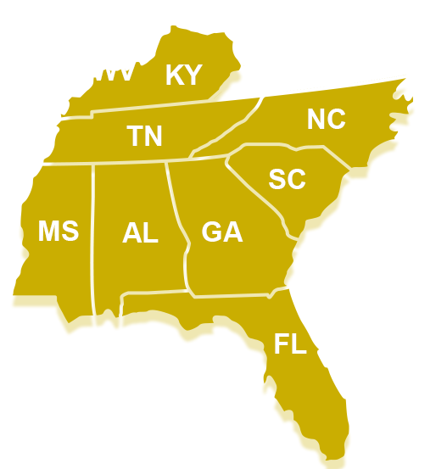
Region 4
Southeast
Sunbelt Region
Forecast of Contract Opportunities

Slide 24
Regional Leadership
Acting Regional Commissioner
Giancarlo Brizzi (GC)
Competition Advocate
Pamela Mitschke
R4 Acquisition Management Division Director
Cynthia Hall (Acting)
R4 OSDBU
Major George
Paula Mensah

Slide 25
Region 4 PBS Acquisition Management Division
4 Tactical Branches (Operation and Maintenance, Janitorial, and Construction under prospectus)
Blue Ridge East
North and South Carolina
Brenda Myers (brenda.myers@gsa.gov)
Blue Ridge West
Kentucky and Tennessee
Mark Bentley (mark.bentley@gsa.gov)
Gulf Coast Branch
Florida and Mississippi
Duncan Warner (duncan.warner@gsa.gov)
Southern Branch
Georgia and Alabama
Wanda George-James (wandageorge-james@gsa.gov)

Slide 26
Region 4 PBS Acquisition Management Division
Capital Branch
Capital Projects over Prospectus
Cathal Duffy (cathal.duffy@gsa.gov)
Special Projects Branch
Regional Elevator, Energy, Utilities
Kimura Armstead (kimura.armstead@gsa.gov)
Strategic Support Branch
Indefinite Delivery Indefinite Quantity (IDIQ)
Job Order Construction Contract (JOCC)
Regional Contracts (Relocation, Furniture)
Karen Dukes (karen.dukes@gsa.gov))

Slide 27
Region 4 - Southeast Sunbelt Region
Forecast of Contract Opportunities
Construction Services Indefinite Delivery, Indefinite Quantity - Multiple Awards - 250K and below
Anticipated Award - 1st Quarter
GA- Indefinite Delivery, Indefinite Quantity- Construction Services
Anticipated Award - 4th Quarter
Regional Roofing Indefinite Delivery, Indefinite Quantity
Anticipated Award - 4th Quarter

Slide 28
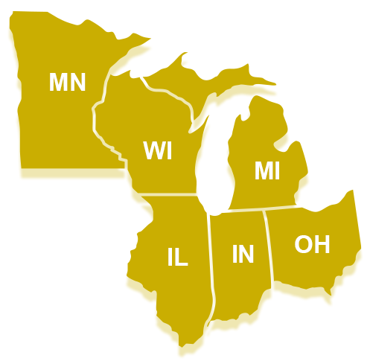
Region 5
Great Lakes Region
Forecast of Contract Opportunities

Slide 29
Repair & Alterations Opportunities in Region 5
Diana E. Murphy U.S. Courthouse Garage Door in Minneapolis, MN.
Current Status: Planning Stage
Procurement Type: TBD (Likely to be total Small Business set-aside)
Procurement Method: Open Market
Anticipated Quarter for Solicitation: 2nd quarter
Anticipated Quarter of Award: 3rd Quarter
Anticipated Contract Start Date: October, 2023 (1st Quarter, FY24 )

Slide 30
Building Services Opportunities in Region 5
Chicago O&M at Metcalfe Fed. Bldg. 77 W. Jackson Blvd. Chicago. IL.
Sources Sought responses due 10/21/22
Procurement Type: TBD (Current contract is Small Business set-aside)
Procurement Method: GSA Schedule
Anticipated Quarter for Solicitation: 12/01/22 (1st quarter)
Anticipated Quarter of Award: 4/01/23 (3rd Quarter)
Anticipated Contract Start Date: 6/01/2023 (3rd Quarter)

Slide 31
Building Services Opportunities in Region 5
O&M and Elevator Services at Minton-Capehart FB, Indianapolis, IN.
Current Status: Planning Stage
Procurement Type: TBD (pending Sources Sought notice results)
Procurement Method: GSA Schedule
Anticipated Quarter for Solicitation: (2nd quarter)
Anticipated Quarter of Award: (3rd Quarter)
Anticipated Contract Start Date: 8/01/2023 (4th Quarter)

Slide 32
Building Services Opportunities in Region 5
Consolidated Building Management Services Minnesota & Wisconsin
Eau Claire, WI FB & USCH (FM, O&M, Elevator, & Janitorial)
Robert W. Kastenmeier USCH, Madison, WI. (FM, O&M, Elev., & Janitorial)
Bishop Henry Whipple FB, Ft. Snelling, MN. (FM, O&M, & Elevator)
W.E. Burger FB & USCH, St. Paul, MN. (Elevator)
Solicited as a total SB set-aside via MAS (eBuy)
Sol. anticipated to be available in Quarter 1
Anticipated award: Quarter 3
Anticipated Start Date: 7/01/2023

Slide 33
Capital Construction Opportunities in Region 5
Two Upcoming Bipartisan Infrastructure Law (BIL) projects in MN:
International Falls (preliminary date: Feb. 2023):
The International Falls Land Port of Entry, built in 1993, located at the foot of the international bridge across the US-Canada border from Ft. France, Ontario. It is the highest traffic volume port in Minnesota, and currently processes more traffic than it was designed to accommodate. The project will expand the capacity of the port to process trade and travelers, enhance security and safety, and allow tenant federal agencies to more effectively carry out their missions. The estimated year of completion is 2029.

Slide 34
Capital Construction Opportunities in Region 5
Two Upcoming Bipartisan Infrastructure Law (BIL) projects in MN (continued):
Grand Portage (preliminary date: Dec. 2023):
The Grand Portage project will involve increasing the number of traffic lanes to improve safety between commercial and non-commercial traffic, along with improved facilities for screening of passenger buses, recreational vehicles, and secondary inspection areas. The project will also include the design and construction of hard surface areas, canopy areas, and enclosed facility space.

Slide 35
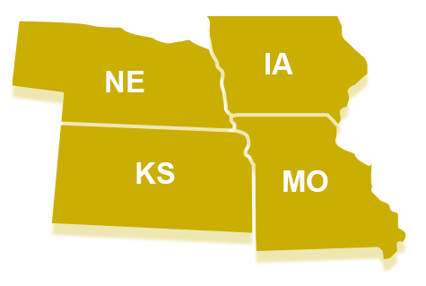
Region 6
The Heartland Region
Forecast of Contract Opportunities

Slide 36
Leadership for PBS R6
David Rumsey – Acting Regional Commissioner for PBS Region 6
Shellie Gill – Acting Deputy Regional Commissioner
Terrence Cowley – Acquisition Management Director
William Strobel- OSDBU Representative
Heartland Region
Small Projects Branch
Construction Branch
Capital Construction & IDV Branch
Service Branch
Policy and Oversight Branch

Slide 37
Service Contract Opportunities
Services
Hannibal, MO Facilities Maintenance
Will be a total small business set-aside
Combined Maintenance - Dole Courthouse, Topeka Federal Building, and Wichita Federal Courthouse
Will be a total small business set-aside
Combined Maintenance - Dole Courthouse, Topeka Federal Building, and Wichita Federal Courthouse
Will be a total small business set-aside

Slide 38
Construction Opportunities
IDV Opportunities
Small Business Construction MATOC
Construction Subcontracting Opportunities
Kansas City, MO - West Dock & Ramps
Estimated Cost - $1,000,000 - $5,000,000
Overland, MO - Curtainwall Phase 3
Estimated Cost - $1,000,000 - $5,000,000
Topeka, KS - Parking Lot & Perimeter Security
Estimated Cost - $1,000,000 - $5,000,000
Lincoln, NE - Sidewalks, Ramps, & Perimeter Security
Estimated Cost - $1,000,000 - $5,000,000
Des Moines, IA - Neal Smith Facade
Estimated Cost - $1,000,000 - $5,000,000

Slide 39
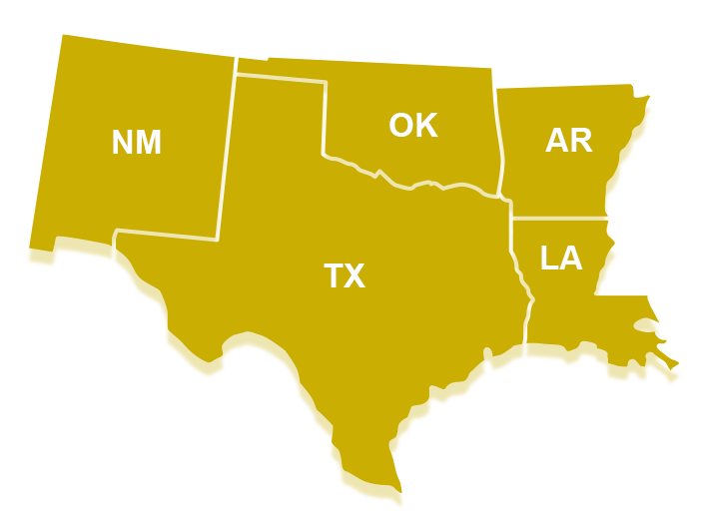
Region 7
Greater
Southwest Region
Forecast of Contract Opportunities

Slide 40
Overview of Region 7
Leadership
Giancarlo Brizzi - PBS Regional Commissioner
Jared Bradley - PBS Deputy Regional Commissioner
Carolyn Smith - Acquisition Management Division Director
Location
Texas, New Mexico, Oklahoma, Arkansas and Louisiana
Acquisition Management Division Branches
Program Support
Capital Investment Program, Regional Support, Indefinite Delivery Indefinite Quantity (IDIQ)
Non-Prospectus Design and Construction
Services
Energy & Acquisition Support

Slide 41
Contract Opportunities - Program Support
Capital Investment Program
Inflation Reduction Act (IRA) and Bipartisan Infrastructure Legislation (BIL) Projects:
Paving at various Land Ports of Entry (LPOE)
Paving construction work at various ports along the border
Three (3) projects have been identified in a Pilot Program: Ysleta, World Trade and Pharr
Awards anticipated in FY24
Set aside for small business concerns
Between $1M - $20M each
BOTA Design Build Construction Project
National Complex Construction IDIQ (large business)
Construction anticipated FY25/26
Over $100 million
Design Build
Brownsville Gateway LPOE BIL Project
National Complex Construction IDIQ (large business)
Construction anticipated FY25/26
Over $100 million
Design Build
POC: Marsha Howard (marsha.howard@gsa.gov)

Slide 42
Contract Opportunities - Program Support
Indefinite Delivery Indefinite Quantity (IDIQ) Section
Zonal Construction IDIQs:
GC/DB Construction multiple award IDIQs to be awarded in 12 zones.
Total Small Business Set-Aside
Between $2M and $8M MOL per contract per year for 5 years.
Multiple awards through 2026 with first two zones to be awarded November 2023
Architect - Engineering IDIQ
Single Award Architect Engineer IDIQs to be awarded in 3 zones (DFW, Louisiana and SE TX)
Set-Aside determination for each zone TBD
$15M MOL per contract over 5 years.
Anticipated award September 2024
POC: Matt Deptuch (matthew.deptuch@gsa.gov)

Slide 43
Contract Opportunities - Regional Support
Indefinite Delivery/Indefinite Quantity (IDIQ) Procurement for Real Estate Appraisals and Appraisal Consulting Services
Current appraisals are for Market Value (MV) and Fair Annual Rental (FAR) assessments
Solicitation 47PH1021R0001 - Total Small Business Set-Aside
Maximum Ordering Limitation (MOL) - $2,000,000
Contracting Officer - Darryl Henderson (darryl.henderson@gsa.gov)

Slide 44
Contract Opportunities - Non-Prospectus Construction
Office Renovation, Albuquerque, NM
Albuquerque Historic Courthouse
Solicitation (47PH0623R0046) issued 7/20/2023 - Total Small Business Set-Aside
Anticipated award date - Sep 2023
Order of Magnitude - $1,000,000 - $5,000,000
IDIQ Task Order - Subcontracting opportunities
POC - Brenna Lanphear (brenna.lanphear@gsa.gov)

Slide 45
Contract Opportunities - Services
Shreveport, Monroe, & Alexandria, LA (O&M); Texarkana, AR (FM)
Anticipated Solicitation - March 2024
Services to begin 1 November 2024
Small Business Set Aside anticipated
GSA Schedules Anticipated
Contracting Officer - Thomas Holguin (Thomas.Holguin@gsa.gov)

Slide 46
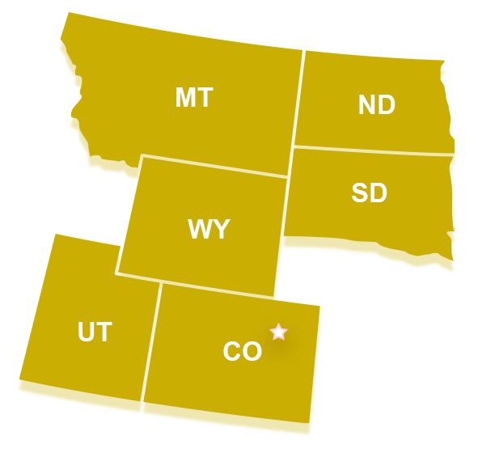
Region 8
Rocky Mountain Region
Forecast of Contract Opportunities

Slide 47
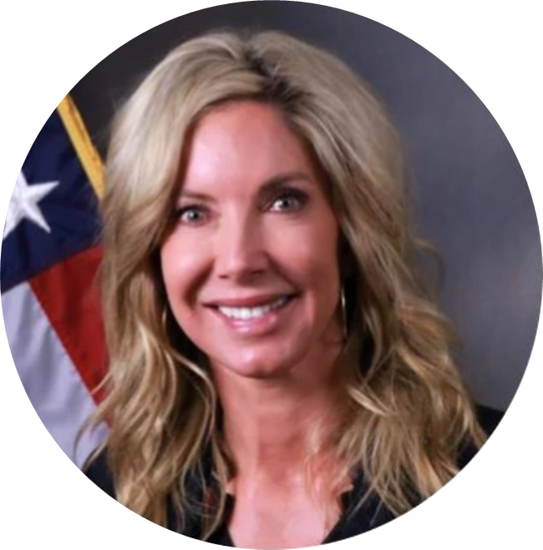
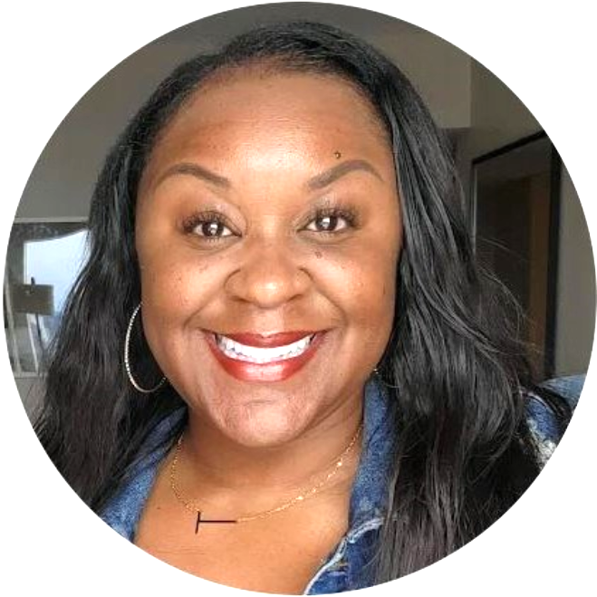
Regional 8 - Leadership
Tanisha Harrison
R8 Regional Commissioner
Tanya Burks
Acquisition Division Director
Chasity Ash
Zone 3 & 4 Supervisory (Acting) Region 8 Small Business Technical Advisor (OSDBU)

Slide 48
Recurring Opportunities
Anticipated Milestone Dates
DFC West Full Facilities
Facilities Engineering and Custodial
Set Aside: Small
Solicitation Date: 4th Quarter FY 23
Award Date: 2nd Quarter FY 24
Downtown Denver O&M
Facilities Engineering Includes Boulder Facility
Set Aside: Small
Solicitation Date: 3rd Quarter FY 23
Award Date: 2nd Quarter FY 24
Denver Federal Center Landscape and Snow Removal
Landscape and Snow Removal
Set Aside: Full and Open
Solicitation Date: 1st Quarter FY 24
Award Date: 3rd Quarter FY 24

Slide 49
Other Opportunities
Wallace F. Bennett Roof Project
Salt Lake City, UT
Set Aside: 8(a)
Dollar Value: $2.1M-$5M
Wyoming Job Order Construction Contract (JOCC)
Casper and Cheyenne, WY
Set Aside: Women Owned
Dollar Value: $2.1M-$10M

Slide 50
Other Opportunities
Video Materic BIM Wallace F. Bennett
Salt Lake City, UT
Set Aside: 8(a)
Dollar Value: Under $100k
Hatch Courthouse Window Replacement
Orrin G. Hatch Federal Courthouse, Salt Lake City, UT
Set Aside: 8(a)
Dollar Value: $150K-$250K
BWCH AHU Replacements
Byron White Courthouse, Denver, CO
Set Aside: Hubzone
Dollar Value: $1.1M-$2.0M

Slide 51
Other Opportunities
Fall Protection
Denver, CO
Set Aside: Small Business
Dollar Value: $501K to $1M
ICE Core
Lakewood, CO
Set Aside: None (subcontracting opportunities 4th Quarter 2023)
Dollar Value: $10.1M to $20M
FDA LAB
Lakewood, CO
Set Aside: None (subcontracting opportunities 1st quarter 2024)
Dollar Value: Over $100M

Slide 52
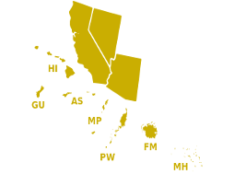
Region 9
Pacific Rim Region
Forecast of Contract Opportunities
AZ
NV
CA

Slide 53
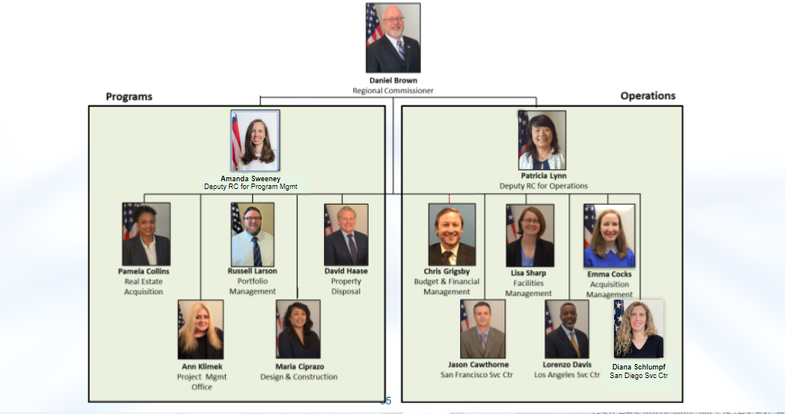
Region 9 PBS Senior Leadership Team

Slide 54
Pacific Rim Region Region 9 Information
General Information: The Pacific Rim Region has nearly 530 employees, manages 36.5 million square feet of workspace, owns 179 assets, and manages over 900 leases in California, Arizona, Nevada, Hawaii, and Pacific Island Territories
Headquarters: 50 United Nations Plaza Federal Building in San Francisco, California
Three services centers:
Los Angeles Services Center (LASC)
San Diego Service Center (SDSC)
San Francisco Service Center (SFSC)

Slide 55
R9 Building Services Forecast FY23 & FY24
Service Type | Location | Set-Aside | Fiscal Year | Planned Award
O&M/Vertical Transportation Equipment Services (VTE) | Los Angeles, CA | SB | FY24 | Dec 2023
O&M/VTE | Los Angeles, CA | SB | FY24 | Apr 2024
Custodial | San Diego, CA | 8(a) Competitive | FY24 | Nov 2023
O&M/VTE/Custodial Complete Facility Maintenance (CFM) | Yuma & San Luis, AZ | SB | FY24 | Nov 2023
Custodial | Oakland, CA | 8(a) Sole Source | FY24 | Oct 2023
Custodial | San Francisco, CA | 8(a) Competitive | FY24 | Feb 2024
O&M | San Francisco, CA | SB | FY24 | Feb 2024
VTE | San Francisco, CA | SB | FY24 | Feb 2024

Slide 56
R9 Prospectus & Capital Construction Projects
Project Title | Location | Type of Work | Range | Set-Aside | Planned Award Fiscal Year (FY)
300 North Los Angeles Cooling Tower Replacement (Listing ID # 40312) | Los Angeles | Construction | $5-10M | SB Set Aside | FY23
11000 Wilshire 24-7 HVAC Construction Procurement (Listing ID # 40282) | Los Angeles | Construction | $5-10M | SB Set Aside | FY23
Raul Hector Castro LPOE | Douglas, AZ | Construction | >$10M | Full/Open | FY27
Douglas LPOE | Douglas, AZ | Construction | >$10M | Full/Open | FY24
PJKK Atrium Glazing | Honolulu, HI | Construction | $5-10M | TBD | FY24
HUD Tenant Improvement | San Francisco, CA | Construction | >$10M | TBD | FY24

Slide 57
Regional Construction & A/E Contract Vehicles
These contract vehicles will provide subcontracting opportunities:
Regional Construction IDIQ, 5 Year PoP, Awarded Feb 2021 and expires Feb 2026.
Zone 1 - Arizona/Nevada, 10 Awardees
Zone 2 - Northern California, 16 Awardees
Zone 3 - Hawaii, 10 Awardees
Zone 4 - Southern California, 13 Awardees
Regional AE IDIQ, 5 year PoP, Awarded Dec 2019
Zone 1 - Arizona/Nevada, 6 Awardees
Zone 2 - Northern California, 7 Awardees
Zone 3 - Southern California, 11 Awardees
Zone 4 - Hawaii and Pacific Territories, 6 Awardees
AE IDIQ will expire Dec 2024

Slide 58
Regional Construction & A/E Contract Vehicles
These contract vehicles will provide subcontracting opportunities:
Regional Construction IDIQ, 5 Year PoP, Awarded Feb 2021 and expires Feb 2026.
Zone 1 - Arizona/Nevada, 10 Awardees
Zone 2 - Northern California, 16 Awardees
Zone 3 - Hawaii, 10 Awardees
Zone 4 - Southern California, 13 Awardees
Regional AE IDIQ, 5 year PoP, Awarded Dec 2019
Zone 1 - Arizona/Nevada, 6 Awardees
Zone 2 - Northern California, 7 Awardees
Zone 3 - Southern California, 11 Awardees
Zone 4 - Hawaii and Pacific Territories, 6 Awardees
AE IDIQ will expire Dec 2024

Slide 59
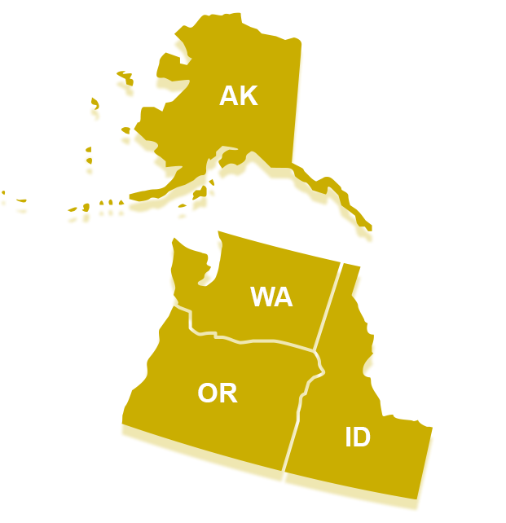
Region 10
Northwest
Arctic Region
Forecast of Contract Opportunities

Slide 60
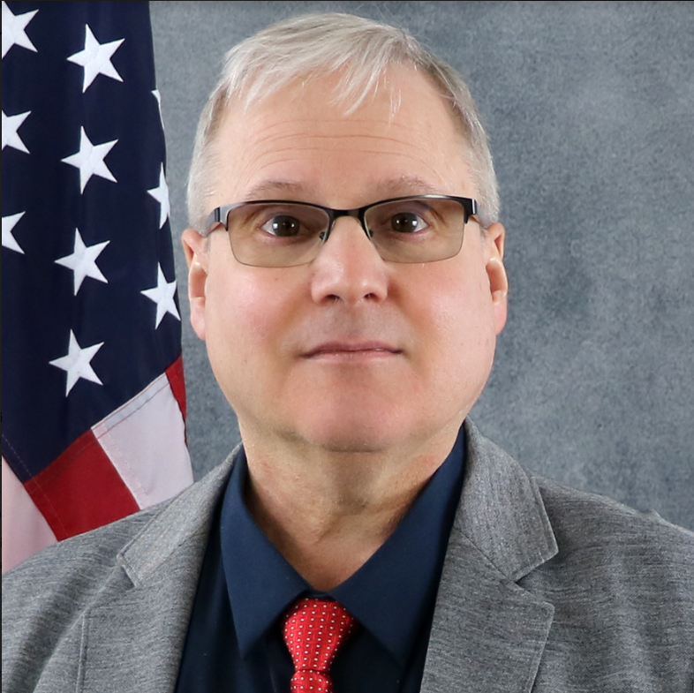
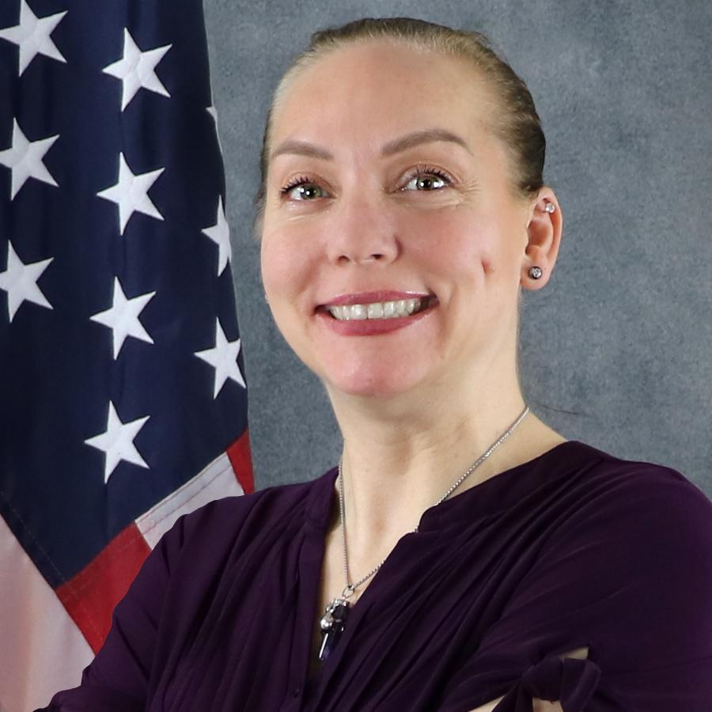
Regional 10 - Leadership
Lisa Pearson
PBS Regional Commissioner
Cynthia Tolentino
PBS Deputy Regional Commissioner
Paul Reed
Acquisition Division Director
Thomas Ebenhoh
Acquisition Services Branch Chief
Heather Bowden
Acquisition Construction Branch Chief
**Regional SBTA: Alex Stutzman

Slide 61
Get to know Region 10
The Region spans Alaska, Idaho, Oregon, and Washington. Our pioneering spirit embraces innovative ways of doing business, and reflects an environmental consciousness that advocates stewardship of our abundant natural resources in keeping with GSA's mandate to champion a more sustainable organization.
Government landlord
We employ approximately 275 full time and contract employees.
We develop and deliver PBS programs, projects and services to GSA customers located in Alaska, Idaho, Oregon and Washington.
We serve customers located in 531 GSA-owned (106 properties, 8.1 million sf) and leased buildings (425 properties, 7.1 million sf) totalling 15.17 million sf, that generate $379 million in revenue.

Slide 62
FY 23 & 24 Contract Opportunities
Recurring Service Opportunities
Small Repair & Alterations Program Reimbursable Work Authorization Program
Construction Opportunities
Western MATOC (Western Washington)
Southern MATOC (Oregon)
Capital Construction Opportunities
Tacoma Union Station - Electrical Upgrades
BIL (Building Infrastructure Law) LPOE
LPOE Pacific Highway
LPOE Porthill, ID
LPOE Lynden, WA
LPOE Sumas, WA
LPOE Alcan, AK

Slide 63
Services Contract Opportunities
FY 23 & 24 New Base Contracts O&M
Portland Area Building Base O&M Services
Western WA LPOE Grounds Services
911 Portland Elevator Maintenance
Edith-Green Wendell Wyatt Portland Elevator Maintenance
Asbestos & Air Monitoring Region 10
Fire Safety Inspections Region 10
Fire Alarm Monitoring Oregon
Opportunities will be posted through FSS eBuy and/or SAM.gov

Slide 64
Construction Contract Opportunities
FY 23 & 24 Capital Construction
Tacoma Union Station Electrical Upgrades
RFP Issue: FY24 Q2
*FY 23 & 24 Small Projects (Repair and Alterations)
Construction: Estimated $16.5M / annual
O&M Repair: Estimated $8.5M / annual
*FY23 & 24 Customer Reimbursable Work Authorization (RWA)
Estimated $30M
Note: * Region 10 prioritizes utilization of MATOC contracts and existing Regional and National IDVs for Small Project requirements

Slide 65
Construction IDV Opportunities
Western MATOC
Estimated Award Date: September 2023
CMV: $50M - $75M
Term: Five Years
Service Area: North and South Puget Sound, WA.
Alteration & Repair Projects from $150K to $5M
Southern MATOC
Estimated Award Date: November 2023
CMV: $50M - $75M
Term: Five Years
Service Area: Oregon and Southern ID
Alteration & Repair Projects from $150K to $5M

Slide 66
Region 10 BIL Land Port of Entry Opportunities
$30M
$55M
$90M
$150M
$185M
Land Port of Entry Pacific Highway, Blaine WA.
Land Port of Entry
Porthill, ID.
Land Port of Entry Sumas WA.
Land Port of Entry Kenneth G Ward, Lynden WA.
Land Port of Entry
ALCAN Tok, AK.
Expansion of the site through land acquisition, new construction, and major repairs and alterations to enhance the LPOE's space capacity and create efficient inbound and outbound operations.
Site acquisition and construction of a new LPOE. This project will improve inbound and outbound operations by optimizing traffic flow.
Design, and construction to modernize the existing LPOE in Alcan, AK. ALCAN is the most isolated port of entry between the United States and Canada.
Design & Construction of a new LPOE that will include the replacement of the obsolete main port building.
Inspection Area and Lane Expansion Modernization
PDS/CMA RFP: Jul 2023
FSS ebuy or BPA
Design/Construction
Sources Sought : Sept 2023
RFP to SAM: Mar/Apr 2024
Occupancy Date: October 2028
PDS/CMA RFP: Jan - Feb 2023
FSS ebuy or BPA
Design/Construction
Sources Sought : Jan 2024
RFP to SAM: April 2024
Occupancy Date: February 2030
PDS/CMA RFP: Jan - Feb 2023
FSS ebuy or BPA
Design/Construction
Sources Sought : Jan 2024
RFP to SAM: April 2024
Occupancy Date: January 2029
PDS/CMA RFP: Jan - Feb 2023
FSS ebuy or BPA
Design/Construction
Sources Sought : Jan 2024
RFP to SAM: April 2024
Occupancy Date: January 2029
CMA/CXA award Dec 2022
8(a) Design Build
RFP: Oct 2023
SCD January 2026
66
*Dates are tentative based on predecessor activities required prior to procurement

Slide 67
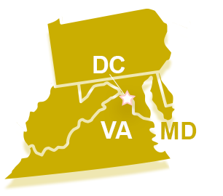
Region 11
National
Capital Region
Forecast of Contract Opportunities

Slide 68
Region 11 Area of Coverage
Our employees manage, build, construct and lease approximately 100 million square feet of federal workspace. This portfolio comprises 43 million square feet of owned space, and 57 million square feet of leased space. Currently, PBS oversees the new U.S. Coast Guard and Department of Homeland Security Headquarters project, the largest construction project in the country. Inherently, PBS continues to be a worldwide force for innovation in commercial real estate.
Headquartered in Washington, DC at the 1800 F St. NW Washington, DC
How much business do we do? More than $456 million in FY22.
Forecasting several prospectus projects for FY23

Slide 69
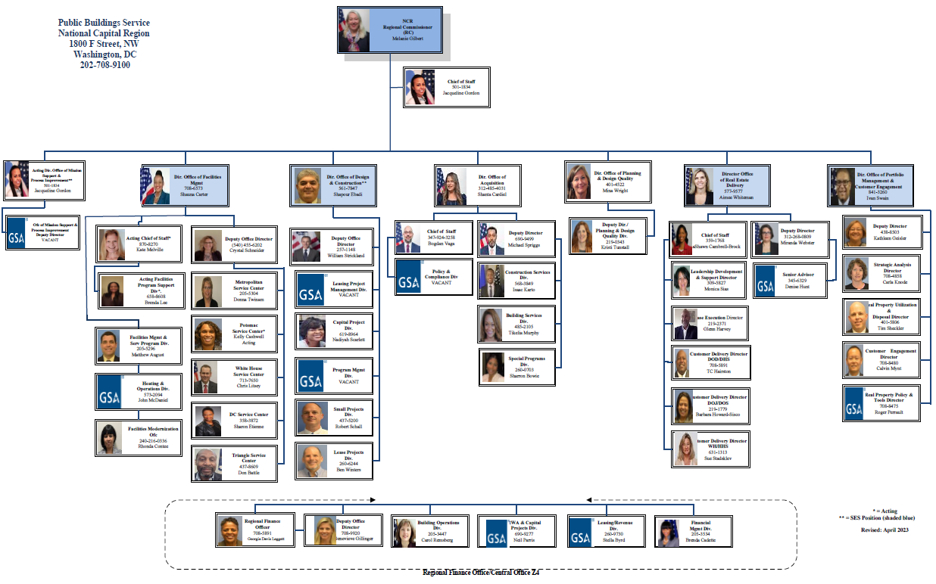
Region 11 PBS Senior Leadership Team

Slide 70
Concessions Opportunities
Dining Services at the Department of Labor
Site visit held: 7/18
Proposals due: 8/10
Contracting Officer: Pat Davis
Dining Services at the Federal Aviation Administration
Expected Solicitation: 8/4
Contracting Officer: Pat Davis
Dining Services at US Patent & Trademark Office
Expected Solicitation: 8/4
Contracting Officer: Pat Davis
All opportunities will be posted on
www.sam.gov

Slide 71
PBS-National Capital Region Industry Events
NCR hosts Bi-Weekly “Networking Half Time” events.
The purpose of this meeting is to allow a specific contractor to present on their company to all business lines of the region. In order to inquire about signing up for this event, please contact the following email address:
apac.request@gsa.gov
Please add “Interest in Presenting at Networking Halftime Sessions” to your subject line.

Slide 72
Acquisition Center for Facilities Management
Forecast of Contract Opportunities

Slide 73
Center Leadership
Regional Commissioner
Joanna Rosato
Competition Advocate
Tom Lyman
Acquisition Center for Facilities Management Division Director
Liliana DelBonifro/Stephanie Hill (Acting)
Regional OSDBU
Helena Koch
helena.koch@gsa.gov

Slide 74
Acquisition Center for Facilities Management Services
ACFMS includes three GSA Regions
Region 3, Mid-Atlantic Region
Region 4, Southeast Sunbelt Region
Region 11, National Capital Region
Areas of Responsibility
Custodial Services
Facilities Engineering Operations & Maintenance
Combined Facilities Management (CFM)
Elevator Services

Slide 75
Acquisition Center for Facilities Management Services
Use of Multiple Award Schedules
Utilized for the procurement of Facilities Engineering Operations & Maintenance Services (O&M) and Complete Facilities Maintenance (CFM)
Supportive of Spend Under Management (SUM)/Best in Class (BIC) Strategy adopted in 2018 to more effectively manage contract spending and reduce contract duplication
Utilization of small business concerns is a priority

Slide 76
Acquisition Center for Facilities Management Services
Multiple Award Schedule (MAS) Eligibility Requirements
Speciality Item Numbers (SINS)
Facilities Maintenance & Management (561210FAC)
Ancillary Supplies & Services (ANCILLARY)
Ancillary Repair & Alterations (ANCRA)
Order Level Materials (OLM)
GSA Schedule contract ultimate 20-year expiration date must be after the anticipated date of last option period (plus potential 6 month extension) or have a continuous contract in place

Slide 77
Acquisition Center for Facilities Management Services
Upcoming Requirements
CFM Requirements
Opportunities will be posted to e-Buy and/or solicited in accordance FAR 8.405-3(b)
Custodial
In accordance with 8.704 Purchase priorities, GSA purchases services on the Procurement List from AbilityOne participating nonprofit agencies
Limited opportunities available via sam.gov (none identified for FY 2024)

Slide 78
Region 4 Atlanta North CFM
Project Title & Location
Atlanta North Complete Facilities Services (CFM) in Atlanta, GA
Anticipated Solicitation Date
FY2024
Anticipated Award Date
FY2024

Slide 79
Region 4 Atlanta Metro CFM
Project Title & Location
Atlanta Metro Complete Facilities Services (CFM) in Atlanta, GA
Anticipated Solicitation Date
FY2024
Anticipated Award Date
FY2024

Slide 80
Region 11 IRS NC & SSMC CFM
Project Title & Location
IRS New Carrollton (NC) & Silver Spring Metro Center (SSMC) Consolidated Facilities Services (CFM) in Lanham, MD and Silver Spring, MD
Anticipated Solicitation Date
July 24, 2024
Anticipated Award Date
FY2024

Slide 81
Region 11 FBI WFO CFM
Project Title & Location
FBI Washington Field Office (WFO) Consolidated Facilities Services (CFM) in Washington, D.C.
Anticipated Solicitation Date
FY2023
Anticipated Award Date
FY2024

Slide 82
QUESTIONS?

Slide 83
GSA

