Slide 1
Project Labor Agreements on
Large-Scale GSA Construction
New Procedures Under Acquisition Letter MV-2026-03
July 2026

Slide 2
Darin Frost
Deputy Assistant Commissioner
Office of Program and Project Management

Slide 3




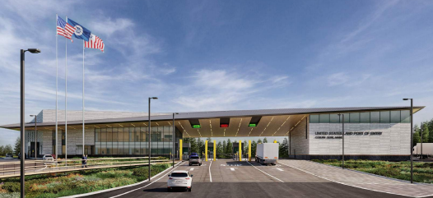
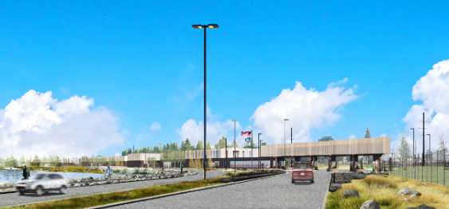
GSA Priorities
1. Optimize
2. Standardize
3. Deliver
GSA Construction Program
$116M New Construction
$718M Repair and Alterations
$804M for Repair and Alterations
$451M Optimization Fund and Judicial Security Program
Infrastructure Investment and Jobs Act: $4.2 Billion
26 Land Port of Entry Major Modernizations
FY26: $1.1 Billion
FY27: $1.3 Billion

Slide 4

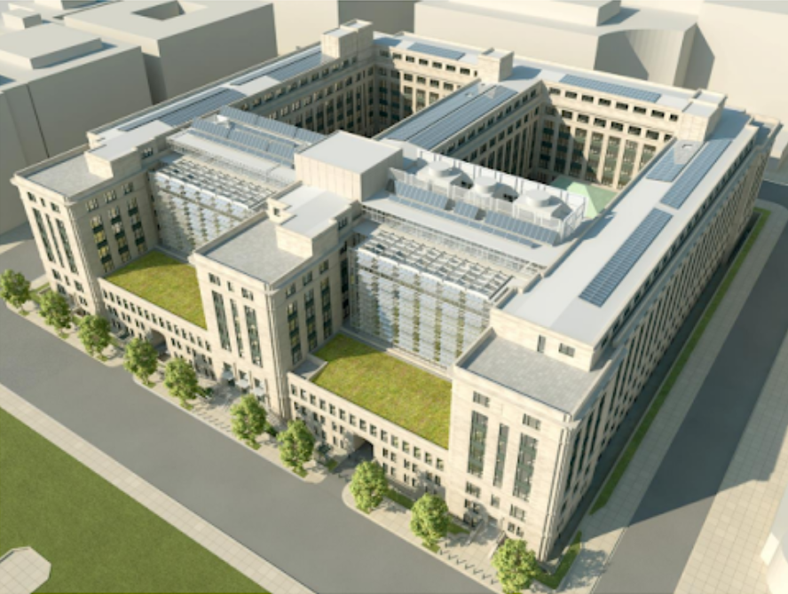
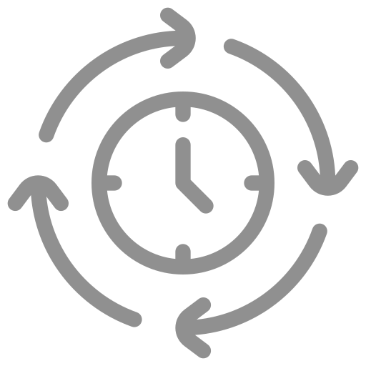
Keys To Mission Delivery
Risk Management
Agency operations
Employee safety and productivity
Customer service
Security
Public access
Reliability of building systems
Timely Execution
Critical to protecting taxpayer investment
Preserve purchasing power
Reduce operational risk
Improve mission readiness
Get critical facility improvements online sooner
Timely delivery is not just about moving faster; it is about moving smarter

Slide 5
Jeff Koses
GSA Senior Procurement Executive

Slide 6





Current State
The FAR Rule on PLAs went into effect on January 22, 2024. OMB issued two Management Memos to provide further guidance.
GSA's approach to implementing the FAR rule could be better customized to its portfolio and business processes.
Central to the current approach is expansive pre-award market research to evaluate the impact of requiring a PLA, on a project by project basis.
The Revolutionary FAR Overhaul emphasized the need to increase speed and to reduce regulatory burden and costs.
GSA has found that its approach is missing opportunities to move faster, to reduce burden, and to reduce costs.

Slide 7







Bottom Line
The new GSA Policy builds on other parts of the FAR which establish premiums for public policy goals. Differences from the old to the new approach:
Timeline
Requirement
Evaluation
Safeguard
Test the market
Require PLA price proposal; allow non-PLA price proposal
Price preference (lesser of 10% or $15M)
CO evaluates reasonableness of PLA premium
NEW Approach
Extensive analysis to predict PLA impact
Multi-level review and approval for PLA determination
Theoretical
impact
Limited pricing flexibility
Old Approach

Slide 8


Value of Time
Timeline Impacts
Market Research
Multi-level Review Process
Total Pre-Solicitation Delay
6 Weeks
7 Weeks
13 Weeks
Evaluation of PLA impact on project scope
Required for PLA exception determinations.
Cumulative impact
of the delay
Financial Impacts
On a standard $125 Million Capital Project with a 4% annual inflation rate, a 13-week delay alone results is a loss of purchasing power of almost $1.25 million per project.

Slide 9



Litigation Landscape
Court of Federal Claims
Federal District Court
11th Circuit Court
5
4
2
Protests involve GSA procurements
26 protests GOV-wide
Lawsuits challenge
EO and FAR rule
Non-union and unions are suing
Active litigation data is updated frequently. Slide content is based solely on information available to GSA as of June 2026.

Slide 10





New Approach: Paired Pricing Procedures
Process: Offerors submit both PLA and non-PLA pricing for the same scope.
Evaluation: GSA evaluates and reduces the PLA price by the lesser of 10% or $15 million and compares it to the non-PLA price, per offeror.
Selection: Best-value trade-offs are conducted using the competitive PLA or non-PLA price and corresponding technical approach.
Compliance: If a non-PLA offer wins, the paired-proposal record serves as the project-specific evidence required by EO and OMB M-25-29.
Flexibility: The FAR 22.5 pre-solicitation exception process remains available for extraordinary cases.

Slide 11

Price Evaluation Example 1 - Federal Courthouse Renovation in a Major Metropolitan Market
A federal courthouse renovation in a major metro area. The local union workforce is deep. PLA pricing competes well, and after the 10% reduction, the PLA offer is the better value. The PLA proceeds.
Offeror
PLA Proposed
Reduction Applied
PLA Evaluated
Non-PLA Proposed
Tradeoff Price
A
$140,000,000
10% ($14,000,000)
$126,000,000
$127,000,000
PLA Price $126,000,000
Outcome: Evaluated price reduced 10%. PLA price used.

Slide 12
Price Evaluation Example 2 - Federal Office Building Renovation in a Major Metropolitan Market
A federal office building renovation in a high-cost urban market. At $160 million, a 10% reduction would be $16M, exceeding the cap of $15M, so the cap applies. The PLA offer is still the better value. The PLA proceeds.
Offeror
PLA Proposed
Reduction Applied
PLA Evaluated
Non-PLA Proposed
Tradeoff Price
A
$160,000,000
($15,000,000)
$145,000,000
$155,000,000
PLA price $145,000,000
Outcome: A 10% reduction would be $16 million.
Reduction capped at $15 million. PLA price used.

Slide 13
Price Evaluation Example 3 - Land Port of Entry New Construction on a Remote Border
A Land Port of Entry on a remote border crossing. There is little local union construction capacity, and the PLA price reflects the cost of bringing labor in. Even with the $15 million reduction applied, the PLA price is not competitive. The non-PLA offer proceeds.
Offeror
PLA Proposed
Reduction Applied
PLA Evaluated
Non-PLA Proposed
Tradeoff Price
A
$200,000,000
($15,000,000)
$185,000,000
$150,000,000
$150,000,000
Outcome: A 10% reduction would be $20 million. Reduction capped at $15 million. Premium for PLA is not reasonable. Non-PLA price used.

Slide 14
Price Evaluation Example 4 - PLA Price Not Submitted
An offeror submits a non-PLA price without a paired PLA price. There is no PLA price to evaluate, so the offer cannot proceed. The procedure is not a path around the PLA requirement.
Offeror
PLA Proposed
Reduction Applied
PLA Evaluated
Non-PLA Proposed
Tradeoff Price
A
-
-
-
$138,000,000
Not eligible
Outcome: Did not propose a PLA price

Slide 15



What It Delivers
Real data, not
theoretical data
Faster procurements
Market-driven outcomes
The procedure does not pre-determine PLA cost.
Where qualified firms compete with reasonable PLA pricing, PLAs proceed and win on best value.
Where they do not, a non-PLA offer may proceed instead.
The cost evidence comes from offers on the project itself.
That record is the project-specific evidence the courts have required.
GSA makes the PLA call inside the competition, not before it.
In an inflationary market, the 13 weeks saved are 13 weeks of cost avoided.

Slide 16
Questions

Slide 17
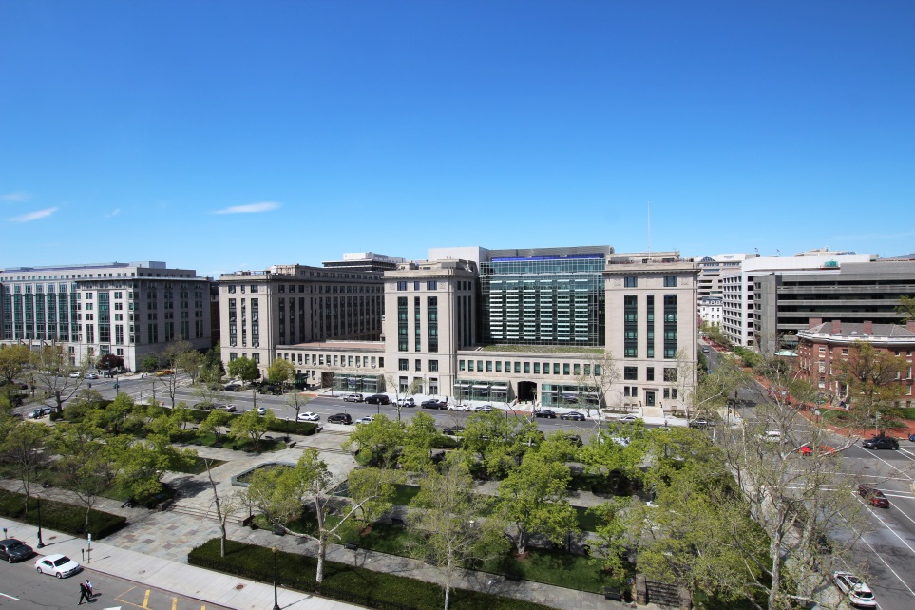
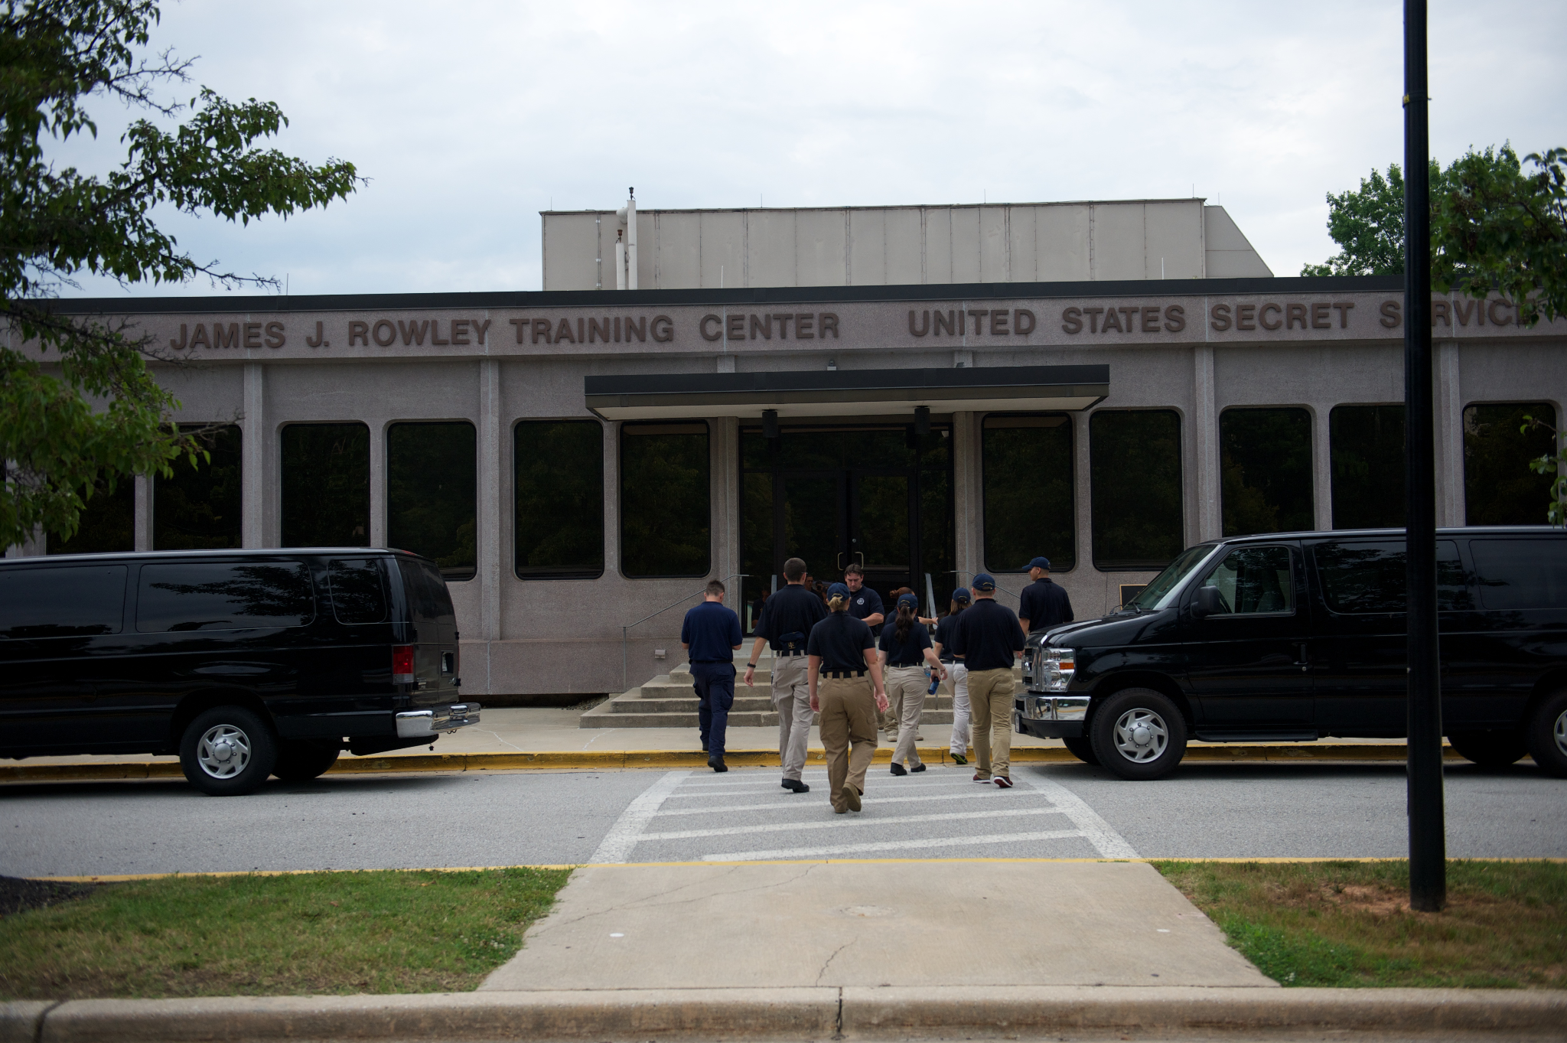

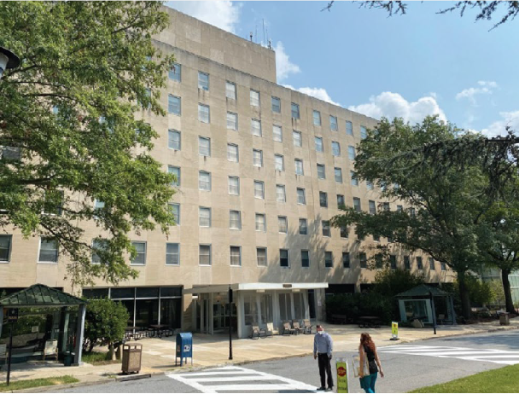
Upcoming Solicitations
GSA Headquarters
James J. Rowley Training Center (JJRTC), United States Secret Service (USSS)
1800F, CMc Construction Services for GSA Headquarters at 1800F Street NW, Washington, DC.
Estimated issue date:
July 17, 2026
Construction of a Specialized Mission Training Facility (SMTF) at the James J. Rowley Training Center (JJRTC), United States Secret Service (USSS), in Laurel, MD.
Estimated issue date:
July 8, 2026
Thurgood Marshall U.S. Courthouse
Armed Forces Retirement Home,
Sheridan Building
Elevator Modernization at the Thurgood Marshall U.S. Courthouse, New York, NY.
Estimated issue date:
August 3, 2026
(Solicitation Issued and Amended to Include the new PLA Procedure)
RFP 47PB5226R0001: Construction Services at the Armed Forces Retirement Home, Sheridan Building, Washington, DC.

Slide 18
GSA

