Slide 1
New Travel & Expense (T&E) Business Standards Review for Industry

Slide 2
Workshop Housekeeping
The workshops will be recorded and posted to the ETSNext Industry Community page on Interact
All participants are on mute and there is no individual camera access
Please use the Chat tool to report technical difficulties
Please use the Q & A functionality to ask questions
You can upvote a question, if you have the same or a similar question
Today’s Workshop will be approximately 1 hour
Workshop 2 on Thursday, October 28th will be approximately 2 hours
Workshop 3 on Tuesday, November 16th will depend on the number of FAQs that are developed and the questions asked during the open Q&A

Slide 3
Agenda
T&E Business Standards Overview - OGP
T&E Management Standards Committee Process & Schedule - OGP
Why T&E Business Standards Matter - FAS
Notes:
At this point I would like to turn it over to Tom Mueller, from OGP, who is the Standards Lead for Travel and Expense Management

Slide 4
T&E Business Standards Overview
Business standards are driven by Strategy 1 “Agree on What We Can Share,” of OMB memo M-19-16, Centralized Mission Support Capabilities for the Federal Government.
The Federal Integrated Business Framework (FIBF) is a model that enables agencies to better coordinate and document common business needs and focus on outcomes, data, processes, and performance
T&E Business Standards are critical in driving the government to eliminate redundancy, reduce risk, and leverage federal buying power to deliver mission support services that make government more efficient and effective.
https://ussm.gsa.gov/fibf/

Slide 5
T&E Business Standards Overview
The T&E Standards Lead, in coordination with the GSA Federal Acquisition Service (FAS) and an interagency working group, developed the baseline using the Federal Integrated Business Framework process.
The T&E Business Standards baseline includes:
Functions and Activities
Business Capabilities
Use Cases
Standard Data Elements
Service Measures (formerly called Performance Measures)
Serve as a foundation to establish a future state E-gov Travel Service (ETS).
https://ussm.gsa.gov/fibf-travel/

Slide 6
T&E Business Standards Background
The initial T&E Business Standards baseline was approved by the Office of Management and Budget in November 2020. The goal in developing a T&E baseline in support of the ETSNext procurement strategy is to:
Eliminate features, functions, and processes based on agency specific processes and policies;
Streamline Financial Management integration, and voucher processes;
Improve the user experience by reducing the time on task to process T&E; and
Enable government-wide travel data analysis.
https://ussm.gsa.gov/fibf-travel/

Slide 7
T&E Standards Management Committee Background
FAS had originally convened a working group in 2017 and 2018 to develop the baseline Travel and Expense Business Standards.
As part of the annual update process, the GSA Office of Government-wide Policy (OGP), the Standards Lead, convened an interagency working group to document common business processes and gather feedback on the T&E business standards in 2021.
The goal was to address gaps identified in the approved baseline.
After topics were discussed and reviewed, GSA incorporated feedback into the standards.
Notes:
It is anticipated that the T&E business standards will be reinforced by accompanying Federal Travel Regulation (FTR) and Financial Management (FM) regulation and policy updates to support the award and implementation of modernized services. Agency-unique needs beyond those defined in the T&E business standards will be reviewed by a cross-agency panel with a supporting business case foundation, and approved through a formal governance process by the ETSNext Executive Steering Committee (ESC) in consultation with the OSSPI and OMB.

Slide 8
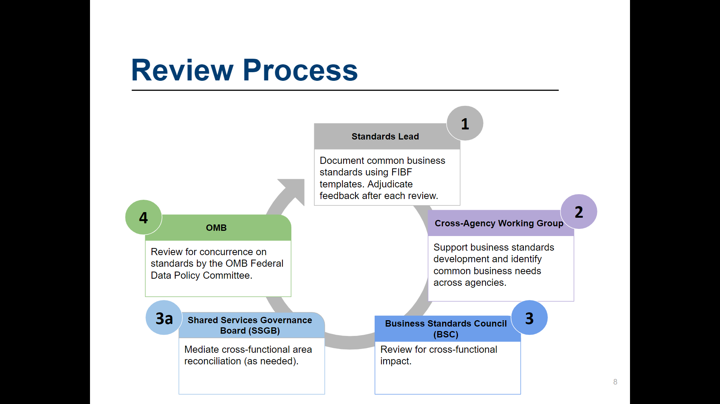
T&E Business Standards (FIBF) Governance Process
The T&E Business Standards are reviewed yearly and updated as necessary.
8
https://ussm.gsa.gov/fibf/
Notes:
This is an iterative process and may be updated based upon changes to law, policy, and regulation
The initial interagency working group met biweekly between March and July 2021 to review and provide input to the updated T&E business standards.
Specific topics were assigned for each meeting to review.
Agencies had one week to provide feedback.
The T&E Standards Lead had one week to respond to the feedback.
After all designated topics were covered, the interagency working group was placed on hiatus until Fiscal Year 22.

Slide 9
Cross-Functional Collaboration
T&E’s business integration touchpoints with vertical and horizontal functional areas.
Human Capital
Travel and Expense
Federal Financial Management
Integration Touchpoints
Obligation Process Lifecycle
Electronic Records Management
Cybersecurity Services
https://ussm.gsa.gov/fibf-cyb-soc/
https://ussm.gsa.gov/fibf-ERM/
Notes:
The Obligation Process Lifecycle is the term that encompasses the entire integration process between travel and expense and financial management from the Funds Check on an authorization through to payment of the Voucher/Expense Report.

Slide 10
Why the T&E Business Standards Matter to Industry
T&E Business Standards

Slide 11
Why T&E Business Standards Matter to You…
It’s OMB approved
Culmination of a cross-government effort to create Business Use Cases, Business Capabilities, & Standard Data Elements
First time the government is going to market with a common Business Process and set of Business Standards (requirements) and processes
First time the government is coordinating directly with the Financial Management community on interface standards
Standard Integration, Standard File Formats, Standard Data Elements
T&E Business Standards will be used as the basis for ETSNext requirements
https://ussm.gsa.gov/fibf-travel/
https://ussm.gsa.gov/fibf-fm/
Notes:
This is a cross government exercise
The overall process was established by OSSPI for the development of standards
A cross agency Working Group developed the initial T&E Standards
Representatives of both T&E Solutions and all 4 financial management solutions
The draft standards were presented to and endorsed by the STOC membership
The T&E Standards Baseline was submitted to OMB and approved by OMB in November of 2020
The standards define the core services for travel and expense, so that you can plan appropriately
Core T&E
Reservations
Online / OBT
Agent Assisted
Pre-Trip Approval (Authorization)
Fulfillment (TMC)
Automated Quality Control
Expense Report (Voucher)
Regulatory & Standard T&E Reporting
Standards are just for the T&E process
There are additional requirements for Technology Services and Business Support Services e.g. those that support technology and operations and maintenance that support the T&E solution(s)
T&E Business Standards do not include the Technical and Operational Standards, which will also be part of the ETSNext Requirements.
Those include service delivery management, facilities/telecommunications, hardware/OS/Storage, software management, data/content management, business application support
Coordination with the Financial Management Community, Treasury FIT, FMSC, FM QSMO on standards and impact to standard integration and data standards for the Obligation Process Lifecycle
T&E Data Standards have been mapped to the FM Data Standards
T&E Business Standards includes the Service, Function, Activities, Business Capabilities, Use Cases, and Data Standards

Slide 12
Cross-Functional Collaboration (continued)
T&E integration standardization with Human Capital and Financial Management
Electronic Records Management and Cybersecurity Standards Incorporated
Interface Standardization
Interface Standardization
Human Capital
Travel and Expense
Federal Financial Management
FM FIT
FMSC
FM QSMO
Increased Automation
Standard Data Elements
Electronic Records Management
Cybersecurity Services
https://ussm.gsa.gov/fibf-cyb-soc/
https://ussm.gsa.gov/fibf-ERM/
Notes:
ETSNext will be using standardized interfaces for Financial Management and is developing plans for Human Capital (HR)
FM Standard Interfaces and Standard File Formats for the Purchase Order (Authorization) and the Invoice (Expense Report/Voucher)
HR Standard Interface for generation of User Profiles and User Profile Maintenance
User Profiles may require integration with HR as a manual process may not be available
Electronic Records Management and Cybersecurity Standards will be incorporated, in addition to the requirements in the solicitation itself
National Archives and Records Administration (NARA) - 6 Years
Cybersecurity standards in addition to the NIST Standards and GSA Security Guidelines implementing the NIST Standards
At a minimum, agencies will need to update their FM interfaces to align with the new standard integration including the standard data elements, which have been mapped between T&E and FM

Slide 13
Travel and Expense Business Standards
Question & Answer
Session Q&A
Open Q&A
What other topics or areas do you have questions about?

Slide 14
Travel & Expense Business Standards
Summary
T&E Business Standards Overview
High-level overview of the standards development process and artifacts
T&E Management Standards Committee Process & Schedule
Governance process for the T&E Business Standards
Why T&E Business Standards Matter
OMB Approved
Government-wide end-to-end business processes for T&E

Slide 15
Thank you for your attendance
Thank you for your attendance.

