Slide 1
New Travel & Expense (T&E) Business Standards Review for Industry
presented by
Michael Salter

Slide 2
Workshop Housekeeping
The workshops will be recorded and posted to the ETSNext Industry Community page on Interact
All participants are on mute and there is no individual camera access
Please use the Chat tool to report technical difficulties
Please use the Q & A functionality to ask questions
You can upvote a question, if you have the same or a similar question
Today’s Workshop will be approximately 2 hours
Workshop 3 on Tuesday, November 16th will depend on the number of FAQs that are developed and the questions asked during the open Q&A

Slide 3
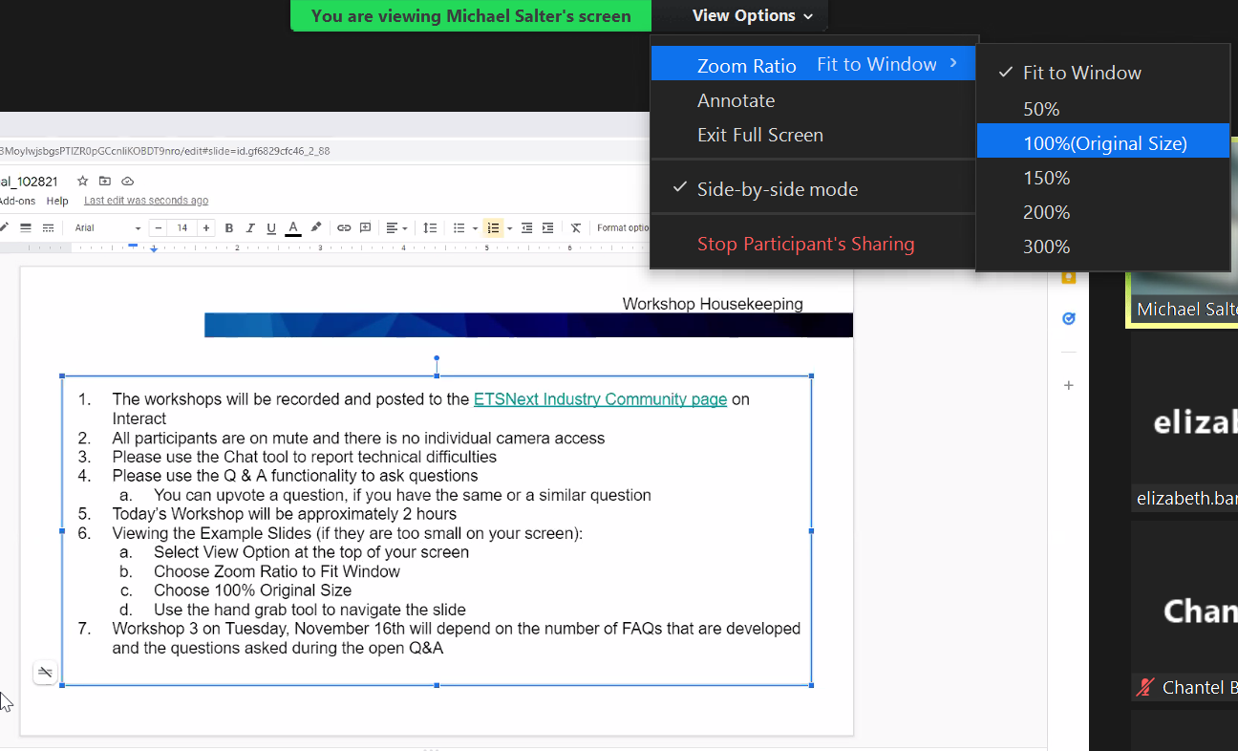
Zoom - View Options
Viewing the Example Slides (if the content is too small on your screen):
Select View Option at the top of your screen
Choose Zoom Ratio to Fit Window
Choose 100% Original Size
Use the hand grab tool to navigate the slide
Notes:
Zoom View Options:
Instructions to enlarge viewing while attending Zoom conference calls.
Text to left of Screenshot is step-by-step instructions to enlarge viewing
To the right, is the visual under View Options with “Drop Down Box” when performing the above action.
Lastly, the Text Box list seven (7) pieces of information to obtain recorded audio and location of where this workshop is posted.

Slide 4
Travel & Expense Business Standards
How to “Read” the T&E Business Standards
Agenda
Travel & Expense Business Standards Artifacts
Service, Function, Activities
Use Cases
Capabilities
Standard Data Elements
Travel & Expense Business Standards Examples
Making a Reservation
Funds Check and Funds Obligation on the Authorization
Traveler with a Family Emergency

Slide 5
T&E Business Standards
Standardized Core T&E Services for ETSNext
Five Components of the Solution(s)
Reservations
Online / OBT
Agent Assisted
Authorization (Pre-Trip Approval)
Fulfillment (TMC)
Automated Quality Control
Voucher (Expense Report)
Regulatory & Standard T&E Reporting
Financial Management Integration
Obligation Process Lifecycle
Notes:
Standardized Core T&E Services for ETSNext
Five Components of the Solution (s) are numbered to the left
The T&E Business Standards define the end-to-end process for Travel & Expense, with a focus on what will be the core services for ETSNext.
Changes in Reservations can impact the obligation process lifecycle
Integration to the FM solution can happen throughout the life of a trip including amendments and cancellations

Slide 6
T&E Business Standards - Workflow
Pre-Trip Approval Reservations
(OBT & TMC)
Final Itinerary confirmed / approval documented
Traveler books itinerary via OBT
Traveler calls TMC for travel planning and booking
(Authorization)
Booking information populates the TA, Traveler completes TA, and submits for approval
Supervisor receives notice of pending travel requests
PosAck
Traveler is notified of
Traveler signs into the portal
Traveler is notified and using TAVS, modifies TA request as necessary for re- consideration
Completed Travel Authorization and documented in PNR/ interface to financial system for obligation of funds
Authorization granted?
No
_{PNR} PNR
Yes
Obligation
OK to Ticket
Fulfillment (TMC)
Authorization Data
PosAck
PNR
created by OBT or by TMC
PNR is managed by Mid-Office automation for QC, file finishing, and continued monitoring for ticket usage
Mid-Office measures against Quality requirements. Notifies QC or Booking agent of any PNR anomalies or remaining requirements
When authorization is received, PNR is final checked. When complete and error- free, PNR is ticketed and confirmed with traveler
Funds Check
Note: The expectation is that both booking data and authorization data flow into the voucher
Financial
Management (Integration)
Funds Check and Acknowledge ment
Payment Created (Invoice) & Acknowledge ment
Funds Check and
Obligation (PO) Created
Pos Ack
Acknowledge ment
& Acknowledge ment
Funds Check
PosAck
Disbursement
Expense Report
(Voucher)
TA and booking data flow into voucher system
Traveler uploads receipts (OCR,
Mobile)
Traveler completes Voucher, updating actual costs and submits for approval
Supervisor receives notice of pending voucher approval
Completed Travel Voucher/ Voucher submitted to agency financial system for payment
Traveler modifies voucher in TAVS
Voucher
No
approved?
Yes
Notes:
Note that Reporting is not included in this work flow as it occurs after the expense has been reimbursed
This is showing the process from making a reservation to being reimbursed
This flow includes the standard obligation process lifecycle but does not include any of the alternate paths such as amendments or cancellations
This process is unique to the government
Also note that the expectation is that both booking data and authorization data flow into the voucher
This could change based upon credit card integration and the ability for an expense solution to be able to calculate per diem

Slide 7
T&E Business Standards - Federal Integrated Business Framework (FIBF)
Federal Business Lifecycle
End to End Processes
Service, Function, Activities List
Service Measures -
Draft
FIBF
Business
Capabilities
Performance
Metrics
Business
Capabilities
Standard
Data
Elements
Scenarios & Business
Use Cases
Mapped to FM Standard Data Elements
Standard
Data
Elements
Business
Use Cases
Mapped to FM Business Use Cases
Notes:
The Federal Integrated Business Framework or FIBF was used to develop the T&E Business Standards
As noted during the first session, The Federal Integrated Business Framework (FIBF) is a model that enables agencies to better coordinate and document common business needs and focus on outcomes, data, processes, and performance
It is comprised of 5 major components
Service, Function Activities
Business Capabilities
Business Use Cases, which consist of several scenarios and mapped to the FM Use Cases
Standard Data Elements, which are mapped to the FM Standard Data Elements
Performance Measures which are currently going thru the approval process with OSSPI

Slide 8
How to “Read” the T&E Business Standards…
We will be walking through several examples of how to read the T&E Business Standards documentation available at https://ussm.gsa.gov/fibf-travel/
Understand how T&E will work in the future for the civilian government
Review the Service, Function, Activity to understand the 10 Activity Areas
Review the Use Case and note the Activity Area associated with the steps of the Use Case
Review the Capabilities associated with the particular Activity Area referenced in the Use Case
Go to the Capabilities to review the inputs, processes and outputs associated with the use case
Review the Standard Data Elements for the associated Capabilities to see the minimum data necessary to complete the end to end process
This is not a technical data specification but is just the minimum data necessary to complete the process
Notes:
We will be walking through several examples of how to read the T&E FIBF documentation
First, review the Service, Function, Activity to understand the 10 Activity Areas
Second, review the Use Case and note the Activity Area associated with the steps of the Use Case
Third, review the capabilities associated with the particular Activity Area referenced in the Use Case
Go to the associated Capabilities for the Use Case to review the inputs, processes and outputs associated with the use case and the data, inputs and outputs required to complete the capability
Finally, go the Data Standards for the associated Capabilities to see the minimum data necessary to complete the end to end process
This is not a technical data specification but is just the minimum data necessary to complete the process
Please focus on the following Activities
Travel Personnel Profile Set-up and Maintenance
Travel Reservation Assistance and Processing - TMCs
Temporary Duty (TDY) and Local Travel Authorization Processing
Travel Ticketing - TMCs
Traveler Emergency Assistance Request Processing - TMCs
Temporary Duty (TDY) and Local Travel Voucher Processing and Audit
Temporary Duty (TDY) and Local Travel Monitoring and Reconciliation
Temporary Duty (TDY) and Local Travel Regulatory Reporting - Data & Analytics
Temporary Duty (TDY) and Local Travel Management Reporting and Analysis - Data & Analytics

Slide 9
Service, Function, Activities
Use Cases
Capabilities
Standard Data Elements
T&E Business Standards
Notes:
Level 1 Use Cases have a high travel volume impact and a high dollar value impact

Slide 10
T&E Business Standards Agenda
Agenda
T&E Business Standards Documents
Service, Function, Activities for Travel and Expense
10 Activity Areas
Use Cases
Combines multiple scenarios into a story to explain how Travel & Expense will work for the civilian government
Capabilities
The basis for the Business Requirements for ETSNext
Standard Data Elements
The minimum data necessary to complete the end-to-end process
Break
Examples - Three
Making a Reservation
Funds Check and Funds Obligation on the Authorization
Traveler with a Family Emergency
Notes:
Agenda

Slide 11
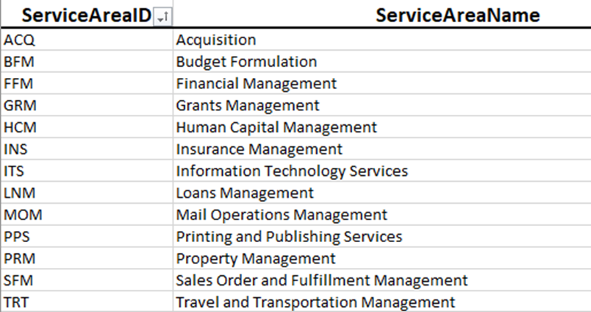
T&E Business Standards- Service, Function, Activities
Notes:
Travel & Expense is in the Service Area of TRT called Travel & Transportation Management
As you can see Financial Management is also included under FFM

Slide 12
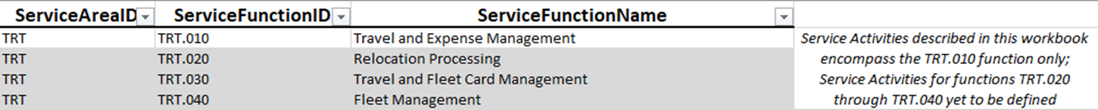
T&E Business Standards- Four Function, Activities
Notes:
T&E Business Standards: Four Functions and Activities
Travel is composed of four (4) functions only. For this purpose of T&E Management under TRT.010 it is the only function that has been developed. Service activities for functions TRT.020 through TRT.040 are yet to be defined.

Slide 13
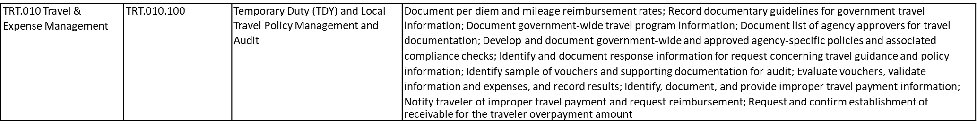
T&E Business Standards- Service, Function, Activities (Travel Personnel Profile Set-up & Maintenance)
Notes:
T&E is comprised of 10 Activity areas starting with TRT.010 Travel Personnel Profile Set-up and Maintenance

Slide 14
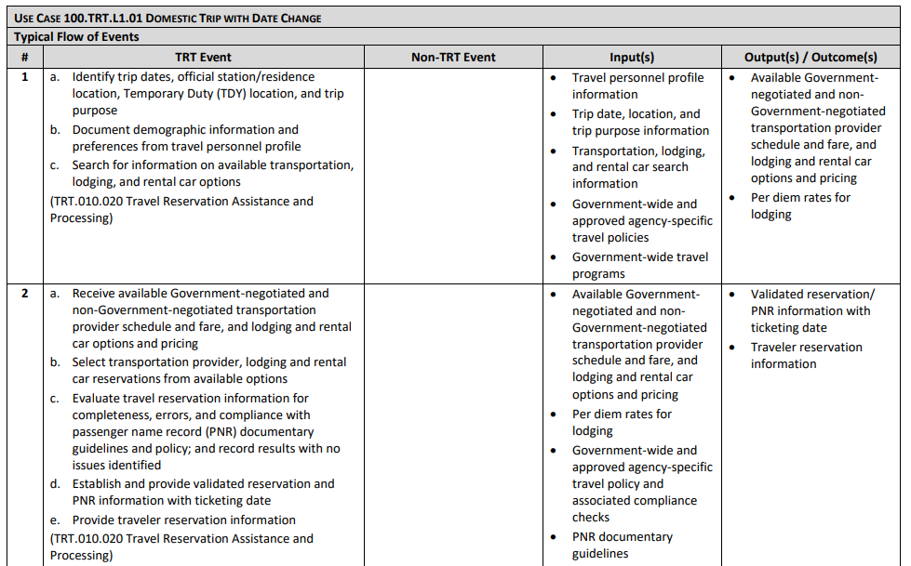
T&E Business Standards - Use Cases Con’t)
Notes:
This is the first page of the Use Case Level 1 # 1 Domestic Trip with a Date Change
This shows the typical flow of events for this particular Use Cases
While there are a number of Use Cases, not every single use case may be addressed in the Use Cases have been developed.
The existing Use Cases are based upon Level 1 and 2 Scenarios and therefore there are Level 1 and 2 Use cases
There are Level 3 scenarios but Level 3 Use Cases were not developed as part of the standards baseline
As you can see the Activity Area
The steps that occur for T&E
Next would be any non TRT events, such as FM, which you’ll see in an upcoming example
Also included are the Inputs to the steps and finally the Outputs or Outcomes
The second step is similar, note the Activity Area is the same for this step but other Activity Areas will be addressed throughout the Use Cases
Finally, you can see that the Outputs from Step 1 become inputs to step 2, however there are additional inputs for Step 2 than Outputs in Step 1

Slide 15
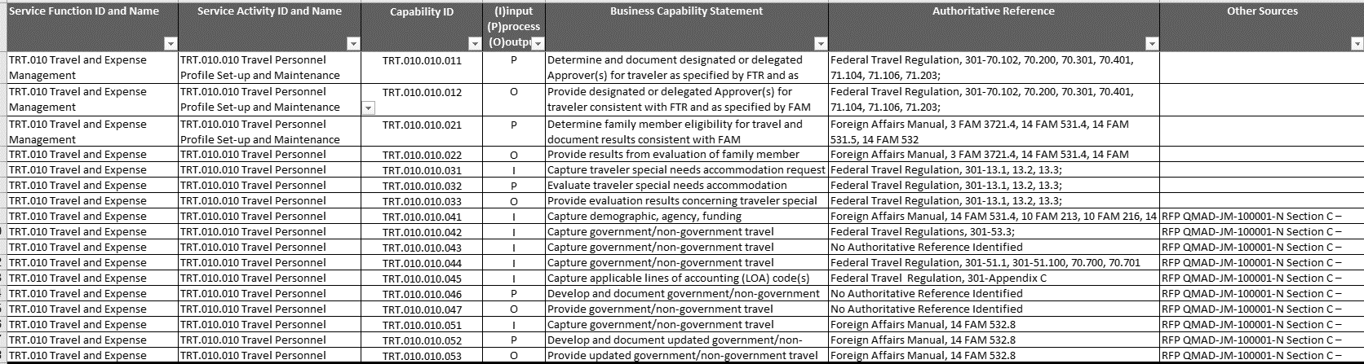
T&E Business Standards - Capabilities
Notes:
The Business Capabilities are similar to Business Requirements in a standard Software Development Lifecycle (SDLC)
The are comprised of the following
Service Function ID - TRT.010
Service Activity ID and Name - TRT.010.010
Capability ID -TRT.010.010.011
The type of Capability
Input, Process or Output
Capability Statement
Authoritative Source Reference
Other Sources that do not meet the definition of authoritative source such as the ETS2 Statement of Work, which is referenced in these rows

Slide 16
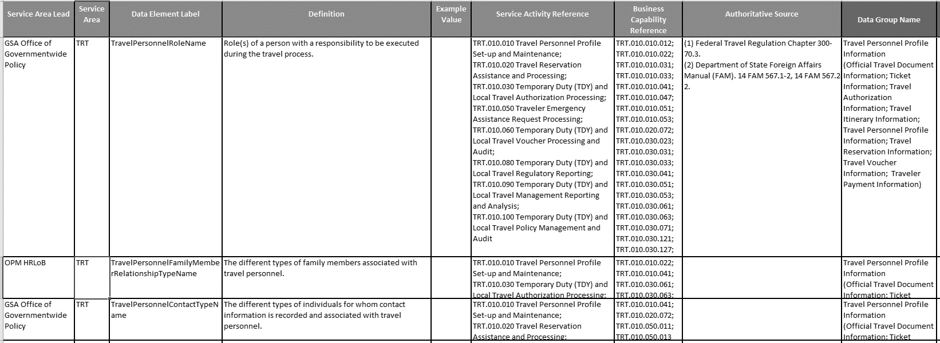
T&E Business Standards - Standard Data Elements
Notes:
Standard Data Elements
Service Area Lead - who “owns” the data element or source of the data
Service Area - The Service Area for the Data Element, in this case T&E
Data Element Label - the name of the data element
Definition -what the data element is used for
Example Value
Service Activity Reference - Which Service Activities use the data element
Business Capability Reference - which business capabilities use the data element
Authoritative Source - source for the data element, usually the same as the capability
Data Group Name - a way to group the data elements
Technical Data Specs
These would not be completed until after award as we don’t want to proscribe
Domain Values - Standardize Data Values for the Data Element
Validations
Related Element References - if they are tied to another data element
Other Relevant Organizational Information - additional information
MITRE Recommendations - additional information on the baseline data elements
Additional Sources - Sources outside the authoritative sources

Slide 17
T&E Business Standards Summary
Summary
T&E Business Standards documentation available at https://ussm.gsa.gov/fibf-travel/
Service, Function, Activities for Travel and Expense
10 Activity Areas
Use Cases
Combines multiple scenarios into a story to explain how Travel & Expense will work for the civilian government
Capabilities
The basis for the Business Requirements for ETSNext
Standard Data Elements
The minimum data necessary to complete the end-to-end process

Slide 18
T&E Business Standards - Incorporated Recommendations
ETS Standardization
Financial Management Integration
Obligation Process Lifecycle
Standard Data Elements Workbook
Standard Values including:
Trip Purposes
Expense Types
Payment Methods
Common Compliance (Policy) Checks
Policy Standardization
Streamlined Approval Process
1 no more than 3
Increased Utilization of Lowest Non-Refundable Airfare where appropriate
Standardized Financial Management Integration
Implement consistent fund obligations
Develop common process for cross-fiscal year trip expenses
Develop a unique Traveler ID with HC and FM
Streamlined Authorization Process
Simplify generation of the authorization expense estimate
Simplify accounting class designation on authorization and voucher
Common Approach to Travel Advances
Moving Advances out of the Travel Solution
Standardized Voucher Processing
Eliminate the need to amend authorization at time of voucher submission
Standardize process for voucher expense payment for centrally billed account
Standardize process for additional trip expenses after a voucher has been paid
Notes:
The following are recommendations that were incorporated into the Baseline standards
Compliance Checks can be found in the Standard Data Element Workbook on a separate tab

Slide 19
Break
10 Minutes

Slide 20
Making a Reservation
Level 1 Use Case
T&E Business Standards
Notes:
Level 1 Use Cases have a high travel volume impact and a high dollar value impact

Slide 21
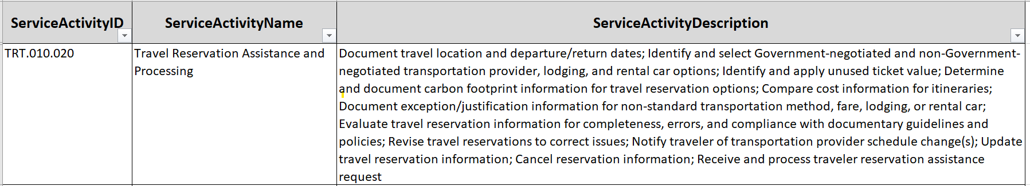
T&E Service, Function, Activity - Making a Reservation (con’t)
Notes:
These are the current approved versions on the USSM Website.

Slide 22
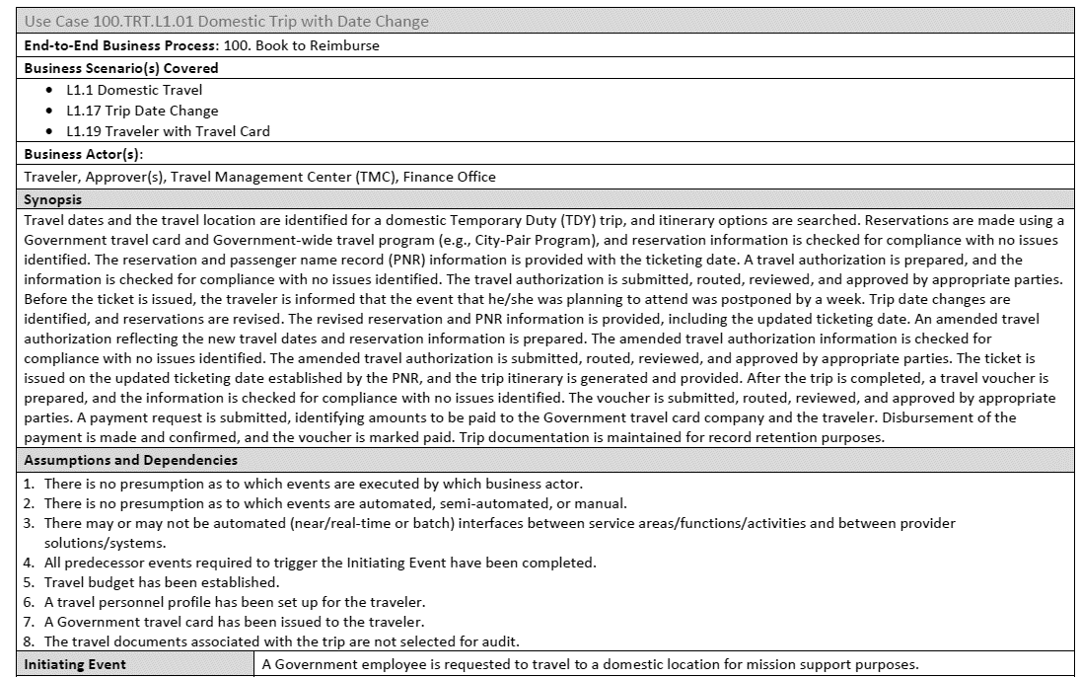
T&E Use Cases - Making a Reservation Summary
Notes:
This is the Summary Page of a Business Use Case
Title Level 1 #1 Domestic Trip with a Date Change
You’ll see this in the upcoming examples
The Business Area, which is based upon Financial Management, and travel falls under Book to Reimburse
The Business Scenarios that are addressed in the Use Case
The Business Actors or participants in the Use Case
The Synopsis which is hybrid high-level / Step-by-Step review of the Use Case
Assumptions and Dependencies
The first 4 are the same in all of the Use Cases
The rest will vary depending on the Use Case
Finally the Initiating event or what triggers the Use Case to occur

Slide 23
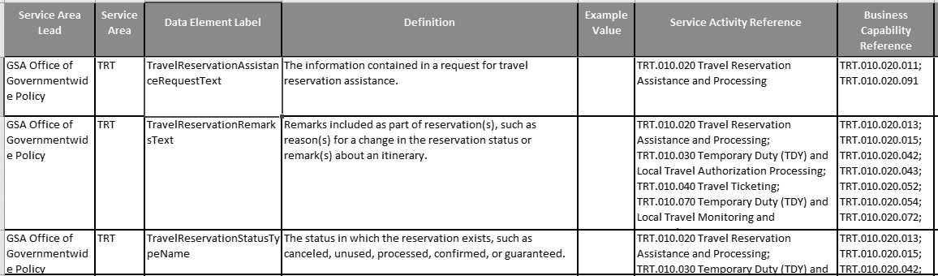
T&E Data Standards - Making a Reservation
Notes:
This slide represents the T&E Data Standards-Making a Reservation
This slide identifies the standards set by GSA’s Office of Governmentwide Policy
Notice in the first row, third column from the left; Data Element Label for Travel Reservation Assistance Request Text, is enjoined with the Definition
The Definition in column four (4) provides the definition for the data element label
The sixth box over, Service Activity Reference, refers to the Service ID TRT.010.020 ; Travel Reservation Assistance and Processing
The last column identifies the Business Capability Reference for the Activity referenced in column six (6)

Slide 24
Funds Check & Obligation of Expense Estimate on the Authorization
Level 1 Use Case
T&E Business Standards

Slide 25
T&E Business Standards-Workflow Diagram
Booking, Authorization, and Expense Flow – Government Custom – ETS2 & FIBF Baseline
Pre-Trip Approval Reservations
(OBT & TMC)
Final Itinerary confirmed / approval documented
Traveler books itinerary via OBT
Traveler calls TMC for travel planning and booking
(Authorization)
Booking information populates the TA, Traveler completes TA, and submits for approval
Supervisor receives notice of pending travel requests
PosAck
Traveler is notified of
Traveler signs into the portal
Traveler is notified and using TAVS, modifies TA request as necessary for re- consideration
Completed Travel Authorization and documented in PNR/ interface to financial system for obligation of funds
Authorization granted?
No
_{PNR} PNR
Yes
Obligation
OK to Ticket
Fulfillment (TMC)
Authorization Data
PosAck
PNR
created by OBT or by TMC
PNR is managed by Mid-Office automation for QC, file finishing, and continued monitoring for ticket usage
Mid-Office measures against Quality requirements. Notifies QC or Booking agent of any PNR anomalies or remaining requirements
When authorization is received, PNR is final checked. When complete and error- free, PNR is ticketed and confirmed with traveler
Funds Check
Funds Check and Obligation are unique to the government T&E process
Financial
Management (Integration)
Funds Check and Acknowledge ment
Payment Created (Invoice) & Acknowledge ment
Funds Check and
Obligation (PO) Created
Pos Ack
Acknowledge ment
& Acknowledge ment
Funds Check
PosAck
Disbursement
Expense Report
(Voucher)
TA and booking data flow into voucher system
Traveler uploads receipts (OCR,
Mobile)
Traveler completes Voucher, updating actual costs and submits for approval
Supervisor receives notice of pending voucher approval
Completed Travel Voucher/ Voucher submitted to agency financial system for payment
Traveler modifies voucher in TAVS
Voucher
No
approved?
Yes
Notes:
We chose this example because this is a “Unique” process to the government
Note that Reporting is not included in this work flow as it occurs after the expense has been reimbursed
This is showing the process from making a reservation to being reimbursed
This flow includes the standard obligation process lifecycle but does not include any of the alternate paths such as amendments or cancellations
Also note that the expectation is that both booking data and authorization data flow into the voucher
This could change based upon credit card integration and the ability for an expense solution to be able to calculate per diem

Slide 26
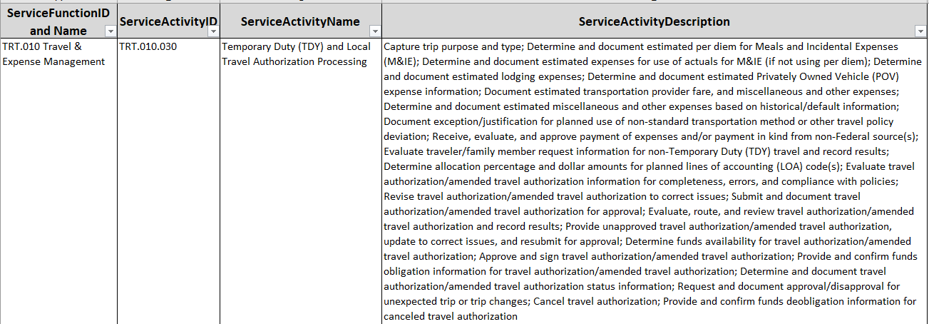
T&E Service, Function, Activities - Funds Check & Obligation
Notes:
The T&E Service Activity ID TRT.010.030 in column two (2) is assigned to
Column theree (3); Service Activity Name-Temporary Duty (TDY) and local Travel Authorizaton Processing
Column four (4) provides a description outlined in red to do the following:
Determine funds available for travel or amended authorizations
Approve and sign travel.amended authorization
Provide and confirm funds obligation information for travel/amended authorization…

Slide 27
T&E Use Case - Funds Check & Obligation
Notes:
Use Case Scenario for Domestic Trip with Date Change
The Activity ID is 100 TRT.L1.01 which is an End-to-End Business Process
Business Actor(s) -Travel Management Center (TMC), Finance Office
The Synopsis describes the activity for review, routing, and approval by the appropriate parties
Assumptions and Dependencies-See 1-8

Slide 28
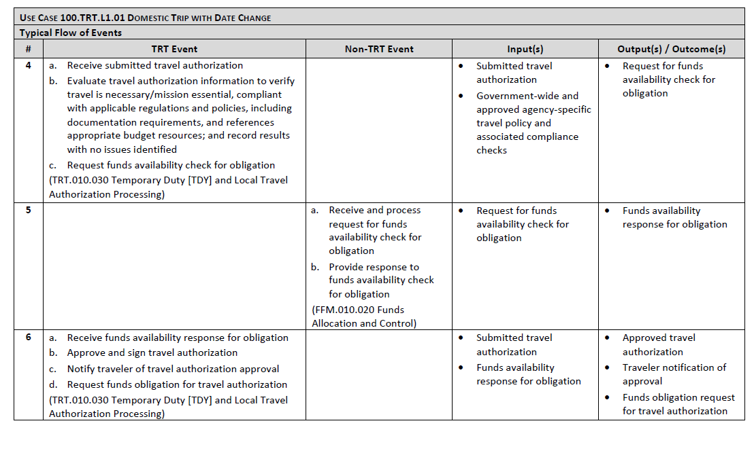
T&E Use Case - Funds Check & Obligation (con’t 1)
https://ussm.gsa.gov/fibf-fm/
Notes:
Use Case 100.TRT.L1.01 Domestic trip with date change (continued)
Column 2 list the TRT Event and Activities under Step 4 and 6
Column 3 list NON-TRT Events and Activities under Step 5
Column 4 are the Input(s) which touch each activity; whether TRT or Non-TRT events
Column 5 list the output(s) which are the results of the input(s) in Column 4
Website listed below to the left

Slide 29
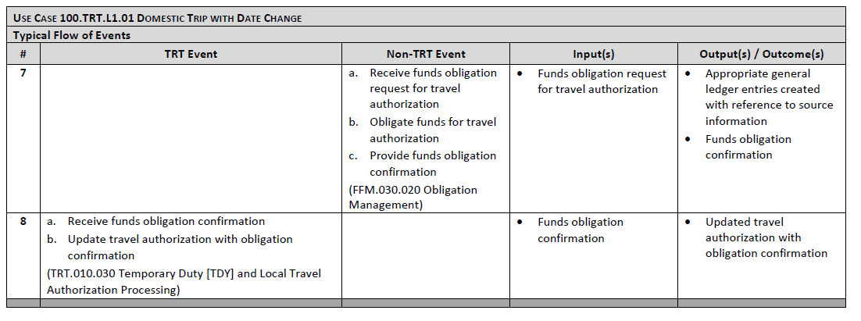
T&E Use Case - Funds Check & Obligation (con’t 2)
https://ussm.gsa.gov/fibf-fm/
Notes:
Use Case 100 TRT. L1.01 Continue Steps-Domestic Trip with Date Change
Step 7 is not applicable to TRT Events, but ARE applicable to Non-TRT Events as seen in Column 2
Step 8 applies to TRT Events
Column 4 and 5 apply to both events within Step 7 and 8; TRT and Non-TRT Events.
Website listed below for further FIBF information

Slide 30
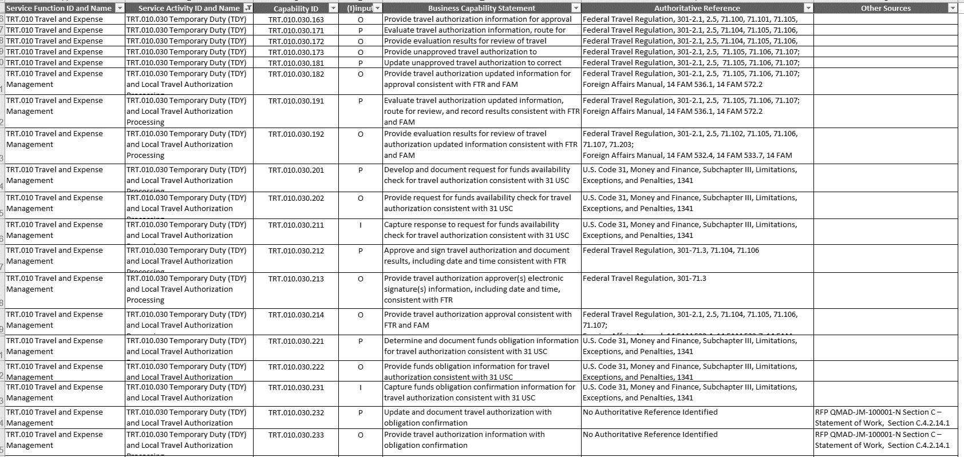
T&E Capabilities - Funds Check & Obligation
Notes:
This slide depicts the Funds Checks & Obligation in more detail
Top row left to right list the ID’s for the following
Function ID and Name,
Service Activity ID
Capability ID
The top row also list the Input, Output, or Person; in addition to the Business Capability Statement and Authorization Reference
The next set of columns below (2, 3, 4, 5) describe the Activity ID which appends to the Capability ID, that applies to the activity and capability and identify each to either a Input, output or person.
Each of these actions transfer to a Business Capability Statement and Authoritative Reference.
Note: The FTR 301 is the authoritative reference, to include subsequent subparts thereof, related to each activity and or statement

Slide 31
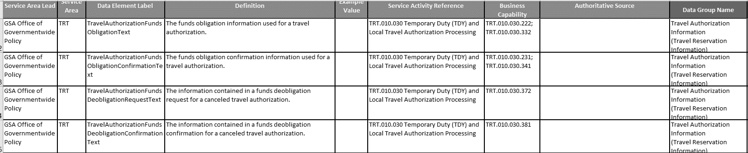
T&E Data Standards - Funds Check and Obligation
Notes:
The Office of Governmentwide Policy leads the T&E Data Standards-Funds Check and Obligation
Each Data standard in this slide falls under the TRT Service Area
Each standard is assigned a Element Label as shown in Column 3 which corresponds to its Definition in Column 4
Each Data Standard is assigned a Service Activity Reference and Business Capability as shown in Column 6 and 7.
Lastly, in this scenario, all fall under the Data Group Name in Column 9; Travel Authorization Information (Travel Reservation information)

Slide 32
T&E Data Standards - Funds Check and Obligation Q&A
Funds Check and Obligation Q&A

Slide 33
Travel with a Family Emergency
Level 2 Use Case
T&E Business Standards
Notes:
Level 2 Use Cases either have a large travel volume impact or a high dollar value impact.

Slide 34
T&E Service, Function, Activities - Traveler Family Emergency
Notes:
This slide depicts the T&E Service, Function, Activities for Traveler Family Emergency.
Service Activity ID is TRT.010.050
The Service Activity name is Traveler Emergency Assistance Request Processing
The Service Activity Description provides instructions

Slide 35
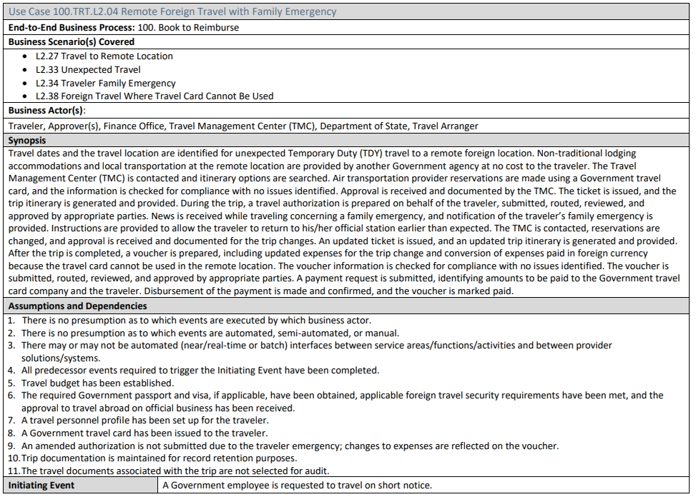
T&E Use Cases - Traveler Family Emergency
Notes:
Use Case 100 TRT.L2.04 Remote Foreign Travel with Family Emergency
This is the second Use Case Scenario involving Foreign Travel and family emergency which falls under TRT L2.04
The Activity ID is 100 TRT.L2.04 which is an End-to-End Business Process
Business Scenario’s are assigned a TRT ID number showing what is assigned and covered under 100.TRT.L2
Travel to Remote Location
Unexpected Travel
Traveler Family Emergency
Foreign Travel where a Travel Card Cannot be Used
Business Actor(s) -Travel Management Center (TMC), Finance Office, Department of State (this scenario) and Travel Arranger
The Synopsis describes the activity for receipt of news regarding the family emergency, notification and instructions to book travel along with approvals and vouchering.
Assumptions and Dependencies-See 1-11

Slide 36
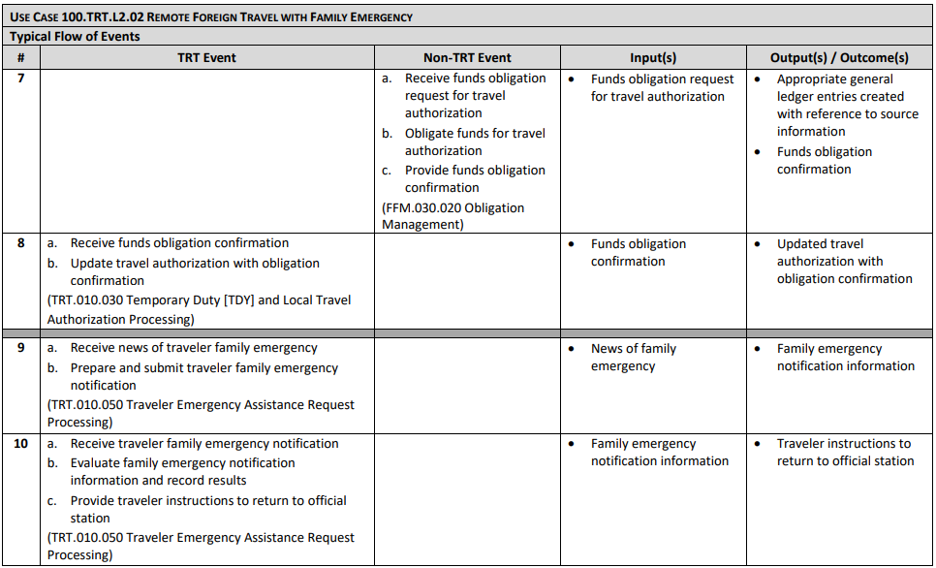
T&E Use Cases - Traveler Family Emergency (con’t 1)
Notes:
Use Case 100 TRT.L2.04 Remote Foreign Travel with Family Emergency (cont.)
Step 7 is not applicable to TRT Events, but ARE applicable to Non-TRT Events as seen in Column 2
Step 8-10 apply to TRT Events
Column 4 and 5 apply to both events within Step 7 thru 10; both TRT and Non-TRT Events as input(s) and output(s) .
Website listed below for further FIBF information

Slide 37
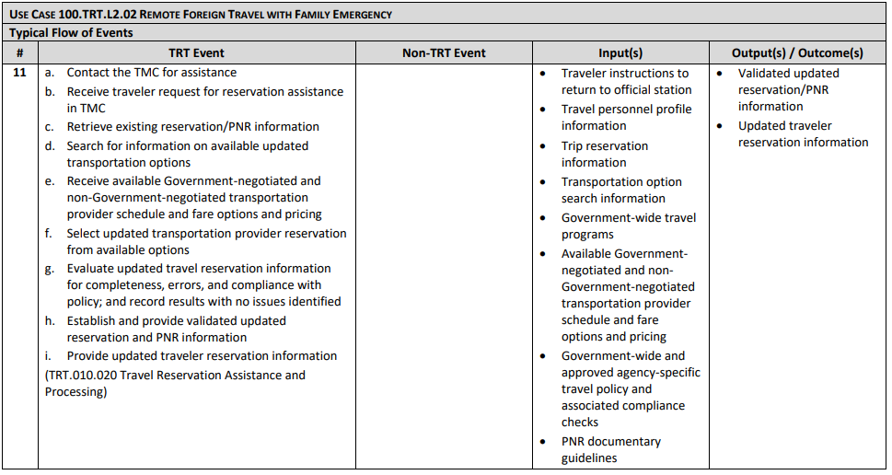
T&E Use Cases - Traveler Family Emergency (Continued)
Notes:
T&E Use Cases - Traveler Family Emergency (Cont.)
se Case 100 TRT.L2.04 Remote Foreign Travel with Family Emergency (cont.)

Slide 38
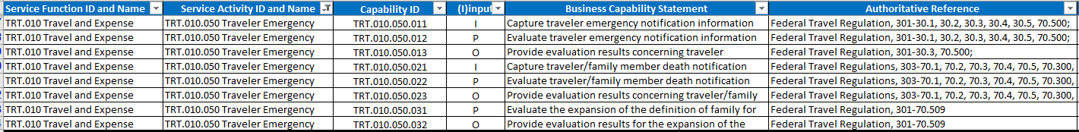
T&E Business Capabilities - Traveler Family Emergency
Notes:
T&E Business Capabilities-Traveler Family Emergency
Column one (1) identifies the service function of Travel and Expense under TRT.010
Column two (2) is the Service Activity ID and Name (Traveler Emergency) TRT.010.050
Column three (3) represents the Capability Id for each Business Capability Statement (column 5)
Column four (4) identifies if the function is input, output or person
Column five (5) providers the Capability for each activity
Column six (6) provides the Authority under the FTR which is governs each capability

Slide 39
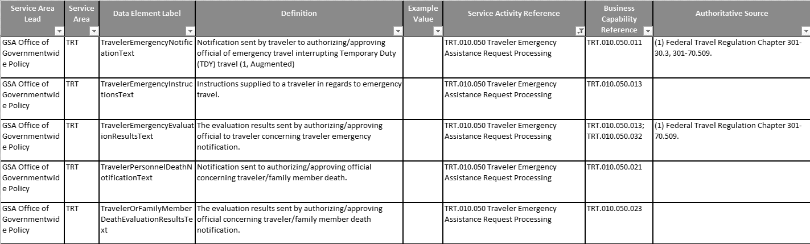
T&E Data Standards - Traveler Family Emergency
Notes:
T&E Data Standards - Traveler Family Emergency
The Office of Governmentwide Policy leads the T&E Data Standards for this Traveler Family Emergency Scenario
Each Data standard in this slide falls under the TRT Service Area
Each standard is assigned a Element Label as shown in Column 3 which corresponds to its Definition in Column 4
Each Data Standard is assigned a Service Activity Reference and Business Capability as shown in Column 6 and 7.
The Service Activity Reference in Column eight (8) is tied to the Business Capability Reference in Column nine (9)
Note: The Authoritative Source is not always applicable to each capability or label as in the second line item in Column nine (9)
Line two (2); column (9) shows zero authoritative source due to column four (4) are instructions supplied to the traveler, and does NOT require an approval to complete this process.

Slide 40
Travel & Expense Business Standards Summary
Summary
Travel & Expense Business Standards Artifacts
T&E Business Standards documentation available at https://ussm.gsa.gov/fibf-travel/
Service, Function, Activities
Use Cases
Capabilities
Standard Data Elements
Travel & Expense Business Standards Examples
Making a Reservation
Funds Check and Funds Obligation on the Authorization
Traveler with a Family Emergency

Slide 41
Travel and Expense Business Standards (Q&A and Session 3 information)
Question & Answer
Session Q&A
Open Q&A
What other topics or areas do you have questions about?
Session 3
Tuesday November 16 at 1:00 p.m.
You can submit questions about the T&E Business Standards over the next two weeks to etsnext@gsa.gov
We will be developing Frequently Asked Questions (FAQs) from the questions received
Session Agenda - OGP & ETSNext PMO
FAQs
Open Q&A

Slide 42
Thank you for your attendance.

