Slide 1
Using Data to Increase Equitable Outcomes in Procurement
February 5th, 2024
Office of Integrated Marketing

Slide 2
Presenters
LaVaughn Seepersad-Fayson
Government-wide Category Management PMO
Equity in Procurement Data Working Group General Services Administration (GSA)
lavaughn.seepersad-fayson@gsa.gov
Nick Sanitsky
Equity in Procurement Data Working Group
General Services Administration (GSA)
nick.sanitsky@gsa.gov

Slide 3
Poll Question #1
In your line of work, how often do you consider equity and/or equitable outcomes as a priority?
Always- Equity is a consideration in everything I do
Sometimes- When it’s appropriate, equity becomes a factor
Never- Equity is not a part of anything I work on
I have not thought about my work thru the Equity lens

Slide 4
Is it Equality or Equity?

Slide 5
Why Increase Equitable Outcomes in Procurement?
EO 13985
January 2021
President’s Speech
June 2021
M-22-03
December 2021
Advancing Racial Equity and Support for Underserved Communities through the Federal Government
Agencies were required to identify and address potential barriers to equal opportunities to underserved communities through government programs and policies
Commemorating the 100 year Anniversary of the Tulsa Race Massacre
President Biden announced a goal to “Increase the share of contracts awarded to small disadvantaged businesses (SDBs) by 15% by 2025…about $100B
Advancing Equity in Federal Procurement; agencies were reminded of increased SDB goals
Other SBs were added to the original SDB goal: WOSB, SDVOSB, & HUBZone
All are now collectively referred to as Socio-Economic Small Businesses (SESBs)
It’s an Administration priority!

Slide 6
M-23-11: February 2023
Creating a More Diverse and Resilient Federal Marketplace through Increased Participation of New and Recent Entrants
Building on M-22-03- establishes common definitions of “New” and “Recent” entrants so that Agencies can baseline, track and benchmark their progress in bringing new entrants into the Federal marketplace, and how well they retain these entrants.
New Entrant: an entity of any size that has received a prime federal award above the MPT* for the first time, or after having not received an award in the previous 5 fiscal years.
Recent Entrant: an entity of any size that has received a prime federal award above the MPT during the 3 yr period following the fiscal year in which it was a first-time entrant.
*MPT = Micro-Purchase Threshold ($10k)

Slide 7
Poll Question #2
What data would you consider analyzing when developing strategies to increase equity in procurement?
Registration Data from SAM.gov
Obligation data from FPDS
Internal Agency Award Data
Geographical Data
None of the Above

Slide 8
What Data Could be Considered?
Factoring in Equity and Diversity, PLUS New Entrants
Registration Data- of all types of small businesses that are registered to do business with the Federal Government, and their associated NAICS and PSCs, plus active/inactive status on SAM.gov
Trend Data- Small business utilization (SBU) over the years plus comparison of awards to other than small businesses (OSBs)
Quantitative Data- Contract volume per vendor, average award size, number of vendors awarded per NAICS/PSC
Geographical Data- proximity of small vendor base to specific projects, vendor concentration/limitations in certain areas

Slide 9
How can you use the data?
Equity~allocates resources & opportunities so that everyone has what they need to succeed (“level the playing field”)
Type of Data | Potential Actions
Registration | Work with organizations to alert registered active and inactive vendors in a certain category about an upcoming opportunity; send invites for info sessions; increase the number of new entrants in the Federal marketplace
Trend | Use this data to plan for upcoming opportunities and create strategies to work with various socioeconomic small businesses (SESBs)
Quantitative | Use contract volume and average award info to develop acquisition strategies that provide opportunities for a wider vendor base; decrease the numbers of vendors with “no or low sales”
Geographical | Target vendors that are close to projects; increase impact in communities

Slide 10
Demo of the Governmentwide Procurement Equity Tool
Notes:
Ryan/Andrea
Andrea will share screen during live demo
QASP 1: USPTO Sample - https://hallways.cap.gsa.gov/app/#/doclib?filter%5Btype%5D%5B0%5D=1773&document=78388
This one is basic but good
Shows basic elements of QASP
Doesn’t show actual performance metrics
QASP 2: Army Contracting Command Template - https://hallways.cap.gsa.gov/app/#/doclib?filter%5Btype%5D%5B0%5D=1773&document=4380
This is a template
Good resource if you want to use it
Can build off of it
Allows you to reuse multiple times
Again non-specific
Important again to note that like last time, creates special section for performance measurements
QASP 3: NASA QASP for Software - https://buy.gsa.gov/docviewer?id=1931&docTitle=nasa%27s%20quality%20assurance%20plan%20for%20software&docType=112
UTM Link for Kelly Chat: https://buy.gsa.gov/docviewer?id=1931&doctitle=nasa%27s%20quality%20assurance%20plan%20for%20software&doctype=112?utm_campaign=atrw_fall2023&utm_medium=referral&utm_source=zoom
Most specific QASP example yet
Love the key abbreviations list
Structured nicely with table of contents, makes it easier to read despite length
Details organizational structure
Details more of the evaluation and review criteria
Would love to see an attachment that includes the review and criteria sheet to see how it is laid out
But, we can take best practices from all three and combine them
Goes to show how general and QASP can be, but it must fit your acquisition needs

Slide 11
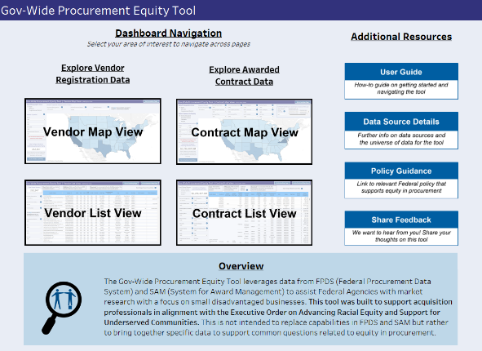
Government-Wide Procurement Equity Tool
Supports agencies in conducting market research and analysis
Geographic layout (map view) and tabular layout (list view)
Identify vendors, contract volume, and obligations
Filter by business characteristics
Sourced from SAM and FPDS data

Slide 12
Questions?

Slide 13
Resources with links

Slide 14
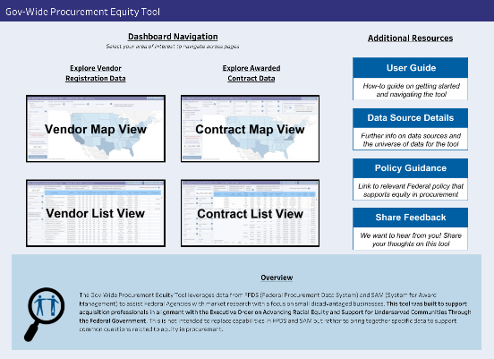
Gov’t-wide Procurement Equity Tool
https://d2d.gsa.gov/report/government-wide-procurement-equity-tool
Tool utilizing prime award (FPDS) and vendor registration (SAM) data to help Federal users perform market research and analysis for a variety of business types.

Slide 15
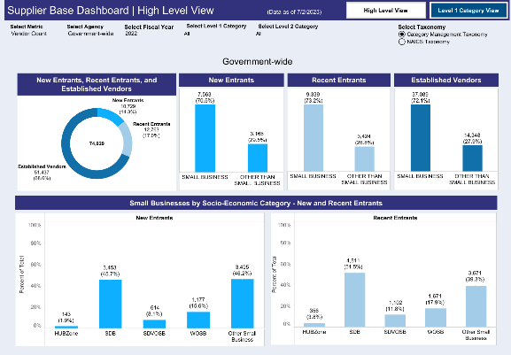
Supplier Base Dashboard
https://d2d.gsa.gov/report/supplier-base-dashboard
Per OMB memo M-22-03, this tool provides reporting on Federal efforts to increase the number of new entrants to the Federal marketplace and reverse the general decline in the small business supplier base

Slide 16
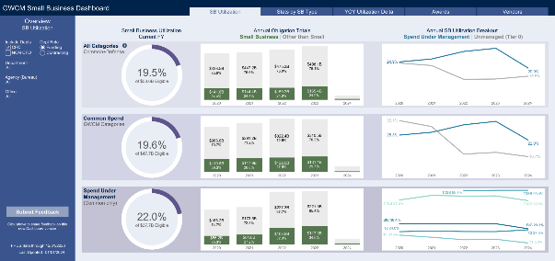
Category Management Small Business Dashboard
https://d2d.gsa.gov/report/small-business-dashboard
Detailed small business data by agency and category of spend

Slide 17
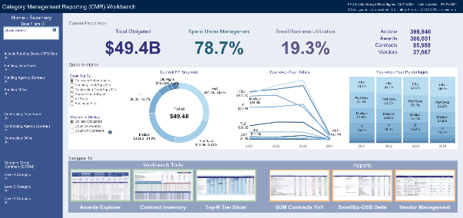
Category Management (CMR) Reporting Workbench
https://d2d.gsa.gov/report/cm-reporting-workbench-cmr
Collection of six tools and reports with small business, contract, and category management data

Slide 18
Thank You!
Office of Integrated Marketing

